Slide 1
Blended and experiential learning
A case study of the flipped classroom in adults’ training.
Melpomeni PAPADOPOULOU, France

Slide 2
inTRODUCTION
Experiential learning → learning by doing in a professionnal environment.
Reflexivity → analyzing professional situations.
Alternative or work-integrated training → a pedagogical method that combines education in an academic institution with training in a professional setting.
Blended learning → alternating e-learning and face-to-face learning.
E-learning → learning conducted via electronic media, typically on the Internet.

Slide 3
Presentation plan
Theoretical frame :
The flipped classroom (Lebrun, 2016)
The three reasons in alternative learning (Denoyel, 2002)
Research contexte :
Background
Methodology
Data analyse
Conclusion

Slide 4
The flipped classroom
© 2011-2019 Animatron

Slide 5
The three reasons in alternative learning
Sensible reason | Experiential reason | Formal reason
Action, experience, deliberation | Reflexivity, dialogue | Theory and knowledge production

Slide 6
Research Background
3 trainers of blended learning, 11-20 trainees per group, 18-50 years old
Course 1
Course 1 et 2
Course 3.3
Course 8 et 3
Course 0
Course 3.1, 3.2
Course 5 et 6
Course 4
October
November
December
January
February
March
April
Course 1
Course 2
Course 5 et 6
Course 7
Course 6
Course 3
Course 4

Slide 7
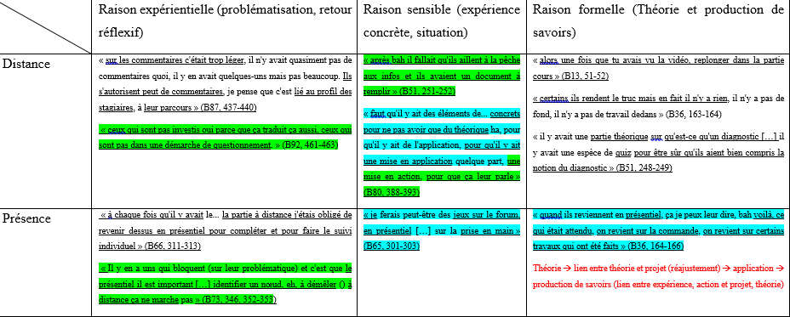
Research method
1) Semi-directional interviews, 2) Explicitation interview method (Vermersch, 2010), 3) Content analysis (Bardin, 2013)

Slide 8
Data analyse : The double alternation
3 reasons Modality | Deliberative primacy action | Reflective primacy dialogue | Intentional primacy perspective
Distance | Professional experiences, practice, tutoring
Presence

Slide 9
Data analyse : The double alternation
3 reasons Modality | Deliberative primacy action | Reflective primacy dialogue | Intentional primacy perspective
Distance | Professional experiences, practice, tutoring
Presence | Theory application, experimentation, feedback, group work, community.

Slide 10
Data analyse : The double alternation
3 reasons Modality | Deliberative primacy action | Reflective primacy dialogue | Intentional primacy perspective
Distance | Professional experiences, practice, tutoring | Individual support
Presence | Theory application, experimentation, feedback, group work, community.

Slide 11
Data analyse : The double alternation
3 reasons Modality | Deliberative primacy action | Reflective primacy dialogue | Intentional primacy perspective
Distance | Professional experiences, practice, tutoring | Individual support
Presence | Theory application, experimentation, feedback, group work, community. | Collective support, reflection on the experience in group, awareness

Slide 12
Data analyse : The double alternation
3 reasons Modality | Deliberative primacy action | Reflective primacy dialogue | Intentional primacy perspective
Distance | Professional experiences, practice, tutoring | Individual support | Content transmission, project methodology, individual work, peer review, self-assessment
Presence | Theory application, experimentation, feedback, group work, community. | Collective support, reflection on the experience in group, awareness

Slide 13
Data analyse : The double alternation
3 reasons Modality | Deliberative primacy action | Reflective primacy dialogue | Intentional primacy perspective
Distance | Professional experiences, practice, tutoring | Individual support | Content transmission, project methodology, individual work, peer review, self-assessment
Presence | Theory application, experimentation, feedback, group work, community. | Collective support, reflection on the experience in group, awareness | Experimentation in groups, accompaniment

Slide 14
Conclusion : apply or get involved
Experience, action
Sensible reason
Distance
Theory, knowledge prodcution
Formal reason
Distance/Présence
Reflection on the experience
Experiential reason
Présence

Slide 15
MERCI! Thank you! Ευχαριστω!
melpomeni.papadopoulou@univ-tours.fr

