Slide 1





Motor abnormalities progression in prodromal PD
    Raphael Couronne, Marie Vidailhet, Graziella Mangone,
    Stéphane Lehéricy, Stanley Durrleman
    Contact : raphael.couronne@inria.fr
Notes:
Good Morning everyone, I will be presenting our work on motor abnormalities progression in prodromal Parkinson’s Disease, done at the Brain and Spine institute in Paris.

Slide 2
Introduction
Estimating a model of disease progression at the very early stage of PD is a major challenge to track disease progression and measure the outcome of therapeutic interventions.
Aim: To estimate the temporal dynamics of occurrence of motor signs in idiopathic REM Sleep Behaviour Disorder (prodromal phase of Parkinson Disease)
Notes:
Estimating a model of disease progression at the very early stage of Parkinson Disease is a major challenge,
To both track disease progression and measure the outcome of possible therapeutic interventions.
Our aim in this study was to estimate the temporal dynamics of occurrence of motor signs in idiopathic REM Sleep Behaviour Disorder (prodromal phase of Parkinson Disease)

Slide 3
Patient Selection
PPMI Longitudinal dataset of iRBD patients
Summary of clinical characteristics at baseline
 | iRBD patients | Control patients
Number | 62 | 194
Female / Male | 13 / 49 | 70/126
Age | 69.3 (59-83) | 60.8 (31-84)
Number of time points | 8.9 (4-11) | 5.6 (1-7)
Follow up duration | 2.7 (1.6-3.6) | 4.7 (0-5.1)
MoCA | 26.2 (11-30) | 28.2 (26-30)
MDS-UPDRS part III. Rigidity Bradykinesia Gait Voice/Face | 3.6 (0-15) 0.3 (0-3) 0.4 (0-3) 0.2 (0-1) 0.1 (0-1) | 1.2 (0-13) 0.25 (0-4) 0.02 (0-2) 0.04 (0-1) 0.04 (0-2)
Mean (Range)
Mean (Range)
Notes:
We used the prodromal dataset of PPMI, that included 62 iRBD patients, followed on an average of 3 years over 9 visits.
We also used the Control PPMI dataset, in order to extract cutoffs of abnormalities for each of the considered sub-motor scores.

Slide 4
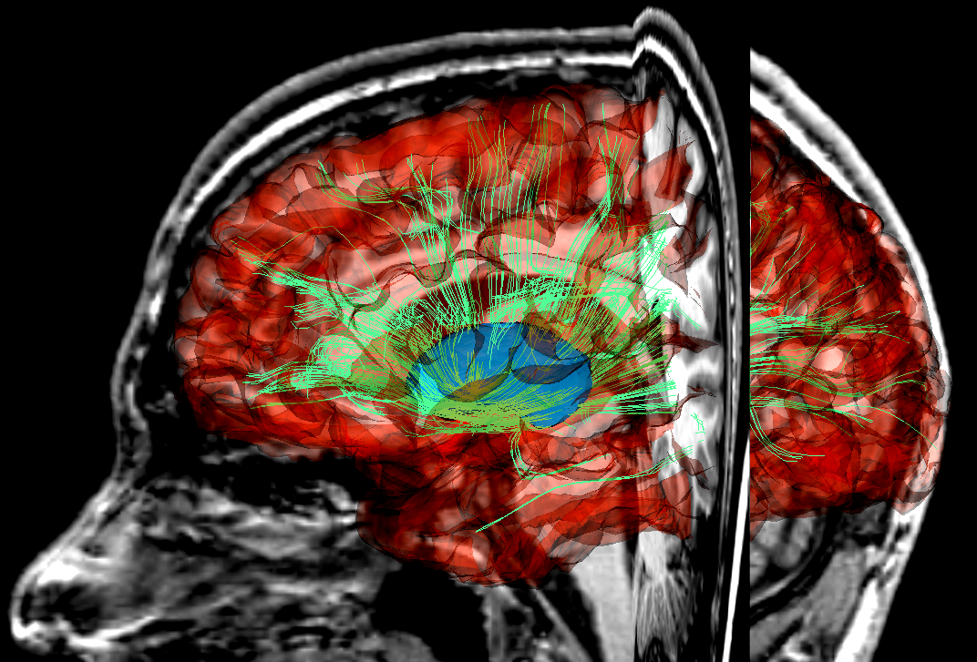
Model
Overview
4
-
27/03/2019
Notes:
Now, to give a brief overview of the model we used, let’s consider 3 patients that follow their own trajectories of the disease. We want to be able to compare their progression.
The general idea is that we want to recombine small parts of individual trajectories to build a long term and general average trajectory. (clic)
Mathematically, this translate into a “Mixed Effect Model”.
We give more details about the model in the following slides.

Slide 5
Theory : A bayesian non-linear mixed effect model
Space of observation : univariate or multivariate
Patient 1 observations
Patient 2 observations
Notes:
Let's suppose our data points for 2 patients (in red) lie on a manifold, of either univariate, or even multivariate observations : for example multiple clinical scores.

Slide 6


Theory : A bayesian non-linear mixed effect model
Define an average trajectory
Patient 1 observations
Patient 2 observations
Notes:
We build and average trajectory, which like in mechanics is only defined by its initial position and speed at t0.
This trajectory is then followed in time, like a canon-ball.

Slide 7
Theory : A bayesian non-linear mixed effect model
Individual trajectories
Patient 1 observations
Patient 2 observations
Notes:
We build and average trajectory, which like in mechanics is only defined by its initial position and speed at t0.
This trajectory is then followed in time, like a canon-ball.
(clic)
We then consider individual trajectories as parallels of this average trajectory in the manifold.

Slide 8
Theory : A bayesian non-linear mixed effect model
Following the individual trajectories
Patient 1 observations
Patient 2 observations
Notes:
A priori, we travel these individual curves at the same time of the average trajectory, we have an absolute time. But as we know, 2 patients at same age can be at very different stages of the disease, and evolve at different speeds. We want to be able to capture this effect in our model.
So we consider time as a random variable, and reparametrize it with 2 variables for patient : onset and speed.
(In fact, our average trajectory should always describe an increase of parkinsonian symptoms, from none, to suspicion of PD, to conversion to PD and even beyond.))

Slide 9
Theory : A bayesian non-linear mixed effect model
Time reparametrization
Patient 1 observations
Notes:
Let’s zoom in on patient 1 on the time window where we have observations.
The onset delays the progression. (clic)

Slide 10


Theory : A bayesian non-linear mixed effect model
Time reparametrization : onset
Patient 1 observations
Notes:
In this case, patient 1 has a late onset.
At its initial age, patient 1 is further away in the average progression.

Slide 11
Theory : A bayesian non-linear mixed effect model
Time reparametrization : onset
Patient 1 observations
Notes:
Now patient 1 is delayed in time, but we also want each patient to have its own speed of progression.
(((
his progression is still as same speed of the average trajectory.
Then each patient has its own speed of progression.)))

Slide 12
Theory : A bayesian non-linear mixed effect model
Time reparametrization : speed
Patient 1 observations
Notes:
In this case, patient 1 evolves at higher speed than the average, covering more of the average trajectory in the same time duration.
To sum up the example, patient one has early onset and evolves faster.

Slide 13
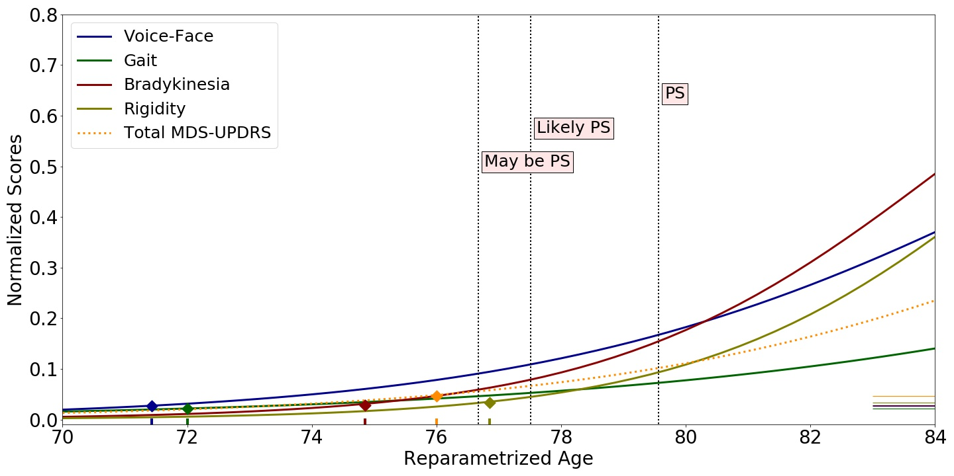
Results : Average trajectory of motor signs
Model-wise “average patient”, proxy to a scenario of disease progression
Abnormalities cutoffs
Reparametrized age of conversion to abnormal values
Notes:
When applied to the motor subscores of prodromal patients, we obtain those results. An average progression of the scores according to time for each of the modality …
We report the cutoffs of abnormalities we obtained from the control cohort.
We then look at the times of intersection between the average progression and these cutoffs to get
an occurrence time.
We also add Parkinsonism level scores for scale.

Slide 14
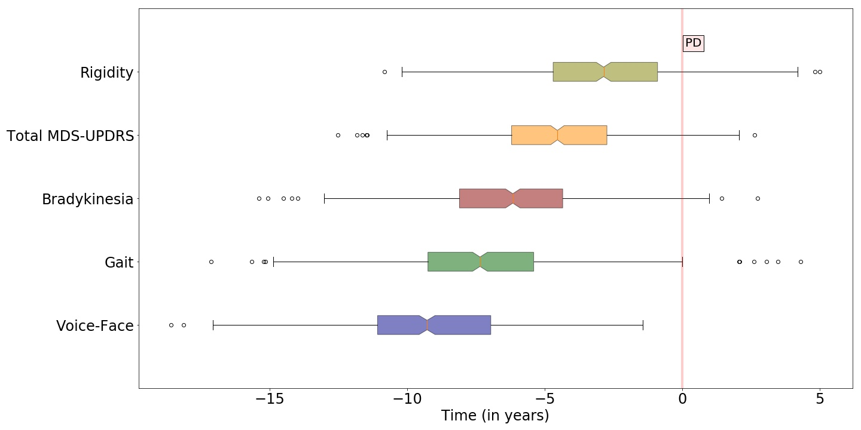
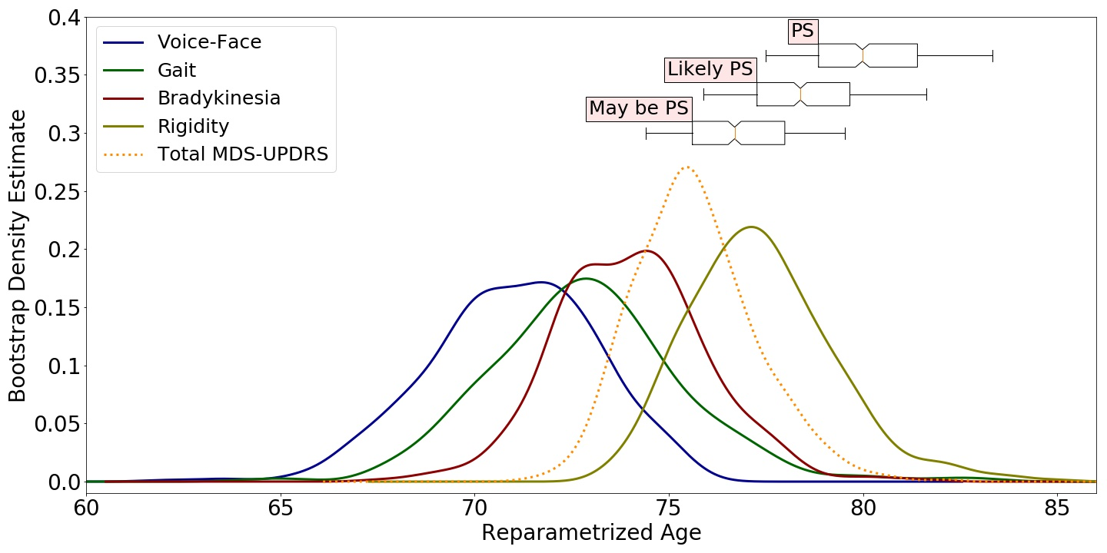
Results : Distribution of motor signs occurence
Distribution of occurrence relatively to PD conversion
Relatively to PD conversion
Bootstrap Density of reparametrized age of conversion
Notes:
We bootstrap the process (p=500) to account for sampling bias and stochastic variations in the estimation algorithm, and obtain confidence intervals. Relatively to PD conversion, we find that Voice-Face modality is affected first, with median time to conversion of 9 years. Then Gait, Bradykinesia, MDS-UPDRS and Rigidity at respectively 7, 6, 5 and 3 years before conversion

Slide 15
Results : Distribution of motor signs occurence
 | Our method | Postuma et al. (Brain'12)
Voice / Face | 9.2 (4.6-14) | 9.8 (6.7-29.8)
Gait | 7.3 (2.1-12) | 4.4 (3.9-5.4)
Bradykinesia | 6.1 (1.6-11) | 5.4 (4.8-6.5)
MDS | 4.6 (0.45-8.5) | 4.5 (3.7-5.6)
Rigidity | 2.9 (2-7.1) | 4.4 (3.9-5.5)
Notes:
Our results are in a general agreement with those of a previous study, with one difference which is we observe Gait abnormalities before Bradykinesia.

Slide 16
Discussion
Take home message
We estimated a scenario of progression of prodromal PD
The mixed-effect model
  Multivariate :
  estimate the joint progression of multiple clinical features
  Reparametrize time :
  no need for reference time (i.e. age at diagnosis): automatically align the dynamics of each patient
  Give an estimate of the sequence of alterations on average, and for each individual subject
  Bootstrapped :
  for variance estimation
  Generic :
  Applicable to other neurodegenerative diseases
    Poster 493
    raphael.couronne@inria.fr
Notes:
To conclude, we estimated a scenario of progression of prodromal PD, using a mixed-effect model, that :
-handles multivariate data, to estimate the progression of the scores all at once
-reparametrize time
-we bootstrap for variance estimation
Thank you for your attention.

