Slide 1

Air-Sea Turbulent Fluxes and Upper-Ocean Currents during the TURBORADAR-TURBIDENT Experiments
Denis Bourras¹, Alexei Sentchev², Hubert Branger³, Rosalie Fuchs⁴, Ivane Pairaud⁴, Philippe Fraunié¹, Christophe Yohia⁵, Christopher Luneau⁵, Céline Quentin¹, and Jean-Luc Devenon¹
EGU2019-14294
¹ Aix-Marseille University, Mediterranean Institute of Ocean Physics, Marseille, France
² Laboratoire d'Océanologie et Géosciences Université du Littoral - Côte d'Opale CNRS UMR 8187, France
³ Institut de Recherche Phénomènes Hors Equilibre AMU CNRS UMR 7342, France
⁴ IFREMER LERPAC, 83507-F La-Seyne-sur-Mer, France
⁵ OSU Institut Pytheas UMS 3470, Marseille, France

Slide 2
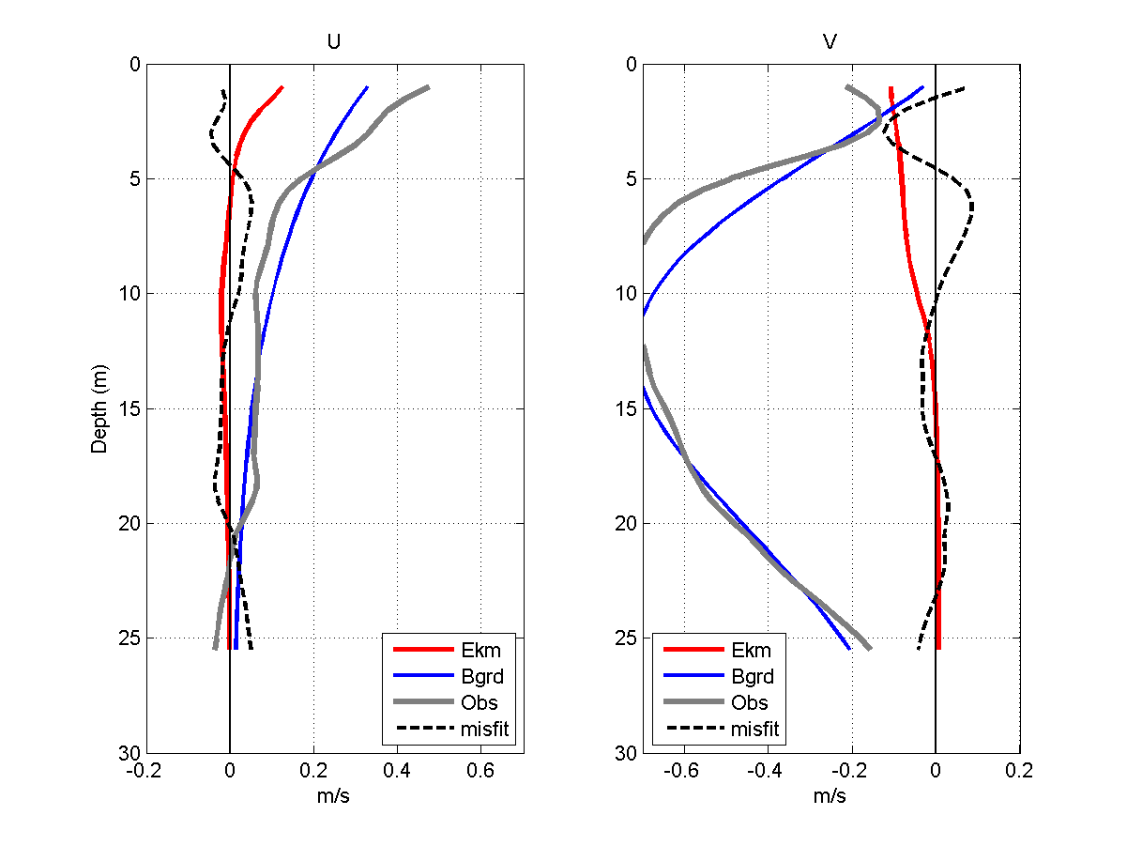
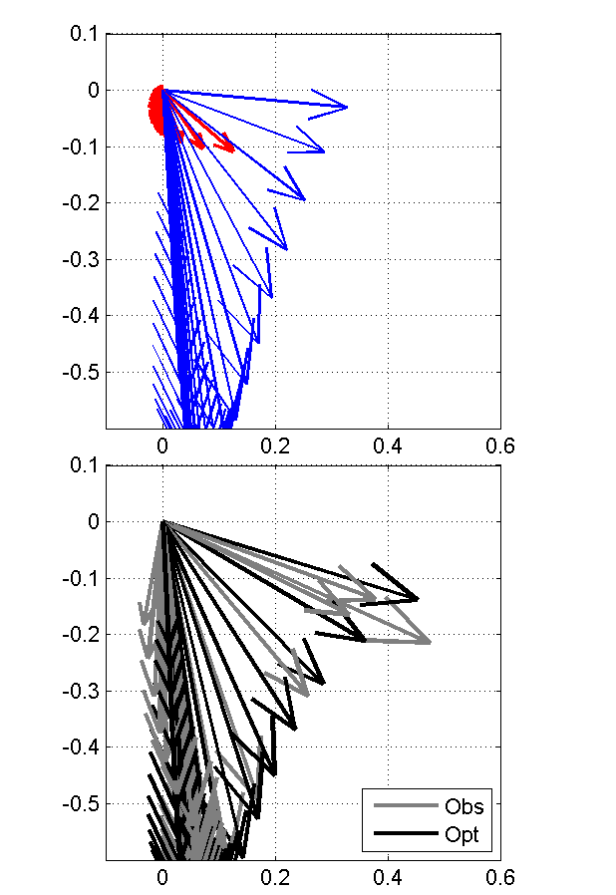
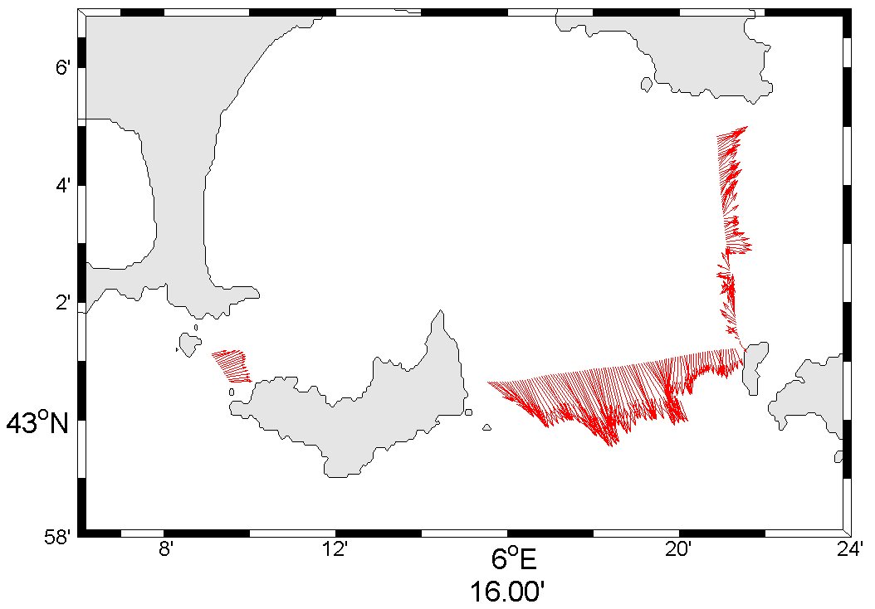
The TURBORADAR and TURBIDENT experiments are devoted to the study of
  The circulation and the properties of a region of the NW Mediterranean
  in response to strong wind events (mistral)
  Eddy diffusivity coefficients in the mixed layer
  Surface current shear, from an array of ground-based HF RADARs
Surface currents, subsurface circulation, and thermal configuration were already documented in the poster EGU 2019-13256 : Identification of eddy viscosity profile in the marine surface layer in transient wind conditions, by P. Fraunié et al. (fraunie@univ-tln.fr)
Current field in the surface layer 2m thick (1-3m depth)
K_{z}
Wind
#3
#1
#2
Out flow
Flow in
Wind-induced velocity (red) is obtained by using a variational approach to fit a 1-D (Ekman) model to the observed velocity profile (gray).

Slide 3
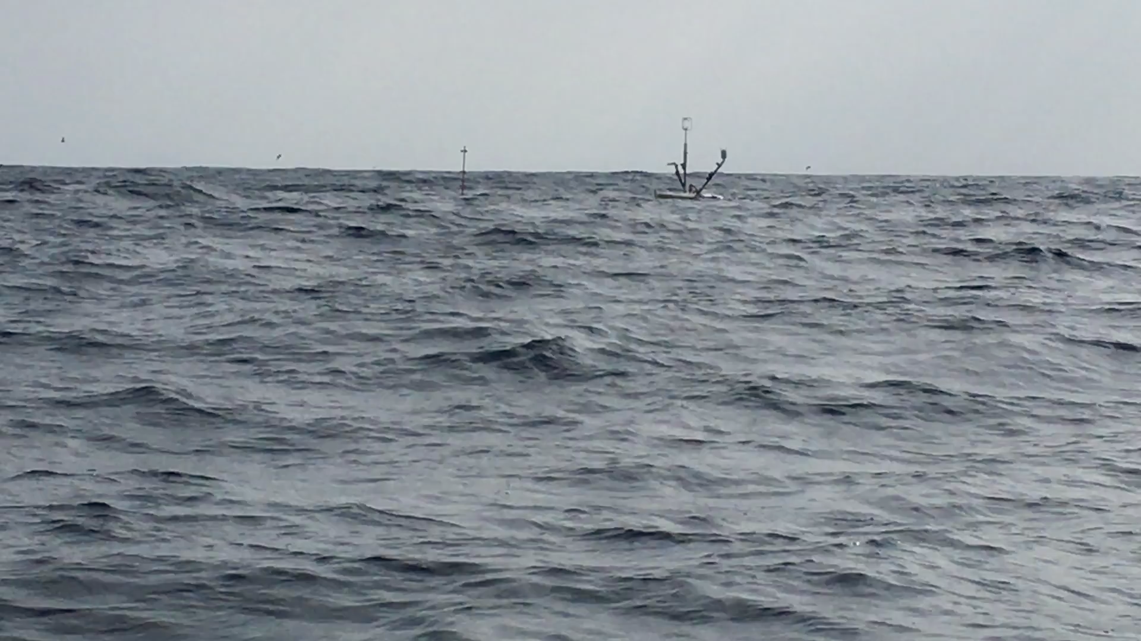
This talk focuses on OCARINA data, a surface drifting and wave-following platform dedicated to turbulent air-sea flux measurements in the wave-boundary layer.

Slide 4
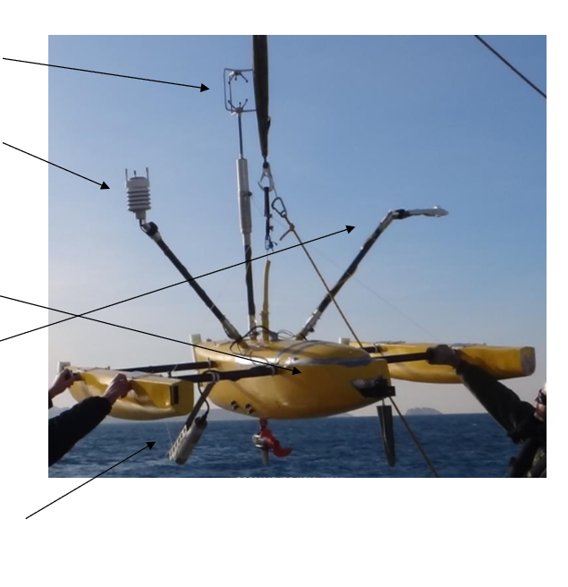
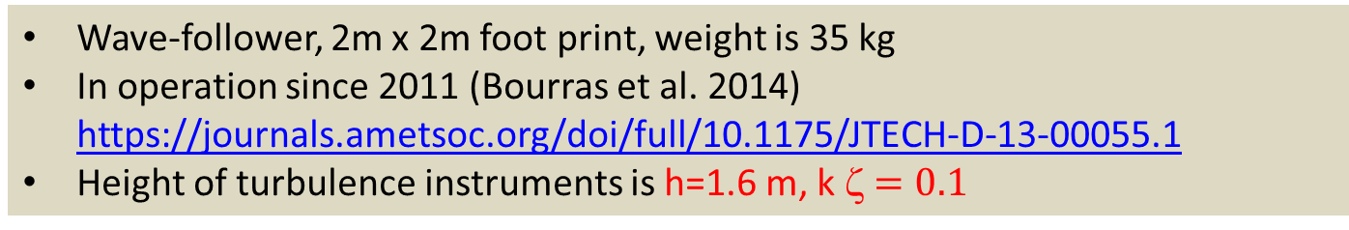
Wave-follower, 2m x 2m foot print, weight is 35 kg
In operation since 2011 (Bourras et al. 2014) https://journals.ametsoc.org/doi/full/10.1175/JTECH-D-13-00055.1
Height of turbulence instruments is h=1.6 m, k ζ$=0.1$
Gill R3-50 sonic anemometer (u,v,w+ sonic temperature) at 50 Hz
Vaisala WXT-520 weather station (T,p,RH) at 1 Hz
Xsens MTI-G IMU (accelerations, gyroscopes, GPS, magnetometers and barometer), at 50 Hz
Campbell CNR4 pyranometer and pyrgeometer for upward and downward radiation fluxes
OCARINA platform
Seabird SBE37-SI : Sea surface temperature and salinity

Slide 5
Issues addressed:
Does it make sense to measure wind turbulence with a low-profile wave-following platform?
How are the friction velocity (u*) estimates modified in unsteady conditions?

Slide 6




PART I: Required notions
I.1 Wind spectrum: three separate frequency ranges
I.2 Context of the Wave-Boundary Layer (WBL)
Air-sea turbulent flux calculation methods (classical view):
  I.3 Bulk (similarity, flux-gradient)
  I.4 Eddy-Covariance (EC)
  I.5 Inertial-Dissipation (ID)
$$τ/ρ=C_{D}{\overline{U}}^{2}={u_{∗}}^{2}$$
$$τ/ρ={\left({\overline{u^{′}w^{′}}}^{2}+{\overline{v^{′}w^{′}}}^{2}\right)}^{1/2}$$
$$ε=\frac{2π}{U_{r}}{\left(\frac{{|E_{U}\left(f\right)|}^{2}}{c}\right)}^{\frac{3}{2}}f^{\frac{5}{2}}$$
K41:
$$u_{∗}={\left(κzε\right)}^{\frac{1}{3}}{\left(φ_{m}\left(ζ\right)−ζ−φ_{imb}\right)}^{−\frac{1}{3}}$$
TKE:

Slide 7
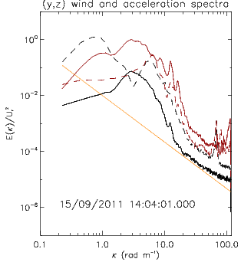
I.1 Wind spectrum vs scale
Inertial sub-range
weather systems, flat sea
Production of turbulence
(Motion correction)
Viscous dissipation
<u>(t)
<u’>=0
u’(t)
Measured range
Flux calculation:
Bulk
Eddy-covariance
Inertial-dissipation
~½ hour
~1 second

Slide 8
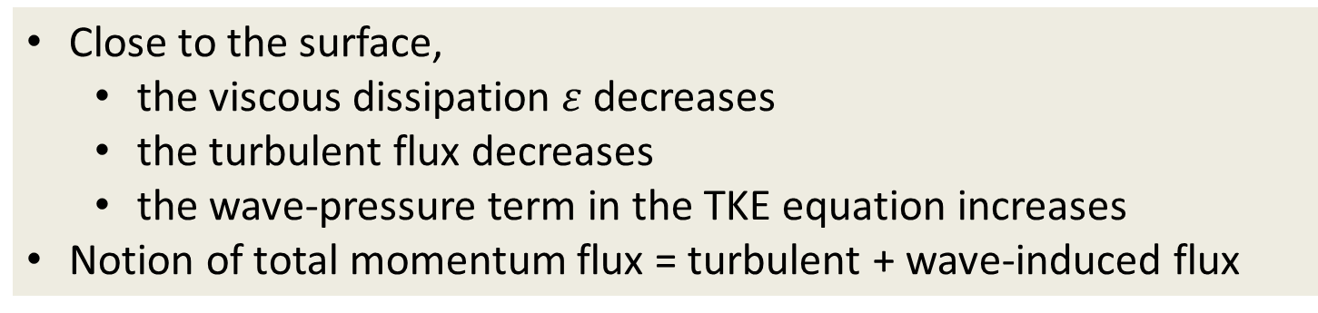
I.2 Measurements in the WBL
Close to the surface,
  the viscous dissipation $ε$decreases
  the turbulent flux decreases
  the wave-pressure term in the TKE equation increases
Notion of total momentum flux = turbulent + wave-induced flux
Helpful references: a lot of material is borrowed from Hara & Sullivan (2015) hereafter:
Cifuentes-Lorenzen, A., Edson, J.B. & Zappa, C.J. (2018). Air–Sea Interaction in the Southern Ocean: Exploring the Height of the Wave Boundary Layer at the Air–Sea Interface. Boundary-Layer Meteorology, 169: 461. https://doi.org/10.1007/s10546-018-0376-0
Edson, J. B., Jampana, V., Weller, R. A., Bigorre, S. P., Plueddemann, A. J., Fairall, C. W., Miller, S. D., Mahrt, L., et al. (2013). On the Exchange of Momentum over the Open Ocean. Journal of Physical Oceanography, 43(8), 1589-610. https://doi.org/10.1175/JPO-D-12-0173.1
Hara, T., & Sullivan, P. P. (2015). Wave Boundary Layer Turbulence over Surface Waves in a Strongly Forced Condition. Journal of Physical Oceanography, 45, 868-883. https://doi.org/10.1175/JPO-D-14-0116.1

Slide 9
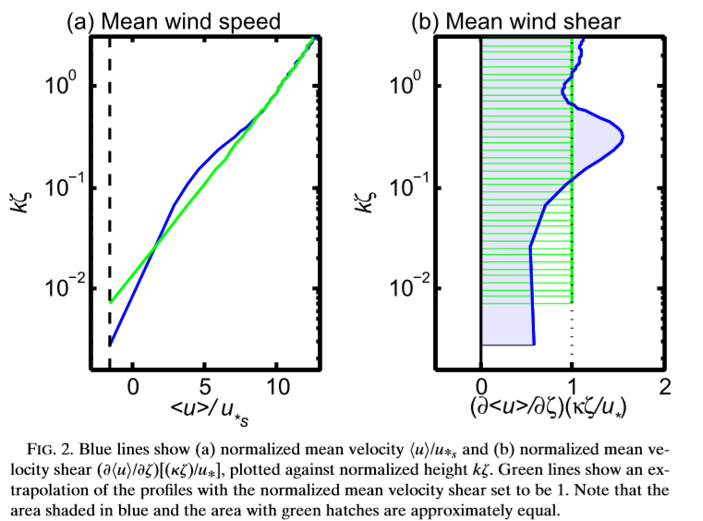



I.3 BULK estimation method
The mean values of $\overline{U}$and $∂\overline{U}/∂z$may be impacted in a worst case scenario
k ζ
Flux-gradient relationship
Constant flux layer
$$u_{∗}=κz{ Φm(ζ)}^{−1} ∂\overline{U}/∂z$$
$$0.1$$
(sea surface is flat at a 30-minute scale)
In moderate wind & sea conditions, the bulk estimates of u* should compare to measurements above the WBL, i.e. to 3-10 m height data (see slide 13)
Height measurement range
Figure on the right by Hara and Sullivan (2015)
LES simulations with strong wind forcing and steep sine waves.
Green is similarity (constant shear)
Blue is LES results

Slide 10
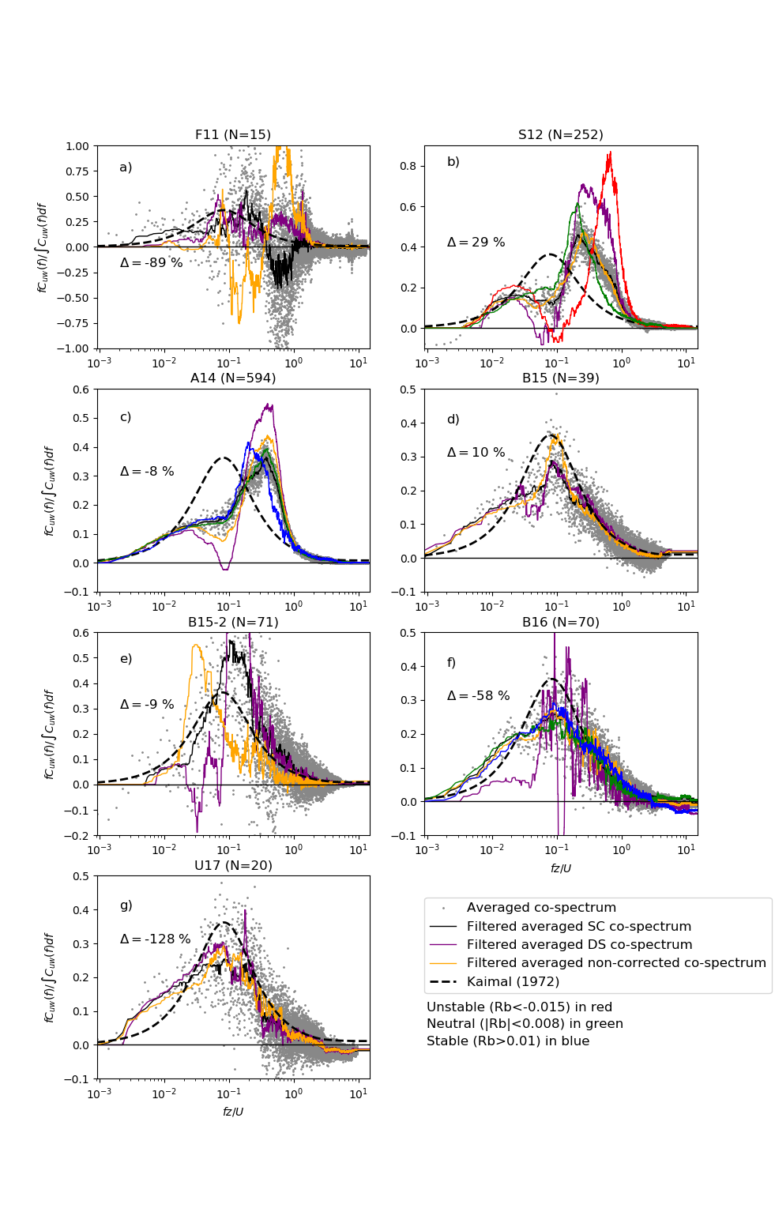

I.4 EC estimation method
With a wave follower, a total stress (turbulent + wave-induced) is measured
(Hara & Sullivan, 2015, p880)
Co-spectra from STRASSE 2012 data^{(*)}
k ζ
$$0.1$$
Additional remarks :
Motion correction for the vertical wind component w is required or not, depending on wave steepness^{(*)}
The co-spectrum maximum peak may occasionally be shifted toward large values of fz/U, suggesting that Kaimal (1972) normalization may have to account for wave characteristics ^{(*)}
^{(*)} Bourras et al. (2019, in revision at JGR Oceans)

Slide 11
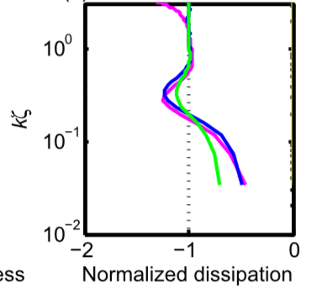
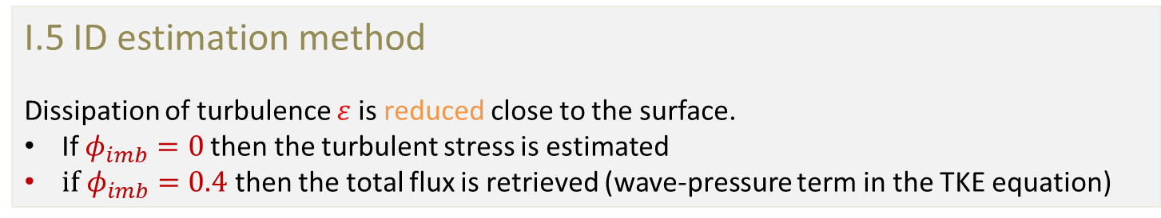


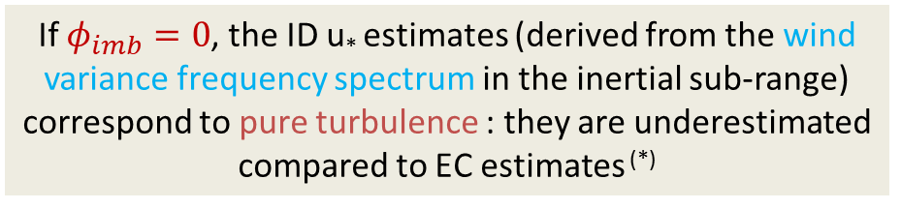
I.5 ID estimation method
Dissipation of turbulence $ε$ is reduced close to the surface.
If $φ_{imb}=0$then the turbulent stress is estimated
${if φ}_{imb}=0.4$ then the total flux is retrieved (wave-pressure term in the TKE equation)
$$ε=\frac{2π}{U_{r}}{\left(\frac{{|E_{U}\left(f\right)|}^{2}}{c}\right)}^{\frac{3}{2}}f^{\frac{5}{2}}$$
K41:
$$u_{∗}={\left(κzε\right)}^{\frac{1}{3}}{\left(φ_{m}\left(ζ\right)−ζ−φ_{imb}\right)}^{−\frac{1}{3}}$$
TKE:
If $φ_{imb}=0$, the ID u* estimates (derived from the wind variance frequency spectrum in the inertial sub-range) correspond to pure turbulence : they are underestimated compared to EC estimates ^{(*)}
Above figure from Hara and Sullivan (2015)
Colored lines denote different parameterizations
Wave-pressure term $φ_{imb}$ = 0.4 was evaluated on seven data sets ^{(*)}
^{(*)} Bourras et al. (2019, in revision at JGR Oceans)

Slide 12
Proposed approach for qualifying turbulence data and justify what is measured : reconcile u* estimates derived from EC, ID and bulk
Application of the EC method:
  Our reference
  Gives an estimation of the total stress
  It is next used to
    estimate the imbalance term in the TKE equation
    find a parameterization of the bulk drag coefficient
Adjustment of the ID method:
  Gives the total stress (or just the turbulent part of the stress if no imbalance term is accounted for), or equivalently of the turbulent stress above the WBL.
Adjustment of the Bulk method:
  Drag coefficient can be compared to existing parameterizations

Slide 13
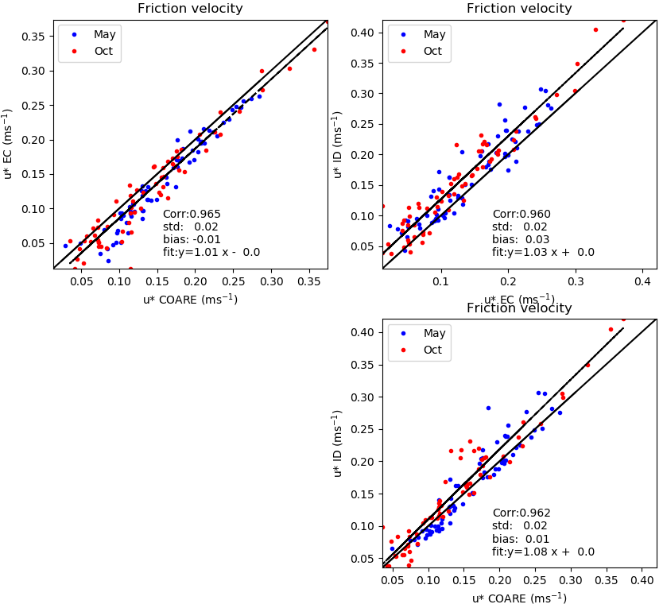
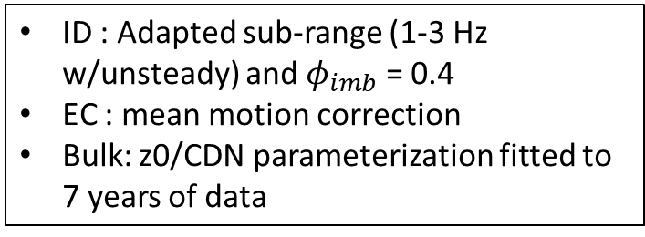
PART II.1: Results for TURBORADAR 2018 (u* comparisons)
ID : Adapted sub-range (1-3 Hz w/unsteady) and $φ_{imb}$ = 0.4
EC : mean motion correction
Bulk: z0/CDN parameterization fitted to 7 years of data
Standard deviation of the difference is 2 cm/s (10 %)

Slide 14
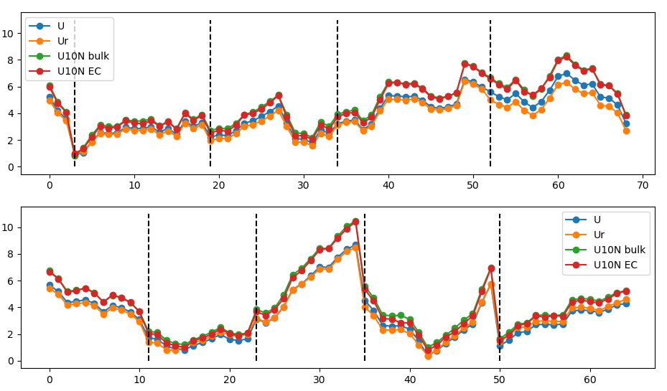
PART II.2: Unsteady conditions (Times series of wind)
Leg 1 : may 2018 : 5 days
Wind
Day 0
Day 1
Day 2
Day 3
Day 4
Leg 2 : Oct 2018 : 5 days
Day 0
Day 1
Day 2
Day 3
Day 4
Wind
Time series (1 point is a 1 100 sec time average)

Slide 15
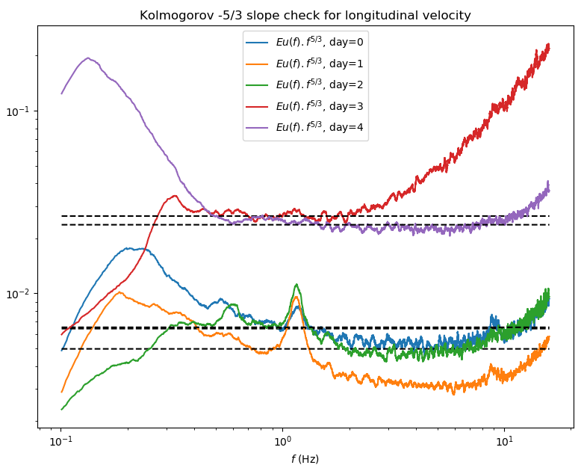
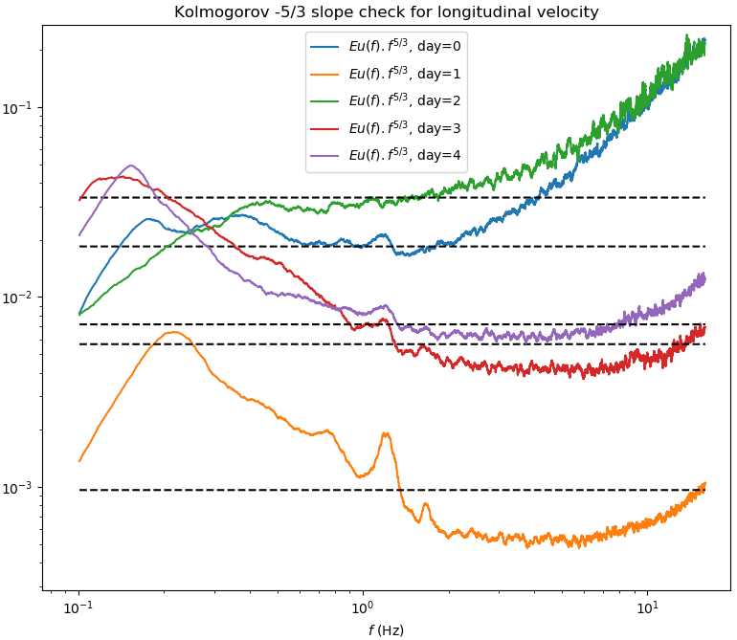
PART II.3: Unsteady conditions (Inertial sub-range)
May 2018
Oct 2018
The helpful part of the wind sub-range is in the range [3;6] Hz
It is rejected toward smaller frequencies for day 3 (May) and days 0,2 (Oct)

Slide 16
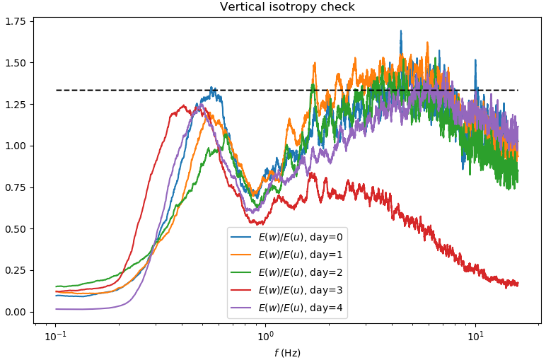
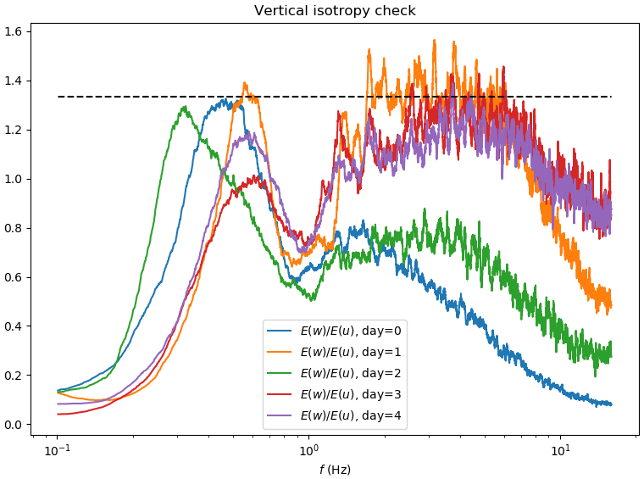
PART II.4: Unsteady conditions (deviation to vertical isotropy)
May 2018
Oct 2018
Isotropy in unsteady cases is ~0.7 in the inertial sub-range
For the other days, it is close to the 4/3 reference value

Slide 17
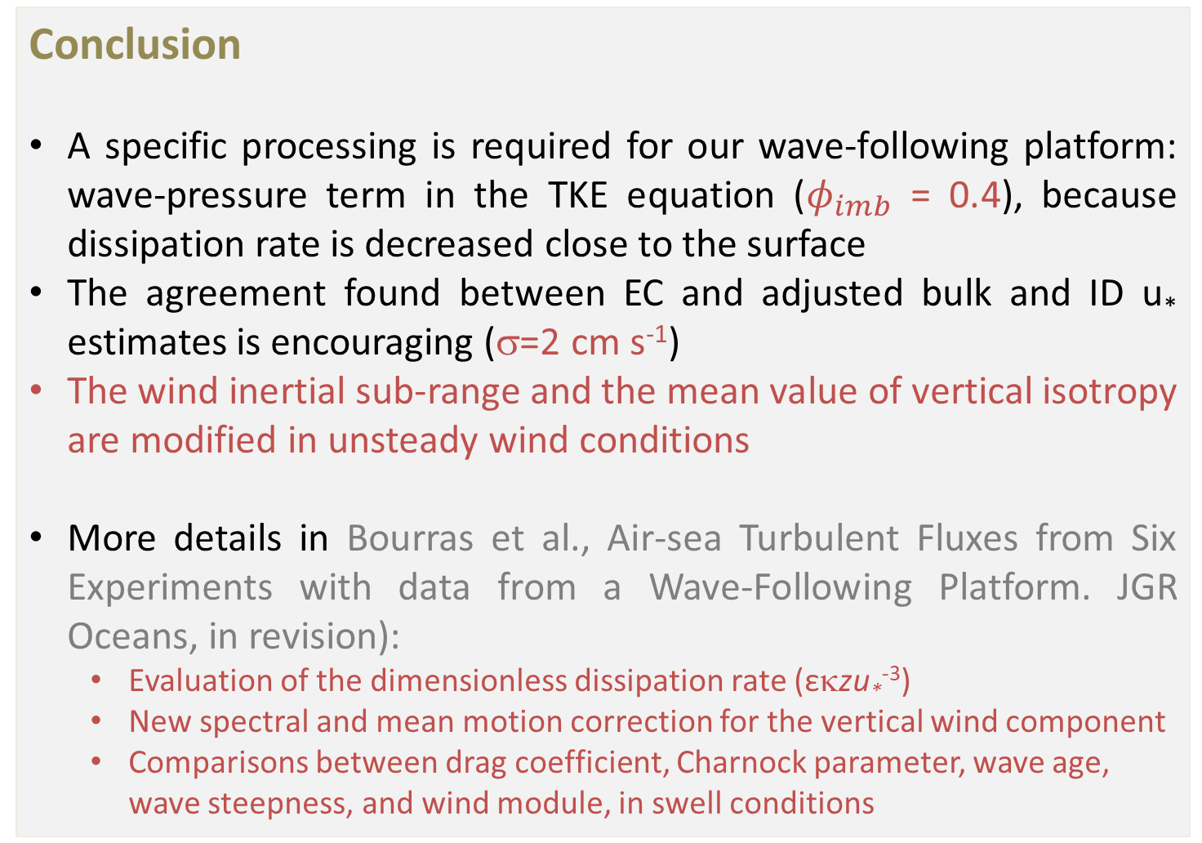
Conclusion
A specific processing is required for our wave-following platform: wave-pressure term in the TKE equation ($φ_{imb}$ = 0.4), because dissipation rate is decreased close to the surface
The agreement found between EC and adjusted bulk and ID u* estimates is encouraging (σ=2 cm s⁻¹)
The wind inertial sub-range and the mean value of vertical isotropy are modified in unsteady wind conditions
More details in Bourras et al., Air-sea Turbulent Fluxes from Six Experiments with data from a Wave-Following Platform. JGR Oceans, in revision):
  Evaluation of the dimensionless dissipation rate (εκzu*⁻³)
  New spectral and mean motion correction for the vertical wind component
  Comparisons between drag coefficient, Charnock parameter, wave age, wave steepness, and wind module, in swell conditions

Slide 18
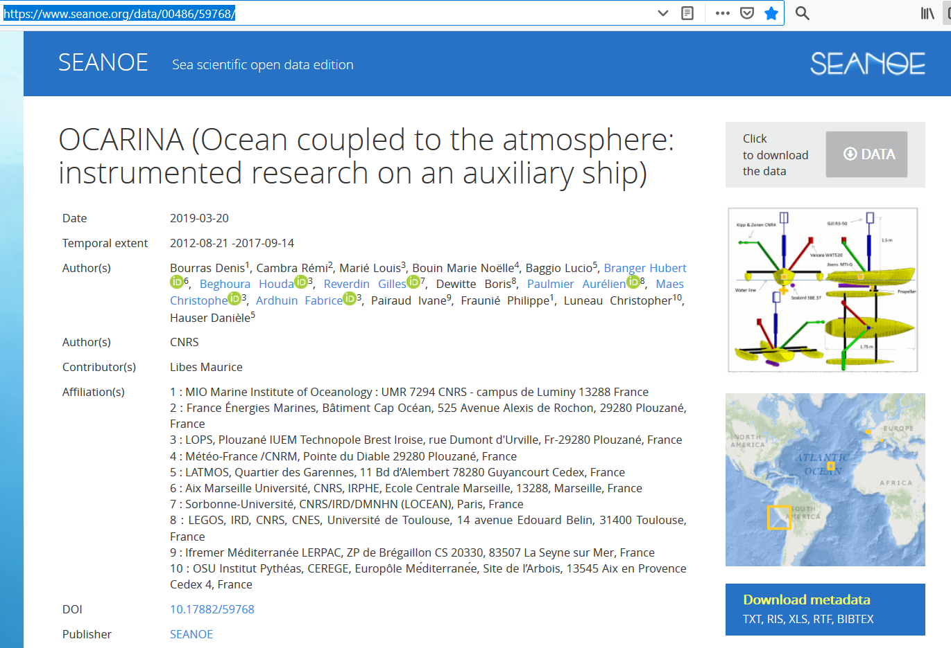
OCARINA Data from experiments before TURBORADAR are available at :
https://www.seanoe.org/data/00486/59768/
Processed and raw data are already available for seven experiments
TURBORADAR 2018 data available soon

