Slide 1


Feasibility of wood peeling process assisted by radiant energy.
Anna DUPLEIX
PhD student – First year
Professor Rémy MARCHAL¹
Professor Mark HUGHES²
Joint supervisors: Dr Louis-Etienne DENAUD¹
Dr Andrezj KUSIAK³
Dr Fréderic Rossi¹
¹Arts&Métiers ParisTech Cluny, France; ²Aalto University, Helsinki, Finland ; ³Université de Bordeaux, France.

Slide 2
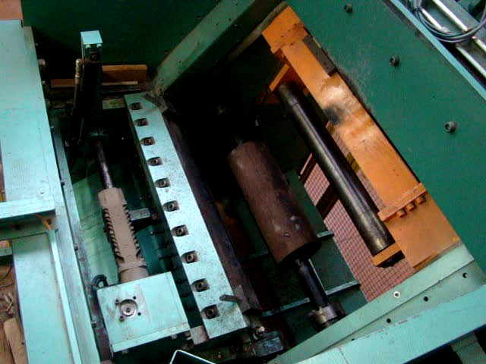
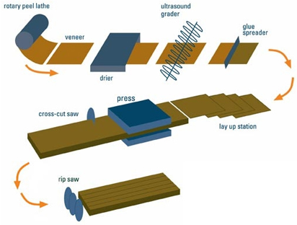
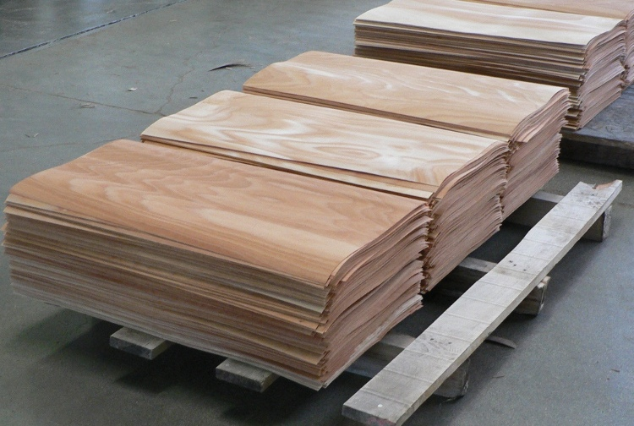
A high-value added process.
A high production rate.
Peeling process¹
Sources: ¹CarterHoltHarvey WoodProducts New Zealand; ²Bois Déroulés de l’Auxois.
v =1 to 10 m/s
²
Soaking
24-72 h
Time of process
Peeling
1 min
Thickness =0.5 to 10 mm
Slow down by log preparation.

Slide 3
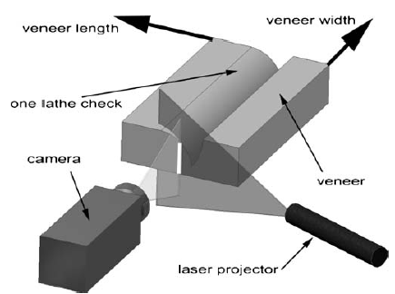
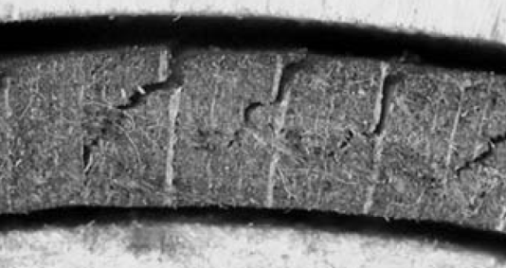
What is wood heating prior to peeling aimed at?
Improving veneer surface quality deformability
to fluidise resin pockets
to soften lignin and knots
to facilitate peeling of shavings
to reduce the risk of lathe checkings
SMOF setup⁴
Lowering cutting efforts
Sources: ³P.Navi Traitement hyggrothemro du bois, ⁴SMOF.
to increase wood deformability
to reduce applied power
to limitate wear of the cutting tools
A = loose side
B = tight side
Open lathe checkings⁴
To « soften » wood prior to peeling.

Slide 4
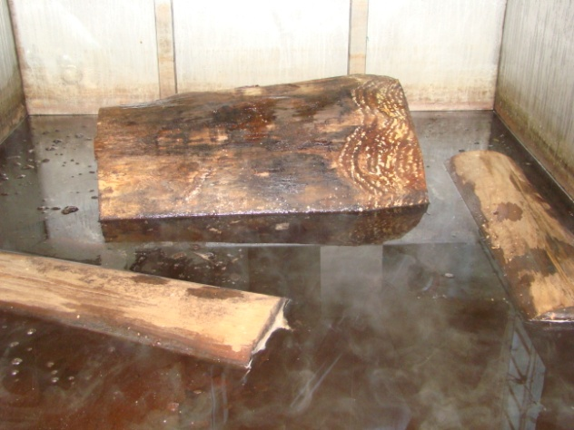
Soaking: a traditional method
Aim of soaking: To heat bolts in the whole volume.
^{5;6}
⁷
Sources: ⁵Baldwin, 1981; ⁶Bois Déroulés de l’Auxois; ⁷ Arts&Métiers ParisTech Cluny.
Severe drawbacks in terms of
Cost | Yield | Veneer quality
Energy efficiency Water pollution Facilities requirements | Stock downtimes Wood cohesion Handling | Coloration Durability Wooly surface
But time-consuming, empirical and imperfect.

Slide 5
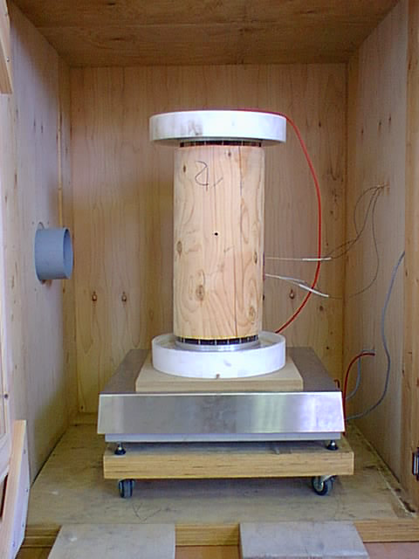
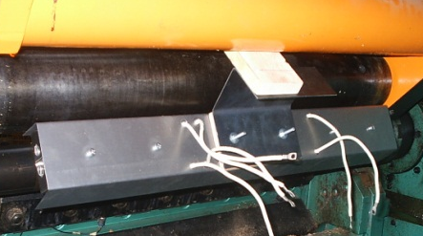
Previous trials on alternative methods to soaking
Arts et Métiers ParisTech Cluny
Volume
heating
Surface
heating
Electric ohmic heating
    Microwave heating (MW)
    Infrared heating (IR)
⁸
Temperature sensors
¹⁰
Electrodes
insulated
with Teflon®
Infrared
heater
Bolt
Sources: ^{8,10} Arts&Métiers ParisTech Cluny; ⁹University of Melbourne.
Scale
⁹
Microwave
heater
To heat wood prior to peeling.

Slide 6
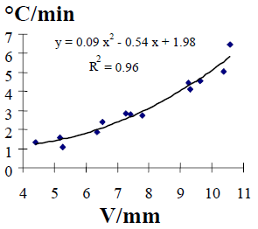
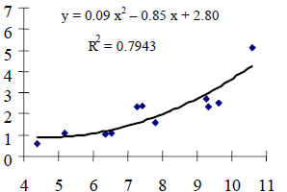
For same veneer quality, a high heating rate method.
Volume
heating
Electrode
¹¹
Sapwood
Heartwood
°C/min
°C/min
U = 10 V/mm
Electrode
V/mm
Current flows mainly in sapwood
V/mm
Sources: ¹¹ Marchal, R. et al., 2000-2004.
But heterogeneous and requiring high voltages.

Slide 7
Learning from volume electric ohmic heating.
1
Wood does not need to be "cooked" to "soften" as required by peeling.
Using water as vector of heat produces heterogeneous heating.
2
heartwood
sapwood
How to heat wood without using water as a vector of heat?

Slide 8
Interest of radiant energy
Energy efficiency
Planck’s law
Radiation penetrates into green wood
VISIBLE
INFRARED

Slide 9
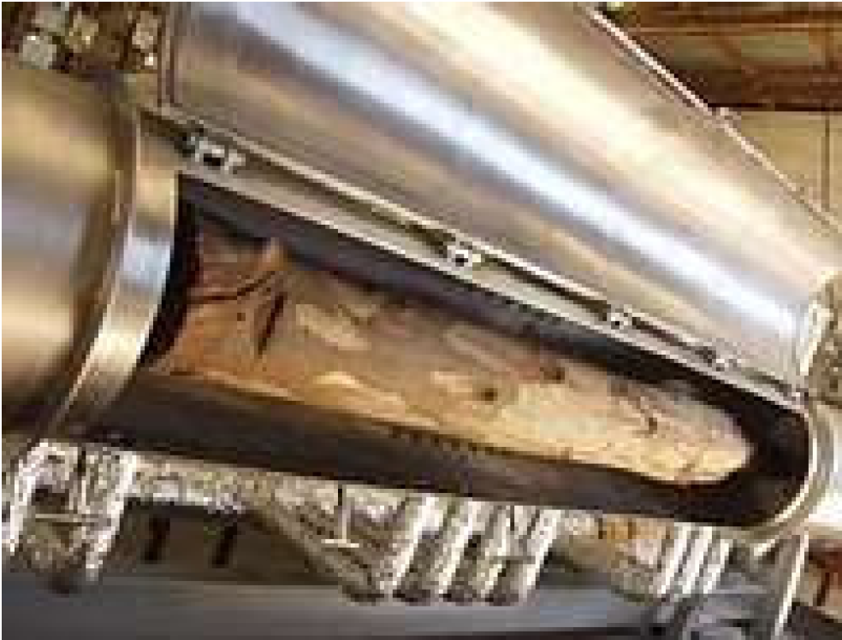
Homogeneous and rapid heating but dangerous.
MW Volume
heating
Probe
60 mm
MW
Log
Sources: ¹² Torgonikov et al., 2010; ¹³University of Melbourne.
¹²
¹³
Coaxial cables and waveguides from electric generator to MW applicator.
Looking for radiant energy heating easier to implement.

Slide 10
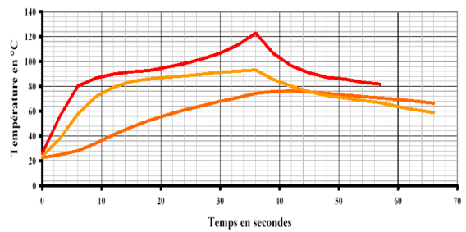
IR thermal kinectics
IR Surface
heating
140
120
100
80
60
40
20
0
¹⁴
IR penetration
Surface layer
Temperature (°C)
Conduction
Subjacent layers
0 10 20 30 40 Time (s)
Sources: ¹⁴ CETIAT, 2003.
Rapid surface heating.

Slide 11
Alternative methods to soaking
 | Advantages | Drawbacks
Electric ohmic heating | - rapidity | - requiring high voltages
Microwave heating | - rapidity - energy efficiency | - complexity of technology
Infrared heating | rapidity - easiness of implementation | - penetration depth
IR most suitable alternative method to heat wood prior to peeling.

Slide 12
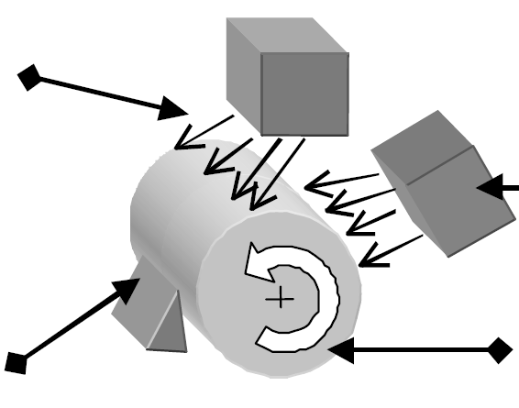
Aim of research: to develop on-line IR heating system
directly embedded on the peeling lathe
to heat wood surface while peeling
activated when peeling comes to heartwood
IR radiation
IR radiation
Peeling knife
Bolt

Slide 13
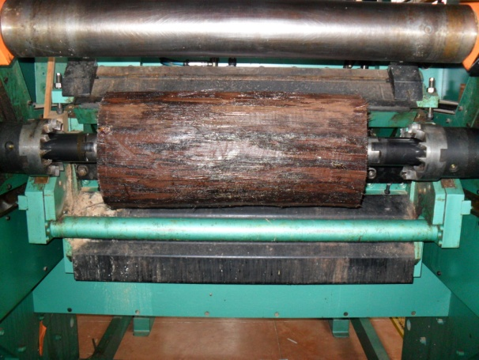

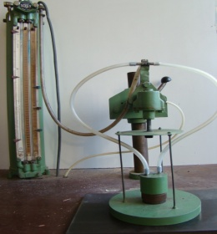

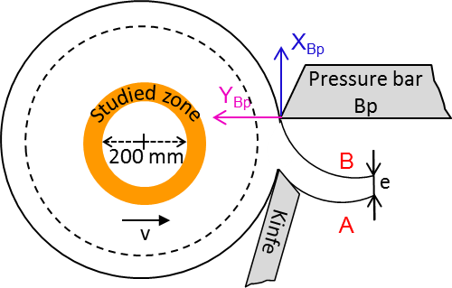
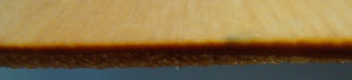
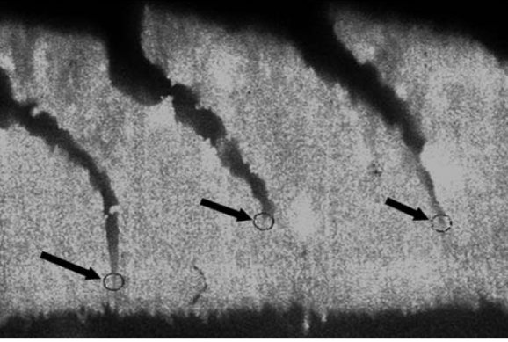
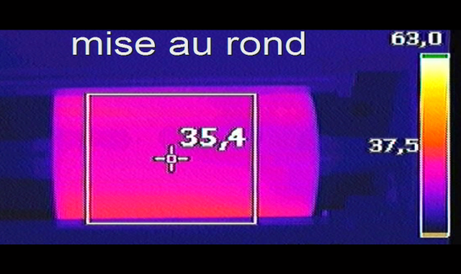
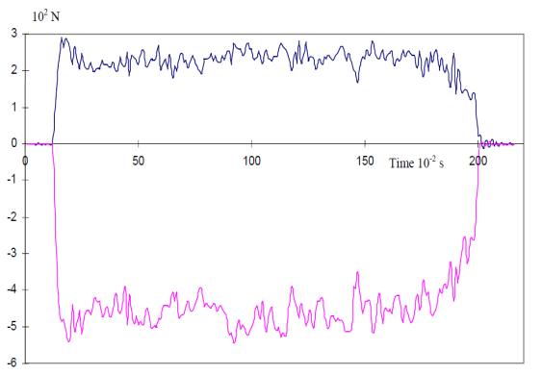
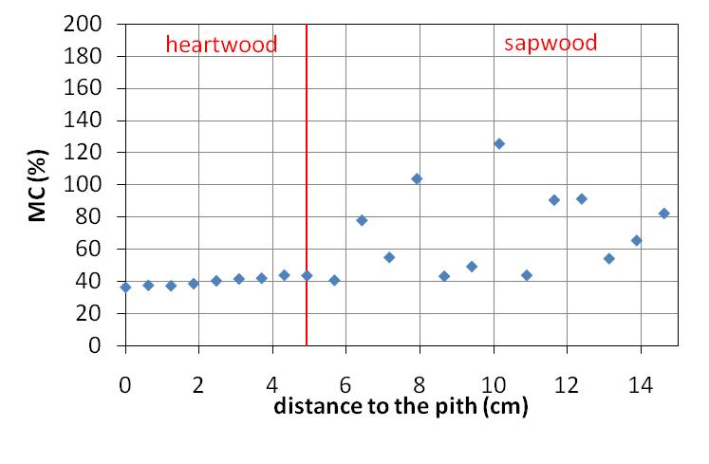
Study of the influence of heating temperatures on peeling.
Species
Douglas-fir
Beech
Spruce
Birch
Process parameters
Veneer quality assessment
V = 1 m/s
Bp = 5%
e = 3 mm
Checks index (fuitometer)
Heating bolts by soaking
70°C
60°C
50°C
45°C
40°C
35°C
30°C
20°C
Veneer thickness
e ± Δe
Checks frequency and depth (SMOF)
Process assessment
On-line surface temperatures (IR camera) Cutting efforts on pressure bar Moisture Content cartography of bolt
Objectives To lower heating temperatures in compromise with veneer surface quality.
Results Target temperatures for modelling.

Slide 14
Peeling unit
Technical development of embedded IR heating system
Validating tests on embedded IR heating system
Minimum required peeling T°C
Specifications
Technical feasibility
Requirements
Thermal unit
Characterisation of wood behaviour under IR radiation
Modelling IR heat transfer during peeling process
Values
Optimisation of IR heating parameters
Start
Conclusion
Economical feasibility
Economical unit
Economical study of embedded IR heating system
Post-doc
S. Ould Amadou
Time
Current work

Slide 15
Feasibility of wood peeling process assisted by radiant energy.
Anna DUPLEIX
PhD student – October 2010
Thank you for your attention.
Professor Rémy MARCHAL
Arts&Métiers ParisTech Cluny, France
Professor Mark HUGHES
Aalto University, Helsinki, Finland

