Slide 1


IR heating of green wood while peeling.
Collaboration:
Louis-Etienne DENAUD¹, Mark HUGHES², Andrezj KUSIAK³, Rémy MARCHAL¹, Sid’Ahmed OULD AHMEDOU¹, Fréderic ROSSI¹.
¹Arts et Métiers ParisTech LaBoMaP, France
³Université de Bordeaux, France
²Aalto University, Helsinki, Finland
Anna DUPLEIX – PhD Candidate
anna.dupleix@ensam.eu

Slide 2
IR heating of green wood while peeling.
Plan
The project idea
Heating temperatures
Modelling principles
Thermal characterisation results
Future work
Anna DUPLEIX – PhD Candidate
anna.dupleix@ensam.eu

Slide 3
IR heating of green wood while peeling.
1.The project idea
Anna DUPLEIX – PhD Candidate
anna.dupleix@ensam.eu

Slide 4
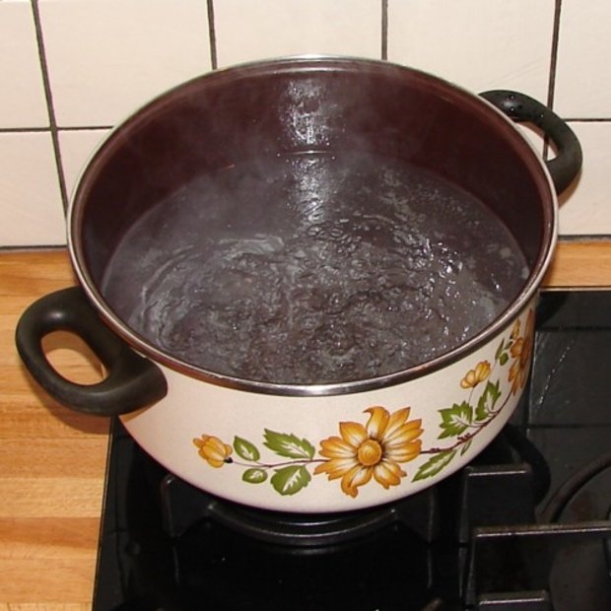

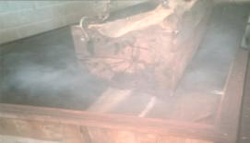
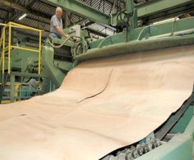
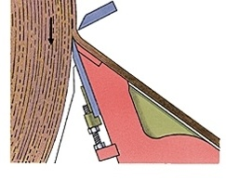
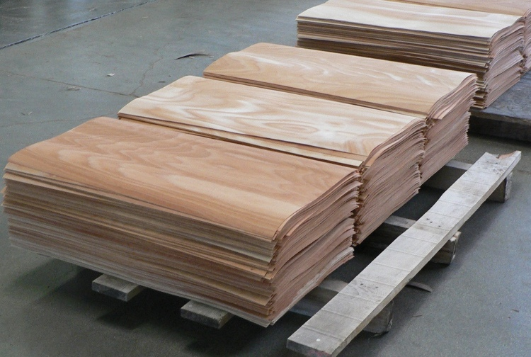
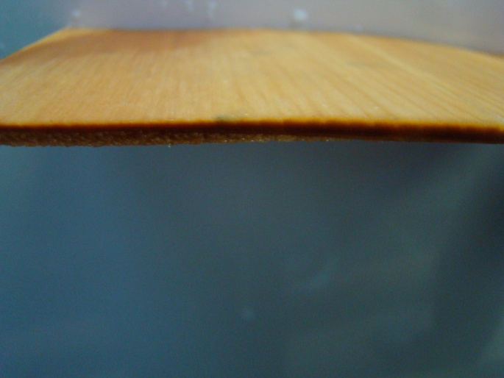
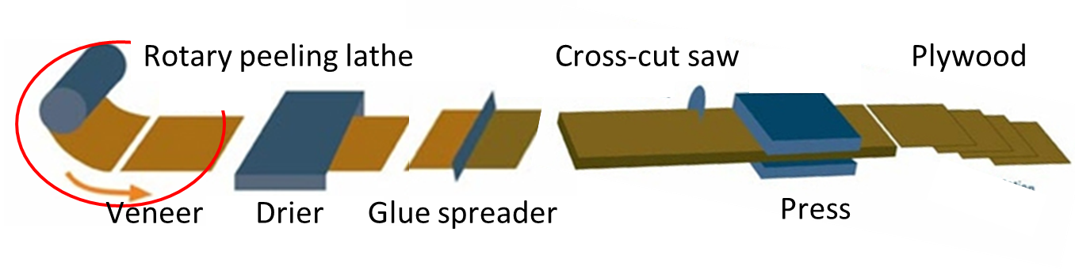
Peeling process: veneer production
Soaking
Peeling
Pressure bar
Knife
Veneer
e ± Δe
Plywood

Slide 5
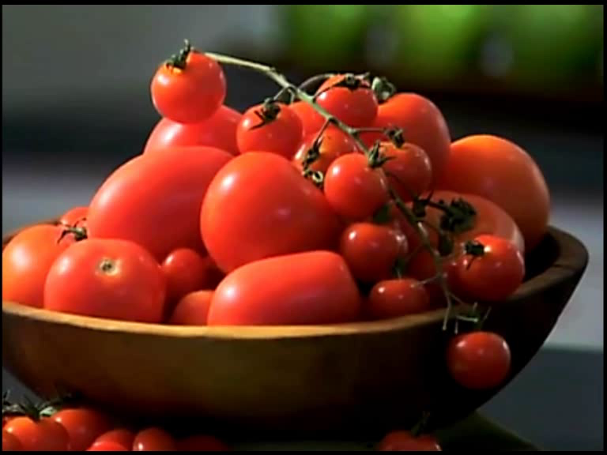

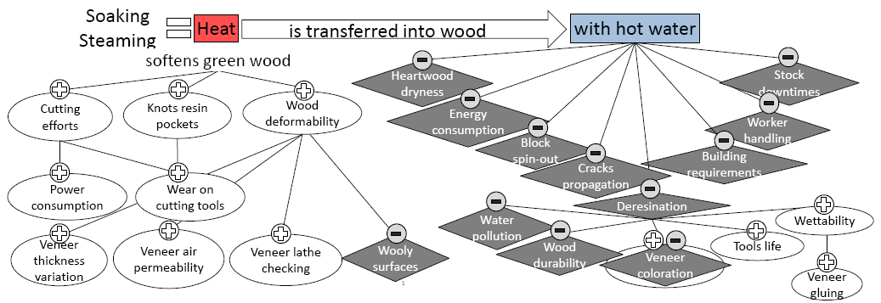
Why soaking?

Slide 6
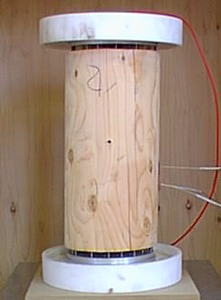
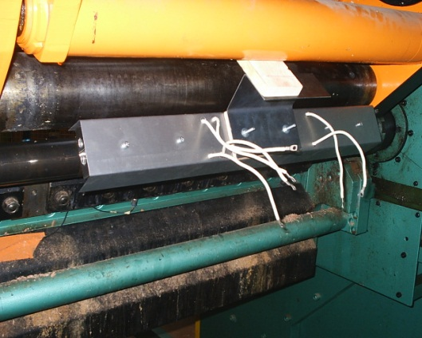
Alternative methods to heating wood prior to peeling avoiding soaking
Volume
heating
Electric ohmic heating
              Microwave heating
Electrode
Microwave
heater
U = 10 V/mm
Electrode
Wood does not need to be cooked for a long duration nor at boiling temperatures
Cell wall has to be brought at the required medium range temperature
Surface
heating
    Infrared heating (IR)
Infrared
heater

Slide 7
Peeling unit
Technical development of embedded IR heating system
Validating tests on embedded IR heating system
Minimum required peeling T°C
Specifications
Technical feasibility
Requirements
Thermal unit
Characterisation of wood behaviour under IR radiation¹
Modelling IR heat transfer during peeling process²
Values
Optimisation of IR heating parameters
Start
Conclusion
Economical feasibility
Economical unit
Economical study of embedded IR heating system
Time
Work in collaboration with : ¹Post-doc S. Ould Ahmedou
²Master thesis G. Belluche

Slide 8
IR heating of green wood while peeling.
2.Heating Temperatures
Anna DUPLEIX – PhD Candidate
anna.dupleix@ensam.eu

Slide 9
Results summary
No interest in heating up to 70°C
With heating temperatures:
- Cutting efforts start to decrease
- Lathe checkings are less deep and closer
- Minor thickness variation
Already at 50°C, positive effects of heating ensure efficient peeling process.

Slide 10
IR heating of green wood while peeling.
3.Modelling results
Anna DUPLEIX – PhD Candidate
anna.dupleix@ensam.eu

Slide 11
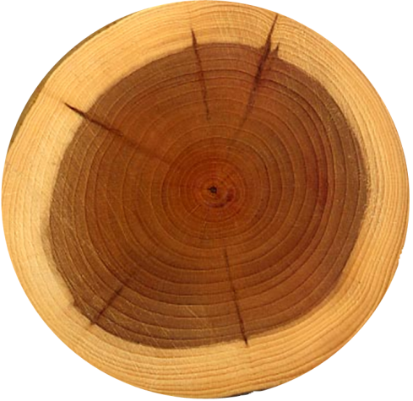
Modelling in-line IR surface heating: principle
Efficient wavelengths? Efficient power?
Maximum cutting speed?
Without overheating bolt surface?
The answer
here:
By numerical modelling of IR heating while peeling
IR
heater
Equations solver Comsol Multiphysics®
Procedure implemented under MatLab®
Bolt

Slide 12
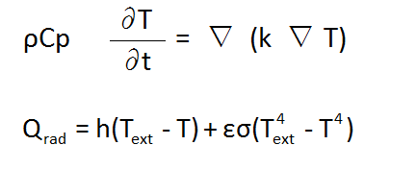
Methodology: meshing and equations
(1)
(2)
ρ wood density (kg.m⁻³)
Cp heat capacity of the wood (J.kg⁻¹.K⁻¹)
T bolt temperature (K)
k conductivity of wood (W.m⁻¹.K⁻¹)
Q_{rad} external IR heat source
h heat transfer coefficient (W.m⁻².K⁻¹)
T_{ext} external IR source temperature (K)

Slide 13
Simulation results
e=2mm
v=0.1m/s
e=1mm

Slide 14
IR heating of green wood while peeling.
3.Thermal characterisation
Anna DUPLEIX – PhD Candidate
anna.dupleix@ensam.eu

Slide 15
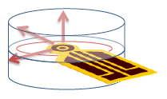
The transient HotDisk method
At t₀
At t > t₀
T(K)
High λ
Low κ
T(K)
Low Cp
0 K
High Cp
T(K)
T+1(K)
0 K
Low λ
High κ
T(K)
T(K)
Low Cp
0 K
0 K
Remaining
heat
Heat rate
Heat speed
Heat storage
Conductivity λ
Diffusivity κ
Heat Capacity Cp

Slide 16
Transversal conductivity

Slide 17
Heat capacity

Slide 18
Diffusivity

Slide 19
IR heating of green wood while peeling
4. Future Work
Anna DUPLEIX – PhD Candidate
anna.dupleix@ensam.eu

Slide 20
Peeling unit
Technical development of embedded IR heating system
Validating tests on embedded IR heating system
Minimum required peeling T°C
Specifications
Technical feasibility
Requirements
Thermal unit
Characterisation of wood behaviour under IR radiation¹
Modelling IR heat transfer during peeling process²
Values
Optimisation of IR heating parameters
Start
Conclusion
Economical feasibility
Economical unit
Economical study of embedded IR heating system
Time

Slide 21
FUTURE WORK
To integrate in the model:
green wood thermal properties : Cp, k = f(MC)
> with transient HotDisk®method (TREFLE, Bordeaux)
> should speed up heat penetration
green wood optical properties : emissivity, transmittivity, absorptivity = f(λ)
> modifying model’s equations with IR volumic Beer- Lamberts absorption law(CNRS, Orléans)
> should deepen radiation penetration
To experimentally validate the model
to establish it as an essential decision-making tool to design in-line IR heating system directly embedded on the cutting machine
To study the economical feasibility of the project
(s
(1)
with
and
(2)

Slide 22
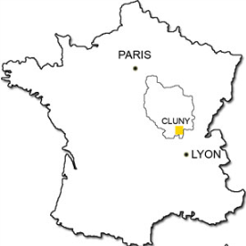
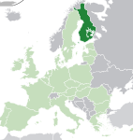
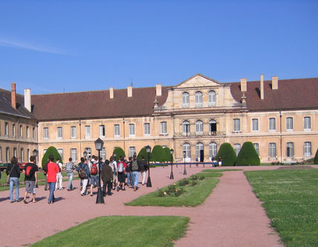
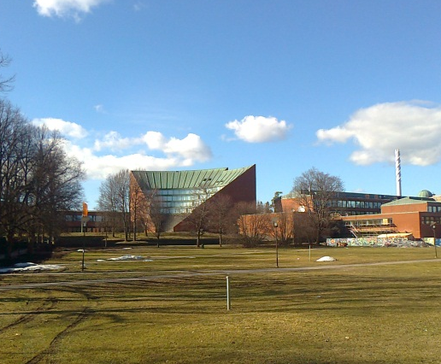
IR heating of green wood while peeling.
Thank you for your attention
Anna DUPLEIX – PhD Candidate
anna.dupleix@ensam.eu

