Slide 1


IR heating of green wood while peeling: a numerical model.
Collaboration:
Louis-Etienne DENAUD¹, Mark HUGHES², Andrezj KUSIAK³, Rémy MARCHAL¹, Sid’Ahmed OULD AHMEDOU¹, Fréderic ROSSI¹.
¹Arts et Métiers ParisTech LaBoMaP, France
³Université de Bordeaux, France
²Aalto University, Helsinki, Finland
Plan:
The project idea
The model principles
The simulation results
Anna DUPLEIX – PhD Candidate
anna.dupleix@ensam.eu

Slide 2
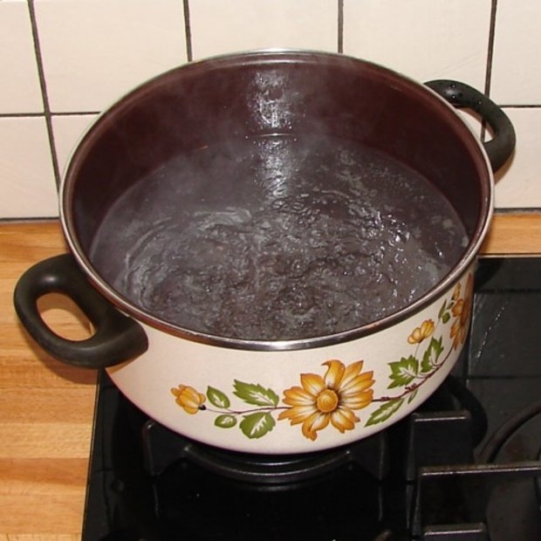

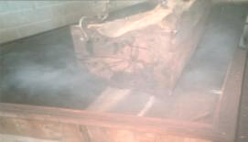
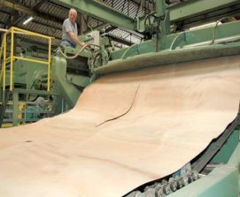
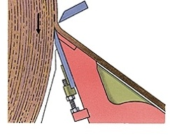
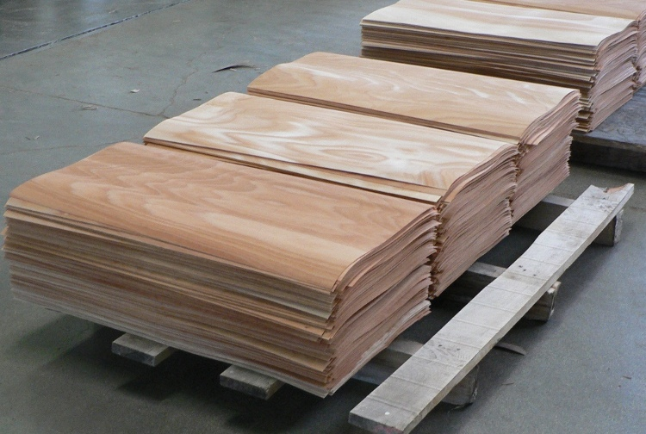
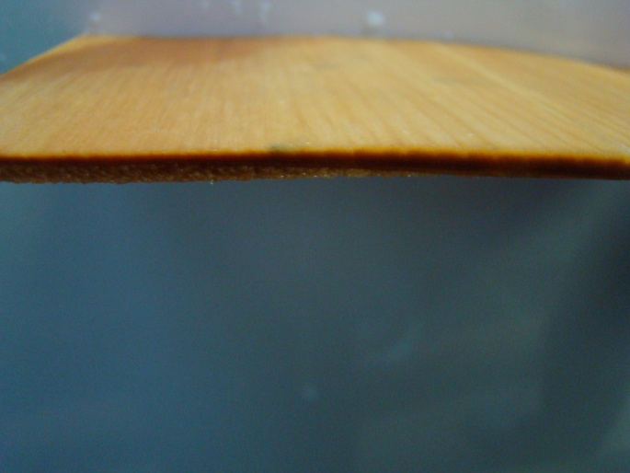
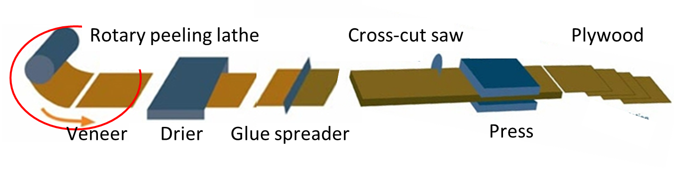
Peeling process: veneer production
Soaking
Peeling
Pressure bar
Knife
Veneer
e ± Δe
Plywood

Slide 3
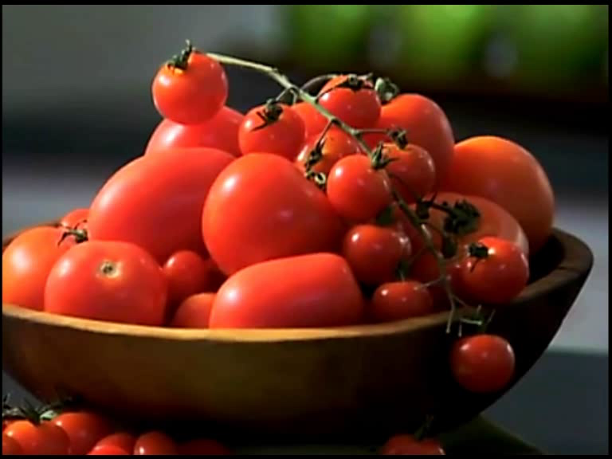

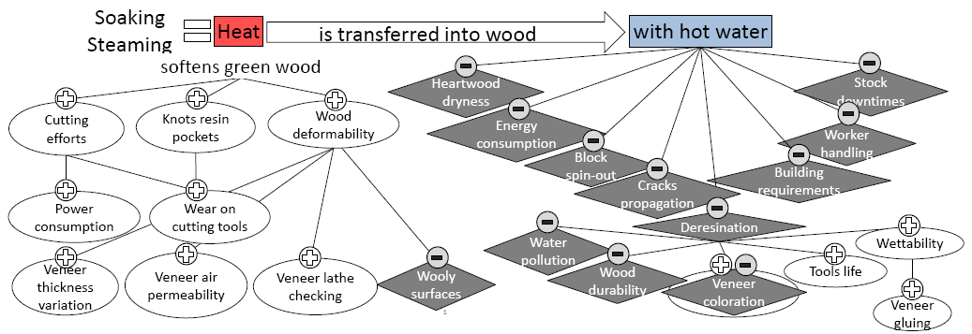
Why soaking?

Slide 4
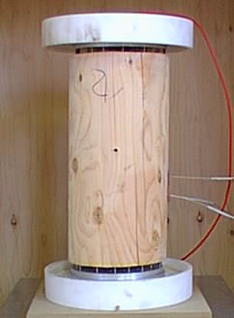
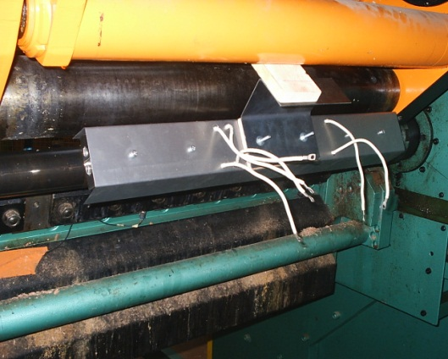
Alternative methods to heating wood prior to peeling avoiding soaking
Volume
heating
Electric ohmic heating
              Microwave heating
Electrode
Microwave
heater
U = 10 V/mm
Electrode
Wood does not need to be cooked for a long duration nor at boiling temperatures
Cell wall has to be brought at the required medium range temperature
Surface
heating
    Infrared heating (IR)
Infrared
heater

Slide 5
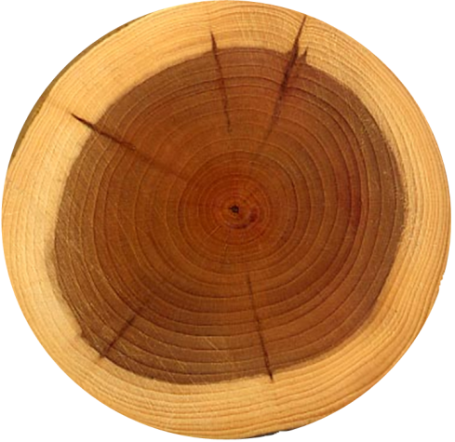
Modelling in-line IR surface heating: principle
Efficient wavelengths? Efficient power?
Maximum cutting speed?
Without overheating bolt surface?
The answer
here:
By numerical modelling of IR heating while peeling
IR
heater
Equations solver Comsol Multiphysics®
Procedure implemented under MatLab®
Bolt

Slide 6
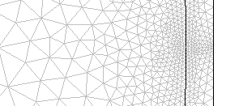
Methodology: meshing and sensitivity analysis
3

Slide 7
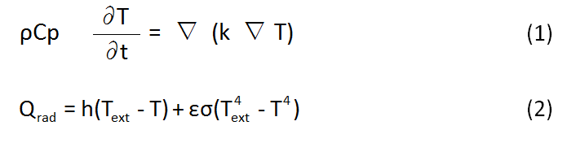
Heat transfer equations
(1)
(2)
ρ wood density (kg.m⁻³)
Cp heat capacity of the wood (J.kg⁻¹.K⁻¹)
T bolt temperature (K)
k conductivity of wood (W.m⁻¹.K⁻¹)
Q_{rad} external IR heat source
h heat transfer coefficient (W.m⁻².K⁻¹)
T_{ext} external IR source temperature (K)
VISIBLE
INFRARED
Planck’s law
ε wood emissivity (no dimension)
σ Stefan-Boltzmann constant (W.m⁻².K⁻⁴)

Slide 8
Subdomain settings
kg.m⁻³
Each Finite Element is parametered with wood physical properties, taking into account natural defects (knots, rays, off-centered pith)
Continuous peeling with a circle trajectory

Slide 9
Boundary conditions
Constant angle
Constant distance
IR
heater
Bolt

Slide 10
Temporal evolution of temperature within the bolt during one turn
Peeling speed = 0.1 m/s

Slide 11
Influence of the distance between the knife and the IR source
IR source temperature T_{ext} = 2500°C
peeling speed v = 0.3 m/s

Slide 12
Influence of peeling speeds and peeling thickness
IR source temperature T_{ext} = 500°C
Peeling thickness e = 1 mm

Slide 13
Influence of peeling speeds and peeling thickness
IR source temperature T_{ext} = 500°C
Peeling thickness e = 2 mm

Slide 14
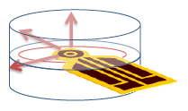
FUTURE WORK
To integrate in the model:
green wood thermal properties : Cp, k = f(MC)
> with transient HotDisk®method (TREFLE, Bordeaux)
> should speed up heat penetration
green wood optical properties : emissivity, transmittivity, absorptivity = f(λ)
> modifying model’s equations with IR volumic Beer- Lamberts absorption law(CNRS, Orléans)
> should deepen radiation penetration
To experimentally validate the model
- to establish it as an essential decision-making tool to design in-line IR heating system directly embedded on the cutting machine
(s
(1)
with
and
(2)
CONCLUSIONS SO FAR ON THE OPTIMUM CONFIGURATION
To locate IR source as far as possible from the knife

Slide 15
IR heating of green wood while peeling: a numerical model.
Thank you for your attention
Baldwin, R.F., (1975) Plywood Manufacturing Practices. Miller Freeman Publications Inc., San Fransisco, California, pp 62-78.
Bardet, S., Beauchêne, J., Thibaut, B.,(2003) Influence of basic density and temperature on mechanical properties perpendicular to grain of ten wood tropical species. Annals of Forest Science. 60(1):49-59. Bedard, N., Laganiere, B., (2009) Debarking Enhancement of Frozen Logs. Part II: Infrared System for Heating Logs Prior to Debarking. Forest Products Journal. 59(6):25-30.
Coste, N., (2005) Interest of radiant energy for wood peeling and slicing process. Master's thesis, University of Melbourne.
Dupleix, A., Marchal, R., Bléron, L., Rossi, F., Hughes; M., (2011) On-line heating temperatures of green-wood prior to peeling. Joint International Symposium on Wood Composites and Veneer Processing and Products Proceedings.
Flir Systems (2004) ThermaCAM User's Manual.
Gaudilliere, C., (2003) Contribution au développement d’une chauffe électrique rapide de bois vert de Douglas en vue de son déroulage. Master's thesis, Arts et Métiers ParisTech.
Glass, S.V., Zelinka, S.L., (2010) Wood handbook, Chapter 04: Moisture relations and physical properties of wood. General Technical Report FPL-GTR-190 Department of Agriculture, Forest Service, Forest Products Laboratory, Madison, WI, US. 4-1 - 4-19.
Lutz, J.F., (1960) Heating veneer bolts to improve quality of douglas-fir plywood. Technical report USDA Forest Service General FPL-2182, Forest Products Laboratory, Madison, WI, US.
Marchal, R., Collet, R., (2000) Contribution au développement d'une chauffe électrique rapide de bois vert de douglas en vue de son déroulage. Technical report, Arts et Métiers ParisTech.
Marchal, R., Gaudilliere, C., Collet, R., (2004) Technical feasibility of an embedded wood heating device on the slicer or the peeling lathe. International Symposium Veneer Processing and Products Proceedings. pp 29-44.
Matsunaga, M., Minato, K., (1998) Physical and mechanical properties required for violin bow materials II: Comparison of the processing properties and durability between pernambuco and substitutable wood species. Journal of Wood Science. 44(2):142-146.
Potter, B.E., Andresen, J.A., (2010) A finite-difference model of temperatures and heat flow within a tree stem. Revue Canadienne de Recherche Forestière. 32(3):548-555.
Torgovnikov, G., Vinden, P., (2010) Microwave wood modification technology and its applications. Forest Products Journal. 60(2):173.
Yamauchi, S., Iijima, Y., Doi, S., (2005) Spectrochemical characterization by FT-Raman spectroscopy of wood heat-treated at low temperatures: Japanese larch and beech. Journal of Wood Science. 51(5):498-506.
Anna DUPLEIX – PhD Candidate
anna.dupleix@ensam.eu

