Slide 1
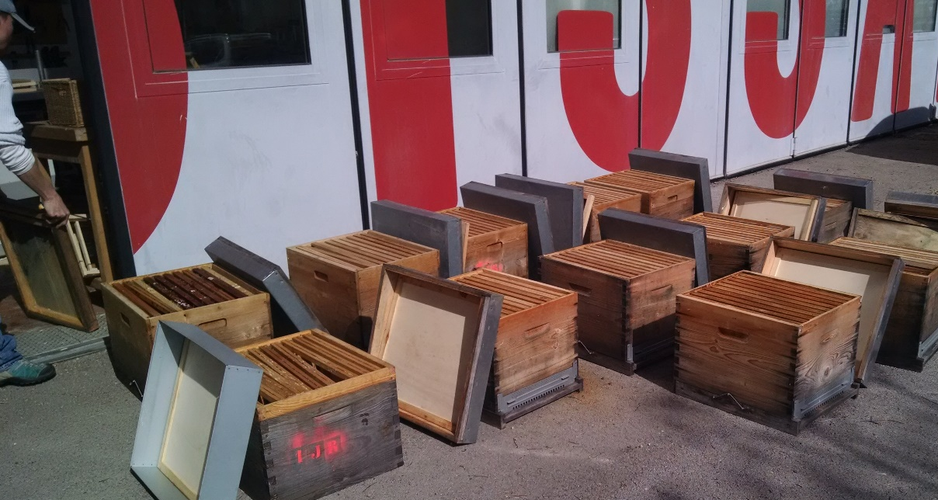
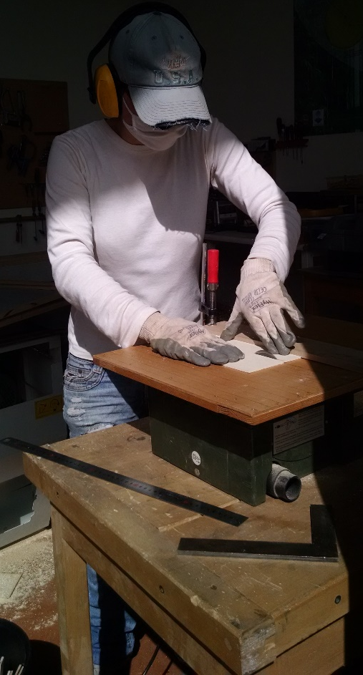
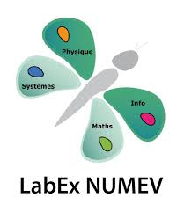
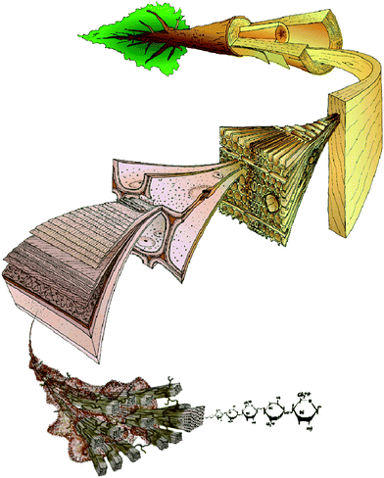
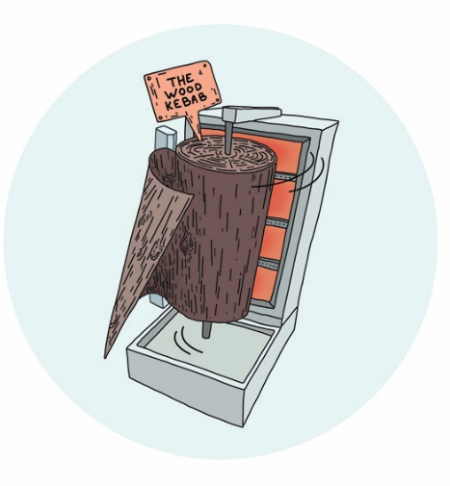
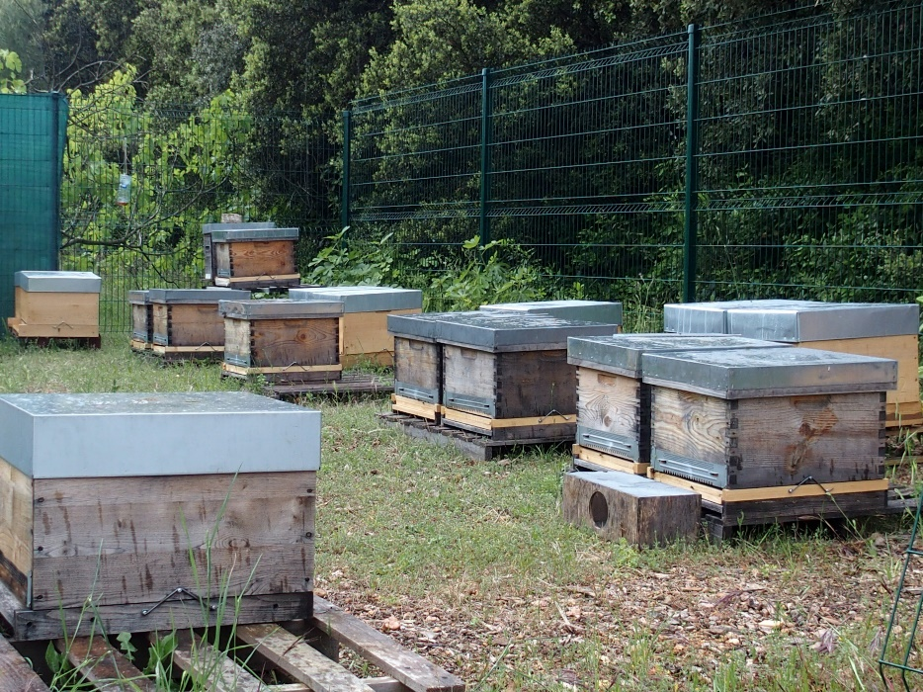
Beekeepers, bees and beehives.
Investigating the third party: wood material for beehives.
Wood Sciences
Beekeeping
Anthropology
Wood sciences
Start :sept. 2016
Duration : 30 months
Budget : 120 000 €
Apidology
Notes:
To introduce my self for you to understand the particular features of the BeeWood project.
I am an engineer from a French school, who got specialised to wood sciences in different universities: especially auckland univ., Aalto univ, and arts et metiers paristech where I did my PhD about wood peeling.
And I am also a beekeeper because after my PhD when I completed a one-year degree in agriculture and worked for 2 years with a beekeeper in his own farm.
I am now involved into a post-doctoral project that I have created which deals logically with the interaction between the wood material for the hives and the domestic bee colonies
This project features strong multidisciplinary approach : apidology, wood sciences, and anthropology; practical (we build our own hives, and grow our swarms helped by professional beekeeper) and experimental studies. The project has started in last sept for 2,5 years as I still work part-time as a beekeeper. And I work with colleagues from these institutions from montpellier.
I can explain it to you later in the discussion; but what is important is to remember that it is multidisciplinary
Ou logique etablissement/ ou logique laboratoire
Pas de euh….
Funded by labex numev, to federe around numerique pour l’environnment et le vivant, differents laboratoires

Slide 2
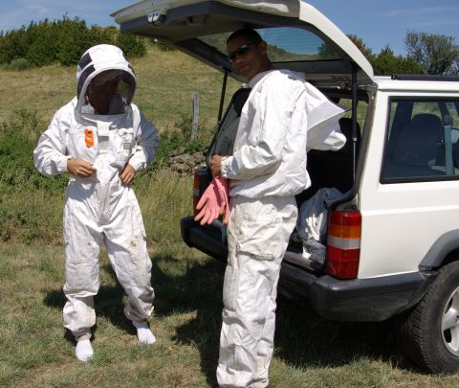
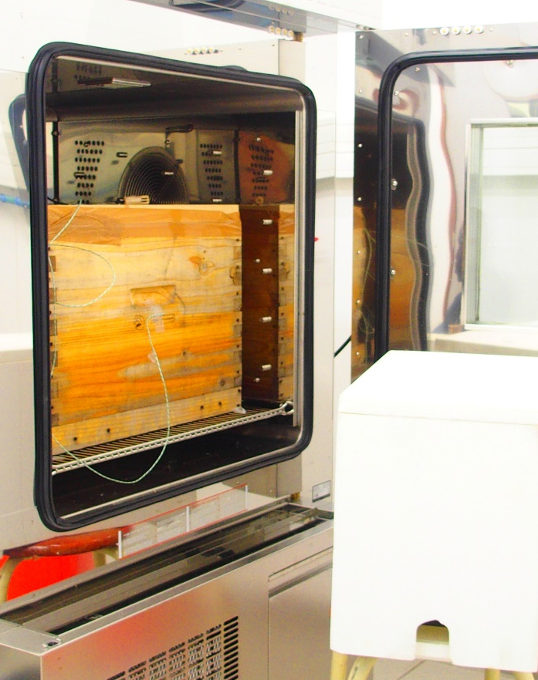
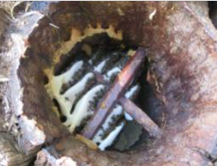
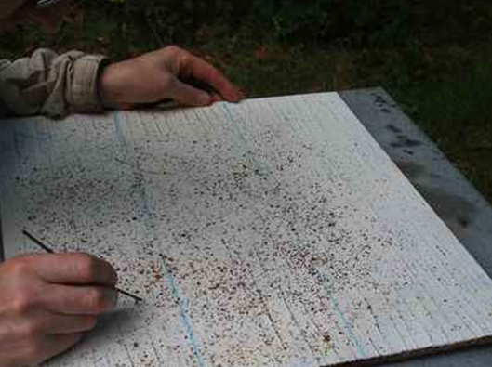
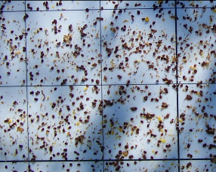
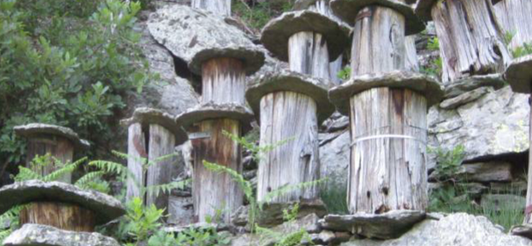
3 hypothesis are tested
Qualitative and quantitative survey on the perception of the hives from the beekeepers and the hive manufecturers/sellers
Measurements and numerical modeling of internal hygrothermal climate
In vivo and vitro experimentations on varroa mites and chestnut hives
Anthropology
Wood sciences
Apidology
Notes:
The investigations we carry out are aimed at testing 3 hypothesis involving various methods
-Traditional beekeeping knowledge in chestnut trees growing region that varroa mites are repulsed by chestnut wood such as in beams for spiders (experimentations in vivo by comparing varroa counting in chestnut hives vs spruce hives for homogeneous swarms (sister queenbee)/ and in vitro with electroantenogramm on varroa in contact with chestnut extractives – to come); coming from the observation of spiders (while experimentations is reproductible via la mise en place d’un artefact)
-Comparing internal hygrothermal climate of wood hives vs polystyrene hives regarding the need of the colonies in terms of temperature and humidity (this is actually how the project is born,when I worked in Finland on apiary with only polystyrene hives coming from a packaging company ) ;
-Beekeepers rely on their suppliers concerning the material of the hives even if they have noticed that the quality has decreased over the years while they are aware of the significance of the different roles played by the hives on the colonies (these roles will be studied by a master student in agronomy/beekeeper through qualitative and quantitative surveys

Slide 3
La connaissance de la vie , G. Canguihem, 1992 (p.48)
« Concernant la cellule […], c’est Hooke qui découvre la chose […]. Ayant pratiqué une coupe fine dans un morceau de liège, il observe la structure cloisonnée. C’est bien lui qui invente le mot, sous l’empire d’une image, par assimilation de l’objet végétal, un rayon de miel, œuvre d’animal, elle-même assimilée à une œuvre humaine, car une cellule, c’est une petite chambre. »
Notes:
As a little story, canguihem explains in La connaissance de la vie that teh word cell for wood come from the hives. The interaction wood material/ beehives has then already been made for a long time (1667) and reflects in the choice of the vocabulary

Slide 4
Asking for help…
Any mention in the literature of the role played by wood specie in the beehive?
anna.dupleix@umontpellier.fr

