Slide 1
Biaxial Testing of Knitted NiTi Textiles: DIC VS Adapted Image Processing
N. Connesson*, F. Tissot † , D. Favier*, L. Heller‡
‡Institute of Physics, Prague, Czech Republic
*Laboratoire TIMC, Grenoble, France

Slide 2
Introduction
L. Heller, ‡Institute of Physics, Prague, Czech Republic
NiTi Knitted textile (φ 100 µm)

Slide 3
Introduction
NiTi Knitted textile (φ 100 µm)
L. Heller, ‡Institute of Physics, Prague, Czech Republic
Mechanical behaviour
???
Biaxial testing

Slide 4
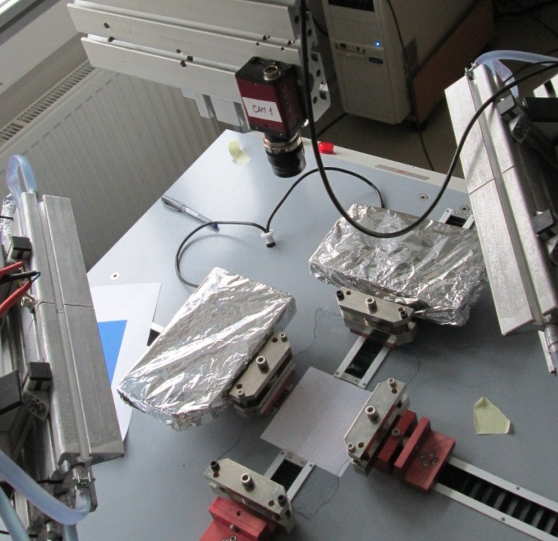
Introduction
Biaxial testing
Camera
Grips and
Force transducer

Slide 5
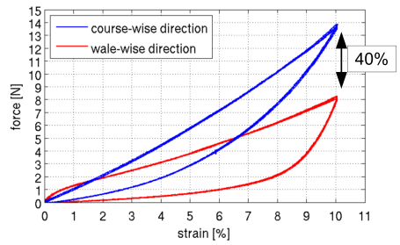
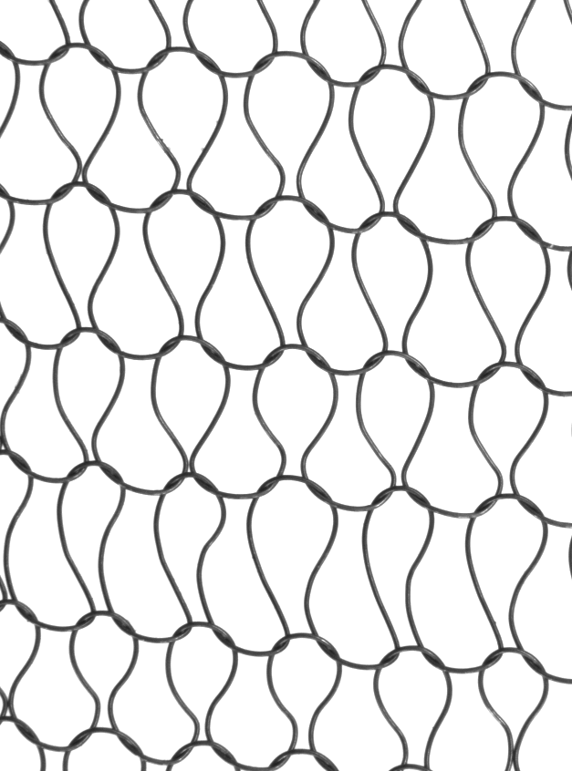
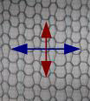
Introduction
Biaxial testing
Harmonic main load
Anisotropy
Harmonic main load
Displacement
Extract data from the pictures …

Slide 6
Introduction
Data we would like to extract :
Displacement fields
=> Strain fields
And… :
Geometria of wire/loops
Gliding => energy dissipation by friction
Harmonic main load

Slide 7
Introduction
How to extract these data ?
Displacement fields / Strain fields
Geometria of wire/loops
Gliding => energy dissipation by friction
DIC VS Adapted Image Processing

Slide 8
Outline
Introduction
I. DIC
II. Data Processing
Displacements fields
Shape and gliding
Conclusion

Slide 9
Outline
Introduction
I. DIC
II. Data Processing
Displacements fields
Shape and gliding
Conclusion

Slide 10
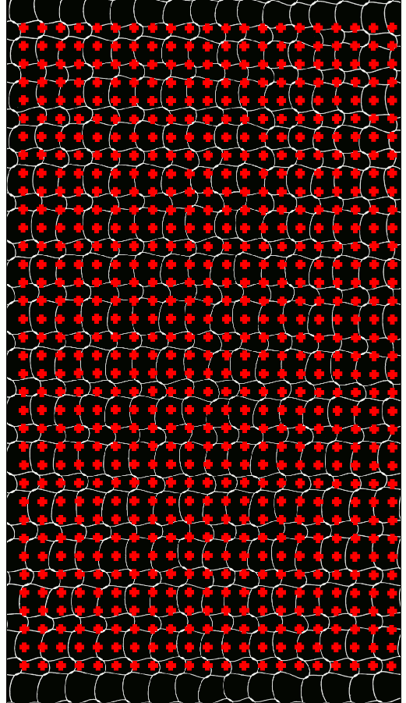
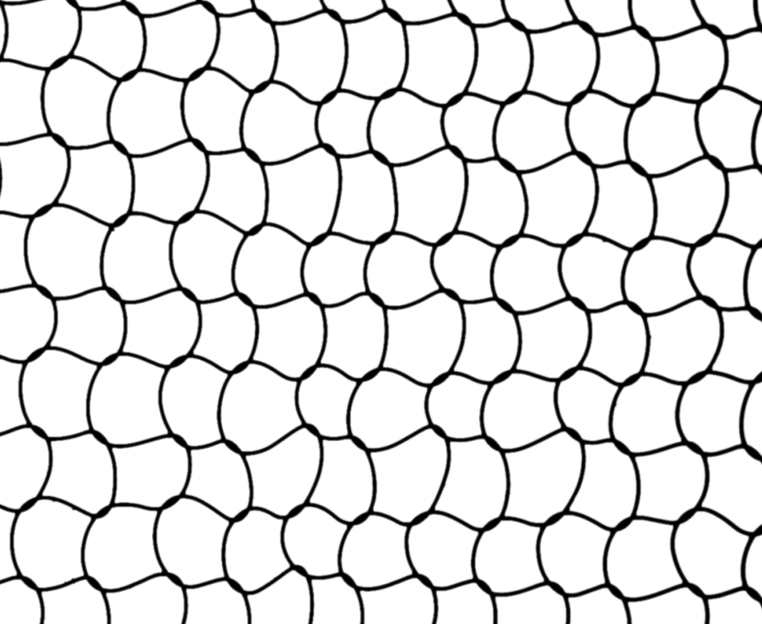
I. DIC
Displacement fields / Strain fields
Geometria of wire/loops
Gliding => energy dissipation by friction
2D Digital Image Corrélation (Vic 2D)
Not an optimal speckle…
Immaterial points tracking => lack physical meaning ☹

Slide 11
I. DIC
Can we do better ?
Well, yes !

Slide 12
Outline
Introduction
I. DIC
II. Data Processing
Displacement fields
Shape and gliding
Conclusion

Slide 13
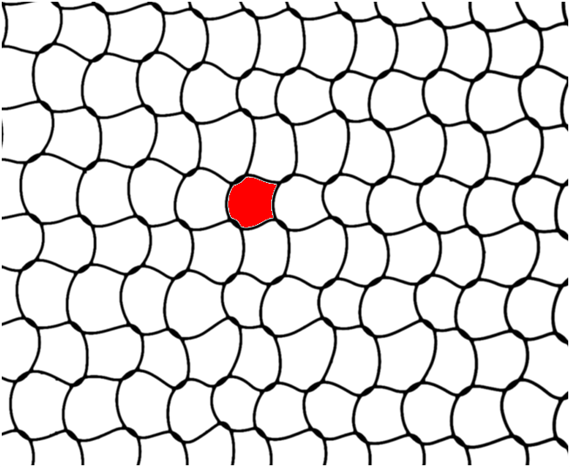
II. Data Processing a) Displacement fields
Displacement fields / Strain fields
Geometria of wire/loops
Gliding => energy dissipation by friction
Loop center identifcation
(Bwlabel, Matlab)
Knitted structure
=>
Time tracking
=>
Loop center
=> more physical meaning ☺

Slide 14
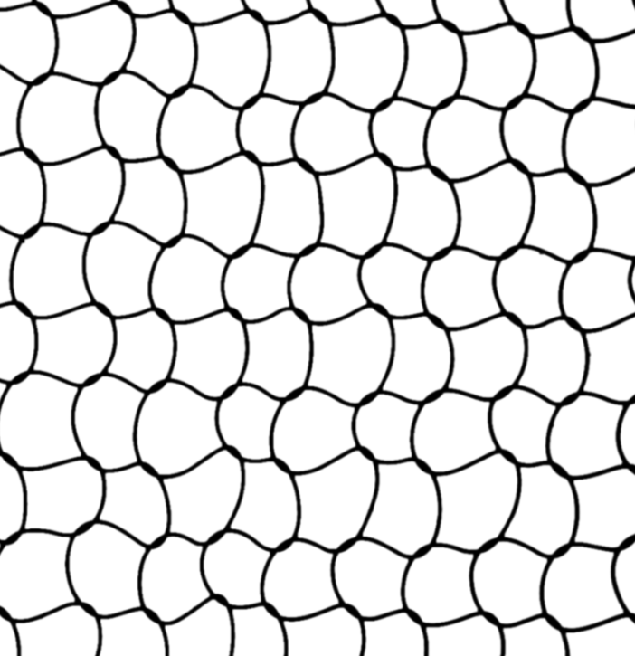
Displacement fields / Strain fields
Geometria of wire/loops
Gliding => energy dissipation by friction
II. Data Processing a) Displacement fields
Time tracking (Bwlabel, Matlab)
Update position at t₀ => position at t₁
t₀
t₁=t₀+dt

Slide 15
II. Data Processing a) Displacement fields
Displacement fields / Strain fields
Geometria of wire/loops
Gliding => energy dissipation by friction
Time tracking (Bwlabel, Matlab)
Update position at t₀ => position at t₁
t₀
t₁=t₀+dt

Slide 16
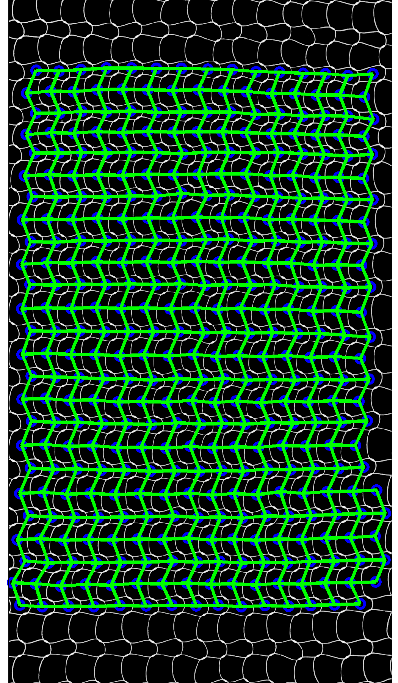
II. Data Processing a) Displacement fields
Displacement fields / Strain fields
Geometria of wire/loops
Gliding => energy dissipation by friction
Home made data processing
DIC (Vic 2009)

Slide 17
II. Data Processing
We exctracted :
Displacement fields / Strain fields
Geometria of wire/loops
Gliding => energy dissipation by friction

Slide 18
Outline
Introduction
I. DIC
II. Data Processing
Displacement fields
Shape and gliding
Conclusion

Slide 19
II. Data Processing b) Shape and gliding
Displacement fields / Strain fields
Geometria of wire/loops
Gliding => energy dissipation by friction
Spoiler :

Slide 20
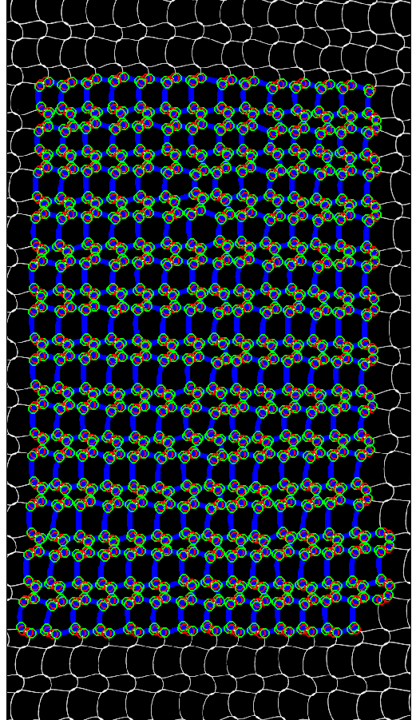
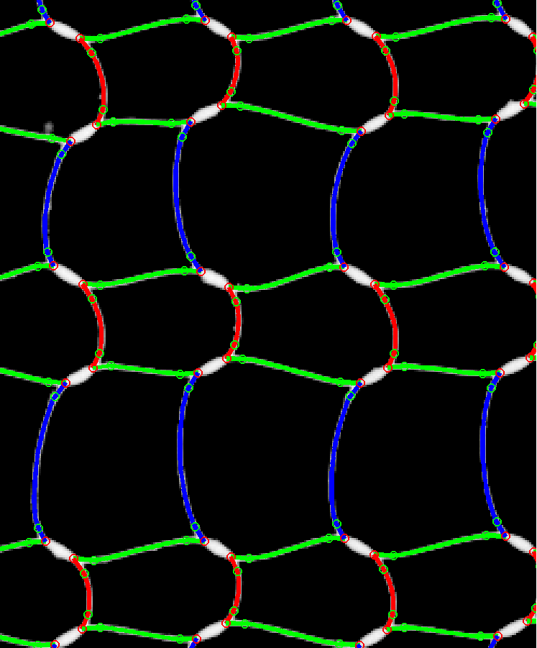
II. Data Processing b) Shape and gliding
Displacement fields / Strain fields
Geometria of wire/loops
Gliding => energy dissipation by friction

Slide 21
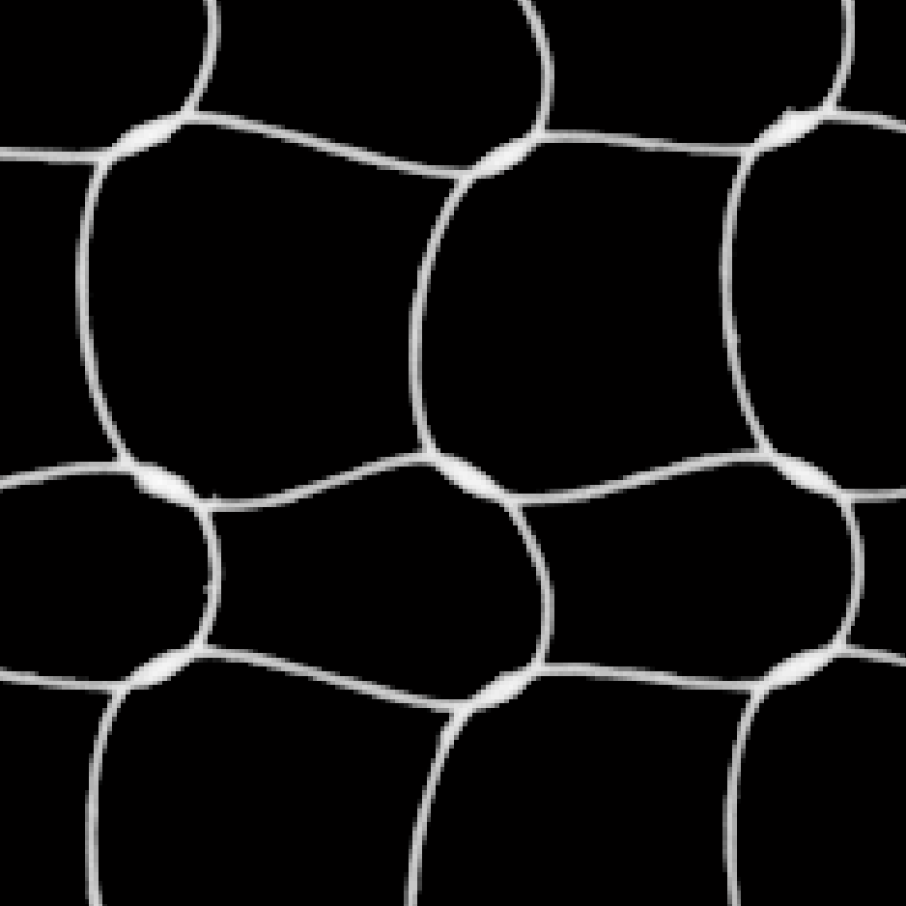
II. Data Processing b) Shape and gliding
Displacement fields / Strain fields
Geometria of wire/loops
Gliding => energy dissipation by friction
Bwlabel

Slide 22
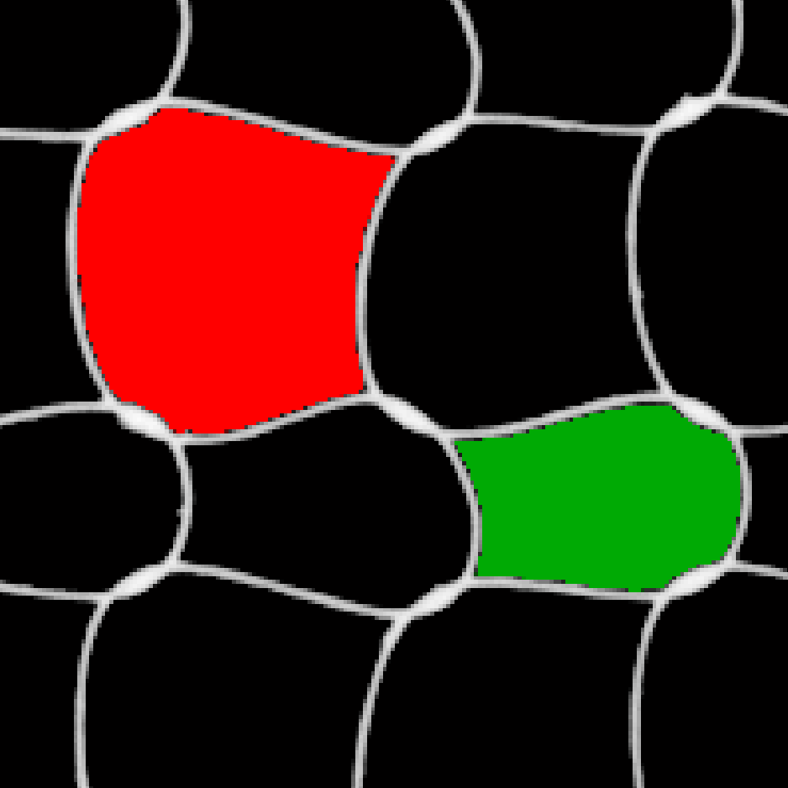
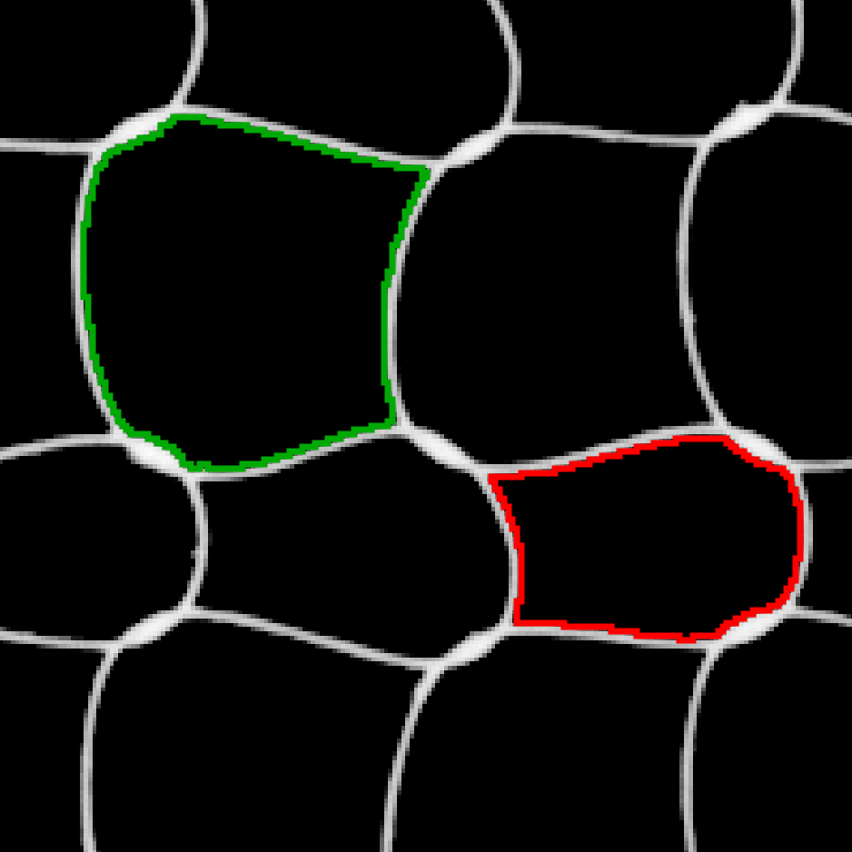
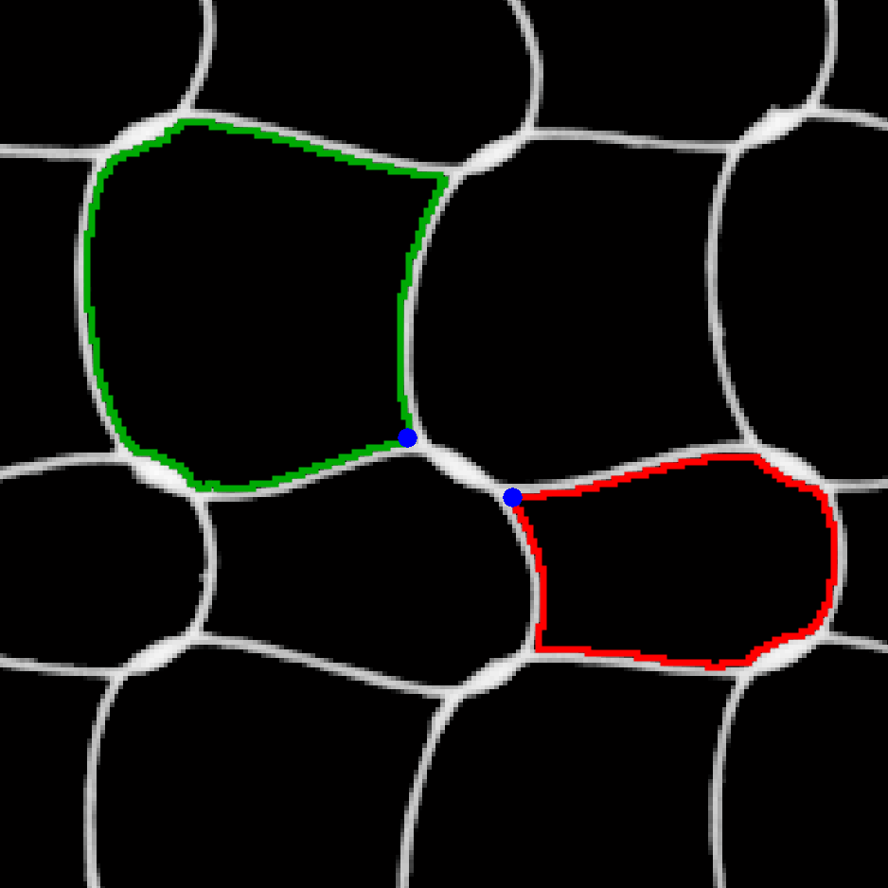
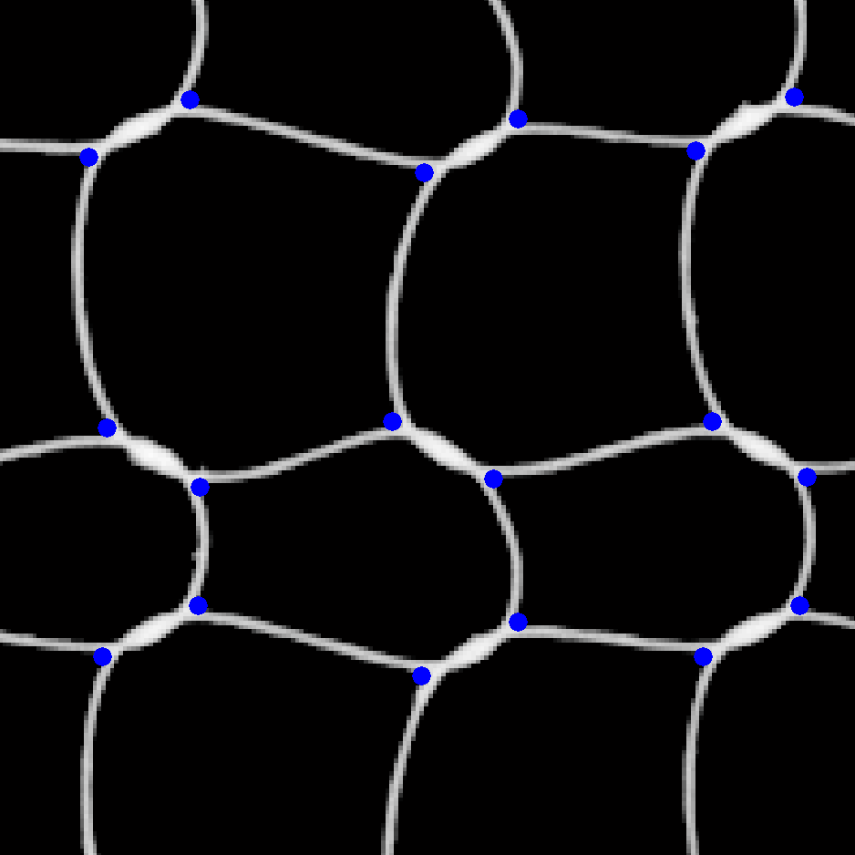
II. Data Processing b) Shape and gliding
Displacement fields / Strain fields
Geometria of wire/loops
Gliding => energy dissipation by friction
Bwlabel
Bwperim

Slide 23
II. Data Processing b) Shape and gliding
Displacement fields / Strain fields
Geometria of wire/loops
Gliding => energy dissipation by friction

Slide 24
II. Data Processing b) Shape and gliding
Displacement fields / Strain fields
Geometria of wire/loops
Gliding => energy dissipation by friction

Slide 25
II. Data Processing b) Shape and gliding
Displacement fields / Strain fields
Geometria of wire/loops
Gliding => energy dissipation by friction

Slide 26
II. Data Processing b) Shape and gliding
Displacement fields / Strain fields
Geometria of wire/loops
Gliding => energy dissipation by friction

Slide 27
II. Data Processing b) Shape and gliding
Displacement fields / Strain fields
Geometria of wire/loops
Gliding => energy dissipation by friction

Slide 28
II. Data Processing b) Shape and gliding
Displacement fields / Strain fields
Geometria of wire/loops
Gliding => energy dissipation by friction

Slide 29
II. Data Processing b) Shape and gliding
Displacement fields / Strain fields
Geometria of wire/loops
Gliding => energy dissipation by friction

Slide 30
II. Data Processing b) Shape and gliding
Displacement fields / Strain fields
Geometria of wire/loops
Gliding => energy dissipation by friction

Slide 31
II. Data Processing b) Shape and gliding
Displacement fields / Strain fields
Geometria of wire/loops
Gliding => energy dissipation by friction

Slide 32
II. Data Processing b) Shape and gliding
Displacement fields / Strain fields
Geometria of wire/loops
Gliding => energy dissipation by friction

Slide 33
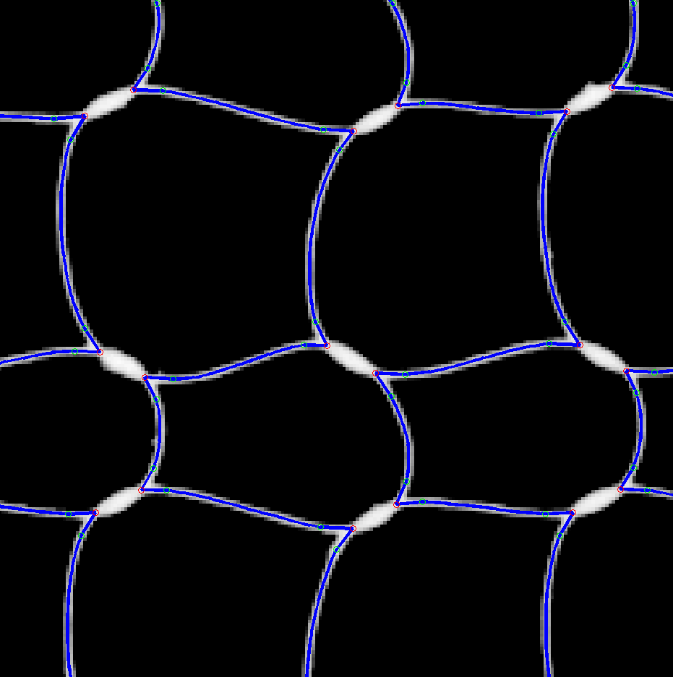
II. Data Processing b) Shape and gliding
Displacement fields / Strain fields
Geometria of wire/loops
Gliding => energy dissipation by friction

Slide 34
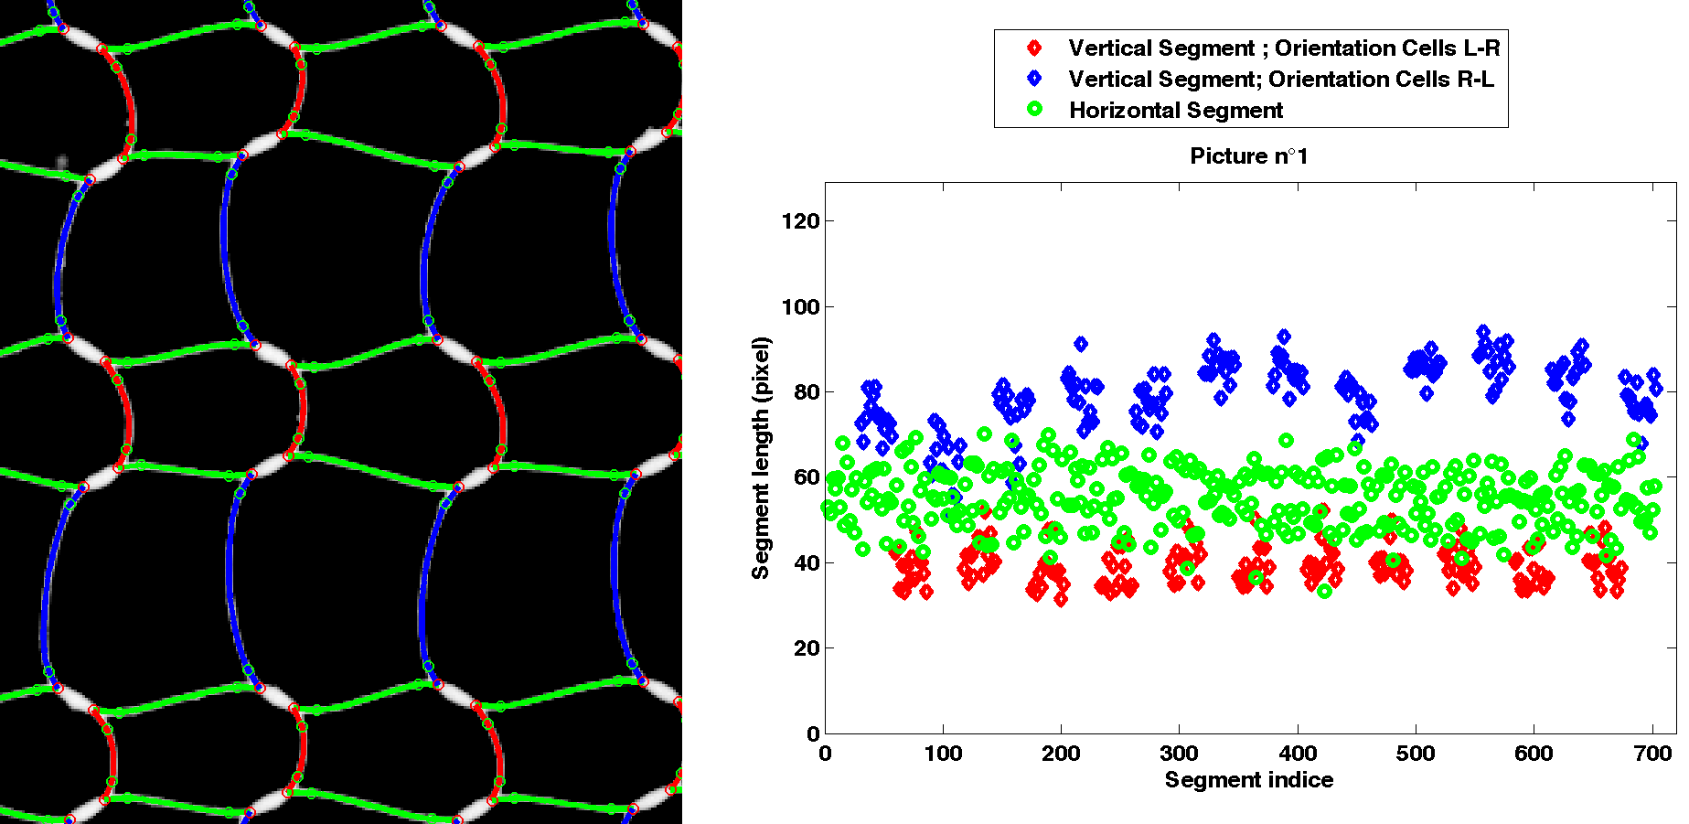
II. Data Processing b) Shape and gliding
Displacement fields / Strain fields
Geometria of wire/loops
Gliding => energy dissipation by friction

Slide 35
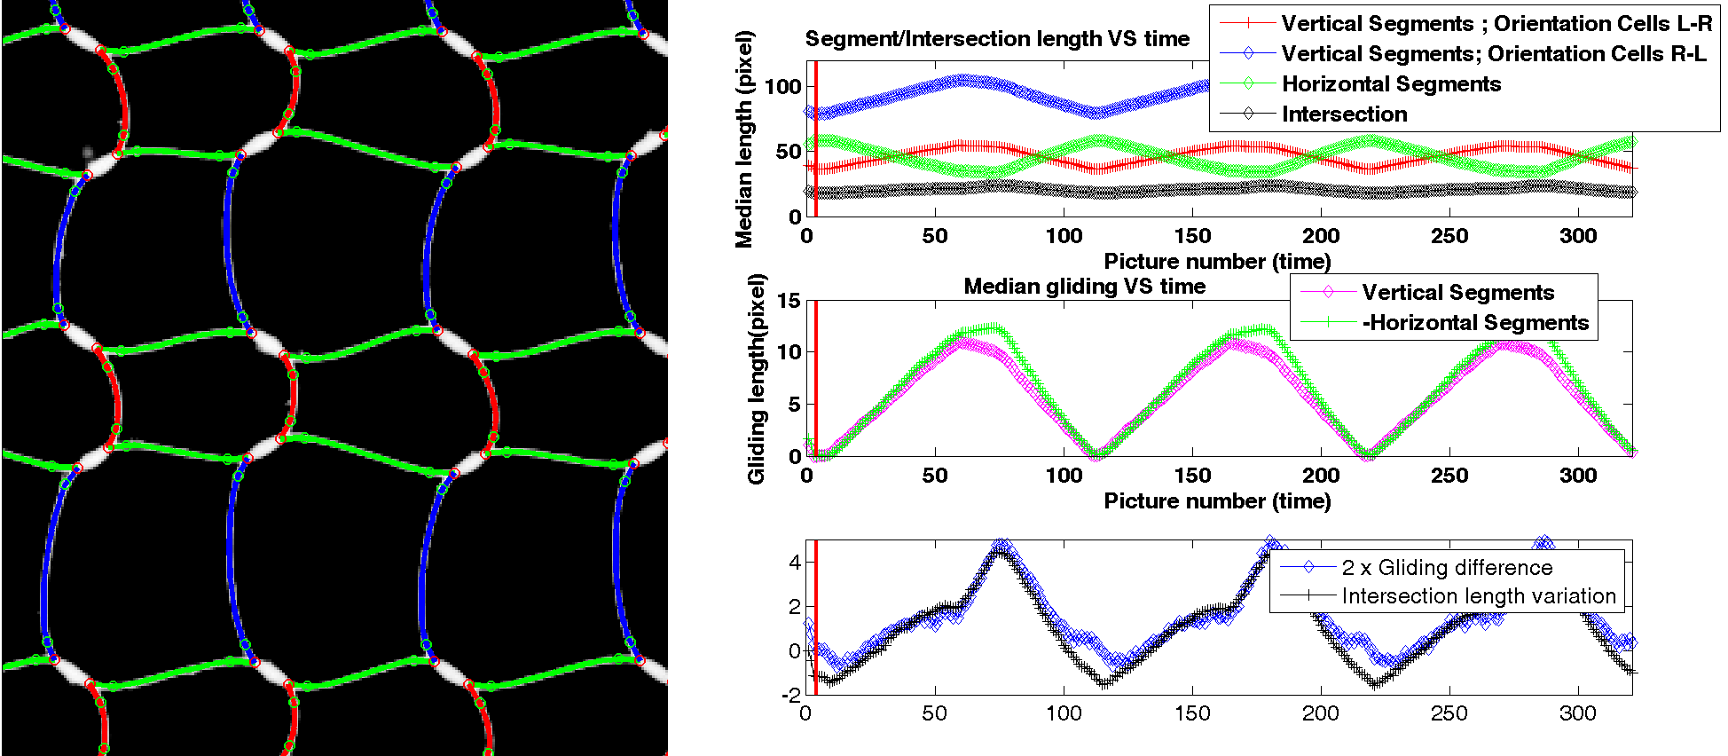
II. Data Processing b) Shape and gliding
Displacement fields / Strain fields
Geometria of wire/loops
Gliding => energy dissipation by friction

Slide 36
Outline
Introduction
I. DIC
II. Data Processing
III. Comparision
IV. Further processing
Conclusion

Slide 37
Conclusion
Displacement fields / Strain fields
Geometria of wire/loops
Gliding => energy dissipation by friction
DIC (Vic 2009)
Home made data processing

Slide 38
The End

Slide 40
Friction
Idée : Solide soumis à deux efforts

Slide 41
Centre de gravité
Poids mg

Slide 42
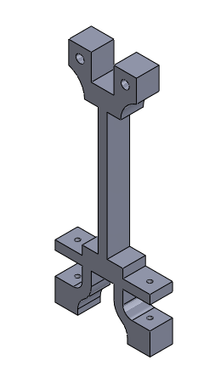
Centre de gravité
Poids mg

Slide 43
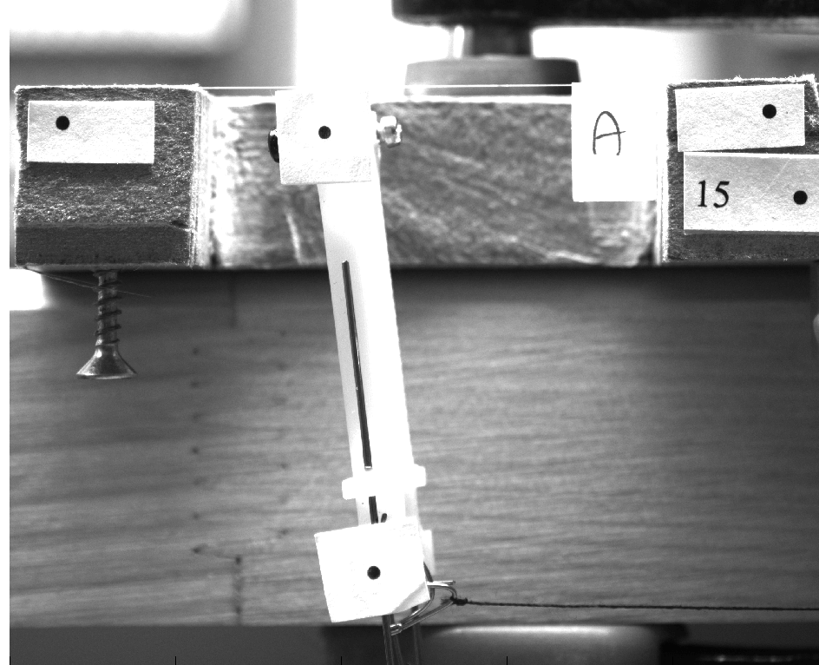

Slide 44
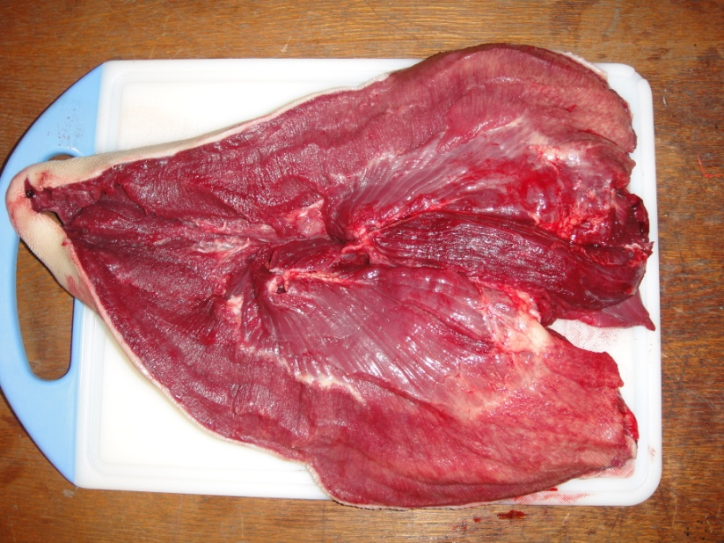
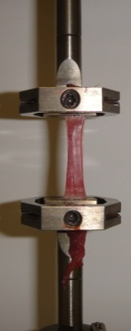
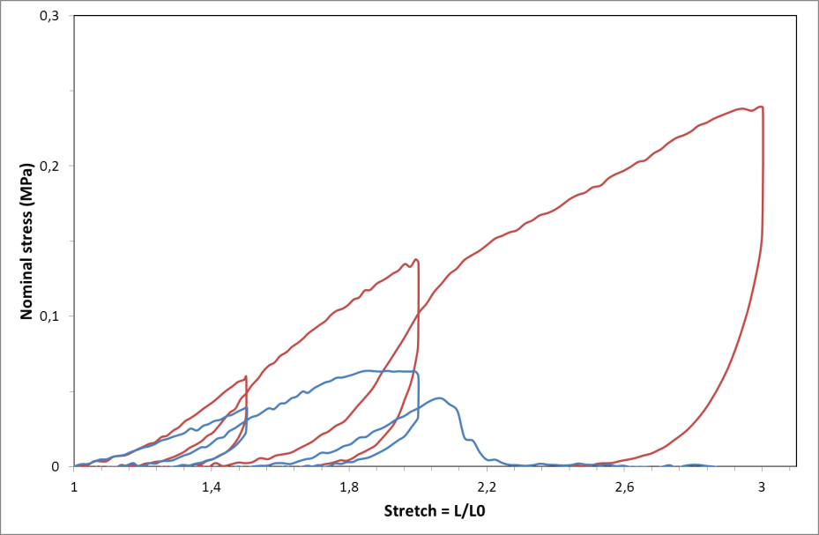
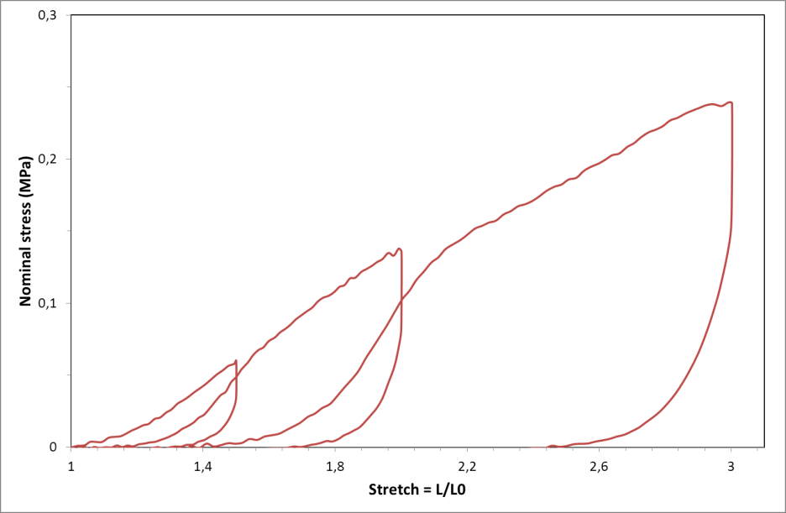
Introduction : utilité
Historiquement :
Matériau architecturé,
Tricots de métaux (acier, NiTi, etc)
Ludek Heller
Utilisation possibles : en NiTi, c’est biocompatible !
Langue de boeuf
Non linear behavior
//
Anisotropy
┴
Gipsa Lab collaboration (P. Perrier)

Slide 45
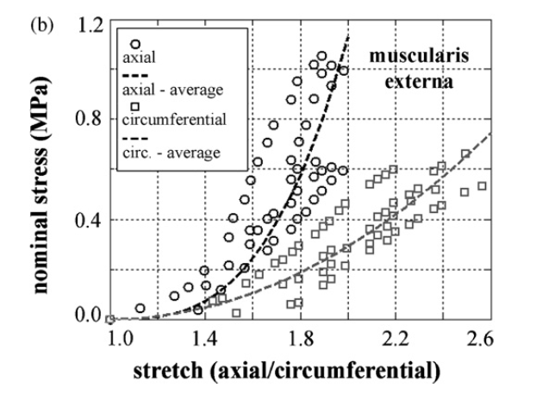
Introduction : utilité
Historiquement :
Matériau architecturé,
Tricots de métaux (acier, NiTi, etc)
Ludek Heller
Results from tensile tests on tissue samples from oesophagus; Natali et al (2009)
Tensile test on artery; Chagnon et al (2012)

Slide 46
Introduction : utilité
Paramètres :
Historiquement :
Matériau architecturé,
Tricots de métaux (acier, NiTi, etc)
Géométrie,
Diamètres,
Traitement thermiques
Shape setting
Ludek Heller
Applications ?
…

Slide 47
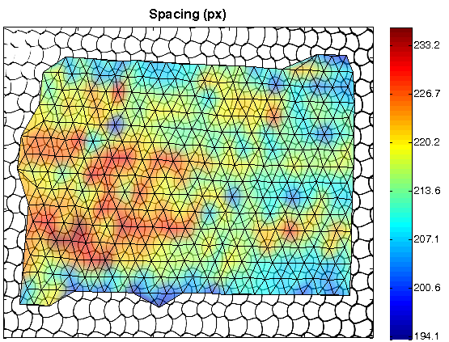
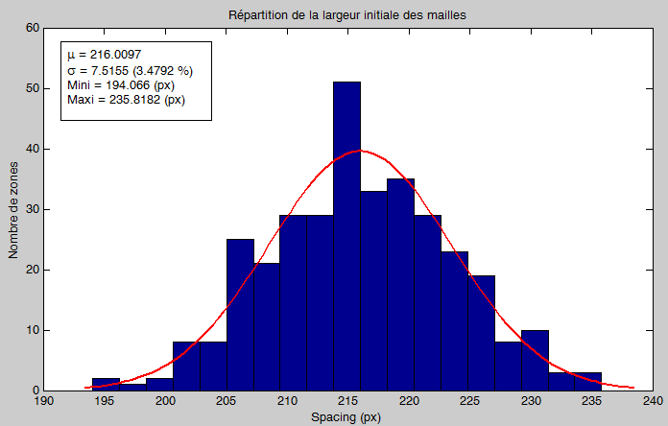
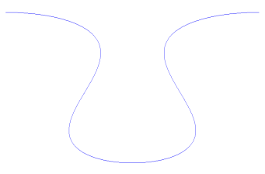
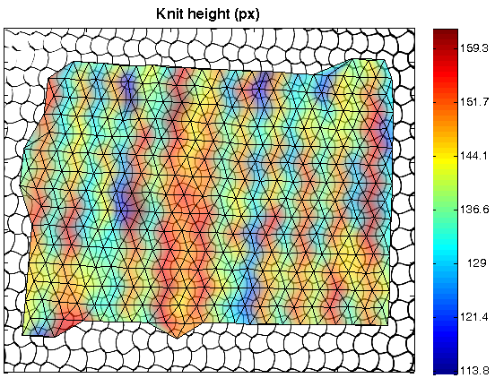
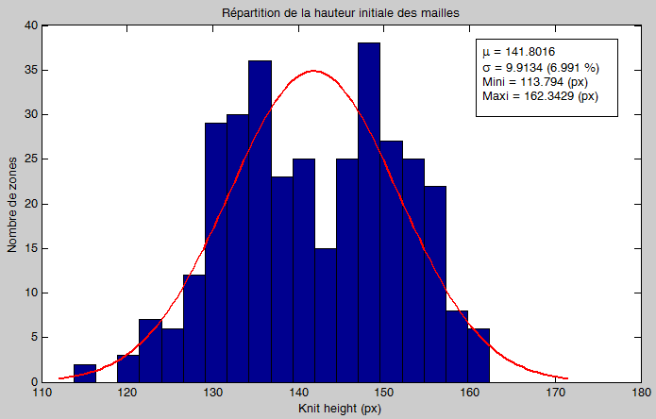
Analyse: Géométrie initiale
Cellule i
Position CdG,
4 Segments,
Intersections.
L
h
L
h
~ 135
~ 148

Slide 48
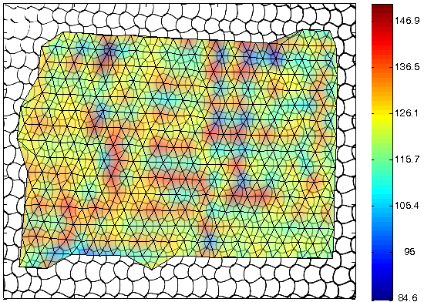
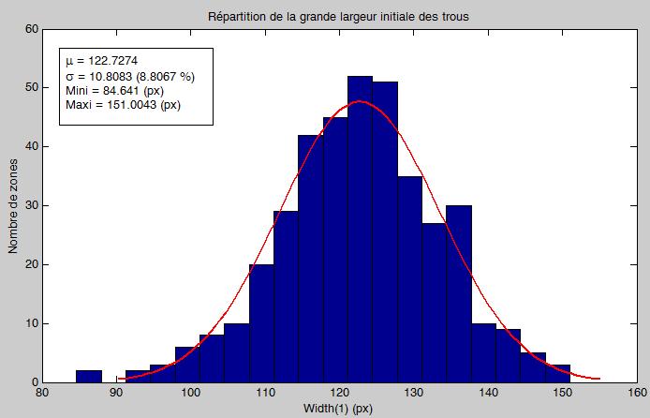
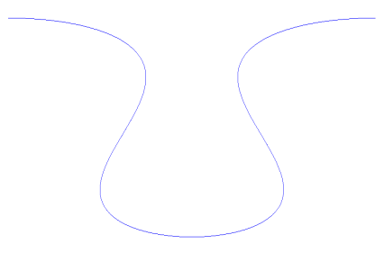
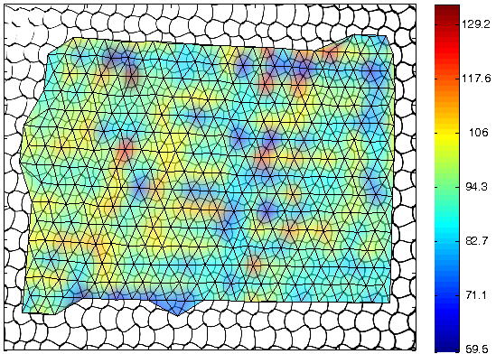
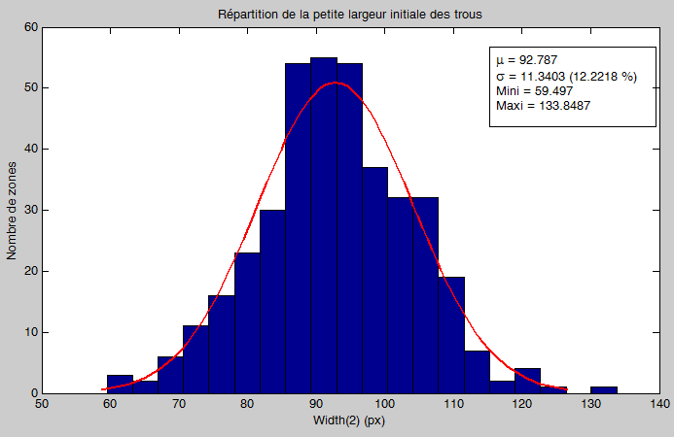
Analyse: Géométrie initiale
Cellule i
Position CdG,
4 Segments,
Intersections.
largeur 1
largeur 1
largeur 2
largeur 2

Slide 49
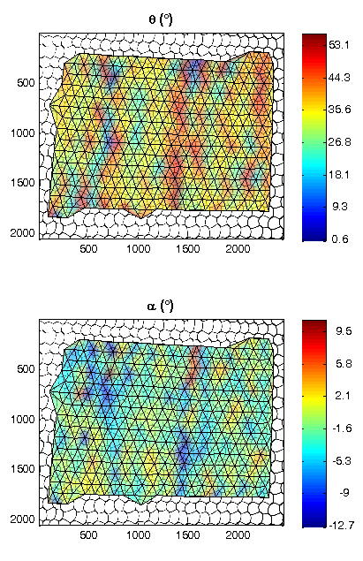
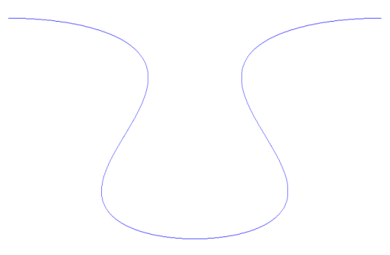
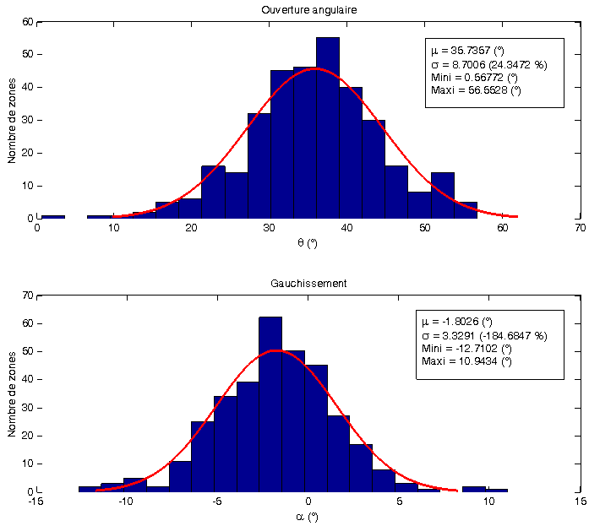
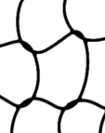
Analyse: Géométrie initiale
Cellule i
Position CdG,
4 Segments,
Intersections.
θ
Axe de symétrie (théorique)
α₁
α₂

Slide 50
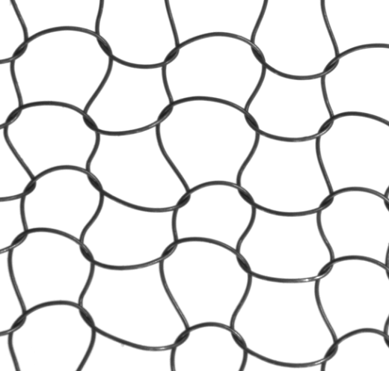
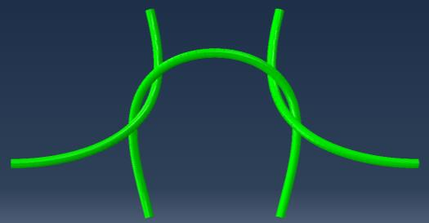
Approche numérique : Modèle EF
Fil NiTi (Ni-54wt%) : ø0,1 mm,
X: 4,35 mm / Y: 2,305 mm
Géométrie “moyenne” représentative (??)
Conditions limites: périodiques + déplacement
Modèle de matériau : Bilinéaire (Acier) ou Auricchio
Frottement sec (Expérience “maison’, ok)

