Slide 1
“Working up from the black towards the light” Modernist wood-engraving and photography
ESSE 2016 Galway
Seminar S39
Sophie Aymes
Université de Bourgogne-Franche-Comté

Slide 2
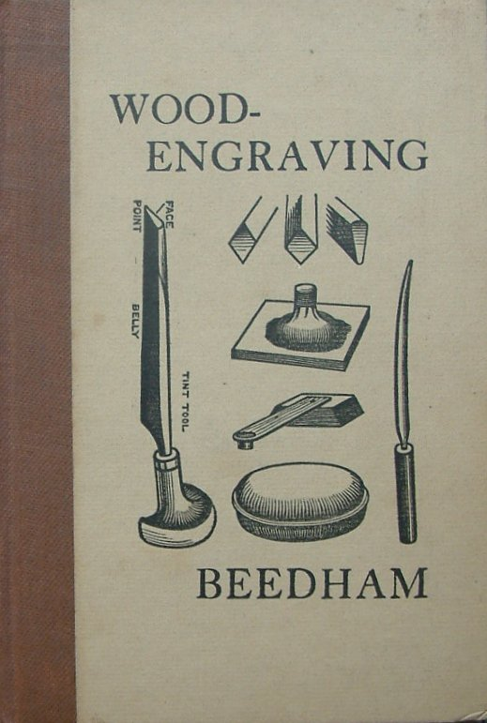
A few TItles
John Beedham, Wood Engraving (1920)
Edward Gordon Craig, Woodcuts and Some Words (1924)
Herbert Furst, The Modern Woodcut (1924)
Clare Leighton, Wood-Engraving and Woodcuts (1932)
Iain Macnab, Wood-Engraving (1938)
John Farleigh, Graven Image (1939)

Slide 3
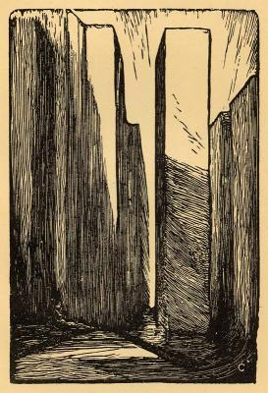
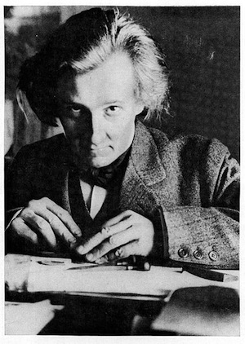
Edward Gordon Craig
Scene
(The Mask,
vol. 1, n°5, 1908)

Slide 4
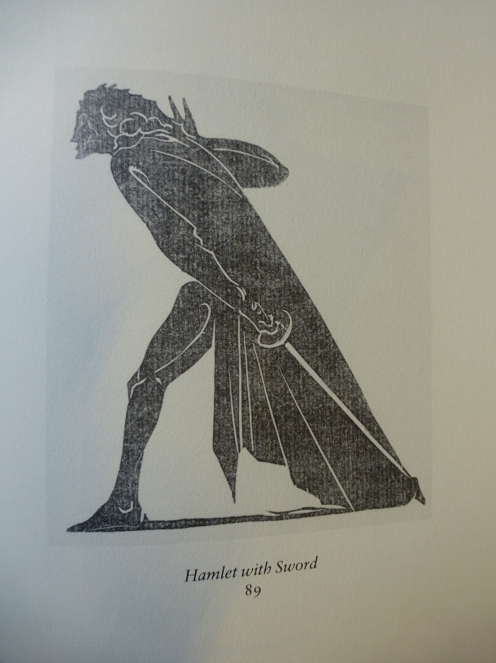
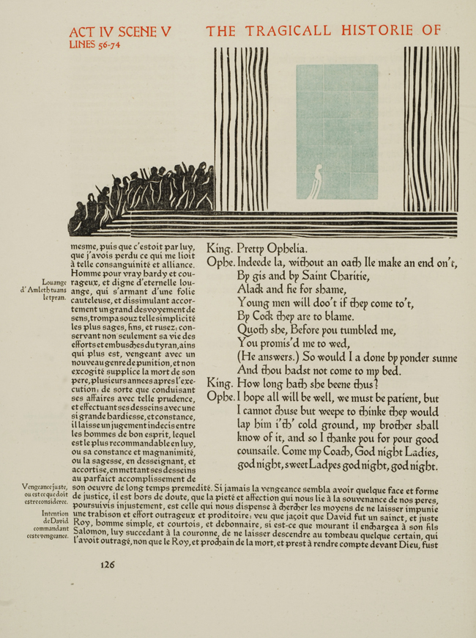
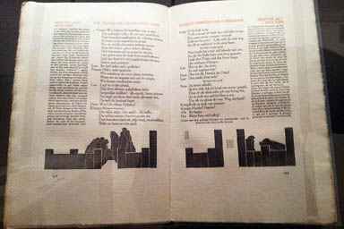
Hamlet (1928, 1930)
Count Harry Kessler’s Cranach Press
Edward Gordon Craig’s wood-engravings
Eric Gill’s letters
Edward Johnston’s typeface, cut by Edward Prince
Under the supervision of Emery Walker

Slide 5
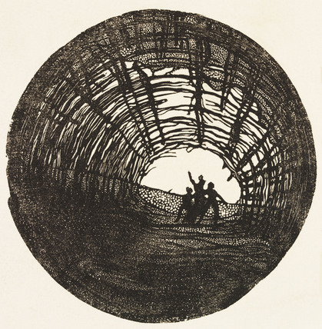
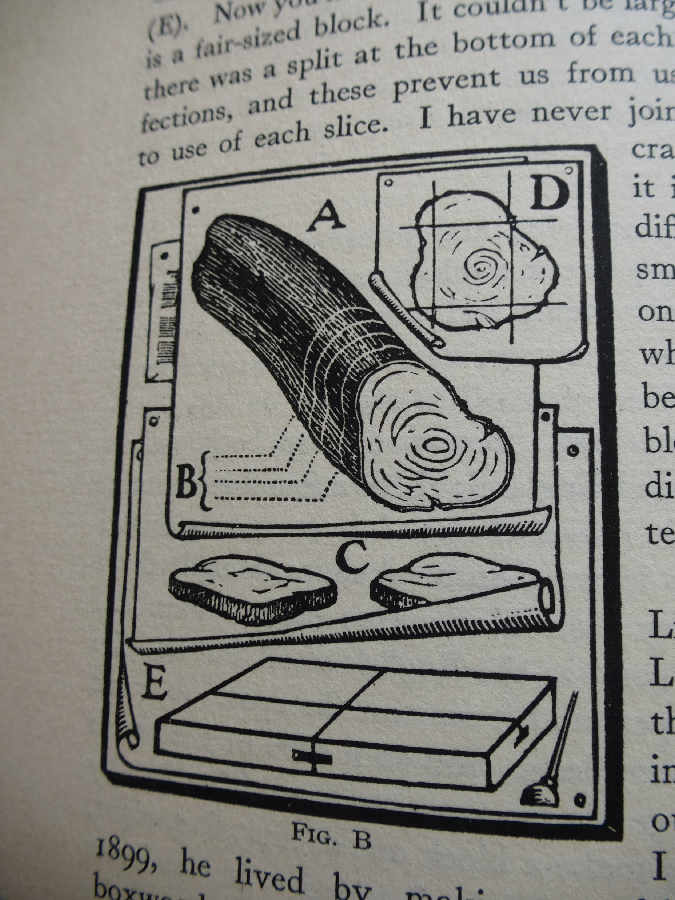
Woodcuts and Some Words (1924)
King Lear (The Mask, vol. I, no. 5,
opp. p.96, 1908)

Slide 6
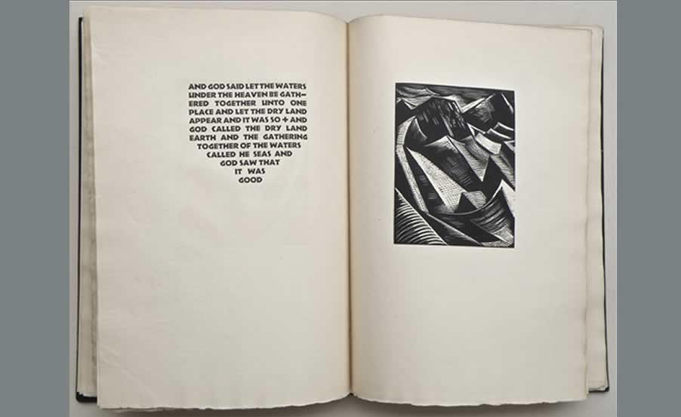
Paul Nash Genesis (Nonesuch Press, 1924)

Slide 7
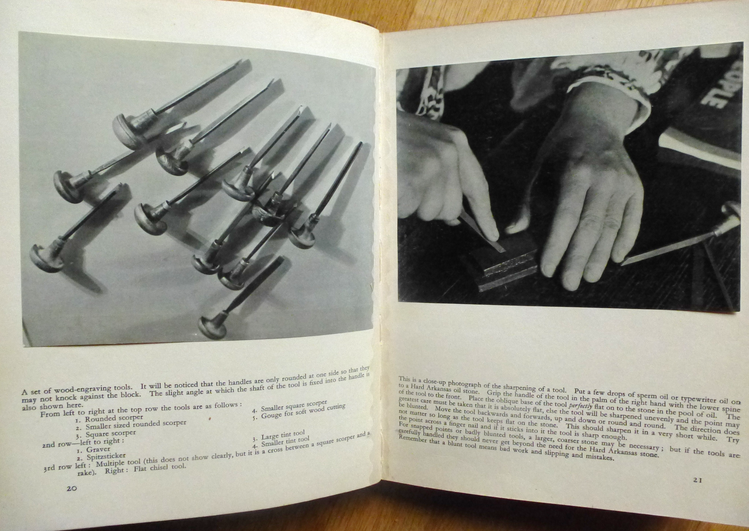
Clare Leighton Wood-Engraving and Woodcuts (1932)

Slide 8
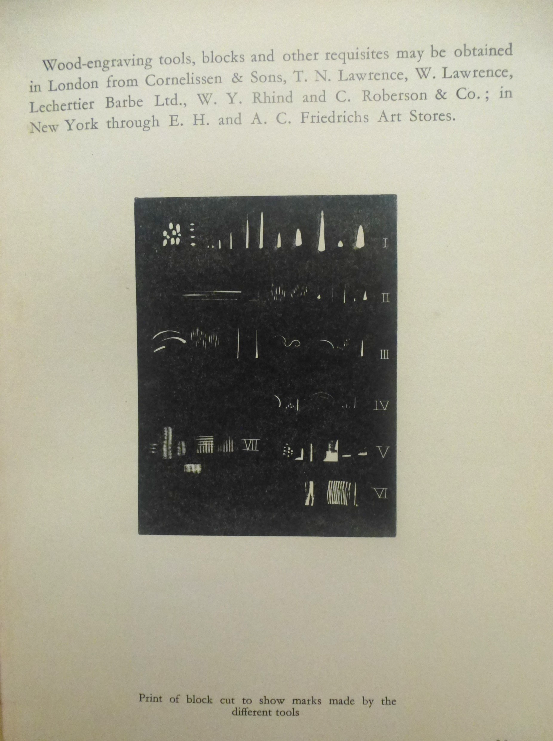
Wood-Engraving and Woodcuts Marks made by the different tools (p. 23) Loading (1931)
Ma

Slide 9
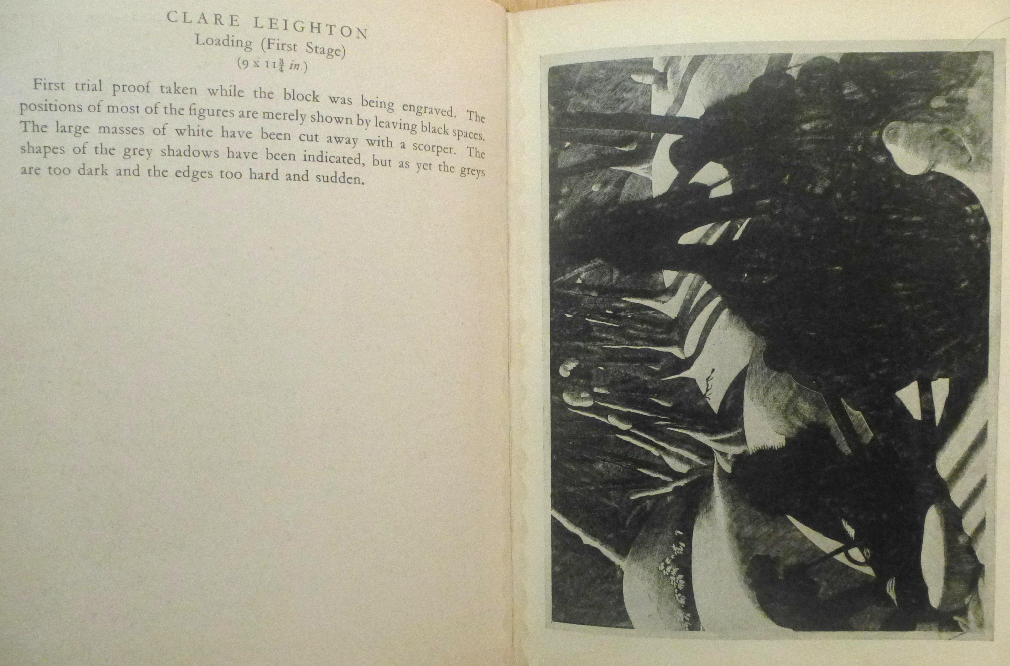
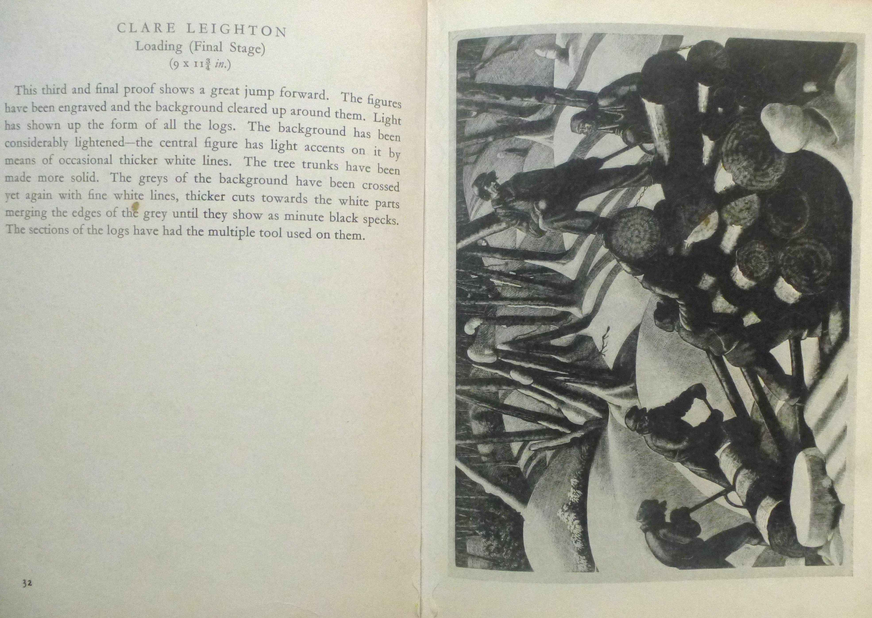
Loading in three stages

Slide 10
Conclusion & discussion

