Slide 1
Regional Autonomy and inter-ethnic relations, Seram island, Moluccas, Indonesia
Eduardo Erlangga Drestanta
The 3$rd$ Maluku cultural Congress and the 6$th$International Maluku research conference in Dobo

Slide 2
The goal of this research is to understand inter-ethnic relations in Seram island on facing the challenge of globalization. (impact of implementation the adat law in Sawai and Masihulan)
Problématique:
The main question is whether regional autonomy, particularly village autonomy by giving more freedom to community demands, is not exacerbating local tensions, with each group trying to derive maximum benefit from this new law. If the answer is positive, it could weakening our national maxim "Unity in Diversity".

Slide 3
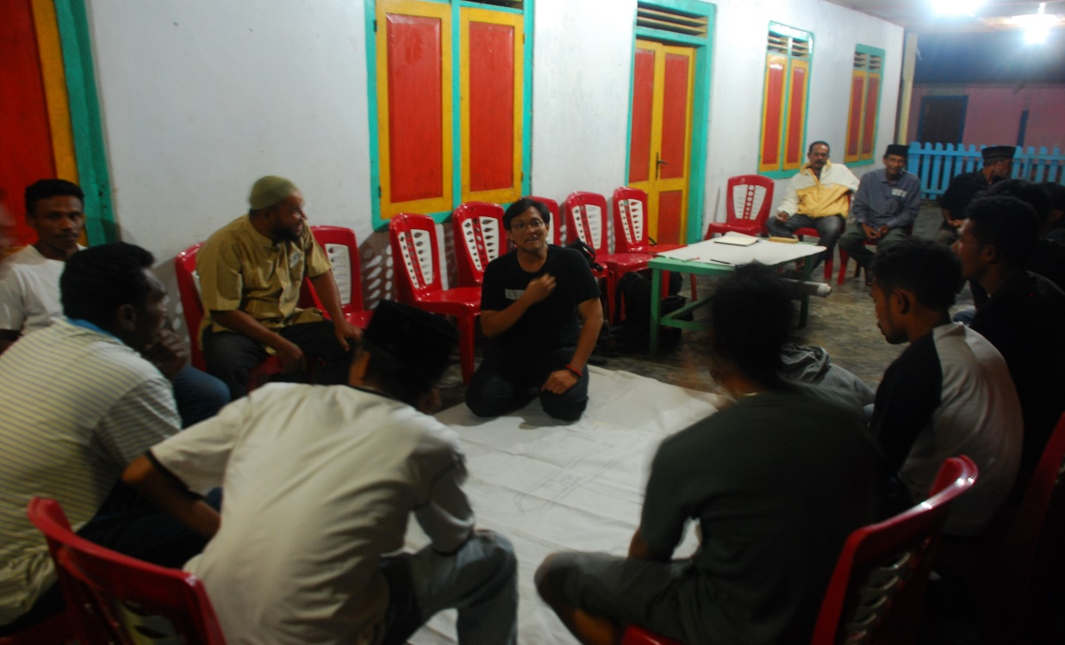
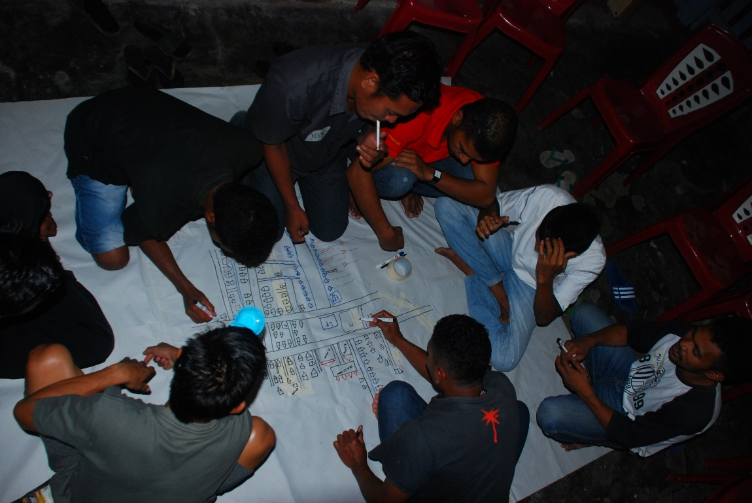
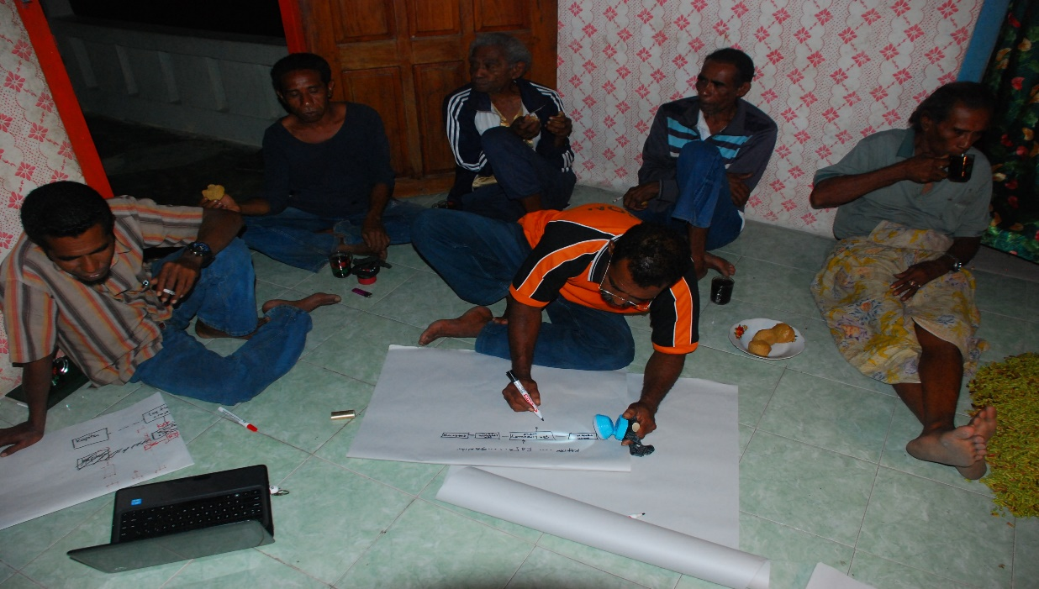
Méthodologie de recherche:
FGD (focus group discussion)
Ethnography
Partisipative map, SIG

Slide 4
- Sawai, the son of globalization « principal entrance »
-Colonial era, regentchappen formation-establishes a small military post in Sawai, trading activiy-monopoly spice trade. Petuanan (parental guardian)-Aniala(children) became Negeri.
-Old Order, UUD 1945 that recognize Indonesia’s territory that cover 250 Zelfbestuurende land-schappen dan Volksgemeen-schappen, includeing Maluku with a concept Negeri.
-New Order, UUD Desa no 5 tahun 1979
-post-reformation, UUD desa adat no 6 tahun 2014
-tensions:
- ’indigenous people’ and arrivals
- Ulayat land – sharing
- Village funding
- election of king

Slide 5
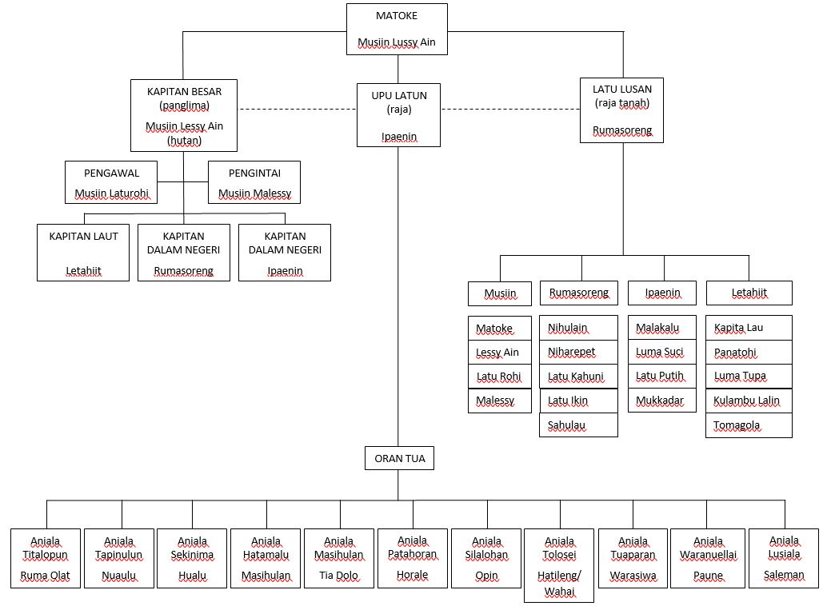
The Structure du Negeri Adat Sawai, concept « petuanan »-« Aniala »

Slide 6
-Masihulan becoming new son of globalization and « principal entrance »
‘escape from Sawai’
- ’orang hutan’/ ‘indigenous people’ Circulation movement and distruibution of SOA in forest
-Kaisuku- trading activiy-monopoly spice trade
-1935 Popotun- RMS activity
-1960 Rohune-conflict ambon
-2000 Mapa
problem negeri:
-lost of baileo
-claim fam for election
-last fam Matoke

Slide 7
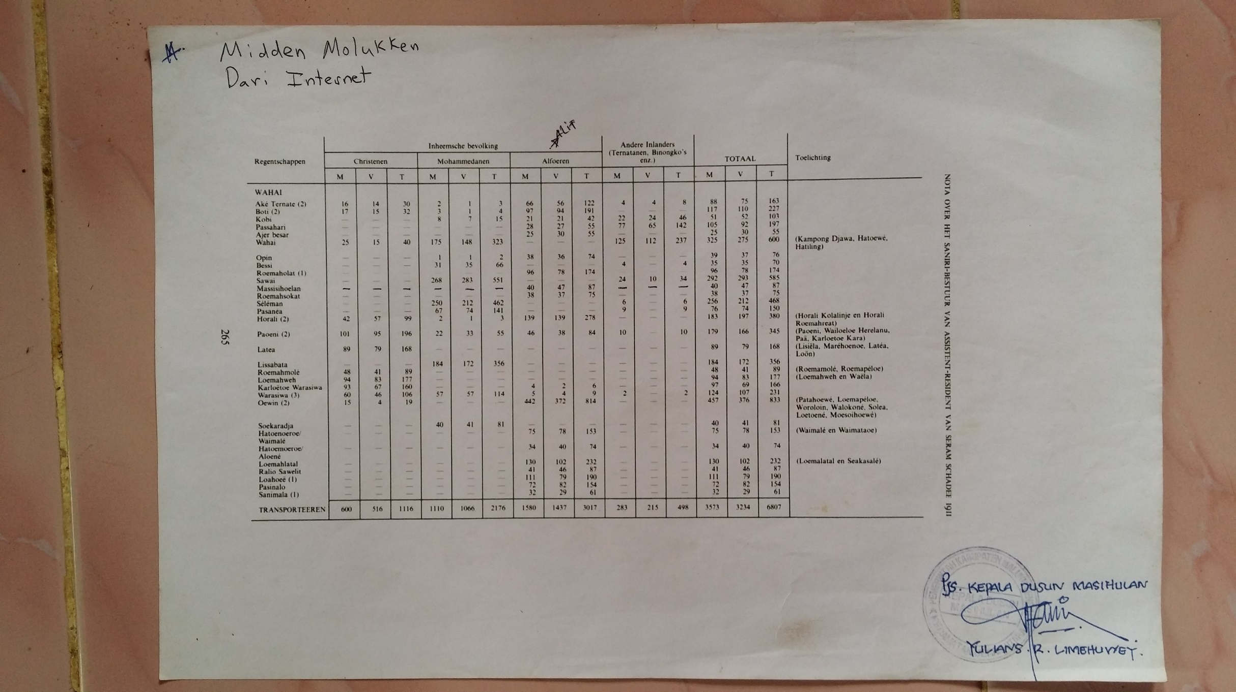
the division of Negeri and démographic in Seram island-1911 by Dutch

Slide 8
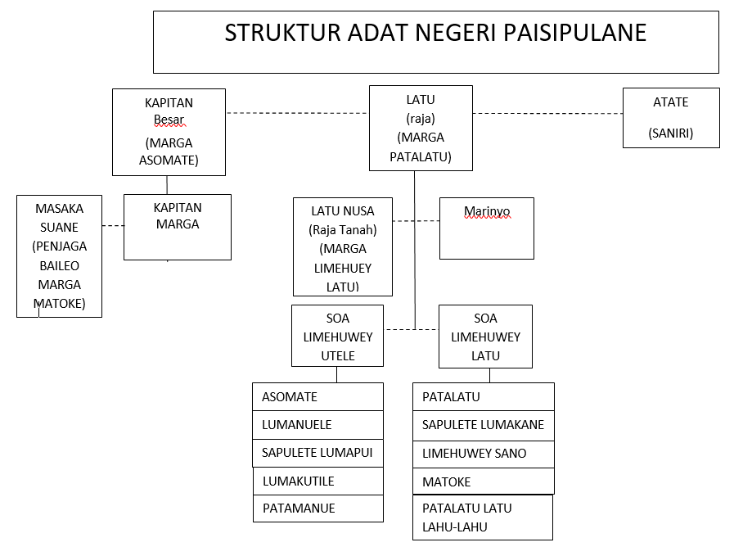
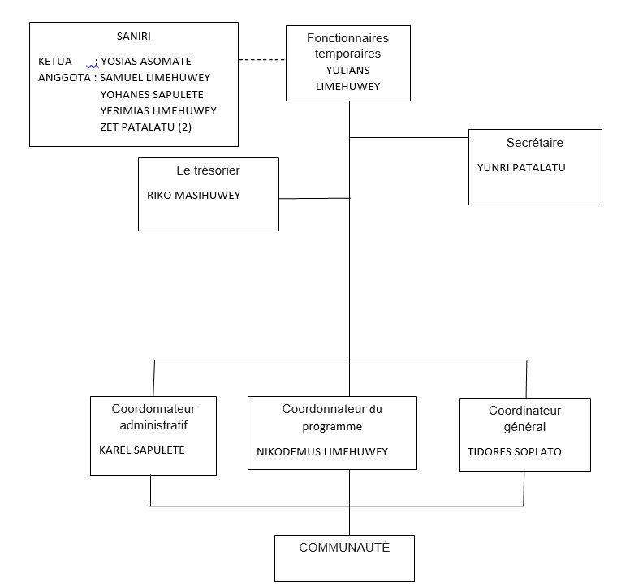
the structure Negeri administrative
the structure Desa

Slide 9
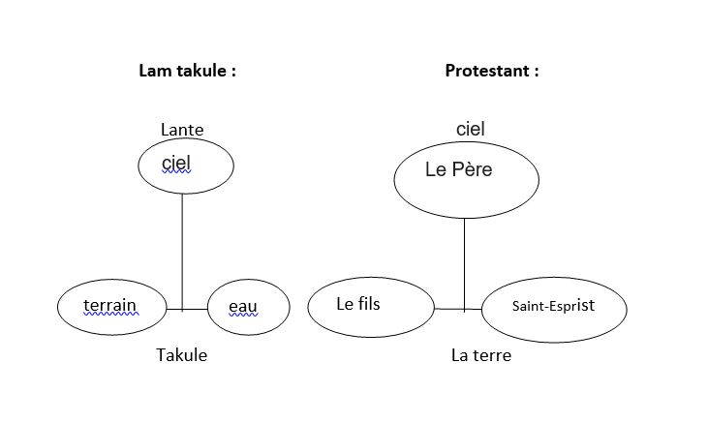
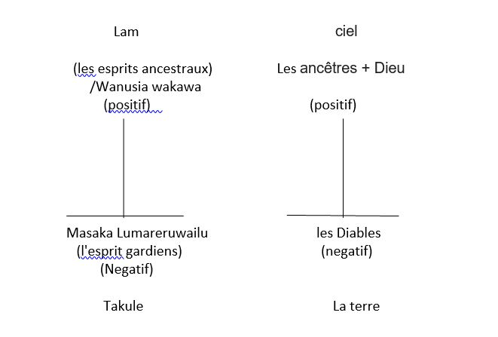
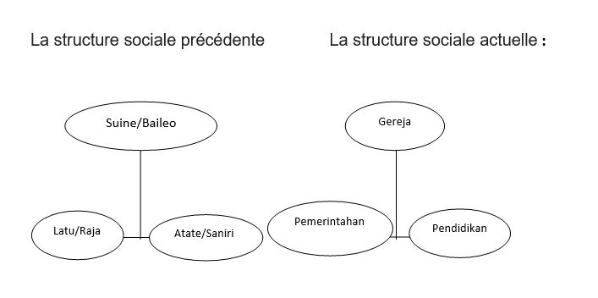
Transformation of « lante takule »
Transformation of « telu atu »

Slide 10
The National Park of Manusela – 2014 174.545,59 Ha
Prohibiton for hunting and entry

Slide 11
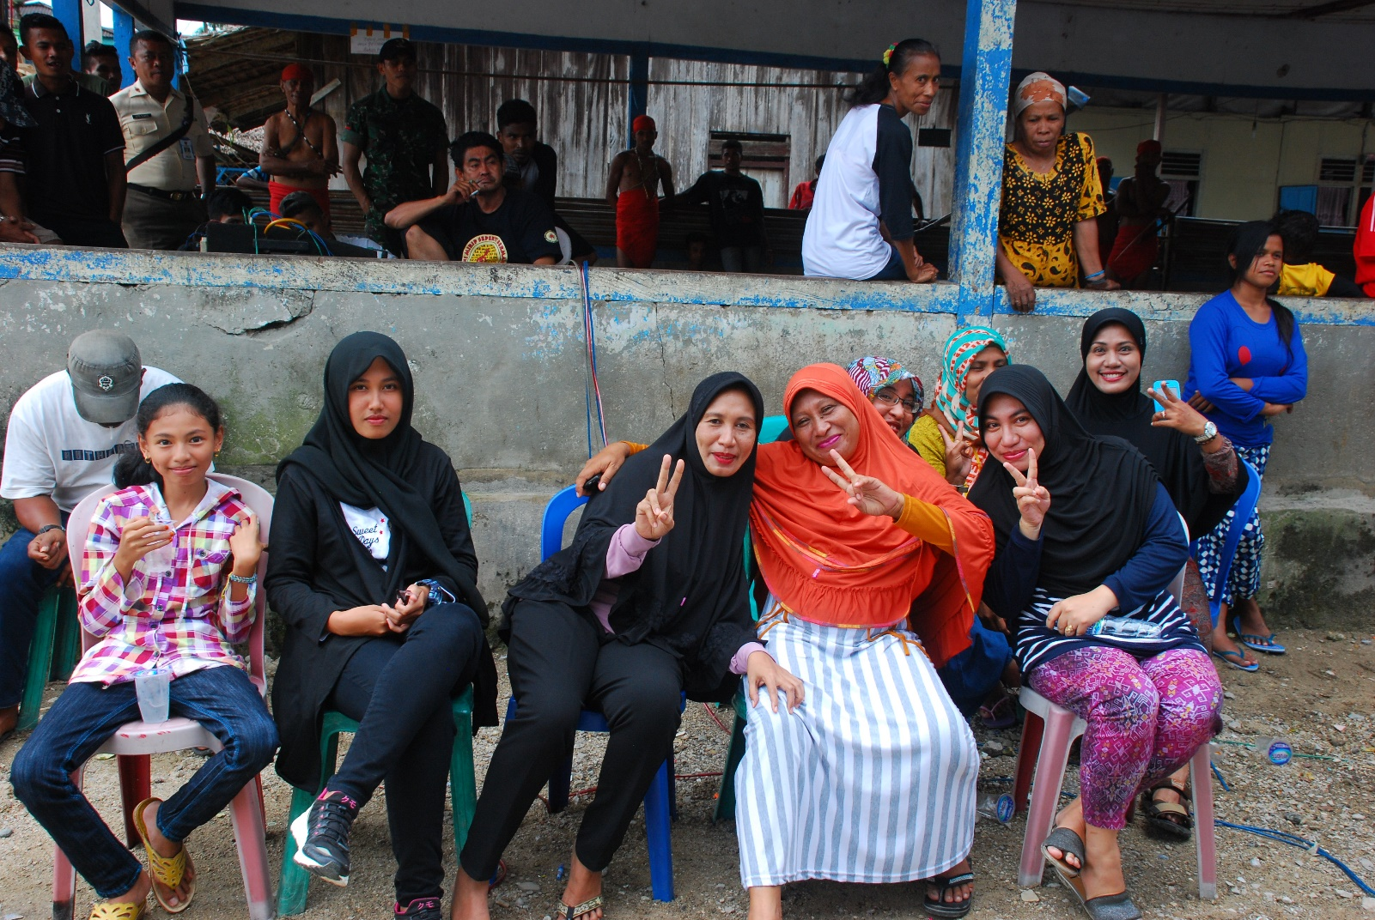
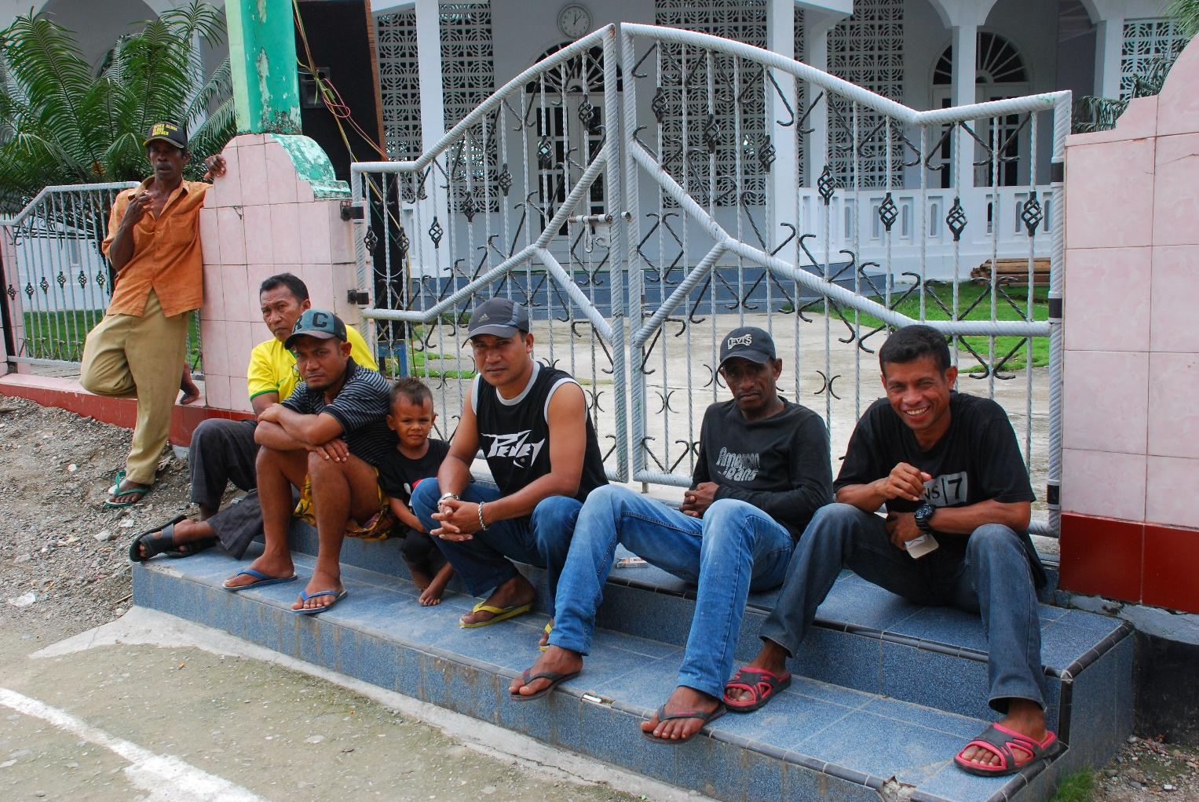
Sawai

Slide 12
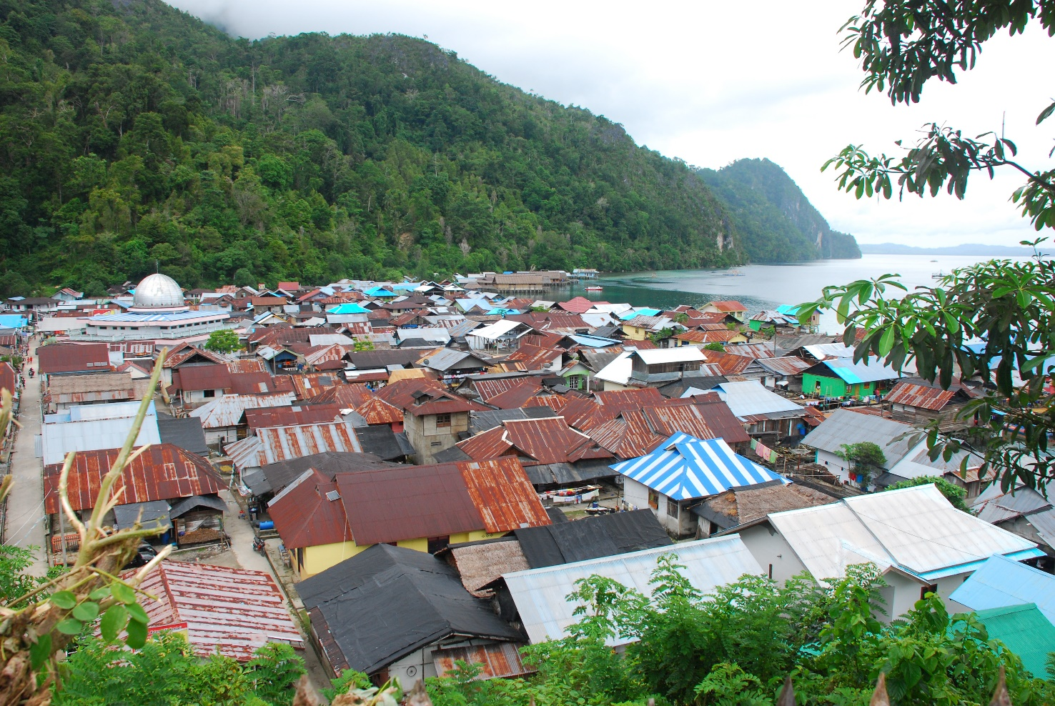
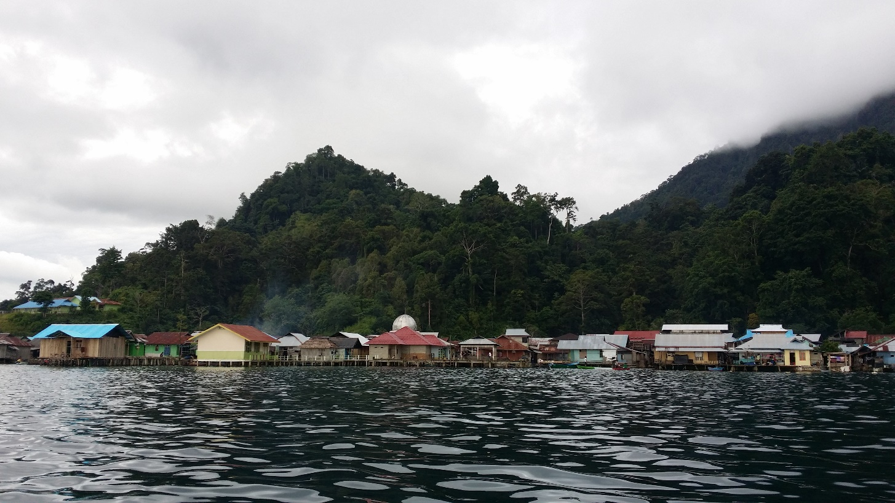
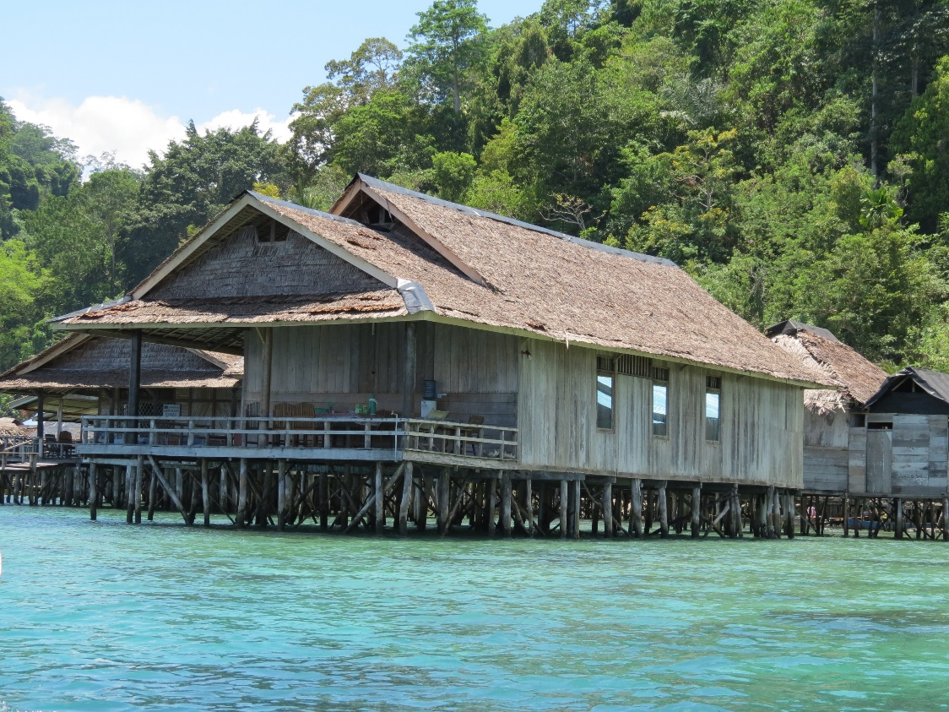

Slide 13
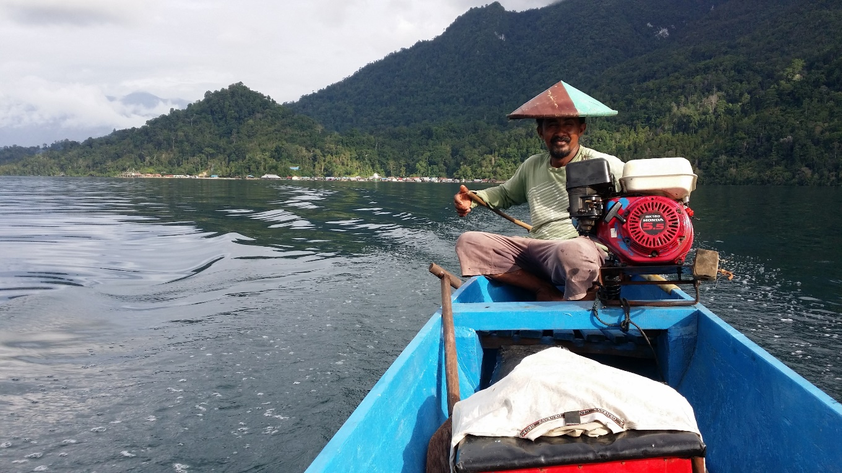
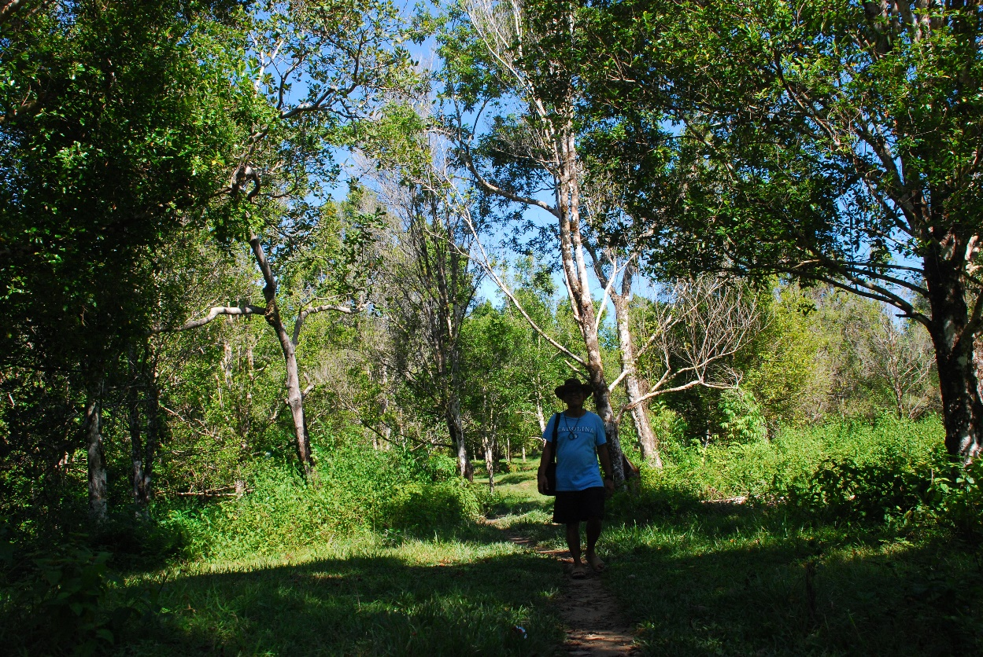
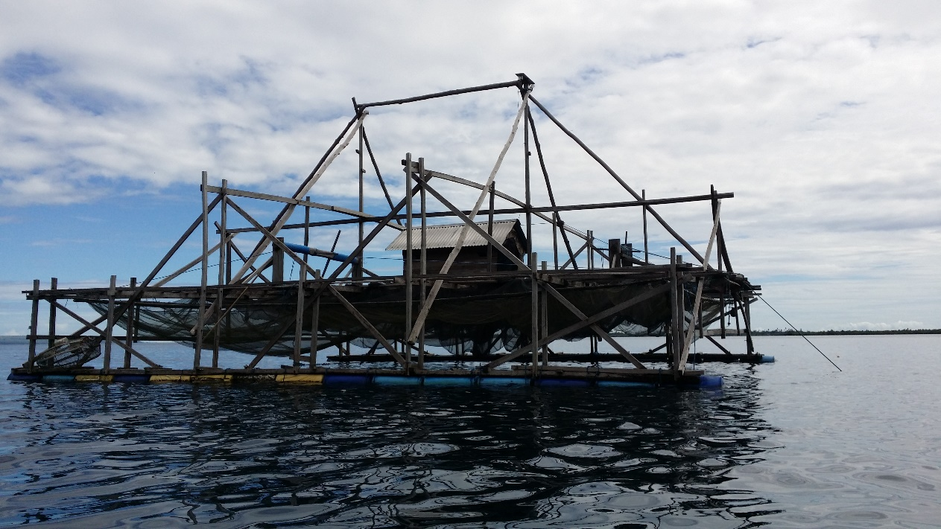

Slide 14
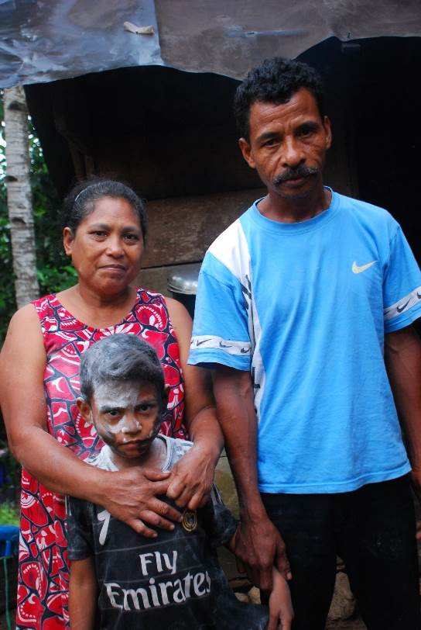
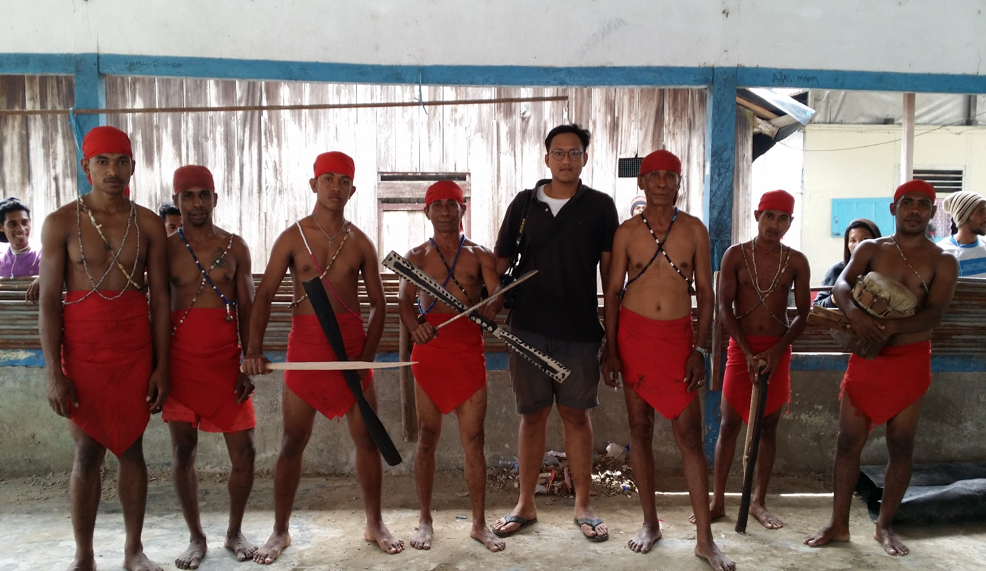
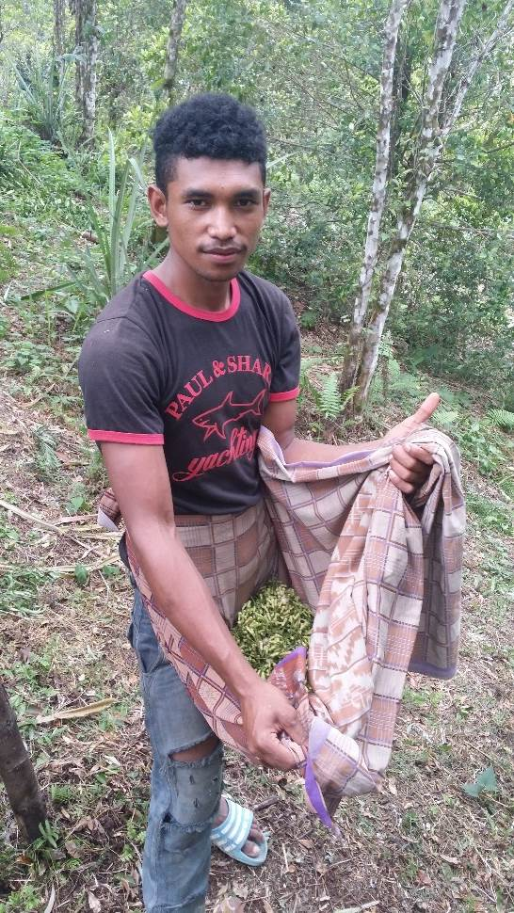
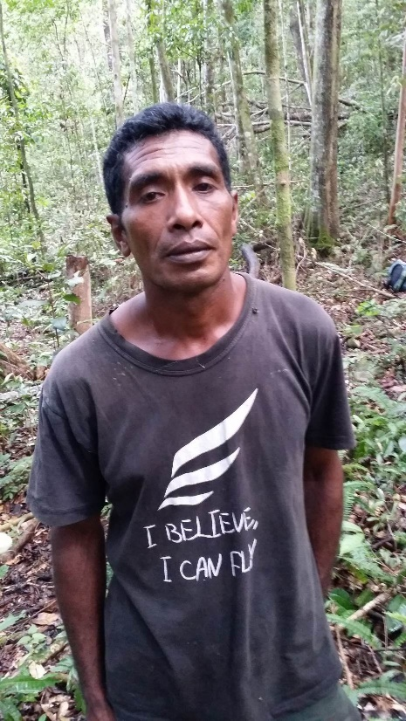
Masihulan

Slide 15
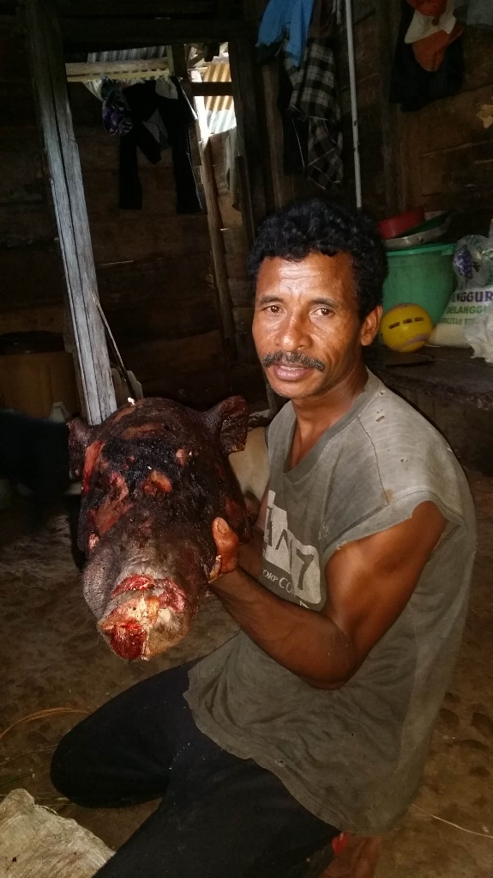
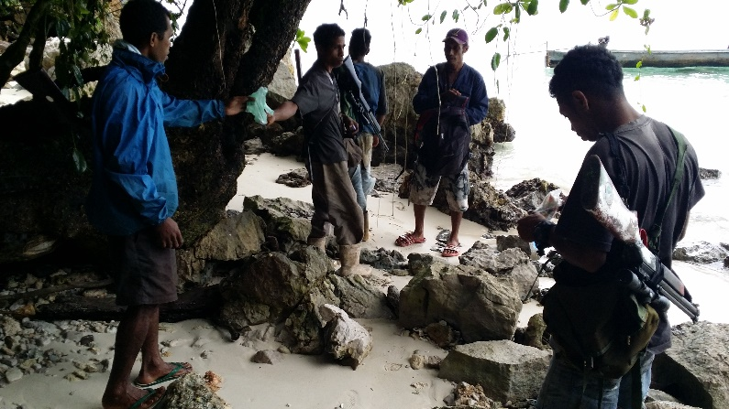
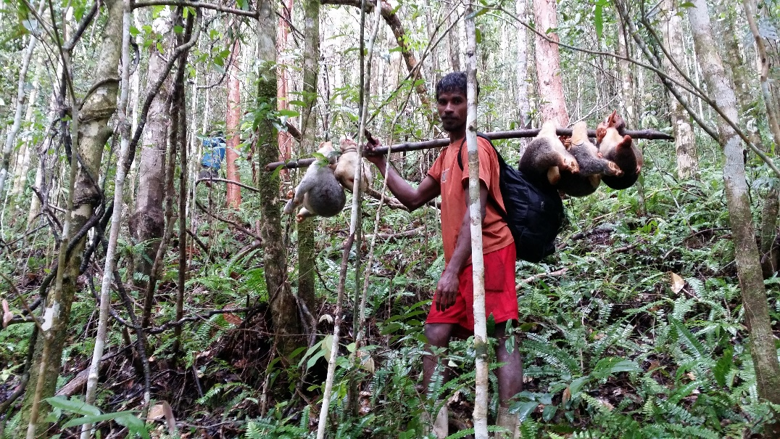
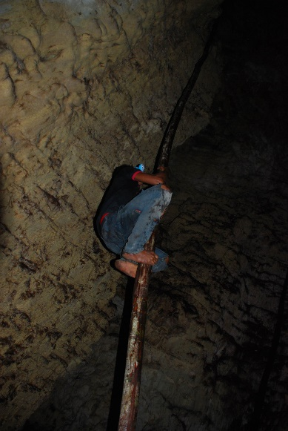
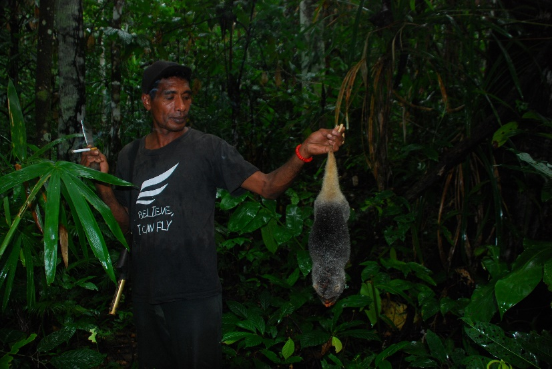
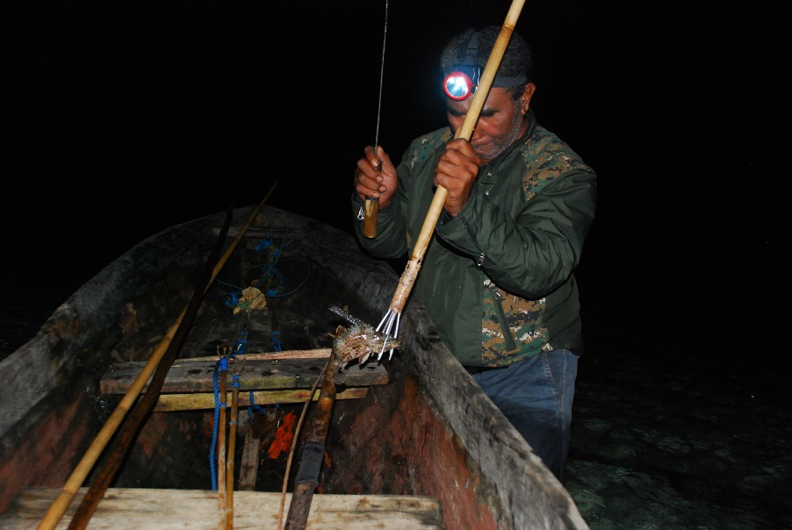
L’Interdiction de chasser

Slide 16
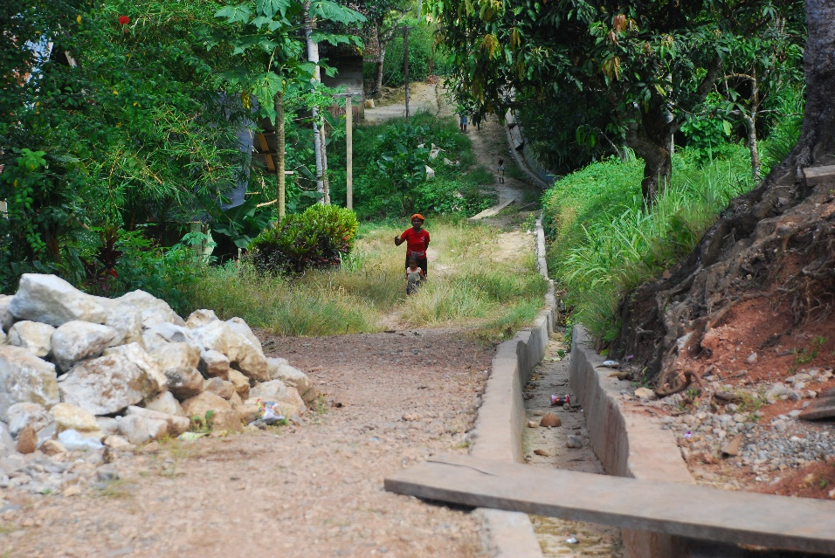
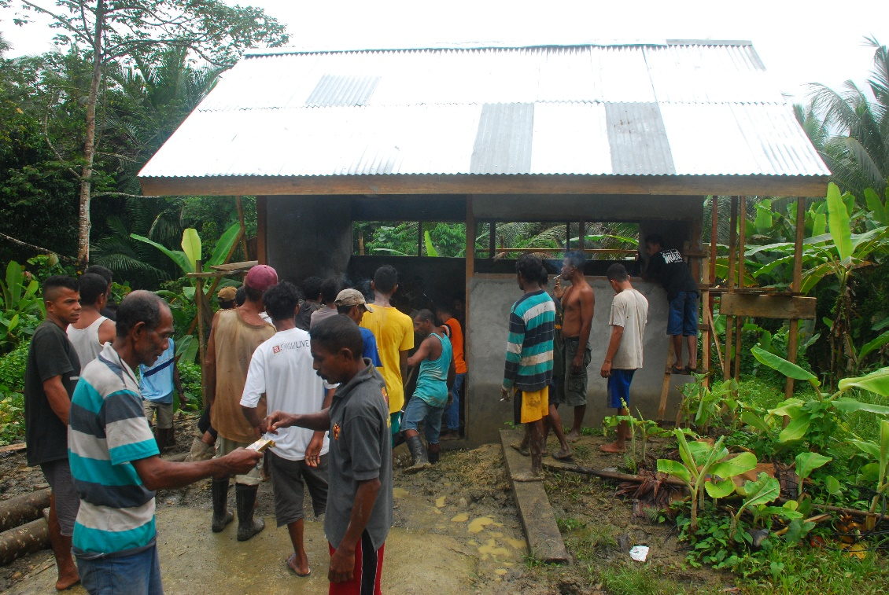
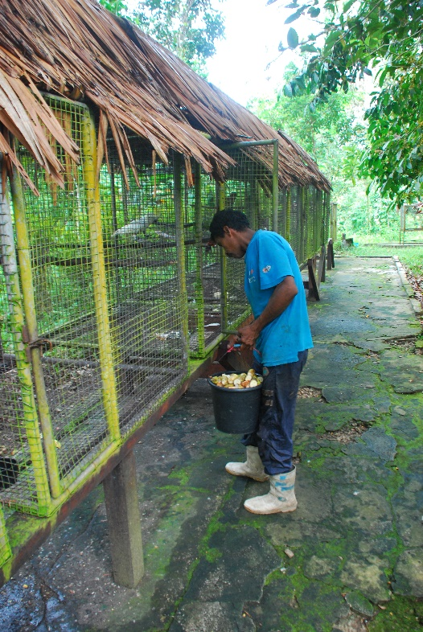
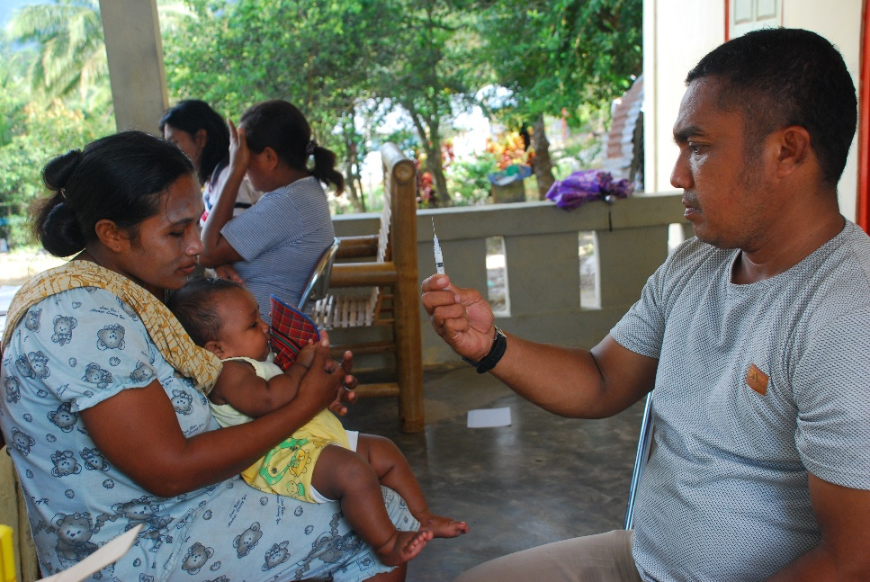
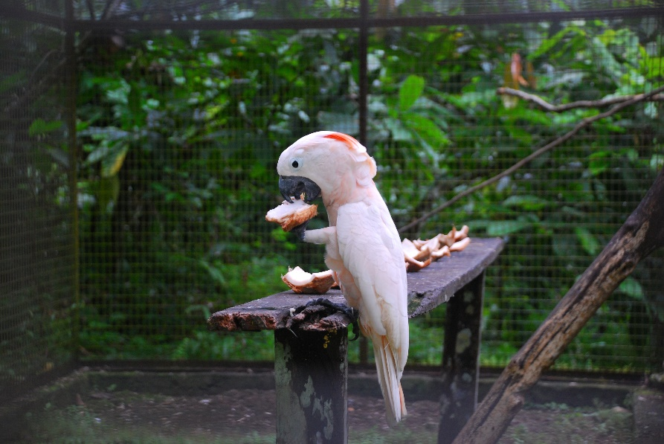
New Masihulan

Slide 17
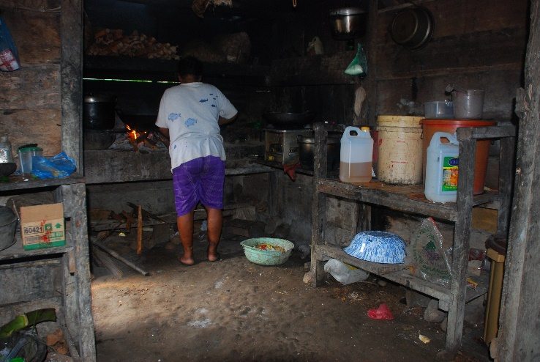
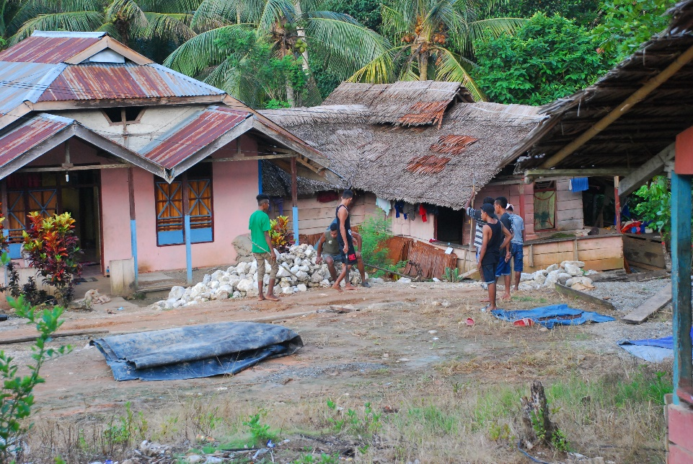
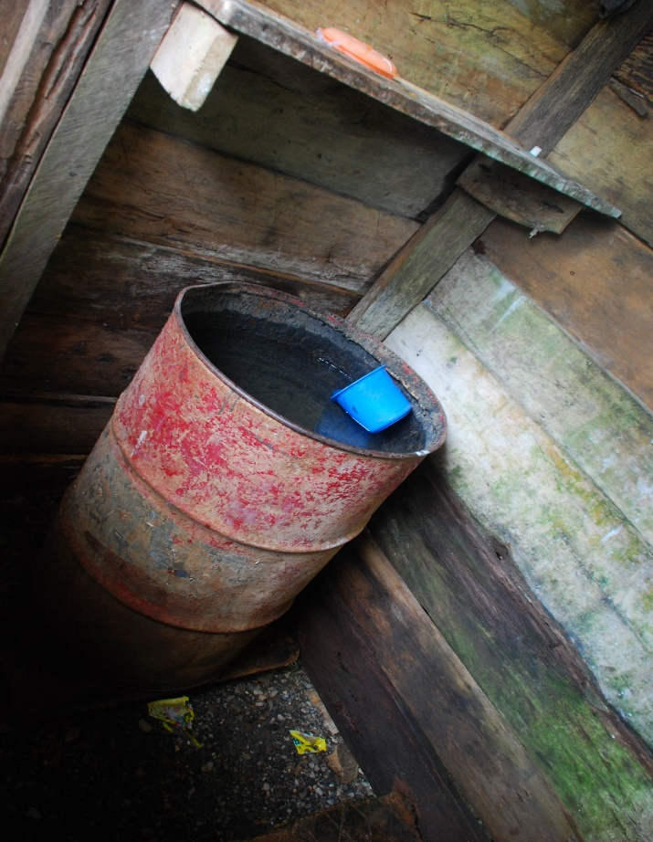
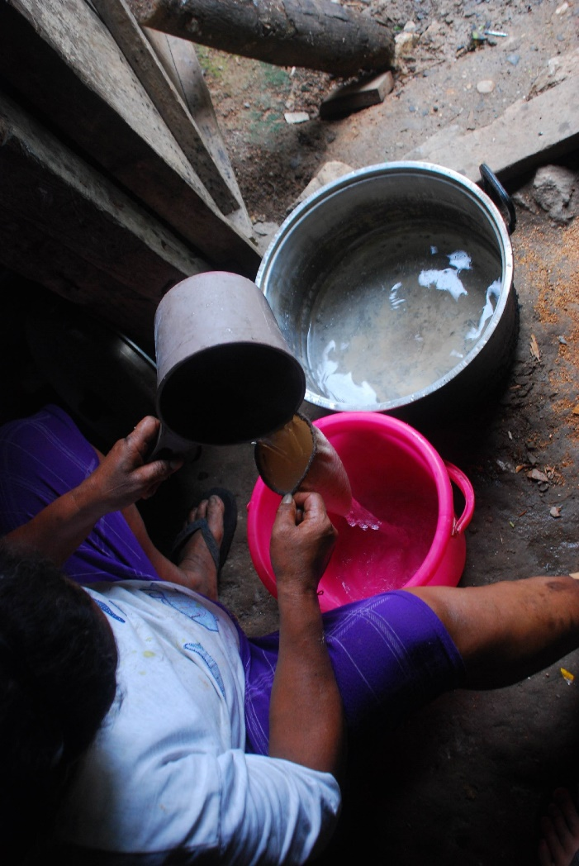
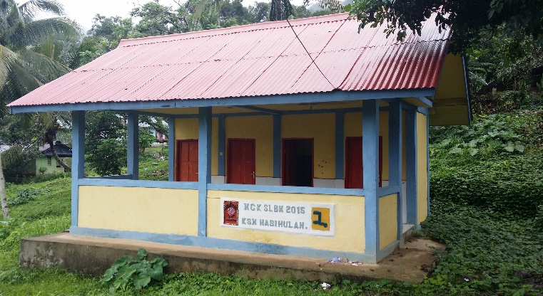

Slide 18
Thank you Comment and feedback….

