Slide 1

BANKING ON NATURE:
THE MARKET AS A NEW FEATURE OF ENVIRONMENTAL POLICIES
Stéphanie Barral
French National Institute on Agronomic Research (INRA)
Center on Organizational Innovation, Department of Sociology, CU
Center for Science and Society | October 5th, 2017
Notes:
Because I was expecting a diversity of disciplines within the audience, I have tried to propose a presentation of these new environmental policies that is not too specific but that is not too general at the same time. I would like to address the complexity of such policies and to highlight some of their key points at the same time. Through two different examples, I will show how I develop a sociological approach of environmental banks that particularly addresses the question of the role of environmental sciences in the making of market-based policies and market exchanges.
Because there is an increase on the use of markets as an answer to environmental sustainability issues, I beleive it is important to address the question of their outcomes and to link this question with an analysis of the process of their making. What world are the markets building ? I am particularly interested in understanding « what type of natural environment are they building » and in that sense willing to engage further with environmental scientists.
First steps of a research for my next book project, that I intend to develop during the next three or four years.

Slide 2
TOWARD MARKET-BASED INSTRUMENTS IN ENVIRONMENTAL POLICIES
Command-and-control
Cap and trade / command and commodify
Soft law and voluntary instruments
Notes:
For standard economics, environmental problems stem from the fact that the environment belongs to everybody in general and to nobody in particular. This is what Hardins grasped as the Tragedy of the Commons in his 1968 overly cited article. Because the environment has no specific owner, no markets and no price (central information for economics) they are not integrated in the capitalist sphere and they remain as “negative externalities” of production and trade. What responses should be proposed to counter those negative externalities? How to get them into the market economy? First, it is required to define what is a tradable environmental good, that is to say define property rights; and second there is a need of creating institutions in order to organize the regulation of their production or of their circulation.
Two variations from this:
Command and control policies: polluter pays principle, taxes (Pigou)
Coase: symmetrical analysis of the polluter and the pollute => exchange of property rights (cf carbon market)
Command and commodify : State-directed and market-oriented environmental policies = regulatory marketization (Rea 2017)
Ex: payments for ecosystem services (NY and the Catskill Mountain project, Costa Rica and Vittel in France), REDD, Carbon markets, Mitigation banks
What does this show? First, that State interventions are not neutral in terms of what representation of the environment, and here, of the biodiversity are carried out; and secondly, that the arbitrage between private and public actors is also a central political question.

Slide 3
MITIGATION AND CONSERVATION BANKS
Clean Water Act (1972)
Endangered Species Act (1973)
Mitigation of impacts from economic development: « No Net Loss principle »
Wetland credits and species credits
Notes:
Compliance with federal regulations
Notion of regulatory market
Definition of a conservation bank
The prevalence of bank on permittee responsible and in lieu fee mitigation shows here again how markets are acknowledged as the optimal solution to manage development impacts on biodiversity.

Slide 4
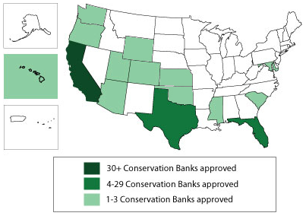
BANKING IN THE USA
www.fws.gov

Slide 5
ISSUES AT STAKE
Ethical questions
Ecological issues
Socio-economic points
Views from the sociology of science
Notes:
Ethical questions: the degree of intervention we want on the world / new social relation between the human and the living world, that acknowledges a superior position as a « nature-maker »
Ecological issues: question of the environmental efficiency of such instruments. Is the NNL principle an ideal or is it possible to reach it? What ecosystems are these policy building? What degree of genetic diversity do they bring about?
Socio-economic points: What is the price of such policies? What are the risks of the privatization of environmental policies? Do they benefit citizens evenly in the country?
From marketzation to financialization?
How do these markets work and from that understanding, how it gets possible to act on them
WHAT ARE THE NEW FUNCTIONS Of SCIENCE, new methodologies, new organizations, new economic field => how do environmental sciences intertwin with markets? What world is this building?

Slide 6
BULLOCK BEND MITIGATION BANK
120 acres in Yolo County, CA
Joint Bank USACE, USEPA, USFWS, NOAA, State Dep FWS → interagency review team
5 types of credits / 5 service areas
Simple indicators, simple metrics
(1 acre = 1 credit)
Notes:
Westervelt
Logging company
22 banks in 6 different States
Low level of quantification of the outcomes
Credit release is based on simple indicators such as a number of species, the development of a certain vegetation cover, a height of water,

Slide 7
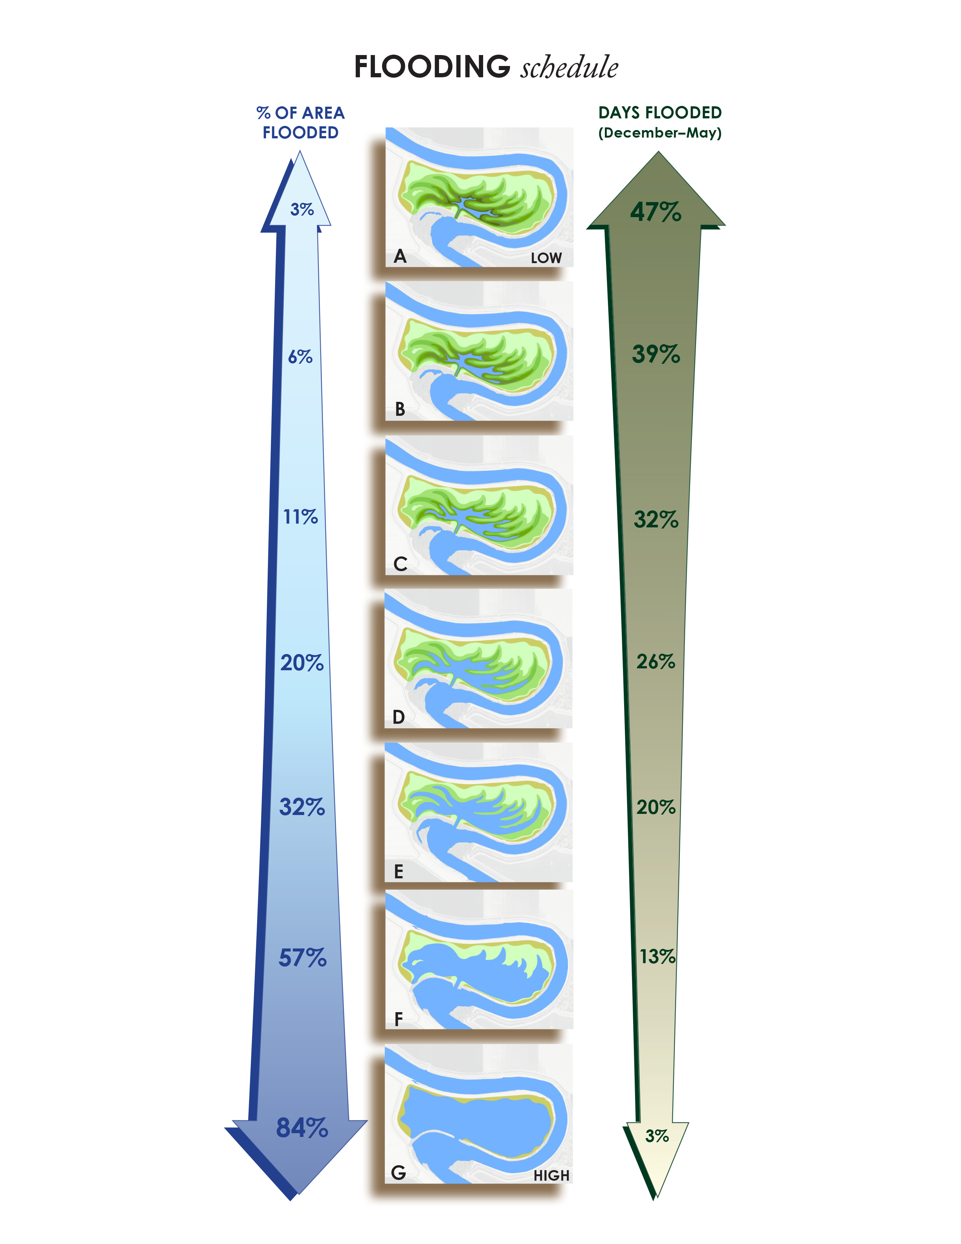
www.vesterwelt.com

Slide 8
www.vesterwelt.com
Notes:
Simple metrics are required in order to facilitate the accreditation process of the bank, especially in States and counties where there are several layers of institutions involved in the process.
TIME is the major constraining factor in the making of a bank. The first credits are usually released 1 to 3 years after the first investments are being made
As a consequence, we currently see a multiplication of different methodologies that are used for ecological restoration. One salmon credit to stick with the example, may not be a « fair currency » in the sense that it may have been produced and controlled through different ways. Even though agencies at the technical level are trying to be the garant of the process, the distribution of experts and the difficulties of knowledge accumulation tend to limit the standardization of the methodologies even at the field level.
On the debit side, on the impacter side, we notice the same type of observations: the measure of the impact is not always consistent with the measure use for the credit production; it is usually not carried out by the same teams in the agencies and even though agents try to make those match as much as possible, it remains an informal process wose success is not guranted.
PRICE OF THE CREDITS

Slide 9
SAGE GROUSE ADVANCED MITIGATION PROJECT
Exchange platform: pre-listing mitigation
Multi-stakeholder volontary project
Functional acres: assessment of habitat quality
Habitat Quantification Tool
Notes:
Pre-listing processes: reguated through a marketplace with common rules for all stakeholders, common price and common methodology
Debits and credits are calculated in the same way : idea of a common currency
Multiple versions of the tool in different States (Colorado, Wyoming, Nevada, Montana etc.)
EDF is a middle-ground operator that coordinates the process of tool production. They gather several actors, such as ranchers associations, landowners, State and federal agencies (Fish& Wildlife, etc.). EDF acts as a coordinator, they have more skills and knowledge on policy than on biological aspects ; Ecometrix is also an actor that has a library of tools. EDF coordinates the science team, made of scientists from universities and State agencies
Tool design can take up to two years and cost up to $100 000
Financed by the States and the private actors that are willing to have these pre-listing initiatives
Transparency and efficiency are presented as the main justifications for the development of such a complex tool
« Paying for outcomes rather than practices has also been shown to acheive more conservation per dollar spent than paying for management practices »
Rely on ecological sciences for considerations on the type of habitat that are needed for foraging and breeding habitats. The HQT is a framework that defines the relevant parameters to assess the quality of the habitats, associate each parameter with a coefficient that state the relative weight of each parameter in the assessment of the habitat quality (eg: is the horizontal structure of the vegetation more important that its diversity) and then proposes and aggregation of all the parameters into one metric being the functional acre. Collective process of scientific decision-making + methodologies on the way to assess a value to each parameter in the field

Slide 10

Notes:
These two examples show that conservation banking is a highly regulated field.
The role of science ranges from a very simplistic one for individual banks where the main issue is time of the process
To an advanced one where very sophisticated metrics are being developped in order to organize a large and transparent market
Let’s take a further look at the way environmental sciences are being framed and mobilized within this field
I show that scientific knowledge is not only a modelisation process of restoration, it is also a negotiation process

Slide 11
TIGHT REGULATIONS BUT WIDE SCIENCE?
Layers of institutional frameworks
Projects ought to be done « upon the best available science » but no standards of methods
Variety of sources of information for site selection and restoration designs
Notes:
Variety of sources: NGO, universities, Federal and State such as the recovery plans of the ESA-listed species

Slide 12
TIGHT REGULATIONS BUT WIDE SCIENCE?
“The people from the State, they have a much more conservative view on conservation, whereas we tend to be more flexible”
Notes:
Here is a quote from an interview with a biologist of the USFWS in CA that shows how the political objectives defined at the macro-level by each agency has an impact on the negotiation process and the outcomes of the projects.
This shows how at the macro-level of the institutions the way scientific results are being translated into political categories and objectives. First level where positions are adopted where debate and interpretation may be the process in the scientific field
Project of up front mitigation avec Highway Authority in CA, FWS, ACE implying WES
Westervelt is looking for the land for mitigation, and before purchasing the land or doing action for conservation, all stakeholders sit at the table and see whether this piece of land can meet the requirements of the agencies for conservation. Biologists sit at the table and talk, before legal issues or other issues may be raised.
“The people from the State, they have a much more conservative view on conservation, whether we tend to be more flexible.” For instance, the size of the hole for a fox is according to the federal agency guidelines, 5 inches, whereas the State says three. So it takes hours of negotiations to get the same point on several issues.
Try to take the most recent science, being done in universities at the moment (this fox is particularly well studied).
Other example: they look at the habitat of a lizard and the potential that it may be threatened in this habitat, whereas the State services will allow no death of the lizard.

Slide 13
WHEN ECONOMY AND ECOLOGY MEET
At the bank level:
Trade-offs between ecology and economy
“The more subtypes you create, the less usable they are”
Notes:
In this quote, we see an actualization of a historical debate in the environmental sciences, that relates to subtypes and populations within species
It also speaks about the kind of restored environment we are aiming at: do we wanna tend toward this ideal garden of Eden where all creatures are living, or in other words meaning that the intra-genetic variability of species is something that counts for general equilibrium of the ecosystems, or do we just wanna be able to say « we are safe, there are still one tiger population in Florida »

Slide 14
WHEN ECOLOGY AND ECONOMY MEET
“For a shrimp, we knew that there was no market on the service area that we had defined at first so we decided to expand it more south because we new that the bank could have a market; and then we on our side could have conservation of the shrimp. No one seemed to have a problem with that among the IRT members. That was an easy decision that was not based on biology”

Slide 15
WHEN ECONOMY AND ECOLOGY MEET
“There’s a lot of development going on over here, there’s no bank: dollar sign, dollar sign, dollar sign. (…) But the longer it takes the lower returns for us. So we don’t want to be asking for the moon because number 1, we loose credibility and number 2, it’s just gonna delay everything. So there’s this fine line between asking for something that’s reasonable but also attractive”

Slide 16
WHEN ECONOMY AND ECOLOGY MEET
“Our intent was to make the science process a process where the scientists could be free to develop whatever tool they came up with. (…) And then the process of developing the rules of the exchange itself was a negotiated stakeholder process. And throughout the project, it became increasingly difficult to keep those two things separate. There were enormous pressures put on myself and others to integrate them. Some of the stakeholders did not like what the scientists were doing. Because they could see it was going to cost them money. ”

Slide 17
ECONOMY AS A DRIVER FOR CONSERVATION
“For some species, we have been working on 20 years of conservation so there is not a lot of time lost on discussion”

Slide 18
SCIENCE AS A POLITICAL TOOL
Market-based conservation policies at the crossroads of new competences for federal and State agencies
How to ensure science’s autonomy? How to regulate trade offs between science and economy? What are the policies acheiving at the ecosystem scale?
Marketization of conservation: toward good species and bad species? Toward a segregated landscape?
Notes:
Politics of biodiversity impose a simplification of the conception of biodiversity through the categories that are addressed and the type of metric they develop. What ecological world is this building? Can simplification sustain ecological uplift? How far is this goal-oriented science from fundamental science? Are macro-species an interesting proxy for ecosystems?
Where should action be carried out? A better view of how policies are carried out can help assessing how are the outcomes reached.
How could together environmental sciences and social sciences address the issue of ecological quality in market-based conservation policies?
Segregated landscapes = States with a lot of banks and an important conservation status versus States with poor conservation policies?

Slide 19
Thank you for your attention
Please feel free to contact me:
stephanie.barral@inra.fr

Slide 20
METRICS AS COORDINATION TOOLS
A good biodiversity metric…
Incorporates the landscape context of the site
Is valid
Is practical, economical
Can be applied at different scales

