Slide 1
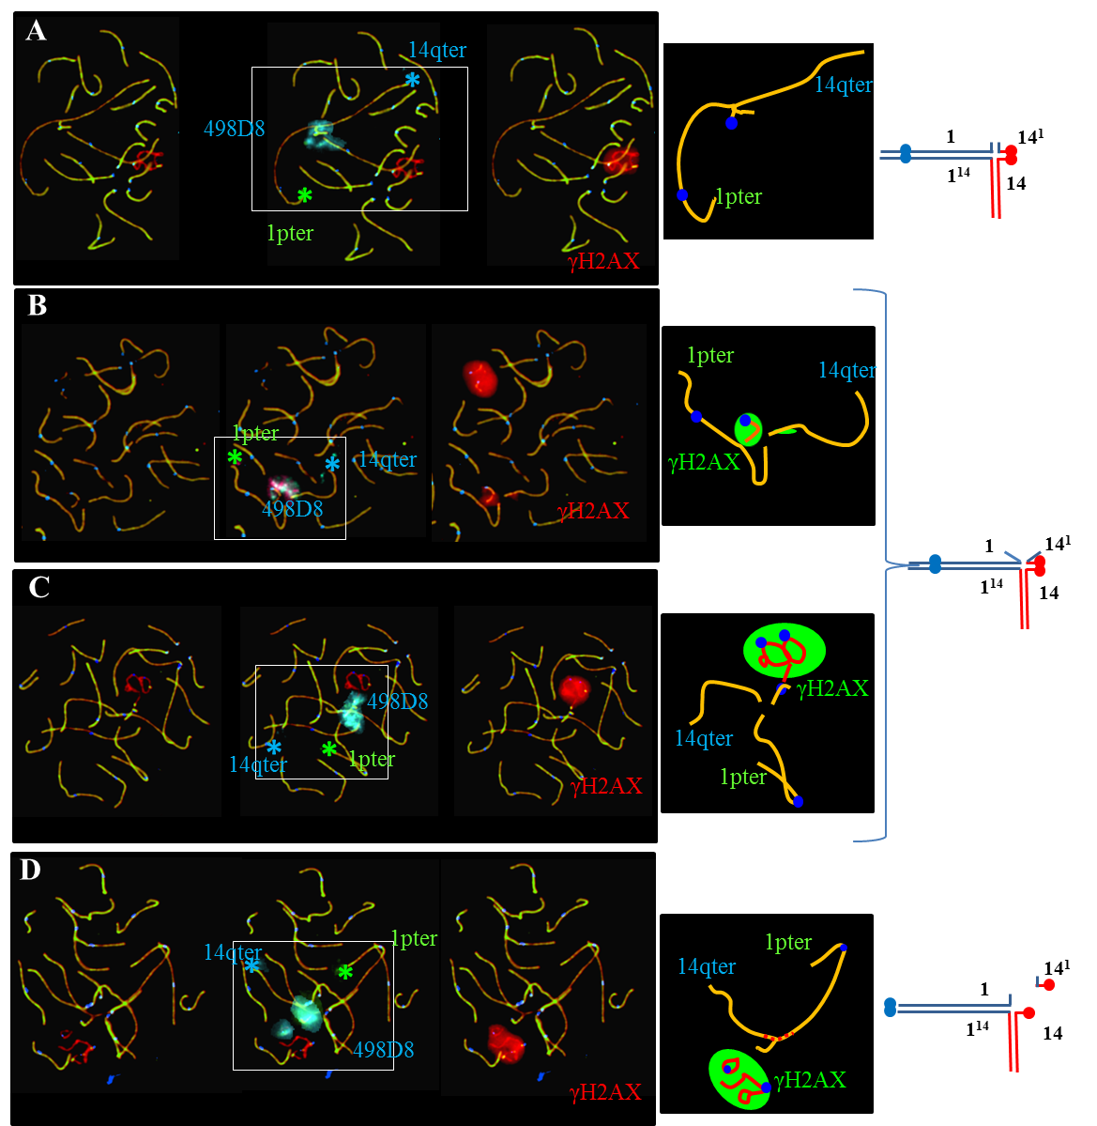
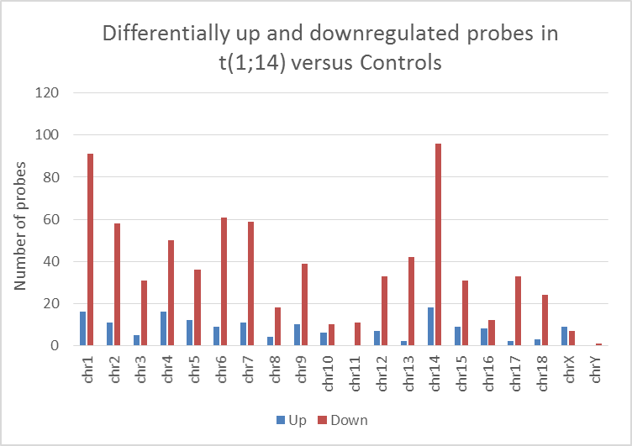
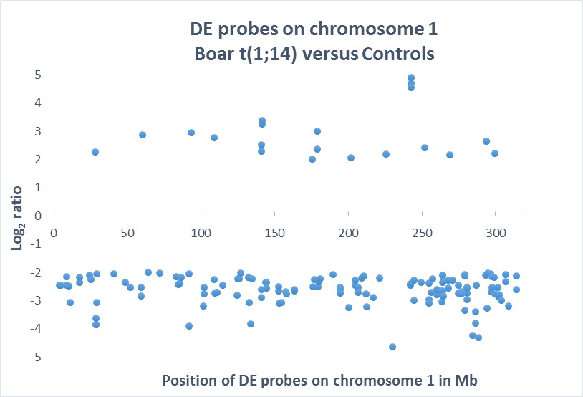
Meiotic Pairing and Gene Expression Disturbance in Germ Cells from an Infertile Boar with a Balanced Reciprocal Autosome-Autosome Translocation
Harmonie Barasc¹, Annabelle Congras¹, Nicolas Mary¹, Lidwine Trouilh², Valentine Marquet¹, Stéphane Ferchaud³, Isabelle Raymond-Letron⁴, Anne Calgaro¹, Anne-Marie Loustau-Dudez¹, Nathalie Mouney-Bonnet¹, Hervé Acloque¹, Alain Ducos¹ and Alain Pinton¹
¹ GENPHYSE, Université de Toulouse, INRA, INPT, ENVT, Toulouse, France; ² LISBP, Université de Toulouse, CNRS, INRA, INSA, Toulouse, France; ³ GenESI Génétique, Expérimentation et Système Innovants, F-17700 Saint-Pierre-d’Amilly, France; ⁴ STROMALab, Université de Toulouse, CNRS ERL5311, EFS, ENVT, Inserm U1031, UPS, Toulouse, France
Introduction
Balanced constitutional reciprocal translocations are the most common structural chromosomal rearrangements identiﬁed in humans and pigs (frequency of 0.1% and 0.4%, respectively - Benet et al., 2005; Ducos et al., 2007). Carriers are generally phenotypically normal, but such rearrangements frequently lead to reproductive disorders. Indeed, the prevalence of reciprocal translocations is about 10 times higher among infertile men and some carriers present spermatogenesis disturbances leading to oligo- or azoospermia, sometimes associated with terato-and/or asthenospermia (Dong et al., 2012; Mau-Holzmann, 2005; Van Assche et al., 1996). Reciprocal translocations are also responsible for recurrent miscarriages and congenital defects in the offspring of carrier parents (Benet et al., 2005).
The aim of our research was to analyze the meiotic process in an oligoasthenoteratospermic boar carrying an asymmetric reciprocal translocation involving chromosomes 1 and 14.
The reciprocal translocation t(1;14)(q2.11;q1.2) (Fig. 1) was identified in a Landrace x Duroc crossbred boar phenotypically normal, but presenting abnormal semen parameters: 19x10⁶ spz/ml (instead of 250x10⁶, on average, in normal individuals), with only 5% of alive, and 78% and 66% acrosome and distal droplets abnormalities, respectively. 5 sows were inseminated, but no pregnancy could be obtained.
Fig. 1: GTG-banded normal and derivative chromosomes 1 and 14
Meiotic Pairing and Gene Expression Analyses
Meiotic pairing
Analyses of the transcriptional activity
A
B
38%
70%
Fig. 3: Differentially expressed probes on all the chromosomes (A) and on the SSC1 (B).
Gene expression in testis was analyzed using an Agilent 60K customized porcine microarray. Comparison of the t(1;14) boar with a pool of control boars revealed 2278 differential expressed genes from which 75% correspond to downregulated in particular on SSC1 and SSC14 (Fig. 3A) (increased density in the SSC1 breakpoint region (Fig. 3B). An up regulation of some X genes was also observed (Fig. 3A).
11%
Conclusion
The main goal of this study was to investigate thoroughly the meiotic disturbances that result in the infertility of a young OAT boar carrying an autosome-autosome reciprocal translocation. Our results showed that some autosomal regions (SSC14 centromeric region) exhibited pairing defects sometimes associated with the XY body, leading to a down-regulation of some autosomal genes (MSUC), as well as to an up-regulation of some X genes. This is the first case of a meiotic sex chromosome inactivation (MSCI) defect associated with MSUC documented in a pig carrying an autosome-autosome translocation. Further studies will be necessary to investigate if MSCI defects and MSUC occurrence depend on the nature of the chromosomes involved in the translocation, or on the lengths of translocated chromosomal fragments.
These results were submitted in Chromosome Research.
77%
30%
Fig. 2: Analysis of the meiotic pairing in pachytene spermatocytes using FISH (probes on SSC1 and SSC14 )and immunostaining of the synaptonenal complex proteins SCP1 (green) and SCP3 (red), as well as γH2AX (red) and the centromeres (blue). Scale bars are all equal to 10µm.
Analysis of 284 pachytene nuclei revealed two pairing configurations: in 70% of the cells, the chromosomes formed a quadrivalent (Fig. 2A, B, C), whereas in 30% of the cells, a “trivalent plus univalent” structure (Fig. 2D) was observed. 49% of the quadrivalents exhibited γH2AX positive regions from which 11% colocalized with the XY Body (Fig 2C). The univalents (small 14¹ chromosome) were associated to the XY body in 77% of the cases (Fig. 2D).
References:
Benet, J., Oliver-Bonet, M., Cifuentes, P., Templado, C., and Navarro, J. (2005). Segregation of chromosomes in sperm of reciprocal translocation carriers: a review. Cytogenet. Genome Res. 111, 281–290.
Ducos, A., Berland, H.M., Bonnet, N., Calgaro, A., Billoux, S., Mary, N., Garnier-Bonnet, A., Darre, R., and Pinton, A. (2007). Chromosomal control of pig populations in France: 2002-2006 survey. Genet Sel Evol 39, 583–597.
Dong, Y., Du, R.-C., Jiang, Y.-T., Wu, J., Li, L.-L., and Liu, R.-Z. (2012). Impact of chromosomal translocations on male infertility, semen quality, testicular volume and reproductive hormone levels. J. Int. Med. Res. 40, 2274–2283.
Mau-Holzmann, U.A. (2005). Somatic chromosomal abnormalities in infertile men and women. Cytogenet. Genome Res. 111, 317–336.
Van Assche, E., Bonduelle, M., Tournaye, H., Joris, H., Verheyen, G., Devroey, P., Van Steirteghem, A., and Liebaers, I. (1996). Cytogenetics of infertile men. Hum. Reprod. Oxf. Engl. 11 Suppl 4, 1-24-26.
UMR1388 INRA/INPT GenPhySE
Equipe Cytogene
Contact : h.barasc@envt.fr

