Slide 1


Conversion between prosodic transcription systems: from ToBI to INTSINT for English learner interlanguage prosody analysis
Leonardo Contreras Roa
LIDILE EA 3874 - Université Rennes 2

Slide 2
Conversion between prosodic transcription systems
1. Context
2. Similarities and differences between ToBI and Intsint
3. Equivalence proposal
4. Results
5. Discussion
6. Conclusions and future work

Slide 3
1. Context

Slide 4
Context
PhD research
Carrying a contrastive analysis of interlanguage prosody with native speech prosody.
Interlanguage data → Intsint
English native data → Intsint
Learners’ L1 Native data → ToBI
Need for a system of equivalences!

Slide 5
L1 French
(France)
L2 English
(L1 French)
L1 English
L2 English
(L1 Spanish)
L1 Spanish
(Chile)
ToBI
Intsint

Slide 6
L1 French
(France)
Reference corpus
International Atlas of Romance Intonation (Prieto et al., 2010)
Elicitation task
L1 Spanish
(Chile)
ToBI

Slide 7
L2 English
(L1 French)
My corpus
2 parts:
- Same methodology as Prieto et al. (2010)
- Contextualized reading out loud task
L1 English
L2 English
(L1 Spanish)
Intsint

Slide 8
Questions
What are the differences between ToBI and Intsint?
What do they have in common?
Can we compare data transcribed in different transcription systems?
What is “lost in translation”?

Slide 9
Objectives
Main objectives
Comparing native intonation contours transcribed in ToBI with interlanguage intonation contours transcribed in Intsint, at a tone sequence level.
Determining if contours in interlanguage intonation can be associated to the learners’ L1 intonation.
Specific objectives
Proposing a set of theoretical equivalences between ToBI tones and Intsint tone sequences.
Testing these equivalences by applying the Momel algorithm and Intsint transcription to ToBI transcribed utterances.

Slide 10
Previously proposed equivalence systems
Ladd (2008:91) developed Roach’s work: ToBI and Standard British
1 | H*L-L% | Fall
2 | H* L-H% | Fall-rise
3 | H* H-L% | Stylised high rise
4 | H* H-H% | High rise
5 | L* L-L% | Low fall
6 | L* L-H% | Low rise (narrow pitch range)
7 | L* H-L% | Stylised low rise
8 | L* H-H% | Low rise
9 | L+H* L-L% | Rise-fall
10 | L+H* L-H% | Rise-fall-rise
11 | L+H* H-L% | Stylised high rise (with low head)
12 | L+H* H-H% | High rise (with low head)
13 | L*+H L-L% | Rise-fall (‘scooped’)
14 | L*+H L-H% | Rise-fall-rise (‘scooped’)
15 | L*+H H-L% | Stylised low rise
16 | L*+H H-H% | Low rise
17 | H+L* L-L% | Low fall (with high head)
18 | H+L* L-H% | Low rise (with high head)
19 | H+L* H-L% | Stylised low rise (with high head)
20 | H+L* H-H% | Low rise (high range)
21 | H*+L H-L% | Stylised fall (‘calling contour’)
22 | H*+L H-H% | Fall-rise (high range)

Slide 11
Other equivalence systems
Ladd (2008:91-92):
“[…] it is pointless to attempt to state a complete correspondence between the two systems. For one thing, the British tradition is not monolithic, but includes a range of divergent analyses of certain phenomena, including the general problem of ‘heads’ (patterns of prenuclear accents) and specific distinctions such as that between ‘high fall’ and ‘low fall’.
[…] This means that there is no single agreed British inventory of nuclear tone types we can compare item by item against the Pierrehumbert analysis.”

Slide 12
ToBI and Intsint: basic equivalences
Intsint | M | T | B | H | L | U | D
ToBI | - | H | L | H | L | - | H!
Di Cristo, 2013:161

Slide 13
2. ToBI and Intsint: Similarities Differences

Slide 14
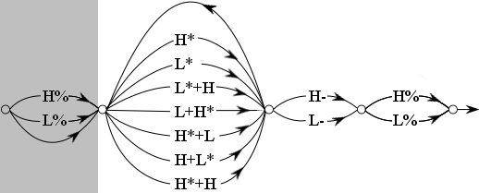
adapted from Pierrehumbert, 1980
Tonal
space
M | S | H | L | U | T | D | B
Intsint
ToBI

Slide 15
ToBI and Intsint: differences
 | ToBI | Intsint
Levels of transcription > | Multi-tier representation of prosodic phenomena: Pauses Intonation Accent | Transcription of intonation
Levels of abstraction > | Phonological transcription Aims to establish an inventory of pitch accents with a distinctive value in a specific language | Phonetic transcription “Surface phonological transcription” (Di Cristo, 2013) Allows the transcription of formal observable intonation phenomena, regardless of distinctive value or language
Source of information | Auditory analysis of pitch F0 curve used as a reference | F0 modelled values (Momel algorithm) Subsequent auditory correction

Slide 16
ToBI and Intsint: similarities
"Intonation can be represented as sequences of tones
or minimal autonomous prosodic entities"

Slide 17
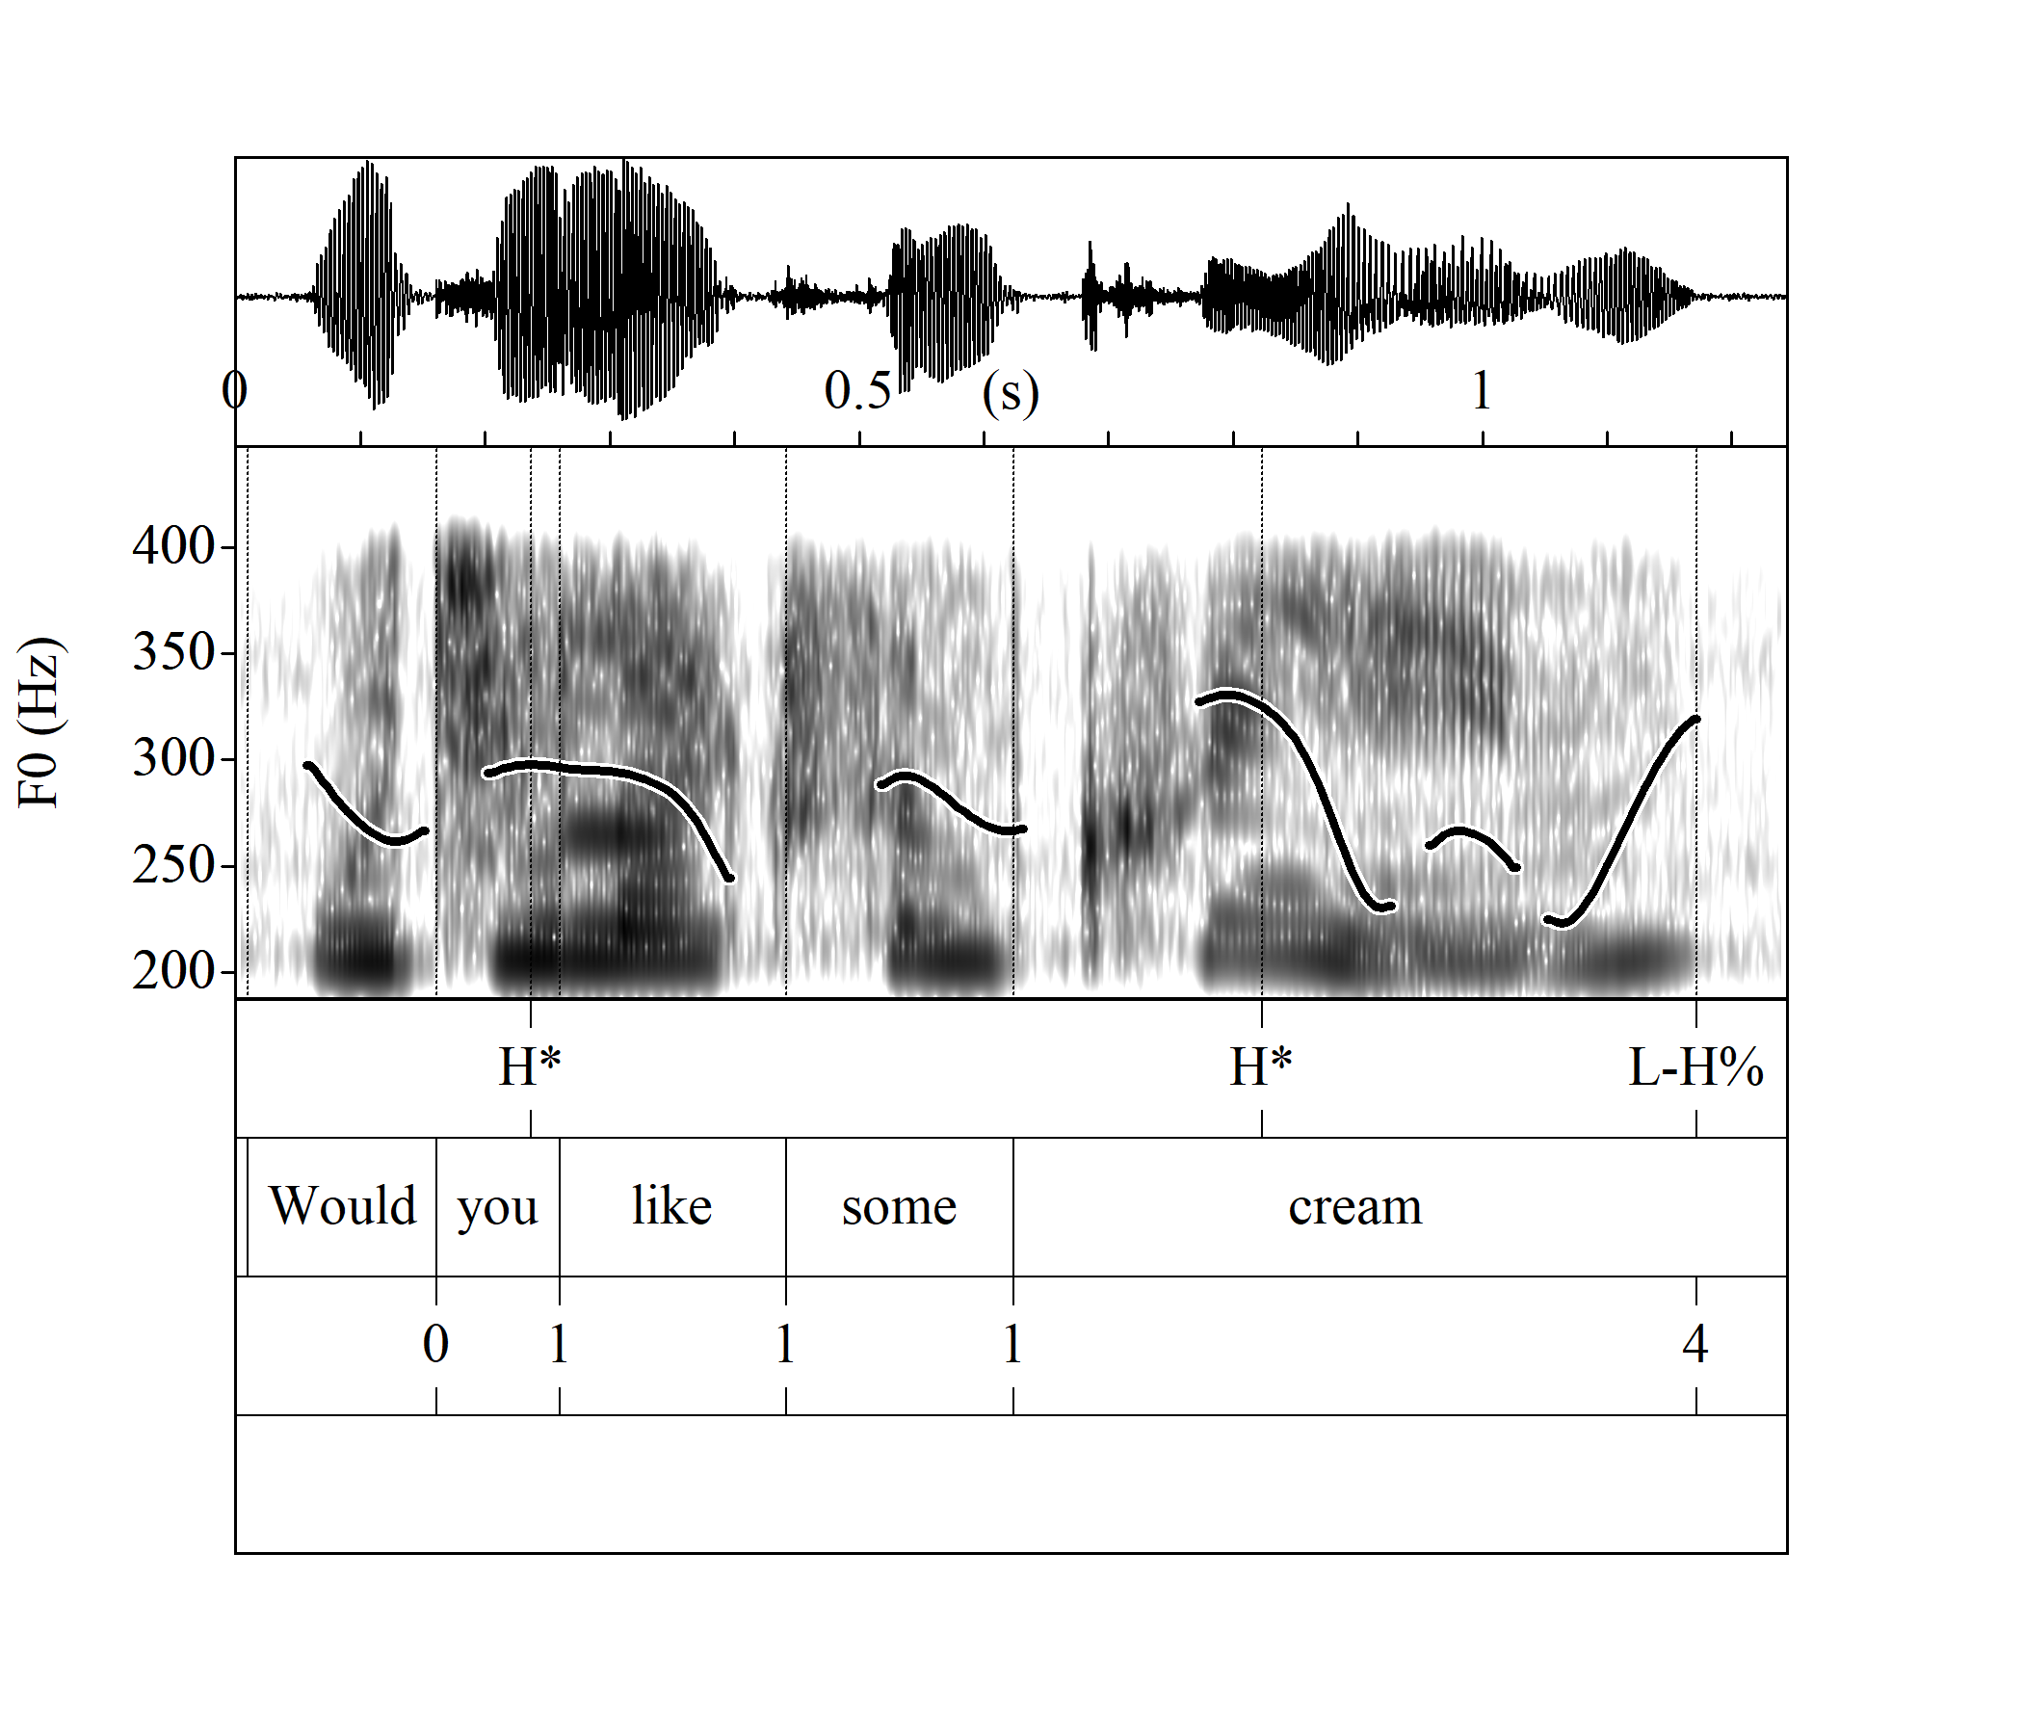
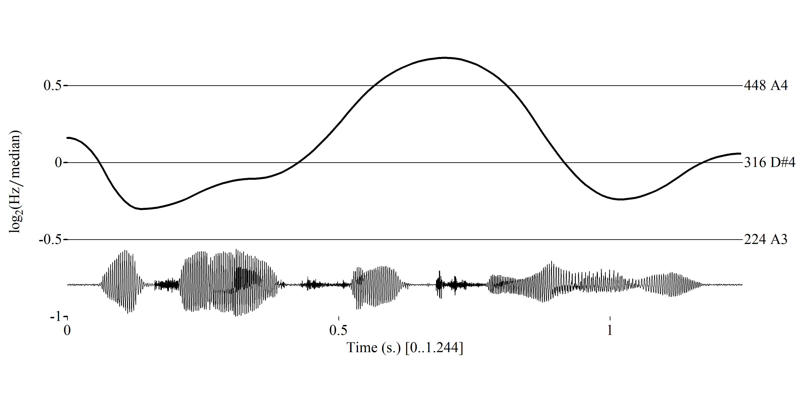
<
Modelled F0 curve
nodes
F0 curve and
spectrogram
Tones
Transcription
Break indices
M
B
U
T
B
U
Comments
ToBI
Intsint

Slide 18
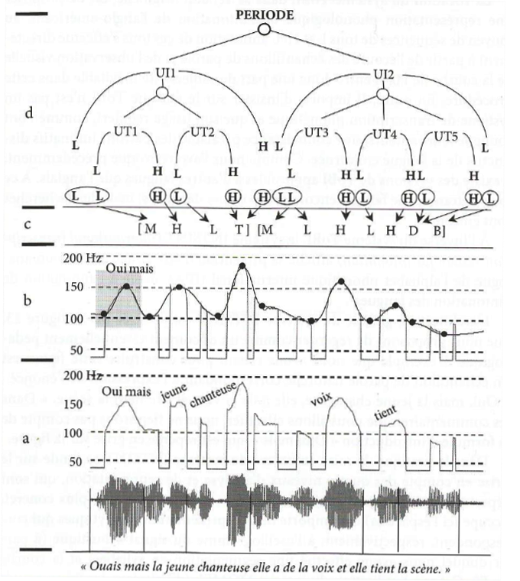
<
Underlying
phonological
representation
+ break indices
+ accents
+ boundaries
ToBI
Surface phonological
representation
Intsint
Phonetic level
Momel algorithm
Acoustic signal
and F0 curve
Di Cristo, 2013:112

Slide 19
3. Conversion proposal

Slide 20
This is a theoretical exercise based on the description of the ToBI Tones (Pierrehumbert, 1980).
It deals with the pitch accents used for the prosodic description of English.
It proposes different theoretically possible sequences of Intsint tones for each ToBI tone.

Slide 21
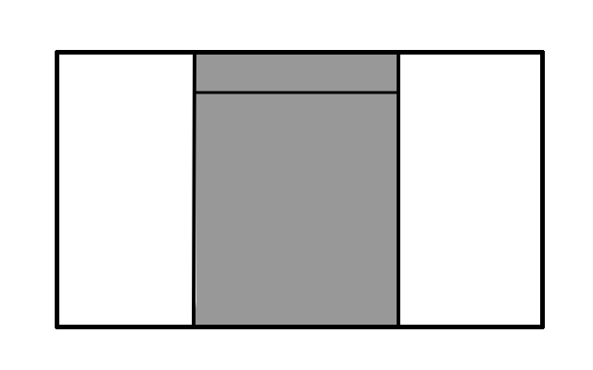
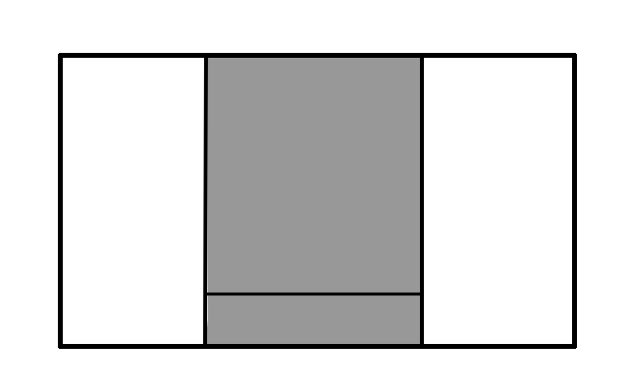


Pitch accents
H*
L*
$$\left\{\begin{aligned}T \\ H\end{aligned}\right\}$$
$$\left\{\begin{aligned}B \\ L\end{aligned}\right\}$$

Slide 22
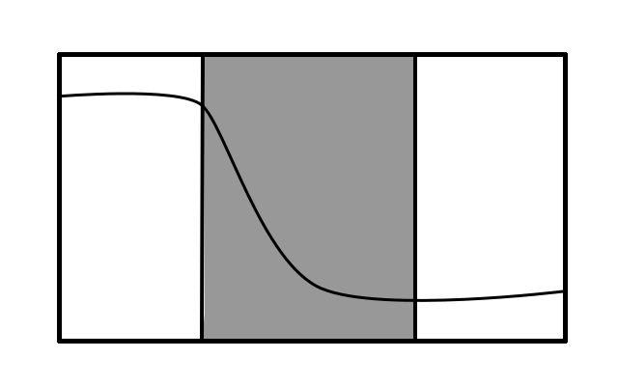
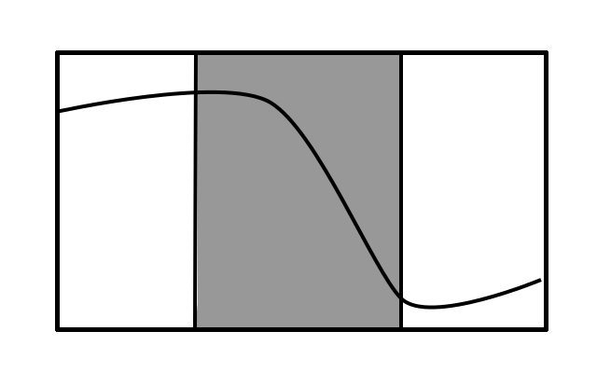
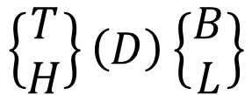
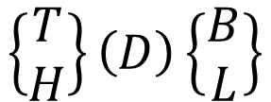
Pitch accents
TB HB TL HL | TDB HDB TDL HDL DL DB TD HD D
H+L*
H*+L
$$\left\{\begin{aligned}T \\ H\end{aligned}\right\}\left(D\right)\left\{\begin{aligned}B \\ L\end{aligned}\right\}$$
$$\left\{\begin{aligned}T \\ H\end{aligned}\right\}\left(D\right)\left\{\begin{aligned}B \\ L\end{aligned}\right\}$$

Slide 23
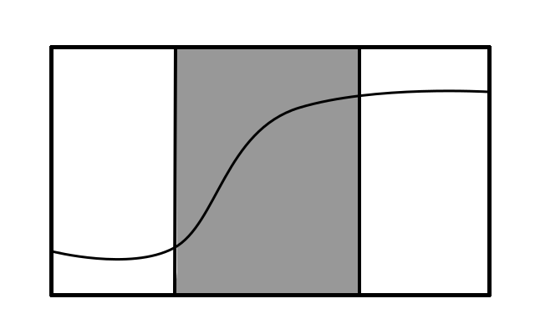
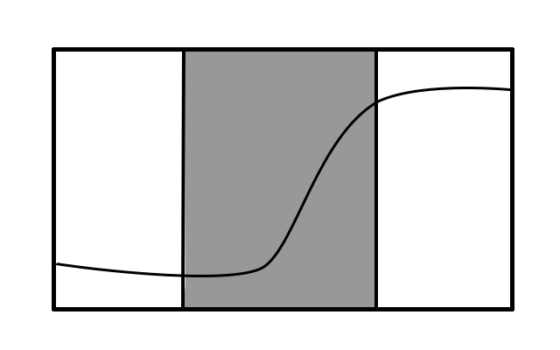


Pitch accents
BT BH LT LH | BUT BUH LUT LUH UT UH BU LU U
L+H*
L*+H
$$\left\{\begin{aligned}B \\ L\end{aligned}\right\}\left(U\right)\left\{\begin{aligned}T \\ H\end{aligned}\right\}$$
$$\left\{\begin{aligned}B \\ L\end{aligned}\right\}\left(U\right)\left\{\begin{aligned}T \\ H\end{aligned}\right\}$$

Slide 24
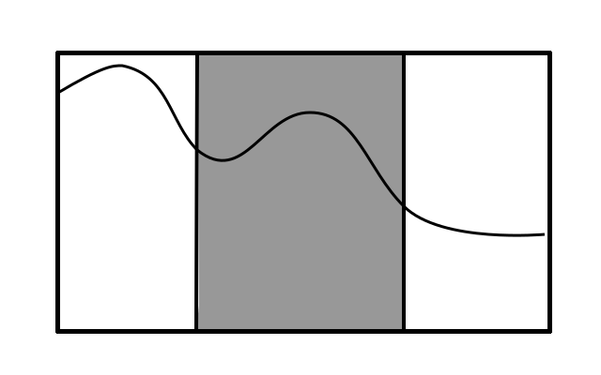
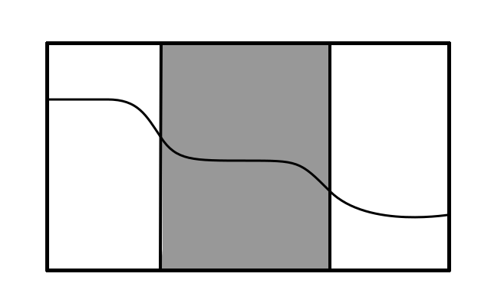
Pitch accents
!H*
!H*
H
D

Slide 25
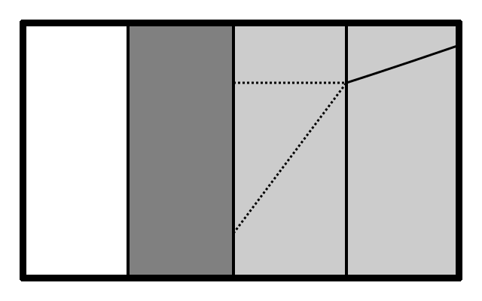
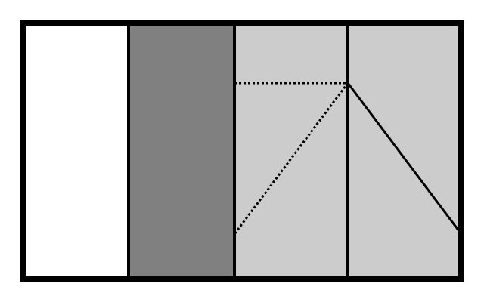
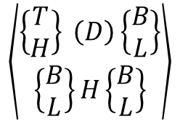
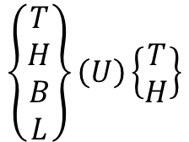
Boundary tones
H-H%
H-L%
$$\left\{\begin{aligned}T \\ H \\ B \\ L\end{aligned}\right\}\left(U\right)\left\{\begin{aligned}T \\ H\end{aligned}\right\}$$
$$\left\langle \begin{aligned}\left\{\begin{aligned}T \\ H\end{aligned}\right\} \left(D\right)\left\{\begin{aligned}B \\ L\end{aligned}\right\} \\ \left\{\begin{aligned}B \\ L\end{aligned}\right\}H\left\{\begin{aligned}B \\ L\end{aligned}\right\}\end{aligned}\right\rangle$$

Slide 26
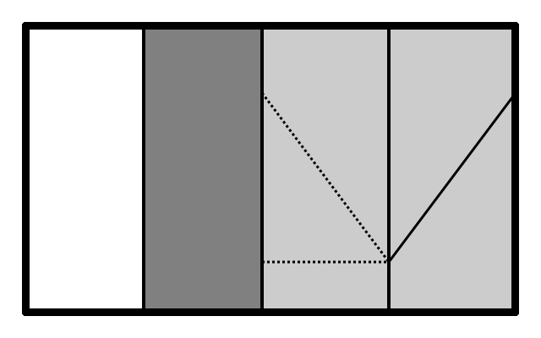
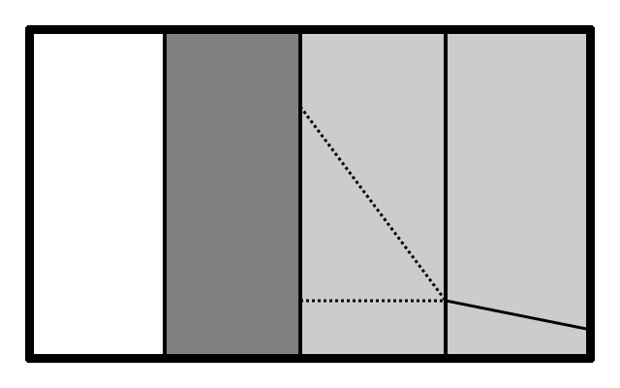
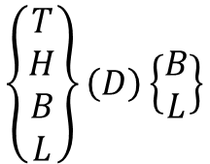
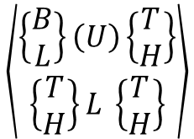
Boundary tones
L-H%
L-L%
$$\left\langle \begin{aligned}\left\{\begin{aligned}B \\ L\end{aligned}\right\}\left(U\right)\left\{\begin{aligned}T \\ H\end{aligned}\right\} \\ \left\{\begin{aligned}T \\ H\end{aligned}\right\}L \left\{\begin{aligned}T \\ H\end{aligned}\right\}\end{aligned}\right\rangle$$
$$\left\{\begin{aligned}T \\ H \\ B \\ L\end{aligned}\right\}\left(D\right)\left\{\begin{aligned}B \\ L\end{aligned}\right\}$$

Slide 27


Guidelines
Only one of each absolute tones (T-B) can be present within an IP
→ IP boundaries are determined by level 4 breaks and/or boundary tones.
Accent marks (*) can be added to the possible Intsint tone combinations to show the contrast between two ToBI tones:
L*+H L+H*
Accent marks can also be added to the real Intsint tone combinations, to compare the real Intsint transcription with the theoretical one.
$$\left\{\begin{aligned}B \\ L\end{aligned}\right\}∗\left(U\right)\left\{\begin{aligned}T \\ H\end{aligned}\right\}$$
$\left\{\begin{aligned}B \\ L\end{aligned}\right\}\left(U\right)\left\{\begin{aligned}T \\ H\end{aligned}\right\}$*

Slide 28
Phonology
Phonetics
Possible Intsint
tone combinations
+ accent
Real Intsint
tones
+ accent
ToBI
tones
Real Intsint
tones

Slide 29
4. Results

Slide 30
In order to confirm these theoretical equivalences, the Momel algorithm and Intsint transcription were applied to a small corpus (n=60 utterances) of ToBI annotated utterances in English (Beckman & Ayers, 1997).

Slide 31
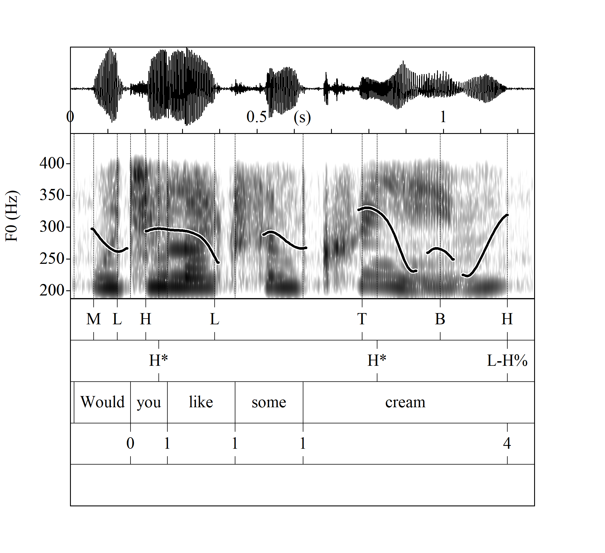


Slide 32
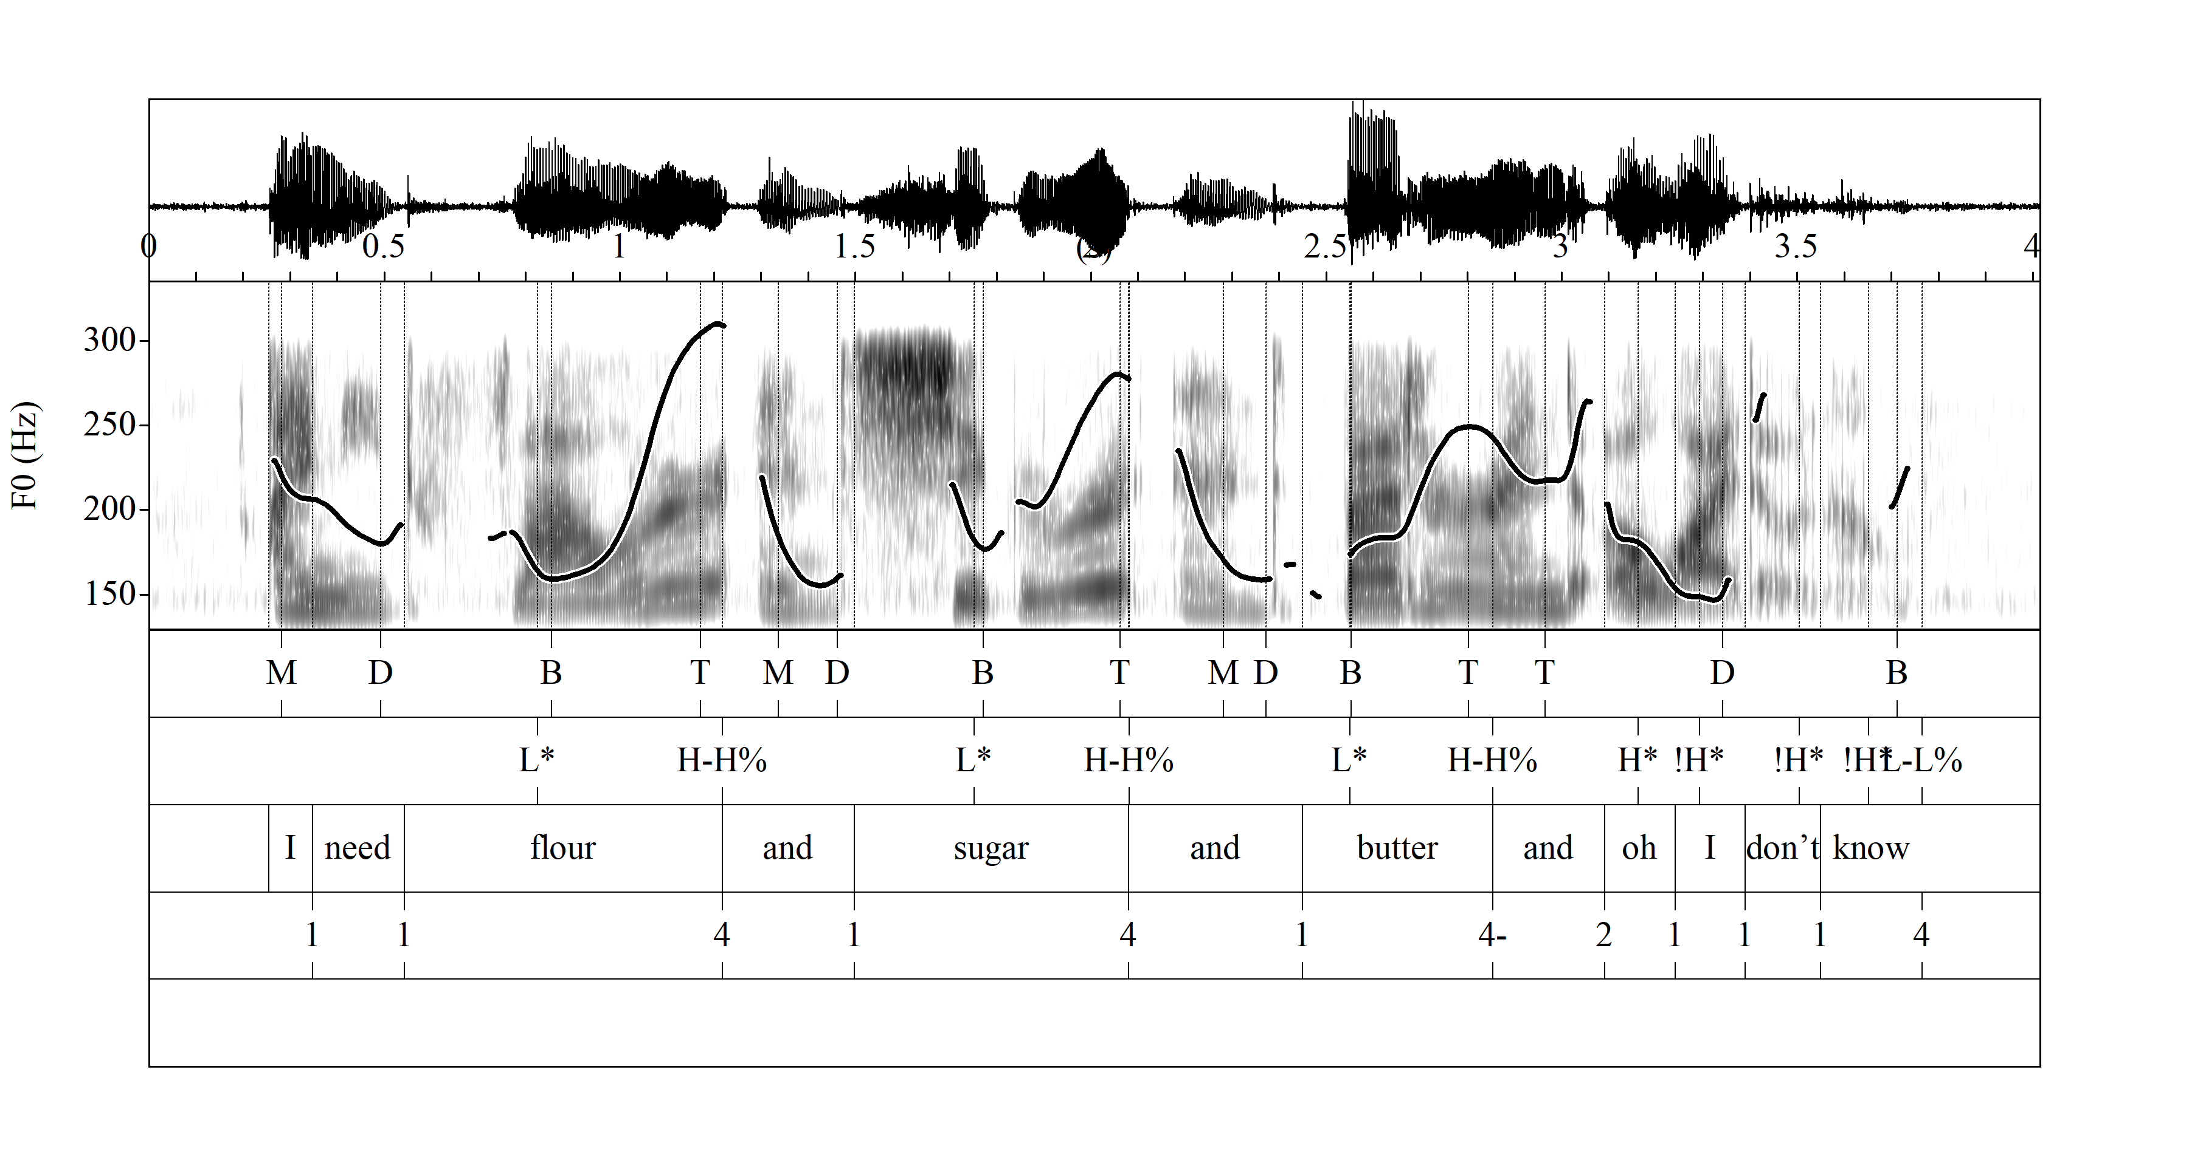

Slide 33
Results: pitch accents

Slide 34
Results: pitch accents

Slide 35

Results: pitch accents
$$\left\{\begin{aligned}B \\ L\end{aligned}\right\}\left(U\right)\left\{\begin{aligned}T \\ H\end{aligned}\right\}$$

Slide 36
Results: pitch accents

Slide 37

Results: boundary tones
$$\left\langle \begin{aligned}\left\{\begin{aligned}B \\ L\end{aligned}\right\}\left(U\right)\left\{\begin{aligned}T \\ H\end{aligned}\right\} \\ \left\{\begin{aligned}T \\ H\end{aligned}\right\}L \left\{\begin{aligned}T \\ H\end{aligned}\right\}\end{aligned}\right\rangle$$

Slide 38

Results: boundary tones
$$\left\{\begin{aligned}T \\ H \\ B \\ L\end{aligned}\right\}\left(D\right)\left\{\begin{aligned}B \\ L\end{aligned}\right\}$$

Slide 39
Discussion
The equivalences presented are idealized combinations of tones and do not take into account differences between the interpretation of the ToBI transcriber and the modelling of the Momel algorithm:
H* vs. L+H* (Silverman et al., 1992; Wightman, 2002)
Intsint will often transcribe more tone sequences than ToBI, especially in long utterances or in cases of spontaneous speech. In these cases, it can be hard to determine what information can be associated to a ToBI tone.
Intsint will sometime transcribe impossible tone sequences for the transcribed ToBi tones.

Slide 40
Conclusions
Due to the differences between the two transcription systems, establishing a conversion system or an absolute system of equivalences is not viable.
Creating a framework or guidelines for the comparison of ToBI and Intsint transcription seems to be a better alternative.

Slide 41
Future work
Applying the equivalence to larger corpora to confirm which Intsint sequences are more likely to represent one ToBI tone.
Finding the source of unexpected Intsint combinations.

Slide 42
Future work
Analyzing the structures and tones proposed for S_ToBI and F_ToBI
Finding Intsint equivalences for these tones
Testing them
S_ToBI ¡H → Upstep M% → Mid boundary tone <H* → Delayed peak (Ortiz-Lira & Frota, 2010) | F_ToBI Tonal patterns and phrasing (Delais-Roussarie et al, 2015)

Slide 43
Future work
Applying the comparison framework to compare Intsint-coded interlanguage prosody with ToBI-coded native language prosody.

Slide 44
References
Beckman, M., & Ayers, G. (1997). Guidelines for ToBI Labeling.
Delais-Roussarie, E., et al.(2015). Intonational Phonology of French: developing a ToBI system for French. In S. Frota & P. Prieto (Eds.), Intonational variation in Romance (pp. 63–100). Oxford: Oxford University Press.
Di Cristo, A. (2013). La prosodie de la parole. Bruxelles: De Boeck.
Ladd, R. (2008). Intonational Phonology. Cambridge: Cambridge University Press.
Ortiz Lira, H., Fuentes, M., & Astruc, L. (2010). Chilean Spanish Intonation. In P. Prieto & P. Roseano (Eds.), Transcription of Intonation of the Spanish Language (pp. 255–283). Munich: Lincom Europa.
Pierrehumbert, J. (1980). The phonology and phonetics of English intonation. MIT.
Prieto, P., Roseano, P., & Borràs-Comes, J. (2010-2015). Interactive Atlas of Romance Intonation. Retrieved from http://prosodia.upf.edu/iari/
Silverman, K. et al. (1992). TOBI: A Standard for Labeling English Prosody. In 2nd International Conference on Spoken Language Processing (ICSLP 92) (pp. 867–870). Banff, Canada.
Wightman, C. (2002). ToBI or not ToBI? In I. Marlien & B. Bel (Eds.), Proceedings of the 1st international conference on Speech Prosody (pp. 25–29). Aix-en-Provence: Laboratoire Parole et Langage.

