Slide 1
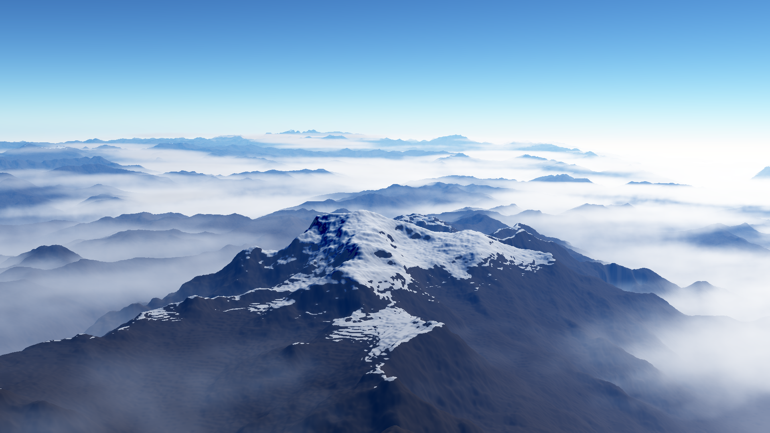
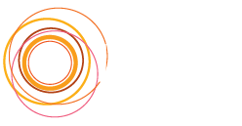
Procedural cloudscapes
Antoine Webanck¹, Yann Cortial², Eric Guérin², Eric Galin¹
¹ Université Lyon 1, CNRS, LIRIS, France
² INSA-Lyon, CNRS, LIRIS, France
Notes:
Hello everyone, and thanks for being here with me. My name is Antoine Webanck, I am a PhD student from the University of Lyon, in France. During this presentation, I will talk about my work on procedural cloudscapes.

Slide 2
Introduction
1. Cloudscape model
2. Cloudscape morphing algorithm
Results
Conclusion
Notes:
My presentation will be articulated as follow: [Here’s an outline of my presentation]
I will start by introducing the problematic and cover the related work.
I will then describe our cloudscape model,
and explain how our cloudscape morphing algorithm works
Then, I will show you some results,
before concluding, and focusing on limitations and future work.

Slide 3
Real example
High diffuse clouds layer
Convective towers
Low cloud sheet cover
Procedural cloudscapes, Antoine Webanck et al.
Notes:
To illustrate our problem, let’s take an example.
This is a photograph of a real cloudscape.
In this photograph, we can see different cloud features:
We can see some convective towers, CLICK
Under the base of the towers, we see a cloud sheet cover CLICK
And higher over the convective towers, we see more diffuse clouds forming a second cloud layer CLICK.
That’s an example of what we want to model and animate.

Slide 4
Problem
Modeling and animation of large scale cloudscapes
User control
Scientific challenges
Define a 4D (3D + t) function
$$a\left(p,t\right):ℝ^{4}→ℝ^{+}$$
Authoring such a function is complex
Chaotic natural phenomena (thermodynamics, fluid physics)
Procedural cloudscapes, Antoine Webanck et al.
Notes:
Our objective is to model and animate large scale clouds such as in the previous photograph.
But doing so, we still want to provide an intuitive control to the user.
Our problem can be seen as the definition of a function that maps from the 4D domain of space and time to the positive cloud density domain.
As you can imagine, authoring such a function is complex, even more considering the chaotic natural phenomena behind the clouds.

Slide 5
Related work: atmosphere animation
Cloud
Planet atmosphere
Cloudscape
Miyazaki2001
Dobashi2008
Dobashi2006
Ebert1997
Harris2003
Dobashi2010
Modeling
Our method
Dobashi1998
Neyret1997
Miyazaki2002
Withers2008
$${10}^{−2}$$
$${10}^{3}$$
$${10}^{5}$$
$${10}^{8}$$
Scale (m)
Simulation
Procedural
Morphing
Animation
Miyazaki2001
Dobashi2006
Goswami2016
Ebert1997
Liu2006
Chung-Min2011
Neyret1997
Miyazaki2002
Dobashi2010
Our method
Procedural cloudscapes, Antoine Webanck et al.
Notes:
To tackle the challenging problems of modeling and animating clouds, some work has already been done in the field of Computer Graphics.
For the modeling CLICK, some methods simulate the formation of the clouds.
Other methods use examples such as user sketches or satellite images.
And there are also some procedural methods, which model clouds directly, with fractals and procedural noise.
But if we look at the scale of the modeled clouds, the majority of these methods are limited to one or a few isolated clouds CLICK.
Very few work has been done to model larger clouds formations, such as cyclones, at the scale of the planet atmosphere.
We lie in between, at the scale of what we called cloudscapes CLICK.
For the animation CLICK, the most popular solution is to simulate the evolution of the clouds.
The problem with a simulation is that it is hard to control, and it is an expensive process, which limits interaction.
On the other hand, some procedural methods propose to animate procedural noise details directly, or to morph clouds between specified shapes by interpolating cloud primitives.
We build upon these procedural animation and morphing techniques CLICK, to propose an efficient and intuitive morphing algorithm.

Slide 6
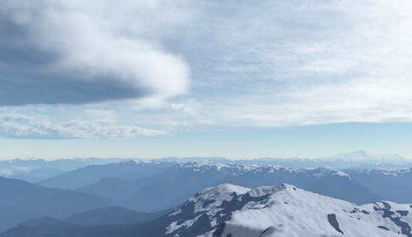
Pipeline preview
Environment
Generic control function $c\left(p, t\right)$
Atmosphere density field
a (p, t)
Morphing computation
Anisotropic Shortest Path
Optimal transport
Cloudscape generation
Wind field
$$w\left(p,t\right)$$
Terrain
$$z\left(p\right)$$
Keyframes
Procedural clouds details
$$φ\left(p, t\right) \\ δ\left(p,t\right)$$
$$c(p,t_{A})$$
$$c(p,t_{B})$$
Feedback control loop
$c\left(p,t_{C}\right)$ with $t_{C}∈ ]t_{A},t_{B}[$
Procedural cloudscapes, Antoine Webanck et al.
Notes:
I will now present an overview of the whole pipeline of our method.
As inputs, our pipeline needs : CLICK
a wind field, and a terrain heightmap to define the environment, and
keyframes to describe the state of the cloud layers at different times
The first step is the morphing CLICK, which computes animated control primitives, that interpolate the given keyframes according to the environment.
Note that, the animated primitives can be reinjected as keyframes, in a feedback control loop, allowing to edit them more precisely CLICK.
The second step is the generation of the cloudscape CLICK.
For each cloud layer, the animated primitives produced by the morphing are combined with procedural clouds details, to give the specific shapes to the clouds.
Independent layers are then all blended together.
The final output is the 4D density field function CLICK, which can be rendered by raymarching for instance.

Slide 7
Introduction
1. Cloudscape model
2. Cloudscape morphing algorithm
Results
Conclusion
Notes:
I will now explain what is our cloudscape model.

Slide 8
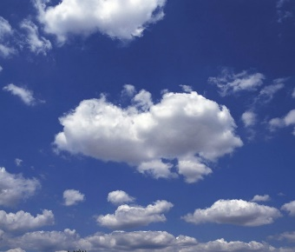
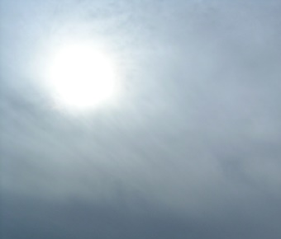
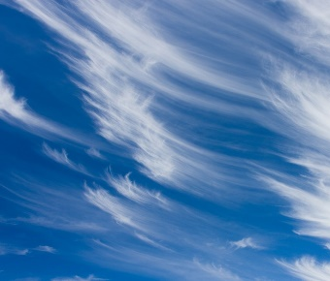
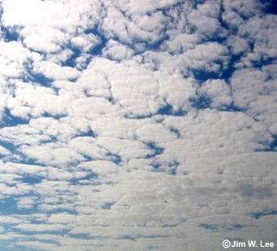
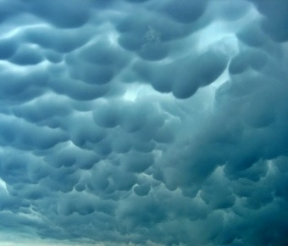
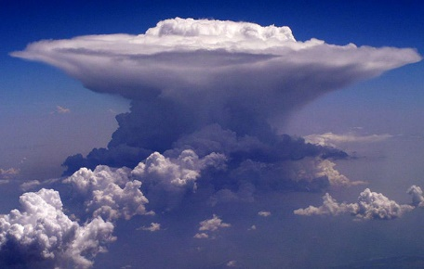
Clouds in meteorology
Clouds names refer to their shape and altitudes
Cumuliform clouds have prominent convective bulbs
Stratiform clouds are almost homogeneous layers
Cirriform clouds are high and look like hair
Cumulus
Stratus
Cirrus
12 km
Altocumulus
Mammatus
Cumulonimbus
Cirrus
Cirrocumulus
Different clouds at different altitudes
Cirrostratus
7 km
Altocumulus
Type | Range (km)
Cirrus | 1 to 2
Stratus | 0.2 to 0.8
Cumulus | 0.1 to 5
Cumulonimbus | 7 to 12
Altostratus
2 km
Cumulonimbus
Cumulus
Stratus
Nimbostratus
Procedural cloudscapes, Antoine Webanck et al.
Notes:
To define our cloudscape model, we looked at the classification of clouds used in meteorology.
The clouds are classified and named according to their specific shape and altitude.
As you can see, the nature produces multiple types of clouds with intricate shapes.
Each shape is already difficult to model by itself, it is even more challenging to combine multiple types of clouds, and to animate them.

Slide 9
Global cloudscape model
Cloud density function $a\left(p,t\right):ℝ^{4}→ℝ^{+}$
Each cloud type in a different layer
altitude range $[a,b]$
wind field $w\left(p,t\right)$
control function
shape and details functions
Cloud density function of layer $i$
$a_{i}\left(p,t\right):ℝ^{4}→ℝ^{+}$
Blend of all layers
$a\left(p,t\right)=\sum_{i}{a_{i}\left(p,t\right)}$
Wind conditions
Altitudes ranges
Procedural cloudscapes, Antoine Webanck et al.
Notes:
Let me remind you that we want to define the cloud density function $a\left(p,t\right)$.
I will now explain how we chose to define this function.
Inspired by the classification of clouds, we considered each cloud type separately and defined it in its own layer CLICK.
To each layer we associate specific attributes:
an altitude range CLICK
a wind field CLICK
And we define specific functions that I will describe later CLICK:
a control function
And some shape and details functions
Thus, we have one density function per layer CLICK.
The global cloud density function is then simply a blend of all the layers functions CLICK.

Slide 10
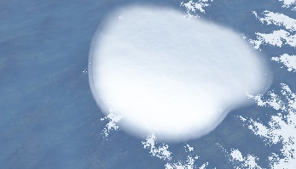
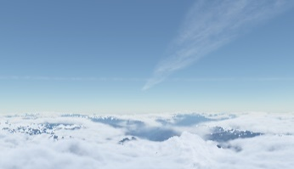
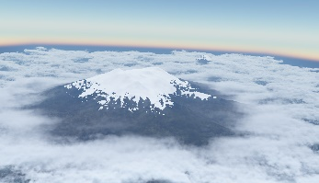
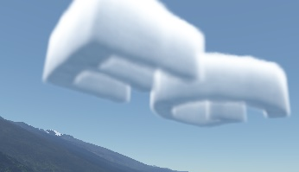
Control function
Heart
Contrails
Large-scale control function for the cloud cover
$c\left(p,t\right):ℝ^{4}→ℝ^{+}$
Defined manually for special effects
Defined with primitives for morphing
$c\left(p,t\right)=\sum_{j}{c_{j}\left(p,t\right)}$
Primitives parameters
Maximum density
Position
Radius
EG
EG logo
Hole
Cover special effects
$$s\left(x\right)$$
Density
Radius
Position
Control primitive
Primitives
Control function
Procedural cloudscapes, Antoine Webanck et al.
Notes:
For simplicity, we now consider a single layer.
The goal of the control function is to control the presence or absence of clouds at a high level for this layer.
It can be seen as a cloud density function without details.
A control function can be defined manually for special effects such as carving specific shapes or holes in the clouds.
[Here CLICK, you can see some examples of such special effects.]
In order to apply a morphing method to the control function, we define it as a sum of spherical control primitives CLICK.
Each primitive has some parameters CLICK.
maximum density reached only at its center, decreasing with a smooth falloff function $s\left(x\right)$
center position
radius
Now you know how the smooth control function is defined, but it is not enough to obtain clouds with a detailed shape.
[Sure, with a lot of primitives, you could achieve some details but it would be very memory consuming.]
Even worse, it would become tedious to define lots of primitives which is the opposite of a high level control tool.

Slide 11
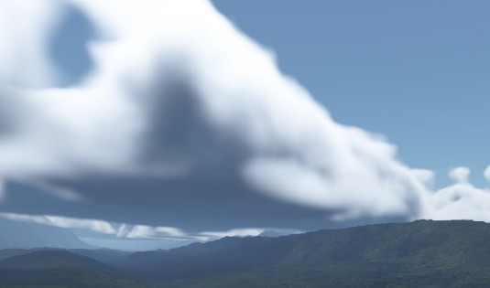
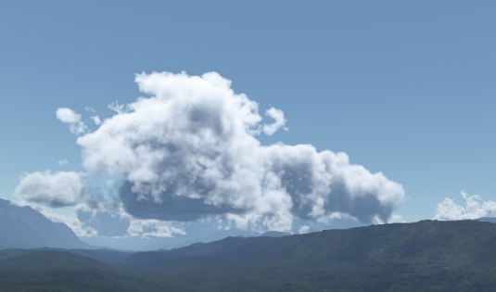
Clouds shape and details
Control function and procedural noise
$a_{i}\left(p,t\right)=f\left(c\left(p,t\right),φ\left(p,t\right),δ\left(p,t\right)\right)$
Smooth control function
$c\left(p,t\right)$ $:ℝ^{4}→ℝ^{+}$
Large shape
$φ\left(p,t\right)$ $:ℝ^{4}→ℝ^{+}$
Smaller details
$δ\left(p,t\right)$ $:ℝ^{4}→ℝ^{+}$
c and φ
c
c, φ and δ
Procedural cloudscapes, Antoine Webanck et al.
Notes:
The high level control function is smooth, it lacks the detailed features that characterize a cloud type CLICK.
To solve this problem, we enrich the control function with procedural noise.
The large-scale shapes are defined by $φ\left(p,t\right)$ composed of several octaves of noise of low frequency CLICK.
The smaller details are encased in $δ\left(p,t\right)$ with higher frequencies CLICK.
Please see the full paper for detailed examples of the procedural noises combined to model some specific types of clouds.

Slide 12
Introduction
1. Cloudscape model
2. Cloudscape morphing algorithm
Results
Conclusion
Notes:
I will now explain how our morphing algorithm works.

Slide 13
Cloudscape morphing
Animate each cloud layer separately
Morph between subsequent keyframes primitives
1. Trajectories computation
2. Trajectories selection
3. Ghosting
4. Interpolation
Procedural cloudscapes, Antoine Webanck et al.
Notes:
In the definition of the cloudscape model, we used a time varying control function composed of animated control primitives.
I will now detail how our morphing method creates such a control function from given keyframes.
The morphing algorithm consists in four main steps :
1) CLICK The computation of trajectories and costs between each pair of initial and final primitives.
2) CLICK The selection of a subset of trajectories to link initial and final primitives.
3) CLICK The creation of ghost primitives to replace expensive trajectories.
4) CLICK The interpolation of primitives.

Slide 14
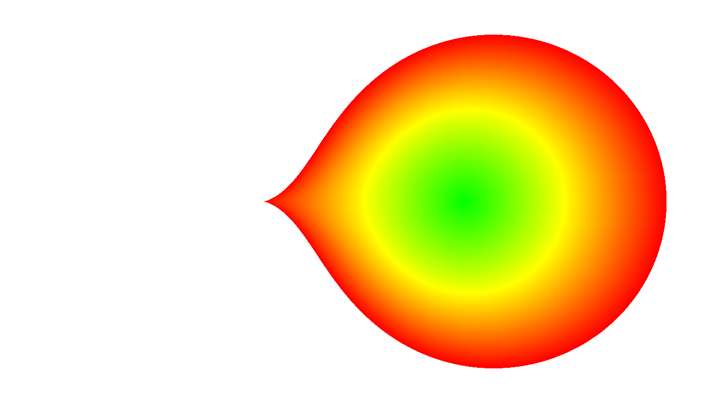
Step 1: trajectories computation
Compute all anisotropic shortest paths $ρ_{ij}^{∗}$
Sample the XY domain
Discretize time between keyframes $Δt=[t_{A},t_{B}]$ in $n$ time steps $t_{k}$
Define anisotropic cost function $κ$ between subsequent samples
Anisotropic shortest path between subsequent samples
$$ρ_{11}^{∗}$$
$$A_{1}$$
$$B_{1}$$
$$A_{2}$$
$$ρ_{32}^{∗}$$
$$B_{2}$$
$$y$$
$$t_{B}$$
$$t_{A}$$
$$t_{k}$$
$$t_{k+1}$$
$$x$$
$$κ$$
Procedural cloudscapes, Antoine Webanck et al.
Notes:
The first step of the morphing is to compute the trajectories that will be used for interpolating control primitives.
Given two subsequent keyframes A and B composed of initial and final primitives CLICK, a terrain CLICK, and wind conditions CLICK, we compute all the anisotropic shortest paths CLICK between initial and final primitives.
To do so,
1) We sample the XY domain over the terrain CLICK.
2) We then discretize the time between the two subsequent keyframes in $n$ time steps CLICK.
3) Define an anisotropic cost function $κ$ between subsequent samples CLICK.
3) Apply the Dijkstra algorithm to this implicit graph CLICK.
Now, we will detail the definition of the cost function $κ$ as it is a central component of our method which will guide the creation of primitives trajectories.

Slide 15
Step 1: anisotropic cost function
Anisotropic cost function
$κ(p_{0},t_{0},p_{1},t_{1}):ℝ^{3}×ℝ^{3}→ℝ^{+}$
$κ\left(p_{0},t_{0},p_{1},t_{1}\right)=λ_{w}κ_{w}+λ_{s}κ_{s}+λ_{e}κ_{e}$
$$p_{1}$$
$$θ$$
$$\vec{w}$$
$$p_{0}$$
$$δt \vec{w}$$
Wind
Terrain slope and elevation
$$κ_{w}\left(p_{0},t_{0}, p_{1},t_{1}\right)=\left\|p_{1}−δt \vec{w}\right\|⋅\left(2−cos\left(θ\right)\right)$$
$$κ_{s}\left(p_{0}, p_{1}\right)=∇\tilde{z}\left(p_{0}\right)⋅\frac{p_{1}−p_{0}}{\left\|p_{1}−p_{0}\right\|}$$
Drag distance
Angle
Slope cost
$$κ_{e}\left(p_{0}, p_{1}\right)=\frac{\tilde{z}\left(p_{0}\right)−a}{b−a}$$
Elevation range
$$\left[ab\right]$$
Simplified terrain
$\tilde{z}\left(p\right)$
Overlap cost
Procedural cloudscapes, Antoine Webanck et al.
Notes:
Our goal when defining the cost function is to account for the environment conditions when building trajectories.
That’s why we express $κ$ as a linear combination of three specialized cost functions.
$κ_{w}$ CLICK is accounting for the divergence [or detour] of the trajectory from the trajectory obtained by following the wind.
It considers the distance of the detour and its angular deviation.
$κ_{s}$ CLICK accounts for the terrain slope, adding cost when climbing and elevation.
And $κ_{e}$ adds more cost to the areas that are more overlapping with the cloud layer.

Slide 16
Step 2: trajectories selection
$n×m$ known trajectory costs
Compute mass of initial and final primitives $m_{i}$ and $m^{j}$
Apply optimal transport to optimize cost per unit of mass
Less than $n+m−1$ trajectories subset
Masses $m_{ij}$
$$ρ_{11}^{∗}$$
$$m_{11}$$
$$A_{1}$$
Discrete optimal transport
$$m_{1}$$
$$B_{1}$$
$$m_{1}$$
$$m^{1}$$
$$m^{1}$$
$$m_{21}$$
$$A_{2}$$
$$m_{2}$$
$$m_{2}$$
$$m^{2}$$
$$m_{22}$$
$$m^{2}$$
$$ρ_{32}^{∗}$$
$$B_{2}$$
Procedural cloudscapes, Antoine Webanck et al.
Notes:
The second step of our morphing algorithm is to select a subset of trajectories to interpolate the primitives between two keyframes.
It is important to restrain the number of interpolation trajectories and thus, the number of primitives, for performance reasons.
It also imposes to find the better fitting trajectories.
We already know each possible trajectory and its associated cost CLICK.
We then compute the normalized mass of each primitive CLICK.
We use the costs and masses as input of a discrete optimal transport method CLICK.
The optimal transport is a global optimization of the transport cost per unit of mass.
It outputs the limited subset of trajectories CLICK and mass ratios to transport the mass between the two keyframes CLICK.

Slide 17
Step 3: ghosting
Ghost primitives of null density: appearing or vanishing primitives
Discard expensive trajectories $ρ_{ij}^{∗}$
Extrapolate trajectories following the wind
Backward (fade in) $ρ_{ij}^{−}$
Forward (fade out) $ρ_{ij}^{+}$
Redistribute mass to ghost primitives $A_{i}^{+}$ and $B_{j}^{−}$
$$B_{1}^{−}$$
$$ρ_{21}^{−}$$
$$A_{2}$$
$$ρ_{21}^{∗}$$
$$B_{1}$$
$$ρ_{21}^{+}$$
$$A_{2}^{+}$$
Procedural cloudscapes, Antoine Webanck et al.
Notes:
The third step of the morphing algorithm is the ghosting.
In this step, we create ghost primitives of null density that allow new primitives to appear or old primitives to vanish with fade-in or fade-out effects.
Because the optimal transport of the former step is a global optimization, it always finds a solution, even in very unrealistic conditions.
Consider two morphing primitives CLICK with a final primitive only reachable by going against the wind.
Thanks to the cost function $κ$, the only possible trajectory is very expensive, but it is the only solution to allow the morphing.
To solve this problem, CLICK we discard the chosen trajectory.
But doing so, we would also lost all the transported mass and the associated primitives.
That’s why we extrapolate two new and independent trajectories by following the wind:
CLICK backward in time,
CLICK and forward in time.
CLICK At the end of each extrapolated trajectory, we put what we called a ghost primitive, which is invisible because it has no density.
We then dispatch the discarded masses to the ghost primitives, on the extrapolated trajectories, CLICK which produces a fade-out of the initial primitive, while the final primitive fades-in.

Slide 18
Step 4: interpolation
One primitive per trajectory
Interpolate
Position following the trajectory
Radius linearly
Density linearly weighted by relative mass
$$C_{1^{−}1}(t)$$
$$C_{11}(t)$$
$$C_{22}(t)$$
$$C_{{22}^{+}}(t)$$
Procedural cloudscapes, Antoine Webanck et al.
Notes:
The fourth and final step of the morphing algorithm is the interpolation of the primitives.
For each trajectory involving mass, we create an interpolating primitive of interpolated parameters.
Its position follows the trajectory
Its radius is linearly interpolated
Its density is weighted by the relative mass of its associated initial, final or ghost primitives
CLICK

Slide 19
Introduction
I. Cloudscape model
II. Cloudscape morphing algorithm
Results
Conclusion
Notes:
I will now show you some results achieved with our method.

Slide 20
Results – Cold front
Clouds: 8 cloud types
Statistics: 8 control functions, no morphing
Procedural cloudscapes, Antoine Webanck et al.
Notes:
This is a footage showing a rain storm scenario, which is called a cold front in meteorology.
It features different types of clouds implemented in our model with procedural details.
You will see waves of clouds from the three families of clouds in addition to the heart of the storm: the Cumulonimbus.
[Cirrus, Altostratus, Altocumulus, Cumulus humilis, Stratocumulus, Cumulus congestus, and Cumulonimbus capilatus]

Slide 21
Results – Cross winds
Clouds: Stratocumulus and Cirrus
Statistics: 110 primitives, morphing in 81s
Procedural cloudscapes, Antoine Webanck et al.
Notes:
This footage features two cloud layers of lower Stratocumulus and higher Cirrus.
Each layer follows its associated wind which blows in opposite direction to the other.
[To model the layers control functions, we only used a total of 110 control primitives.
The morphing computation took 81 seconds.]

Slide 22
Results – Good weather
Clouds: Stratus and Cumulus
Statistics: 460 primitives, morphing in 68s
Procedural cloudscapes, Antoine Webanck et al.
Notes:
This footage shows stratus/fog dissipating while rising up, before some denser clouds start to appear.
It is an example of result obtained with a clever application of the ghosting, to create fade-in and fade-out effects.
[To model the layers control functions, we used a total of 460 control primitives.
The morphing computation took 68 seconds.]

Slide 23
Conclusion
Controllable procedural animated cloudscape
Efficient model with procedural details
Controllable by intuitive key-framing
Coherent morphing accounting for environment
Procedural cloudscapes, Antoine Webanck et al.
Notes:
To sum up, our method allows to model and animate cloudscapes.
Our procedural model is efficient,
The keyframes provide intuitive temporal control,
The animation is coherent and accounts for the wind conditions and terrain,
And the ghosting process lets the user compromise between blind morphing which can go against environment conditions, and pure advection by following the wind.

Slide 24
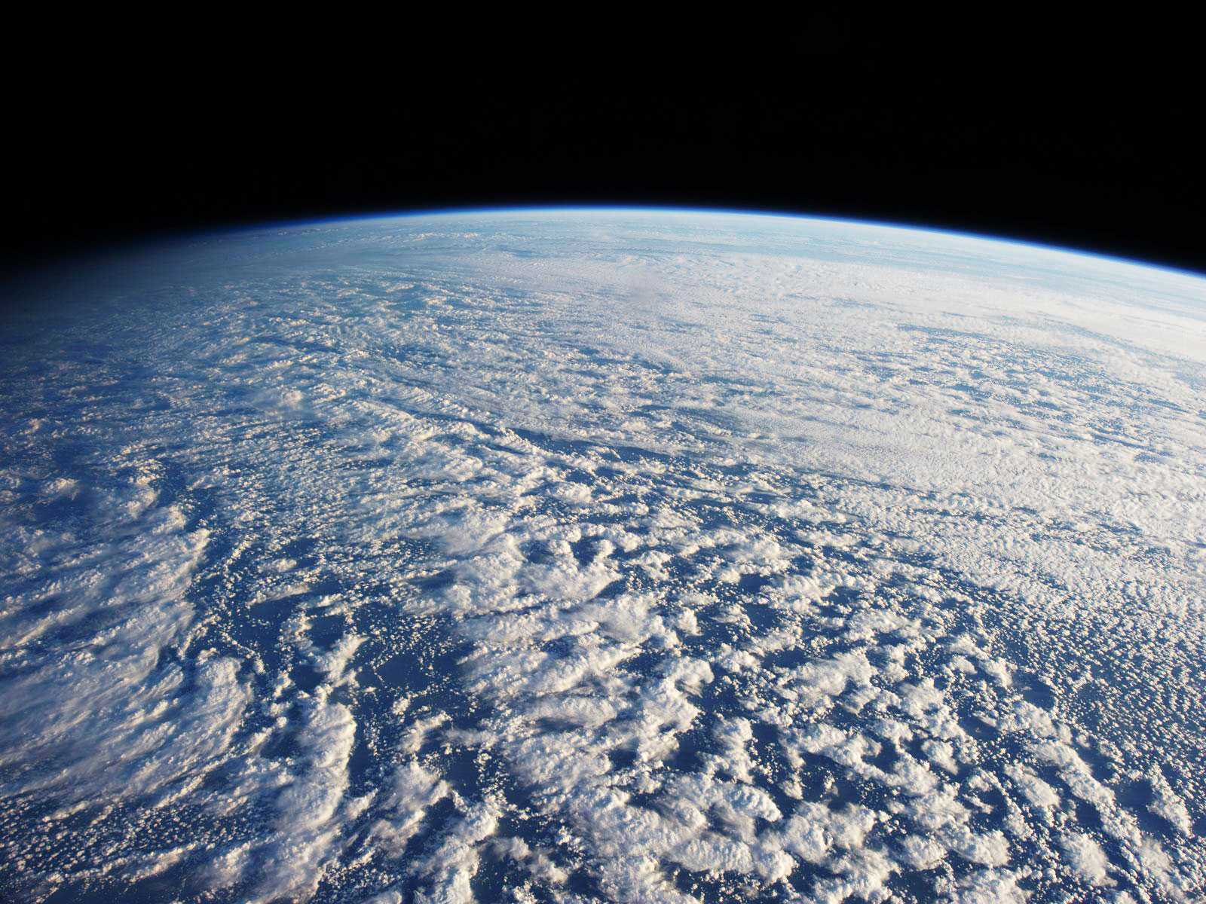
Future work
Stratocumulus over the Pacific Ocean, NASA
More types of clouds
Inter-layer morphing
Planet scale
Procedural cloudscapes, Antoine Webanck et al.
Notes:
Nevertheless, there is still room for improvements:
We could add more types of clouds to our procedural model.
We would like to design morphing between different layers.
The morphing of the primitives from different layers is trivial, but it is not the case of the procedural details of two different types of clouds.
And finally, just have a look at the background. It is photograph of showing plenty of Stratocumulus at the scale of the Earth.
A cloudscape modeled with our method would only be a tiny part of these cloud formations.
It would be interesting to model at the higher scale of the planet atmosphere and to design some Level Of Details tools.
THANK YOU FOR LISTENING!

Slide 25
Procedural cloudscapes
Antoine Webanck¹, Yann Cortial², Eric Guérin², Eric Galin¹
¹ Université Lyon 1, CNRS, LIRIS, France
² INSA-Lyon, CNRS, LIRIS, France

