Slide 1
“New techniques” of modification of the genomes and epigenomes (NTMGE)
Yves Bertheau
IFOAM EU Workshop
2017/07/06
Echzell (Germany)

Slide 2
Reminder on genomes, epigenomes and epitranscriptome

Slide 3
Chromosomes’ structures and changes
DNA: Point mutation, indels, substitution
by e.g. chemicals,
irradiation, DNA repair
systems such as NHEJ,
MMEJ…
Transversion, conversion
Translocation, inversion,
duplication/amplification,
insertion by e.g. transposition, polyploidization…
DNA and chromatin
(histone and non histone
proteins): epimutation
RNA: epimutation
(epitranscriptome)
High compaction of DNA, due to RNA, proteins… Opening needed to produce proteins…
Human genome ± 1.9m
Nucleotides ATGC

Slide 4
“Central dogma of biology”
RNA transcripts as well as their abundance are representative of a cell at the moment…
But in reality:
alternative splicing generates many isoforms (eukaryotes: splicing from exons/introns of a “encoding sequence”),
indeed different abundances for various transcribed are present,
the transcriptome is a mixture of transcripts of all genes,
Exon skipping may produce aberrant proteins and disease…
For instance: the human transcriptome is made up of tens of thousands of transcripts of the 20,000 genes (plants: 25-40,000 genes)
DNA
transcription
RNA
translation
Protein

Slide 5
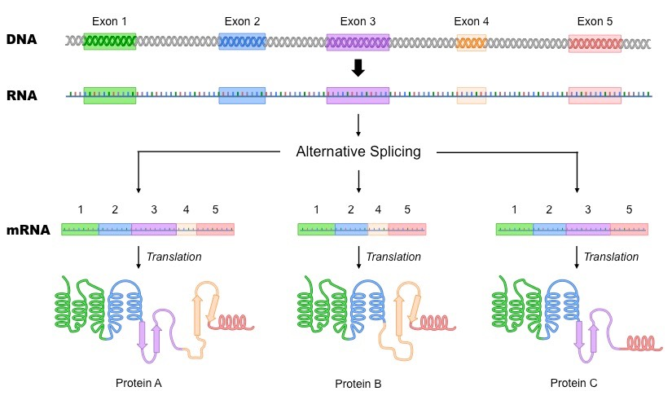
Alternative splicing and non-coding DNA
Production of small RNA involved in gene regulation,
Several proteins can originate from a gene (see e.g. ENCODE Human genome project)
Large non-coding regions (ca 95% of human genome…) with rather unknown functions (“dark matter”), with or without selection pressure…
Non-coding regions involved in gene regulation in complex networks of genetic interactions.
Notes:
Non coding DNA, see Palazzo et al. 2015. Non-coding RNA: what is functional and what is junk? Frontiers in Genetics.
Non-coding DNA:, e.g. cis and trans regulating elements, non functional RNA such as ribosomal RNA and tRNA, introns, pseudogenes, repeated sequences, transposable and viral elements,
The ENCODE Project Consortium, 2012, An integrated encyclopedia of DNA elements in the human genome. Nature.

Slide 6
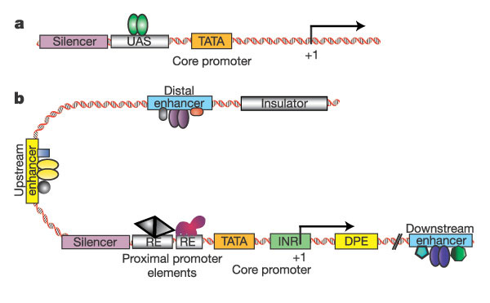
Eukaryotic transcriptional unit: very complex with distal effects…
Levine et Tjian Nature, 2003
Notes:
See Palazzo et al. 2015
Sanyal et al. 2012. The long-range interaction landscape of gene promoters. Nature.
At least in some cases distal enhancers now to be considered as promoters?

Slide 7
Scaffold/matrix attached regions S/MARs
Scaffold/matrix attached regions (S/MARs) are regions of the DNA strand that are found the basis of chromatin loops. They anchor the DNA to the proteinaceous nuclear matrix.
Each loop is considered to be a functional domain.
S/MARs may act as border elements and thus, protect gene expression from position effects.
S/MARs
genes
residual DNA

Slide 8
Scaffold/matrix attached regions S/MARs
open chromatin
promoter
enhancer
gene
compact chromatin
SAR
(transcribed
region)
LCR
(regulated)
SAR
SAR
SAR
LCR
nuclear scaffold
J. Bode / E. Wingender 1993

Slide 9
Chromosomal structure capture: interactions between different loci on several chromosomes
Genes poor chromosomes
Genes rich chromosomes
Schneider et al. 2007
Spector et al. 2003

Slide 10
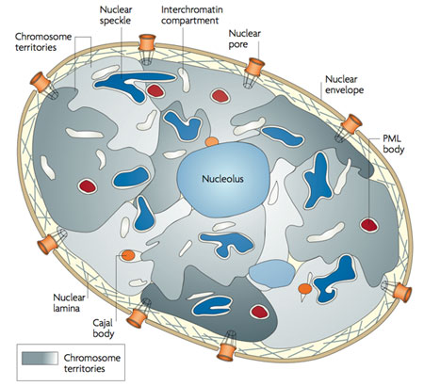
Chromosomal structure capture: interactions between different loci on several chromosomes
inter-chromosomal interactions
Schneider et al, 2007
Branco et Pombo, 2006
Very large holes necessary for the delivery of all NTMGE reagents
Notes:
Branco Pombo 2006 http://www.sciencedirect.com/science/article/pii/S0962892406003588

Slide 11
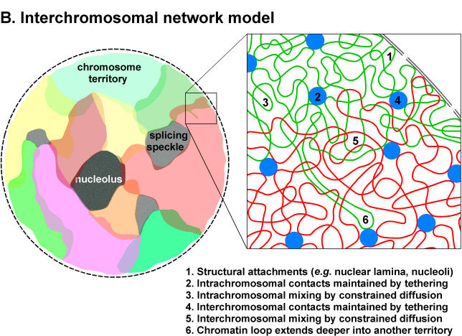
Complex interaction networks
Notes:
See Ciabrelli and Cavalli, 2015. Chromatin-driven behavior of popologically associating domains. Journal of Molecular Biology.
Pombo and Dillan, 20015. Three-dimensional genome architecture: players and mechanisms. Nat Rev Mol Cell Biol

Slide 12
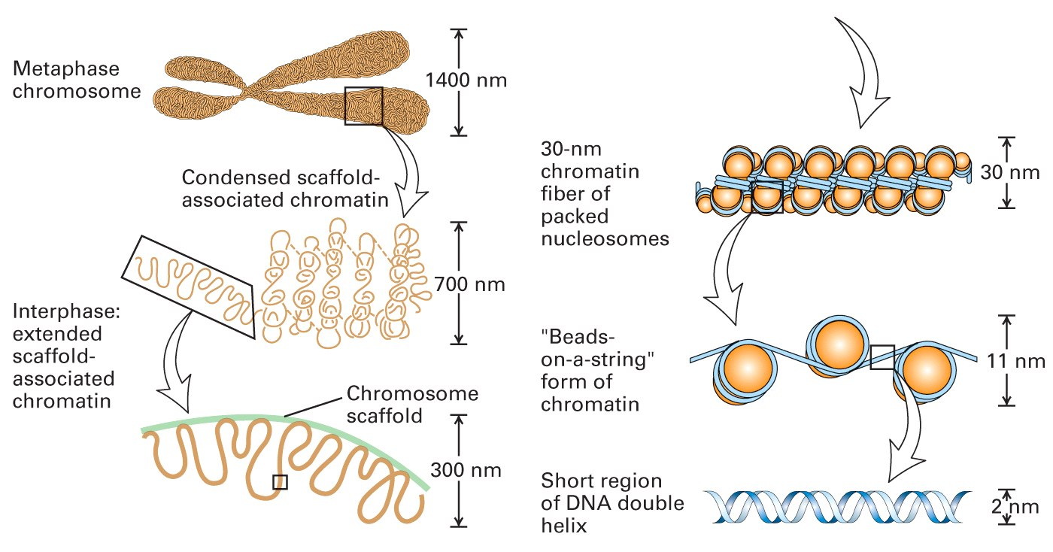
Chromatine structure, epimutations and gene regulation…

Slide 13
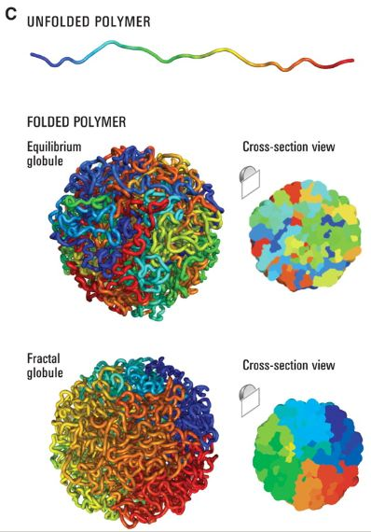
Reminder about genomes and epigenomes
Very large non-coding DNA parts,
e.g.: human 95% (from the “junk DNA” to
a new Terra incognita),
A single nucleotide change may affect functions
and/or regulation, gene splicing… both at short
and long distances (e.g. DNA modification induces
epigenetic changes)
Very slight correlation between
linear and spatial organizations,
Epigenomes (proteins, DNA and RNA
[= epitranscriptome]):
“now we know from where we have
to start” (conclusion of the EFSA meeting,
June 2016)
We are thus very far from mechanical
and linear molecular biology of the 70s’ used
for the communication about NTMGE
Notes:
Spatial genome organization see Ramani et al. Genomics Proteomics Bioinformatics 2016

Slide 14
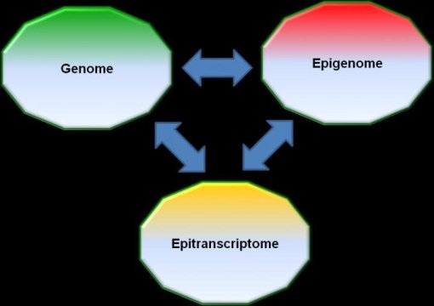
Interactions between domains very badly known

Slide 15
A few plants’ specificities
Not mobile,
organization of the genomes (nuclear, chloroplast and mitochondria) and ploidies,
large differences genotypic and phenotypic between mono- and dicotyledonous and between species’ varieties, particularly Elite lines (e.g. corn ca. 20% of differences with strong linkage disequilibrium…),
cell (to remove for transformations) walls of recalcitrant plants for regenerations (or use of immature embryos and mosaicism...),
A few cells (germ lines) of apical and axillary meristems are preserved from mutations and epimutations (analogy with animal germlines isolation at the beginning of development), some derived cells used to maintain organisms’ homogeneity and plant longevity (see e.g. the Lausanne Napoléon’s tree)…
Notes:
It is thus not always obvious to generalize data from a kind of organism (even cell line) to other ones: e.g. mammals to plants…
It is also important to keep in mind the new paradigm in molecular biology: cells’ genomes interactions through hormones, proteins, minerals, RNA and DNA, not only between tissues of an organism but also between species, e.g. through feeding…
Also genome as dynamic system of networks, complex regulation… far from the mechanistic 70s’ view of molecular biology…
Zhang et al. 2012Cell Res. 22(1): 107-126
Vaucheret Chupeau 2012 Cell Res. 22(1): 3-5
Dickinson et al. 2013 Nat. Biotech. 31(11): 965-967
Liang et al. 2013. RNA biology. 10(3): 367-370
Beatty et al. 2014 BMC Genomics. Small RNAs from plants, bacteria and fungi within the order Hypocreales are ubiquitous in human plasma 15(1): 933
Chin et al. 2016 Cell Res. 26(2): 217-228
Spisak et al. 2013. PLoS One 8(7): e69805
See also the companies’ communication about the efficacy of DNA vaccines and the absence of effect of DNA of GMOs
"In addition, the plant genome is extremely diverse," says Jeffry Sander, a researcher with the Department of Molecular Engineering. Between two varieties of maize, there is the same genetic distance as between a man and an ape. "Pioneer proposes several dozens, according to the humidity, temperature, wind, nature of the soil, or diseases or pests to fight ..." To make them evolve to improve them is our core business, "continues Jeffry Sander. Each time, sequencing must be repeated. “ (In Le Monde Science & Medicine "In the Plant Factory of the Future ", Nathaniel Herzberg, 2017/06/07, page sch4).
Napoléons’ tree: Ledford 2017. Ancient oak's youthful genome surprises biologists. Nature.
Also true for tomato
Sarkar, N. et al. Preprint at bioRxiv http://dx.doi.org/10.1101/149203 (2017).
Burian, A., Barbier de Reuille, P. & Kuhlemeier, C. Curr. Biol. 26, 1385–1394 (2016).
Watson, J. M. et al. Proc. Natl Acad. Sci. USA 113, 12226–12231 (2016).

Slide 16
Conclusion
All DNA, proteins and RNA changes (including point mutations) may have effects either locally or distally,
Changes can be easily or not detectable by e.g. phenotypic or genotypic changes, but face numerous issues of sequencing platforms, assembly and comparison software, ata bases errors, ack of sufficient quality control and quality assurance procedures, gold references standards,
Most – if not all – of the artificial induced mutations left genomic / epigenomic scars usable in techniques’ identifications and differentiation of in vitro and in vivo changes,
DNA changes, such as insertion, are inducing, generally distal, epimutation(s),
Focuses on nuclear genomes do no provide insights on plastids’ genomes,
More and more epimutations (DNA, RNA and proteins) are thought to be inheritable by generally unknown mechanisms (= “adaptation”, part of heterosis?...),
Changes of fitness may be invisible in the greenhouses and further local fields testing, but visible in other circumstances…
The molecular biology as used in the communication about NTMGE takes into consideration only the tip of the iceberg
DNA changes (introduced or not) are only a part of the uncertainties and risk assessment: the GMO paradigm only based on DNA nucleotides since decades has to integrate epigenetics and complex interactions networks, with their largely unknown sectors
Notes:
See for instance conversion frequencies
See confidential report on « NTMGE products detection and techniques identification » to be published as a scientific peer-reviewed paper.

Slide 17
NTMGE (“New techniques” of modification of the genomes and epigenomes)

Slide 18
Initial work in the EU on NTMGE
Zinc finger nuclease technology (ZFN1-ZFN3) + TALEN+ meganucleases (then Crispr-endonuclease)
Oligonucleotide directed mutagenesis (ODM)
Cisgenesis/ Intragenesis vs. Transgenesis
RNA-dependent DNA Methylation (RdDM)
Grafting (GM rootstock / scion)
Agro-infiltration (Agro-infiltration “sensu stricto”, Agro-infection, Floral-dip i.e. plant transformation)
Reverse breeding
Synthetic biology
Working group: 2007-2012
Lack of consensus: report not made publicly available
But several experts used some of its “positive” claims
Notes:
A very large set (= a gibberish) of diverse unrelated different techniques used or not in combinations with several mechanisms but possible final characteristics.
The first version of the NBT set did not include some technics, such as CRISPR-Cas9, published in 2012,
A contrario agro-infiltration is thought by some Countries only as sensu-stricto and in confined areas, while some other ones are also considering agroinoculation and floral dip, and as disseminated organisms. Depeinding on the technique effectivey used may left to transgenic GMOs or NTGME.
Meganucleases: 1990s
Oligonucleotide-directed mutagenesis: late 1990s
Zinc finger nucleases (ZFNs): mid 2000s
Transcription activator like effector nucleases (TALENs): early 2010s
Clustered regularly spaced short palindromic repeats (CRISPR): 2012 but several previous papers of Bayer
A discourse targeting only plants as the technics do not appear to be ready for animals, to avoid fears about Human transformation, while plants will be used for “proof of concept”.
A 2007 first memo from COGEM (Dutch advisory board on GMOs)
Lusser et al. 2011 New plant breeding techniques State-of-the-art and prospects for commercial development EUR 24760 EN
The importance of semantics and semiology…
Have a look to the wording “breeding technique” and the “New” adjective… more or restriction to plants, idea of improvement (techniques presented as the offspring of old and secure techniques)
The faith in backcrosses for “rapidly” coming back from GM organisms to non-GM plants ( but 4 to 14 generations needed according to the location of and distance between off-target / unintended mutation and the targeted trait, not segregation
To decrease the duration (and production costs?)of successive backcrosses: special greenhouses (see for instance Florimond Desprez investments: 5 M€ for reducing the 3 first generations to 14-18 months) with further impact on seeds’ prices…
▪ Zinc finger nucleases are chimeric proteins “Zinc finger” domain (recognising specific DNA sequence) & nuclease cutting double-stranded DNA
▪ ZFN-1 technology:
- delivery of genes encoding ZFNs (without repair template)
- site-specific double-strand break (DSB)
- natural repair process (through non-homologous end-joining NHEJ)
mutation in one or a few bp, short deletions or insertions (site-specific but random change)
▪ ZFN-2 technology:
- delivery of genes encoding ZFNs & repair template (DNA stretch of a few kbp)
- site-specific double-strand break (DSB)
- natural repair process (through homomologous recombination HR)
- mutation in one or a few bp, short deletions or insertions (site-specific and specific change)
▪ ZFN-1 and -2
- ZFN gene expression transient
- or in the case of gene insertion, progeny carrying the transgene is segregated out
▪ ZFN-1
- mutation in one or a few bp, short deletions or insertions (site-specific but random change)
mutation frequency varies, but usually rather low
ZFN-3 technology Leads to site-specific insertion of the target gene
Oligonucleotide directed mutagenesis (ODM)
▪ Oligonucleotides
- share homology with target sequence with the exception of the nucleotides to be modified
- chimeric oligonucleotides (mixed DNA and RNA bases)
- or single-stranded DNA oigonucleotides
- 20 to 100 pb long
▪ Oligonucleotides “target” the homologous sequence in the genome
▪ Create one or more mismatch base pairs corresponding to the non-complementary nucleotides
▪ Meganucleases
- Natural proteins acting as “DNA-scissors”
- Recognise specific DNA sequence (12-30 bp)
- Cause site-specific DNA break
▪ Possible applications as for ZFN technology
▪ Transcription activator–like effector (TALE) proteins
- Proteins that bind to DNA in a sequence-specific way
- Converted into “DNA-scissors” by binding to a nuclease
(catalytic domain of FokI)
- Can be modified for targeting a given sequence
▪ Possible applications as for ZFN technology
Cisgenesis/Intragenesis
Requalification of transgenesis according to the origin and/or modification f sequences
▪ Stable integration of cisgene
▪ In the case of Agrobacterium-mediated transformation, presence of
T-DNA border sequences
▪ Possible unintended effects:
- Interruption of open reading frames (ORFs)
- Creation of new ORFs
- Deletion of host DNA
Gene transfer can lead to modified levels of gene expression
In the case of gene stacking, multiple recombination sites may cause chromosomal rearrangements
In the case of use of selectable markers, they have to be recombined out and leave behind a recombination site
Intragenesis (additional effects)
Possible unintended effects:
New combinations of genes and regulatory sequences – more extensive modification of gene expression to be expected (compared to cisgenesis)
In the case RNAi is used for gene silencing, effects on other genes and metabolic pathways possible
AGROINFILTRATION "SENSU STRICTO”
• Infiltration with suspension of Agrobacterium sp. containing the gene of interest
• Local, transient gene expression at high levels
Infiltration with construct containing the foreign gene in a full-length virus or Agrobacterium vector
Question: what is the status / classification of the progeny?
AGRO-INFECTION
• Infiltration with suspension of Agrobacterium sp. containing the gene of interest inserted into a full-length virus vector
• Facilitates the spreading and expression of the target gene in the plant
FLORAL DIP
• Germline tissue (typically flowers) is immersed into a suspension of Agrobacterium sp. containing a T-DNA construct to transform female gametocyte
• GM seeds are obtained
Agro-infiltration and Agro-infection
▪ Temporary expression of specific coding sequences
▪ No DNA integration in the plant genome
▪ Possible unintended changes:
Agro-infiltration:
- Integration of T-DNA cannot be excluded
Agro-infection:
- RNA viruses cause spreading of the gene construct
- Since spread via RNA molecules, no integration in plant genome
Grafting on GM rootstock
▪ Changes in the genome are targeted to root tissue
▪ Intended manipulation of gene expression (new trait) in the scion can be achieved through movement of specific proteins and/or RNA from roots to scion, e.g. RdDM
▪ Possible unintended changes:
- genetic exchange restricted to graft site
- unintended manipulation of gene expression through movement of specific proteins and/or RNA from roots to scion
NPBT are mainly applied for pest resistance and herbicide tolerance.
Some techniques (like cisgenesis) have been already tested in many crop plants, while others (like ZFN) have been tested mainly in model plants, commercial plants are available

Slide 19
NTMGE: contextualisation
A suite of agricultural technical developments, often referred to as revolutions (Middle Ages, Green...)
Technical development of molecular biology: GMO, then the NTMGE, synthetic biology... without disruptive change,
Public Affairs that led to the refusal by the citizens of certain techniques and leading to regulatory questions, (GMO or not, exempted or not?),
Communities asking for more natural food commodities, a wording embedded by companies,
A society where the progress and innovation are felt as a source of happiness with both private and public stakeholders (ministries of environment and agriculture, GSTC vs. ... Assessment Agency), scientists defending institutional or not interests, politicians with pre-established choices due to socio-economic a priori...
Globally: a new step in science’s politicisation and scientification of politics

Slide 20
Related techniques (used to Produce both GMO and NTMGE products)

Slide 21
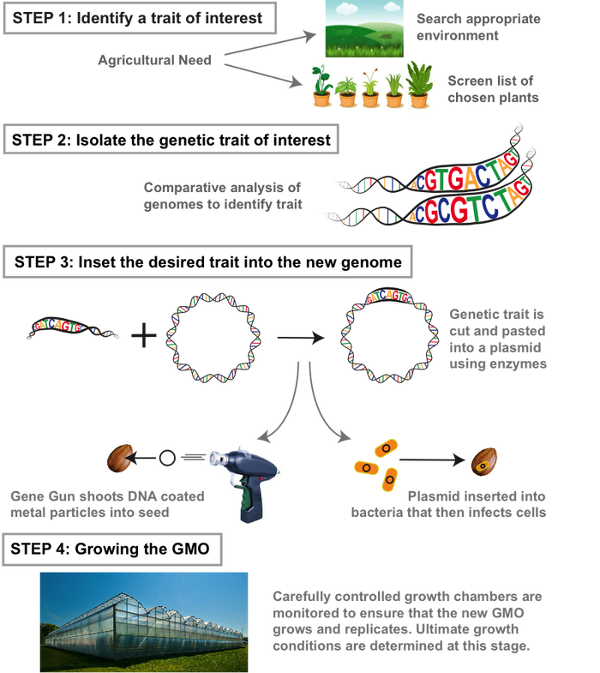
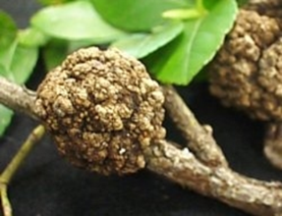
Alternatives:
gene regulation
or sequence modification
Alternatives: identification
Of sequences’ changes or
epimutations (DNA or
chromatine)
GMO production
Sequences’ changes
or epigenetic
insertion or deletion / indel
sequences in one or more
locations…
http://sitn.hms.harvard.edu/flash/2015/how-to-make-a-gmo/
Notes:
Rapid comparison of transgenesis and e.g. (SDN) nucleases based NBT
Agrobacterium, with its drawback (plasmid and nucleus random insertion in targeted / modified species) still the most efficient and used vector (otherwise attempts to use immature embryos for recalcitrant plants).
Biolistics, viruses, PEG, electroporation : common technics between old GMOs and NBT.

Slide 22
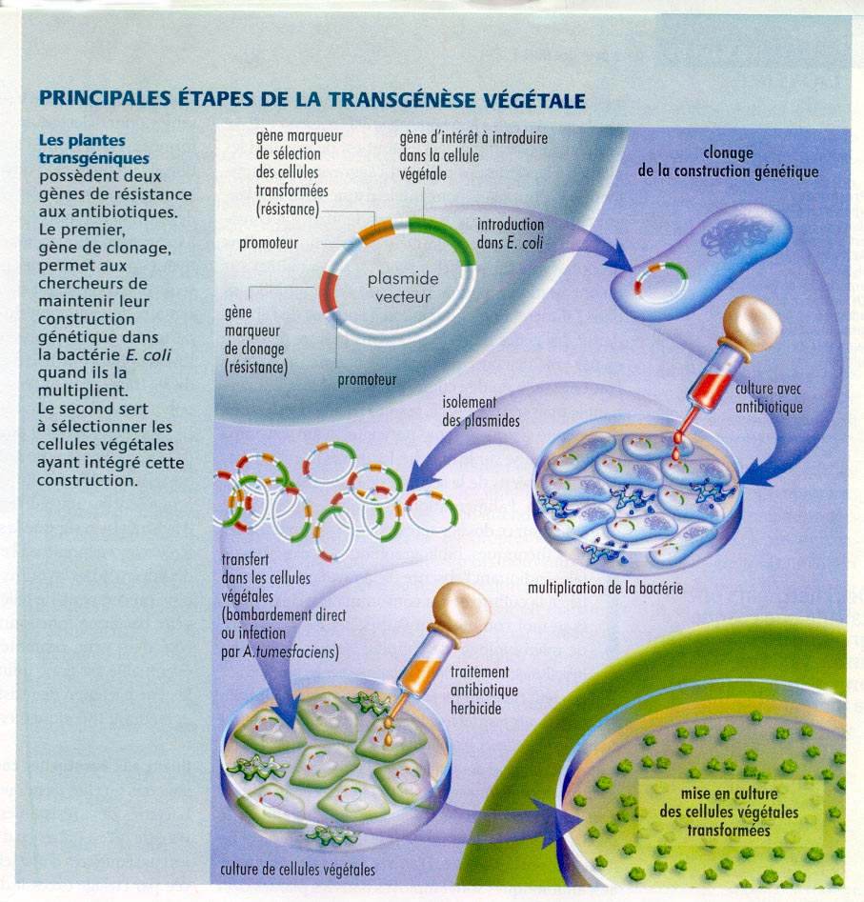
PRINCIPALES ETAPES DE LA TRANSGENESE VEGETALE

Slide 23
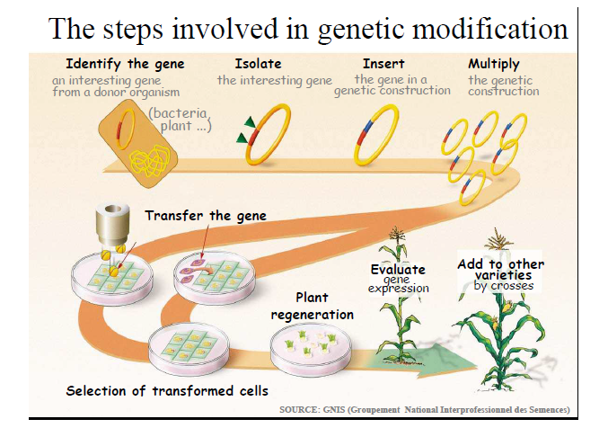

Slide 24
Common techniques to current GMOs and NTMGE
The NTMGE require the use of "old technologies" used for transgenic GMOs, already sold:
protoplastisation, vectorization (very large proteins inducing huge holes in membranes, genome and plasmid of Agrobacterium leftovers…), cell cultures with their somaclonal variants, selection systems of modified cells with or without recombination systems, regeneration of the few not “recalcitrant” plants (thus with the same spectrum of species for GMOs and NTGME),
all stressful techniques induced mutations and epimutations (up to 35% for cell cultures)
Hard to detect (missing reliable software and reference genomes, huge differences between Elite varieties of a species, systematic biases with each NGS platform) point or indels mutations, especially in non-coding or repeated regions, issues with translocations and inversions...
Difficult to discard (insufficient number of backcrosses by companies, co-segregations according to the characters, non Mendelian inheritable regions) leaving millions of bp not “cleaned" while the result is hard to control (issues of missing reliable software and reference genomes)
International Conference held in London in October 2016: labs are desperately looking for “good chefs”, well trained and regret the lack of training schools for future chefs…
Notes:
Voir les articles de Inf’OGM:
https://www.infogm.org/5975-ogm-modifier-plante-pas-anodin
https://www.infogm.org/5982-ogm-modifier-plante-pas-anodin-suite
Look at the English version:
https://www.infogm.org/genetically-modifying-a-plant-is-far-from-harmless
https://www.infogm.org/genetically-modifying-a-plant-is-far-from-being-harmless-follow-up
On old cooking recipes (past decades) see for instance Ledford 2016 Nature 539 (7627): 16-17 about the Conference held in October 2016 o those ‘related technics’.
NBT labs are looking for trained chiefs but training are missing and thus experienced chiefs also…
In most – if not all - of the description of NBT, the related technics such as protoplast preparation or cell culture are omitted while their use in the genome editing technics, rdDM, OdM are all causes of unexpected effects.
Most of theses related technics are also used for transgenesis and are the sources of some of the unintended genome changes also observed for the GMO obtained by transgenesis. Particularly Agrobacterium shuttle, the most efficient vector.
Protoplates’ preparation, cell culture and plant regeneration, somaclonal variation are all inducing by stresses mutations and epimutations, chromosomes’ rearrangements…
Anjanasree K. Neelakandan and Kan Wang 2012 Plant Cell Rep 31:597–620
Wilson, A.K., Latham, J.R., Steinbrecher, R.A. (2006) Transformation-induced mutations in transgenic plants: analysis and biosafety implications. Biotechnol Genet Eng Rev, 23(1), 209-238.
Florentin, A., Damri, M., Grafi, G. (2013) Stress induces plant somatic cells to acquire some features of stem cells accompanied by selective chromatin reorganization. Developmental Dynamics, 242(10), 1121-1133.
Skirycz, A., De Bodt, S., Obata, T., De Clercq, I., Claeys, H., De Rycke, R., Andriankaja, M., Van Aken, O., Van Breusegem, F., Fernie, A.R., Inzé, D. (2010) Developmental stage specificity and the role of mitochondrial metabolism in the response of Arabidopsis leaves to prolonged mild osmotic stress. Plant Physiology, 152(1), 226-244.
Yoo, S.-D., Cho, Y.-H., Sheen, J. (2007) Arabidopsis mesophyll protoplasts: a versatile cell system for transient gene expression analysis. Nat. Protocols, 2(7), 1565-1572.
Marx, V. (2016) Cell biology: delivering tough cargo into cells. Nat Meth, 13(1), 37-40
Lusser, M., Parisi, C., Plan, D., Rodríguez-Cerezo, E. (2011) New plant breeding techniques. State-of-the-art and prospects for commercial development. EUR 24760 EN. In JRC scientific and technical reports (European Commission. DG JRC/IPTS, ed: pp 220.
Yau, Y.Y. and Stewart, C.N. (2013) Less is more: strategies to remove marker genes from transgenic plants. Bmc Biotechnology, 13.
Breyer, D., Kopertekh, L., Reheul, D. (2014) Alternatives to antibiotic resistance marker genes for in vitro selection of genetically modified plants – Scientific developments, current use, operational access and biosafety considerations. Critical Reviews in Plant Sciences, 33(4), 286-330.
Manimaran, P., Ramkumar, G., Sakthivel, K., Sundaram, R.M., Madhav, M.S., Balachandran, S.M. (2011) Suitability of non-lethal marker and marker-free systems for development of transgenic crop plants: present status and future prospects. Biotechnology Advances, 29(6), 703-714
Krizova, K., Fojtova, M., Depicker, A., Kovarik, A. (2009) Cell culture-induced gradual and frequent epigenetic reprogramming of invertedly repeated tobacco transgene epialleles. Plant Physiology, 149(3), 1493-1504
Machczyńska, J., Orłowska, R., Zimny, J., Bednarek, P.T. (2014) Extended metAFLP approach in studies of tissue culture induced variation (TCIV) in triticale. Molecular Breeding, 34(3), 845-854.
Rhee, Y., Sekhon, R.S., Chopra, S., Kaeppler, S. (2010) Tissue culture-induced novel epialleles of a Myb transcription factor encoded by pericarp color1 in maize. Genetics, 186(3), 843-855.
Kawakatsu, T., Kawahara, Y., Itoh, T., and Takaiwa, F. (2013). A whole-genome analysis of a transgenic rice seed-based edible vaccine against cedar pollen allergy. DNA Research 20, 623-631.
Montero, M., Coll, A., Nadal, A., Messeguer, J., Pla, M. (2011) Only half the transcriptomic differences between resistant genetically modified and conventional rice are associated with the transgene. Plant Biotechnology Journal, 9(6), 693-702.
Meins, F. and Thomas, M. (2003) Meiotic transmission of epigenetic changes in the cell-division factor requirement of plant cells. Development, 130(25), 6201-6208.
Very many off-targets (claims of reduction of a factor of 1,500…), difficult to predict (depends on the available considered genome sequences) and detect (software capabilities for assembly and sequences comparisons as speed was pirvilegied up to now to reliability, lack of reliable genomes of reference, huge differences between Elite cultivars see le Monde 2017/06/07 interview of ...) except to focus on some points (where claims of off-target effects not detectable because only a portion of the genome has been studied) because the sequencing "in depth" (we went from a few dozens to several thousands of re-sequencing preferably with several platforms and software to improve the robustness of the results) is still expensive (even if advertised as to soon join the price of a PCR analysis)),

Slide 25
Conclusion
Numerous mutations and epimutations (of DNA, proteins and RNA) are induced by the technics used for both producing current GMOs and NTMGE, all scars usable in technics identification
Several steps (e.g. modified cells selection tools with or without recombination tools, reagents delivery: Agrobacterium still the most efficient…) can leave foreign DNA traces,
Purified proteins or RNA with contaminating DNA (see e.g. the issue of commercial PCR enzymes),
Notes:
The low efficiency of cells modification needs using selection system of the modified cells. Even in the case of recombination system to discard inserted vectors parts, such as the Cre-Lox system, scars and foreign DNA are generally left.
Even the use of mRNA or RNP (Ribonucleoprotein) can leave foreign DNA
e.g.
- mRNA by reverse transcription provide DNA which can be inserted in the genome
- mRNA and protein purification are in all cases contaminated by the DNA of the initial reagents (an issue well known in the area of teh commercial purified polymerase used for PCR)

Slide 26
Some issues with NTMGE...
Notes:
Most of the issues raised by the several NTGE techniques (such as off-targets, unintended other mutations and epimutations, lack of reliability of software used to predict and detect off-targets, limits of mutations cleaning through backcrosses) are gathered in a document of more than 120 pages of notes with all scientific references.
Part of this document is also dedicated to the limits of NGS techniques and their inherent biases, the lack of reliability of assembly and comparisons software, the still present errors of data-bases not carefully curated for sequences and annotations’ errors, and the numerous differences observed between species and even Elite cultivars to rapidly design new GM varieties (see for instance in Le Monde dated 2017/06/07 the interview of a Pioneer’s scientist).
All together will be part of a review paper or book, beside the review paper on the detection and identification of NTMGE products and techniques used for producing thereof.

Slide 27
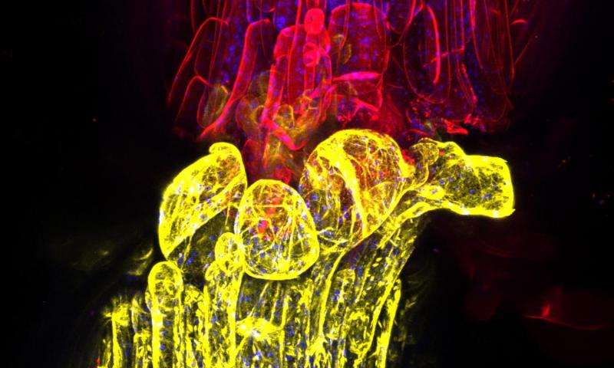
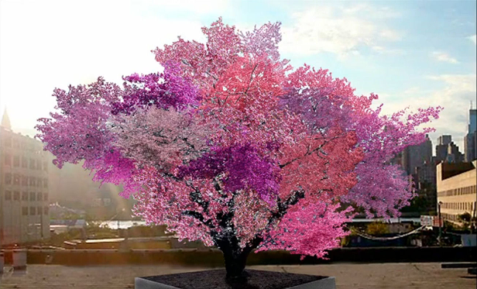
Graft: interactions between scion and (e.g. GM) rootstock
Circulation of pathogens, proteins (e.g. Cry1Ac), DNA, ARN (siRNA and mRNA), hormones…
Gene regulation (silencing…), proteins synthesis of rootstock in scions,
Communication of genomes with establishment of epialleles http://phys.org/news/2016-01-grafted-genomes.html#jCp
The products of the non-GM scion (e.g. fruits) cannot be considered as not being influenced by the GM rootstock
Credit: Charles Melnyk/University of Cambridge
Sam van Aken, Syracue University, New York.
Notes:
http://phys.org/news/2016-01-grafted-genomes.html#jCp
Lewsey et al. 2016 PNAS. 113(6): E801-E810
…/… "Grafting is something done often in the commercial world, and yet, we really don't completely understand the consequences for the two plants," says Joseph Ecker, one of the senior authors of the paper and director of Salk's Genomic Analysis Laboratory. "Our study showed genetic information is actually flowing from one plant to the other. That's the surprise to me.“
…/…
Goldschmidt 2014. Frontiers in plant science. 5: 727
…/… The graft hybrid concept, which was developed and demonstrated by the Soviet horticulturist Michurin (1949), appeared to be in contrast with Mendelian genetics and was rejected (and almost forgotten) by Western scientists who opposed and dis-trusted the Soviet biology led by Lysenko. Several published studies (and most probably many unpublished) could not confirm the appearance of graft hybrids (Stubbe,1954; Bohme,1957; Topoleski and Janick, 1963; Menda et al., 2006). Yet, reports supporting the occurrence of graft transformations appeared from time to time (Frankel, 1956), and increasingly so in recent years (Li et al., 2013; Tsaballa et al., 2013; Wu et al., 2013; Zhou et al., 2013). Proponents of the graft hybrid concept reviewed the supporting evidence and called for reassessment of the graft transformation hypothesis that has been neglected for several decades (Liu, 2006; Liu et al., 2010).
Growth and development in multi-cellular organisms is coordinated by local and long-distance communication between cells and tissues. In plants, signaling molecules, including RNAs, are transported locally between cells, and long-distance in the phloem to provide developmental and defence information (Lough & Lucas, 2006; Sparks, Wachsman & Benfey, 2013). Small RNAs are critical regulators of plant development and defense, and can be mobile. For example, the endogenous miRNAs miR165/6, tasiRNA (tasiR-ARF), and miR394 serve as morphogen-like signals, forming gradients to determine cell fate during leaf and root development (Chitwood et al., 2009; Carlsbecker et al., 2010; Skopelitis, Husbands & Timmermans, 2012; Knauer et al., 2013). Plant virus-induced small interfering RNAs (siRNAs) can also move throughout the plant from the original site of infection to prime the defence mechanism against further virus invasion (Nelson & Citovsky, 2005; Voinnet, 2005).
Small interfering RNAs derived from transgenic hairpin RNAs also spread both locally and over long distances (Palauqui et al., 1997; Voinnet & Baulcombe, 1997; Himber et al., 2003; Brosnan et al., 2007; Liang, White & Waterhouse, 2012). Experiments in Arabidopsis thaliana showed that these siRNAs will move from rootstocks expressing a hairpin RNA targeting a green fluorescent protein (GFP) sequence across graft junctions to silence GFP expression in grafted shoot tissue (Brosnan et al., 2007). Although the hairpin-derived silencing signals generated in roots have been shown to move gradually from cell to cell into the shoot, rather than moving through the phloem (Liang, White & Waterhouse, 2012), the factors controlling silencing mobility in plants are unknown.
In the nematode Coenorhabditis elegans, the movement of silencing signals is facilitated by the dsRNA-channels SID-1 and SID-2 (Winston, Molodowitch & Hunter, 2002; Feinberg & Hunter, 2003), but there is no clear homologue in Arabidopsis. Instead, the spread of silencing in plants is thought to be regulated, in part, by transport through plasmodesmata (PD), the channels that link the cytoplasm of adjacent plant cells, although direct genetic evidence is lacking (Melnyk, Molnar & Baulcombe, 2011).
Graft-transmission of RNA silencing could become of practical importance in horticulture, especially for fruit crops (e.g., apple, pear, grape, and sweet cherry), which are propagated vegetatively by grafting scions of superior clones/cultivars onto clonally propagated rootstocks [14]. The idea to graft non-transgenic scions onto silencing transmitter rootstocks that affect traits within non-transgenic parts of the tree like fruits, seems promising. Beside the advantage of being a straightforward approach to improve individual traits of well-established cultivars such as self-fertility, resistance, flavor, or sugar content, the use of graft-transmissible gene silencing would avoid the possibility of spreading transgenes by outcrossing through pollen and/or seeds. The graft-transmissible manipulation of specific traits provoked by sRNAs has not been demonstrated in apple until now, but it was several times reported in other horticultural plants. For example, wild-type potatoes grafted as stocks with scions overexpressing miR172 showed induced tuberization [15]. For apple, Flachowsky et al. (2012) showed that RNA are transmitted in vitro but not in greenhouses.
In the case of grapevine more than 3,000 genes are exchanging mRNA at a more or less high frequency, depending on the genotype, the combinations and the growth environment (Yang et al. 2015).
Kumari et al. (2015) study on Arabidopsis thaliana : The controlling effect of rootstock over scion is possibly due to altered root-to-shoot and/or shoot-to-root chemical signaling [3]. Several studies on long-distance signaling via graft-union provide evidences for multiple types of mobile signals, such as hormones [4,5,6,7], proteins [8,9], ribonucleoprotein [10], RNAs [11], small RNAs [12,13,14,15,16], minerals [17,18 ] etc, conferring a wide range of effects on scion development. Despite the wide use of grafting in agriculture, very little is known about the molecular mechanism of rootstock-regulation of scion’s phenotypes. Gene expression studies are useful approaches in understanding the genes involved in the effect of the rootstock. Transcriptional profiling in the scions of Prunus cerasus [19] and Malus domestica [20] revealed differences in the expression level of 99 and 116 transcripts, respectively, which could contribute to rootstock-regulation of biomass in scion. Recently, effect of heterografting has been examined on gene expression in scion [21] and graft interface [22] in Vitis vinifera. In the shoot apex of scion, grafted onto vigorous rootstock, the differentially expressed genes related to growth, stress, hormone signaling and hybrid vigour possibly confers vigour effects [21]. Up-regulation of stress response was notified at graft interface of heterografts, as compared to the homografts, suggesting that the tissues involved in graft-union could recognize and behaved differently in case of self or non-self grafting partner [22].
Springer & Scmitz 2017 Nat. Rev. Genet. Exploiting induced and natural epigenetic variation for crop improvement.
Review on epigenetics and epimutation (natural and induced) as a tool in plant breeding (also a major part of somaclonal variations due to plant tissues cultures), effect of rootstock on scions…
Many fruit crops are widely propagated through grafting. In these species, there are opportunities for directed epigenetic changes from rootstock to scion or vice versa120,121. In these cases, a rootstock or scion that produces a mobile signal, such as an siRNA, can direct methylation changes across the graft (FIG. 3c). This could be used in agricultural species to target epigenetic changes122.
Zhao et Song (2014) Plant Biotechnol J. 12(9):1319-28. Virus resistance transferred from GM rootstock to scion.
Thieme et al. 2015. Nature Plant 1: 15025. Numerous mRNA are moving from a part to another one, with translation in distant tissues.

Slide 28
RNAi
Main issue: efficient delivery (agro-infiltration, biolistic, viruses) with different scars,
Interaction with non-target organisms,
Numerous off-targets
Notes:
RNAi
Non-coding RNAs (ncRNAs).
RNAi would induce more off-targets than Crispr methods, including interferon responses (Boettcher and McManus, 2015; Bridge et al., 2003; Nejepinska et al., 2012).
See the book (Kodama and Komamine, 2011) for a review of the molecular weight of proteins (to be penetrated: more than 100 kDA), off-targets with prediction software, as well as siRNA design. Vectorization with agroinfiltration, virus (hence the need for verification of the absence of foreign DNA after transformation) ... As noted by Senthil-Kumar and Misore on page 13, in chapter 2 of this book: "Hence, understanding The off-target effects is crucial for minimizing such effects to better conclude gene function analyzed by RNAi. "and" In-depth systematic studies to understand their molecular basis. "RNAi vectors. In the meantime, gene function and phenotype results from present-day RNAi studies need to be interpreted with caution. "(Senthil-Kumar and Mysore, 2011). Partial knockdown: hence generally wide range of phenotype differing widely. Partial homologies ... but in a number of cases, siRNAs do not necessarily target a specific gene, which leads to non-specific silencing (Jackson et al., 2003; Xu et al., 2006), but also to other effects non-specific (Jackson and Linsley, 2004; Lin et al., 2005; Qiu et al., 2005; Saxena et al., 2003). In an attempt to detect these off-targets due to siRNA, use of software such as PheLIM (Riba et al., 2017) that would be better than RSA, GESS, Haystack, GespeR, or TargetScan (Buehler et al., 2012; Konig et al., 2007; Schmich et al., 2015; Sigoillot et al., 2012). Kodama and Komamine (2011): due to conserved sequences between animals and plants (in particular specific domains of certain genes), any unintended effect observed in plants or pests may raise concerns not only with regard to possible pleiotropies in plants but also for other (non-target) organisms and the environment. Hence, raising questions regarding applications for food purposes. Sometimes silencing of the “good” (targeted) gene can be obtained but in another organism (see the EFSA presentation of Lundgren, Mogren and Welch) cf. (Bachman et al., 2016; Baum et al., 2007), especially about the effect on non-target organisms (Lundgren and Duan, 2013). Interestingly, Monsanto seems to have wanted to silence scientists (Rockett, 2014). As Lundgren, Mogrel and Welch told during the EFSA meeting: "The hazards of RNAi are predictable if you know what species are exposed to the RNAi, if you know the genome of exposed species, if you know the phenotypes of genes that share homology sequence with the siRNA. ". The main problem with interfering RNA technologies is their delivery, agroinfiltration, biolistics and viruses being still the most effective (Sarita et al., 2017). Sometimes the cellular machinery may be indeed saturated which temporarily inhibits the possible use / action of RNAi (Jackson and Linsley, 2010; Khan et al., 2009).
Ribozyme is one of the RNAi in use.
There is a drastic lack of risk assessment guidelines. EFSA thus launched on 12 April 2016, after the symposium held in June 2014 in Brussels, a systematic review about RNAi (https://www.efsa.europa.eu/en/negproc/procurement/npr-efsa-gmo-2016-01) with a budget of 100,000 €.
Epigenome inheritance
There is transmission of epigenome – and thus of paramutations - between generations, when it was previously thought that the modifications were reset to zero, and that this was valid only in plants and not in mammals, but now have a look to the reviews (Buckley et al., 2012; Franklin and Mansuy, 2010; Sharma, 2013; Suzuki and Bird, 2008). It seems that resetting, although epigenetic signatures are found between generations and that epigenetics participate in evolution, would only occur in primates and plants (Mendizabal et al., 2014). However, these resets which could be lower in plants than in animals (Calarco et al., 2012; Richards, 2008) are only partial and inheritability - not Mendelian one - in both mammals and plants would be more important than initially thought (Calarco et al., 2012; Cuzin et al., 2008; Espinas et al., 2016; Feng et al., 2010; Franklin and Mansuy, 2010; Pilu, 2015; Probst and Mittelsten Scheid, 2015; Rakyan and Beck, 2006; Schmitz et al., 2013; Schrey et al., 2012). There are mitotic markers of totipotent stem cells (histone bookmarks) (Liu et al., 2017).
Bachman, P.M., Huizinga, K.M., Jensen, P.D., Mueller, G., Tan, J., Uffman, J.P., Levine, S.L. (2016) Ecological risk assessment for DvSnf7 RNA: A plant-incorporated protectant with targeted activity against western corn rootworm. Regulatory Toxicology and Pharmacology, 81, 77-88.
Baum, J.A., Bogaert, T., Clinton, W., Heck, G.R., Feldmann, P., Ilagan, O., Johnson, S., Plaetinck, G., Munyikwa, T., Pleau, M., Vaughn, T., Roberts, J. (2007) Control of coleopteran insect pests through RNA interference. Nature Biotechnology, 25, 1322-1326.
Boettcher, M. and McManus, Michael T. (2015) Choosing the right tool for the job: RNAi, TALEN, or CRISPR. Molecular Cell, 58(4), 575-585.
Bridge, A.J., Pebernard, S., Ducraux, A., Nicoulaz, A.-L., Iggo, R. (2003) Induction of an interferon response by RNAi vectors in mammalian cells. Nat Genet, 34(3), 263-264.
Buckley, B.A., Burkhart, K.B., Gu, S.G., Spracklin, G., Kershner, A., Fritz, H., Kimble, J., Fire, A., Kennedy, S. (2012) A nuclear Argonaute promotes multigenerational epigenetic inheritance and germline immortality. Nature, 489(7416), 447-451.
Buehler, E., Khan, A.A., Marine, S., Rajaram, M., Bahl, A., Burchard, J., Ferrer, M. (2012) siRNA off-target effects in genome-wide screens identify signaling pathway members. Scientific reports, 2, 428.
Calarco, Joseph P., Borges, F., Donoghue, Mark T.A., Van Ex, F., Jullien, Pauline E., Lopes, T., Gardner, R., Berger, F., Feijó, José A., Becker, Jörg D., Martienssen, Robert A. (2012) Reprogramming of DNA methylation in pollen guides epigenetic inheritance via small RNA. Cell, 151(1), 194-205.
Cuzin, F., Grandjean, V., Rassoulzadegan, M. (2008) Inherited variation at the epigenetic level: paramutation from the plant to the mouse. Current Opinion in Genetics & Development, 18(2), 193-196.
Espinas, N.A., Saze, H., Saijo, Y. (2016) Epigenetic control of defense signaling and priming in plants. Frontiers in Plant Science, 7(1201).
Feng, S., Jacobsen, S.E., Reik, W. (2010) Epigenetic reprogramming in plant and animal development. Science, 330(6004), 622-627.
Franklin, T.B. and Mansuy, I.M. (2010) Epigenetic inheritance in mammals: evidence for the impact of adverse environmental effects. Neurobiology of Disease, 39(1), 61-65.
Jackson, A.L., Bartz, S.R., Schelter, J., Kobayashi, S.V., Burchard, J., Mao, M., Li, B., Cavet, G., Linsley, P.S. (2003) Expression profiling reveals off-target gene regulation by RNAi. Nat Biotech, 21(6), 635-637.
Jackson, A.L. and Linsley, P.S. (2004) Noise amidst the silence: off-target effects of siRNAs? Trends in Genetics, 20(11), 521-524.
Jackson, A.L. and Linsley, P.S. (2010) Recognizing and avoiding siRNA off-target effects for target identification and therapeutic application. Nat Rev Drug Discov, 9(1), 57-67.
Khan, A.A., Betel, D., Miller, M.L., Sander, C., Leslie, C.S., Marks, D.S. (2009) Transfection of small RNAs globally perturbs gene regulation by endogenous microRNAs. Nat Biotech, 27(6), 549-555.
Kodama, H. and Komamine, A. (2011) RNAi and plant gene function analysis. Methods and protocols. In Methods in Molecular Biology, Humana Press, Springer, Totowa, NJ: pp 243.
Konig, R., Chiang, C.-y., Tu, B.P., Yan, S.F., DeJesus, P.D., Romero, A., Bergauer, T., Orth, A., Krueger, U., Zhou, Y., Chanda, S.K. (2007) A probability-based approach for the analysis of large-scale RNAi screens. Nat Meth, 4(10), 847-849.
Lin, X., Ruan, X., Anderson, M.G., McDowell, J.A., Kroeger, P.E., Fesik, S.W., Shen, Y. (2005) siRNA-mediated off-target gene silencing triggered by a 7 nt complementation. Nucleic Acids Research, 33(14), 4527-4535.
Liu, Y., Pelham-Webb, B., Di Giammartino, D.C., Li, J., Kim, D., Kita, K., Saiz, N., Garg, V., Doane, A., Giannakakou, P., Hadjantonakis, A.-K., Elemento, O., Apostolou, E. (2017) Widespread mitotic bookmarking by histone marks and transcription factors in pluripotent stem cells. Cell Reports, 19(7), 1283-1293.
Lundgren, J.G. and Duan, J.J. (2013) RNAi-based insecticidal crops: potential effects on nontarget species. Bioscience, 63(8), 657-665.
Mendizabal, I., Keller, T.E., Zeng, J., Yi, S.V. (2014) Epigenetics and evolution. Integrative and Comparative Biology, 54(1), 31-42.
Nejepinska, J., Flemr, M., Svoboda, P. (2012) Control of the interferon response in RNAi experiments. In Cytokine Protocols (M. De Ley, ed, Humana Press, Totowa, NJ: pp 133-161.
Pilu, R. (2015) Paramutation phenomena in plants. Seminars in Cell & Developmental Biology, 44, 2-10.
Probst, A.V. and Mittelsten Scheid, O. (2015) Stress-induced structural changes in plant chromatin. Current Opinion in Plant Biology, 27, 8-16.
Qiu, S., Adema, C.M., Lane, T. (2005) A computational study of off-target effects of RNA interference. Nucleic Acids Research, 33(6), 1834-1847.
Rakyan, V.K. and Beck, S. (2006) Epigenetic variation and inheritance in mammals. Current Opinion in Genetics & Development, 16(6), 573-577.
Riba, A., Emmenlauer, M., Chen, A., Sigoillot, F., Cong, F., Dehio, C., Jenkins, J., Zavolan, M. (2017) Explicit modeling of siRNA-dependent on- and off-target repression improves the interpretation of screening results. Cell Systems.
Richards, E.J. (2008) Population epigenetics. Current Opinion in Genetics & Development, 18(2), 221-226.
Rockett, C. (2014) Muzzled by Monsanto. Is Big Ag squelching research showing its new RNAi GMOs may be dangerous? . In Boulder Weekly.
Sarita, Geeta, Yadav, S.K., Srivastava, D. (2017) Biotic stress management in rice through RNA interference. In Biotic stress management in rice. Molecular approaches: pp 363-394.
Saxena, S., Jónsson, Z.O., Dutta, A. (2003) Small RNAs with imperfect match to endogenous mRNA repress translation: implications for off-target activity of small inhibitory RNA in mammalian cells. Journal of Biological Chemistry, 278(45), 44312-44319.
Schmich, F., Szczurek, E., Kreibich, S., Dilling, S., Andritschke, D., Casanova, A., Low, S.H., Eicher, S., Muntwiler, S., Emmenlauer, M., Rämö, P., Conde-Alvarez, R., von Mering, C., Hardt, W.-D., Dehio, C., Beerenwinkel, N. (2015) gespeR: a statistical model for deconvoluting off-target-confounded RNA interference screens. Genome Biology, 16(1), 220.
Schmitz, R.J., Schultz, M.D., Urich, M.A., Nery, J.R., Pelizzola, M., Libiger, O., Alix, A., McCosh, R.B., Chen, H., Schork, N.J., Ecker, J.R. (2013) Patterns of population epigenomic diversity. Nature, 495(7440), 193-198.
Schrey, A.W., Richards, C.L., Meller, V., Sollars, V., Ruden, D.M. (2012) The role of epigenetics in evolution: the extended synthesis. Genetics Research International, 2012, 3.
Senthil-Kumar, M. and Mysore, K.S. (2011) Caveat of RNAi in Plants: The Off-Target Effect. In RNAi and plant gene function analysis: Methods and Protocols (H. Kodama & A. Komamine, eds), Humana Press, Springer, Totowa, NJ: pp 13-25.
Sharma, A. (2013) Transgenerational epigenetic inheritance: focus on soma to germline information transfer. Progress in Biophysics and Molecular Biology, 113(3), 439-446.
Sigoillot, F.D., Lyman, S., Huckins, J.F., Adamson, B., Chung, E., Quattrochi, B., King, R.W. (2012) A bioinformatics method identifies prominent off-targeted transcripts in RNAi screens. Nat Meth, 9(4), 363-366.
Suzuki, M.M. and Bird, A. (2008) DNA methylation landscapes: provocative insights from epigenomics. Nat Rev Genet, 9(6), 465-476.
Xu, P., Zhang, Y., Kang, L., Roossinck, M.J., Mysore, K.S. (2006) Computational estimation and experimental verification of off-target silencing during posttranscriptional gene silencing in plants. Plant Physiology, 142(2), 429-440.

Slide 29
CRISPR-endonuclease (6 classes, 19 sub-classes with functions slightly or fully unknown)
A bacterial “acquired adaptive immunity” against phages described since1987,
adapted for modifying the prokaryotic genomes in 2012, then to eukaryotic ones in 2013
Evolutive convergence with animal and plants’ systems of genome stabilization
such as piRNA and transposable elements, small RNA and DICER…
Numerous limitations of use (species, genome regions…)
Main specific issues: unintended changes known as off-targets and exon skipping (providing aberrant proteins)
Notes:
This technique is currently the leader among genome edition technics, first results were obtained and patented by e.g. Bayer… Currently several agreements between companies on patents (Crispr, but also TALEN and ZFN) to constitute a portfolio to preparer the negotiation phase as one cannot predict which techniques will be effectively used for what (see. For instance the claims about low off-targets effects of TALEN vs. Crispr).
No all plant species or genome location are « targetable » (e.g. need for PAM sequences near the target to be modified).
Several endonuclease proteins (and thus PAM sequences) are necessary for extending the size and location of modifiable genomes / genes / non-coding DNA.
C2c2 able to modify RNA instead of DNA.
Numerous modifications (e.g. transforming a DSB – Double Strand Break - endonuclease into a nickase cutting only a DNA strand in the aim of reducing the number of off-target) and combinations of enzymes (e.g. endonuclease and methylase).
Numerous published papers with very few reproduced data, particularly about the detection of off-targets and unintended mutations / épimutations.
Guideline for claiming that a trait is correlated to a genetic change: use ZFN, TALEN and Crispr independent experiments for ensuring the observed phenotype is effectively due to the intended modification.
Exon skipping:
Sharpe and Cooper. 2017. Unexpected consequences: exon skipping caused by CRISPR-generated mutations. Genome Biology
Mou et al. 2017. CRISPR/Cas9-mediated genome editing induces exon skipping by alternative splicing or exon deletion. Genome biology.
Kapahnke et al. 2016. Random splicing of several exons caused by a single base change in the target exon of CRISPR/Cas9 mediated gene knockout. Cells

Slide 30
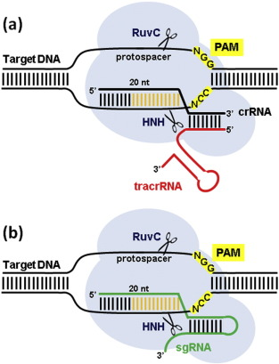
Crispr-Cas9
Strong limitations of action in the genomes by anchoring PAM sequences what explains the races for new other nucleases using different PAM sequences e.g.: Cas9, C2c1, Cpf1 (RNA cutting), or modification to bring a PAM...
Size limitations of inserts see e.g.: for human genes
Numerous Off targets because SDN = sequence directed mutagenesis (sequences homologies)
Reduction of off-target by changes - > nickase activity , reducing the quantities of reagents
C2C2 (Cas13a) and RCas9 changes of RNA...
RNA-guided DNA cleavage by Cas9. (a) In the native system, the Cas9 protein (light blue) is guided by a structure formed by a CRISPR RNA (crRNA, in black), which contains a 20-nt segment determining target specificity, and a trans-activating CRISPR RNA...
Luisa Bortesi, Rainer Fischer Biotechnology Advances, Volume 33, Issue 1, 2015, 41–52
Notes:
Comparison of the native system and the one proposed in 2012 by Doudna and Charpentier.
The sgRNA is more easy to design / change as compared than TALEN or ZFN systems… Claims that TALEN is inducing less off-targets than Crispr systems. Also recent claim of Calyxt (see Le Monde “les plantes du futur” 2017/06/07) that a new robot is able to produce rapidly in a cost-effective way newly designed TALEN tools.
But the changes in creating sgRNA (by linking the crRNA and the TracrRNA) drastically impacts specificity and efficiency by its conformation and energy issues, number of mismatches allowed to reduce off-targets…
The numerous changes applied to the endonucleases, their fusion with other proteins, for instance for modifying the epigenome… induce new unintended mutations and epimutations.

Slide 31
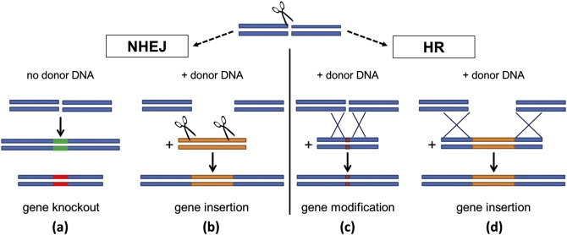
NTMGE: based on initially DSB DNA repair systems
High frequency
Canonical and alternatives (MMEJ)
Prone to numerous errors
Low frequency
Difficult to mobilize
Numerous unintended random mutations and epimutations, exon skipping, difficult to accurately
predict, hardly detectable even with whole genome sequencing and to discard by e.g.
backcrosses
Notes:
NBT as for “spontaneous” mutations & mutagenesis through ionizing radiation or chemical mutagens
▪ Consequences can be
- chromosome breakage, translocation and elimination
chromosome (segment) doubling
prevalent with irradiation
In plants, DSBs are mostly and typically repaired by the imprecise non-homologous end joining (NHEJ) DNA repair pathway, resulting in random deletions and insertions (indels) at the site of repair (Schröpfer et al., 2014). By leveraging the error-prone nature of NHEJ, many groups have reported using engineered nucleases to generate loss of function alleles in a target-specific manner (Carlson et al., 2012; Lor et al., 2014; Shan et al., 2015; Zhang et al., 2015).
NHEJ random DNA repair, the most frequent mechanism used by cells, means you cannot predict what would happen. You thus have to transform numerous cell before having a chance to get the expected result on the target. It is thus still a “trial and error” system which explains whay Addgene is so important for supporting scientits as providing proofs it works in some instances.
“Precision genome editing”, on the other hand, relies on template-directed repair of DSBs using exogenously supplied double stranded DNA or ssODN and as such is more precise than NHEJ (Voytas, 2013). While groups have reported using oligonucleotides in combination with engineered nucleases to increase gene editing frequencies in fish, mammals and flies, in plants the challenge of making and tracking targeted genome edits from individual cells through to whole plants in a non-selectable manner remains a barrier.
chromosome - single base-pair changes (substitution, insertion and deletion)
prevalent with chemical mutagens
▪ Further propagation or backcrossing and selection necessary
Cf. Van de Wiel, C. et al., “Traditional plant breeding techniques”, Wageningen UR Plant Breeding, Report 338 (2010)
Susan W.P. Wijnhoven and Harry van Steeg 2003 Toxicology 193 171–187
At least five main, partly overlapping damage DNA repair pathways operate in mammals: nucleotide excision repair (NER), base excision repair (BER), homologous recombination (HR), end joining (EJ) and mismatch repair (MMR) (reviewed in Hoeijmakers 2001)
NHEJ (Non Homologous End Joining) DNA repair system of DSB (double stranded DNA) is also involved in transgenesis. See e.g. Jun Dai et al. 2010 Int J Biol Sci 6(7):756-768.
MMEJ is also a rapid but also highly error prone DSB reparation system, mostly for short sequences localized insertion (often refered as SDN2) at the differences of European Commission SAM report which focus on HR, drastically difficult to master and not generally considered as responsible of SDN2, but SDN3.
The main issues:
size of the insertion
How to mobilize HR (HDR)
Accessibility of the whole genome (look for endonucleases with new PAM
Ex:: Arabidposis only ca 5% of genome usable…
Genome editing with site-specific nucleases. Double-strand breaks induced by a nuclease at a specific site can be repaired either by non-homologous end joining (NHEJ and MMEJ) or homologous recombination (HR). (a) Repair by NHEJ usually results in the insertion...
Luisa Bortesi, Rainer Fischer. Biotechnology Advances, Volume 33, Issue 1, 2015, 41–52

Slide 32
Main sources of uncertainties to be considered in health and environmental risks’ assessment
The trait(s) and its (their) regulation(s),
The NTMGE, its variant and/or combinations, which cause different unintended effects,
The type, quality and reliability of unintented changes monitoring,
The mutations, epimutations and gene regulation changes due to the related techniques,
The off-targets of NTMGE,
The exon-skipping of NTMGE,
The verified absence of nucleic acids in purified nucleases used in ribonucleoprotein complexes,
The type, quality and reliability of procedures to discard (e.g. by back-crossing) and then monitor resting unintended changes.
Notes:
The issue of DNA contaminated purifed proteins is a very well known issue, for instance in commercial PCR kits (purified DNA polymerase)

Slide 33
Risk evaluation

Slide 34
Some rapid considerations about risk assessment
As observed for current transgenesis: many unexpected effects for the NTMGE (in addition to the related techniques seen above), of the same nature and new: off-targets and exon-skipping
All procedures for GMOs should therefore apply to products NTMGE (= minimal),
new procedures have to developed about epigenetics issues (DNA, proteins and RNA = epitranscriptomics)
Sequencing techniques, assembly and comparison software are still unreliable, data bases of sequences and annotations are still hugely biased,
Number of backcrosses used by companies to discard mutations and epimutations are in practice drastically below the requested minimum number, tacking not into account issues of co-segregation, of non-Mendelian regions (particularly present in Elite cultivars), and the huge differences of sequences and regulations between Elite cultivars, all together with a lack of Gold reference genomes,
nucleic acids can pass the intestinal barrier and regulate the expression of genes of the feedig host,
a genetic change (in coding or non-coding regions) leads almost systematically to epimutations,
a single modified nucleotide can have repercussions on several mega base pairs of distance,
you can't compare a local modification to a natural mutation that if we study the entire genome for changes in
absence of guidelines of assessment for epigenetics. EFSA meeting of june 2016 : .../... The main take-home message from the colloquium was to ask and seek answers to those questions that will increase our understanding of epigenetics. What do epigenetic modifications mean? How do we study them? What is the size of such modifications that we need worry about? Dr Robert Feil of the National Centre for Scientific Research (CNRS), France, said: “We have had some very good discussions and I think this will certainly help us to formulate more precisely what these questions are and to formulate how we want to go ahead.”
Whether this is for health or the environment, complete dossiers as for GMO therefore appears as the minimum to be required to evaluate the potential risks of these techniques in development for over 10 years and to prepare effective follow-up post-marketing (specific and general surveillance)
Dossier not as costly as claimed by companies (see the CIMMYT’s publication)
Notes:
Look June 2016 EFSA meeting at https://www.youtube.com/watch?v=TcD2HILOLXc
Even paternal nutrition can influence phenotype and DNA methylation of offspring.
Non coding regions and RNA are of utmost importance due to off-targets issues and unexpected effects of gene regulation
Ramesh 2013 Mol Biotech 55(1): 87-100
Li et al. 2015 PNAS 112(47): 14728-14733
Turco et al. 2013 Frontiers in plant genetics and genomics 4 Art170
Gold reference genomes, see Craig Venter interview: need of at leats 10 M relibale Human genomes before any attempt of starting precise medicine…

Slide 35
Conclusion
Related techniques induces numerous inheritable scars usable in differentiating in vitro and in vivo mutagenesis,
NTGME specific needs (e.g. PAMs, safe harbor regions…) provide signatures which can be combined with mutagenized parts for identifying the NTMGE used,
Off-targets and exon skipping both provide NTMGE signatures

Slide 36
NTMGE traceabilitY, detection, and identification of products and techniques used

Slide 37
The routine GMOs detection method:
PCR – Potential targets
Plant genome
insert
Plant genome
promoter
gene
terminator
3
1
2
1
2
1
3
1: Screening (P35S / Tnos / nptII…)
2: Construct-specific test
3: Event-specific test
4: Plant reference genes (from 1 per plant species to one for all)
5. Donor organism when needed (INRA’s CaMV test saved tons of seeds)
Current unit: haploid genome
Request of companies and EC: to change into mass / kernels based unit for facilitating coexistence (important change for decreasing GMO contents of stacked genes)

Slide 38
GMO screening (taxa & controls)
Negative
GMO detection
Positive
Authorized?
GMO identification
Illegal
No
Yes
Assay individual ingredients
GMO quantification
No need for labeling
Less than 0.9%
Labeling required
More than 0.9%
4 kinds of targets: ubiquitous elements (screening), taxa reference genes,
construct specific, identification by edge fragments (construct / plan genome)

Slide 39
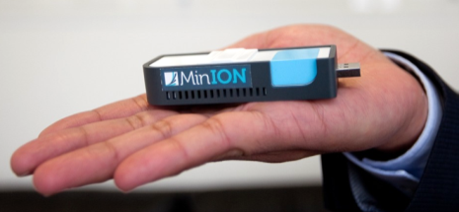
NTMGE product traceability: a cleverly maintained confusion
Traceability (ISO standard): easy and cheap, only depending on the goodwill of retailers: Traceability is the ability to identify and trace the history, distribution, location, and application of products, parts, materials, and services. A traceability system records and follows the trail as products, parts, materials, and services come from suppliers and are processed and ultimately distributed as final products and services.
Detection: easy and relatively cheap depending on the techniques used:
Action or process of discovery, put highlight or note something.
Very easy to achieve when the target is known (Eve, patent, databases...), unknown GMOs: different methods the results sometimes lightweight convergent and facilitated by DSS
methods use: phenotype (ex: seedling tolerance to a herbicide, immunological methods, PCR, LCR, Qβ replicase, SNPLex, LAMP, (methods for omics) spectroscopy to the field and laboratories according to ese methods (ex) (: PCR and LAMP to the field)
No sequence limit size (from a nucleotide to large sequences)
Quantification:
quantitative methods available,
For qualitative methods: the content can be reliably determined towards a threshold with methods of sub-sampling as for example those used in seeds’ certification.
Notes:
Beyond the impossible obligation to GMO developers to mandatorily introduce signature into their GMOs.
Do not be confused by the wording, numerous parts of methods to know what you have in a sample are relatively easy to use or develop.
Data have to be stored and managed in e.g. Euginius database http://www.euginius.eu/euginius/pages/home.jsf and GMDD http://gmdd.shgmo.org/ and/or Genbank… depending on the data.
As for any complex detection, several strategies have be combined through e.g. the “matrix approach” with or without the help of DSS (Decision Support System).
Holst-Jensen et al. 2012 Biotech advances. 30(6):1318–35.
Holst-Jensen et al. 2016 Anal. Bioanal. Chem. 408(17): 4595–4614
Signature to be determined as for cancer, where several patterns could be distinguished (see for instance
Ehrich et al., 2005
Gravina et al., 2015
Laird, 2003
Shen and Waterland, 2007
Suzuki and Bird, 2008 )
Polymorphism and epigenetics patterns
Mendizabal et al. 2014 Integrative and Comparative Biology 54(1): 31-42
All additional use of Crispr (and more generally speaking all DNA changes such as DNA insertion) could induce epigentics changes able to provide part of a signature at least for mammals (the best studies organisms) Sullivan et al. 2015 Biochemistry and Biophysics Reports 2: 143-152
Huge work to be performed before a safe use of Crispr. Hille and Charpentier 2016 Philosophical Transactions of the Royal Society B-Biological Sciences. 371: 1707
If we remind the FP5, FP6 and FP7 EU research funding for GMOs, clearly a political decision has been taken to avoid to provide detection / identification / quantification tools.
Taking the former old GMOs ways to cover this issue of ‘traceability’ would have provide solutions…

Slide 40
Identification of the used NTMGE / the owner of the product
Generally speaking, stresses leave traces in genomes and epigenomes
Profiles of mutations and epimutations (all techniques, scars and off-targets, exon-skipping…) vectorization traces, DNA contaminants of RNP, mutations hot-spots, hypermutations…
Specific NTMGE signatures,
systems of molecular structuring, cell lines profiling and “life history” (see for instance cancer cells typing)...
From the “matrix approach” (used for unknown GMOs) to
unambiguous / univocal signatures...
in vitro and in vivo mutagenesis origins.
A scientific peer-reviewed paper in preparation…
Notes:
Rech et al. 2014

Slide 41
NTMGE product traceability
European Research projects on NTGME have to be launched, as in the 90s’ for current GMOs, for a proof of concept,
Research labs will then transfer techniques, particularly those using univocal signatures, to routine enforcement labs,
Patents and scientific papers watch to feed databases as usual,
Cost are not expected to increase, not impacting consumers,
Even those using NGS (see Oxford Nanopore claims),
EC funded research projects provide rapidly the proof of concept, after a necessary moratorium period due to the current delay in starting the research projects,
Companies supply, as for the current GMOs, the NTMGE products’ signatures, defined by the research labs,
Standardization and inter-laboratory trials are performed by e.g. ENGL,
By the application by the supply chains’ actors of their current traceability procedures and controls.

Slide 42
Conclusion
Detection methods are available: from simplex to multiplex,
Inherited targets are available: from techniques scars and NTMGE specific ones to general cell lines profiling,
Costs are not expected to increase provided:

Slide 43
NTMGE and feeding the world

Slide 44
NTMGE and rapid plant breeding?
The NTMGE: really a revolution?
A plus in varietal selection?
Reduction of the time of screening (greenhouse vs. fields)? selection and integration of new traits?
New characters? Homologies and variations between species and cultivars? Mono features / oligo / multigenic? QTL? A variation in a variety is not necessarily in the same way expressed in another (effect of the genetic background of the environment...), epigenetics of culture conditions of parents influence the expression of characters in progenies (cf. drought resistance...),
an ability to improve the resilience of crops in the face of climate change? Emerging pests and diseases?
Oriented products consumers rather than farmers? The effect of other supply chains actors…
An economy of the promise as for GM of the 1990s and
cloning 20 years ago
Notes:
Up to now, greenhouses observations have still to be completed in multilocation fields.
Genome synteny and genes homologies do not effectively reduce the time of trait selection and introduction due to the errors in sequencing and databases, important differences in encoding and regulating sequences, and of the distal effects (see genomes organization and genes expression by the beginning of this presentation): in most of cases several sequencing are required even between Elite cultivars.
Subtil differences between genomes, see for instance:
Buiate et al. 2017. A comparative genomic analysis of putative pathogenicity genes in the host-specific sibling species Colletotrichum graminicola and Colletotrichum sublineola. BMC Genomics.
At the best a few months gained…
"In addition, the plant genome is extremely diverse," says Jeffry Sander, a researcher with the Department of Molecular Engineering. Between two varieties of maize, there is the same genetic distance as between a man and an ape. "Pioneer proposes several dozens, according to the humidity, temperature, wind, nature of the soil, or diseases or pests to fight ..." To make them evolve to improve them is our core business, "continues Jeffry Sander. Each time, sequencing must be repeated. "(In Le Monde Science & Medicine" In the Plant Factory of the Future ", Nathaniel Herzberg, 2017/06/07, page sch4).
Cox et al. 2017 The Crop journal. Comparing two approaches for introgression of germplasm from Aegilops tauschii into common wheat. There are still numerous issues for introgressing traits, even with markers…
The need for “safe habor”
Songstad et al. 2017 Genome editing of plants. Critical Reviews in Plant Sciences

Slide 45
Metaphors, rhetoric and communication

Slide 46
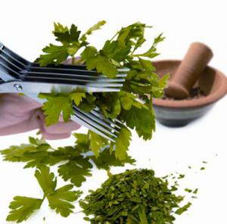
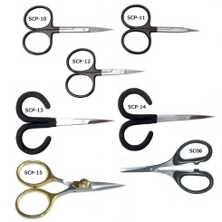
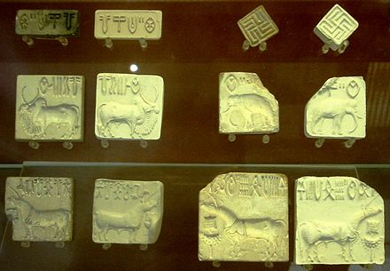
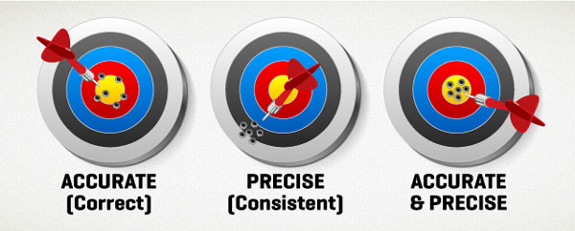
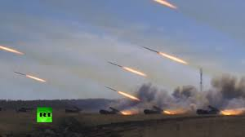
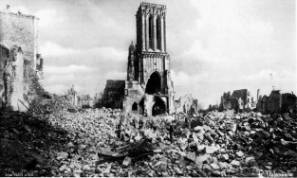
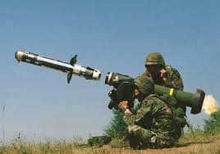
Some misleading metaphors…
But a series of cuts
(with numerous small
pieces to join by an
uncontrolled error
prone repair mechanism)
SDN = Sequence Directed Nuclease:
do not expect an unique and precise
cut by “molecular scissors”
“Genome editing”... Do you expect
known languages in
electronic writing?
You actually have
to edit handwritten
texts between
different unknown
languages
The specific promised modification?
Providing such cells and
genomes to reconstruct
Numerous 'off target’
due to ‘ricochets’
among homologous
sequences
In fact it
is as Stalin’s
organs
Targeted mutagenesis: you imagine
one clean ‘one shot’?
i.e. numerous side-effects due to both related techniques and NTGME
Notes:
Be careful with metaphors: they are often useful for some initial explanations but when repeatedly used it will drastically change your perception, your way of thinking and then of acting.
Do not forget the border between our 2 jobs: scientist and expert. A lot of them forget it.
Keep ‘critical mind’ (officially a part of the training of scientists) in front of any assertion of a lack of hazards. Beyond the usual financial conflicts of interest, there are numerous other links of interest: institutional, politics, economics…
Numerous scientists are unaware of professional ethics…
As already demonstrated by sociologists: the scientist does not leave its opinions at the door of the lab or the expertise room.
Look at the wording/ semantic used.
First example:
gene or genome editing.
You think rapidly about this image as with a “copy and paste” or “cut and paste” in your favorite computer located word processor?
But why did you imagine
That you are using a computer with word processing system?
1.1 In fact you may be using hand written text, which means you will cross-out text…
1.2. It might also bee a type written text. With such old type writer you can inly cut paper, around sentences, you will then use scotch tape and work on in order to hidden the changes at the photocopier. You can also have to completely reformat pages and thus make mistakes I the successive pages…
2. That you know well the language used in this text?
Suppose it is a foreign language you do not know. How accurate and understandable could be your cut and paste?
Suppose you are reading hieroglyphs before Champollion used the Rosetta stone.
What would make your “cut and paste” between eyes or birds differently located? No changes in the text’s meaning? Or in the poesy? The subtilities?
Second example.
Nuclease as molecular scissors
You are often facing the metaphor of endonuclease as a molecular scissor?
You thus spontaneously think to the scissors you have in your sewing box.
Forget it, you are using a multi-blades scissor, as the one you may be using for cutting herbs for cooking.
As you can see, never accept directly the metaphors and images somebody else is providing you… Look at what can be beyond the simple image, easily coming to your mind

Slide 47
Communication
Over-simplified (erasing uncertainties, without statistics...) as recommended in the guidelines on risks’ communication,
Marketing strategies: decoy and lure, loss leader,
Economy of promise (as previously done for cloning, Gos derived pharmaceuticals from GMOs… several decades ago)
Reproducibility issues, absence of standardization, quality control, claims not supported by the results (see e.g. US NIST’s Genome Editing Consortium) and investment bubbles,
Notes:
See Matsui and Corey, 2017. Non-coding RNAs as drug targets. Nat Rev Drug Discov

Slide 48
For an ethical questioning of the debate around the new genome modification techniques
Confusion maintained between science and innovation, scientist and expert, applications such as “gene drive” and NTGME techniques,
a semantic and rhetorical struggle as to the question of nature, outside the context of evolution,
an attempt to privatize of the notion of general interest...
A capture of rent: see the “mosquito gene drive” strategy vs the previous public policies of suppressing mosquitos’ multiplication sites, as cited by the WHO director in 2016,
Virtually unheard among the experts: the link of interest (including institutional), and the need for neutrality and transparency,
a condescension policies of several experts with regard to laymen who don't stick to their view,
an approach by the technological HOW, not by the WHY and for WHO,
technical limitations defavouring again the agricultural and ordinary biodiversities,
unknown and unenforced ethics guidelines,
A politicization of science and a scientification of politics…
Notes:
Mosquitos gene drive and rent capture, see:
Comme le soulignait en mai 2016 la directrice de l’OMS, nous payons l’abandon dans les années 70 des politiques de prévention anti-moustiques en Amérique du Sud et en Afrique : une réduction de mesures préventives publiques ne saurait être remplacée par des politiques parcellaires, telles qu’un lâcher de moustiques GM, avec ou sans forçage génétique
As pointed out in May 2016 the wWHO Director, we pay the abandonment in the 1970s mosquito prevention policies in South America and Africa: a reduction of public preventive measures cannot be replaced by fragmented policies, such as a release of GM mosquitoes, with or without genetic forcing the world 2016/05/26:
Le Monde 2016/05/26 :
Dans son allocution d'ouverture de la 69eAssemblée mondiale de la santé, lundi 23 mai, la directrice générale de l'Organisation mondiale de la santé (OMS) a évoqué les épidémies de Zika et de dengue, et la menace du Chikungunya, auxquelles on pourrait ajouter celle de la fièvre jaune qui s'étend en Afrique. Le Dr Margaret Chan a parlé du «prix payé pour un échec massif de la politique qui a laissé tomber le contrôle des moustiques au cours des années 1970». Coordinateur pour l'écologie et la gestion des vecteurs au département pour le contrôle des maladies tropicales négligées à l'OMS, le Dr Raman Velayudhan revient sur la lutte contre les maladies transmises par les insectes.
http://www.lemonde.fr.proxy.mnhn.fr/planete/article/2016/05/26/zika-dengue-le-prix-paye-pour-l-abandon-de-la-lutte-antimoustiques_4927175_3244.html
France: http://www.assemblee-nationale.fr/12/rap-info/i3242.asp RAPPORT D'INFORMATION DÉPOSÉ en application de l'article 145 du Règlement PAR LA COMMISSION DES AFFAIRES CULTURELLES, FAMILIALES ET SOCIALES sur l'épidémie à virus chikungunya à La Réunion et à Mayotte ET PRÉSENTÉ par M. Bertho AUDIFAX Député.
…/…
Sur le long terme, nous payons aujourd'hui le prix d'une lente réduction de nos moyens et de notre vigilance. Comme l'a rappelé le Premier ministre lors de sa visite à La Réunion en février, nous avons lentement baissé la garde.

Slide 49
As recently recalled by Emmanuelle Carpenter "for some applications, there is still the problem of the so-called mutations "off-target"- i.e. unintended-, which may never be completely excluded.
Jennifer Doudna : “This really underscores the fact that we don’t know enough about nature to anticipate all the ways that nature has come up with to manipulate DNA. Nature’s had a lot longer than we have to be tinkering. We really need fundamental research to uncover those basic mechanisms that drive the development of technologies in the future.”
After years in expertise committees, particularly in the HCB, I like to remember this sentence of Pierre Gilles de Gennes (Nobel Prize):
« Vous savez, les experts sont souvent comme les militaires. Ils sont experts de la dernière guerre mais pas de la prochaine… »
“You know, the experts are often like the military. They are experts of the last war but not the next…”
Notes:
Citation Charpentier: https://www.sciencesetavenir.fr/sante/emmanuelle-charpentier-il-y-a-toujours-un-risque-que-crispr-cas9-soit-mal-utilise_105292
Look also at Why CRISPR Never Could Have Come Out of Silicon Valley
http://motherboard.vice.com/read/crispr-jennifer-doudna-gairdner
J. Doudna stating: This really underscores the fact that we don’t know enough about nature to anticipate all the ways that nature has come up with to manipulate DNA. Nature’s had a lot longer than we have to be tinkering. We really need fundamental research to uncover those basic mechanisms that drive the development of technologies in the future.
Après des années dans des instances d’expertise, en particulier au HCB, j’aime toujours à me répéter cette phrase de Pierre Gilles de Gennes (prix Nobel) : "Vous savez, les experts sont souvent comme les militaires. Ils sont experts de la dernière guerre mais pas de la prochaine… "
(https://ec.europa.eu/research/rtdinfo/41/print_article_934_fr.html)

