Slide 1
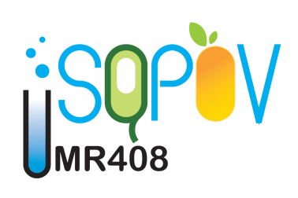
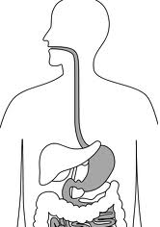
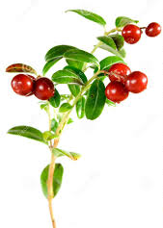
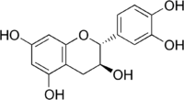
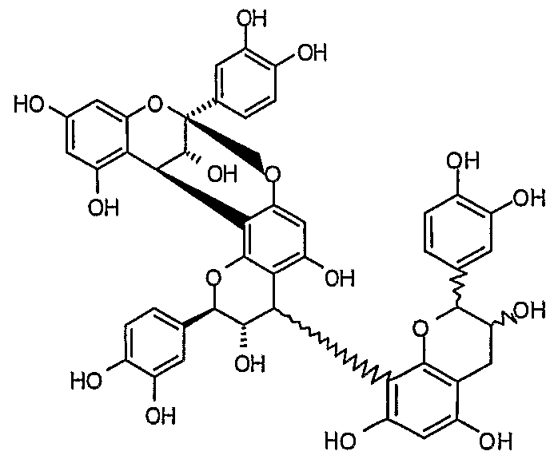
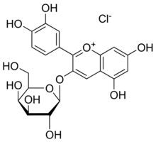
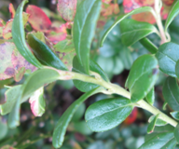
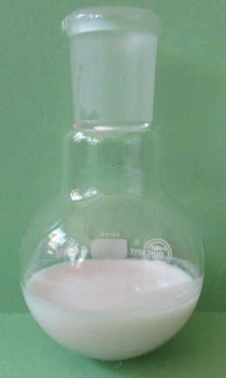
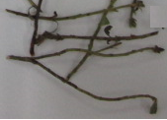
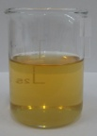
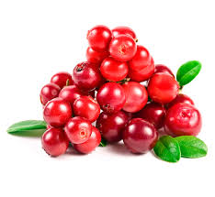
Dietary lipid protection from oxidation
by lingonberry phenolic extracts in
in vitro digestion conditions
Oana-Crina Bujor^{a,b}, Valentin I. Popa^{b}, Claire Dufourª
ªUMR408 SQPOV "Safety and Quality of Plant Products", INRA, Université d'Avignon,
F-84000 Avignon, France
^{b}“Gheorghe Asachi” Technical University of Iasi, Faculty of Chemical Engineering
and Environmental Protection, 700050 Iasi, Romania
BACKGROUND
Polyphenol
consumption/day
0,8-1,3 g [1]
Lingonberry (LB) (Vaccinium vitis-idaea L.) polyphenols:
content and main contributors [3]
Polyunsaturated Fatty Acids
(TG, PL, chlolesterol esters)
+
Stems
94 mg/g DE
Catechin
Quercetin-3-O-Gal
Leaves
65 mg/g DE
Catechin
A-type trimer
Dietary iron
+
Polyphenols
bioaccessibility
[PP] natifs ≈ 0,5 - 1 mM
Fruits
11 (H₂O) mg/g DE
12 (aq. EtOH) mg/g DE
Cyanidin-3-O-Gal
O₂, H⁺
Extracts of lingonberry stems, leaves and fruits:
Can they protect dietary lipids from oxidation during digestion in in vitro conditions?
Lipid oxidation products
(LOOH, L=O, LOH…). [2]
➔ Absorbed in LDL ➔ Atherogenicity
of modified LDL
MATERIALS AND METHODS
Leaves
Extraction and analyses of phenolic compounds
In vitro model of gastric digestion [4]
Lingonberry extracts
Metmyoglobin
[20 µM]_{final}
[0.1 mg DE/mL]
[0.4 mg DE/mL]
Stems
BB
1 - drying/ Microwave-assisted extraction (1% citric acid in water
or 55% aq. EtOH (fruits only)
UPLC/MS
Identification and quantification
of polyphenols.
Inhibition of lipid oxidation
in an in vitro model of gastric digestion.
leaves
stems
fruits
37 °C, 4h
Lipid-derived
conjugated dienes
(CDs)
Abs. at 234 nm
2 - Dried extracts (DE)
pH 5
(initial stage
of digestion)
Fruits
BB
LB
Oil-in-water Emulsion stabilized by:
BSA (Bovine Serum Albumin)
PL (egg yolk phospholipids)
RESULTATS AND DISCUSSIONS
Quantification of polyphenols by UPLC
Gastric digestion: Inhibition of lipid oxidation
BSA model
PL model
Fruits
Water
Fruits
EtOH 55%
Lingonberry extracts from leaves and stems:
➔ Flavanol oligomers and flavonol glycosides were the most representative
classes of phenolic compounds.
➔ Caffeic acid derivatives were present in significant concentrations in leaves and
in lower contents in stems.
Fruit extracts of lingonberry:
➔ In both fruit extracts monomeric and oligomeric flavanols and benzoic acid derivatives
were present as the major phenolic compounds.
Leaf and stem lingonberry extracts were the most effective antioxidants toward the metmyoglobin-initiated lipid oxidation in both BSA- and PL-stabilized emulsions at pH 5 (42-59% inhibition).
Extracts from fruit were added at 4-fold higher concentrations compared to stem and leaf.
➔ The weaker inhibition effect of fruit extracts appears to be due to the high content of sugar in fruit.
➔ The two aqueous and ethanolic fruit extract were the least effective with inhibition rates of 8%
and 12% in the BSA model, but were more active in the PL model (21% inhibition).
➔ anthocyanins and procyanidin trimers proved to be highly inhibitory in the PL model [5].
CONCLUSIONS
Different morphological parts of lingonberry represent a potential source of phenolic compounds.
Leaf, stem and fruit extracts of lingonberry can play a protective role towards oxidation of polyunsaturated dietary lipids during gastric digestion of a simulated Western diet.
References:
[1] Pérez-Jiménez J. et al., Am. J. Clin. Nutr., 2011, 93, 1220–8.
[2] Ursini F. and Sevanian A., Biol. Chem., 2002, 383, 599–605.
[3] Bujor O-C, PhD Thesis, TUIASI, INRA-Univ. of Avignon, 2016.
[4] Lorrain B. et al., J Agric Food Chem., 2012, 60, 9074−9081.
[5] Asprogenidi, K. PhD thesis, Université d’Avignon , 2015.
International Conference Aromatic and Medicinal Herbs in Food, 15 – 16th June 2016, Bucharest
Centre Inra Provence-Alpes-Côte d’Azur
Domaine Saint-Paul
Site Agroparc
CS 40509
84914 Avignon Cedex 9
Contact :
Oana-Crina Bujor
oana_crin@yahoo.com

