Slide 1
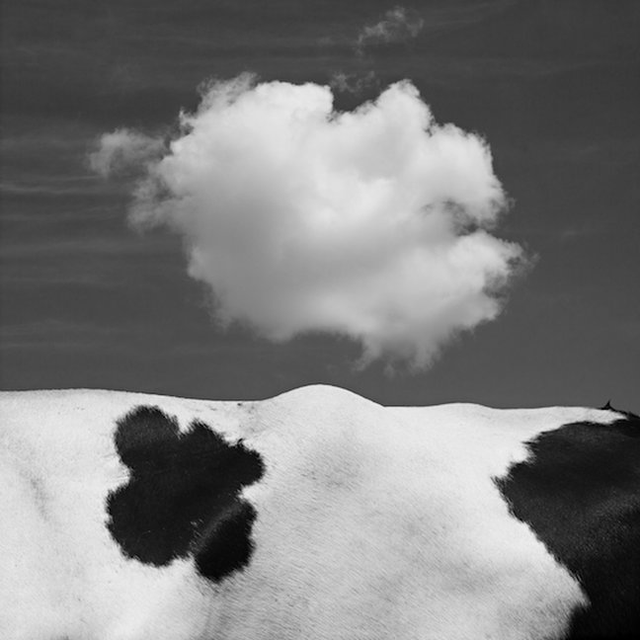
Interbull: constructing international commensurability for dairy cattle selection
Lidia Chavinskaia (LISIS)
Pierre-Benoît Joly (LISIS)
Vincent Ducrocq (GABI)

Slide 2
Project (part of GENOSOUTH coordinated by V. Ducrocq)
Context of genomic « revolution » in dairy cattle breeding and its internationalization
How does this technology of cattle breeding circulate across countries?
Comparability of genetic values
→ Commensurability – making things comparable through a common metric (Espeland & Stevens 1998, Dérosières 2014)
Social and technical process
Crucial point for the market of genetics
Interbull as a space of commensuration with 40 years history
Interbull Meeting Tallinn August 2017
Notes:
My PhD project in Science and Technology Studies (which is one of domains of social studies) aims to contribute to the analyses of international circulation of innovations. Livestock is one of the most technology driven domains of agriculture. International propagation of new technologies of genetic evaluation and breeding has been led by commercial needs firstly for the Holstein breed as the most productive and the most internationalized breed. In the context of genomic « revolution » in dairy cattle breeding and its internationalization I address the problematic of comparability of genetic values across countries. Estimated genetic value or index of bull is what the bull and semen trade is based on. This is the index of product quality which is constructed by comparison and ranking within categories of similar products. While the true product quality in genetics is uncertain, the issue of comparability becomes the issue of commensurability: how to make qualitative and predictive values comparable thanks to a common metric or quantification. The concept of commensuration is both technical and social, as it is defined by several sociologists. The first stage is a social agreement: why and what to commensurate. And the second one is the technical realization of quantification. Statistical genetics in 50’s-60’s allowed the quantification of estimated genetic values. And national systems of genetic selection has been built on. But has it allowed their universal comparability?

Slide 3
Interbull story in 3 stages:
1975 – 1993: Construction of the commensurability
Commercial issue – constructing product quality
From researchers working groups to institutionalized community with politically recognized issue: comparability of genetic indices
Conversions - “translation” of genetic indices
1993 – 2009: Stabilization of commensurability.
MACE (multi-trait across country evaluation)
Calculation center in Uppsala
From research to service
Space of commensuration = trade space
2009 – now: Destabilized commensurability
Genomic selection
New genotype data issue
Demultiplication of players and diversification of services
Interbull Meeting Tallinn August 2017
Notes:
In the 70’s with development of international trade of Holstein breed, people from European countries importing American bulls realized that quantified values perfectly expressed in numbers were not really comparable between different countries. The story of Interbull started at that moment when European importers wanted to know better the quality of what they were buying from abroad. We can define 3 main stages in the history of Interbull: the first one when the lack of commensurability was identified and the process of its construction was launched. The second one is the period of the stabilized commensurability with MACE model and construction of international space of commensuration around the technical infrastructure of Interbull calculation center. And the last one is marked by the arrival of genomic selection which has destabilized the existing international commensurability.

Slide 4
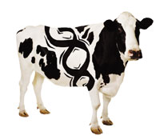
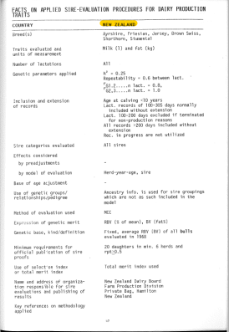
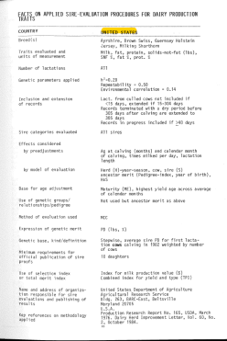
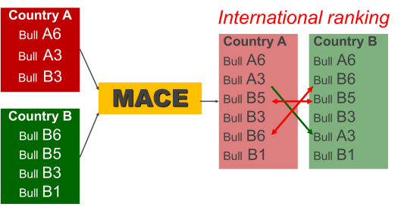
Constructing Commensurability
Biological problematic
+
Social context – multispace of commercial « coopetition »
+
Technical solution – mathematical model estimating correlations and adaptong rankings
GxE
Facts on applied sire-evaluation procedures
for dairy production traits.
Source: Interbull Bulletin n°3, 1988
Interbull Meeting Tallinn August 2017
Notes:
Our socio-historical analysis of Interbull story argues that the process of commensuration is paramount for the international semen trade AND for the propagation of new technologies of genetic evaluation. As I said, the commensuration is both social and technical process. The case of the construction of international commensurability for cattle selection shows that another crucial element to take in account is the biological one. Indeed, the most of political and technical negotiations for international commensurability of genetic values were led around the biological problem of accounting for “genotype by environment interaction” which is inherent to live organisms. From political side, two different logics were confronted: the importers’ one and the exporters’ one – to decide: to take or not to take in account this biological aspect of the live product. From technical side, scientists were negotiating with low correlations which are statistical expression of GxE interaction. The technical commensuration was constrained by the social (political) context of “coopetition” between players: a need to cooperate, to find a common standard, to harmonize, but impossibility to share strategical data because of commercial competition on the international semen market. So the MACE model became a very good compromise: a technical tool allowing the international commensurability of genetic values without a too much difficult standardization of national systems and without obligation to share strategical data. So, political problem was resolved by the technics.

Slide 5
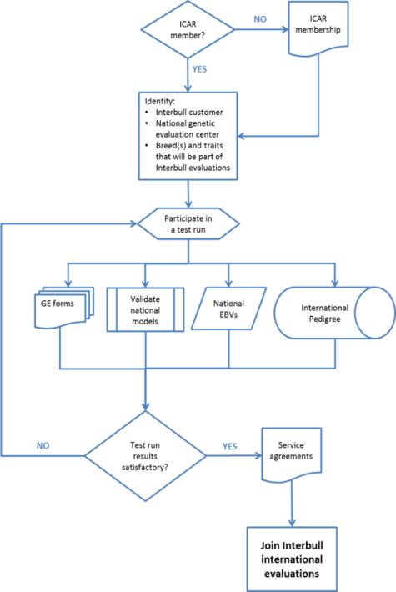
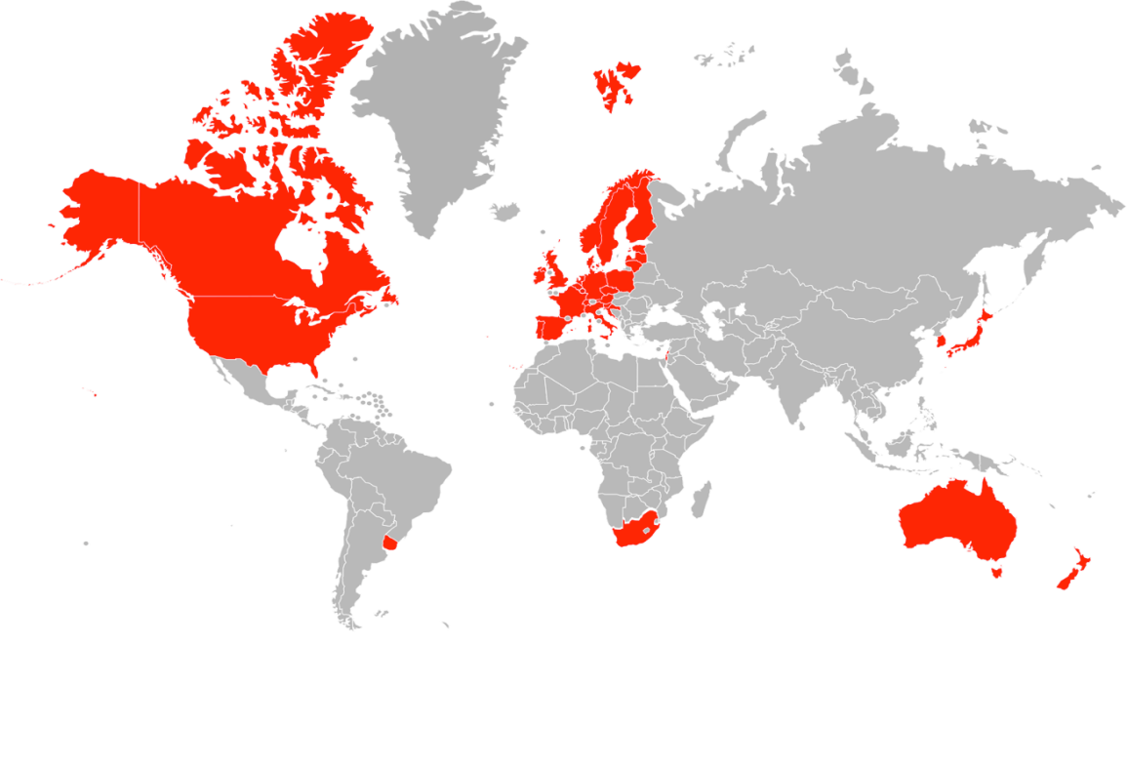
Space of Commensurability
Technical space = political (trade) space
Steps for an organization willing to join t
he Interbull services.
Source: Intebull Code of Practice
Interbull Map. Source: A. Roozen presentation 2016
Interbull Meeting Tallinn August 2017
Notes:
The transnational space of commensurability has been created around MACE and its infrastructure - the center of calculation in Uppsala. Every created space needs established borders. Those of our commensuration space were determined by technical capacities of countries members to prove their ability to be “commensurated” and to positively contribute to the global commensuration. Tests run were set up to assess the technical quality of national evaluations as components of the international evaluation. So, mechanisms of inclusion and exclusion are determined technically, but they have directly a political impact. The inclusion of a country into the commensuration space means its admission into the circle of peers: active and conscious players of the cattle genetics’ market. And a country excluded from the commensuration space is automatically excluded from the trade space (even if it is just for one evaluation session because of some non-conformation, it means that this country cannot commercialize its new bulls and to improve ranking of its old bulls on the international market).

Slide 6
Crisis of commensurability
Source: P. Sullivan Presentation Workshop Ljubljana 2017
Interbull Meeting Tallinn August 2017
Notes:
This space of commensurability was more or less stable until the moment where the new technology of genomic selection destabilized the balance between actors, brought a new issue of genotype data and showed the limits of the commensurability of genetic values. Too much data, too many animals evaluated. National breeding programs change. The models become obsolete and need to be changed, adapted to the new conditions. But the circle of concerned players became larger, players are more diversified and it is more complicated to find compromises, to push different logics in the same direction.

Slide 7
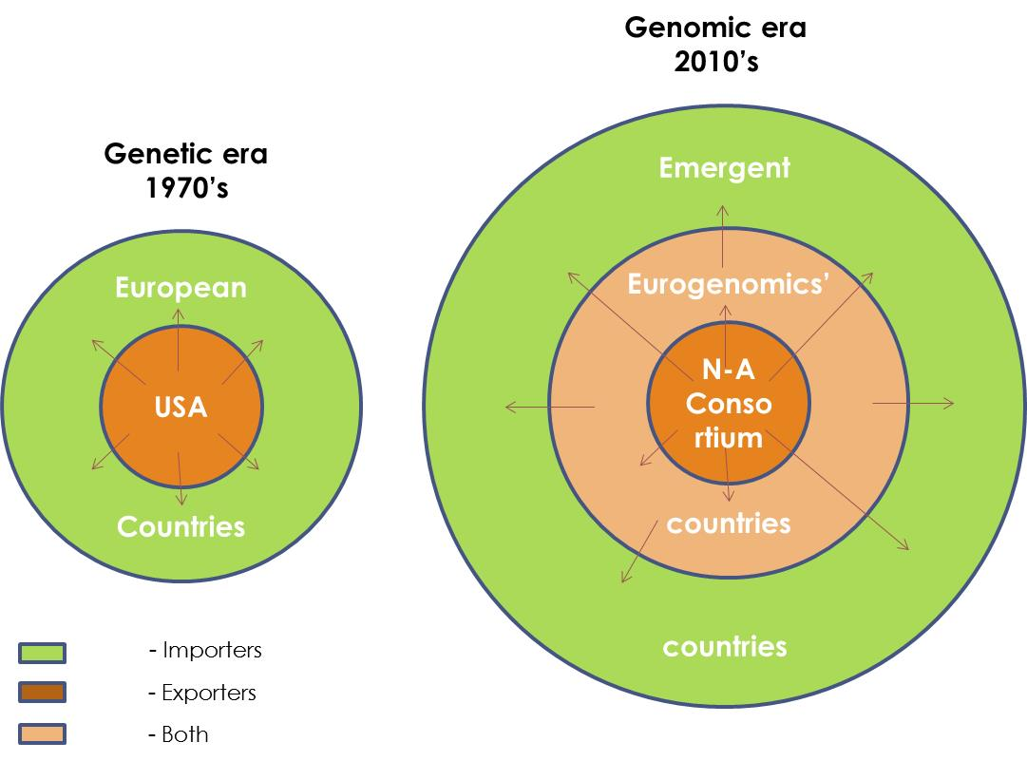
New commensurability for new contrext?
Interbull Meeting Tallinn August 2017
Notes:
But the issue of commensurability is still on the front of debates.
For big (developed) countries in the context of liberalization of genetic and genomic evaluations market with diversification of players and scales of evaluations on national and European levels.
As well as for new countries which want to know better what to import for their own breeding systems.
The circle of players is larger (more importers, more exporters) , their interests are more diversified, but the challenge is quite the same then 40 years ago: to find a new technical solution to the biological problem of accounting for GxE interaction in the context of “coopetition” between players (the strategical data sharing is still problematic).

Slide 8
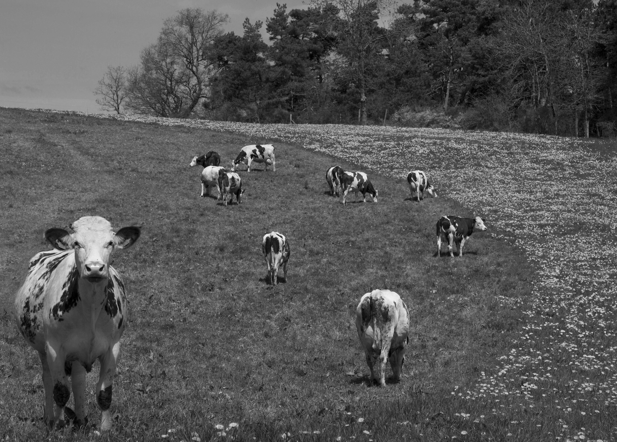
Thank you for your attention

