Slide 1
Design of a low-density SNP chip for genomic selection in layer chickens
Herry Florian^{1,2}, Hérault Frédéric², Varenne Amandine¹, Burlot Thierry¹, Le Roy Pascale² et Allais Sophie²
¹NOVOGEN, 22800 Le Foeil, ²PEGASE, INRA, Agrocampus Ouest, 35590 Saint-Gilles
Xth European Symposium on Poultry Genetics
27/06/2017 – St-Malo
1

Slide 2
Introduction – Context & Objective
Since 2013, a commercial high-density SNP chip of 600 000 SNP for chicken is available
Enables implementation of genomic selection in layers production
But genotyping costs still remain high on a large number of selection candidates
Combining genotyping on low-density SNP chip and imputation should be considered
Main objective : To choose the best strategy for low density genotyping of laying hens to optimize selection scheme
2

Slide 3
Introduction – What is imputation ?
Imputation « is t_e _rt _f g_es__ng _e_te__ » (Dassonneville, 2012)
3

Slide 4
Introduction – What is imputation ?
Imputation « is the art of guessing letters » (Dassonneville, 2012)
3

Slide 5
Introduction – What is imputation ?
Imputation « is the art of guessing letters » (Dassonneville, 2012)
In our case, it is deduction of HD genotyping of selection candidates from their LD genotyping and HD genotyping of reference population (Dassonneville, 2012)
Imputation relies on the rules of Mendelian transmission of the traits and on linkage disequilibrium in the population.
SNP i
SNP j
SNP k
C
G
G
A
T
A
T
C
A
T
A |  | G |  |  |  | G | C |  | C |  |  |  | G | C |  |  | C
T |  | A |  |  |  | C | T |  | G |  |  |  | C | T |  |  | T
Individual 1
G
C
A
G
C
A
G
T
G
C
3

Slide 6
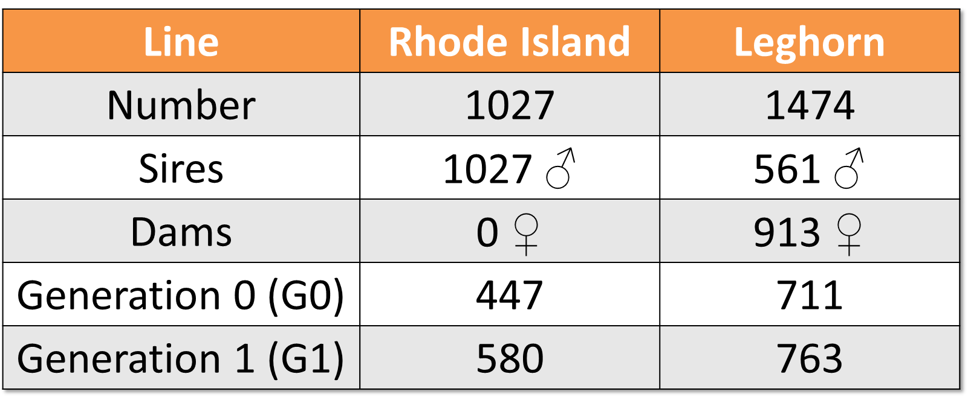
Material & Methods – Study populations
2 different lines of Rhode Island (RI) and Leghorn (L).
Both genotyped on HD SNP Chip.
Respectively 300 351 and 245 667 SNP retained and distributed on the genome for RI and L.
4

Slide 7
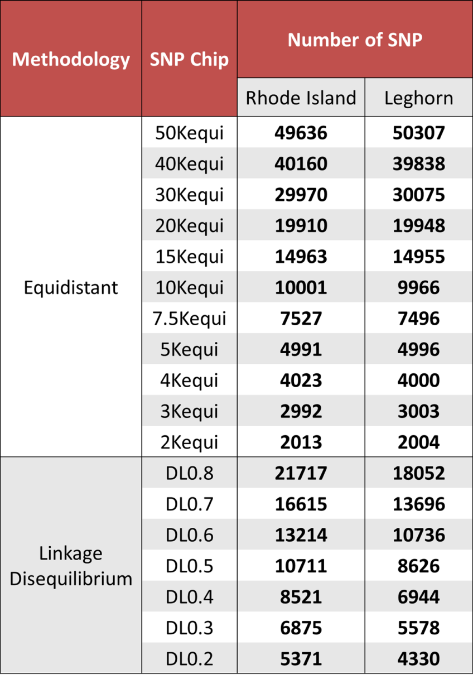
Material & Methods – Low-density SNP chips
Simulation of low-density SNP chip according to 2 different intra-chromosomes methodologies:
« Equidistant » methodology: Selection of SNP at regular intervals, taking into account MAF of SNP
11 low-density SNP chips are designed from 50K to 2K SNP
« Linkage disequilibrium » methodology: Selection of SNP according to the LD between SNP, by hierarchical clustering
Select SNP 4 Imputation
(https://forge-dga.jouy.inra.fr/projects/select_snp_4_imputation)
7 low-density SNP chips are designed for a LD threshold (R²) ranging from 0.2 to 0.8
5

Slide 8
Material & Methods – Imputation software
Use of two software :
FImpute (Sargolzaei et al., 2014)
Beagle (Browning and Browning, 2009)
6

Slide 9
Material & Methods – Imputation strategies
SNP density on low density SNP chip
Reference Population (HD genotyping)
FImpute
LD threshold (R²)
Equidistant or Linkage Disequilibrium methodology
Software
Imputation
Type of chromosome
Beagle
Candidate Population
(HD genotyping imputed)
MAF of SNP
Candidate Population
(HD genotyping)
Comparison
Genotyping error rate (%)
Criterion of validation of imputations
7

Slide 10
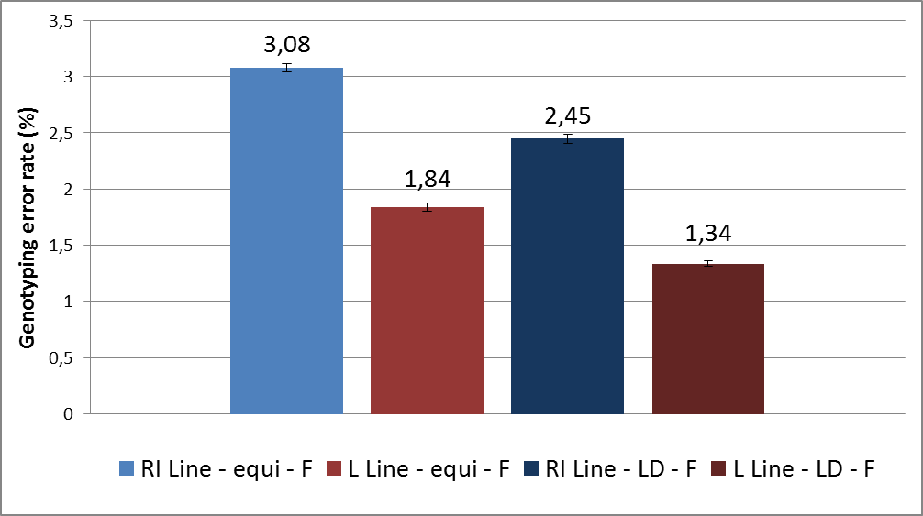
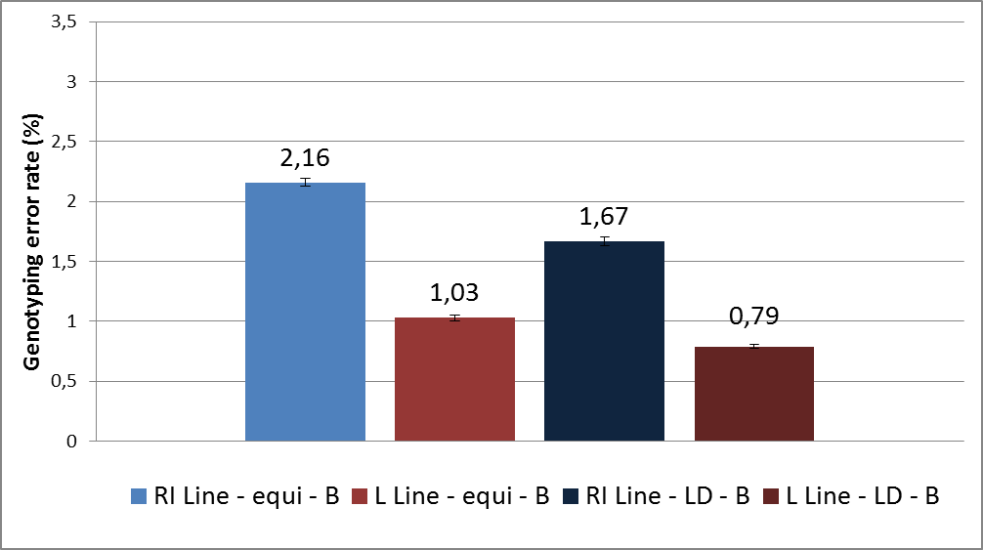
Results & Discussion – Comparison of software
Comparison bewteen Fimpute (F) and Beagle (B) for both lines, at equivalent SNP density
FImpute
Beagle
Beagle > Fimpute
But Fimpute is far much faster than Beagle…
 | Fimpute | Beagle
Execution Time (average) | 5 minutes | 12 hours
8

Slide 11
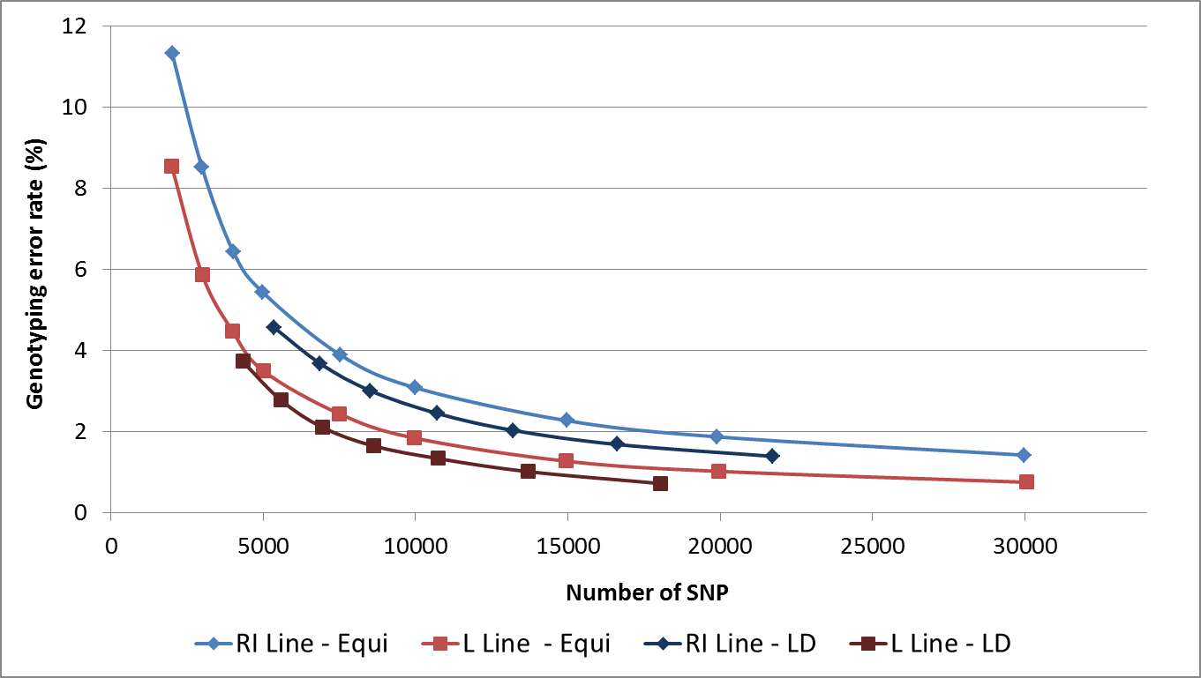
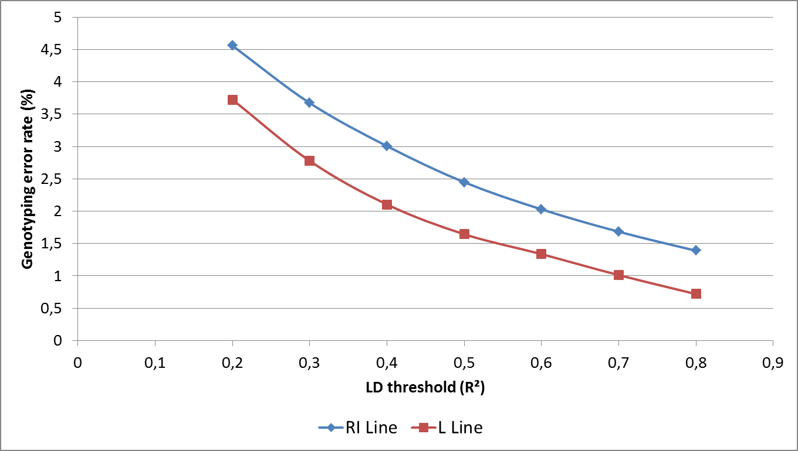
Results & Discussion – What kind of chip for imputations ?
Decrease of genotyping error rate with an increase in the number of SNP
Decrease of genotyping error rate with an increase in LD threshold (R²)
« LD » methodology seems to be better than « equidistant » methodology to get good imputations.
9

Slide 12
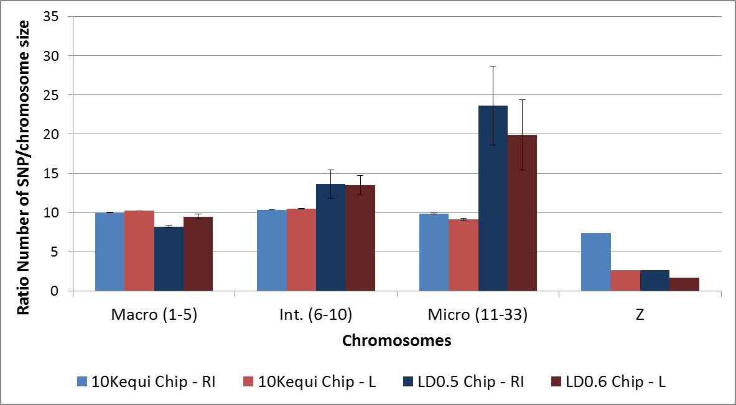
Results & Discussion – What kind of chip for imputations ?
X0.8 – X0.9
X1.3
X2.3 – X2
Structure of the poultry genome:
Macro: High extent of LD → few SNP to cover the chromosome
Micro: Low extent of LD → more SNP to cover the chromosome
With « LD » methodology:
Optimization of the number of SNP on macro-chromosomes
Densification of the number of SNP on micro-chromosomes
10

Slide 13
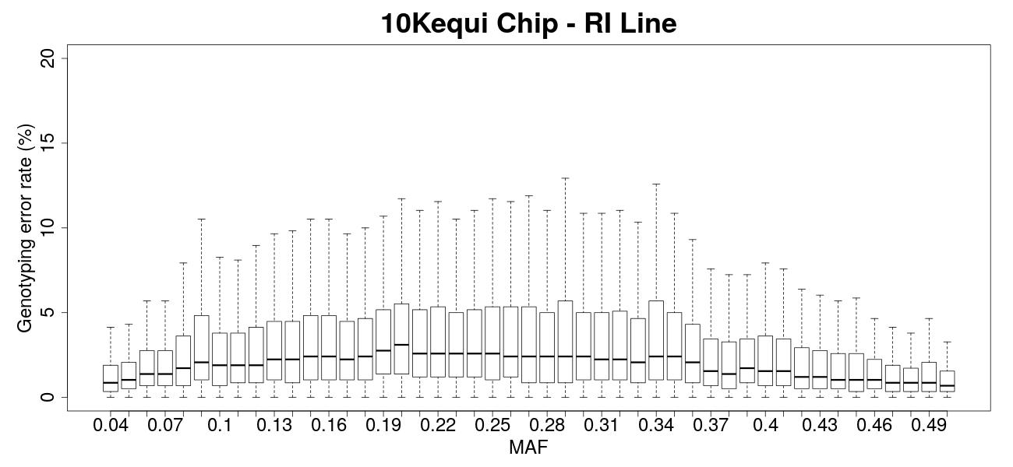
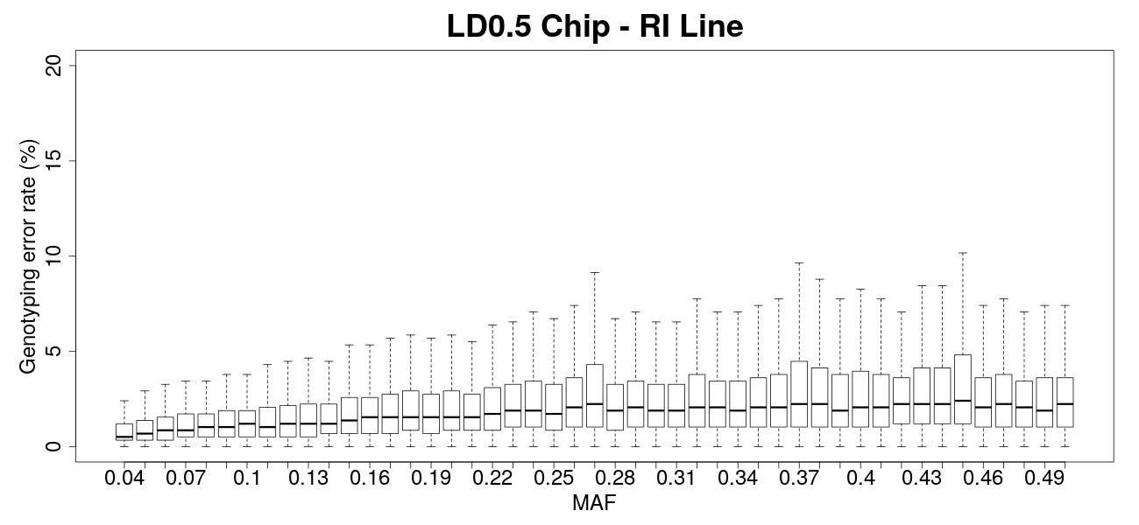
Results & Discussion – Influence of MAF
Higher variability of genotyping error rate with equidistant methodology.
Lower genotyping error rates with LD methodology.
Decrease of genotyping error rates of SNP with high MAF with equidistant methodology.
Valid for both lines.
11

Slide 14
Conclusion
Consideration of the particular structure of chicken species’ LD with LD methodology.
Better results of imputation with low-density SNP chip based on LD.
According to the MAF, lower genotyping error rates with LD methodology, excepted for SNP with high MAF.
Soon :
Creation of a multi-line chicken low-density SNP chip
Study of its imputation accuracy
Study of the impact on genomic evaluations
12

Slide 15
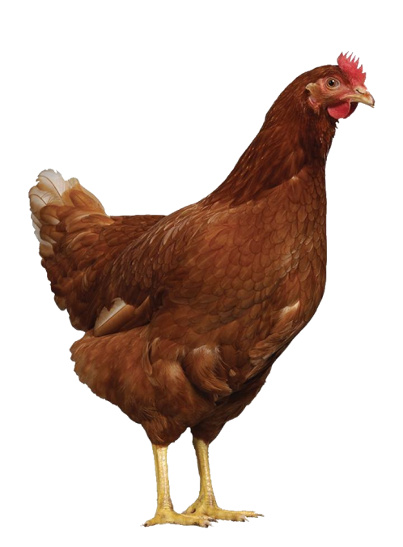
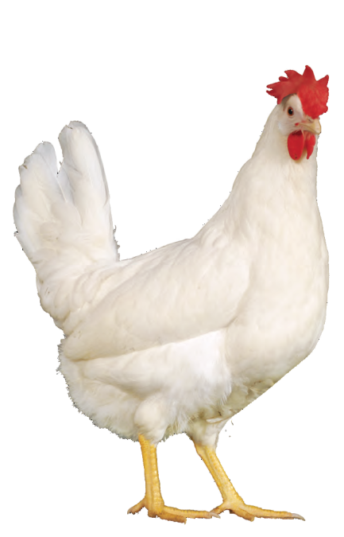
Thanks for your attention !
13

Slide 16
Particular extent of LD
Robert et al., 2015

Slide 17
Distribution of SNP on sexual chromosome Z
A3 Line
P2P4 Line

