Slide 1



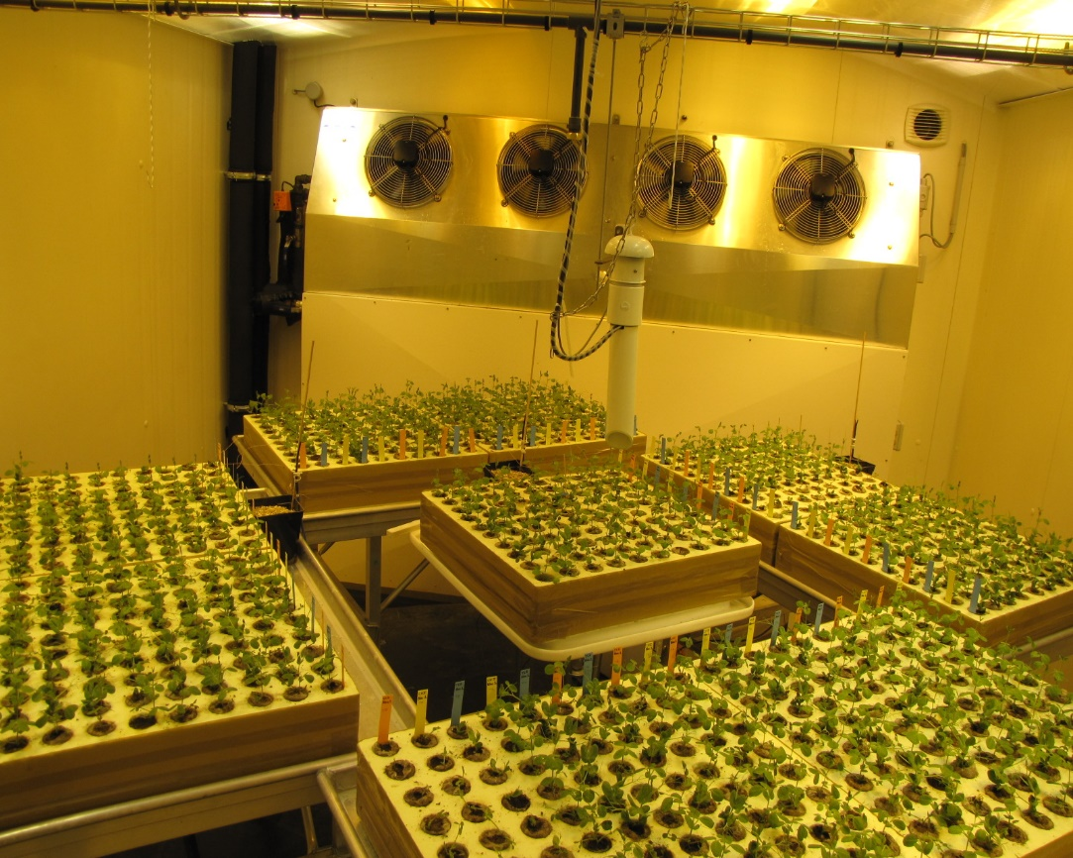
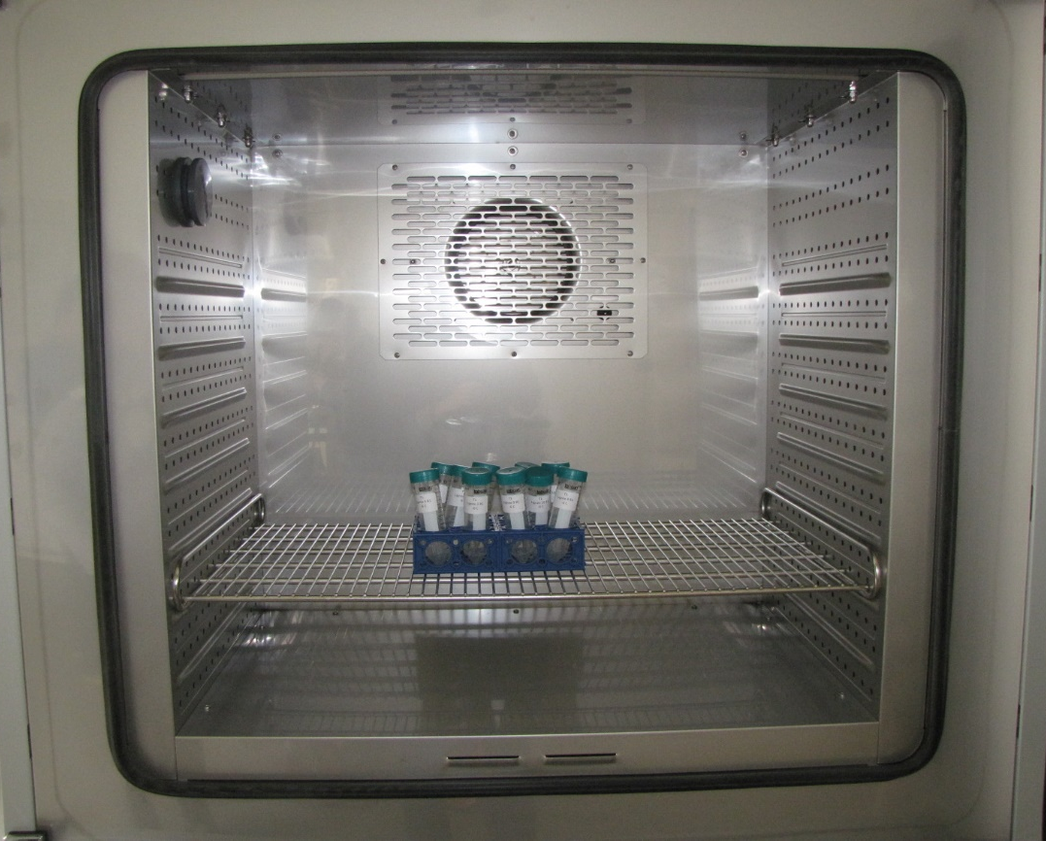
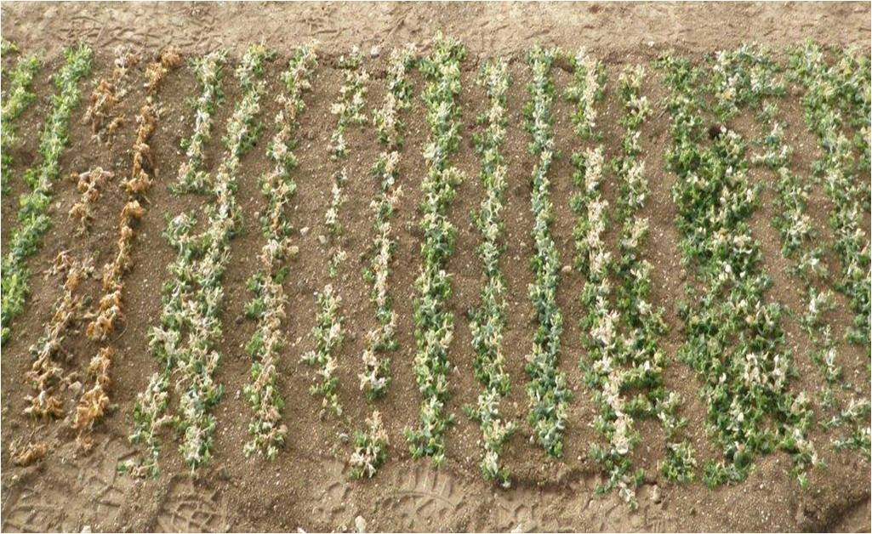


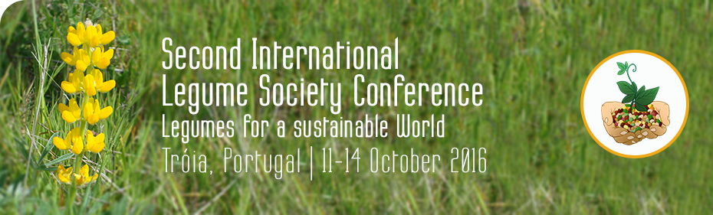

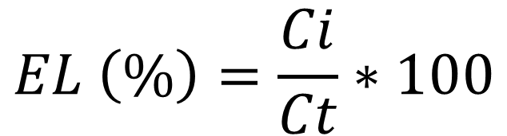
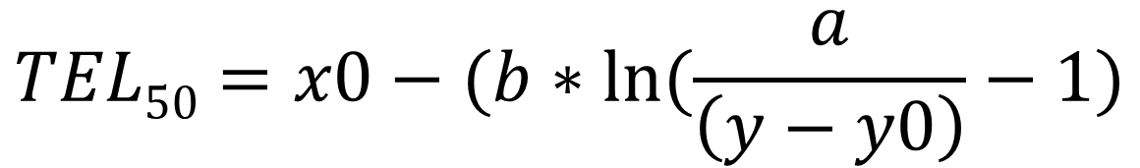
Development of a freezing test in controlled conditions for Pisum sativum
HascoËt e¹, devaux c² , BEJI S³, Jaminon o¹, BANCOURT L¹, KERGROAC’H N¹, HÛ J-F⁴, DEPTA F⁴, LECOMTE C⁵, DUFAYET V⁵, DELBREIL B³, LEJEUNE-HENAUT I¹
¹ : USC Institut Charles Viollette – Adaptation au Froid du Pois, INRA, Estrées-Mons, 80203, Péronne, France
² : Terres Univia, Estrées-Mons, 80203, Péronne, France
³ : USC Institut Charles Viollette – Adaptation au Froid du Pois, , Université Lille1, 59655, Villeneuve d'Ascq, France
⁴ : UE GCIE-Picardie, INRA, Estrées-Mons, 80203, Péronne, France
⁵ : UMR Agroécologie, INRA, 21065, Dijon, France
Freezing is a major environmental limitation to crop productivity for a number of species including legumes. In the context of global climate change, winter crops will experiment milder autumn periods that could interfere with the achievement of cold acclimation, i.e. the ability for plants to increase their level of frost tolerance in response to low but non-freezing temperatures. For the pea crop, a climate analysis coupled to a modelling approach has shown that climate warming will increase the occurrence of freezing damage events, even if these latter will be less severe (Castel et al., 2014). Thus, breeding for frost tolerant winter peas requires not only to improve their frost tolerance threshold, but also to raise their cold acclimation rate. In order to evaluate the genetic variability of this last trait, we are adjusting (optimizing) an experimental protocol in controlled conditions which provides an indirect evaluation of frost tolerance by the measurement of tissues’electrolyte leakage.
Material and Methods
Sampling
Temperature decrease
Samples were subjected to a temperature decrease of 2°C.H⁻¹ to reach test. A 1H steady-state was observed at each test temperature (Fig.3)
Nursery
Seeds were sown in root-isolated trays and placed in a climatic chamber (Fig.1) at 14°C/day, 12°C/night, 10h-photoperiod (400 µmol photons.m^{-2.}s⁻¹), until 3-leaves stage was reached
Parameters of the climatic chamber were switched to provide cold acclimation conditions, 4°C/day, 2°C/night, 10h-photoperiod (200 µmol photons.m^{-2.}s⁻¹)
Initiation of ice nucleation
Measurement of electrolyte leakage
Inititial conductivity (Ci) wa measured using a conductimeter (µS.cm⁻¹)
Total conductiviy (Ct) was measured after 24h at -80°C
Cold acclimation
Liquid nitrogen was spread on each of the plants to be sampled, in order to induce ice nucleation
Plants stems were rinsed and placed individually set in 50mL Falcon© tubes filled with 30mL ultra-pure water. Tubes were then placed in a programmable freezer (Fig. 2)
Figure 1. climatic chamber
Figure 2. programmable freezer
Figure 3. Rate of temperature in the programmable freezer
Results
a
b
Electrolyte leakage was measured after 14 days of cold acclimation for the pea lines Térèse, Isard, China and Champagne tolerant ones. Eight temperatures were tested ranging from +4°C to -27 °C. For each line and each test temperature, the percentage of Electrolyte Leakage (EL) was calculated as:
EL values were fitted to a sigmoïdal regression model with the R program (Fig.4) and TEL₅₀, the temperature corresponding to 50% EL, were calculated for each pea line as follows :
c
d
$$EL \left(\%\right)=\frac{Ci}{Ct}∗100$$
$$TEL50=x0−(b∗ln⁡(\frac{a}{\left(y−y0\right)}−1)$$
Figure 4. Electrolyte leakage (%) vs temperature (°C) for the pea lines Térèse (a), Isard (b), China (c) and Champagne (d)
Data were fitted to a sigmoïdal regression model (red line) and 95% confidence interval (blue line) was also represented.
The TEL₅₀ values showed significant differences between Térèse, already known as a frost sensitive line (TEL₅₀ = -11°C), Isard, known as an intermediate line (TEL₅₀ = -13,7°C) and both tolerant lines China (TEL₅₀ = - 22,7°C) and Champagne (TEL₅₀ = - 23,6°C).
This ranking is also consistent with that observed for freezing tolerance at the Chaux-des-Prés field platform(Fig.5).
Figure 5. TEL₅₀ and 95% confidence intervals, compared to visual frost damages observed in 2012 at the Chaux-des-Prés field platform.
a, b, c : SNK grouping of the TEL₅₀ values
Perspectives
Next improvements of this freezing test under controlled conditions should lead us to rank pea lines not only for their frost tolerance level but also for their cold acclimation rate. This protocol will also help for the phenotypic validation of frost tolerance QTL that requires to detect slight variations among QTL-near isogenic lines.
Castel et al., 2014. 27ème colloque de l'Association Internationale de Climatologie, p271-277.
USC Institut Charles Viollette-Adaptation au Foid du Pois
Estrées-Mons, BP 50136
80203 Péronne FRANCE

