Slide 1
Reasons for the Spatial Aggregation of Indicators A case study in water management
Sandrine Allain, Gaël Plumecocq, Delphine Leenhardt
ESEE Conference, Budapest, 2017
Special session: Negotiating diverging values, interests and institutions in the spatial goverance of commons
22 June 2017

Slide 2
Outline
Introduction : spatial aggregation in the development of indicators
Our case study, our material
Results: reasons underlying aggregations
Discussion

Slide 3
1. Intro: Information compressions
?
A watershed

Slide 4
1. Intro: What’s the matter?
Average number of water use restrictions per year
37
Situation 1
3 different descriptions of the situations
Situation 2
52
3 different objects for evaluating the situations
3 different indicators
Customization 1
Customization 2
Customization 3
Spatial aggregation

Slide 5
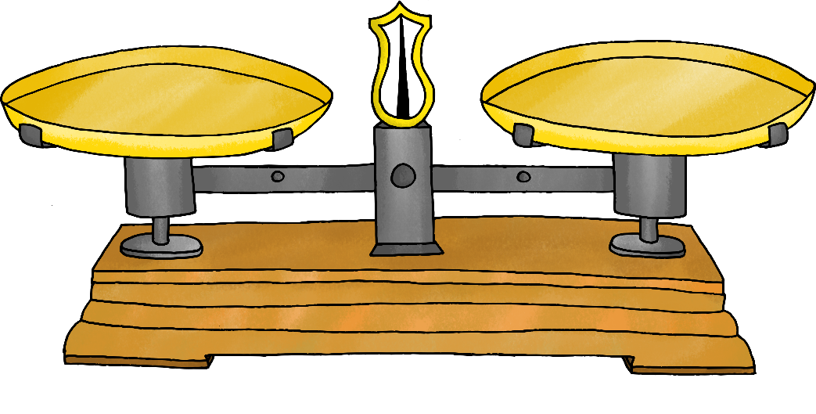
1. Intro: How to make a « good » aggregation choice?
Scientific soundness
Transparency
Ease of interpretation and use
“Indicators have a dual role. They should describe aspects of the situation or options under scrutiny, and also permit protagonists to express normative judgments.”
(Frame and O’Connor, 2011)
What about normative claims ?
The descriptive balance
Test based on justifications for aggregation choices

Slide 6
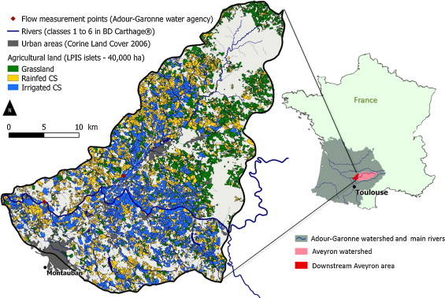
2. Case study: water management in an agricultural landscape
Water = « fugitive » common (Giordano, 2005) -> asymetries, distributional issues
Watershed scale = spatially-explicit data available -> spatial aggregation choices
Which pathways / methods?
Who makes them? (developer vs user)
How are those choices justified?
The downstream of the Aveyron watershed (South-Western France)

Slide 7
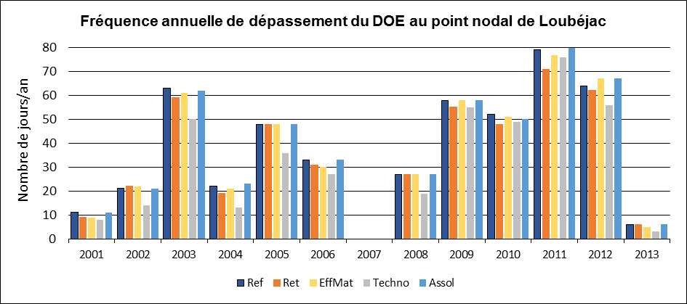
2. Material: a list of indicator profiles
11 evaluation criteria translated into 146 indicator profiles
« Number of days when the low-water target flow is crossed »
Definition
Meaning: related criteria, justification
Estimation: estimation mode, scale of raw data
Customization: representation, aggregation scale
…

Slide 8
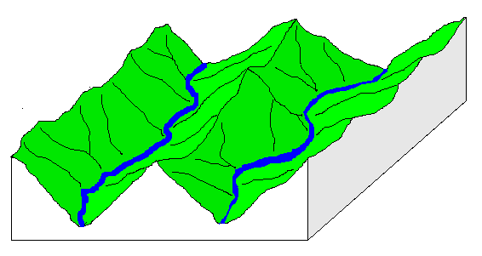
3. Results: some examples
Indicator name
(given by experts)
Scale of raw data available
Aggregation scale
(given by experts)
« Variation of water stored in soils »
Adequation to the criteria
« Fit bw storing capacities and needs of farmers »
Expression of a social rationality
Accounting for uncertainties
« Frequency, distance and severity of water flow disruptions »
Plural interpretations
Contextualizing information
Knowledge gap

Slide 9
3. Results: Developer-led aggregations
To highlight contrasts
To increase readability
To fit to the criteria targeted
To fit to the process scale
To facilitate comparison bw options
To integrate uncertainties
To force the expression of a social rationality
Partial aggregations
Complete aggregations

Slide 10
3. Results: User-led aggregations
To visualize variability
To favour diverse interpretations
To contextualize information
To acknowledge a knowledge gap
?

Slide 11
4. Discussion: Descriptive claims…
To fit to the criteria /process targeted
To acknowledge a knowledge gap
To contextualize info
To increase readability
To facilitate comparison bw options
But not only …
The descriptive balance

Slide 12
4. … coexist with normative claims
To highlight contrasts
To favour plural interpretations
To force the expression of a social rationality
The normative balance

Slide 13
4. Discussion: Both make sense for the governance of commons
Complex processes
Indicators as objects that allow the expression and confrontation of different values and knowledge.
Scientific soundness
Common good
Social incommensurability
Social rationality
Multiple actors
Indicators as objects that compress information and create coherence.
Ease of use
Participation of non-experts

Slide 14
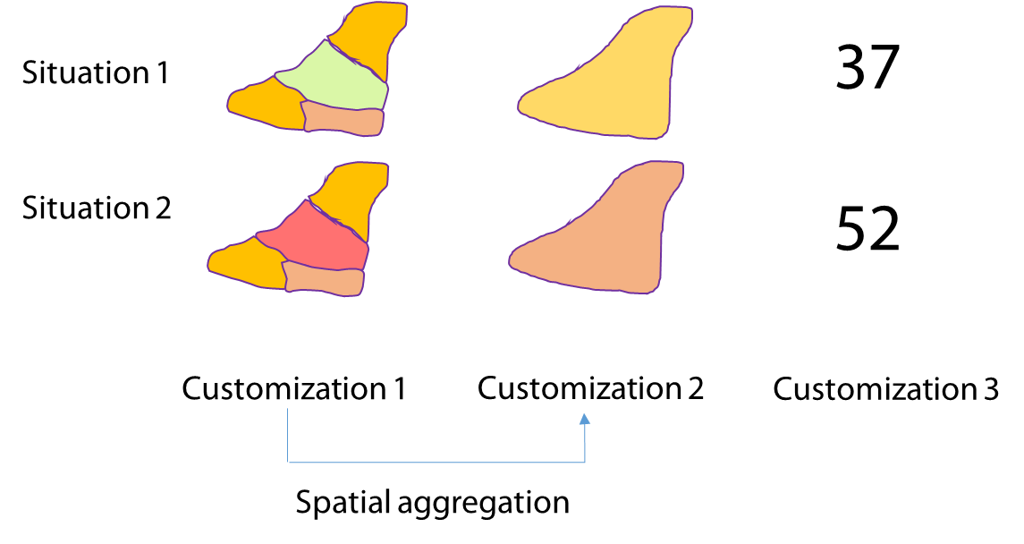
5. Conclusion
Spatial aggregation is one example of information compression that bears both a descriptive and normative aspect.
The choices made contribute to expanding / reducing the array for different uses of indicators.
The way indicators are customized deserves more attention.

Slide 15
Thank you!
Contact : sandrine.allain@inra.fr

