Slide 1
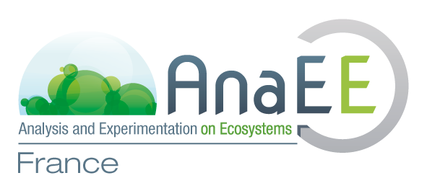
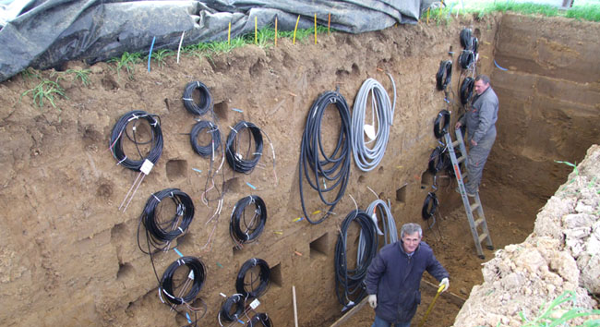
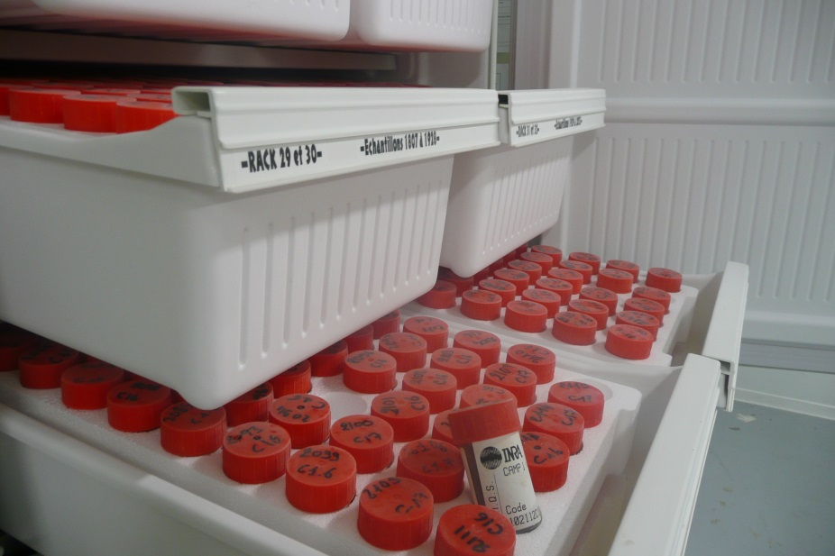
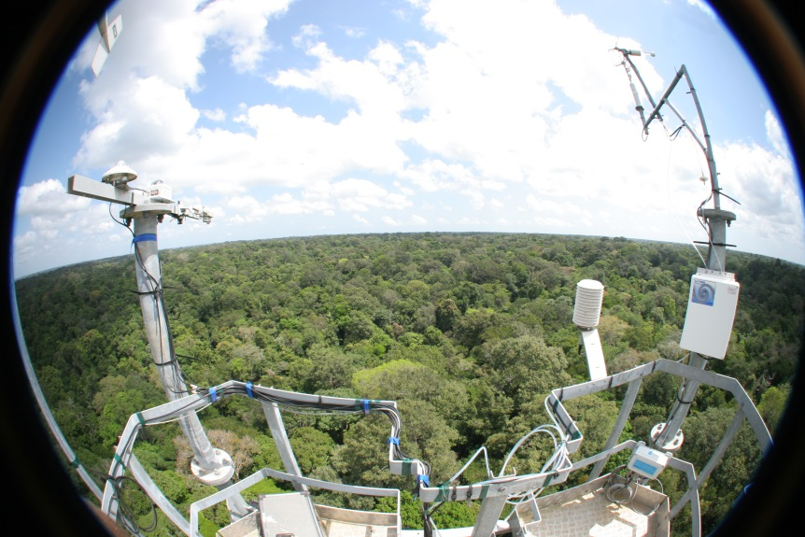
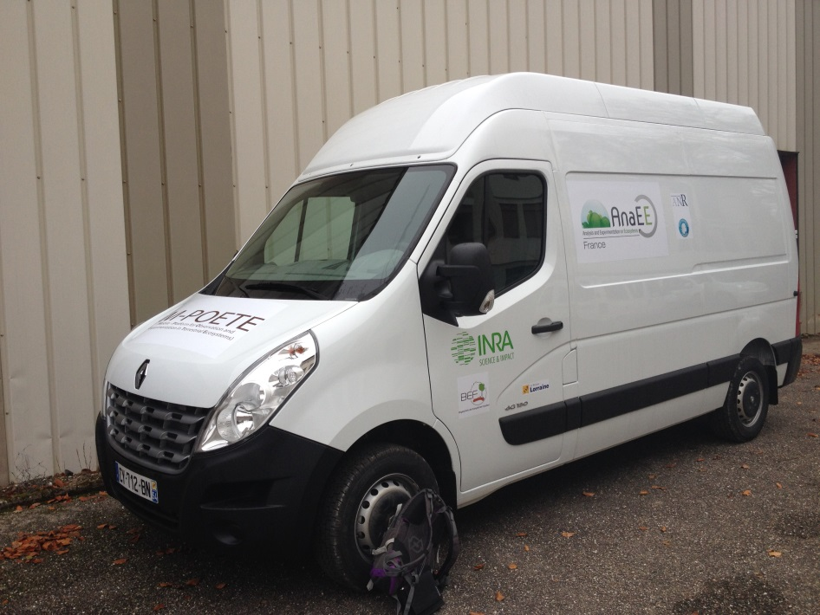
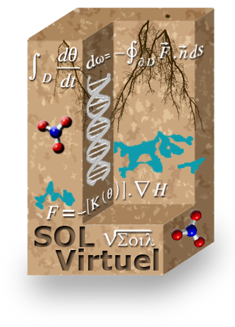
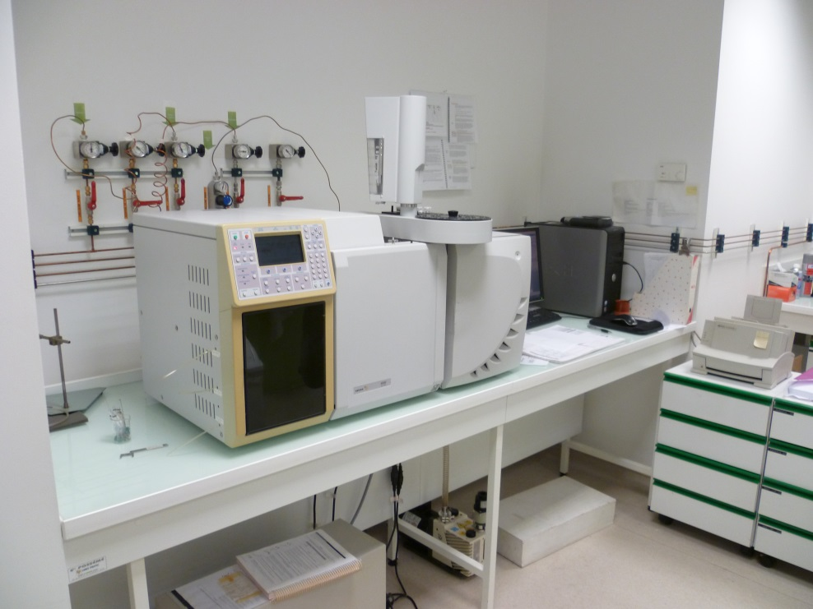
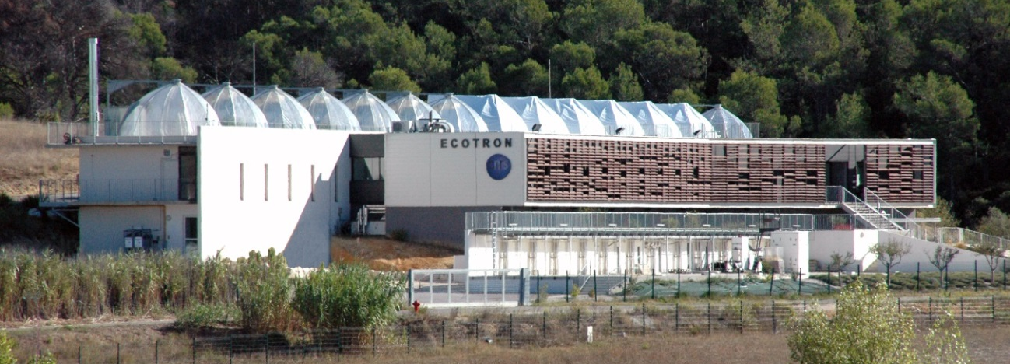
AnaEE-France research infrastructure services
for experimental studies on soil biodiversity
and associated ecological functions
Chabbi A.¹, Chanzy A.^{2*,} Clobert J.³, Houot S. ⁴, Klumpp K. ⁵, Lafolie F. ², Le Galliard J.-F.⁶, Loubet B. ⁴, Mougin C. ⁷, Pichot C. ⁸, Ranjard L. ⁹, Roy J.¹⁰, Saint-André L. ¹¹, Zeller B. ¹¹
1, UR P3F, INRA Centre Poitou-Charentes, Lusignan
2, UMR EMMAH, UAPV-INRA Centre PACA, Avignon *andre.chanzy@avignon.inra.fr
3, USR SEEM, Station d’Ecologie Expérimentale du CNRS à Moulis
4, UMR EGC, AgroParisTech-INRA Centre Versailles-Grignon, Thiverval-Grignon
5, UREP, INRA Centre de Clermont-Ferrand-Theix
6, UMS CEREEP-Ecotron IleDeFrance, CNRS-ENS Foljuif
7, UR PESSAC, INRA Centre Versailles-Grignon, Versailles
8, URFM, INRA Centre PACA, Avignon
9, UMR Agroécologie, Université de Bourgogne-INRA Centre de Dijon
10, Ecotron européen de Montpellier, CNRS
11, UR BEF, INRA Centre de Nancy, Champenoux
AnaEE-France (Analysis and Experimentation on Ecosystems) is the french node of a European research infrastructure dedicated to experimental research on continental ecosystems. It gathers a set of platforms selected for their originality, their quality and their access to the scientific community. The Infrastructure offers clear access rules for a large set of services including in vitro, in natura experimental facilities, front hedge equipments, modelling platforms and data bases. In particular, a wide panel of complementary services is relevant for soil ecology and biodiversity.
© INRA
© INRA
© EcoFog
The SOERE ACBB & the SOERE PRO are long-term experimentation sites (6) on grassland and arable land. Long term treatments have been applied . They are characterized by different levels of intensification or types of organic waste products leading to differentiated ecosystems. Each treatment is heavily instrumented to characterize biogechemical cycles and biodiversity. They also give access to their data bases and archived samples.
http://www6.inra.fr/qualiagro/Nos-partenaires/ Le-reseau-SOERE-PRO
http://www.soere-acbb.com
The GenoSol platform is designed to provide a logistic and technical structure for the acquisition, conservation and characterization of soil microbial genetic resources (DNA) derived from wide-scale soil sampling (several hundred to several thousand samples corresponding to large spatial and/or time scales). It also provides an Information System on soil and
environmental microbial diversity.
http://www2.dijon.inra.fr/
plateforme_genosol
The SOERE F-ORE-T is a long term experimentation platform gathering 15 highly instrumented forest sites (10 in metropolitan France and 5 in the humid intertropical zone). Its aims are: to understand forest ecosystems functioning thanks to carbon stocks and fluxes, water and mineral elements analysis; and second, to evaluate their responses
to change (climate, forestry, land use…).
http://www.gip-ecofor.org/f-ore-t
© INRA
© INRA
The M-POETE platform (Mobile Platform for the Observation and the Experimentation in Terrestrial Ecosystems) aims at characterizing terrestrial ecosystems in situ thanks to a set of mobile equipment (a van with measuring devices, a quad with a winch, two
platforms to deploy the material, two trailers and
two tents). It enables to prospect the site, to
geolocate the samples precisely, to extract
soil and store it, and to make basic
dendrometric measures.
Virtual Soil modelling Platform hosts models including representation of soil biological processes. It offers a model development environment to couple soil biological, physical and chemical processes and their relation with external forcing as the climate or management conditions.
The platform is also directly linked
to AnaEE France data bases.
http://www6.inra.fr/sol_virtuel
The BiochemEnv platform provides equipments and services for the biochemical characterization of
natural environments (enzyme activity in soils
and sediments) and their associated macrofauna
(enzyme activity, phospholipidic fatty acids
(PLFAs), terrestrial fauna biomarkers).
http://www.biochemenv.fr/
© J. Roy
© INRA
© UJF
The Montpellier Ecotron consists of three 12 units platforms: Macrocosms (40 m3), Mesocosms (4 m3) & Microcosms (1 dm3 to 1 m3). The Ecotron Ile-de-France will host a platform of 18 climate chambers (Ecolabs).
The Ecotrons allow a large environmental control
through the simulation of climatic environments (temperature, humidity, light, rainfall & atmospheric composition) & measurements of fluxes and
carbon isotopes for studies on small
terrestrial ecosystems.
http://www.ecotron.cnrs.fr/
http://www.foljuif.ens.fr/
Some AnaEE France in natura experimental platforms enable ecological studies in extreme environments: the SAJF (Station Alpine Joseph Fourier) provides a model site for the study of alpine grasslands and high altitude species, and the Nouragues Ecological Research
Station located at the heart of a tropical rain forest in
a natural reserve in French Guiana, is a privileged equipment for the study of the functioning of
tropical forests and their biodiversity.
http://www.nouragues.cnrs.fr/
https://sajf.ujf-grenoble.fr/‎
Mobile spectrometers are under development to provide advanced equipments to characterize soil biological activity. Two mobile trailers are setup comprising each instruments to measure in real
time the evolution of CO2, H2O, N2O and CH4
fluxes and their isotopic signatures (13C, 15N)
on various ecosystems. In addition, a PTR-MS
will be conditioned to measure in situ
COV emission from soil.
Analytical platform
Experimental platform
Modeling platform
Application for the use of an AnaEE France service is done through the unique web portal http://www.anaee-s.fr. Requests will be sent to the service local committee that evaluates the scientific and technical feasability of the project (to check this last point, it is recommended to contact the service first). The use of an AnaEE France service implies the acceptance of the users’ rights and obligations, in particular concerning the supply of metadata and the opening of the data after a maximum delay of 5 years. The use of several services is encouraged to benefit from their complementarity.
Notes:
nursing capacities, sites web

