Slide 1
Genetic parameters for resistance to infectious diseases
in two French paternal meat rabbit lines
World Rabbit Congress
18/06/2016
Gunia M, David I, Hurtaud J , Maupin M , Gilbert H , Garreau H

Slide 2
Introduction
Diseases in rabbit farms
Antimicrobial resistance
Improve health
AND
reduce antibiotic use
Genetic selection
Notes:
Young rabbits suffer from various diseases during the fattening period
Decreased welfare of the animals
economic loss
Anitimicrobial resistance is a growing concern
Reduction of the use of antibiotic in breeding farms
Need to improve the health of growing rabbit AND reduce the use of antibiotics treatements
Genetic selection to improve health during the fattening period

Slide 3
Aim of the study
Heritability of resistance to infectious diseases
Genetic correlation between disease and production traits

Slide 4
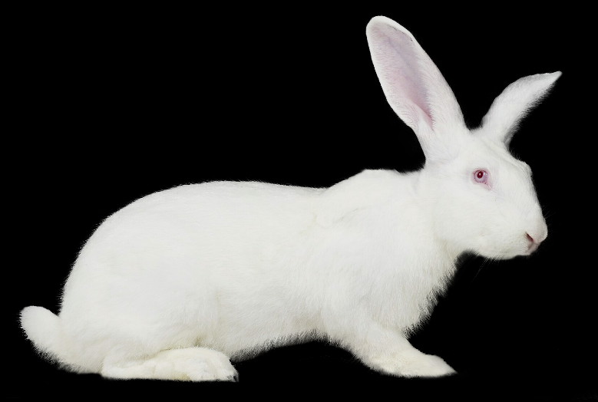
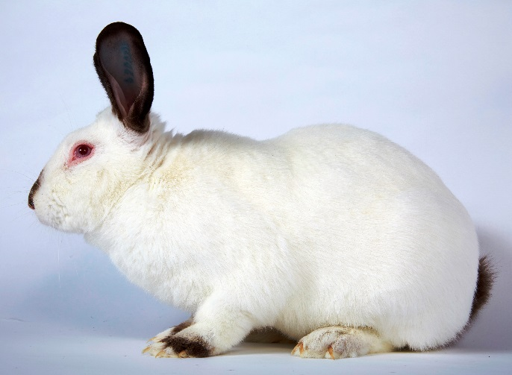
Data
Nucleus farm of the French breeding company Hypharm
2 purebred paternal lines selected for meat production traits
AGP39 and AGP59
150 000 rabbits
1998 - 2014

Slide 5
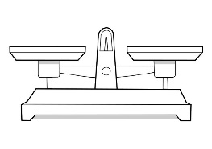
Recording
Weaning
31 days
End of the test
63 or 70 days
Birth
testing
Live weight
Carcass yield
Mortality
Morbidity
respiratory
digestive
infectious

Slide 6
Disease traits
Trait | Description | Prevalence
Digestive syndromes | Diarrhea, bloated abdomen… | 7.1 %
Respiratory syndromes | Nasal discharge, lung lesion, wry neck… | 4.0 %
Infectious syndromes | Digestive + respiratory syndromes | 12.1 %
Infectious mortality |  | 4.7 %

Slide 7
Production traits
Trait | Mean | Standard deviation
Carcass yield (%) | 57.69 | 1.92
Live weight (kg) | 2.88 | 0.39
Data from 1998 to 2014

Slide 8
Statistical analysis
Threshold model creates an underlying continuous unobservable trait, the liability
theoritically better for binary trait
Healthy
Sick
liability
Threshold
Linear model for continuous normally distributed traits
ASREML software

Slide 9
Heritability estimates

Slide 10
Genetic correlations
 | Respiratory syndromes | Infectious syndromes | Infectious mortality | Carcass yield | Live weight (direct) | Live weight (maternal)
Digestive syndromes | -0.18 | 0.65 | 0.92 | -0.40 | 0.11 | -0.11
 | Respiratory syndromes | 0.61 | -0.27 | -0.10 | 0.01 | -0.06
 |  | Infectious syndromes | 0.52 | -0.35 | 0.06 | -0.25
 |  |  | Infectious mortality | -0.18 | 0.00 | 0.14
 |  |  |  | Carcass yield | -0.21 | 0.23
 |  |  |  |  | Live weight (direct) | -0.10
Standard deviations ~ 0.07

Slide 11
Take-home messages
Low but significant heritability for disease traits
Favorable genetic correlations between disease and production traits
It is possible to select rabbits for general disease resistance

Slide 12
Thank you

Slide 13
Statistical analysis
Threshold model create an underlying continuous unobservable trait, the liability
theoretically better for binary trait
Linear model for continuous normally distributed traits
Healthy
Sick
liability
Threshold
y = Xb + Zu + Wm + Ql + e
Random residual effects
Performance or liability
Random common litter effects
Fixed effects
Random genetic animal effects
Random genetic maternal
effects
ASREML software

