Slide 1




Viscoelasticity of Supramolecular
Center-functionalized Polymer
Effect of the strength of Hydrogen Bonding Stickers
Xavier Callies
Costantino Creton, Guylaine Ducouret
AERC 2015 - Nantes

Slide 2
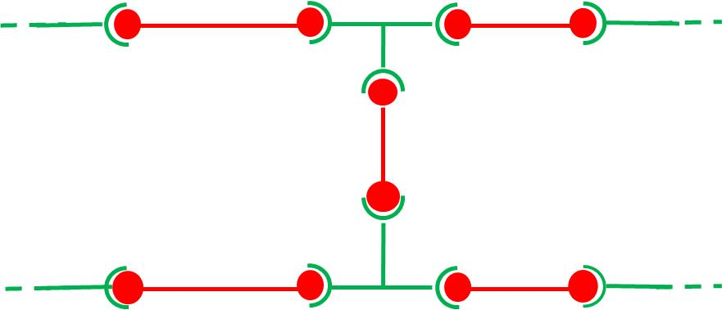
Supramolecular Polymers ?
2
Supramolecular Chemistry
Self-assembly of small molecules by non covalent bonds (H-bonds, ionic…) in solution
Lehn, J. Angew. Chem.-Int. Ed. Engl. 1990, 29, 1304–1319.

Slide 3
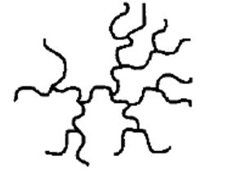
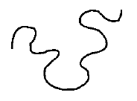
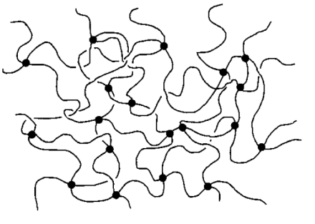
Supramolecular Polymers ?
2
Supramolecular Chemistry
Polymer Physics
Self-assembly of small molecules by non covalent bonds (H-bonds, ionic…) in solution
Association by covalent bonds of monomers
Lehn, J. Angew. Chem.-Int. Ed. Engl. 1990, 29, 1304–1319.
Rubinstein, M.; Colby, R. H. Polymer Physics; Oxford University Press, 2003.

Slide 4
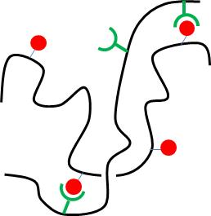
Supramolecular Polymers ?
2
Supramolecular Chemistry
Polymer Physics
Self-assembly of small molecules by non covalent bonds (H-bonds, ionic…) in solution
Association by covalent bonds of monomers
Lehn, J. Angew. Chem.-Int. Ed. Engl. 1990, 29, 1304–1319.
Supramolecular
Polymers
Rubinstein, M.; Colby, R. H. Polymer Physics; Oxford University Press, 2003.

Slide 5
Interest of Supramolecular Polymers ?
3
Specific
Clusters, Aggregates, Networks
or Nanostructures
Interactions
between Stickers
Reversible
Strong dependency with their environment

Slide 6
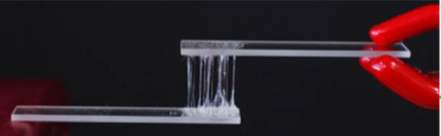
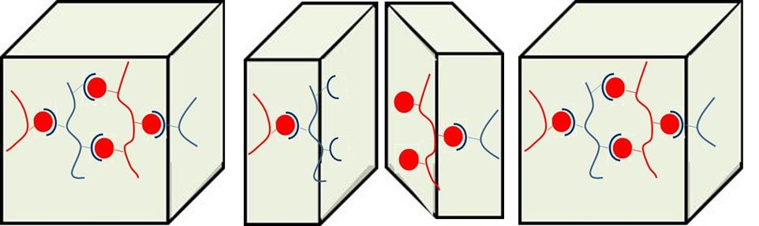

Interest of Supramolecular Polymers ?
3
Specific
Clusters, Aggregates, Networks
or Nanostructures
Interactions
between Stickers
Reversible
Strong dependency with their environment
A wide diversity of applications
Stimuli-responsive
Materials
Self-healing
by simple contact at RT
Healing
UV (Heat)
Fracture
Heinzmann, C. et al,
ACS Appl. Mater. Inter.
2014, 6,4713–4719.
Cordier, P. et al, Nature 2008, 451, 977–980.

Slide 7
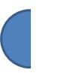
Challenge for all applications
4
How to link the rheological properties and the chemical structure of the polymer chain ?
What is the effect of the strength of stickers on the rheological behavior ?
K = k_{a} / k_{d}
k_{a}
+
k_{d}
ΔH
Chemistry of stickers
Strength of Stickers
Polarity of Polymer Matrix
Notes:
This question was a difficult one because you take this dynamics into account….

Slide 8
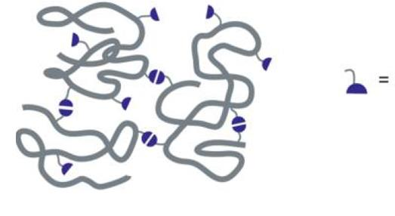
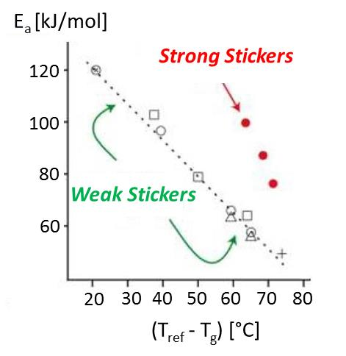
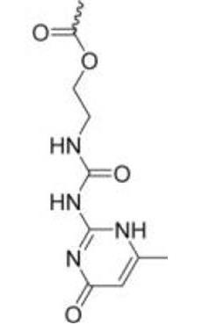
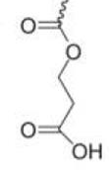
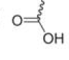
Background
Lewis et al, Macromolecules, 2014, 47, 729–740.
5
Poly(butylacrylate)
Copolymers
or
or
Weak
Stickers
Strong
Stickers

Slide 9
Background
Lewis et al, Macromolecules, 2014, 47, 729–740.
5
Poly(butylacrylate)
Copolymers
or
or
Weak
Stickers
”T_{g} effect”
”T_{g} effect” +
supramolecular
network
Strong
Stickers
Weak
Stickers
Strong
Stickers

Slide 10
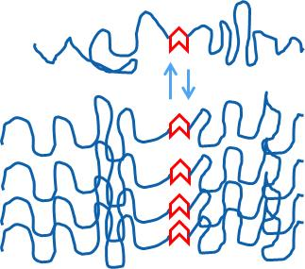
Center-functionalized Polymers ?
6
Self-assembly of stickers
into filaments is favored
Bouteiller, L. et al.. Adv. Funct. Mater. 20, 1803–1811 (2010).
Frauenrath, H. et al. Chem. Sci. 3, 1512-1521 (2012)
Predictable shape
of the aggregates
Link the rheology and
the supramolecular Chemistry

Slide 11
Center-functionalized Polymers ?
6
Self-assembly of stickers
into filaments is favored
Bouteiller, L. et al.. Adv. Funct. Mater. 20, 1803–1811 (2010).
Frauenrath, H. et al. Chem. Sci. 3, 1512-1521 (2012)
Predictable shape
of the aggregates
Link the rheology and
the supramolecular Chemistry
Strategy of our Project
Synthesis of monodisperse and linear center-functionalized polymers
Change the molecular parameters in a highly controlled way
Systematic characterization of the nanostructure and linear rheology.

Slide 12
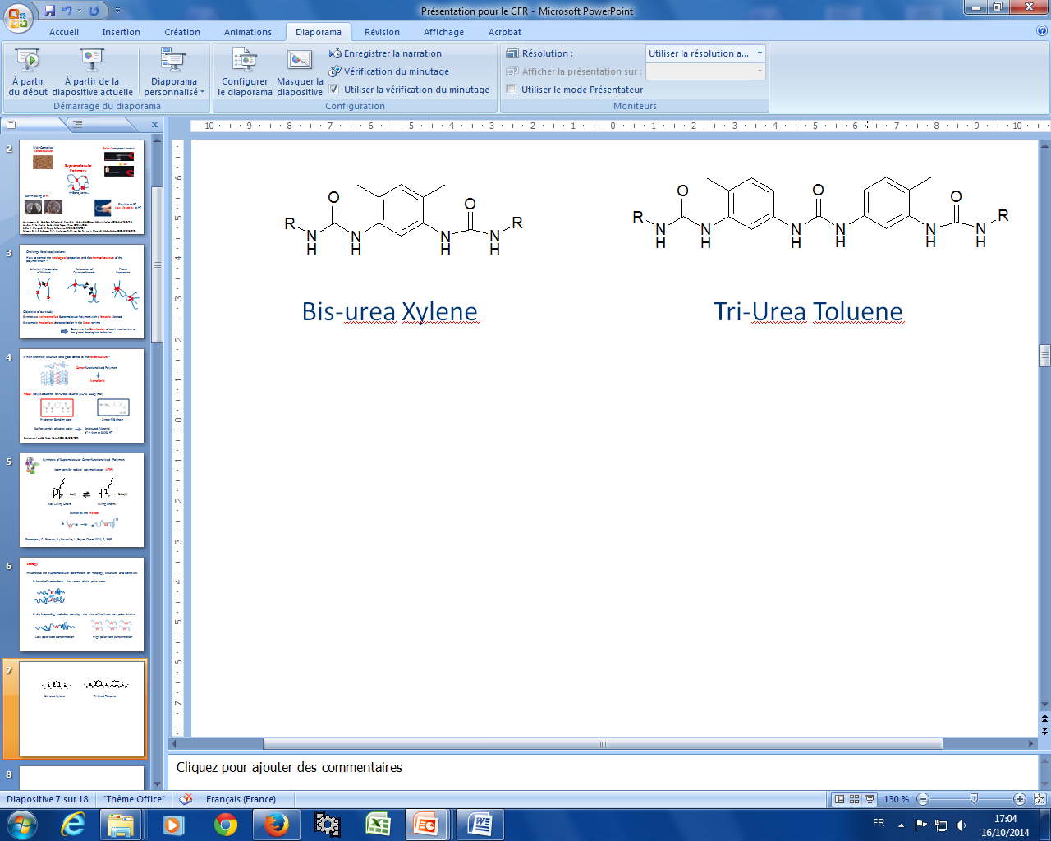
Key-molecular parameters
7
1. Level of interactions : Two hydrogen bonding stickers.
Bis-urea Xylene
Tri-Urea Toluene
”Weak Sticker”
”Strong Sticker”

Slide 13
Key-molecular parameters
7
1. Level of interactions : Two hydrogen bonding stickers.
Bis-urea Xylene
Tri-Urea Toluene
”Weak Sticker”
”Strong Sticker”
2. the interacting moieties density : the size of the linear non polar chains
PnBA
I_{p} ≤ 1,4
5 kg/mol ≤ M_{w} ≤ 100 kg/mol
4% ≥ Sticker (w%) ≥ 0,2%

Slide 14
Key-molecular parameters
7
1. Level of interactions : Two hydrogen bonding stickers.
Bis-urea Xylene
Tri-Urea Toluene
”Weak Sticker”
2nd Part
”Strong Sticker”
1^{srt} Part
2. the interacting moieties density : the size of the linear non polar chains
PnBA
I_{p} ≤ 1,4
5 kg/mol ≤ M_{w} ≤ 100 kg/mol
4% ≥ Sticker (w%) ≥ 0,2%

Slide 15
T_{g} and Nanostructure for Strong Stickers
8
No variation of T_{g} with M_{n} (between 5 and 100kg/mol): T_{g} = -49 ± 1°C (DSC)

Slide 16
T_{g} and Nanostructure for Strong Stickers
8
No variation of T_{g} with M_{n} (between 5 and 100kg/mol): T_{g} = -49 ± 1°C (DSC)
SAXS Investigation
I (u.a)
8kg/mol
23kg/mol
5kg/mol
0,2
0,6
1,0
1,4
q (nm⁻¹)
No peak for M_{n} ≥ 40 kg/mol

Slide 17
T_{g} and Nanostructure for Strong Stickers
8
No variation of T_{g} with M_{n} (between 5 and 100kg/mol): T_{g} = -49 ± 1°C (DSC)
SAXS Investigation
I (u.a)
Self-assembly of
stickers
into filaments
8kg/mol
23kg/mol
5kg/mol
Oriented
Filaments
Randomly
Oriented Rods
0,2
0,6
1,0
1,4
q (nm⁻¹)
M_{n} ≤ 40 kg/mol
M_{n} ≥ 40 kg/mol
No peak for M_{n} ≥ 40 kg/mol

Slide 18
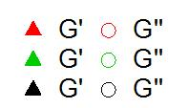
Rheology for Strong Stickers
9
5kg/mol
× 1,6
20kg/mol
× 1
60kg/mol
× 0,5

Slide 19
Rheology for Strong Stickers
9
5kg/mol
× 1,6
20kg/mol
× 1
60kg/mol
× 0,5
M_{n} ≤ 40kg/mol
M_{n} ≥ 40kg/mol
Oriented
Filaments
Dissipative
Gel
Randomly
Oriented Rods
Viscoelastic
Fluid

Slide 20
Shifts
10
5kg/mol
× 1,6
20kg/mol
× 1
60kg/mol
× 0,5
« Frozen » Aggregates
Dissipative Relaxation
of the side chains

Slide 21
ω ≠ f(M_{w})
11
≈ 0,5
G’’ ≥ G’
G’’ ≤ G’
5kg/mol
× 1,6
20kg/mol
× 1
60kg/mol
× 0,5

Slide 22
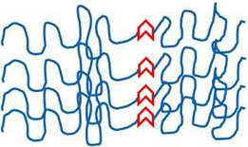
ω ≠ f(M_{w})
11
≈ 0,5
G’’ ≥ G’
Comb-shaped Aggregates
≈
Comb-shaped Polymers
G’’ ≤ G’
5kg/mol
× 1,6
20kg/mol
× 1
60kg/mol
× 0,5
Self-assembly of Stickers
Polymer Matrix
Gel / Fluid
Rouse / Entanglements
T_{g}

Slide 23
Strong Stickers vs Weak Stickers ?
12
Molecular weight dependency ?

Slide 24
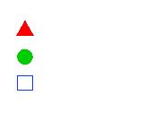
Strong Stickers vs Weak Stickers ?
12
Molecular weight dependency ?
η* (1rad/s, T=25°C)
Strong
Critical Molecular weight (M_{c}) ?
Weak
PnBA
Stickers’ Regime
M_{n} ≤ M_{c}
Entanglements’ Regime
M_{n} ≥ M_{c}
Jullian, N.; Leonardi, F.; Grassl, B.; Peyrelasse, J.; Derail, C. Appl. Rheol. 2010, 20, 33685.

Slide 25
Strong Stickers vs Weak Stickers ?
12
Molecular weight dependency ?
η* (1rad/s, T=25°C)
Strong
Critical Molecular weight (M_{c}) ?
Weak
PnBA
Stickers’ Regime
M_{n} ≤ M_{c}
Entanglements’ Regime
M_{n} ≥ M_{c}
M_{c} ≈ 40kg/mol
M_{c} ≈ 20kg/mol
Strength ↗, M_{c} ↗
Jullian, N.; Leonardi, F.; Grassl, B.; Peyrelasse, J.; Derail, C. Appl. Rheol. 2010, 20, 33685.

Slide 26

Strong Stickers vs Weak Stickers ?
13
Stability of the nanostructure (below M_{c}) ?
M_{n} = 5kg/mol
Strong Sticker

Slide 27

Strong Stickers vs Weak Stickers ?
13
Stability of the nanostructure (below M_{c}) ?
M_{n} = 5kg/mol
Strong Sticker
Weak Sticker

Slide 28
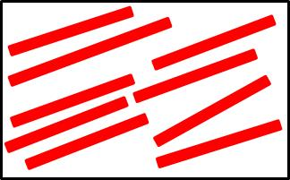
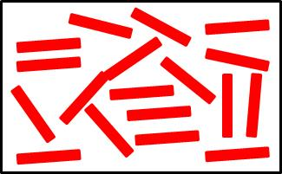
Strong Stickers vs Weak Stickers ?
13
Stability of the nanostructure (below M_{c}) ?
M_{n} = 5kg/mol
Strong Sticker
Weak Sticker
T ≤ T_{ODT}
T ≥ T_{ODT}

Slide 29
Strong Stickers vs Weak Stickers ?
13
Stability of the nanostructure (below M_{c}) ?
M_{n} = 5kg/mol
Strong Sticker
Weak Sticker
T ≤ T_{ODT}
Frozen Structure over a long distance range
Gel plateau
T ≥ T_{ODT}
Scission / Association of Stickers
Viscoelastic Fluids

Slide 30
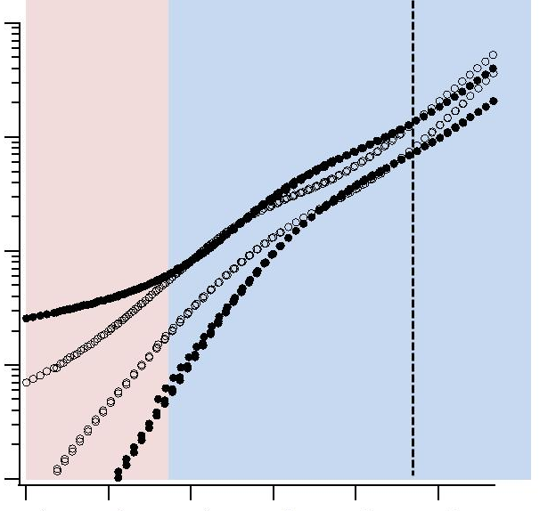
Conclusion on linear rheology of center-functionalized Polymers
14
G’
Gel
/ Fluid
Entanglement
/ Rouse
G’’
Monomer
Friction
ω

Slide 31

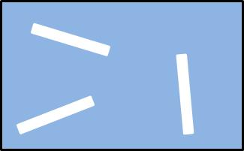
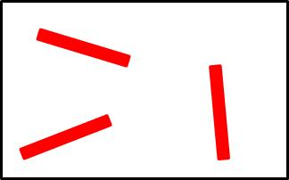
Conclusion on linear rheology of center-functionalized Polymers
14
G’
Gel
/ Fluid
Entanglement
/ Rouse
G’’
Monomer
Friction
ω
Density and Strength of Stickers
T_{ODT} and M_{c}
Fine Control of the viscoelasticity via the chemical structure

Slide 32


Thank you for all People in Project ANR SUPRADHESION
Guylaine Ducouret
Costantino Creton
Cécile Fonteneau
Sandrine Pensec, Laurent Bouteiller
Cyril Véchambre
Jean-Marc Chenal, Laurent Chazeau

Slide 33
Thank you for your attention !

