Slide 1


2015 Public Safety Broadband Stakeholder Meeting
Public Safety Communications:
How to Maintain Connectivity and Improve Resiliency?
Nada Golmie, Fernando Cintrón, Wesley Garey, Camillo Gentile, David Griffith, Aziza Ben Mosbah, Richard Rouil, Ahmed Soua

Slide 2

This work is sponsored by:
FirstNet
(First Responder Network Authority)

Slide 3

This work is sponsored by:
Department of Homeland Security
Science & Technology Directorate
Office for Interoperability and Compatibility
(DHS S&T OIC)

Slide 4
Disclaimers
All information and data presented is preliminary/in progress and subject to change.
The full description of the procedures used in this presentation requires the identification of certain commercial products and their suppliers. The inclusion of such information should in no way be construed as indicating that such products or suppliers are endorsed by NIST, or are recommended by NIST, or that they are necessarily the best materials, instruments, software or suppliers for the purposes described.

Slide 5
Outline
Motivation
Evaluation methodology
  Scenarios
  Performance metrics
Effects of outages on network performance
  Network-level scenario
  Site-level scenario
Resiliency strategies
  Traffic control
  High-power UE
  Parameter configuration
  Device to device communication
Summary

Slide 6
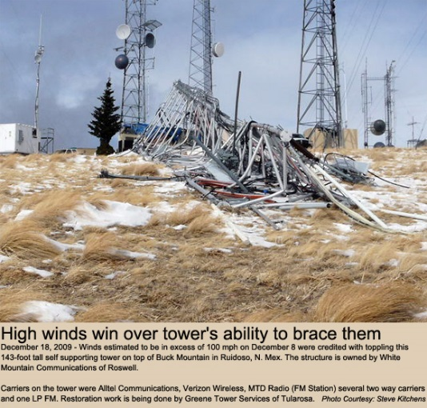
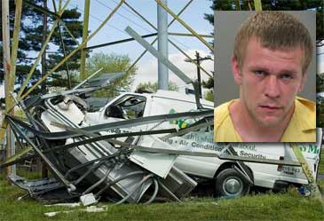
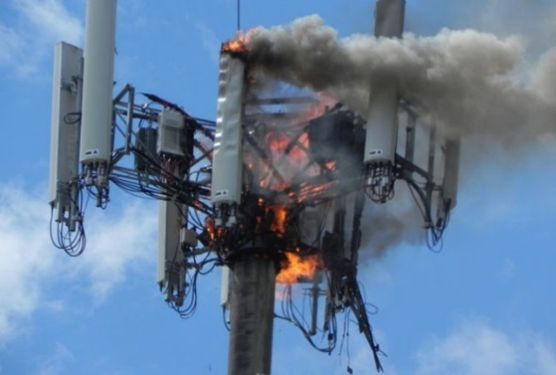
Motivation
Network deployments are subject to:
  Planned “failures”
    Maintenance
    Site relocation
  Unplanned failures
    Construction errors (“backhoe fade”)
    Incidents/natural disasters/power loss
    Equipment failure
    Theft/vandalism/equipment misuse
    Administrative errors (misconfigured system parameters)
First responders need to be “connected” anywhere, anytime
How can users maintain connectivity when sites fail?
Image sources:
http://www.wirelessestimator.com/t_content.cfm?pagename=Cell_Tower_News_12.09
http://www.wirelessestimator.com/t_content.cfm?pagename=breaking_news.cfm6.30.11
http://www.mynews13.com/content/news/cfnews13/news/article.html/content/news/articles/cfn/2013/8/21/cell_phone_tower_cat.html

Slide 7
Evaluation Methodology
Investigate different resiliency strategies to maintain a level of coverage and connectivity regardless of the network status
System failures in a deployed site plan are modeled by deactivating sites and examining the effects on the network performance
  Site deactivation models both localized and random outages
We use RF planning (InfoVista’s Mentum Planet) and network simulation tools (NS-3) to model each resiliency strategy to capture the network-level and communication protocol interactions respectively
Performance metrics include:
  Statistical averages to evaluate coverage and capacity
  Transient effects to capture dynamic range and connectivity

Slide 8
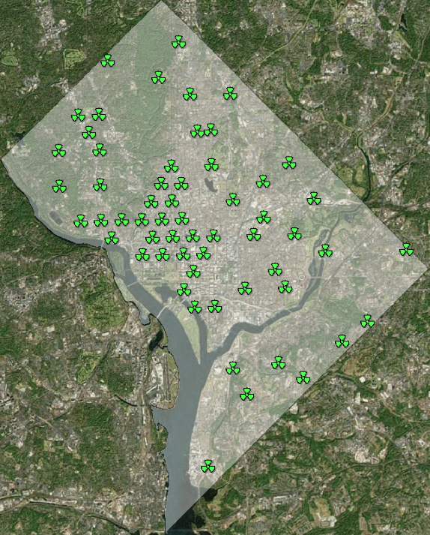

Network-level Scenario
Given a percentage (random or localized) outage for a site plan, what is the resulting public safety user coverage?
How to maintain coverage during outages?
Localized Outages
Random Outages

Slide 9
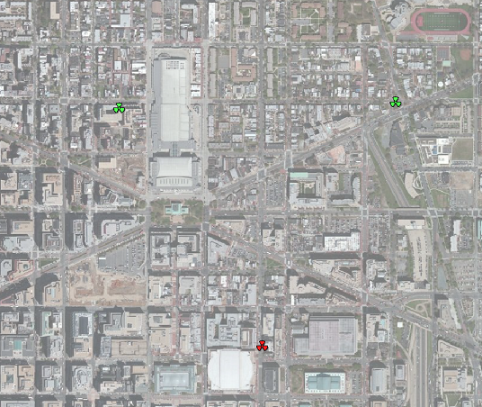

Site-level Scenario
A group of first responders are called to an incident in an area where sites may be down
Responders communicate with each others (via application-level broadcast)
Other responders are also present in the network
Site A
Site B
Responders using group communication
Site C

Slide 10
Performance Metrics
Signal,
Reference Signal Received Power (RSRP)
Signal to Interference plus Noise Ratio (SINR)
Interference
Noise
USER
Resource Blocks (RBs) needed to transmit packet
MCS 28
SINR
MCS 0
Transmission Bandwidth
(50 RBs for 10 MHz)
THROUGHPUT /
USER
Does user packet have enough RBs?
YES
USER COVERED
NETWORK THROUGHPUT
NO
USER NOT COVERED

Slide 11
Outages in Typical LTE Deployments
Baseline Results

Slide 12
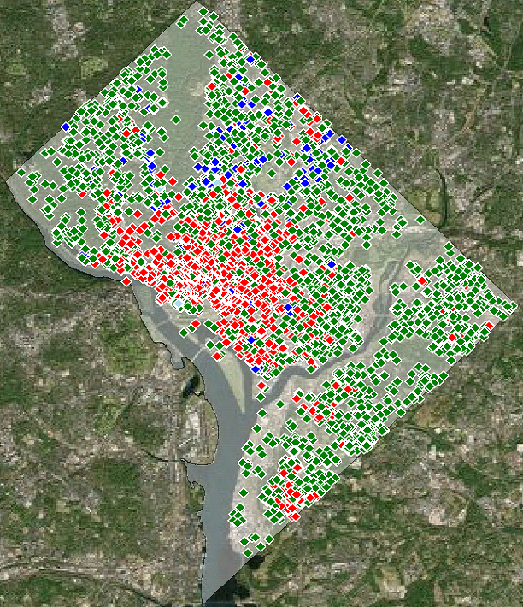
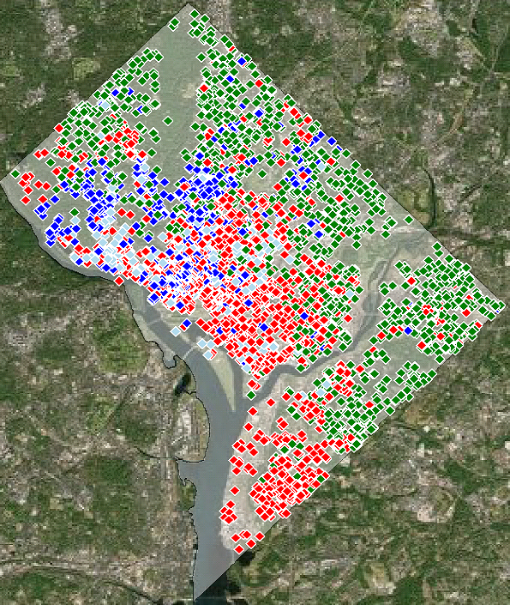
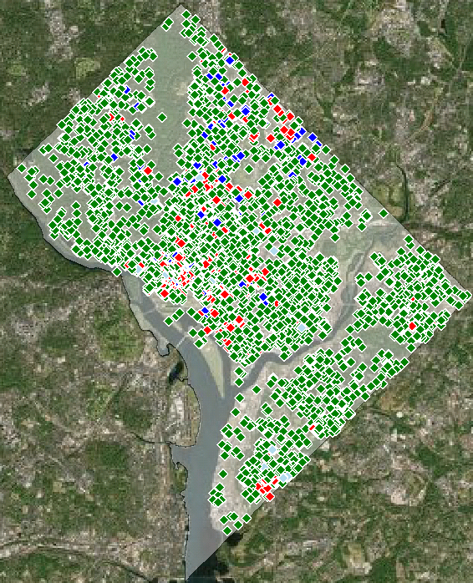
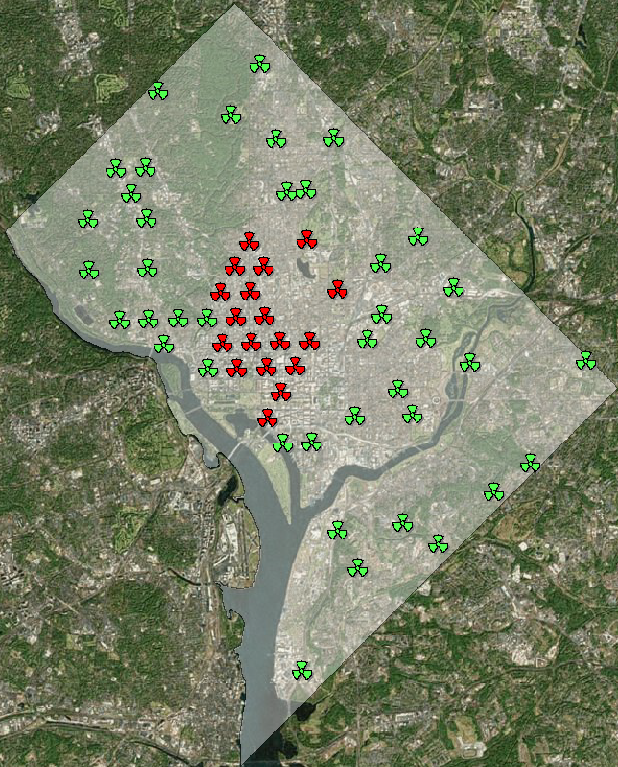
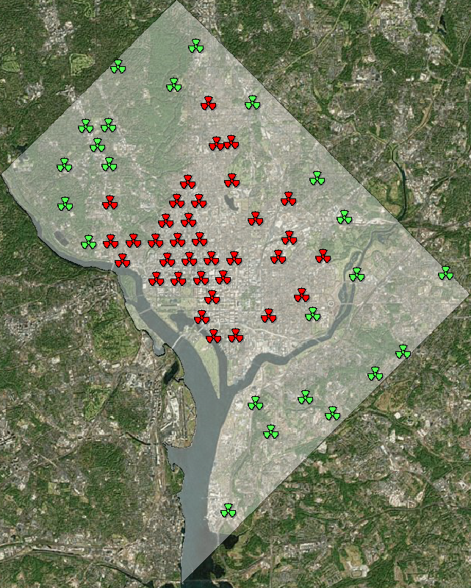
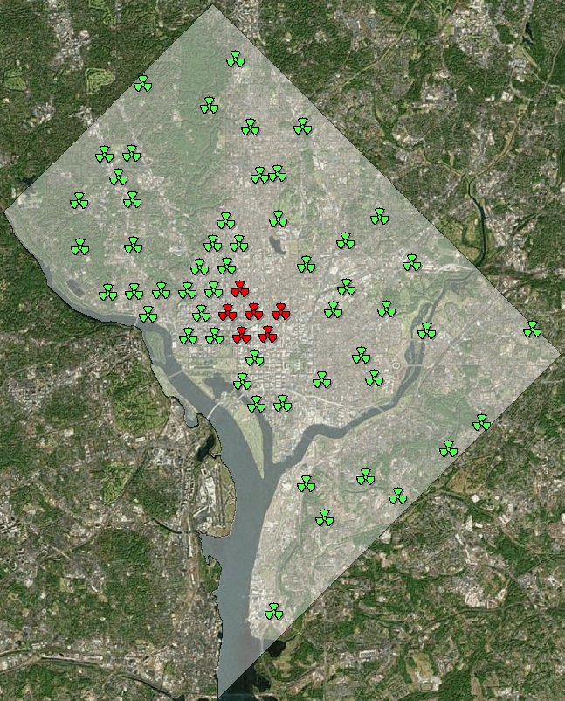
How Users Experience Outages Today
Localized Outages
Active site
Inactive site
Covered user DL failure UL failure
Outage 10%
Coverage 83%
Outage 30%
Coverage 60%
Outage 60%
Coverage 33%
In localized outage, the inactive sites are concentrated in one area of the city
The coverage failures surround the inactive sites

Slide 13
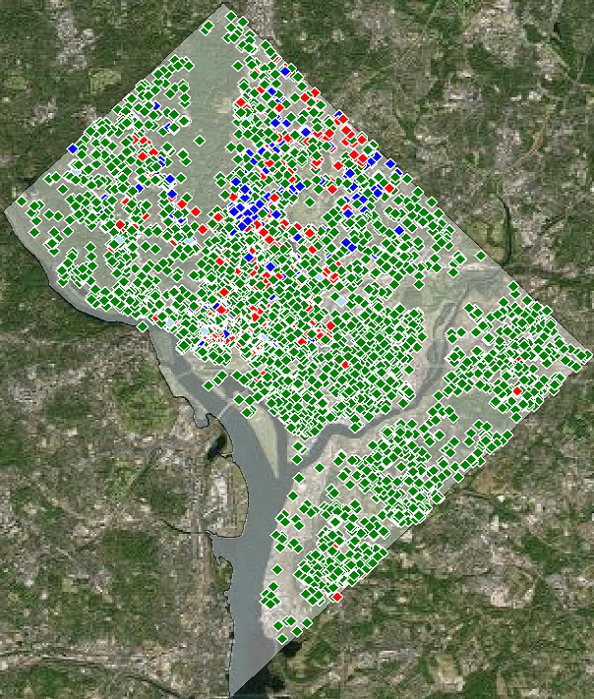
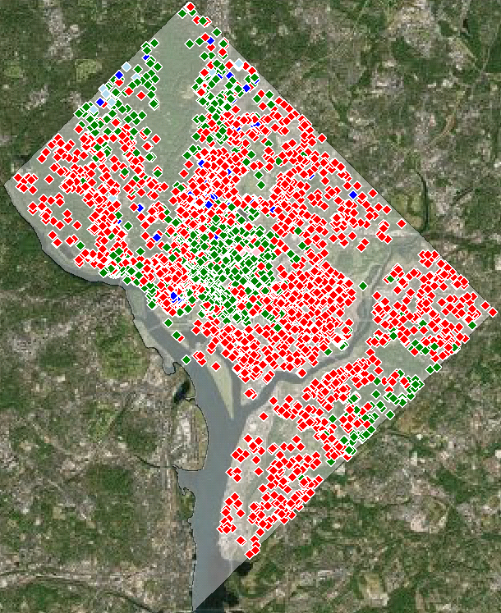
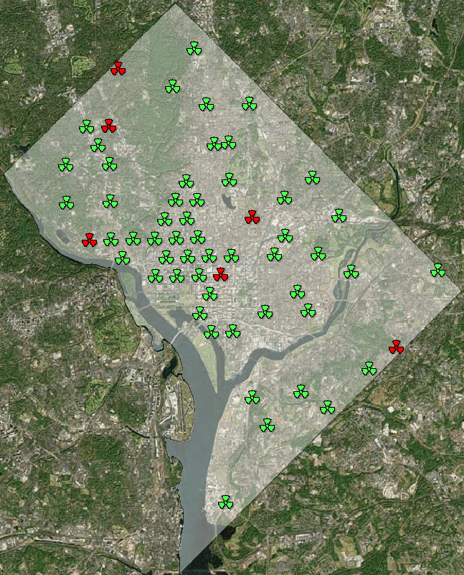
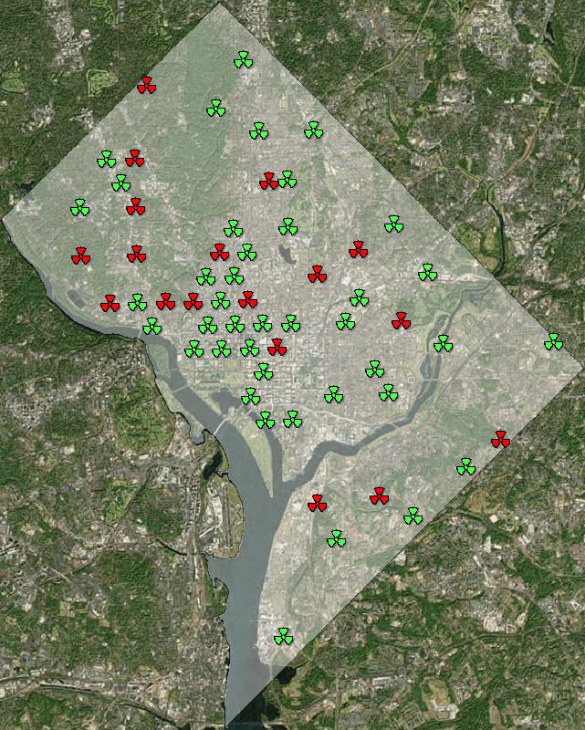
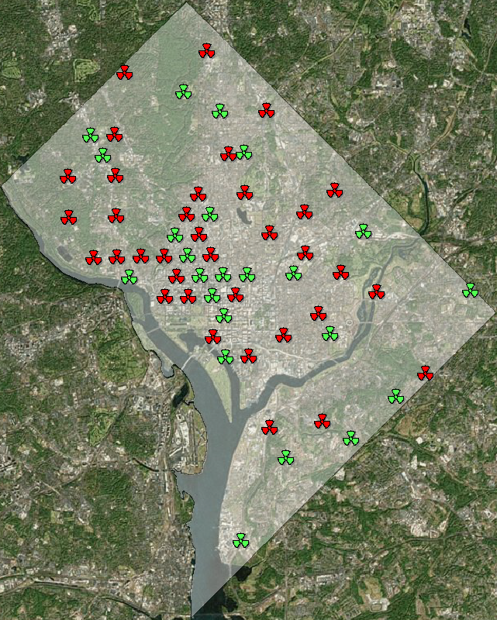
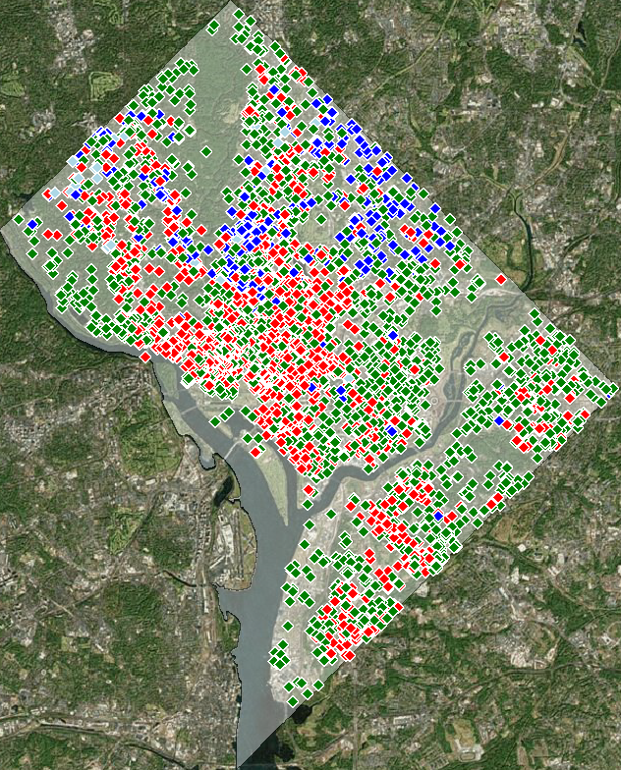
How Users Experience Outages Today
Random Outages
Active site
Inactive site
Covered user DL failure UL failure
Outage 10%
Coverage 84%
Outage 30%
Coverage 55%
Outage 60%
Coverage 28%
In random outage, the inactive sites are distributed throughout the city
As for the localized case, higher outage translates into lower coverage

Slide 14
Coverage and Throughput
Baseline
Although the outage topologies are different, the resultant coverage and throughput are comparable.
How to maintain coverage during outages?

Slide 15

Packet Loss
Baseline
Responders are at cell edge
Site A
Site B
Site C
With all sites active, packet loss is observed when responders are at the cell edge.
When Site C is failed, the responders experience a total loss of connectivity (100 % packet loss)
  The coverage gap is 500 m

Slide 16
Reference Signal Received Power
Baseline
Site A
Site C
Site B
Site A
Site B
The RSRP increases when the responders are located between 100 m and 200 m due to higher antenna gain
When site C is failed, the responders try to stay on the remaining sites as long as possible
When the responders are located between 650 m and 950 m from site A, the responders are not able to detect and connect to any site

Slide 17
Modulation Coding Scheme
Baseline
Site A
Site C
Site B
As responders move away from site A, the quality of the signal degrades
  A lower SINR triggers the use of a lower MCS
  More resource blocks are needed to carry the responder traffic
The uplink MCS is degrading much faster than the downlink indicated an uplink-limited network

Slide 18
Resource Block Usage
Baseline
Increased cell load when users are at cell edge
Congestion
When responders are at the edge of a cell, their lower MCS causes an increase in the RBs utilization
During Site C failure, the number of RBs used reached its maximum value
  Congestion occurs where there are no RBs available
How to reduce or eliminate the coverage gaps caused by site failures?

Slide 19

Traffic Control

Slide 20
Traffic Control Strategy
The basic idea consists of trading capacity for coverage during an outage in order to maintain connectivity
By limiting the traffic admitted on the public safety network it may be possible to mitigate site failures and maintain target coverage. Ways to implement traffic control include:
  Data rate adaptation
  Priority and preemption
Given an outage percentage and a user coverage target, the traffic control strategy is to throttle the traffic demand in order to meet the target coverage
The implementation of this strategy in response to failures may be achieved based on predetermined coverage and capacity targets

Slide 21
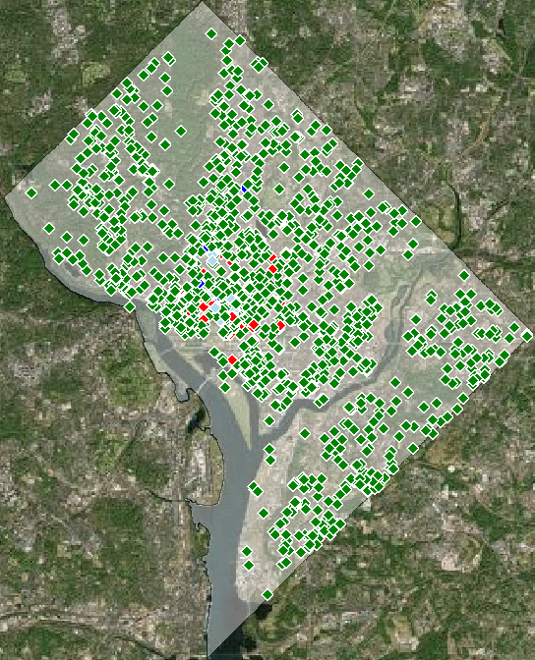
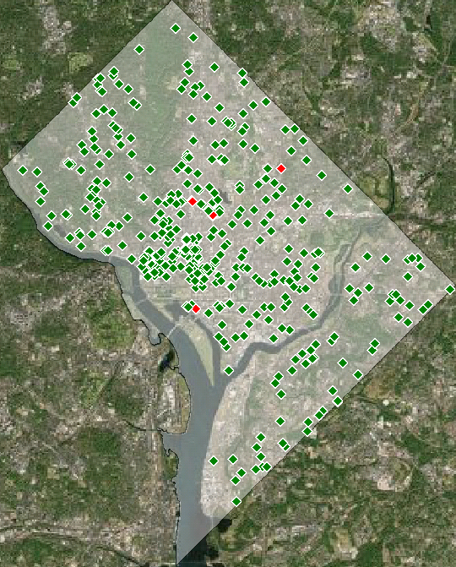
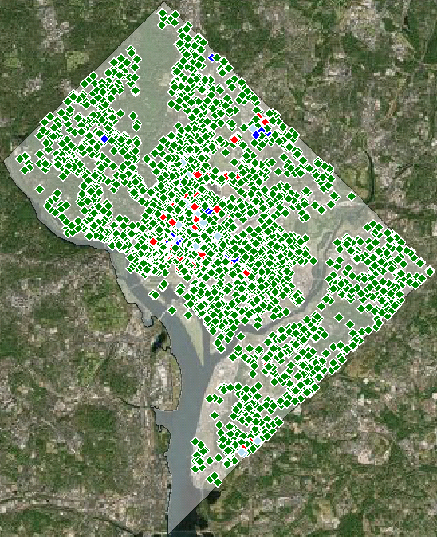
Coverage Maps
Baseline vs. Traffic Control
Covered user DL failure UL failure
Outage 10%
Outage 30%
Outage 60%
Coverage 84%
Coverage 95%
Coverage 60%
Coverage 95%
Coverage 33%
Coverage 95%
By reducing the traffic demand, coverage can be restored to 95%
Although the outage increases, the coverage now remains fixed
Increased coverage comes at the expense of reduced throughput

Slide 22
Coverage and Throughput
Baseline vs. Traffic Control
With traffic control, coverage can be restored to 95% across all outages, but the sustainable network throughput can drop significantly
The results are similar for random outage, but the drop in throughput is less since the outage topology is less severe

Slide 23
Resource Block Usage
Baseline vs. Traffic Control
No congestion
Congestion
The results shown are based on a 50% traffic reduction for all users
Congestion is experienced when the resources-block usage is saturated at 50
Reducing the traffic in the network reduces the usage, eliminating congestion even when the responders are at cell edge

Slide 24
Packet Loss
Baseline vs. Traffic Control
Reduction
The drop in resource block-usage in turn reduces packet loss
The coverage gap for the responders is not reduced
The network is no longer capacity-limited in the uplink, but coverage-limited

Slide 25

High-power UE
Can you hear me now?

Slide 26
High-power UE Strategy
Another strategy to maintain connectivity during an outage is to use higher power for UE transmission
The high-power strategy consists of increasing the transmitted power from the baseline value of 0.2 W to the high-power value of 1.2 W to improve the coverage footprint
However, with higher transmitted power comes increased interference

Slide 27
Coverage and Throughput
Baseline vs. High-power UE
Transmitting at higher power may not always be beneficial due to the increased interference it creates
In a more comprehensive study, we have found higher power to be beneficial in rural areas where traffic is low and the opposite in urban areas where it is high

Slide 28
Coverage and Throughput
Traffic Control vs. Traffic Control + High-power UE
When combined with traffic control, which limits uplink interference, high-power transmission can be more effective in restoring throughput
High-power transmission is most effective when outage is severe:
  Localized outage
  High outage percentages

Slide 29
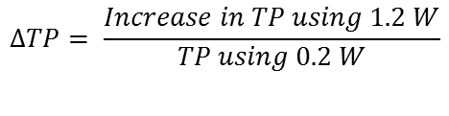
Throughput Improvements
Traffic Control vs. Traffic Control + High-power UE
$$ΔTP= \frac{Increase in TP using 1.2 W}{TP using 0.2 W}$$
With traffic control, the increase in throughput using the 1.2 W UE can be as great as 130%

Slide 30
MCS
Traffic Control vs. Traffic Control + High-power UE
Higher MCS
Higher power provides better uplink SINR for the responders, allowing for more efficient MCS and increased capacity

Slide 31
Resource Block Usage
Traffic Control vs Traffic Control + High-power UE
No congestion
Extended coverage
Higher MCS in the uplink leads to lower resource-block usage
Higher-power UE provides extended coverage on the uplink

Slide 32
Packet Loss
Traffic Control vs. Traffic Control + High-power UE
Coverage gap reduced by 40 %
Extended coverage on the uplink reduces the coverage gap by 40%
The network is no longer uplink-limited, but downlink-limited due to lack of reference coverage
=> Can this coverage gap be reduced further?

Slide 33
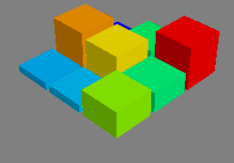

Parameter Configuration

Slide 34
LTE support for Self Optimizing Networks
Self Optimizing Networks (SONs) are defined by the automation of the planning, configuration, and optimization of the network.
  Reduces operational expenditure (OPEX) by reducing manual configuration of network elements
  Speeds up network recovery
LTE standardized key functions/interfaces to support multi-vendor SON solutions in three main categories:
  Self-Configuration
    Enable cell to self-configure its Physical Cell Identity, transmission frequency and power
    Automatic Neighbor Relations (ANR)
    Dynamic configuration of S1 and X2 interfaces, IP address and IP backhaul
  Self-Optimization
    Mobility Load Balancing (MLB)
    Mobility Robustness Optimization (MRO)
    Energy Saving.
    RACH optimization to minimize number of attempts on the PRACH causing interference
    Inter-cell interference coordination (ICIC)
  Self-Healing
    Coverage and Capacity Optimization (CCO) due to cell failures
    Cell outage detection and compensation
    Minimization of Drive Tests (MDT) enables UEs to collect and provide RAN information from indoor and outdoor environments

Slide 35
Reconfiguration using Antenna Down Tilt
The network coverage is affected by the site configuration
  Azimuth, tilt, height, transmit power, etc…
Some antennas, called Variable Electrical Tilt (VET) antennas are capable of modifying the radiation pattern without physically rotating the antenna. The operation can be performed remotely
Changes made in our scenario:
  Site A downtilt reduced from 10 degrees to 2 degrees
  Site B downtilt reduced from 10 degrees to 5 degrees
Current coverage
downtilt

Slide 36
MCS
Baseline vs Parameter Configuration
Higher MCS uplink and downlink
Changing the downtilt affects both the uplink and downlink
While decreasing the downtilt increases coverage, areas near the cell are not performing as well due to the antenna pattern

Slide 37
Resource Block Usage
Baseline vs Parameter Configuration
Congestion
Extended coverage
Congestion
Extended coverage
Coverage is increased but capacity is limited
Congestion occurs when the responders are at the cell edge leading to packet loss

Slide 38
Packet loss
Baseline vs Parameter Configuration
Coverage gap reduced by 60 %
The coverage gap for the responders is reduced from 500 m to 200 m.
While decreasing the downtilt increases coverage, areas near the cell are not performing as well due to the antenna pattern
Some packet loss is observed at cell edge due to congestion

Slide 39
Impact of Downtilt on Packet Loss
Parameter Configuration
Network reconfiguration can improve or degrade the network performance
Self optimization of the network requires coordination among cells

Slide 40
Packet Loss and Resource Block Usage
Traffic Control + High Power UE + Parameter Configuration
In our example, the combination of the traffic control, high power UE, and parameter configuration allowed the network to recover from a site outage
The responders are able to maintain connectivity regardless of their location

Slide 41

Device to Device

Slide 42
3GPP: Proximity Services (ProSe) Overview
Introduced to LTE in 3GPP Release 12
The objective of ProSe is to enable Device-to-Device (D2D) communication services in nearby User Equipments (UEs)
Services:
  Discovery: The ability to detect the presence of another UE in proximity
  Direct Communication: The capability to exchange user traffic without going through the eNodeB
Potential Advantages
  Spectrum utilization improvement
  Improvement in overall throughput
  Lower energy consumption in mobile devices

Slide 43

D2D Direct Communication Scenarios
In coverage single cell
In coverage multiple cells
UE 1
UE 2
UE 1
UE 2
Partial Coverage
Out of coverage
UE 1
UE 2
UE 1
UE 2

Slide 44
3GPP: ProSe Features Defined in Release 12
The following subset of capabilities have been standardized in Release 12 (March 2015):
  Direct Discovery, only open discovery when UE is in coverage
  One-to-many communication for public safety using physical layer broadcast
  EPC-level discovery
Areas for further considerations:
  Lower spectral efficiency (64 QAM not allowed)
  Reliability (Fixed retransmissions with no feedback)
  No Quality of Service (QoS), no Priority
  Collisions in the resource pool when UEs select their own resources
  Limited resources/preconfiguration

Slide 45
MCS
Baseline vs D2D
When in coverage, the resources needed by the responders depend on their relative location to each other
MCS 20 was used for both in coverage and out of coverage case

Slide 46
Resource Block Usage
Baseline vs D2D
Congestion
D2D protocol (pool, MCS, retransmissions) may not be as efficient as uplink transmissions and results in higher RB usage

Slide 47
Packet loss
Baseline vs D2D
Coverage gap is eliminated
When the responders are out of coverage, we observe that packets are still being exchanged
The lack of synchronization between users results in collision so only a portion of the traffic goes through

Slide 48
3GPP: Work Items for Release 13
Discovery
  Type 1 discovery (i.e. resources allocated on non-UE specific basis) for partial and outside network coverage (PS only)
  Restricted Discovery
  Support for multiple carriers and Public Land-Mobile Networks (PLMNs)
Communication
  Coverage extension using UE-to-Network Relays
  Group priority
  Support for Mission Critical Push-To-Talk (MCPTT)
  Service continuity
Items applying to both Discovery and Communication
  In network coverage enhancements
  Co-existence interference with adjacent carrier frequencies
  Impact on cellular traffic and its QoS

Slide 49
Resiliency Strategy Summary
Strategy | Pros | Cons/Limitations
Traffic Control | Can increase coverage for both uplink and downlink | Does not increase reference coverage
High Power UE | Increase uplink coverage | Interference Does not increase reference coverage
Parameter Configuration | Can increase coverage and capacity | Complex
D2D Communication | Provides out of network coverage | Limited throughput No reliability
The performance evaluation results show that there is no “silver bullet” to maintain connectivity during site outages
A combination of multiple solutions is needed to provide the coverage and capacity needed for Public Safety

Slide 50
Current Activities
Understanding additional resiliency strategies
Investigating different outage & incident traffic distributions
Developing guidelines and insights for using resiliency strategies in response to outages:
  Our results so far indicate that the benefits of the various resiliency strategies depend on the outage and network deployment
  In order to be effective solutions need to be accessible to Public Safety and deployed/activated quickly when outages occur
  Which solution to apply in real time when an outage occurs?

Slide 51
Thank you!
Questions?

Slide 52
Backup

Slide 53


Impact of Outage on Modeling Assumptions
Topology
eNodeB distance (m) | 1600
Users A distance to eNodeB (m) | [225,250]
Users B distance to eNodeB (m) | [275,250]
eNodeB
Antenna model | 3GPP TR 36.814 (Macro-cell)
Mechanical tilt (degree) | 10
Propagation model | Cost 231
Shadowing (dBm) | 10
Bandwidth DL+UL (MHz) | 10 + 10
Tx Power (dBm) | 46
Scheduler | Round Robin
UE
Antenna model | Omnidirectional
Antenna gain (dB) | 0
Tx Power (W) | 0.2, 1.2
RSRP threshold (dBm) | -110
Traffic
Number of users per cell | 10
User traffic distribution | Constant bitrate (CBR)
User packet size (byte) | 1280 | Data rate (kb/s) | 512
User packet interval (s) | 0.02
Number of responders | 10
Responder traffic distribution | CBR
Responder packet size (byte) | 256 | Data rate (kb/s) | 102.4
Responder packet interval | 0.02
Request
Response
User traffic model
Transmitter
Packet
Packet
Packet
Packet
Receivers
Group communication traffic model

