Slide 1



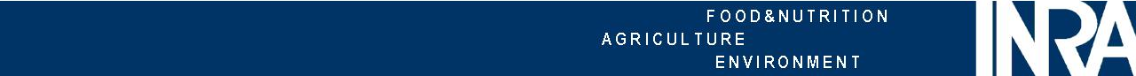
Modeling the filtration of deformable and permeable colloidal particles: the case of casein micelles
Peng Qu*, Antoine Bouchoux, Geneviève Gésan-Guiziou
INRA - French National Institute of Agricultural Research
Agrocampus Ouest
UMR1253 STLO, Science and Technology of Milk and Egg, F-35000 Rennes, France
1
GDR AMC2 2011
Toulouse
13-14 October, 2011

Slide 2
1. Context
Dead-end filtration of colloidal particles
[Bacchin, Gordon Research Conference Membranes,2006]
Diffusion and convection
in a polarised layer
x
Compression and permeation
in a deposit
3
J
→ A single equation to describe concentration polarisation and deposit layers
φ → volume fraction
D(φ) → collective diffusion coefficient
With
D₀→ individual diffusion coefficient
K(φ)→ sedimentation coefficient
k(φ) → permeability
Π → osmotic pressure
2

Slide 3
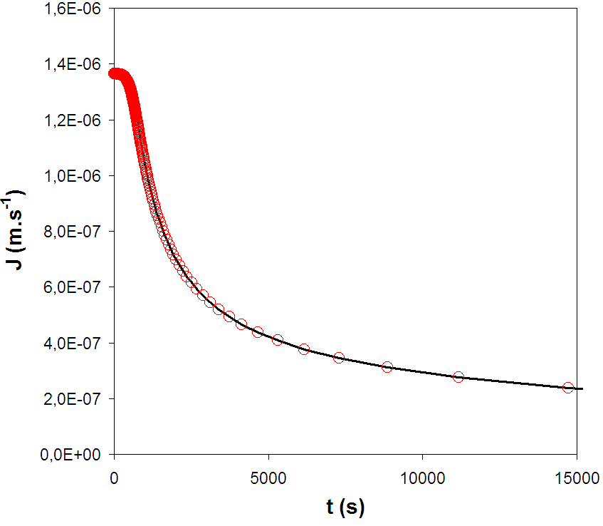
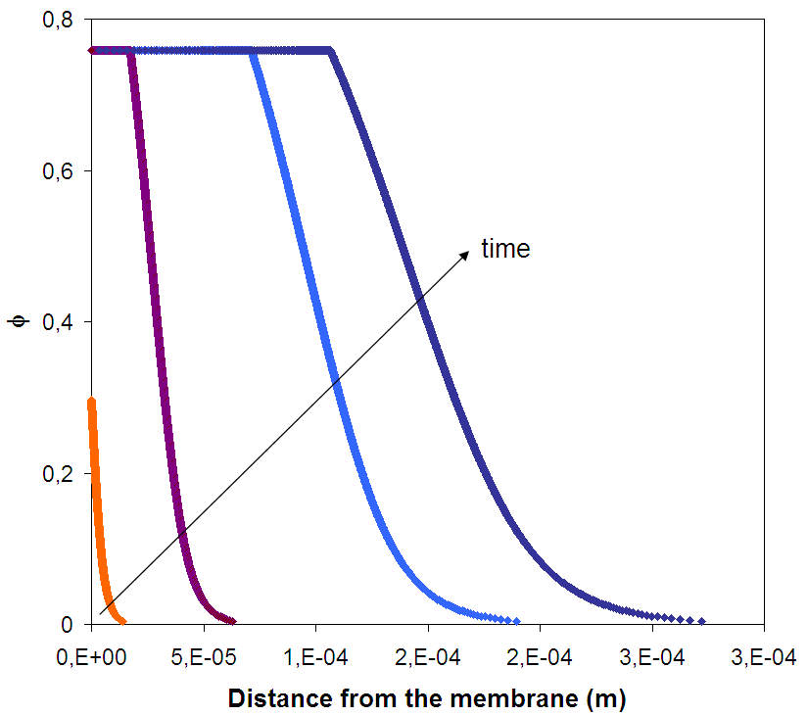
1. Context
Filtration model for non-interacting hard spheres
Permeability
Osmotic pressure
Happel equation
Carnahan-Starling equation
ΔP
3
3

Slide 4
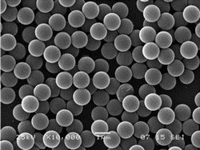
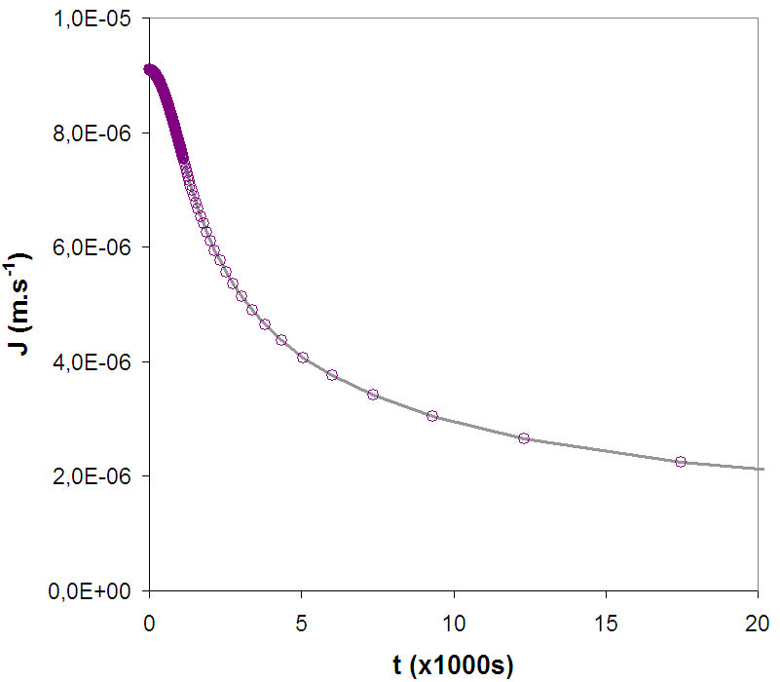
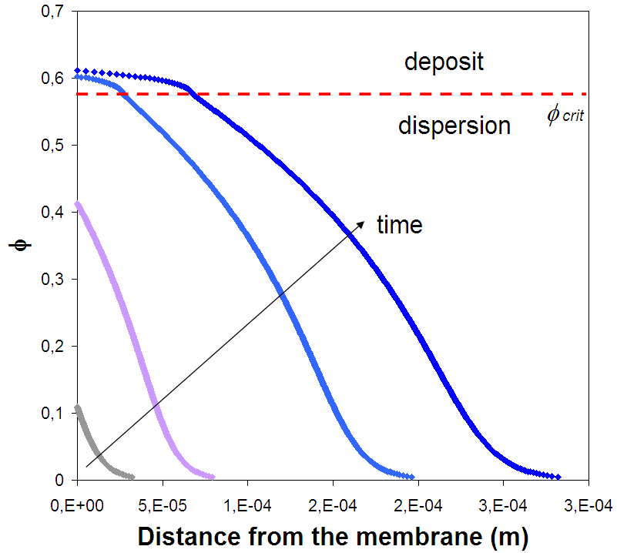
1. Context
Experimental measurements
Filtration model for charged hard spheres
(Latex)
Permeability
Osmotic pressure
Happel equation
[Bacchin et al., Desalination, 2006]
ΔP
4
4

Slide 5
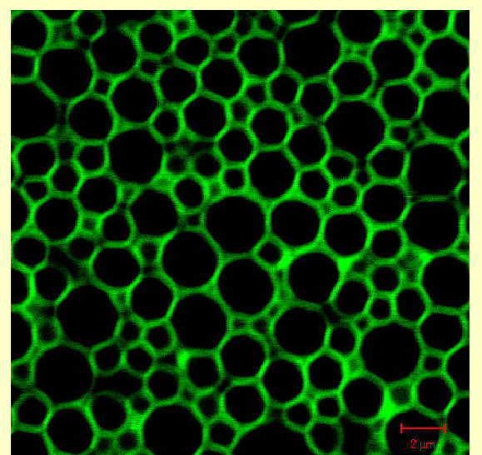
2. Research questions
Filtration model for compressible and/or permeable particles
Permeability
Osmotic pressure
Happel equation
Experimental measurements
Emulsion
Micro-gels
Casein micelles
5

Slide 6
2. Research questions
Filtration model for compressible and/or permeable particles
Permeability
Osmotic pressure
Happel equation
[Bouchoux et al., Biophys. J., 2009]
~80% of the proteins in milk
= Colloidal object (≈ sphere) :
Size distribution ~50-500nm
Water content 3.7g water/g proteins
Why milk filtration ?
Cheese production & proteins fractionation
Casein micelles
6

Slide 7
2. Research questions
Filtration model for compressible and/or permeable particles
Permeability
Osmotic pressure
Happel equation
- How to determine the permeability?
[Bouchoux et al., Biophys. J., 2009]
Casein micelles
7

Slide 8
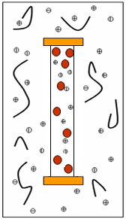
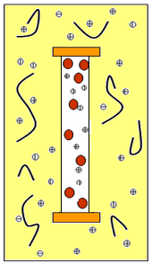
3. Measurement of permeability: strategy 1
Using osmotic stress
e
m_{gel}
J₀
J₀
J_{t}
t
Π
Π + ΔΠ
Π
Π + ΔΠ
ΔP=ΔΠ
e=V_{gel}/A_{sac}
8

Slide 9
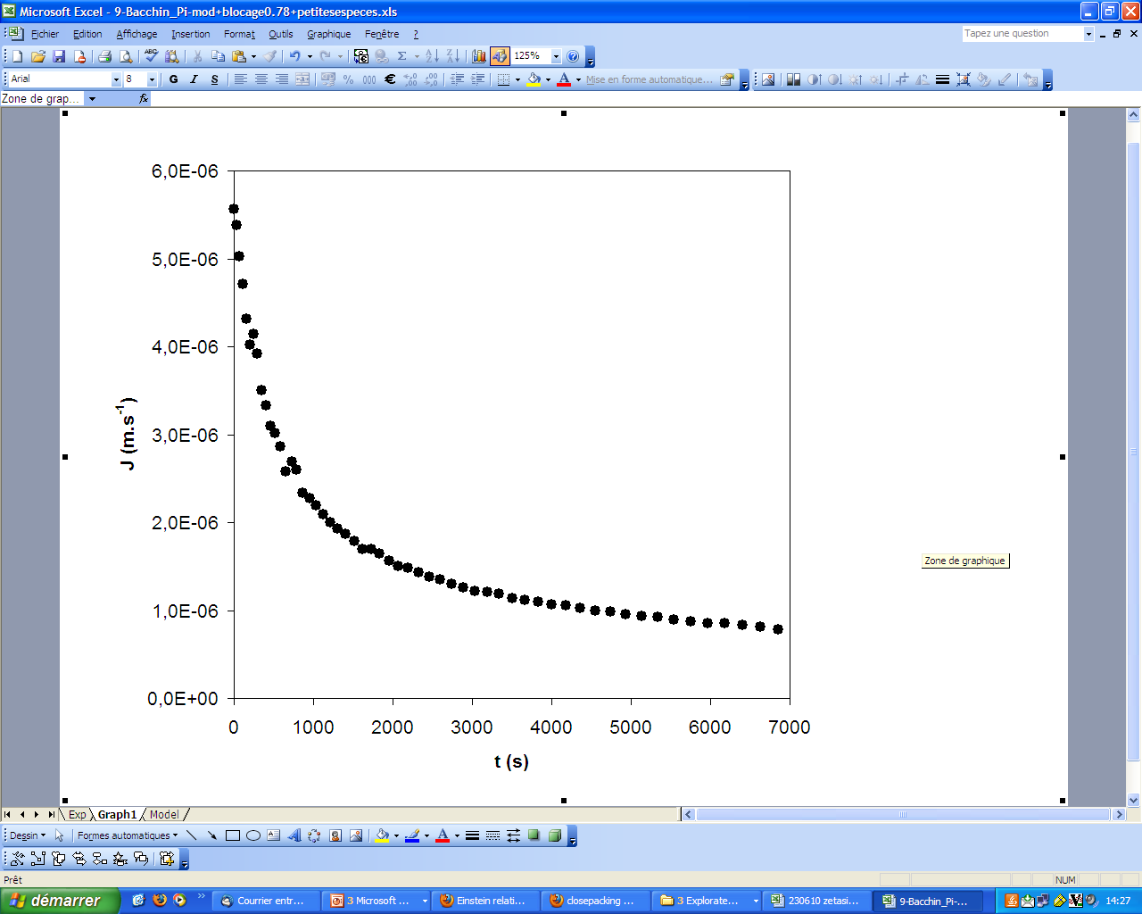
3. Measurement of permeability: strategy 2
Using the model “reversely”
[Bowen et Williams, J. Coll. Int. Sci., 2001]
Permeability
Osmotic pressure
Model validation:
Can we use the results for the prediction of filtration in any other conditions?
[Bouchoux et al., Biophys. J., 2009]
9

Slide 10
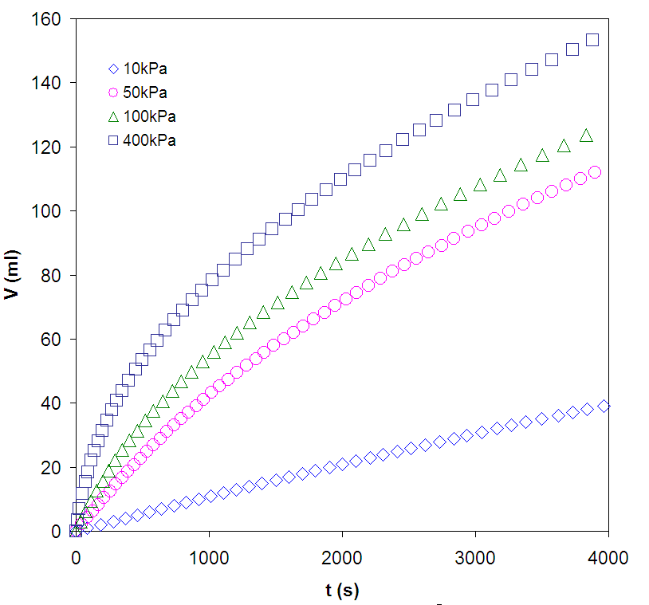
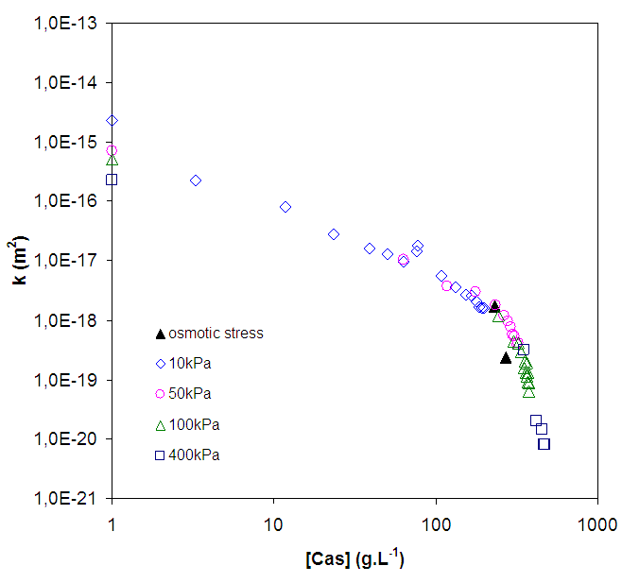
4. Permeability of casein micelles
The results are continuous and homogeneous
The results determined by the two methods are similar
10

Slide 11
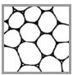
4. Permeability of casein micelles
Permeability values = 2 regimes
close packing
Phase transition (close packing) limits permeability
11

Slide 12
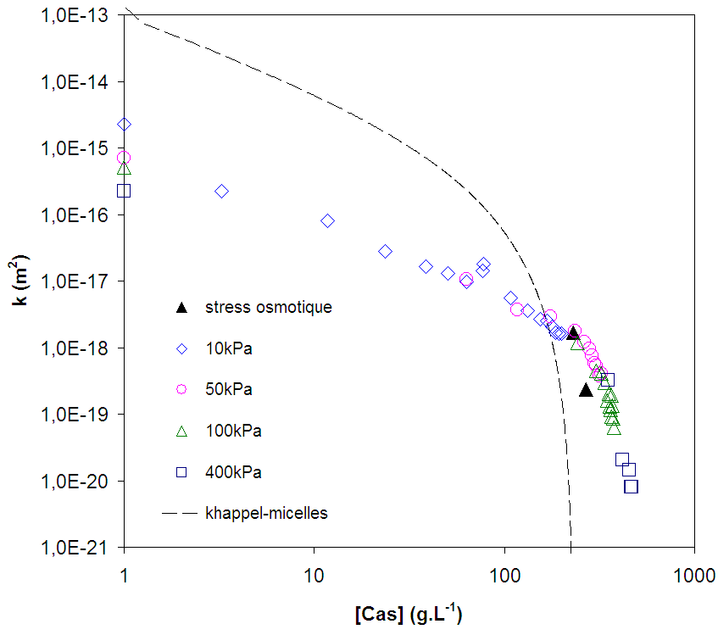
4. Permeability of casein micelles
Regime 1 - Before close packing
close packing
r_{p}=50nm
Very different from the “monodispersed hard spheres”
12

Slide 13
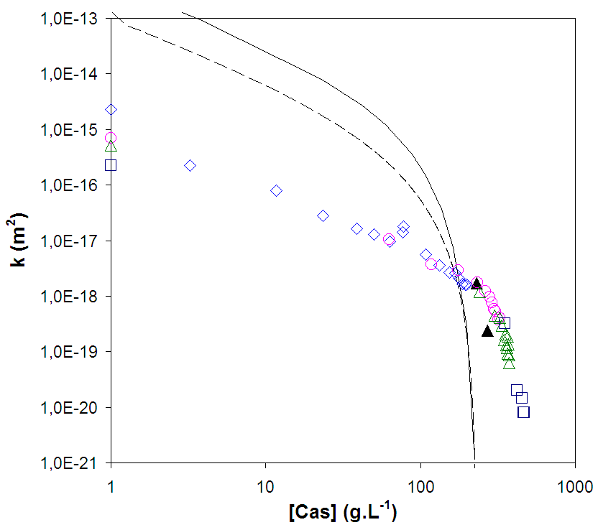
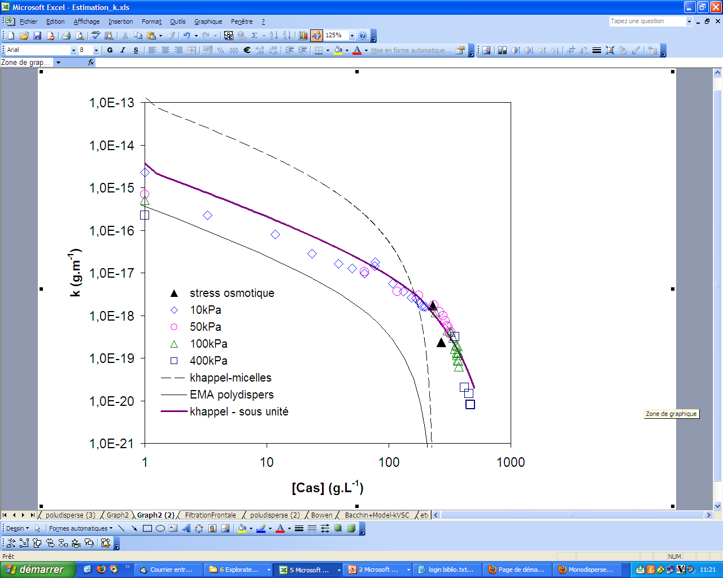
4. Permeability of casein micelles
close packing
Regime 1 - Before close packing
[McMahon et Oommen, J. Dairy. Sci., 2008]
[Li et Park., Ind. Chem. Res., 1998]
The difference is not due to the polydispersity
It should not be due to the porosity of micelles
→ dispersions of porous particles are supposed to be more permeable than dispersions
of hard particles [Adade, JCP, 2010]
Other effects (proteins residual from proteolyses of micelles ) affect the measurement? → work in progress…
13

Slide 14
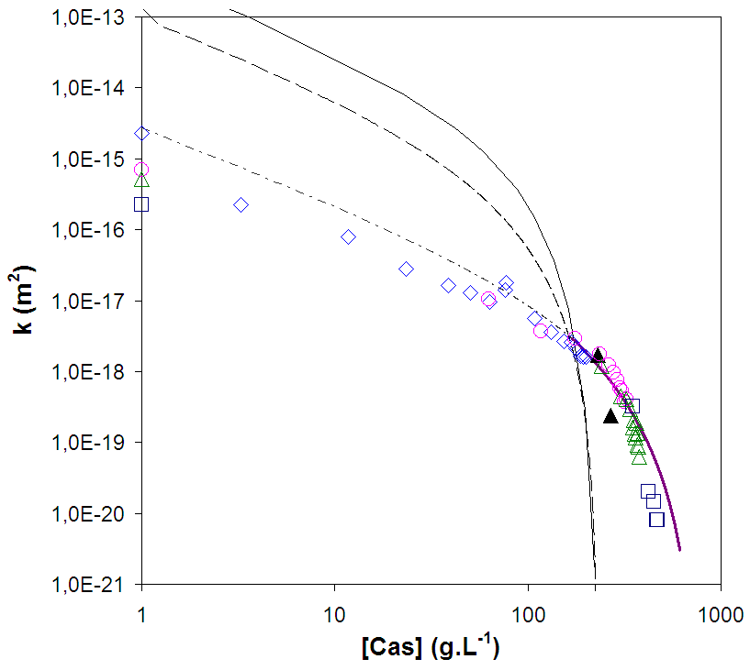
4. Permeability of casein micelles
Regime 2 - After close packing
close packing
r_{p}=4.5nm
After close packing:
Casein micelles ≈ bags of small spheres
How does the internal organization of casein micelles affect the permeability ?
14

Slide 15
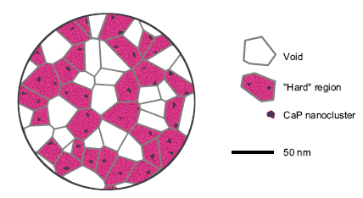
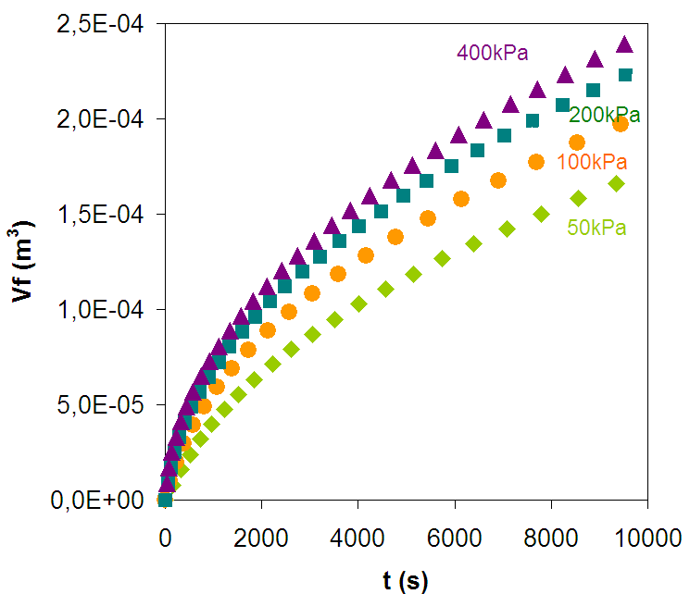
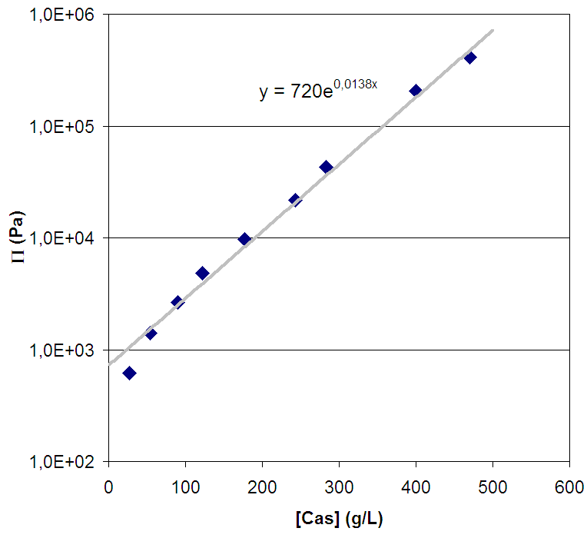
5. Permeability of modified casein micelles
Effect of NaCl 100mM
Ca²⁺ Na⁺
SAXS: void region ↓
Casein micelles
Filtration experiments
Osmotic pressure
[Bouchoux et al., Biophys. J., 2009]
15
14

Slide 16
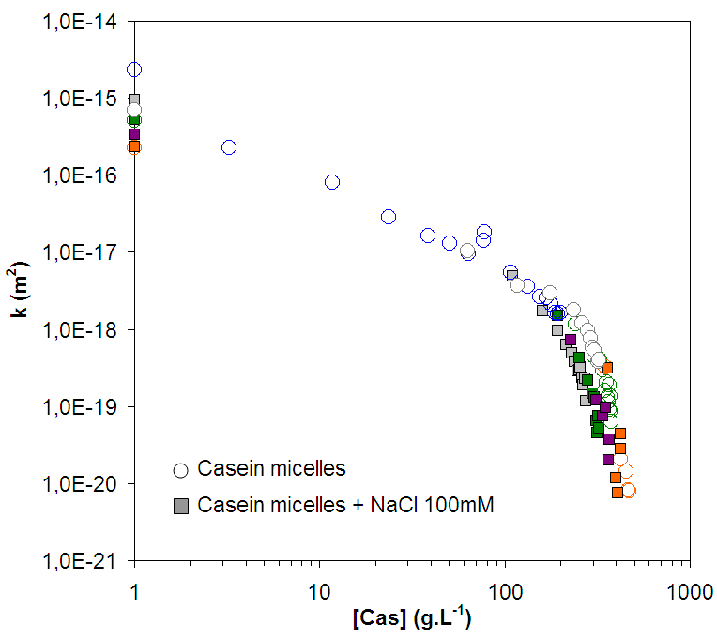
5. Permeability of modified casein micelles
Effect of NaCl 100mM
close packing
180-350 g/L, permeability is limited by the addition of 100mM NaCl
→ More tortuous or less porous structure
>350 g/L, the permeabilities of the two dispersions become similar
16

Slide 17
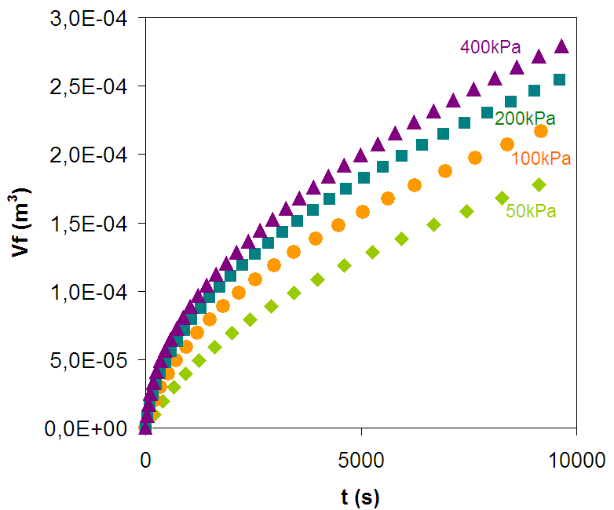
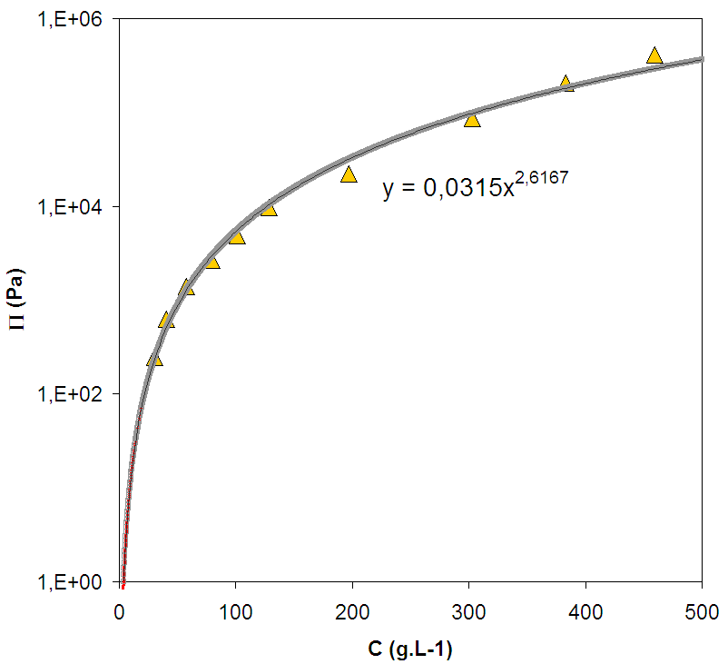
5. Permeability of modified casein micelles
Sodium Caseinate
Casein micelles
Sodium caseinate
Filtration experiments
Osmotic pressure
[Bouchoux et al., Biophys. J., 2009]
17

Slide 18
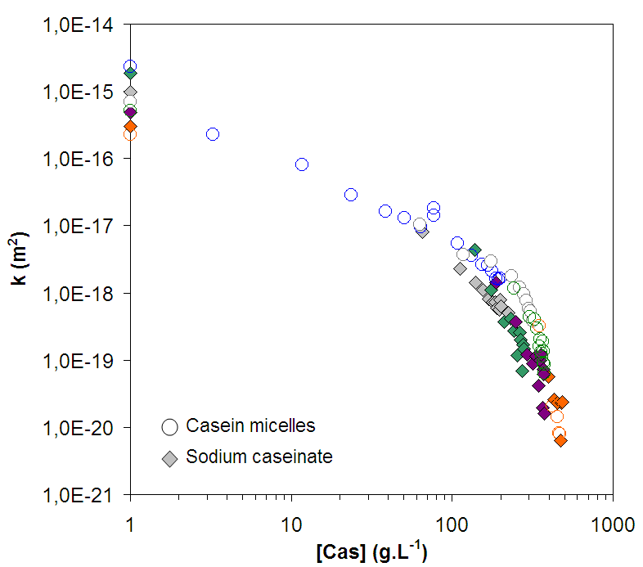
5. Permeability of modified casein micelles
Sodium Caseinate
close packing
Casein micelles
Sodium caseinate
150-350 g/L, sodium caseinate dispersion is less permeable
→ More tortuous or less porous structure
>350 g/L, the permeabilities of the two dispersions become similar
18

Slide 19
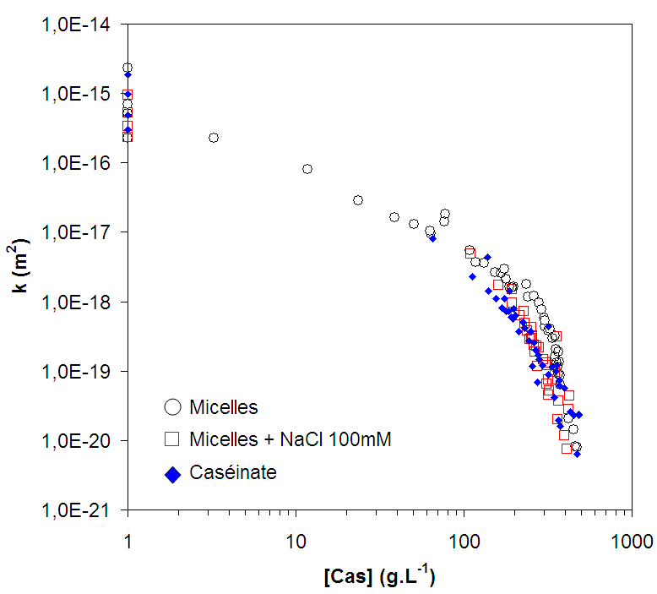
5. Permeability of modified casein micelles
close packing
After close packing: the permeability is limited while the salt is added or the micelles
are dissociate
→ More tortuous or less porous structure
>350 g/L, the permeability is less dependent of the different conditions
→ Whatever its initial structure, the system becomes homogeneous when it is highly packed
19

Slide 20
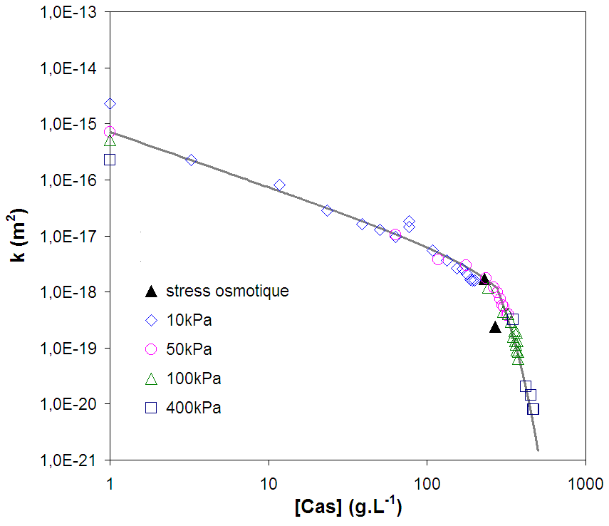
6. Model validation
Permeability
Osmotic pressure
[Bouchoux et al., Biophys. J., 2009]
Prediction is possible
20

Slide 21
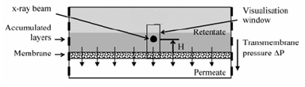
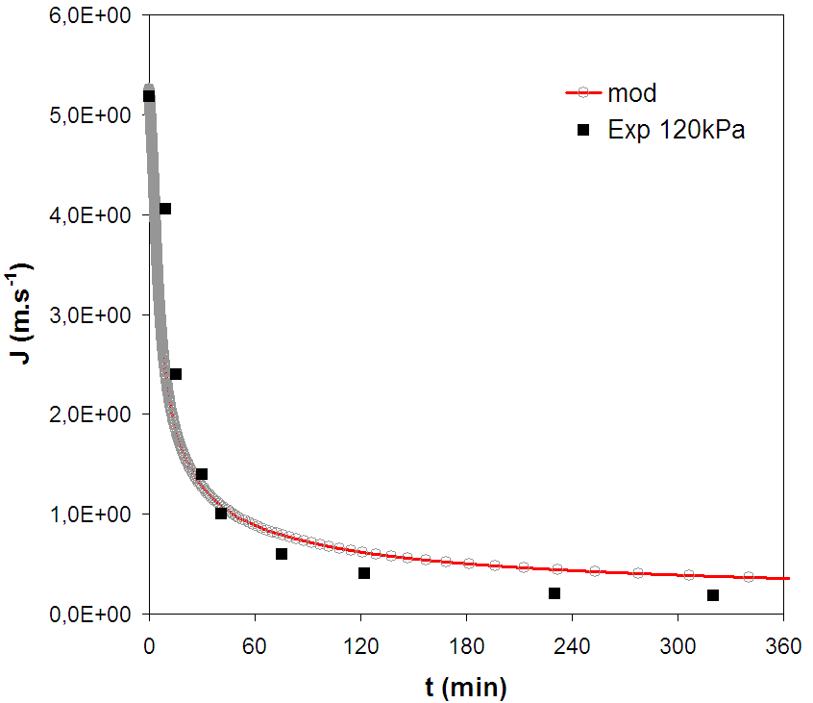
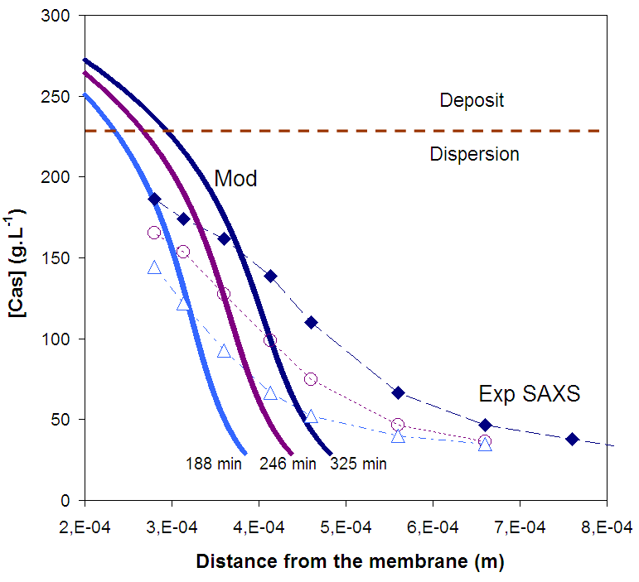
6. Model validation
Prediction vs. experimental results
[David et al.,Langmuir, 2008]
The results are satisfying and encouraging
21

Slide 22
7. Conclusion
1. We determined the permeability of dispersions of permeable and
compressible colloids
2 regimes = before and after close-packing
2. Casein micelles are individually permeable, the permeability can be limited
while the salt is added or the micelles are dissociated.
3. Able to predict the filtration of soft objects – General model for colloids
In the future…
Continue to understand how the permeability is affected by the organization of
casein molecules in the micelles? What are the consequences on the filtration?
pH? Internal cross linking by enzyme?...
22

Slide 23

Thank you.
Thanks to Mr. Patrice Bacchin.
23

