Slide 1


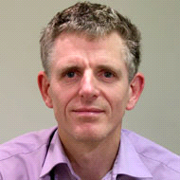
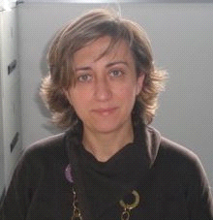



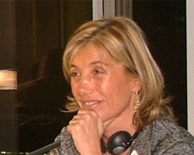
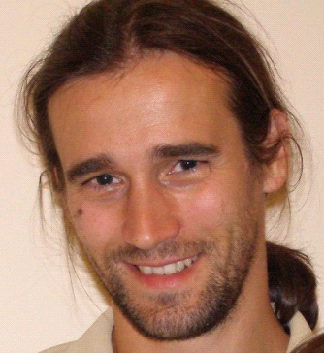
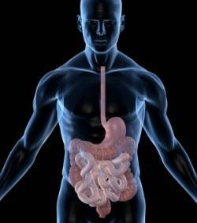
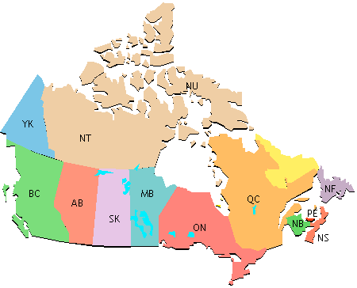
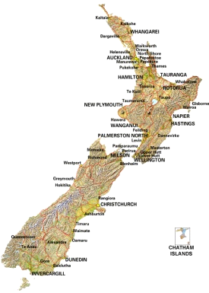


INFOGEST
Improving health properties of food by sharing our knowledge on the digestive process
2011 ⏐ 2015
INFOGEST is a COST Action gathering scientists from different disciplines (food science, nutrition, gastroenterology, immunology…) to better understand the disintegration of foods in the gastrointestinal tract and identify the beneficial food constituents released during digestion
Participating countries
BE, CA, CH, CZ, DE, DK, ES, FI, FR, HU, IE, IL, IT, LT, LU, NL, NO, NZ, PL, PT, RS, TR, UK
INFOGEST’s specific objectives are :
* Spread and improve current basic knowledge on food digestion
* Identify the beneficial food components released in the gut during digestion
* Support the effect of beneficial food components on human health
* Promote harmonization of currently used digestion models
Contact details
Chair of the Action
DUPONT Didier,
Senior Scientist
INRA, FRANCE
didier.dupont@rennes.inra.fr
Science Officer
Science Officer Food and Agriculture
COST Office
ioanna.stavridou@cost.eu
Website
www.cost-infogest.eu
INFOGEST is organized into 3 Working Groups
INFOGEST
INFOGEST
Dairy
Vice
Vice
-
-
chair
Chair
chair
Chair
Fruits &
Vegetables
Alan
Alan
Mackie
Mackie
-
-
UK
Didier Dupont
UK
Didier Dupont
-
-
France
France
Egg
Relationship between food
Relationship between food
Relationship between food
Evaluation of the health
In vitro
Evaluation of the health
In vitro
,
,
in vivo
in vivo
and
and
in
in
silico
structure and nutrient
silico
structure and nutrient
structure and nutrient
effects
models of mammalian
effects
bioaccessibility
models of mammalian
bioaccessibility
bioaccessibility
-
-
-
gastrointestinal digestion
bioavailability
gastrointestinal digestion
bioavailability
bioavailability
WG3
WG2
WG3
WG1
WG2
WG1
WG1
Digestion models harmonization
BFC identification
Digestion models harmonization
BFC identification
BFC identification
Immunomodulatory
Immunomodulatory
properties
Comparison
properties
Comparison
in vitro
in vitro
/
/
in vivo
Stability during processing
in vivo
Stability during processing
Stability during processing
Regulation of appetite and satiety
Digestion products identification
Regulation of appetite and satiety
Food multi
Digestion products identification
Food multi
Food multi
-
-
-
scale characterization
scale characterization
scale characterization
Effect of BFC on human
Effect of BFC on human
microbiota
BFC absorption /bioavailability
microbiota
BFC absorption /bioavailability
F
Capozzi
B. De
Meulenaer
A.
Brodkorb
I.
Recio
T.
Lea
A.
Bordoni
Italy
Belgium
Ireland
Spain
Norway
Italy
INFOGEST gathers 140 scientists from 43 institutions in 24 countries (EU, Canada, New Zealand)
?
Manchester
Univ
Tech
Univ
Denmark
Univ
Aarhus
MTT
Univ
Eastern
Finland
Canada
Birmingham
Univ
Norwegian
Univ
Life
Sci
VTT
Nofima
What is really happening during digestion ?
Wageningen UR
Rothamsted
Res
Teagasc
Univ
Reading
Univ
Leeds
Univ
Ghent
Cent
Rech
Lippmann
Laval
Univ
Inst
Food
Res
Agroscope
Posieux
Univ
Guelph
Leatherhead
Food
Res
Polish
KTU Food
Inst
Univ
Greifswald
Academy
of
Sci
INRA
Max
Rubner
-
Institut
Univ
Belgrade
AgroParisTech
Centr
Univ
Novi
Sad
Ben
Gurion
Food
Res
Inst
CSIC
Technion
Univ
Univ
Alto Douro
TNO
ITQB
Milan State
Univ
Univ
Bologna
Ege
Univ
Pom
Med
Univ
New
Zealand
Lund Univ
Inst
Chemical
Technology
Riddet
Inst
New participants are welcome!!!

