Slide 1
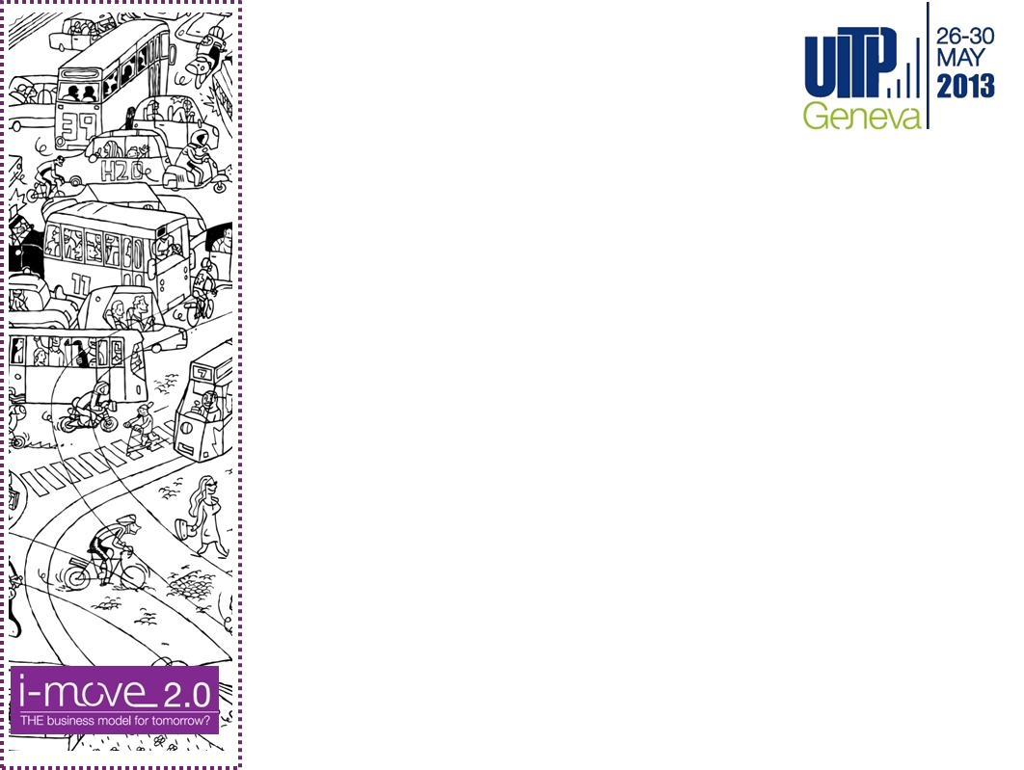

Keeping or not a BRT line on the route of a new subway?
Reza Vosooghi
Tehran Transportation and Traffic Organization
Tehran, Iran

Slide 2
CONTENTS
Tehran : rapid urbanization & ecological challenge
Public transport development : Subway & BRT
Azadi-Enghelab corridor : two public transportation modes
Analysis and solutions
Conclusion : towards a sustainable city

Slide 3
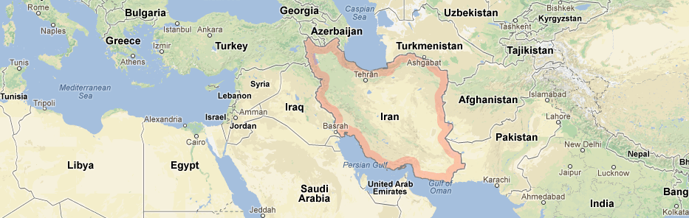
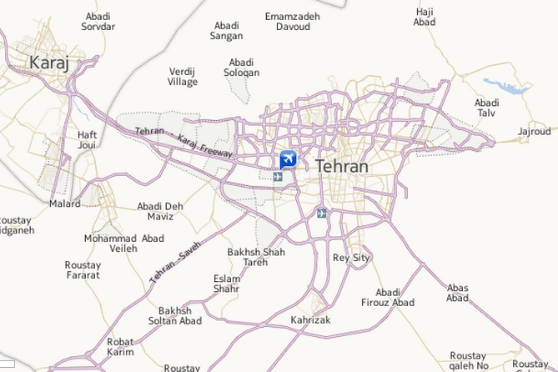
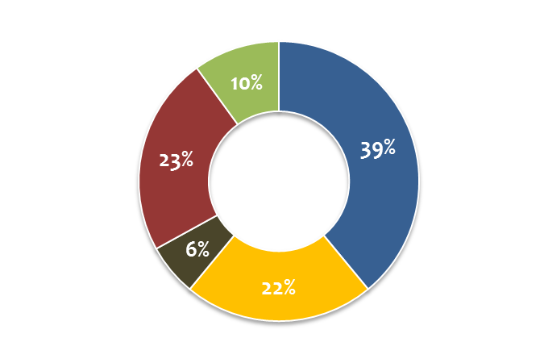
TEHRAN: rapid urbanization
Day time population: 12 million
Night time population: 8,2 million
Area (Tehran): 740 km2
Residents Trip: 17.1 million/day
Subway
Daily trips
Private car
Bus
Motorcycle
Taxi Share

Slide 4
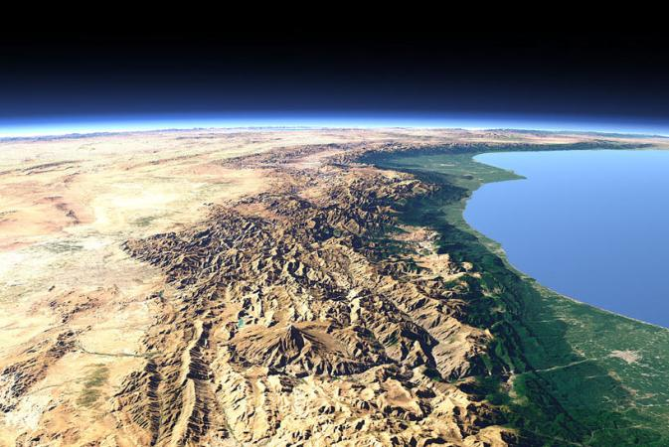
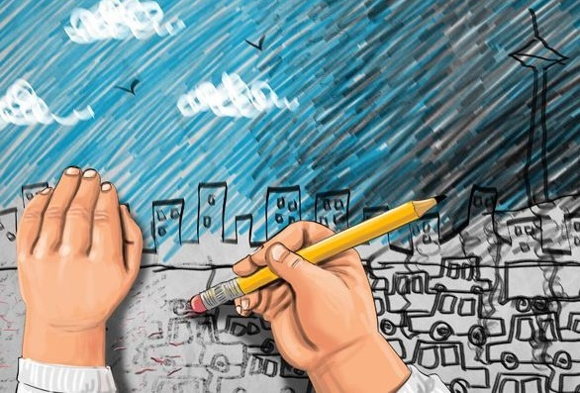
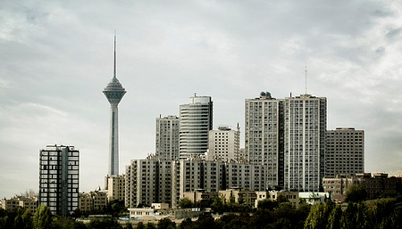
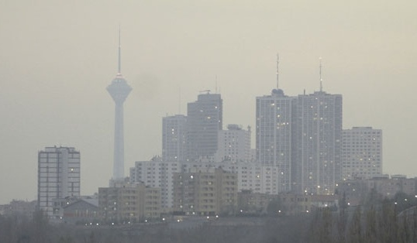
TEHRAN: ecological challenge

Slide 5
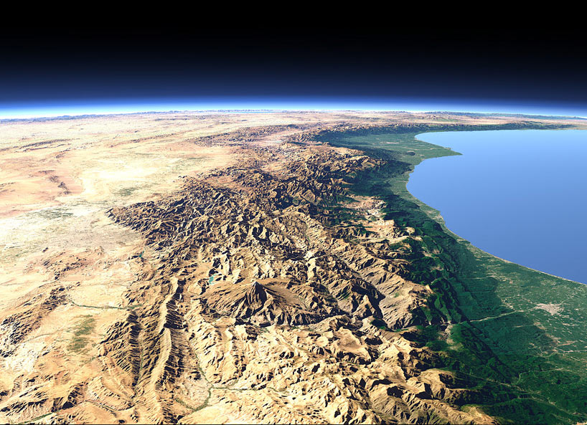
TEHRAN: ecological challenge
Tehran is surrounded by mountains and natural ventilation and air flows are blocked
Tehran
Caspian Sea

Slide 6
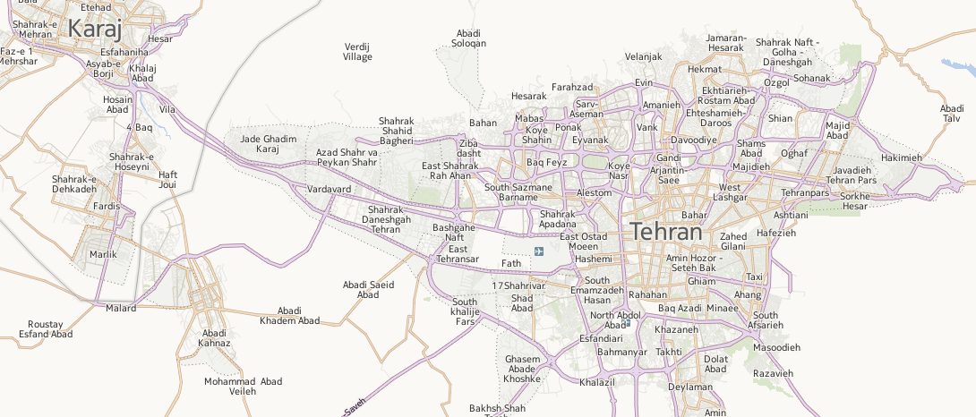
TEHRAN: public transport development
→ Subway
Subway length
(km)
31
40
68
79
89
98
125
140
1999
2001
2003
2005
2007
2009
2011
2013

Slide 7
TEHRAN: public transport development
→ BRT
Subway length:
31
40
68
79
89
98
125
140
BRT length:
(km)
19
62
105
115
1999
2001
2003
2005
2007
2009
2011
2013

Slide 8

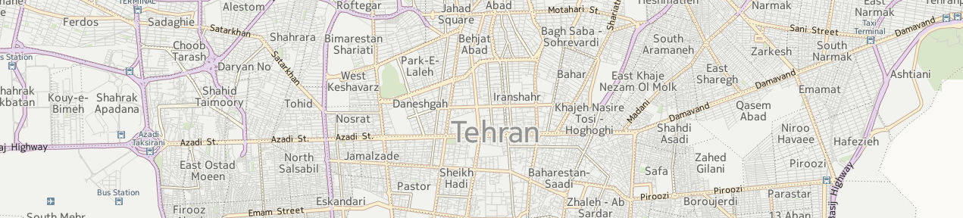
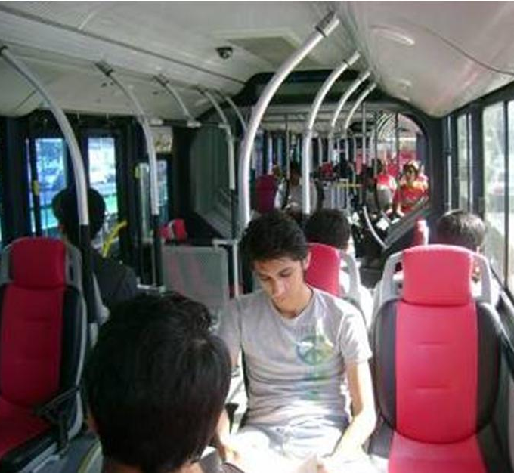
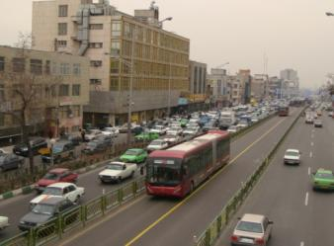
TEHRAN: public transport in the most congested corridor
BRT 1 (2007)
Length : 19 km , Station No. : 26
Fleet No. : 280 (200 articulated)
Passengers No. : 280,000
(Record : 530,000)
Headway : 1 min
Reduced travel time → 35%
Increased No. passengers of public
transport → 147%
Decreased emissions → 46%
(in 18 km corridor)
10 km
2010
2012
2011
2009
2008

Slide 9

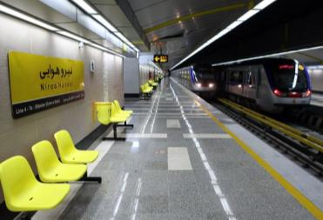
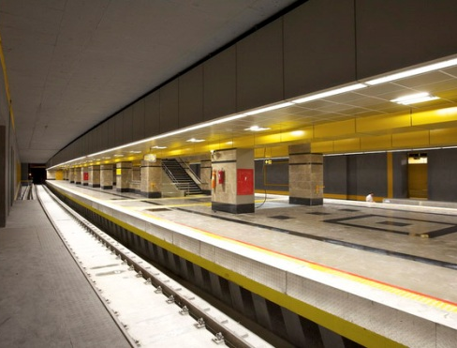
TEHRAN: public transport in the most congested corridor
BRT 1 (2007)
Length : 19 km , Station No. : 26
Fleet No. : 280 (200 articulated)
Passengers No. : 280,000
(Record : 530,000)
Headway : 1 min
Subway 4 (2008-2012)
Length : 24 km , Station No. : 19
Fleet No. : 13 (programmed : 24)
Passengers No. : 320,000
(Programmed : 1,000,000)
Headway : 7-10 min (programmed <3 min)
10 km
2010
2012
2011
2009
2008

Slide 10
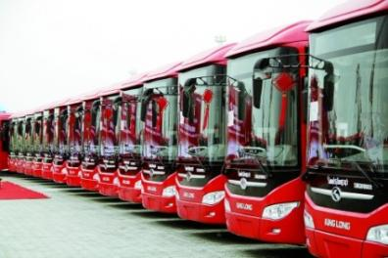
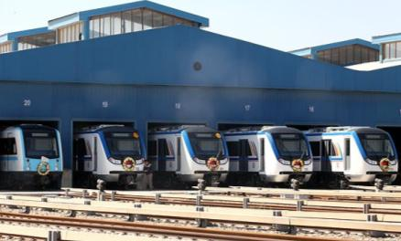
BRT Vs. Subway?
BRT 1 (2007)
Subway 4 (2008-2012)
280 buses
(200 articulated)
13 rams
=
=
60,000,000 $
90,000,000 $
Actual headway : 1 min
Programmed headway : 1 min
Actual headway : 7-10 min
Programmed headway < 3 min
Passengers No. : 280,000
Record : 530,000
Passengers No. : 320,000
Programmed Passengers No. : 1,000,000
z
z
Total investment
Performance
Total investment
Performance
11
1
50%
Current investment
35%
10

Slide 11

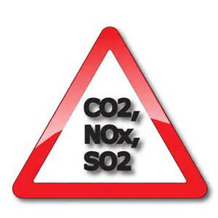

BRT Vs. Subway?
BRT 1 (2007)
Subway 4 (2008-2012)
280 buses
(200 articulated)
13 rams
=
=
60,000,000 $
90,000,000 $
Actual headway : 1 min
Programmed headway : 1 min
Actual headway : 7-10 min
Programmed headway < 3 min
Passengers No. : 280,000
Record : 530,000
Passengers No. : 320,000
Programmed Passengers No. : 1,000,000
OBJECTIVE
z
z
Total investment
Performance
Total investment
REQUIREMENTS
Performance
INFRASTRUCTURE
CHALLENGES
11
1
Passengers demand
50%
Current investment
35%
10

Slide 12
ANALYSIS : increase in Subway 4 share
Total passengers : 600,000
74% of BRT passengers are in common itinerary
10 km

Slide 13
ANALYSIS: equal average trip distance
AVERAGE TRIP DISTANCE
BRT 1
6.54 km
SUBWAY 4
6.58 km

Slide 14
ANALYSIS : “Why not Subway?”
AVERAGE TRAVEL TIME / DISTANCE
COMMERCIAL SPEED
BRT 1
19,3 km/h
SUBWAY 4
36,2 km/h
5 km
Current headway (7 min) → For distance > 5 km → ATT Subway < BRT
IF headway achieve 3 min → For Distance > 3,5 km → ATT Subway < BRT
SURVEY : “Why don't you take the Subway line 4?”
17%
40%
30%
10%
3%
I didn't know it exists
It's very crowded
other
Much time to go down to the station and wait for a train
I 'm afraid of traveling underground

Slide 15
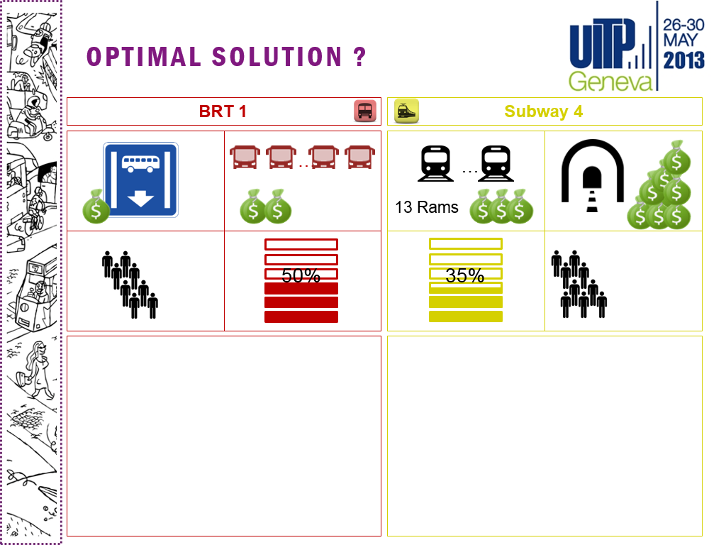

Slide 16
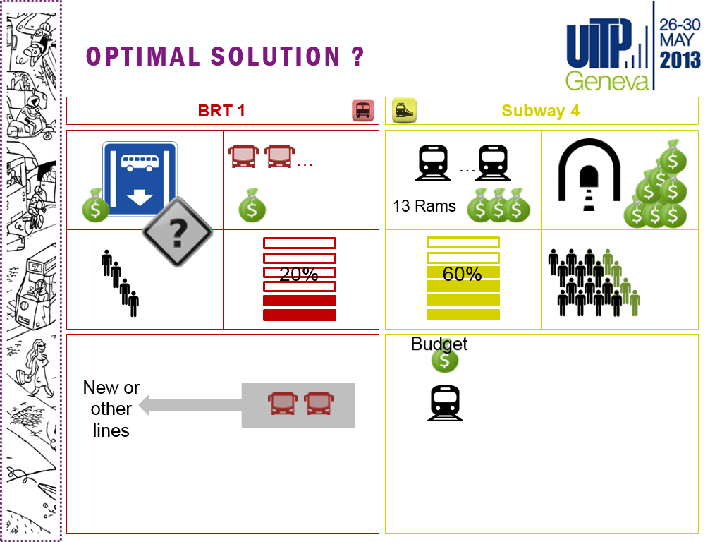

Slide 17
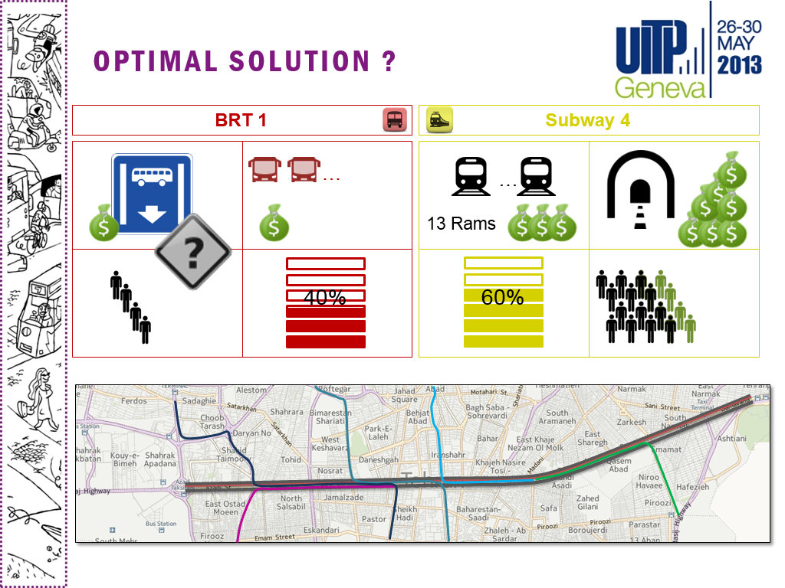

Slide 18
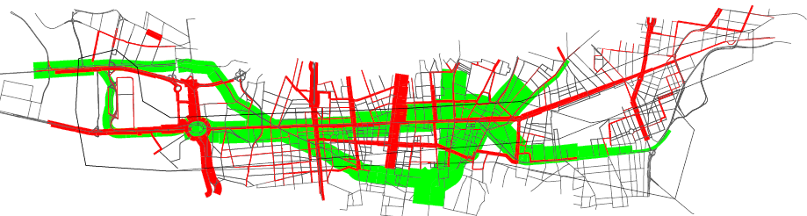
RESULTS : BEFORE → AFTER
ME modeling
Subway 4
BEFORE
AFTER
Total Passengers No.
Passengers No. (10 km)
320,000
280,000
600,000
440,000
87%
BRT 1
Total Passengers No.
Passengers No. (10 km)
280,000
208,000
110,000
80,000
Passengers No. in special line
190,000
32%
Transfer : private car to public transport
16,000
+160,000
- 5%
Growth in number of passengers of public transport
4%
Emissions decrease (CO2 & NOx) in Tehran
5%

Slide 19
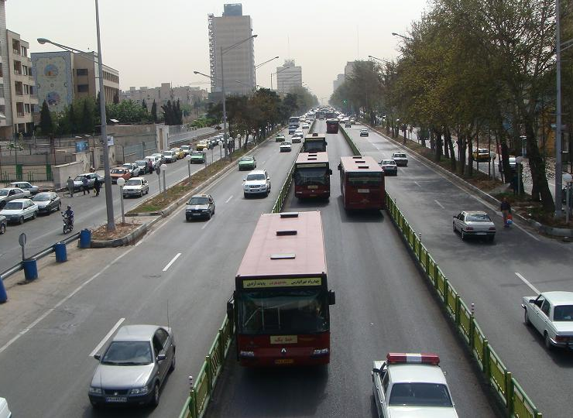
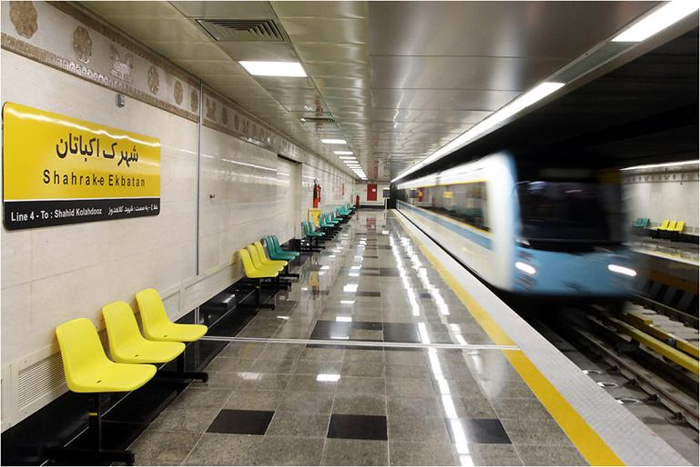
CONCLUSION:
→ towards a sustainable city
START OF CONSTRUCTION: 2007
START OF OPERATION: 2007
START OF CONSTRUCTION: 2004
START OF OPERATION: 2008-2012
Optimum use of infrastructure
Increased number of public transport passengers
Reduction of air pollution
And finally: progress towards a sustainable city

