Slide 1
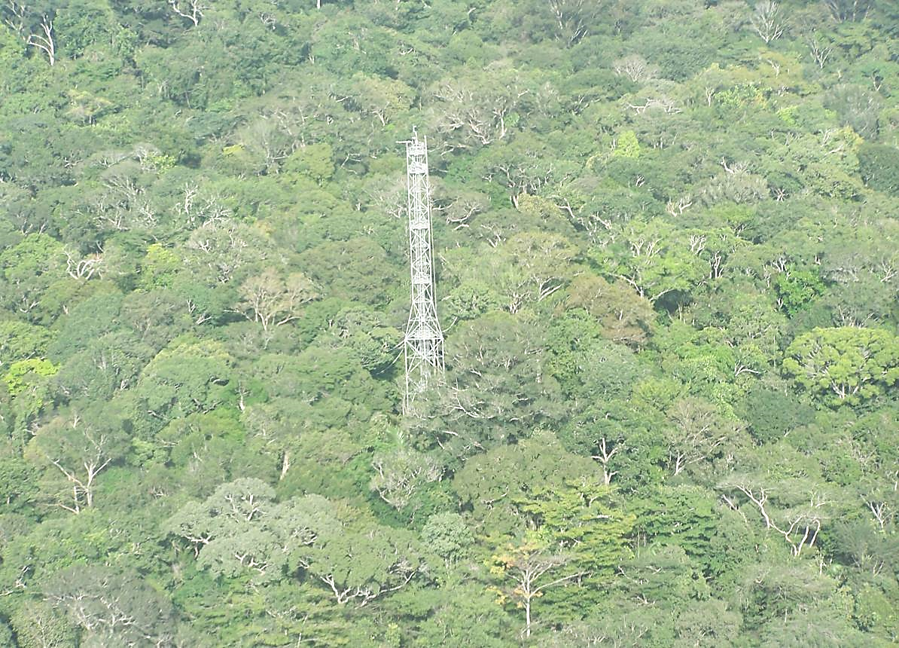
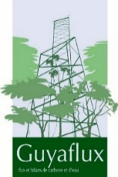




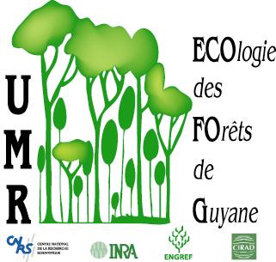
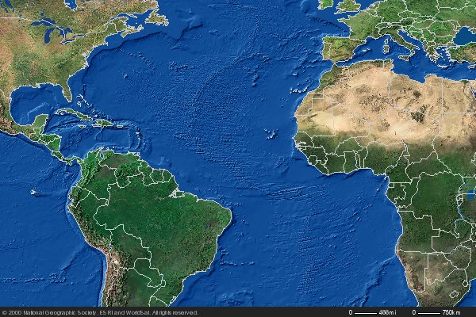
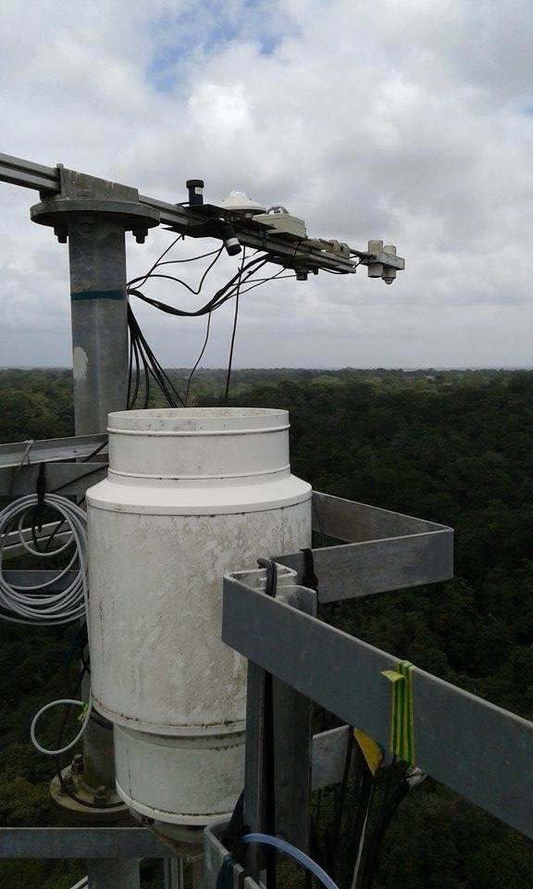

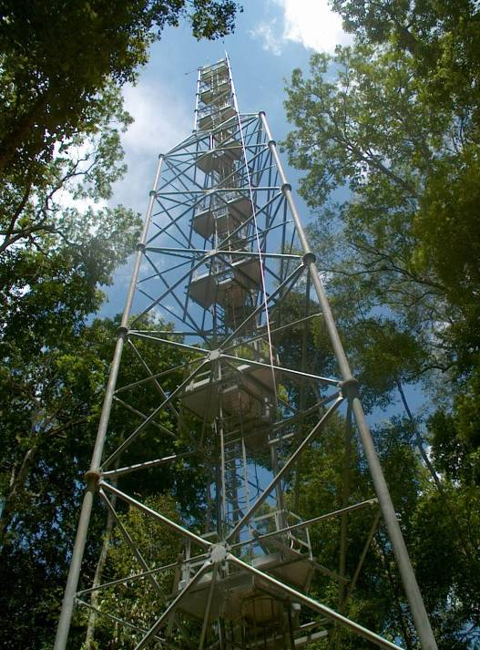
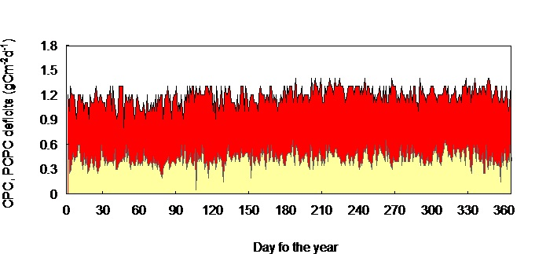
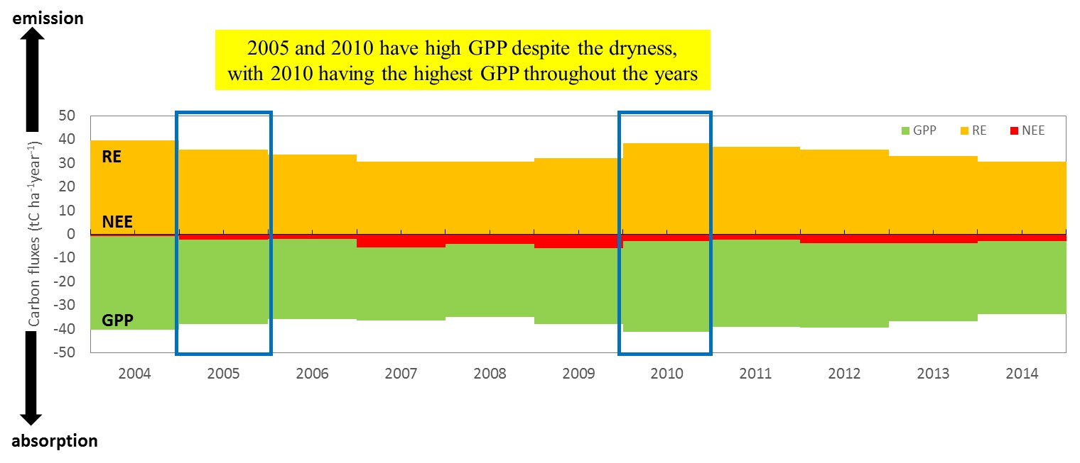
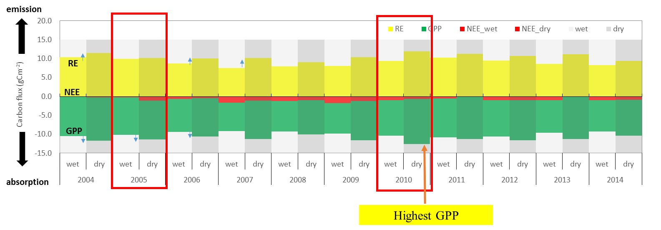
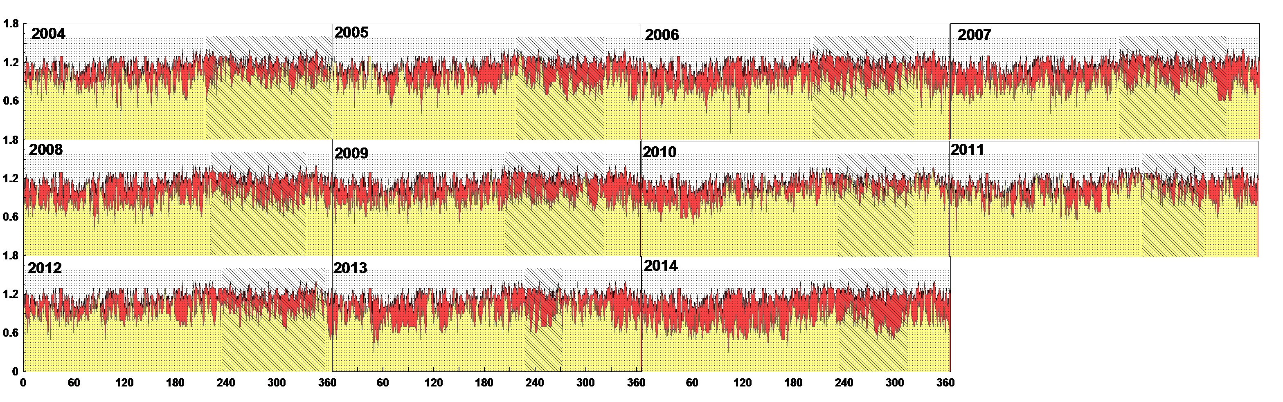
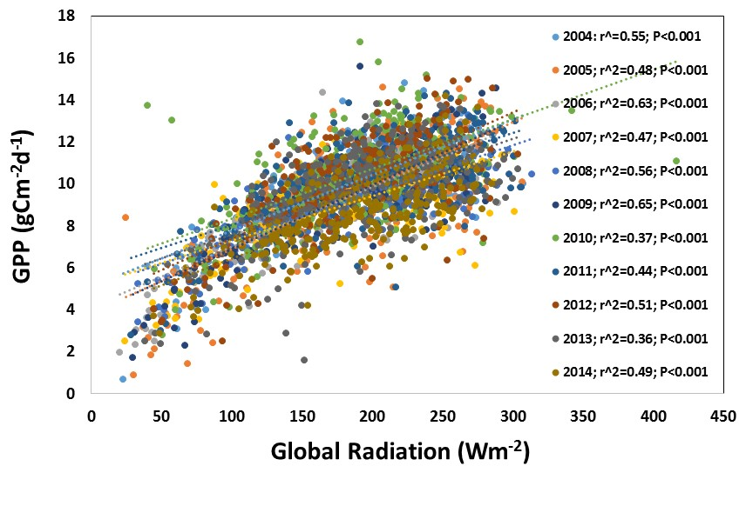
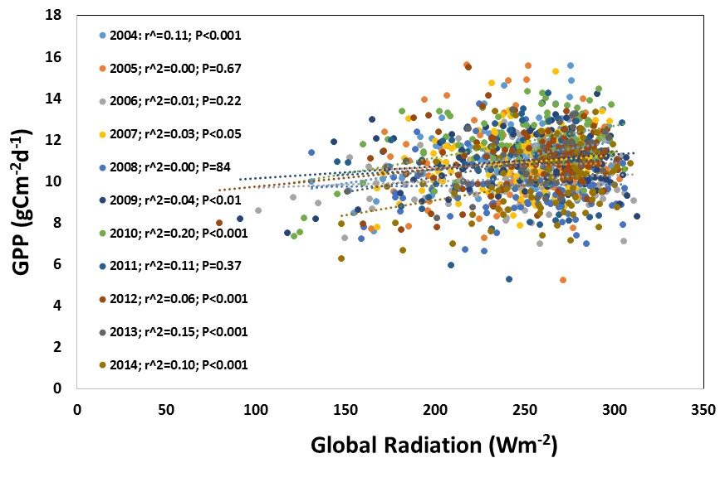
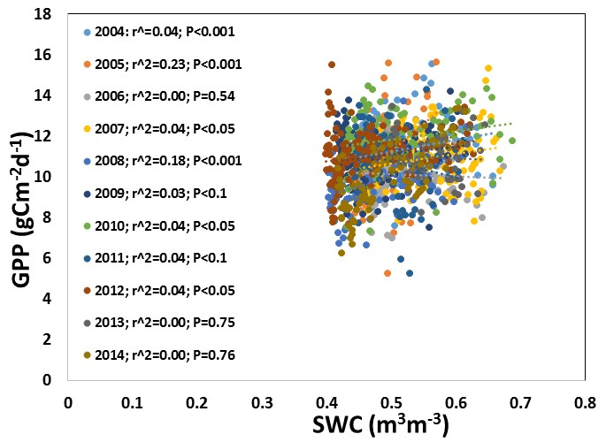
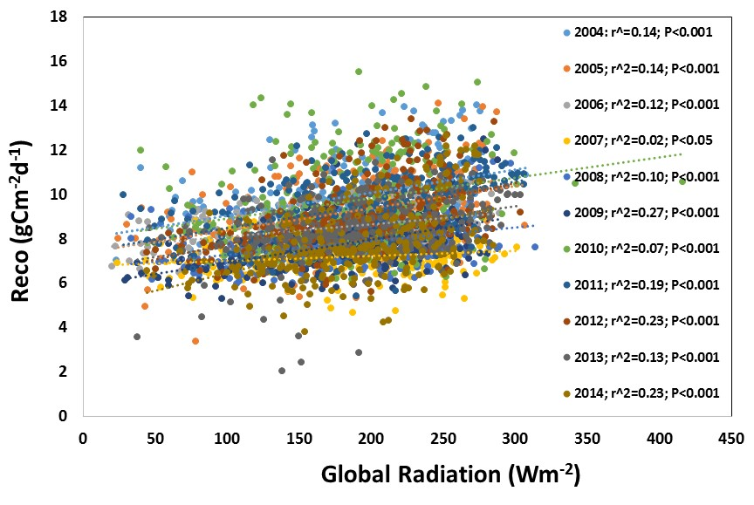
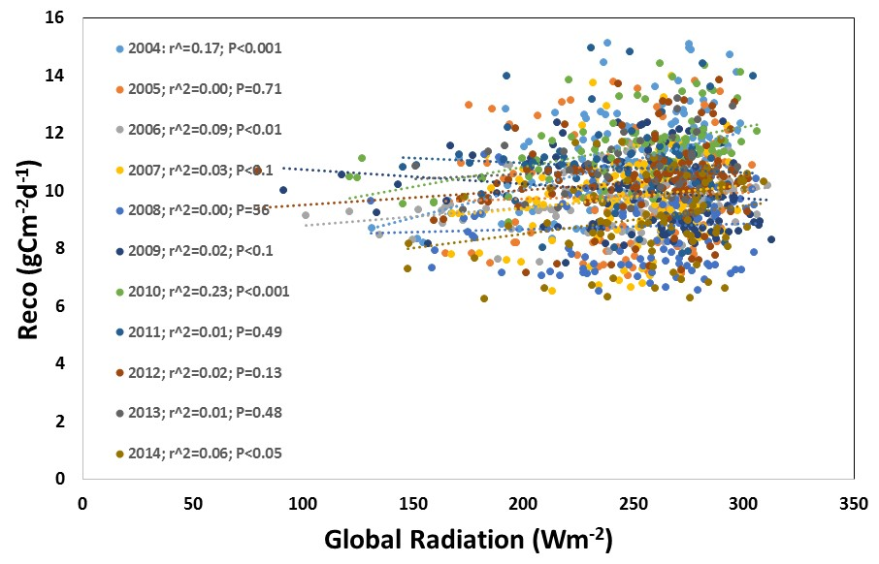
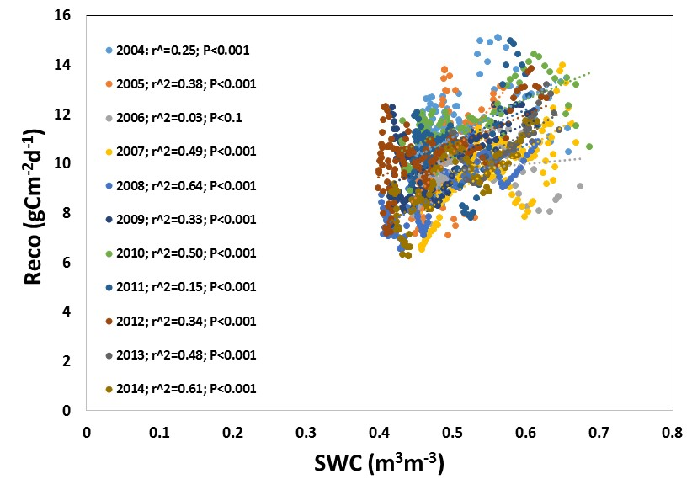
Paper number:
B33C-0671
The effect of drought on carbon storage capacity
in a tropical rainforest of French Guiana
Abstract
Maricar Aguilos¹, Benoit Burban¹, Jocelyn Cazal¹, Jean-Yves Goret¹, Bruno Hérault² and Damien Bonal³
¹INRA Institut National de la Recherche Agronomique, UMR Ecologie des Forêts de Guyane, BP 316 Avenue de France Kourou Cedex, French Guiana ²CIRAD, UMR Ecologie des Forets de Guyane, BP 316 Avenue de France, Kourou Cedex, French Guiana and ³INRA, UMR EEF 1137, Champenoux, France
Amazon forest − a very important carbon sequestering ecosystem did not escape from the wrath of droughts, two of which occurred in 2005 and 2010. Thus, this study was conducted to elucidate how these dry spells alter the interannual and seasonal variations in carbon fluxes and verify the commonly-invoked notion that drought will create significant impact to the ecosystem’s productivity. Using an 11-year (2004–2014) eddy covariance flux and meteorological data, the relationships between potential productivity and droughts occurring in a tropical rainforest of French Guiana, South America were examined. A new method in determining disturbance effect called ‘perfect-deficit’ approach was also explored. Surprisingly, the effect of drought in ecosystem productivity was observed to be subtle. The ecosystem even remained a net sink all throughout the study period in an annual basis. Despite being the driest year, 2010 has the highest gross primary production (GPP). However, there was large
inter-annual variation in net ecosystem exchange (NEE) from -0.66 ± 0.50 tC ha⁻¹ y⁻¹ in 2004 to -5.72 ± 0.50 tC ha⁻¹ y⁻¹ in 2009, with an average annual sink of around -3.21 ± 0.50 tC ha⁻¹ y⁻¹. Seasonally, there were higher GPP and ecosystem respiration (RE) during dry than in wet seasons. Highest GPP occurred in 2010 which is the driest period from 2004-2014 across Amazonia. Global radiation (Rg) caused significant effect to GPP and RE during wet seasons but not during dry seasons. Weaker relationships between GPP or RE and soil water content (SWC) were observed when dry seasons were moderate but the effect was stronger during extreme dry seasons, thus requiring for a deeper understanding during these extreme drought years. Modeling studies should therefore consider site-specific drought responses since it did not seem to negatively alter carbon fluxes in this Amazonian forest. Long-term observation is needed to examine closely how this ecosystem will respond to future drought incidents as these events are occurring more frequent and becoming severe.
I. Introduction
II. Materials and Methods
Amazon basin plays an important role in the global carbon budget.
It accounts for 15% of global photosynthesis and a major contributor to terrestrial carbon sink.
Unfortunately, this biome is facing threats from drought.
Amazon region had suffered two exceptional droughts in 2005 and 2010 (Xu et al., 2011 and Lewis et al., 2011)
Increasing occurrences of drought urge us to study their impacts on terrestrial carbon budget.
Study site
French Guiana, South America – a tropical wet forest
10 – 40 m above sea level; soils are nutrient-poor acrisol
Ave. rainfall is 3041 mm; ave. air temperature is 25.7°C
Guyaflux experimental unit covers >400 ha of undisturbed forest
620 tree ha⁻¹ tree density (DBH >0.1 m); Tree species richness is 140 species ha^{-1 ;} Mean tree height is 35 m; emergent trees>40m
The CO₂ flux monitoring tower
55 m high
20 m higher than the overall canopy height
French Guiana
Objectives
The Perfect Deficit Approach
PCPC curve
(perfect canopy photosynthetic capacity curve)
Present the interannual and seasonal variations in carbon fluxes (GPP, RE, NEE) and carbon
balance at a tropical rainforest site in French Guiana and understand which climatic factors
influenced these fluxes; and
Determine the effect of severe drought events (2005-2010) on the CO₂ fluxes using the
perfect-deficit approach.
Meteorological and flux data
Air temperature and humidity
bulk rainfall
wind direction and speed
global and infrared incident and reflected
radiations
incident and reflected photosynthetic
photon flux density
(maximum ecosystem productivity during the entire record period e.g 10 years)
Atmospheric pressure
soil temperature
volumetric soil water content
Vapor Pressure Deficit
data were collected and compiled as 30 min averages or sums and processed following the standard flux data processing, gap-filling and analysis procedures.
CPC deficits
Hypothesis
perfect annual CPC curve
Drought will cause significant impact to the carbon fluxes; and
Differences in solar radiation, air temperature, soil water content (rain) may explain differences
in GPP, RE and NEE among years or among seasons.
(daily maximum ecosystem
productivity in a given year)
III. Results
Interannual variation in GPP, RE and NEE
Seasonal variation in GPP, RE and NEE
Interannual change in climatic parameters
The CPC Chart
PCPC, CPC (gCm⁻²d⁻¹)
Drivers of ecosystem productivity and respiration
IV. Conclusions
wet
dry
dry
Day of the year
CPC chart shows a subtle effect of drought on GPP.
Despite being the driest year, 2010 has the highest GPP making it a remarkable record of GPP for the decade.
GPP is higher than RE all throughout the recorded timeframe, thus the ecosystem remains a carbon sink.
Dry periods have higher ecosystem productivity than wet periods.
Solar radiation remain the key factors influencing the variations in ecosystem productivity.
Reduced soil water content during dry periods only moderately reduce GPP
Caution must be taken in modeling drought effects because forests, even located at the same region, may respond differently with drought.
How this rainforest will cope with the climate extremes in the long run is a worthy question that needs to be answered, hence, must be closely monitored.
CPC and climatic parameters percent reduction from perfect values (%)
Strong significant effect
No significant effect
With significant effect
wet
dry
dry
The critical time or extreme period in a year can be clearly identified through the perfect-deficit graphs.
Any increase or decrease in CPC deficits would reflect the impact of extreme climatic events on the potential
productivity of the forest
Moderate effect
No significant effect
Moderate effect
Acknowledgment:
Jena platform, Labex CEBA,
Observatoire du Carbone, CPER-Guyaflux.
Maricar Aguilos is supported by an INRA grant.

