Slide 1





MEASURING AND MODELING SOIL INTRA-DAY VARIABILITY OF THE ¹³CO₂ & ¹²CO₂ PRODUCTION IN A SCOTS PINE FOREST
Longdoz Bernard, Goffin S., Parent F., Plain C., Epron D., Wylock C., Haut B., Maier M., Schack-Kirchner H., Aubinet M.,

Slide 2
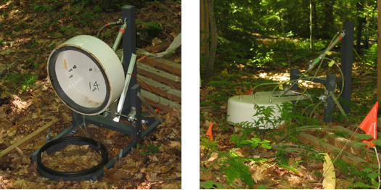
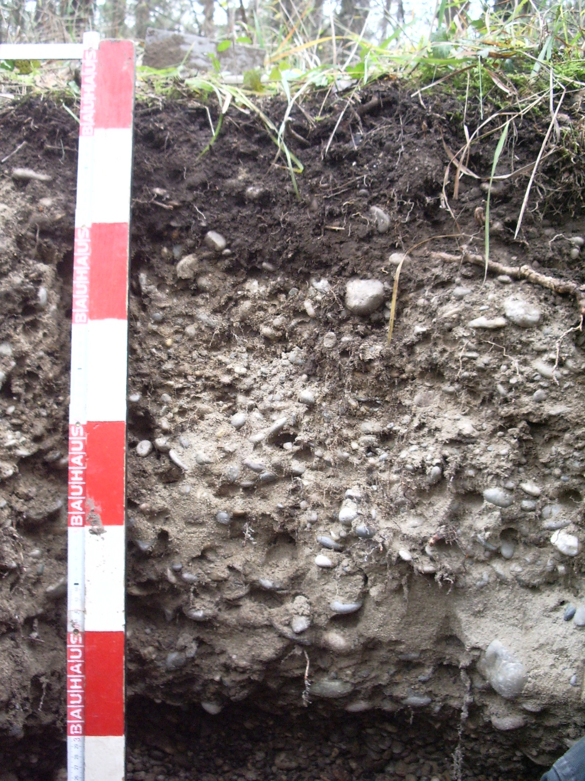
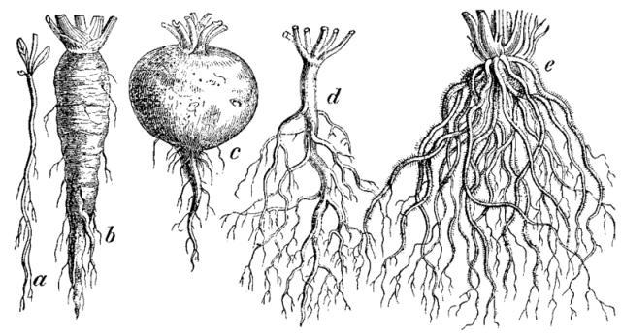

Background
Soil CO₂ efflux (Fs)
Past
today
Future
Empirical description
Mechanistic understanding
  Climate Change Impact & Positive feedback ?
Fs
Transport
Production
Low
Diffusion
Autotrophic
CO₂
Advection + Dispersion
[CO₂]
CO₂
Heterotrophic
Depth
CO₂
Liquid phase
Abiotic
High

Slide 3
Background & Objectives
Fs
Transport
Production Ps
f(porosity, humidity…)
Ps ➪
CO₂
Heterotrophic
Autotrophic
Porosity
Ps ➪
CO₂
f(Temperature, humidity, substrate, pH,…)
High
CO₂
➪
Ps
Fine and Coarse Roots
Corg
Low
⇒ Multilayer Approach needed

Slide 4
Background & Objectives
δ¹³CO_{2 atm} ≃ -8‰
δ¹³C_{leaf} = δ¹³CO_{2 atm} + Δ_{photo}(climate)
≃ -27‰
⇒ Temporal variation of δ¹³Ps give information about transfer time and pathway of photoassimilates in the
δ¹³C_{phloem}
δ¹³Fs
⇒ δ¹³Ps fluctuations
help for source partitioning kinetic
δ¹³Ps
δ¹³P_{auto}
δ¹³P_{hetero}
⇒ Quantify the δ¹³Ps temporal fluctuations
Notes:
So, for example, the isotopic signature of CO2 in the atmosphere is -8 per mil…and the isotopic signature of plant material is -27 per mil. It means that there is a strong discrimination againt C13 during assimilation. Vegetation assimilate preferentially the 12CO2 than the 13CO2 so that the plant material is depleted in 13CO2 in comparison with the atmosphere. That discrimination against 13C may change with climatic conditions. For example, during drought events, that discrimination decrease…it means that the photoassimilats become more enriched is C13. As a portion of photoassimilates are then used as substrate for soil respiration, the temporal variation of the isotopic composition of soil respiration may give information about the transfert time of photoassimilats. Another interesting point is that the isotopic composition between autotrophic and heterotrophic sources may also differ…if it is the case, the isotopic composition of soil respiration may give additionnal information about the sources involved.

Slide 5

Objectives
Improving mechanistic understanding of F_{s} and P_{s}
Multilayer Approach
Isotopic Signal Analysis
Sources & δ¹³C
Determine Ps and δ¹³Ps for the different soil horizons.
Find factors affecting Ps & δ¹³Ps intra & inter day fluctuations
Evaluate by modeling what is the part of Ps in the Fs temporal variability
Sources & δ¹³C
Sources & δ¹³C
Sources & δ¹³C
Sources & δ¹³C
Sources et δ¹³C

Slide 6
Determine Ps and δ¹³Ps for ≠ layers
Fs
¹²CO₂ & ¹³CO₂ mass balance for the n^{th} layer:
Diffusive Flux-Gradient approach :
z
F_{n/n-1}
n-1
Ps_{n}
Δε_{n}*C_{n}
n
F_{n+1/n}
n+1
⇒

Slide 7
Determine Ps and δ¹³Ps for ≠ layers
Determination of ε, D and C :
Soil cores sampled along the vertical profile
Relationship ε(SWC) and D(SWC) determined at the lab
The D(SWC) obtained is the D¹²(SWC) one, D¹³= 1.0044*D¹²
¹²CO₂, ¹³CO₂ and SWC vertical profile measured in the field
Boundary conditions : (F & δF)_{bottom} = 0; Fs and δ¹³Fs measured
➨ Ps and δPs for each layer

Slide 8
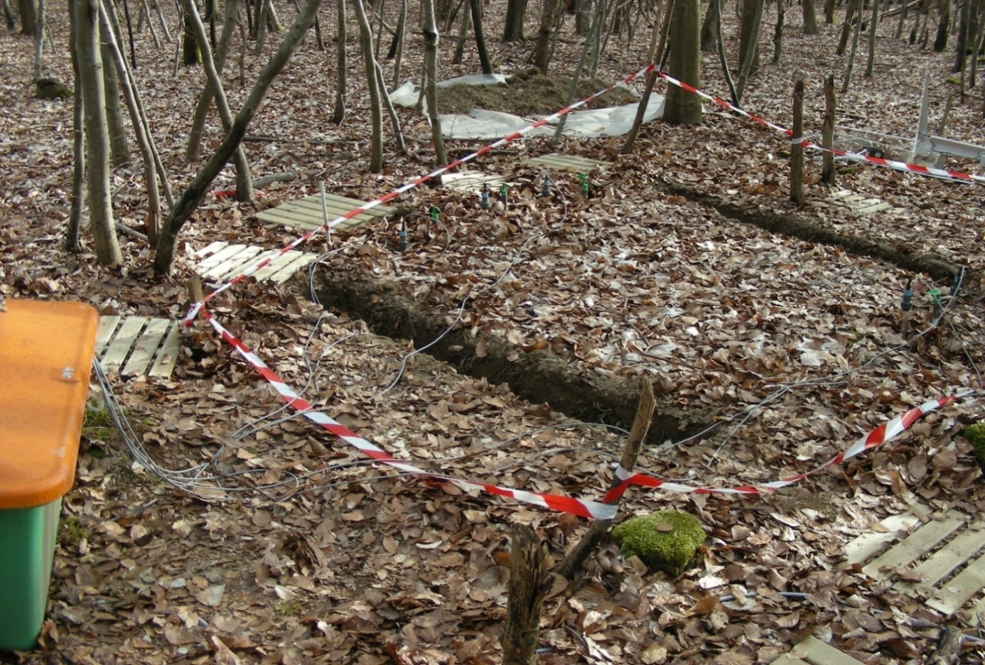
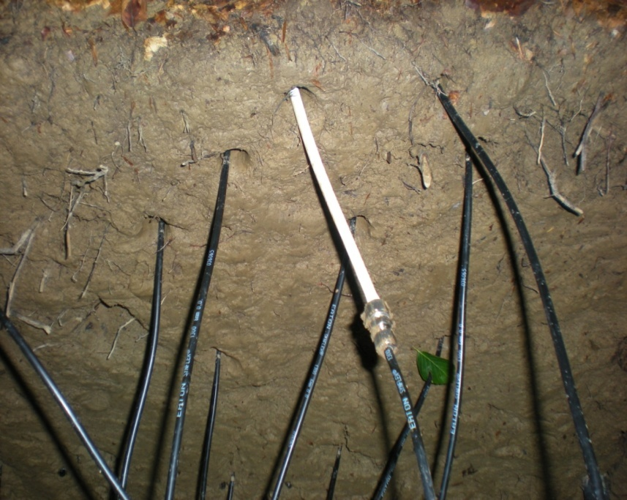
Determine Ps and δ¹³Ps for ≠ layers
Field experimental device
Membrane porous /hydrophobic tube
(Parent et al. 2013)
Soil depth
0 cm
2m
5 cm
10 cm
20 cm
40 cm
80 cm
Notes:
Here is our experimental device, we inserted at several depths in the soil a series of sensors: CO2 probes to measure the vertical profile of CO2 concentration, Temperature and Soil water content probe to measure respectively temperature and soil water content profile and also a series of porous tubes connected to a specific gaz analyseur that differentiates the 13CO2 and 12CO2 so that we have a measurement of the vertical profile of isotopic signature of CO2 profile. In addition to that soil measurements, we measure the surface CO2 fluxes and its isotopic signature.

Slide 9
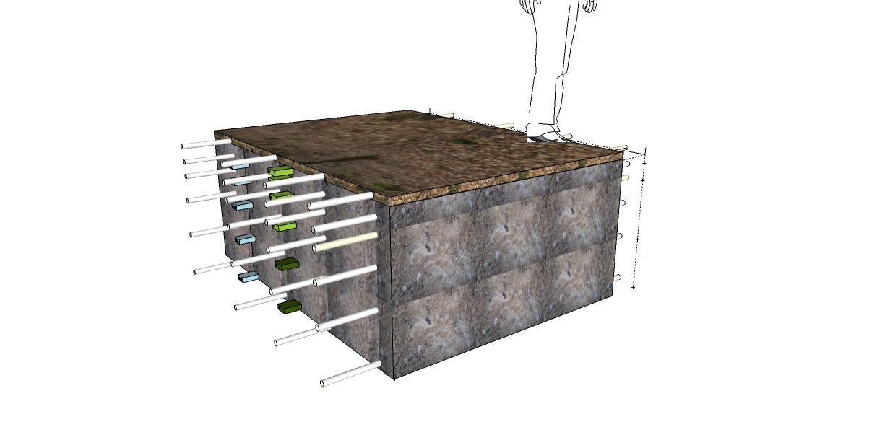
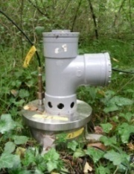
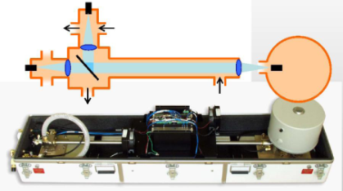
Determine Ps and δ¹³Ps for ≠ layers
In situ measurements during 21 days (intra-day variability)
Soil Chamber
TDLS:
¹²[CO₂] & ¹³[CO₂]
Membrane tubes ➩ [CO₂] & δ¹³CO₂ in soil layers
Chambers
➩ Fs & δ¹³Fs
2 m
SWC sensors
TDLS:
T° sensors
Notes:
Here is our experimental device, we inserted at several depths in the soil a series of sensors: CO2 probes to measure the vertical profile of CO2 concentration, Temperature and Soil water content probe to measure respectively temperature and soil water content profile and also a series of porous tubes connected to a specific gaz analyseur that differentiates the 13CO2 and 12CO2 so that we have a measurement of the vertical profile of isotopic signature of CO2 profile. In addition to that soil measurements, we measure the surface CO2 fluxes and its isotopic signature.

Slide 10
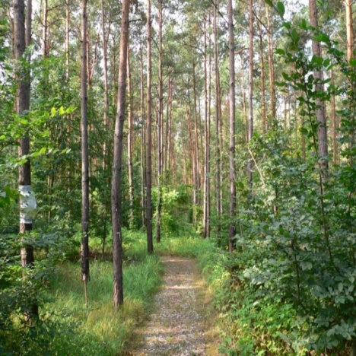
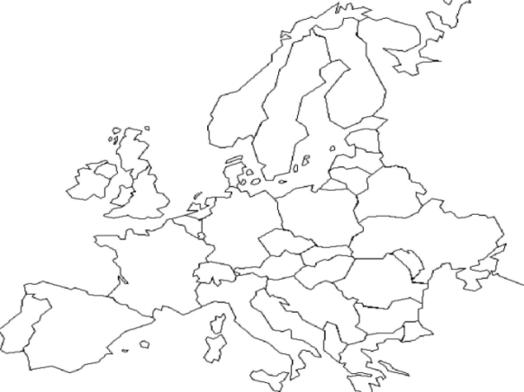
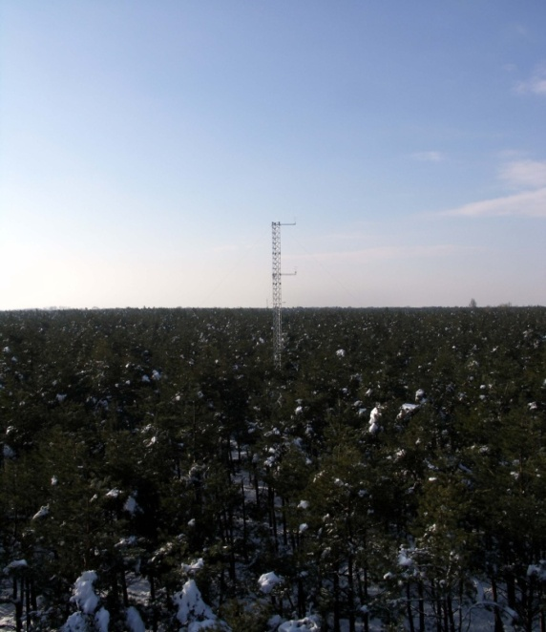
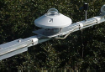
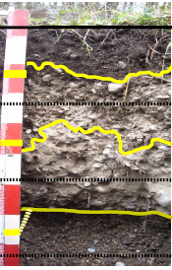
Determine Ps and δ¹³Ps for ≠ layers
Site Description
Hartheim experimental site
(47°56’N-7°36’E)
Slow growing 46 year old Scots Pine Forest (Pinus sylvestris L.)
Mean annual air Temp:10.3°C
Mean annual precip: 642 mm
Ol
Ah
AhC
Haplic Regosol (calcaric, humic) (FAO, 2006)
Eddy Covariance tower
Meteorological station
C
Humus type is mull (1-3 cm thick)

Slide 11

Determine Ps and δ¹³Ps for ≠ layers
Vertical Profile of Ps
2.5cm
Ol
0 cm
Ah
-20 cm
AhC
-40 cm
C
-80 cm

Slide 12
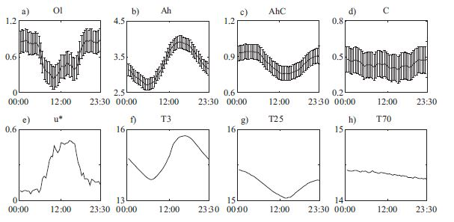
Factors affecting Ps and δ¹³Ps
(Goffin et al. 2014)
Intra-day Ps variability
Ps mean diel evolution (µmol m⁻² s⁻¹ )
Mean diel evolution of drivers
Positively correlated to LOCAL T° in Ah & AhC
Negatively correlated to u* in litter layer ???

Slide 13
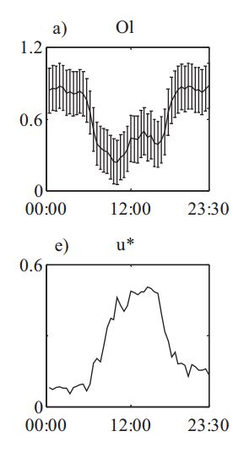
Factors affecting Ps and δ¹³Ps
Oh layer
u* is the driver of advective and dipersive fluxes !
➪ because of the total diffusive assumption
⇒
T° dependence
u* dependence

Slide 14
Factors affecting Ps and δ¹³Ps
Inter-day δ¹³Ps variability
Significant day to day variations in δ¹³Ps of Ah (> 2.5‰)
δ¹³Ps (‰)
(SWC)
Julian day
Best explained by soil moisture
SWC decrease ➩ enrichment
Same impact as for photosynthesis discrimination !!!

Slide 15
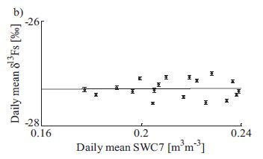
Factors affecting Ps and δ¹³Ps
Enrichment not observed in chamber efflux measurements
Mixing of ≠ layers contributions
Perturbation of soil climate below the chambers ?

Slide 16
Who (transport or production) is responsible for Ps and δ¹³Ps temporal variability ?
(Goffin et al. 2015)
3 model versions simulating CO₂ production and transport
Reference model (RM):
Ps_{n} simulated with Q10 relationship using t° of the n^{th} layer
Diffusion is the only transport process
Transport Version (TV):
Advection and dispersion are added to diffusion
Production Version (PV):
In addition to T°, simulated production depend on VPD reflecting Phloem Pressure Concentration Wave (PPCW)
Comparison of RM, TV and PV outputs with soil [CO₂] and Fs measurements

Slide 17
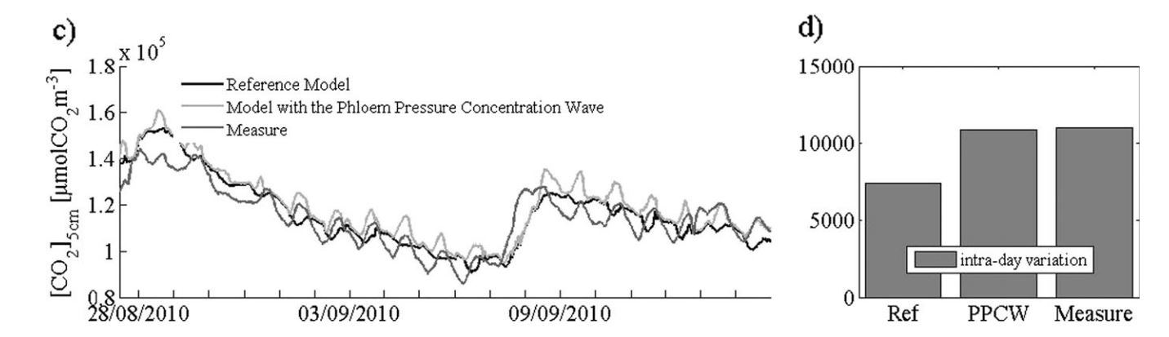
Who (transport or production) is responsible for Ps and δ¹³Ps temporal variability ?
RM: Relatively good reproduction of the general trend but intra-day variability too low and not in phase
No significant improvement with TV
PPCW : Not perfect but diurnal fluctuations are better reproduced and difference in phase is reduced
➨ Working on production description before transport is a better option to improve soil CO₂ model

Slide 18
Key points
Set up of an experimental in-situ device to obtain vertical profile of Ps and δPs
Identify a dependence of horizons to their own temperature
Observe enrichment of Ps with soil drought in Ah horizon
Soil CO₂ model should develop production description before transport to simulate hourly/daily variability

Slide 19
The End

Slide 20
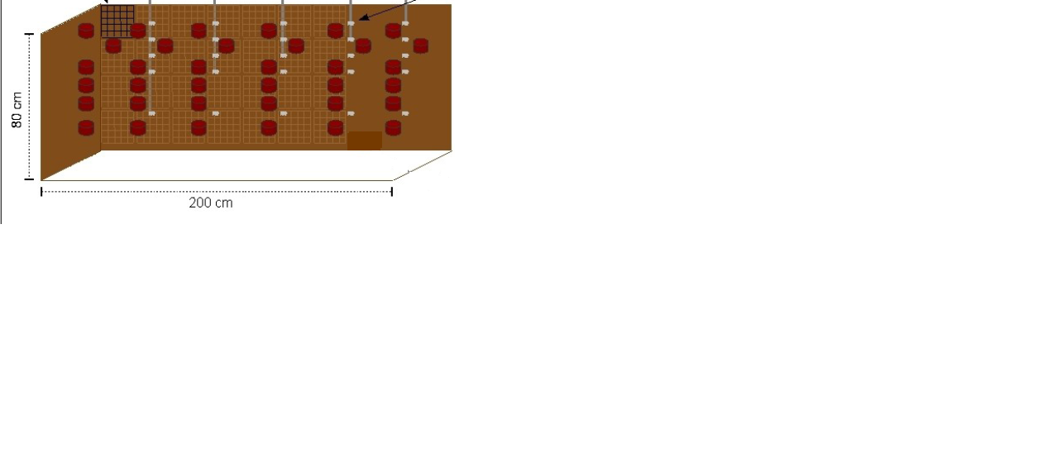
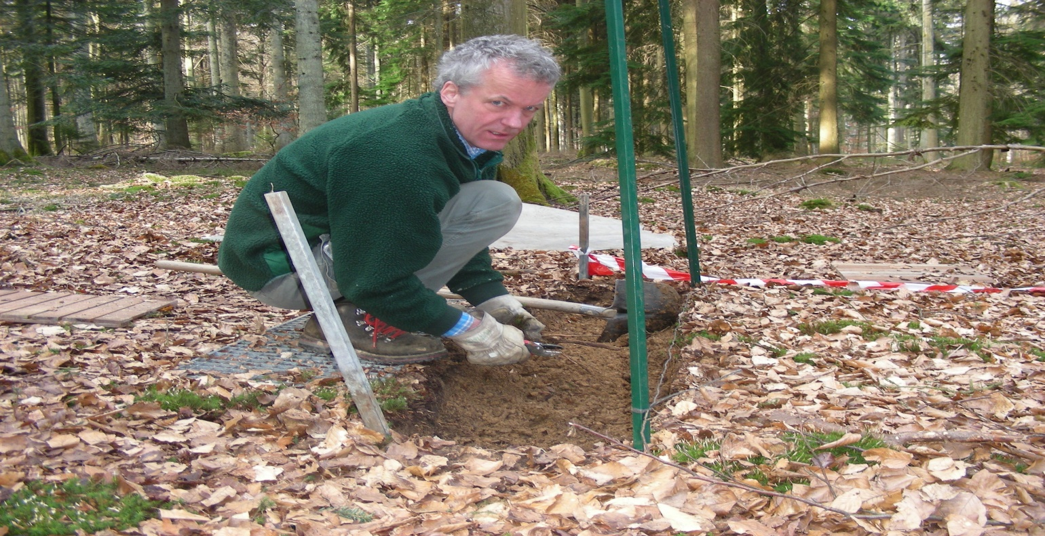
Materials & Method
Laboratory Measurements
Undisturbed soil cores of 200 cm³ collected in each horizon
Soil horizon specific physical parameters :
  Porosity, pF curves
  Relationships between Ds(SWC)
Notes:
And in addition to that in situ measurement, we collected several sample in each soil horizons to determine in laboratory soil horizon specific characteristics. More specifically soil horizon specific relationships between the diffusion coefficient and soil water content.

Slide 21
Material & Method
Laboratory measurements – Ds determination
Laboratory measurements
Ds [m²s⁻¹]
Ds(SWC)_{Ah1}
Ds(SWC)_{Ah2}
Ds(SWC)_{AhC}
Ds(SWC)_{C}
In Situ measurements

Slide 22
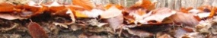
Materials & Method
Background & Objectives
Materials & Method
Results & Discussion
Conclusions
Laboratory Measurements– Parametization
Litter
Level 0
Pingintha et al, 2009

Slide 23
Determine Ps and δ¹³Ps for ≠ layers
Day to day variation
Vertical Profile of CO₂ sources
Ah Production terms
Litter Production terms
Soil production shows clear diel and daily fluctuations in Ah
  Unlike other horizons, Ol production was best explained by surface soil water content (SWC) (R²=0.46)
The diel and daily fluctuations are best explained by the T measured in the topsoil
  → temperature is the most important driver of soil CO₂ production

