Slide 1
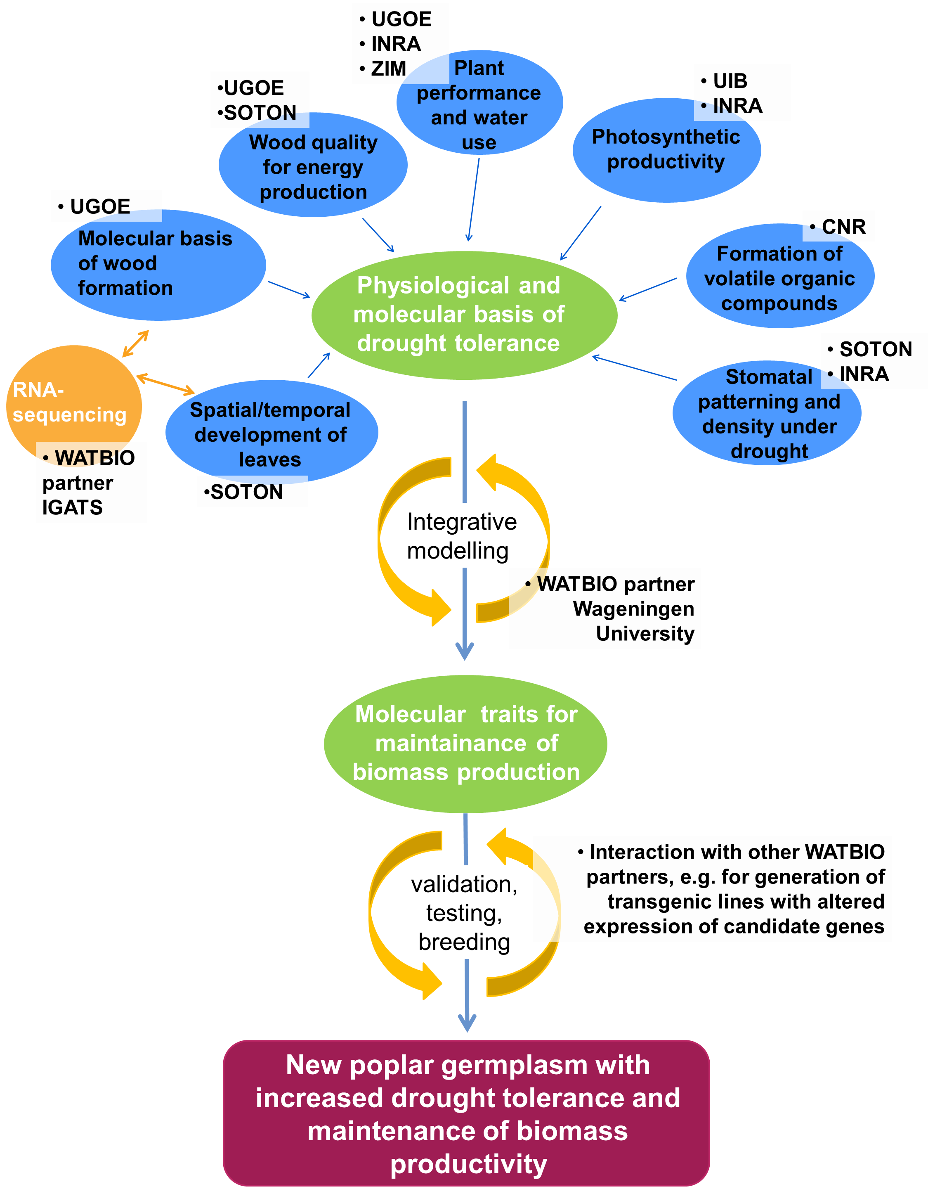
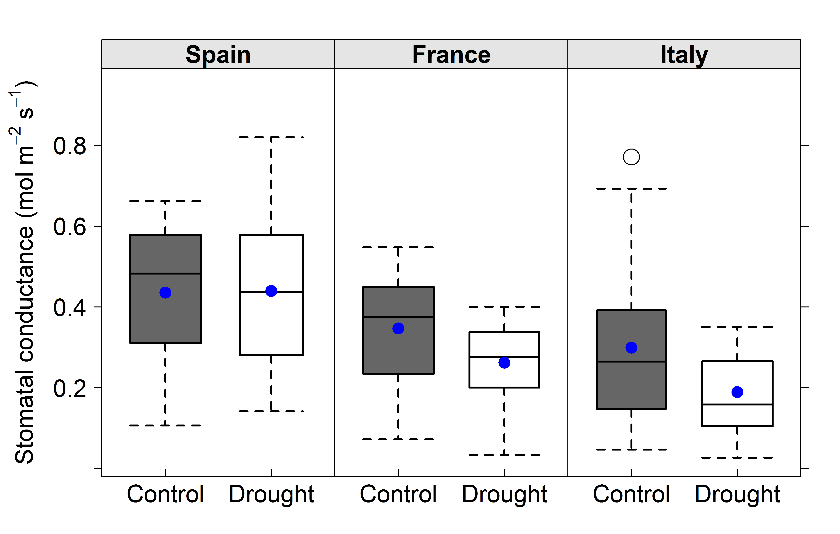
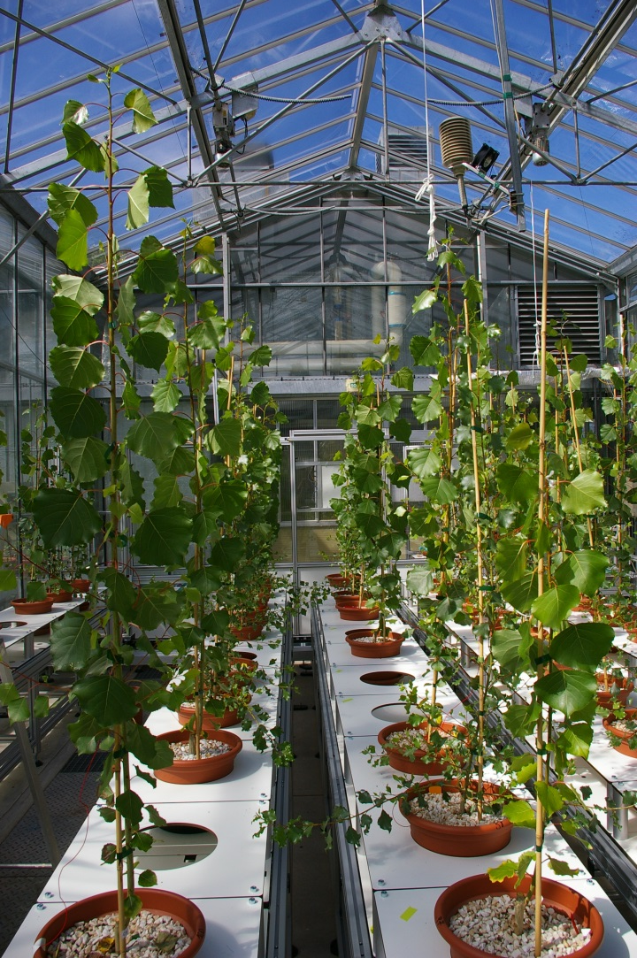
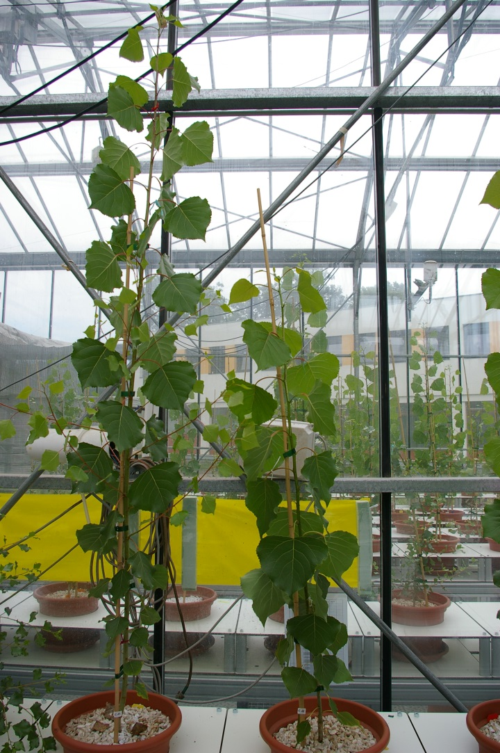
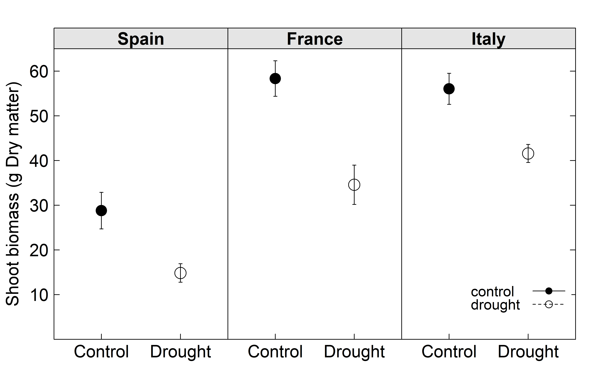
Investigating the molecular basis of drought tolerance in Populus: The WATBIO Populus core experiment
¹Wildhagen H, ²Smith H, ²Allwright M, ²Valdes-Fragoso M, ³Douthe C, ⁴Cohen D, ⁴Brendel O, ⁴Le Thiec D, ⁴Hummel I, ⁴Bure C, ¹Janz D, ¹Paul S, ⁵Haworth M, ⁶Rüger S, ⁵Centritto M, ⁵Loreto F, ³Flexas J, ⁴Bogeat-Triboulot M-B, ²Taylor G, ¹Polle A
¹ Büsgen-Institute, Dep. of Forest Botany and Tree Physiology, Georg-August-University Göttingen, Germany (UGOE)
² Centre for Biological Sciences, University of Southampton, UK (SOTON)
³ Universitat de les Illes Balears, Spian (UIB)
⁴ UMR Ecologie et Ecophysiologie Forestières, INRA Nancy, France (INRA)
⁵ Consiglio Nazionale delle Ricerche, Italy (CNR)
⁶ ZIM Plant Technology GmbH, Germany
Introduction
Concept
Results
Populus core experiment: Investigation of drought stress responses of selected Populus genotypes
Unifying research aim of participating groups: Analysis of development of tissues and organs under drought in order to identify mechanisms important to maintain growth under limited water availability
Main hypothesis: Populus genotypes originating from different environments harbour adaptation mechanisms that can be exploited to produce new germplasm for sustained biomass production under stress
The involved partners contribute their expertise to achieve the main goal of the WATBIO project
Drought caused a significant reduction of stomatal conductance in genotypes “France” and “Italy”
Water availability in native habitat
**
**
Methods
Fig. 3 | Stomatal conductance of three Populus nigra genotypes after five weeks of a control or drought treatment (see Fig. 2). Measurements were taken at 2000 µmol m⁻² s⁻¹ PPFD, [CO₂]≈400 µmol mol⁻¹, Temperature 25ºC. Blue dots depict the mean, ** denote significant differences between treatments (P<0.01, n=5).
Drought stress experiment with Populus nigra
Biomass productivity, and its decrease under drought, differs among genotypes
A
B
Water availability in native habitat
- 41%
- 26%
A core set of measurements is carried out
Biomass yield
Soil water status
Plant water status
Leaf size, total leaf area
Branching patterns
Stomatal conductance
Wood/lignocellulosic quality, saccharification potential
- 48%
Fig. 1 | Growth of Populus nigra trees in a greenhouse with an automated watering system at INRA Nancy (A, B). Trees of three genotypes (‘‘Spain“, ‘‘France“, ‘‘Italy“) were exposed to a control or moderate drought treatment for five weeks. B) Two representative plants of genotype‘‘Italy“ at the end of the experiment (left, control; right, drought treated).
Fig. 4 | Biomass production of three Populus nigra genotypes after five weeks of a control or drought stress treatment (see Fig. 2). Data show means ± SE, n = 6.
RNA-Seq revealed strong differences in transcript abundances among genotypes, and varying sizes of drought effects among tissues
A collection of samples was used for transcriptome profiling by RNA-Seq
Genotype “Italy”: samples of developing xylem, fine roots, leaves collected weekly during the experiment
Genotypes “Spain”, “France”, “Italy”: samples of developing xylem, fine roots, and various leaf stages collected at the end of the experiment
Tab. 1 | Number of differentially expressed (DE) genes per tissue. Samples were collected at the end of the experiment. Detection of DE genes was carried out with DESeq2 (false discovery rate 0.05).
Tissue | Effect/Contrast | No. of tested genes | DE genes
Dev. xylem | Treatment-x-genotype | 23421 | 0
 | Treatment |  | 77
 | Genotype |  | 14046
 | France/Italy |  | 6117
 | Spain/Italy |  | 6196
 | Spain/France |  | 6727
Fine roots | Treatment-x-genotype | 27239 | 9
 | Treatment |  | 1862
 | Genotype |  | 11999
 | France/Italy |  | 4492
 | Spain/Italy |  | 6646
 | Spain/France |  | 4842
Leaf | Treatment-x-genotype | 25010 | 117
 | Treatment |  | 1661
 | Genotype |  | 17882
 | France/Italy |  | 4557
 | Spain/Italy |  | 10362
 | Spain/France |  | 10565
Outlook
Finish integration of gene expression data with phenotypic traits to identify candidate genes for increased drought tolerance
Test the hypothesis of adaptive divergence within the genus Populus by comparing this study with the second Populus core experiment carried out in summer 2014 with two genotypes of P. tremula
Fig. 2 | Soil water conditions in a drought stress experiment with Populus nigra. Trees of three genotypes were exposed to a control treatment with 90% soil-relative extractable water (soil-REW) or a drought treatment with a target level of 20% soil-REW, which was reached at week 2.
Acknowledgements
We acknowledge the help of P. A. Chuste, J. Groux, A. Marchal, F. Radnai, M. Viger, A. Payne, S. Milner, and C. Xu.
WATBIO
Development of improved perennial non-food biomass and bioproduct crops for water stressed environments
is an international research project funded by the European Union‘s Seventh Framework Programme under the grant agreement FP7-311929
www.watbio.eu
Notes:
Genotypen-Vergleich der PLWP-Daten evtl. wieder raus nehmen

