Slide 1
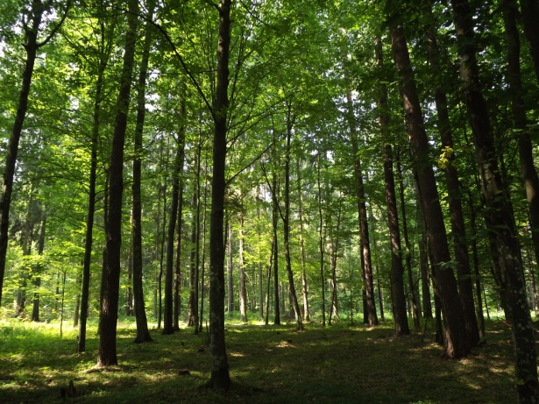







Tree diversity does not always improve resistance of forest ecosystems to drought
Damien BONAL
Charlotte GROSSIORD
Arthur GESSLER
André GRANIER

Slide 2
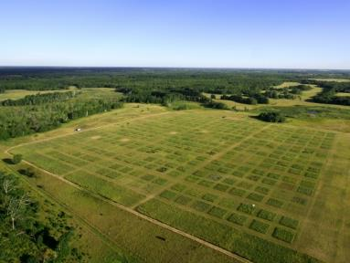
Biodiversity & Ecosystem functioning
Increasing species diversity can lead to important benefits for ecosystems
Biomass Production
+
+
Loreau et al. 2001
Higher biomass production in more diverse ecosystems
www.cedarcreek.umn.edu

Slide 3
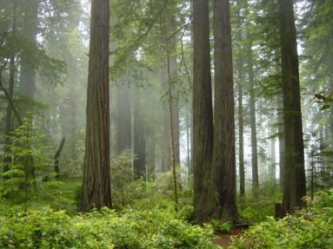
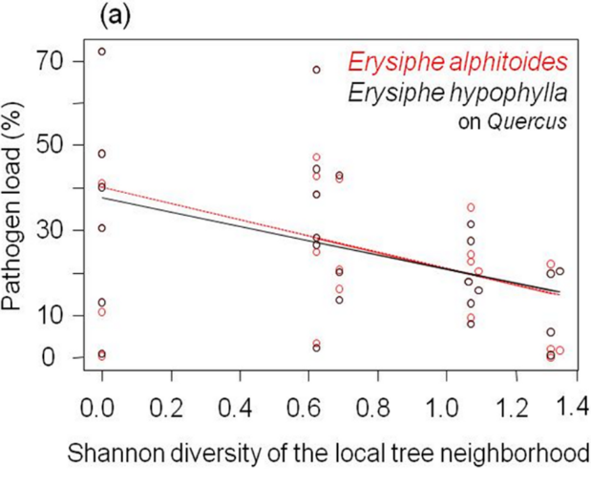
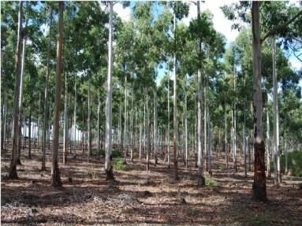
Biodiversity & Ecosystem functioning
Increasing species diversity can lead to important benefits for ecosystems
Resistance against pest & pathogen outbreaks
www.worldofstock.com
-
+
Hantsch et al. 2013
Lower foliar pathogen load in more diverse ecosystems
www.bbc.co.uk

Slide 4

Biodiversity & Ecosystem functioning
Are more diverse ecosystems more resistant to drought?
Stability against climatic perturbations
+
+
Tilman & Downing 1994
Increasing drought resistance in more diverse communities

Slide 5
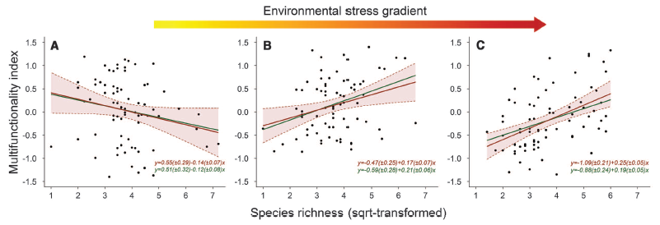
Influence of environmental conditions
Species interactions can shift from negative (competition) to positive (complementarity) as climatic conditions change
(Stress-gradient hypothesis, Bertness & Callaway, 1994)
Jucker & Coomes, 2012

Slide 6
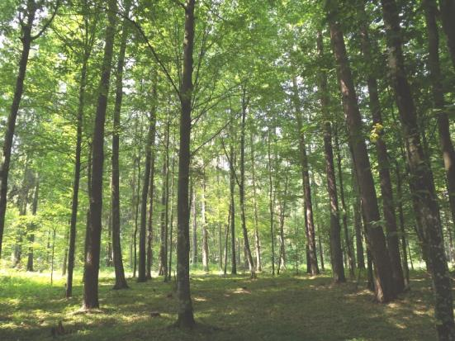
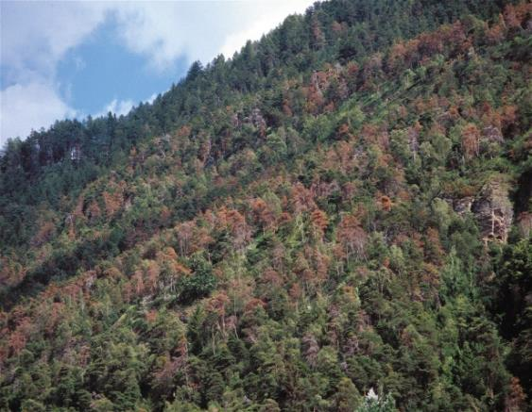
Objectives
Test whether higher tree species diversity in forest ecosystems across Europe is associated with less drought exposure
Grossiord C.
www.nature.com

Slide 7

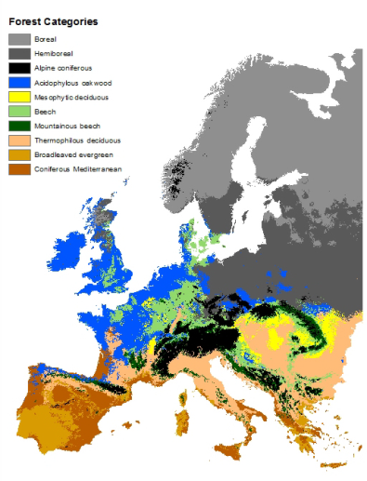
Study Sites
6 regions across North - South gradient in Europe to cover the major forest types and climatic conditions
BOREAL (Finland)
TEMPERATE (Germany)
HEMI-BOREAL (Poland)
MOUNTAINOUS TEMPERATE (Romania)
MEDITERRANEAN (Spain)
Casalegno et al. 2011
THERMOPHILOUS DECIDUOUS (Italy)

Slide 8
Material and Methods
Comparison of ecosystem functioning for different levels of species mixture (1-5)
monoculture
. . . . .
. . . . .
2-sp mixture
3-sp mixture
monoculture
Tree species diversity

Slide 9
Material and Methods
Selection of 25 to 42 stands (30×30m) varying in species richness in each studied region

Slide 10
Material and Methods
Stands with varying tree species richness
The variation in other confounding factors (soil, topography, land‐use history,…) was kept at a minimum.
Temperate
Mountainous temperate

Slide 11
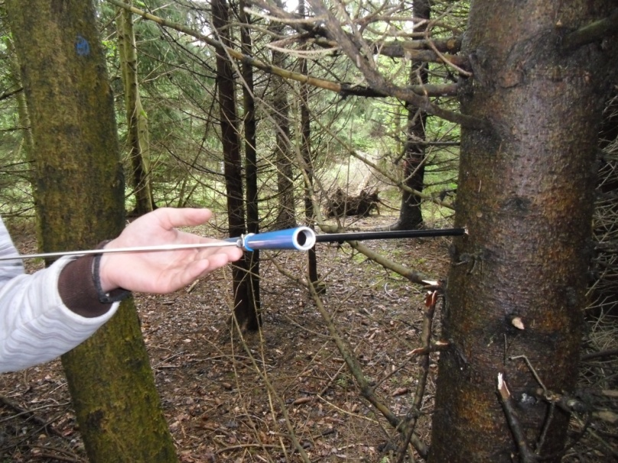
Material and Methods
Selection of 25 to 42 stands (30×30m) varying in species richness in each studied region
Extraction of wood cores from a selection of dominant and co-dominant trees of each species in each stand
6 trees in monoculture
3 trees/species in mixtures
C. Grossiord

Slide 12
Material and Methods
Selection of 25 to 42 stands (30×30m) varying in species richness in each studied region
Extraction of wood cores from a selection of dominant and co-dominant trees of each species in each stand
Selection of years (tree rings) with contrasting climatic conditions (dry vs. wet)

Slide 13
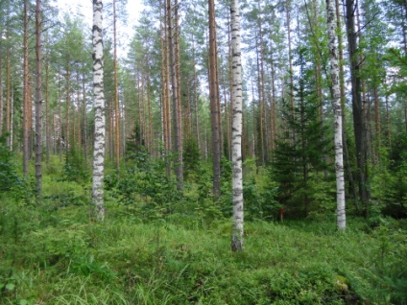
Material and Methods
Selection of years with contrasted climatic conditions
Selection of the driest and the wettest year over the last 15 years with daily climate data and the BILJOU water-balance model (Granier et al. 1999):
Soil relative extractable water
Example of Finland
Water stress index

Slide 14
Material and Methods
Selection of 25 to 42 stands (30×30m) varying in species richness in each studied region
Extraction of wood cores from a selection of dominant and co-dominant trees of each species in each stand
Selection of years (tree rings) with contrasting climatic conditions (dry vs. wet)
Analyses of carbon isotope composition (δ¹³C)

Slide 15
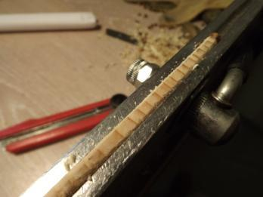
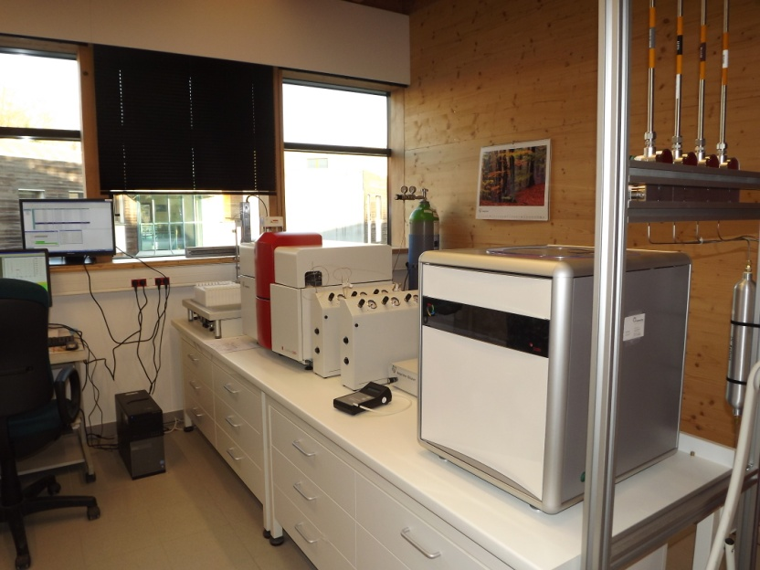
Material and Methods
Sample preparation and analyses
For each core, we extracted the late wood from the two selected years
Samples were then analyzed for carbon isotope composition (δ¹³C, ‰) (PTEF nancy or UC Davis)

Slide 16
Material and Methods
Selection of 25 to 42 stands (30×30m) varying in species richness in each studied region
Extraction of wood cores from a selection of dominant and co-dominant trees of each species in each stand
Selection of years (tree rings) with contrasting climatic conditions (dry vs. wet)
Analyses of carbon isotope composition (δ¹³C) of latewood of each ring
Calculation of plot-level δ¹³C

Slide 17
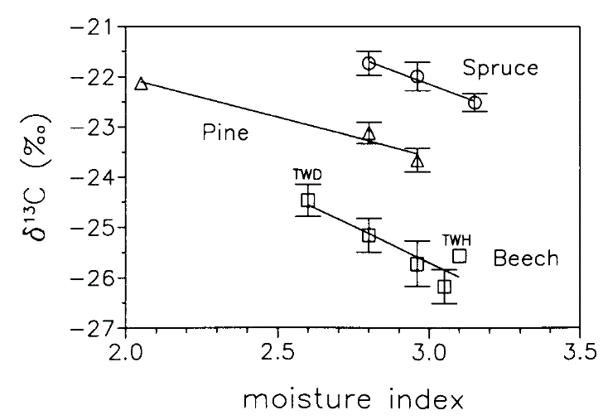
Material and Methods
The difference in plot-level δ¹³C between the DRY and the WET year can be used as a proxy of drought exposure
Less negative δ¹³C values
δ¹³C _{DRY} - δ¹³C _{WET}
Decreasing water availability
Saurer et al. 1995
If difference in δ¹³C is high, low resistance
If difference in δ¹³C is low, high resistance

Slide 18
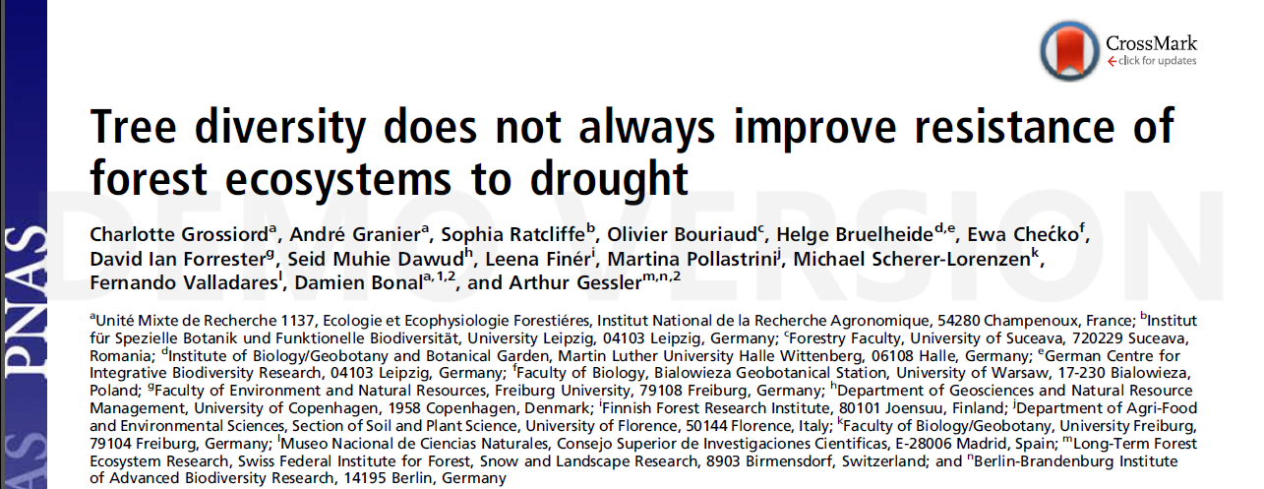
Results

Slide 19
Results
δ¹³C values in DRY year always higher than in WET ones
Increasing drought exposure
Increasing drought exposure
Increasing drought exposure
Increasing diversity
Increasing diversity

Slide 20
Results
No effect of species diversity
Lower drought resistance in species-rich forests
Increasing drought exposure
Increasing drought exposure
Increasing drought exposure
Higher drought resistance in species-rich forests
Increasing diversity
Increasing diversity

Slide 21
Results
Tree species diversity effects seem partially dependent on climatic conditions
Rare events and low intensity of drought
Negative effects
Biotic conditions
(e.g. tree species composition)
Abiotic conditions
(e.g. soil type)
Frequent events and high intensity of drought
Positive effects

Slide 22
Conclusions
Tree species diversity influences the functioning of forest ecosystems in terms of water and carbon acquisition and use
More diverse forests may be more resistant to soil drought than pure ones, but not necessarily
Favoring mixed forest ecosystems could be preferred in certain regions, not only to preserve biodiversity or sustain productivity in the context of climate changes, but also to delay the negative effect of drought
Perspectives

Slide 23
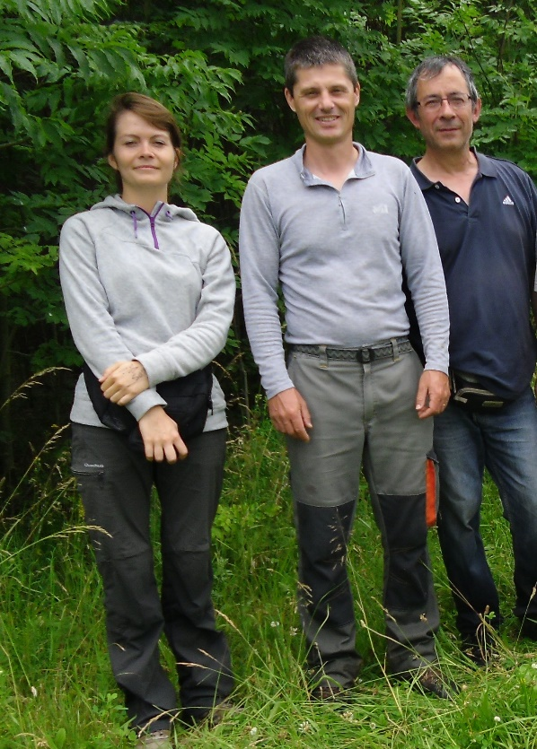
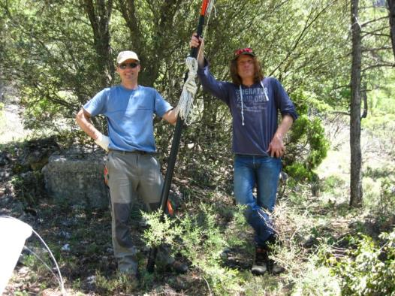
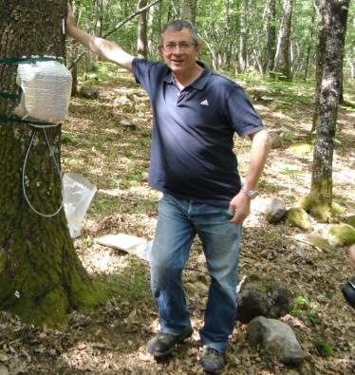
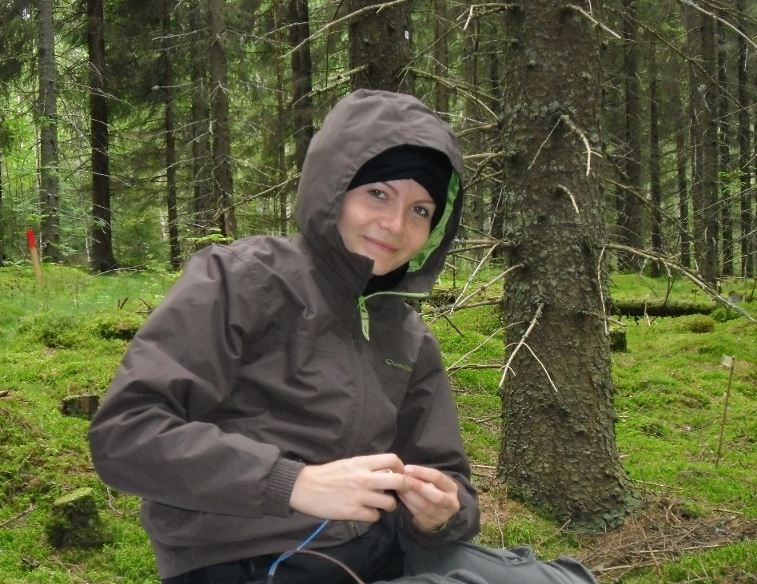
Thanks for your attention

