Slide 1
How does the structure of dairy products affect their digestion mechanisms?
Consequences on human health
Dupont D
INRA Agrocampus Ouest – Milk and Egg Science & Technology
Rennes FRANCE
HEALTH PROMOTION AND DISEASE PREVENTION OF FUNCTIONAL FOODS, NUTRACEUTCALS, AND NATURAL HEALTH PRODUCTS
TÜBİTAK TÜSSİDE, Gebze/Kocaeli, Turkey
13-14 June 2014

Slide 2
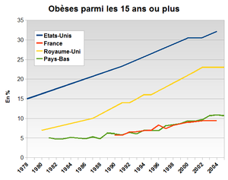
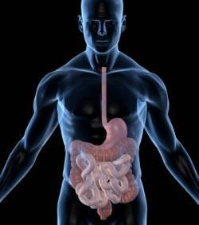
Scientific Context
----- USA
----- UK
----- FR
----- NL
Diet-related diseases ↑
 Prevent these pathologies rather than cure them
Obesity %
Gut = interface between food and human body
Digestion releases food components that can have a beneficial or a deleterious effect on human health
?
… but the mechanisms of food disintegration in the gastrointestinal tract remain unclear and the digestive process has been considered as a black box so far
By increasing our knowledge on food digestion, we will increase our knowledge on the effect of food on human health

Slide 3
Our goals
?
?
Absorption
Bioactivities
- Bioactive peptides
- Allergens
- Fatty acids
- Minerals…
Processing
Raw material
Structured food
Mouth
Stomach
Duodenum
Jejunum
Ileum
Receptors
Réceptors
Gut
Immune System
Mathematical modelling
Reverse engineering
To understand the mechanisms of breakdown of food matrices and their constituents in the gut and identify the beneficial/deleterious food components released during digestion
To determine the impact of the structure of food matrices on these mechanisms
To model these phenomena in order to develop a reverse engineering approach

Slide 4
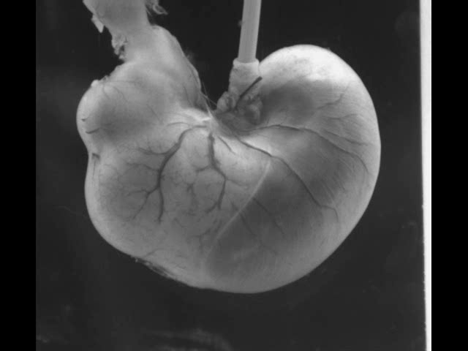

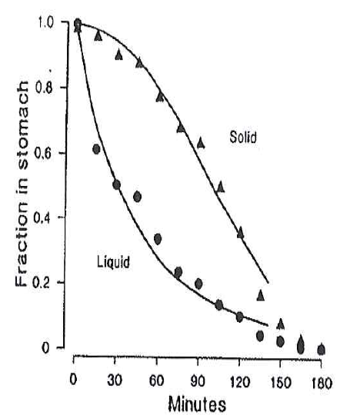
The digestive process
mouth
chewing and deglutition
esophagus
stomach
storage, grinding and mixing in the stomach
pepsinolysis
pylorus
pepsin
HCl
pH 1.3-2.5
gastric emptying
hydrolysis by pancreatic enzymes
trypsin, chymotrypsin
duodenum
pH 6.5-6.8
Kong and Singh, 2008
intestinal transit
peptides and amino acid absorption
small intestine
jejunum
blood
ileum
Gastric phase = key step for the whole digestion process
large intestine

Slide 5
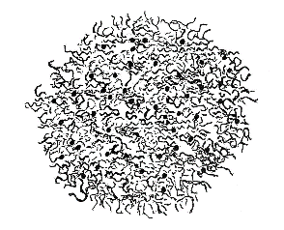
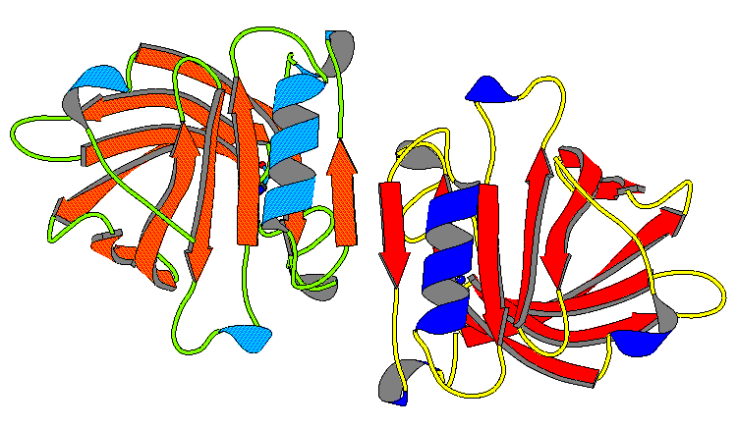
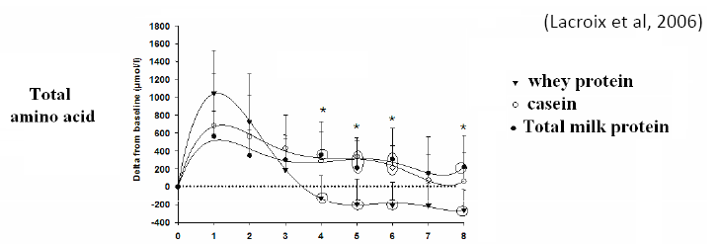
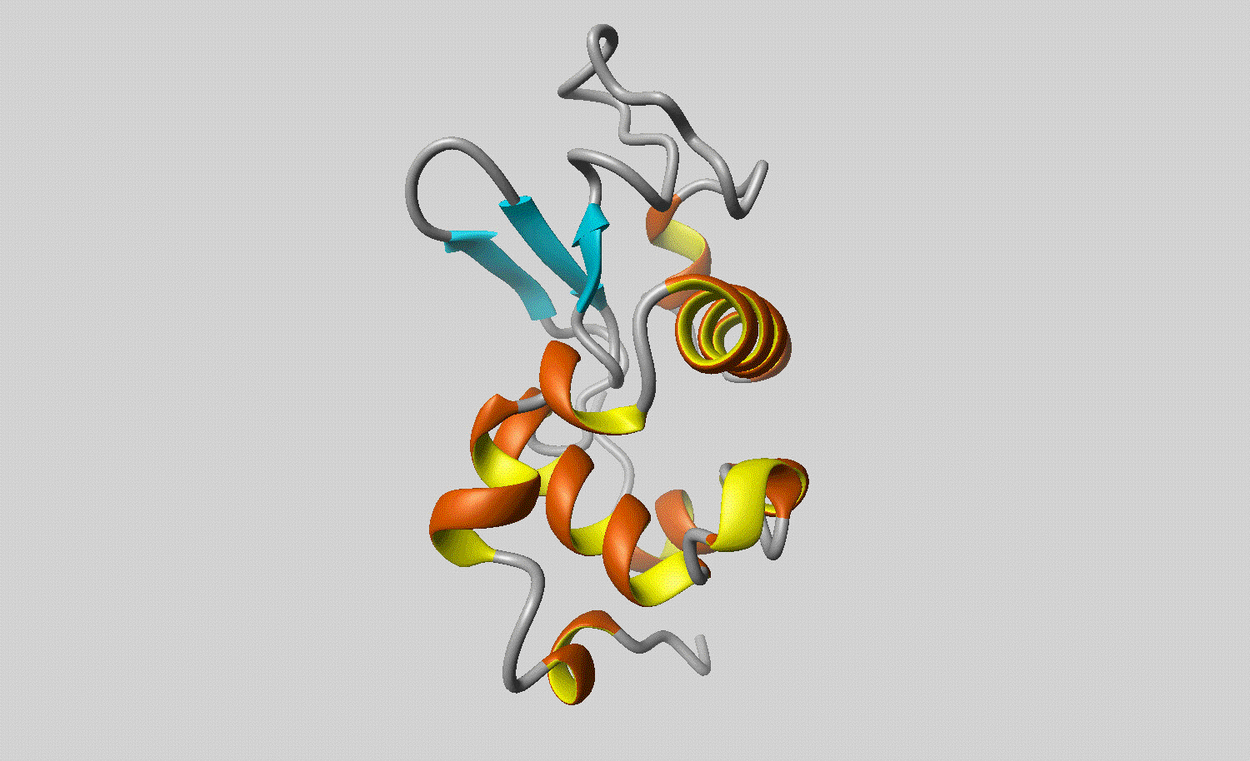
Le lait
Milk
Water (870-875)
Caseins (80%) αs₁, αs₂, β, κ
Proteins (32-35 g/L)
Lipids (34-44 g/L)
Whey Proteins (20%)
α-la, β-lg
Minerals (8-9 g/L), vitamins, …
Lactose (48-50 g/L)
Caseins and whey proteins are:
Structurally opposite (globular/flexible)
Differently metabolized (fast/
slow proteins)
- Highly digestible (>95%)
Excellent sources of essential amino acids
Milk can be transformed into several dairy products (liquids, gels, solids) of similar composition but different structure

Slide 6
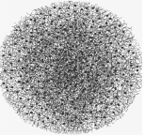
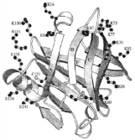
Does the food matrix regulate protein digestion and aa bioavailability?
milk proteins
(caseins, β-lactoglobulin)
Understanding and modeling milk proteins digestion in the gastrointestinal tract of mini-pigs in relation with the dairy matrix ingested
peptides
amino acids
How does the milk product structure influence:
Transit and proteolysis in the gastrointestinal tract ?
Appearance of (bioactive) peptides in the lumen?
Release of amino acids in the blood compartment ?

Slide 7
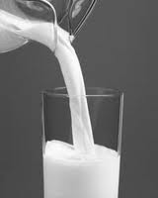
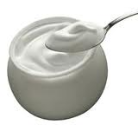
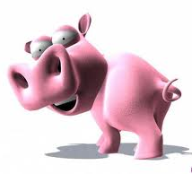


Experimental strategy
6 dairy matrices manufacturing
in vivo digestion by 6 mini-pigs
dynamic modeling of milk proteins transit and absorption (+ hydrolysis)
protein digestion products (end of stomach and jejunum) + amino acids (plasma)
effect of the structure of the dairy matrix on the kinetics of milk proteins digestion (gastric emptying, hydrolysis and absorption)

Slide 8
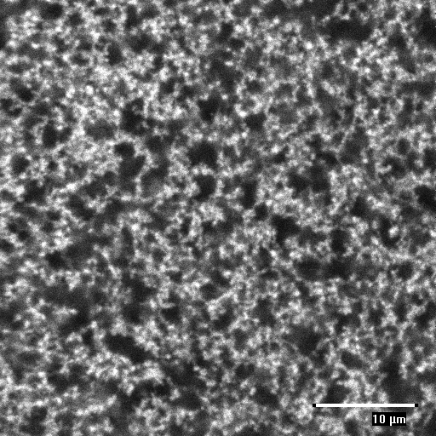
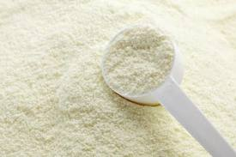
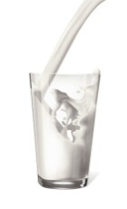
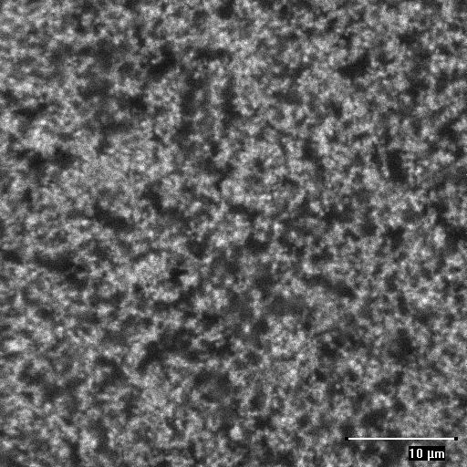
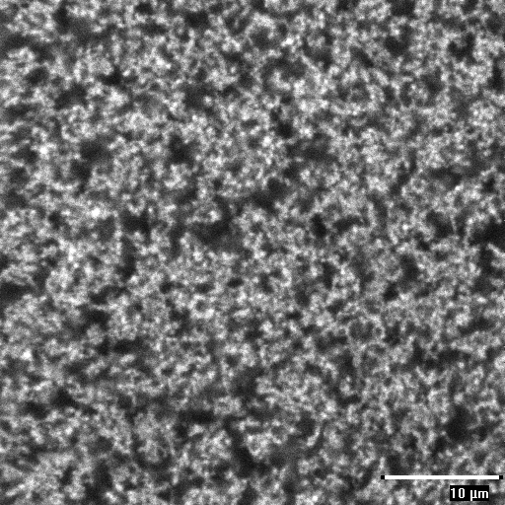
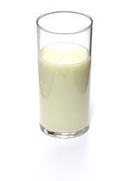
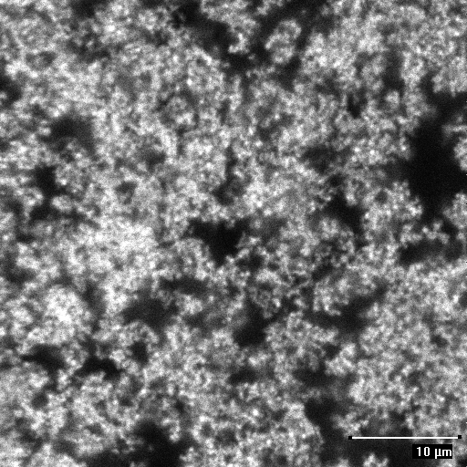
The food matrices
macrostructure
Ultra Low Heat powder
unheated milk (“raw” milk)
rennet gel
pH 6.6
24h-20°C,
rennet 0.003 % v/w
rehydration in water 14.5%
10 µm
heat treatment 90°C-10 min
rennet gel
pH 6.6
microstructure
24h-20°C,
rennet 0.3 % v/w
heated milk
24h-20°C,
GDL 3 % w/w
acid gel
pH 4
24h-20°C,
GDL 3 % w/w + mixer 2 min
stirred acid gel
pH 4
Fat-free matrices:
40 g/L caseins, 10 g/L whey proteins,
95 g/L lactose and minerals
+ marker of the meal transit (Cr²⁺-EDTA) → Mean Retention Time in the stomach

Slide 9
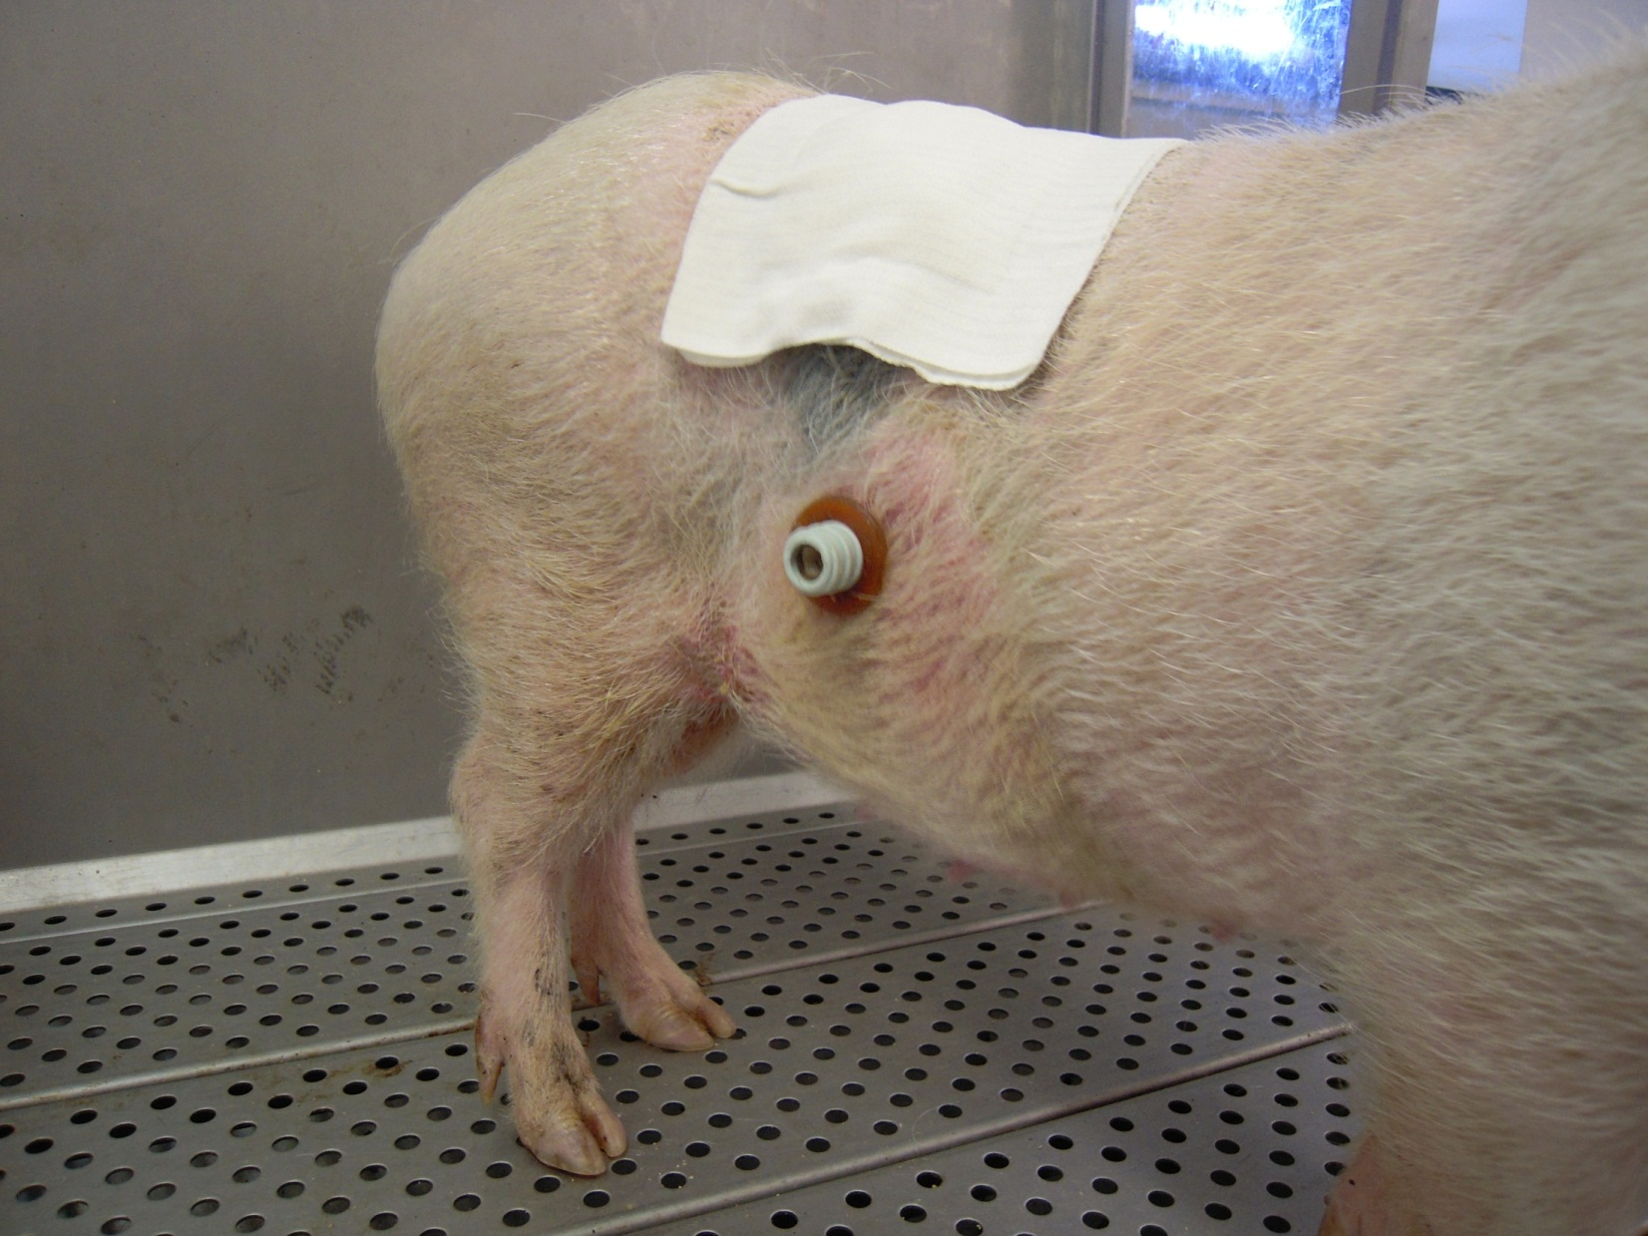
The multi-canulated mini-pigs
6 minipigs (20 ± 1kg)
1 catheter: abdominal aorta
6 minipigs
× 6 matrices
× 8 sampling times after ingestion
=
288 plasma samples collected
2 cannulas:
end of stomach and mid-jejunum
6 minipigs
× 6 matrices
× 8 sampling times after ingestion
× 2 sampling sites
=
576 effluent samples collected

Slide 10
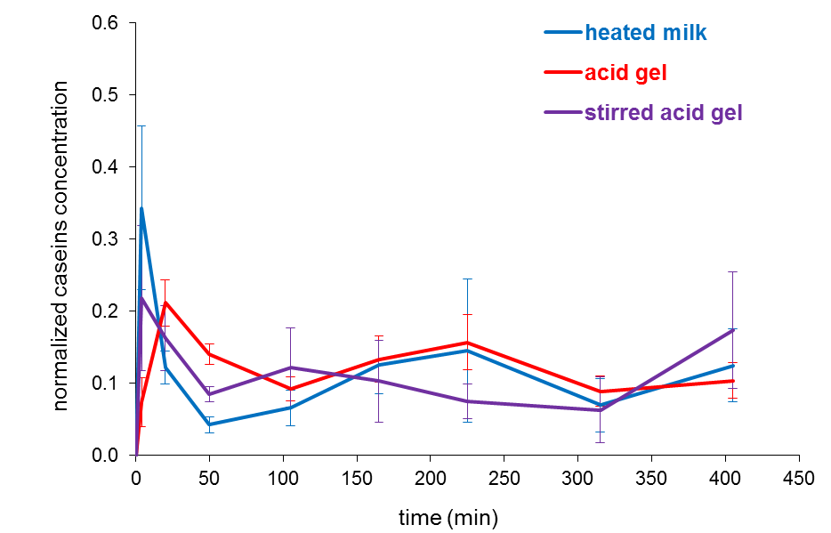
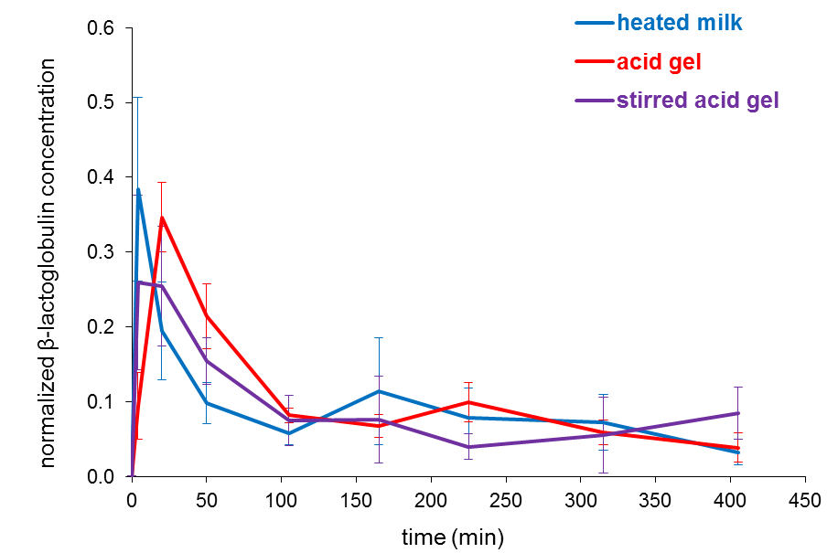
The liquid-gel transition
heated milk
acid gel
stirred acid gel
acid gelation
stirring
1) effect on transit
Mean Retention Time in the stomach (min)
96.9 ± 14.3
148.0 ± 8.9
124.0 ± 14.2
acid gelation
stirring
caseins
β-lactoglobulin
intermediate structure (stirring) → similar digestion kinetics liquid milk/stirred acid gel
Barbé et al, Food Chem. 2013, 2014; Le Feunteun et al. 2013

Slide 11
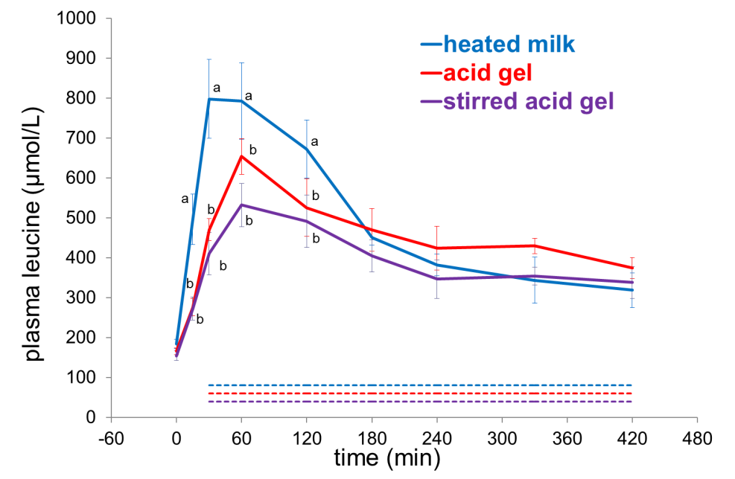
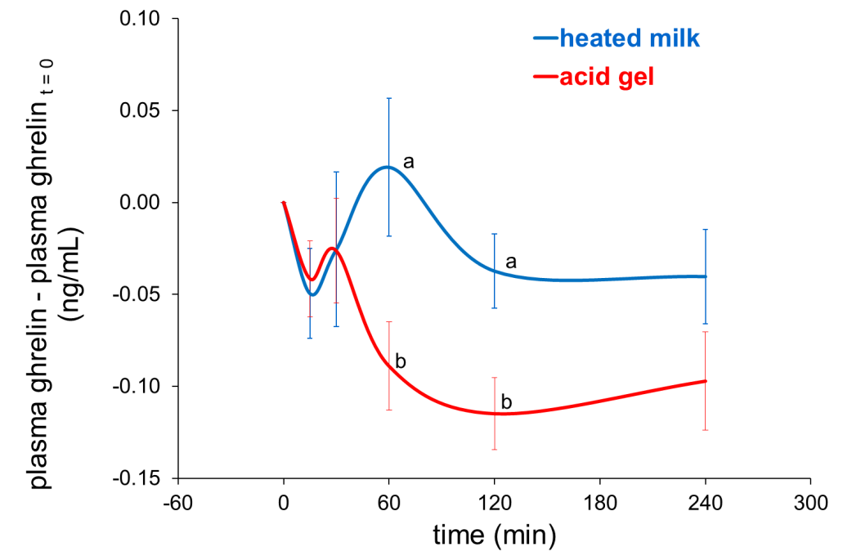
The liquid-gel transition
2) effect on absorption
3) potential effect on satiety
ghrelin (gastrointestinal hormone → appetite stimulation)
milk gelation:
→ delayed proteins transit → delayed AA absorption
maximal AA concentration in the plasma
milk gelation:
postprandial ghrelin concentration =
satiety ?

Slide 12
Many bioactive peptides are released in the gut during digestion
More than 16000 peptides identified in the lumen
Barbé et al. 2014 Food Res Int

Slide 13
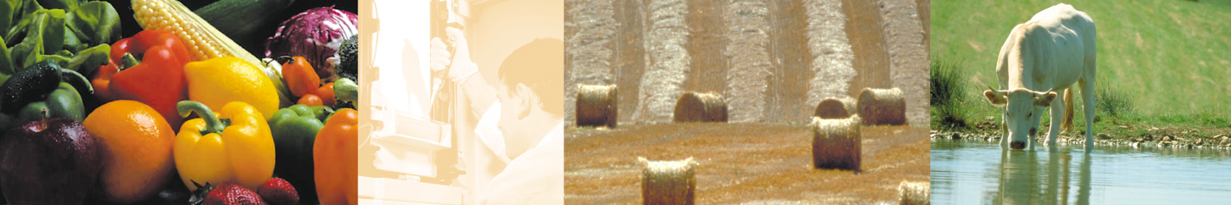
Impact of skim milk powder processing on casein digestion by an in vitro infant model
Hoarau B, Boutrou R, Jardin J, Molle D, Tanguy G, Gaucheron F, Schuck P, Léonil J, Haab B* & Dupont D
INRA – Agrocampus Ouest, UMR STLO, 65 rue de St Brieuc 35042 Rennes France
* VAN ANDEL Institute, 333 Bostwick NE, Grand Rapids, MI 49503, USA

Slide 14
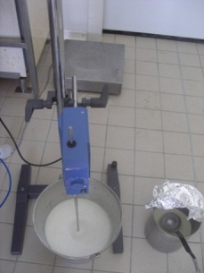
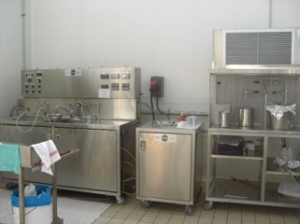
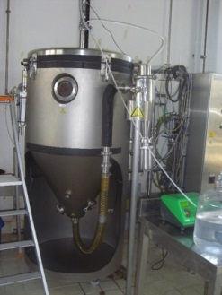
Objective: Determine if heat treatment affects casein digestion
Skimmed ultra-low-heat powder
Step 1 : Dissolution in milliQ water
25% DM
35% DM
ULH Milk
ULH Milk
Step 2 :
80°C/20 s
.
105°C/60 s
80°C/20 s
105°C/60 s
Heat
.
.
.
.
.
treatment
85°C / 3 min
85°C / 3 min
Step 3 :
Spray drying
T
In vitro digestion

Slide 15
Infant gut Model
Gastric phase
Duodenal phase
Milk powders
60 min
pH 3.0
+ pepsin
+ PC
30 min
pH 6.5
+ trypsin
+ chymotrypsin
+ bile salts
Dupont et al. 2010 Mol Nutr Food Res
Aliquots taken after 0, 1, 2, 5, 10, 20, 40 and 60 min digestion
Aliquots taken after 0, 1, 2, 5, 10, 15 and 30 min digestion
Biochemical characterisation

Slide 16
Identification of epitopes resistant to digestion using specific Mabs
κ-casein
1
16
35
54
73
92 105
115
130
150
169
1
1
1
G
G G G G
G
β-casein
1
19
39
56
75
93
113
132
150
166
178
209
PPPP
P
αs₂-casein
1
16
35
55
75
95
114
132
151
170
190
207
PPPP
P
PPPP
PP
P
αs₁-casein
1
19
37
55
74
92
111
128
148
166
184
199
PPPP
PPPP
P
Johansson et al. 2009 Mol Immunol

Slide 17
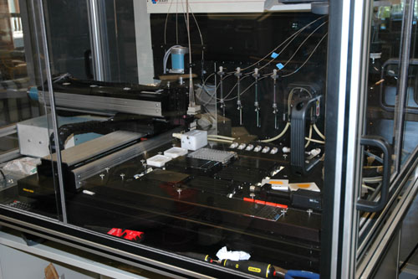
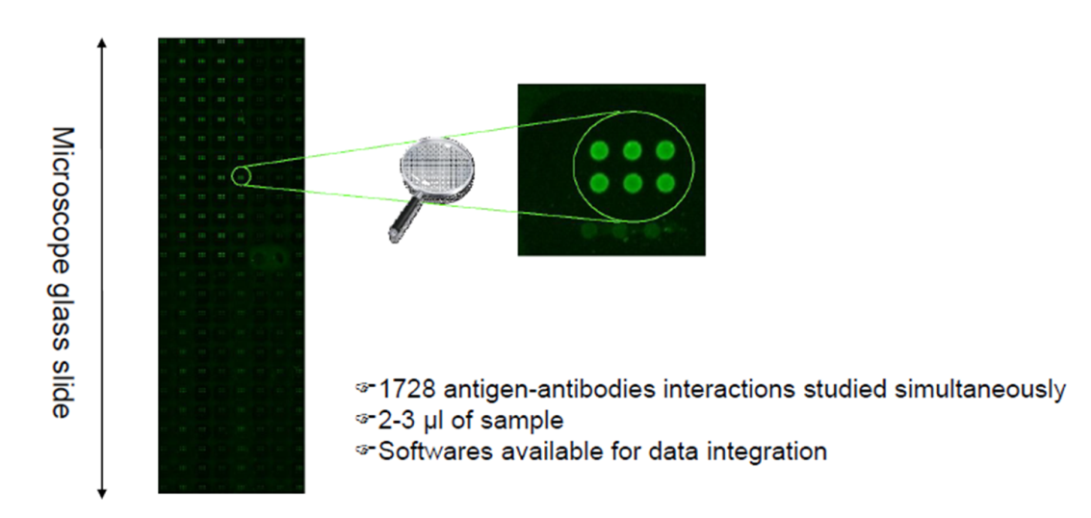

Principle of the technique
Digested sample
Dupont et al. 2010 Food Dig
Microscope slide
Van Andel Inst.
1728 Antigen-Antibody
interactions simultaneously
2-3 µl of sample

Slide 18
Kinetics of β-casein digestion
Gastric phase
Duodenal phase
Residual immunoreactivity
Time (min)
☞ Kinetics of β-casein digestion differ according to the area studied

Slide 19
Residual immunoreactivity of casein fragments
Increasing the heat-treatment makes casein more resistant to digestion

Slide 20
Thermal aggregation of whey proteins on the casein micelle
Casein micelle
MW = 0.5-1 x 10⁶ kDa
av. diam = 180 nm
β-lactoglobulin
MW = 18.6 kDa
2 SS bridges + 1 SH
κ Casein
MW = 19.0 kDa
SS bridges
α-lactalbumin
MW = 14.2 kDa
4 SS bridges
10 nm
To scale schematic representation of the major whey proteins and of the casein micelle in unheated milk

Slide 21
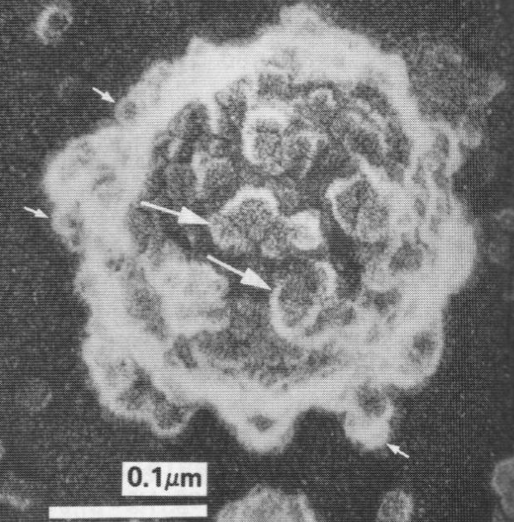
Thermal aggregation of whey proteins on the casein micelle
denatured β-lg
denatured α-la κ casein
α_{s2} casein
micelle-bound
aggregates
[a]
dissociation of κ casein
[b]
serum aggregates
a (Harwalkar et al., 1989)
10 nm
Micelle-bound and serum aggregates are formed, containing denatured whey proteins, κ casein and possible traces of α_{s2} casein. [a] and [b] indicate the 2 possible ways for the formation of the serum aggregates.
b (Rodriguez del Angel & Dalgleish, 2006)

Slide 22
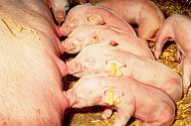
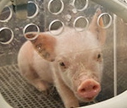
Can IF of different composition modulate the physiological response of the host?
Veg
Veg + PL
+
Mother-fed piglets
(MF = + control)
T1
Dairy Fat + PL
T2
Automatic meal delivery (10 meals/ day)
T3
Rehydration at 20%
Slaughtering
after
Mesenteric Lymph Nodes (MLN)
Collect of effluents and tissues
7 days
Effluents:
-SDS-PAGE
-Elisa
28 days
(90 min postprandial)
Tissues:
-Morphometry
-Enzyme Activities
-Intestinal Permeability
-Local immune response
-Microbiota
Ileum
Proximal
Jejunum
Median
Jejunum
Notes:
Le protocole expérimental est semblable à celui de l’étude in vivo précédente. sauf que dans cette partie nous avons un seul temps d’abattage après le repas qui a été fixé à 90 min. et les porcelets ont été sacrifiés à deux âges à 7 et 28j d’âge ces deux âges vont nous permettre d’avoir un profil de développement de la physiologie entre un stade précoce et un stade tardif du développement de l’intestin, et en plus de la collection des contenus digestifs, nous avons collectés des tissus de jéjunum et d’iléon ainsi que les ganglions mésentériques MLN qui représentent le site inducteur de la réponse immunitaire intestinale. Nous avons aussi rajoutés quelques porcelets de 7 et de 28j allaités par leur mère et ces porcelets que j’appellerai SM vont constituer une référence du meilleur développement et de la maturation intestinale.

Slide 23
Protein Digestion
Casein
β-lactoglobulin
Veg
Veg + PL
Dairy Fat + PL
Jejunum
Ileum
      Milk Proteins better resist to intestinal digestion in the presence of dairy fat
      ➔ Modification of the interface
      (Granger et al 2005; Davies et al, 2001)
Notes:
Les résultats majeurs de cette partie, sont 1èrement, pour la digestion des protéines, quelqueque soit la protéine (cns ou blg) et quelque soit l’âge le compartiment intestinal, la digestion des protéines ne diffère pas entre les formules STD et VegMFGM. En revanche les protéines sont plus résistantes à la digestion avec la formule LaitMFGM. Bien que ce sont de très faibles teneurs de l’ordre de l’ordre 0.3 à 6% de la protéine ingérée mais peuvent avoir des conséquences physiologiques. Cette résistance des protéines avec la formule qui contient des MFGM et la MGL peut être liés aux Agsaturé à courte et moyenne chaine qui composent la MGL qui peuvent former des cristaux qui à leur tour chasseront les protéines de l’interface.

Slide 24
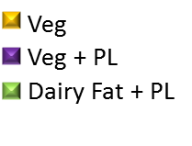
Paracellular Permeability
FD4 = FITC-Dextran (4kDa)
Jejunum
Ileum
Limited effect of the infant formula structure/composition on paracellular permeability
Notes:
Les variations de perméabilité paracellulaire entre 7j et 28j qu’on retrouve ce sont celles attendues et décrites dans la littérature. À savoir, une diminution avec l’âge dans le jéj et une augmentation avec l’âge dans l’iléon. La nature des formule affecte peu ces variations, même si le développement semble accéléré dans le jej prox avec VegMFGM (diminution + rapide à 7j) et dans l’iléon avec LaitMFGM avec une augmentation + rapide à 7j.

Slide 25
Secretory activity of MLN
Interferon-γ (Th1 pro-inflammatory)
Porcelets SM
Mesenteric lymph
nodes (MLN)
Interleukine-10 (Th2 anti-inflammatory)
Milk lipids ➔ maturation of the piglet’s immune system more similar than with sow’s milk
Notes:
L’IFNg estl’indicateur du profil Th1 qui se met en place progressivement après la naissance. Ce phénomène est observé avec la formule VegMIx et LaitMix comme chez les porcelets sous la mère dés 7j. Et se maintien avec LaitMIx à 28j. Pou l’Il-10 c’est le reflet du profil Th2 qui est présent à la naissance et diminue progressivement avec l’âge. Cet indicateur n’est pas différents entre les groupes à 7j, mais diminue avec LaitMix comme chez les SM à 28j.

Slide 26
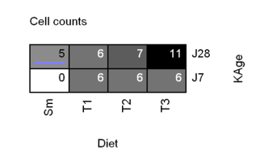
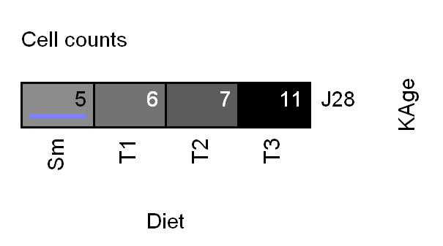
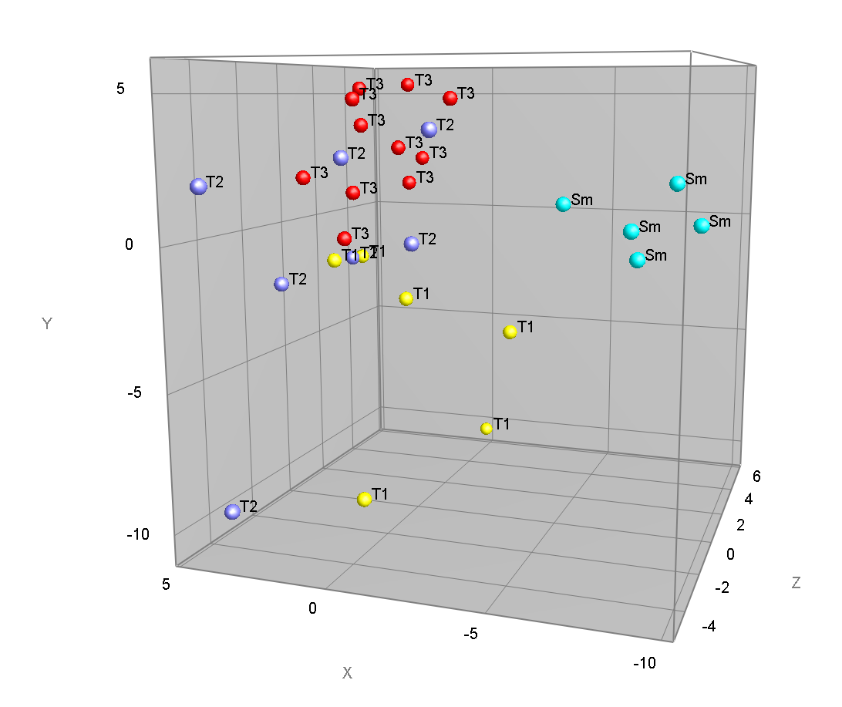
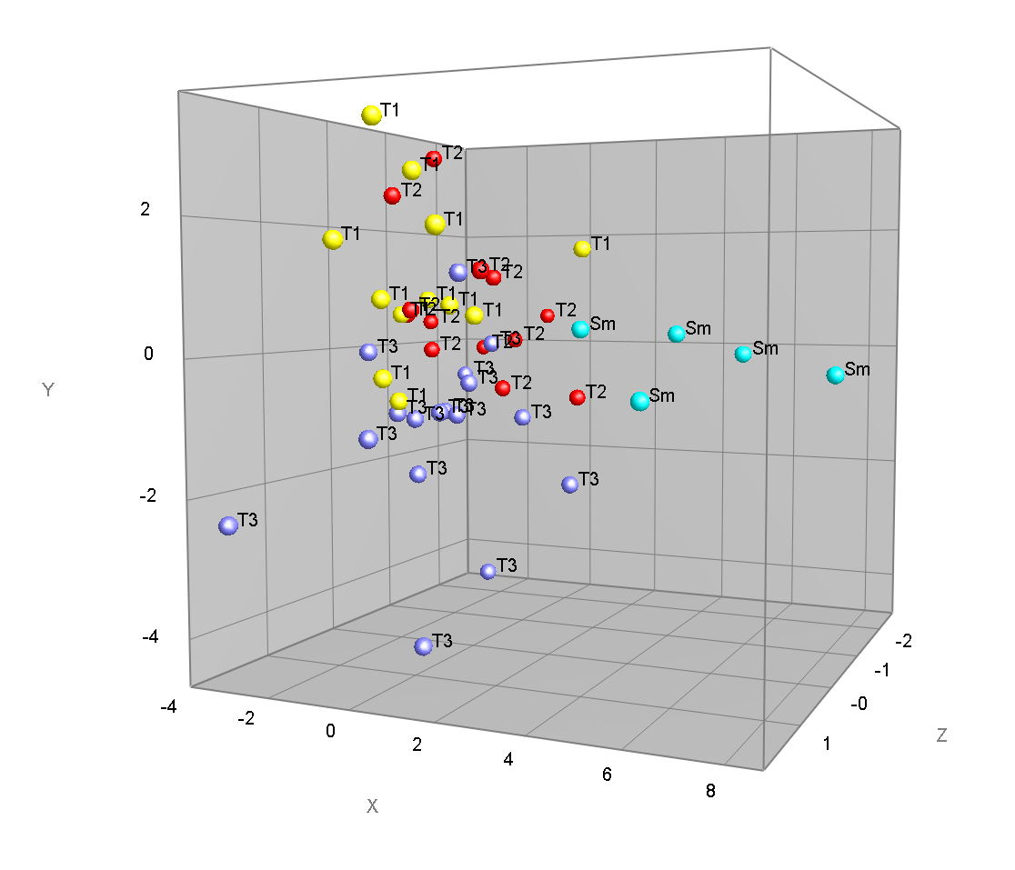
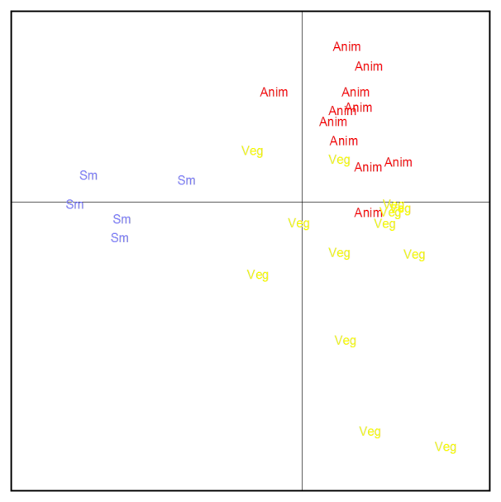

Microbiota by DHPLC
D7 & D28
D28
milk
The composition/structure of the infant formula « orientates » the microbiota
More Proteobacteria with milk fat / More Firmicutes with plant oil
mf
plant

Slide 27
Conclusion
The structure of dairy products, as modified by the processing conditions, regulates the kinetics of protein digestion and dietary amino acids bioavailability
For the neonate, substitution of vegetable oil by milk fat allows a better maturation of the immune system and a modification of the microbiota, but more work is needed to determine whether these modifications are transient or will remain with time
Understanding the disintegration of dairy products in the gastrointestinal tract is essential for designing new foods dedicated to specific sub-populations (elderly, athlete, infant, overweight people….)

Slide 28



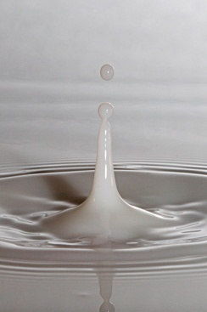
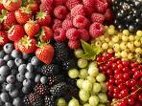
Improving health properties of food by sharing our knowledge on the digestive process
COST Action FA1005
Dr. Didier DUPONT, Senior Scientist, INRA, France
June 2011 – May 2015

Slide 29


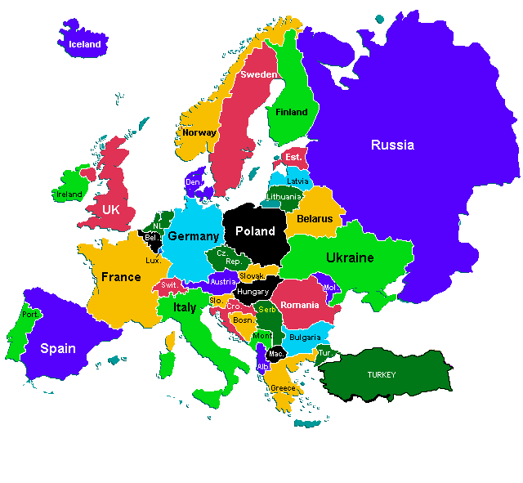






Tech Univ Denmark
Univ Aarhus
Univ Copenhagen
MTT
Univ Oulu
Univ Eastern Finland
Norwegian Univ Life Sci
Chalmers Univ Tech
Nofima
Riga Stradin Univ
Univ Ljubljana
Canada
VTT
Univ Zagreb
NIZO
TNO
Lund Univ
Wageningen UR
Anabio
Rothamsted Res
Teagasc
Univ Reading
Univ College Cork
James Hutton Inst
Univ Leeds
Univ Birmingham
Univ Manchester
Laval Univ
Cent Rech Lippmann
Univ Greenwich
Univ Glasgow
Univ Guelph
Univ Ghent
Agroscope Posieux
Univ Nottingham
Czech Univ Prague
Inst Food Res
Agrocampus Ouest
Inst Chem Technol
Leatherhead Food Res
ACW
KTU Food Inst
FiBL
Univ Sevilla
Lithuanian Univ HS
Univ Greifswald
Gdansk Univ Tech
IRD
Univ Valencia
Maize Res Inst
INRA
Max Rubner-Institut
NGO
AgroParisTech
CNRS
Univ Basque Country
Polish Academy of Sci
Univ Murcia
CTCPA
Univ Belgrade
CSIC
Univ Granada
Univ Novi Sad
Aristote Univ Thessaloniki
Centr Food Res Inst
NIH Ricardo Jorge
Ben Gurion Univ
Univ Alto Douro
Univ Bologna
Univ Roma
Technion
New Zealand
ITQB
Milan State Univ
FEM
CNR
Pom Med Univ
Univ Milan
Univ Naples
Ege Univ
CONICET
Australia
Agric Univ Tirana
Michigan State Univ
Univ Buenos Aires
Deakin Univ
Riddett Inst
Argentina
Univ Queensland
Albania
Montenegro
Plant Food Res
USA
320 scientists - 110 institutes – 34 countries

Slide 30


We are pleased to announce the next
4th International Conference on Food Digestion organized by the
COST Action FA1005 INFOGEST
Naples, Italy
March 2015
in Naples, 17-19 March 2015

