Slide 1



“Image analysis of cheese microstructure and diffusion properties of solutes: An important link to understand cheese ripening mechanisms”
Juliana VALLE COSTA SILVA¹,
Chantal CAUTY¹, David LEGLAND², Sylvie LORTAL¹, Juliane FLOURY^{1,3}
¹INRA, Science and Technology of Milk and Eggs, Rennes, France
²INRA, UMR782, Food Process Engineering and Microbiology, Thiverval-Grignon, France
³Agrocampus-Ouest, UMR1253, Science and Technology of Milk and Eggs, Rennes, France

Slide 2
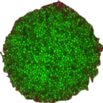
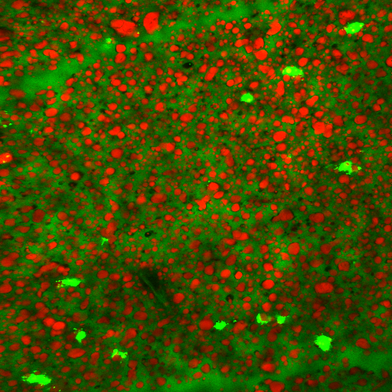
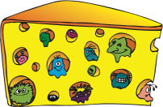

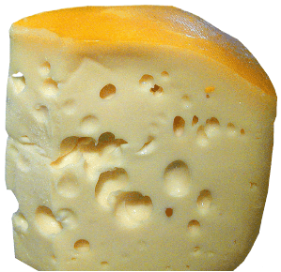
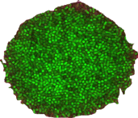
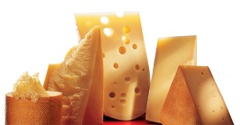
Context
Cheese ripening…
- Key step of cheese making technology
- Complex and specific of each variety of cheese
Substrates
Lactose
Proteins
Fat
Products
Sugars
Peptides and amino acids
Fatty acids
Immobilized colonies
Diffusion phenomena of solutes in cheese
Microbial and enzyme activities
Development of flavor and texture
Substrates
Products
Final quality of cheese
Cheese

Slide 3

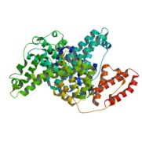
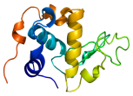
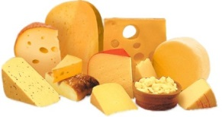
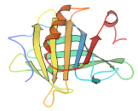
Objective
Diffusion phenomena of solutes in cheese
Image analysis
Diffusion properties
Structure/
composition
Physicochemical
characteristics
of solutes
Structure
Composition
To enable a better understanding of the ripening mechanisms…

Slide 4


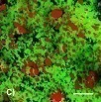
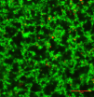
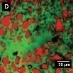
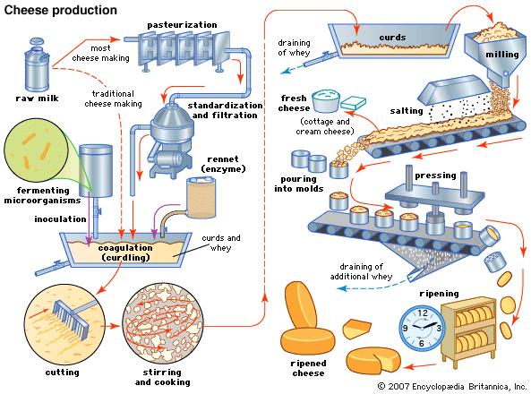
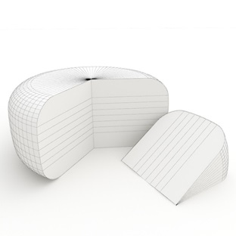

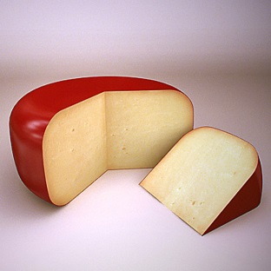
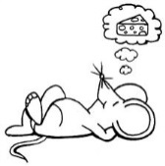
Strategy
How can you understand and control the ripening mechanisms of…
Different cheeses…
Of different microstructures…
With different and complex steps of production and development…
Model cheese
Cheese model
Homogeneous and reproducible

Slide 5
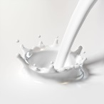
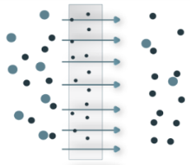

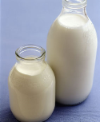
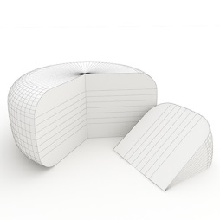
Materials and Methods
UF-model cheese manufacture
Skim milk
UF milk
retentate
UF milk
ultrafiltrate (aqueous phase)
Heat treatment
(93°C for 15 min)
Microfiltration (0.8 μm)
Ultrafiltration (8 kD)
Melting ice for 3 min
Heat-treated retentate
Sodium azide (0.05% wt/wt)
Coagulant agent (0.03% v/v)
Coagulation at 30°C (1h)
Incubation at 19°C (2h)
UF-model cheese

Slide 6
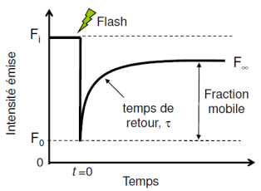
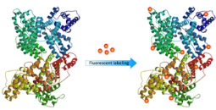
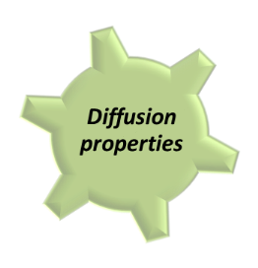
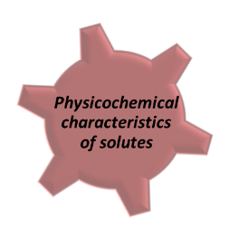
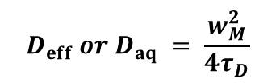
Materials and Methods
Diffusion of solutes through the UF-model cheese and in the ultrafiltrate using the FRAP technique
Prebleach
Bleach
Recovery
Fluorescent molecule
Bleached molecule
Fluorescent solutes:
FITC-dextrans (4 kDa to 2 MDa)
Flexible and neutral solutes
FITC-labeled dairy proteins (α-LA, β-LG and BSA)
Rigid and negatively charged solutes
Typical recovery curve of fluorescence in function of time
$$D_{eff }or{ D}_{aq }= \frac{w_{M}^{2}}{4τ_{D}}$$
D_{eff}: effectif diffusion coefficient in the UF-model cheese (μm²/s)
D_{aq}: diffusion coefficient in the aqueous phase (ultrafiltrate)
w_{M}: profile width in the radial direction (m)
τ_{D}: characteristic time of diffusion

Slide 7
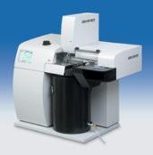
Materials and Methods
Study of the microstructure of the UF-model cheese using TEM
Freeze-substitution and low-temperature embedding protocol:
Protects the structure of dairy constituents
Cryo-fixation
High-pressure freezing:
- Samples are frozen in liquid nitrogen (-196°C) at high-pressure (2100 bars)
- Advantage: at 2 100 bars the melting point of water decreases because the water becomes 1 500 times more viscous. The increase in viscosity reduces the ice crystal growth rate.
Leica EM PACT
Freeze-substitution
- The sample is immersed in a solvent
- Substitution of ice by the solvent
Leica EM AFS2
Embedding
The solvent is replaced with a low-temperature resin:
Ethanol 3:1 resin
Ethanol 1:1 resin
Ethanol 1:3 resin
100% resin
Sectioning
Thin sections (90nm thick) of embedded material are cut with a diamond knife using a Reichert ultramicrotome

Slide 8
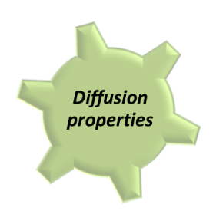

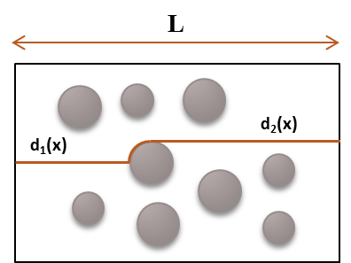
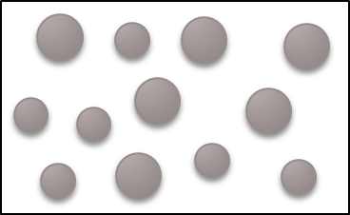

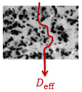
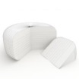


Materials and Methods
Quantitative analysis of the microstructure of the UF-Model Cheese
Image pre-processing
Remove noise
Mean filter
Segmentation
Thresholding
Most critical step; care must be taken
The image is processed to mark relevant features
Quantification of relevant features
Porosity → Reduction of the available volume
Tortuosity (τ) → Increase of the path length
Protein aggregate
$$Tortuosity \left(τ\right)= \frac{L_{actual}}{L_{Euclidian}}=\frac{ d_{1}\left(x\right)+d_{2}\left(x\right)}{L}$$
$$Porosity \left(ε\right)=\frac{Surface of void space }{Total surface}$$
Shortest path containing a point x in the matrix, connecting two opposite edges of the image (Delarue et al. , 2003).

Slide 9
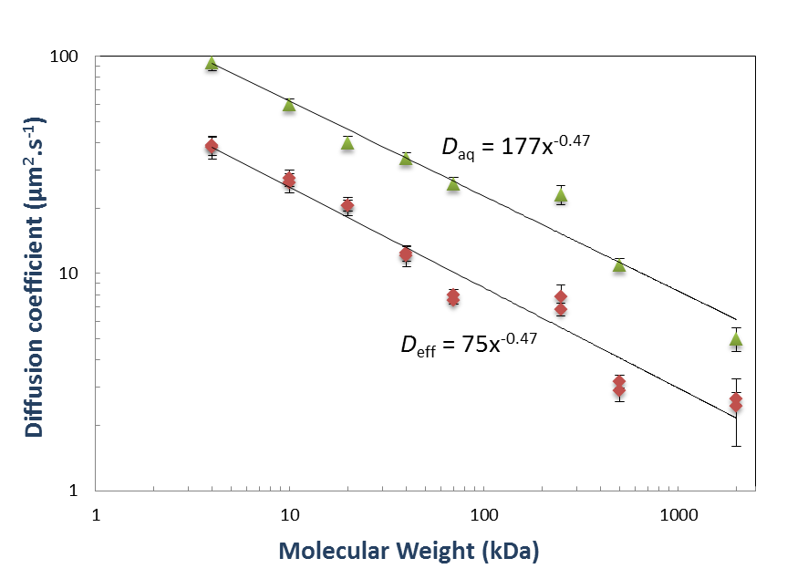
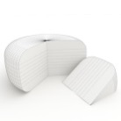


Results and Discussion
Influence of different physicochemical characteristics of solutes on diffusion in the UF-model cheese
Influence of the solute size…
FITC-dextrans (4 kDa to 2 MDa)
- Flexible and neutral solutes
The larger FITC-dextrans were no more hindered by the structure of the UF-model cheese when compared to the smaller ones.
The mobility of FITC-dextrans in the UF-model cheese was reduced by a constant obstruction factor (k = 0.42).
$$Deff≈kDaq$$
$$k=f(ε,τ,…)$$
The pore sizes of this model cheese were believed to be sufficiently large when compared to the size of the solute molecules.
Figure 1. Logarithmic plots of experimental diffusion coefficients of FITC-dextrans in the UF-model cheese () and in the ultrafiltrate () as a function of their molecular weight.

Slide 10
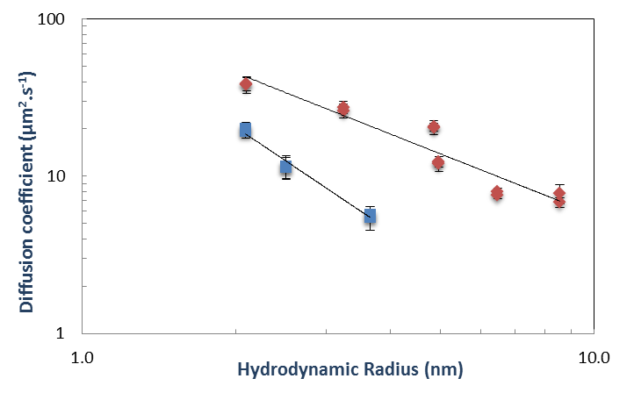


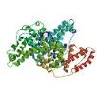
Results and Discussion
Influence of different physicochemical characteristics of solutes on diffusion in the UF-model cheese
Influence of the shape and charge of solutes…
FITC-labeled dairy proteins (α-LA, β-LG and BSA)
- Rigid and negatively charged solutes
Rigid and negatively charged solutes were hindered more than the flexible and neutral solutes in the UF-model cheese
-
-
-
The existence of steric and electrostatic interactions between the protein matrix of the UF-model cheese and the FITC-dairy proteins is suggested.
The diffusion through the protein aggregates could play an important role in the overall diffusion of the FITC-dairy proteins, retarding their movement when they diffuse in the UF-model cheese.
α-LA
β-LG
BSA
Figure 2. Logarithmic plots of experimental diffusion coefficients of FITC-dextrans () and FITC-dairy proteins () in the UF-model cheese as a function of their hydrodynamic radius.

Slide 11
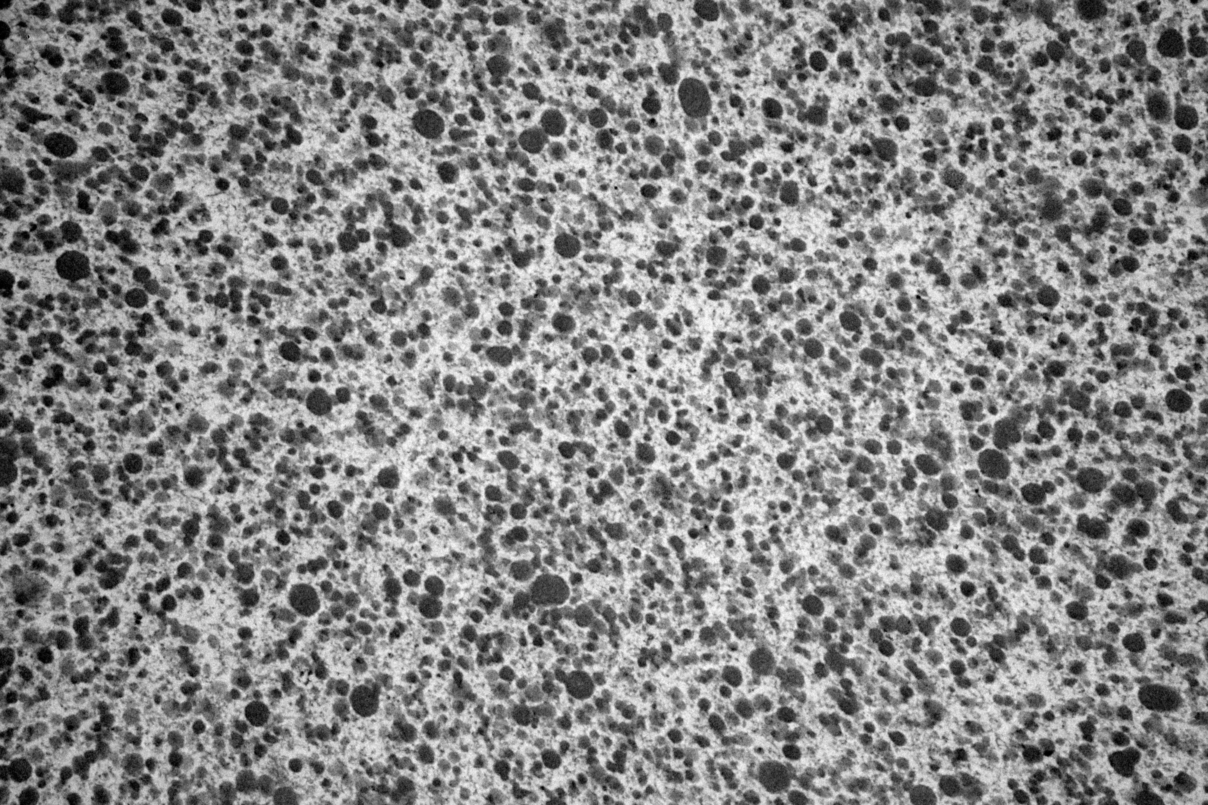
Results and Discussion
Influence of the microstructure of the UF-model cheese on diffusion of solutes
Image Analysis of the UF-model cheese
TEM micrograph of the UF-model cheese
Segmented (binary) image of the UF-model cheese
Quantification of relevant features…

Slide 12
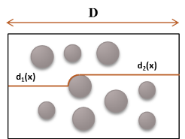
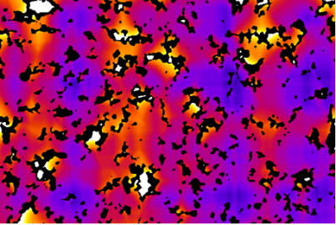


Results and Discussion
Influence of the microstructure of the UF-model cheese on diffusion of solutes
Image Analysis of the UF-model cheese
Porosity (ε)
Tortuosity (τ)
Protein aggregate
$$ε =\frac{Surface of void space }{Total surface}$$
$$τ=\frac{d_{1}\left(x\right)+d_{2}\left(x\right)}{D}$$
Tortuosity distribution in the UF-model cheese.
Blue zones: low tortuosity. Yellow/orange zones: high tortuosity
ε = 0.638 ± 0.007
τ = 1.085 ± 0.008
Under way…
To establish the relationship between these microstructural parameters and diffusion properties by comparing results obtained in model matrices with different microstructures.

Slide 13
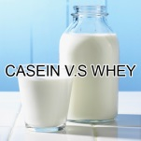
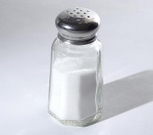
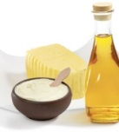
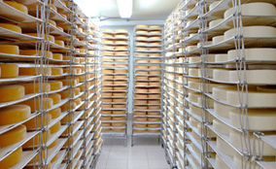
Conclusions and Perspectives
The physicochemical characteristics of solutes influence their diffusion in the UF-model cheese
-
-
-
-
The diffusion of other solutes (flexible and negatively charged, rigid or flexible positively charged) may be studied to elucidate the solute-matrix interactions
+
+
+
+
+
+
+
+
Studies of the diffusion and structure in other model cheese matrices are required to the development of predictive models of diffusion of solutes
A better understanding of the influence of the matrix microstructure on the diffusion of solutes should allow a more generic view of cheese ripening kinetics for future innovations

Slide 14







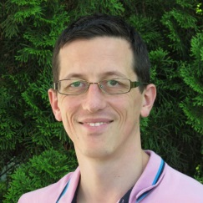
Acknowledgements
My research team (MICRO):
Juliane Floury
Sylvie Lortal
Anne-Thierry
Sophie Jeanson
Valérie Gagnaire
Chantal Cauty
Platform MRic
David Legland

Slide 15
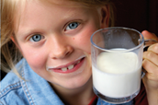
Thank you for your attention!
Juliana.ValleCostaSilva@rennes.inra.fr

