Slide 1
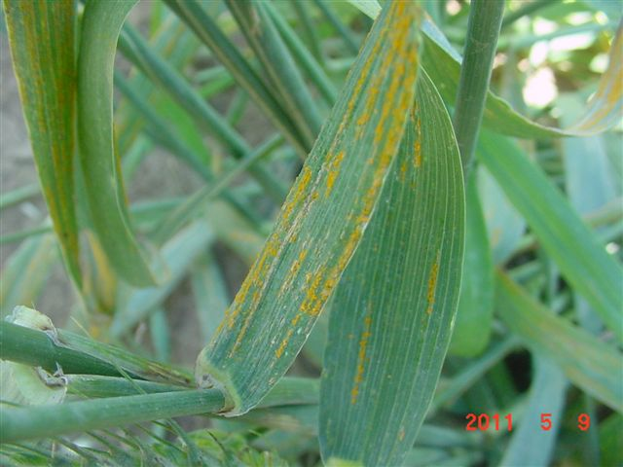
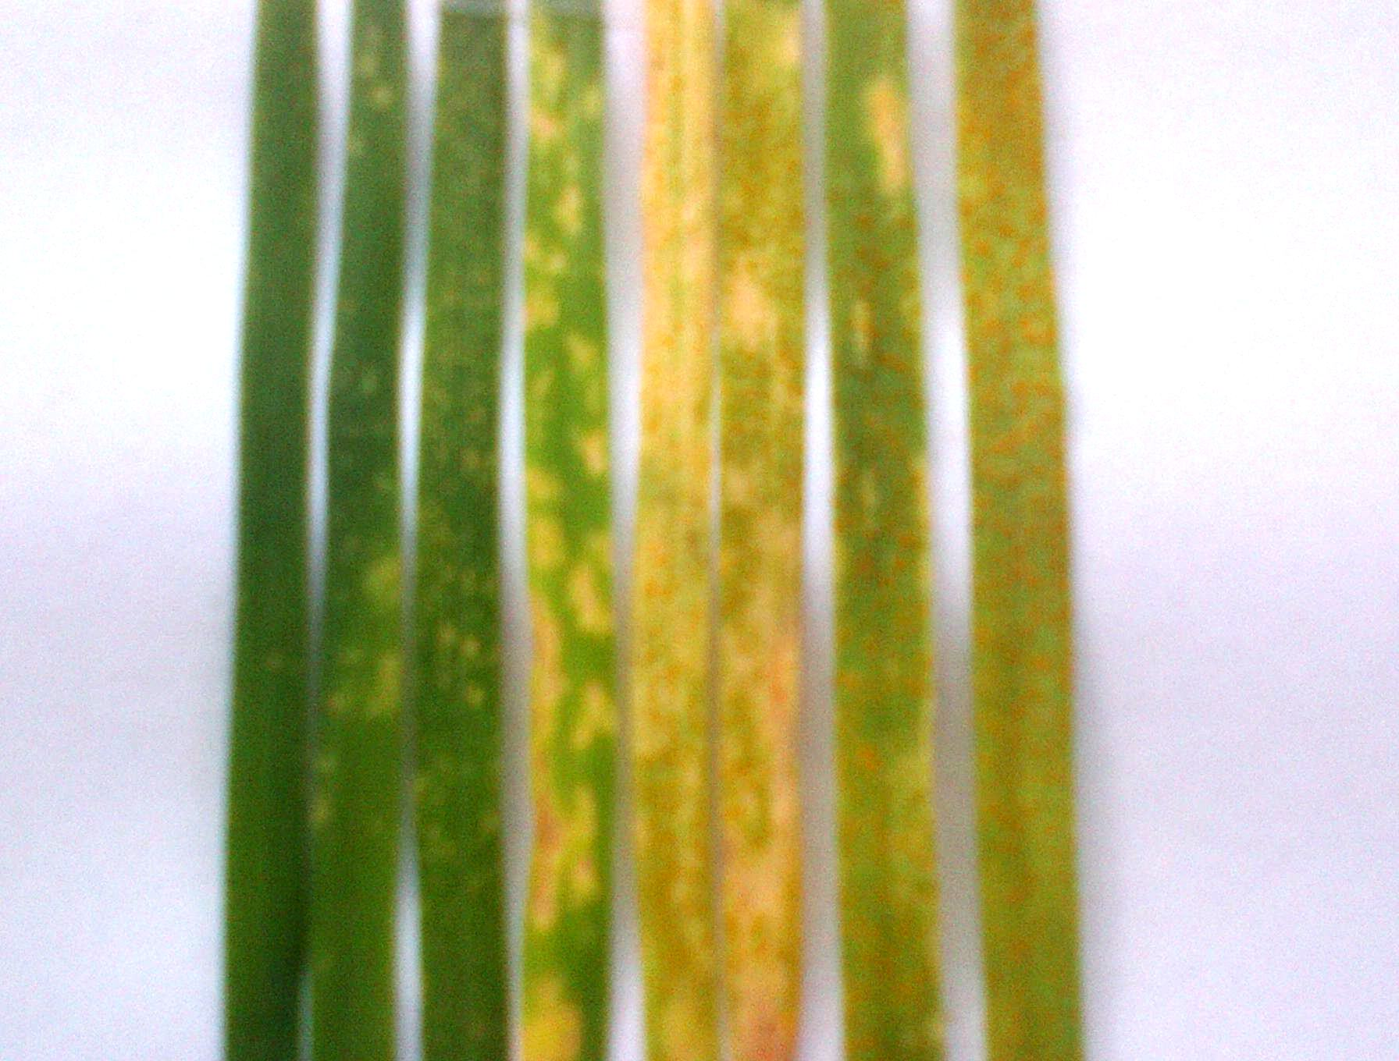
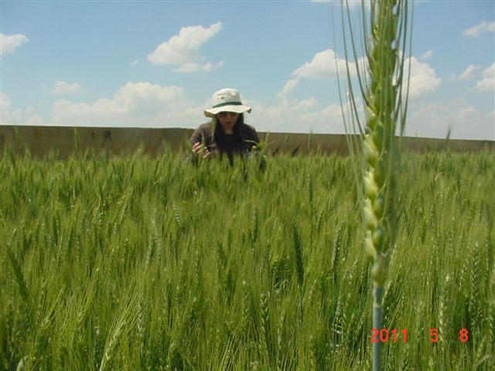
Characterization of seedling yellow rust resistance in wheat commercial cultivars, landraces and elite genotypes from Syria and Lebanon
A A R H U S U N I V E R S I T Y
R. El Amil^{1,2,4}, M. Leconte², C. de Vallavieille-Pope²¸ M. S. Hovmøller³, O. Abdalla⁴, K. Nazari⁴
¹Lebanese Agricultural Research Institute (LARI), 287 Zahleh, Bekaa, Lebanon; ²INRA, UR1290 BIOGER-CPP, BP01,
78850 Thiverval-Grignon, France; ³Aarhus University, Department of Agroecology, Forsøgsvej 14200, Slagelse, Denmark;
4 Regional Cereal Rust Research Center, Aegean Agricultural Research Institute P.K. 9 Menemen, IZMİR Turkey
E-mail: ramil@lari.gov.lb
Preamble
Stripe (yellow) rust caused by Puccinia striiformis f. sp. tritici (Pst) is the major threat to wheat production in Central, West Asia and North Africa. The host resistance has remained the most economical, effective and ecologically sustainable method for disease control. Identification of resistance genes in commercial cultivars and landraces is fundamental to breeding for durable resistance. Gene postulation (multi-pathotype test) is traditionally used in characterization of seedling resistance genes. In present study the seedling resistance genes were postulated in commercial wheat cultivars and landtaces using an array of Pst pathotypes at seedling stage.
Materials and Methods
A total of 135 wheat genotypes including 87 lines from of ICARDA's breeding program, 17 released cultivars from LARI's and 31 accessions from purified Lebanese landraces were used in this study. Eleven pathotypes of Pst available at INRA-Grignon were used to inoculate the host materials with the ability to differentiate low and high infection types for Yr1, 2, 3, 4, 6, 7, 8, 9, 17, 25, 27, 32, Sd, Su, and Sp (De Vallavieille-Pope et al., 2012).
The plants were scored individually 15–17 days after inoculation using a qualitative infection-type scale of 0 to 9 based on the presence of necrosis, chlorosis and the intensity of sporulation (McNeal et al., 1971) (Fig. 1)
Results and Discussion
Most of the landraces (58%) and 4% of elite germplasm were susceptible to all the tested Pst pathotypes indicating absence of effective Yr-gene in these genotypes. 10% of ICARDA’s elite lines are among the resistant genotypes to all pathotypes, followed by Lebanese landraces (6%) and cultivars (5%). Resistance phenotypes of nine, three and two genotypes of the elite lines, cultivars, and landraces, respectively, were remained uncharacterized. Yr27 (29%), Yr7 (17%), Yr6 (12%), Yr3 (12%) and Yr17 (6%) were the most common postulated genes in the cultivars whereas Yr7 (24%), Yr9 (12%), Yr1 (9%), Yr6 (9%) and Yr27 (8%) were identified in elite lines. In landraces, Yr25 (10%), Yr3 (6%), Yr7 (3%) and Yr9 (3%) were the most frequent postulated genes. Yr1 was only postulated in elite lines (9%) and Yr4 was postulated in 3% of landraces and 3% of elite lines (Fig. 2).
%
Fig. 1 : seedling infection type (Left to Right) : incompatible reaction 0 to compatible reaction 9.
%
Fig. 2: Distribution of Yr genes postulated in 87 elite lines, 17 commercial cultivars and 35 wheat landraces
Conclusion
Based on race analysis, Yr1,Yr3,Yr4,Yr5,Yr10,Yr15 and Yr32 are still effective against all Syrian and Lebanese races (Fig. 3) and can be used in combination for developing new resistant wheat cultivars. Since frequency of gene combination of some R-genes (i.e. Yr1, Yr3 and Yr4) in commercial cultivars is low, utilization of these genes alone in farmer cultivars could result in consequent boom and bust cycle. The gene postulation seedling resistance gene in these genotypes should be complemented with characterization of adult-plant resistance genes. Gene-pyramiding strategy by use of effective seedling resistance genes with adult-plant resistance genes would provide durability of resistance to yellow rust (Paillard et al., 2012). Present data can be used in national breeding programs in Lebanon and Syria as well as at regional scale.
*
*
*
*
*
*
*
*
*
References
Fig. 3 : Distribution of Pst races sampled in major bread and durum wheat areas in Syria in 2011 using the BGRI surveillance protocols. In total, 223 samples were collected from 44 fields and characterized for their virulence and SSR profiles.
*Indicates a SSR profile similar to the invasive PstS1/2 strain genotype obtained using 20 SSR markers (Ali et al, 2010).
**Indicates both pathotype and SSR genotype corresponding to PstS2 strain (Hovmøller et al.,2008)
De Vallavieille-Pope et al. 2012. Virulence dynamics and regional structuring of Puccinia striiformis f. sp. tritici in France between 1984 and 2009, Plant Disease, 96,131-140.
Paillard et al., 2012. Durable resistance to stripe rust is due to three specific resistance genes in French bread wheat cultivar Apache. Theor. Appl. Genet. 125(5):955-965.
El Amil et al. 2012. BGRI Technical workshop Beijing, poster 1292
Ali et al., 2010. Reduction in the sex aptitude of worldwide clonal populations of Puccinia striiformis f.sp. tritici. Fungal Genetics and Biology, 47, 828-838.
Hovmøller et al.., 2008. Rapid global spread of two aggressive strains of a wheat rust fungus. Molecular Ecology 17:3818–3826.
2013 BGRI Workshop, 19-22 August 2013, New Delhi, India

