Slide 1

Dynamic modeling of a vector-borne disease, from an individual to a metapopulation perspective
Dourdan, ECTQG 2013
Sylvatic plague in Kazakhstan
Vincent Laperrière, MCF
AMU-UMR 7300 ESPACE

Slide 2
Outline
Context
  Plague in Kazakhstan
  Multi-level organization
Methods
  The Individual Based Model (multi-agent system)
  The deterministic Population Level Model (ODE system)
Results:
  Reference simulation, outcome validation
  Effect of gerbil density and dispersal
Discussion

Slide 3
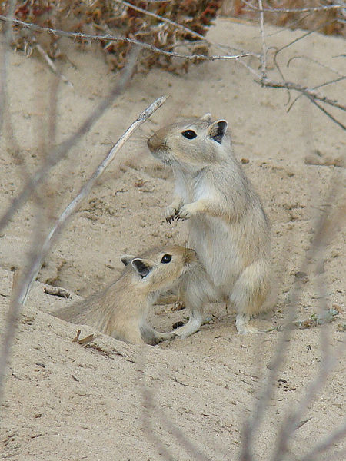
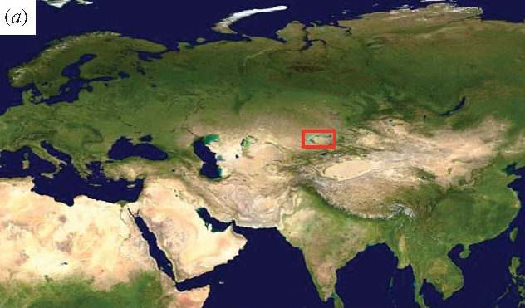
Plague in Kazakhstan
Main host: great gerbil Rhombomys opimus
Main vector : flea of species Xenopsylla gerbilli Minax
Particularities:
an intensive eco-epidemiological monitoring
- strong seasonal effects
Source : Kausrud et al., 2007
Source : Wikipedia

Slide 4
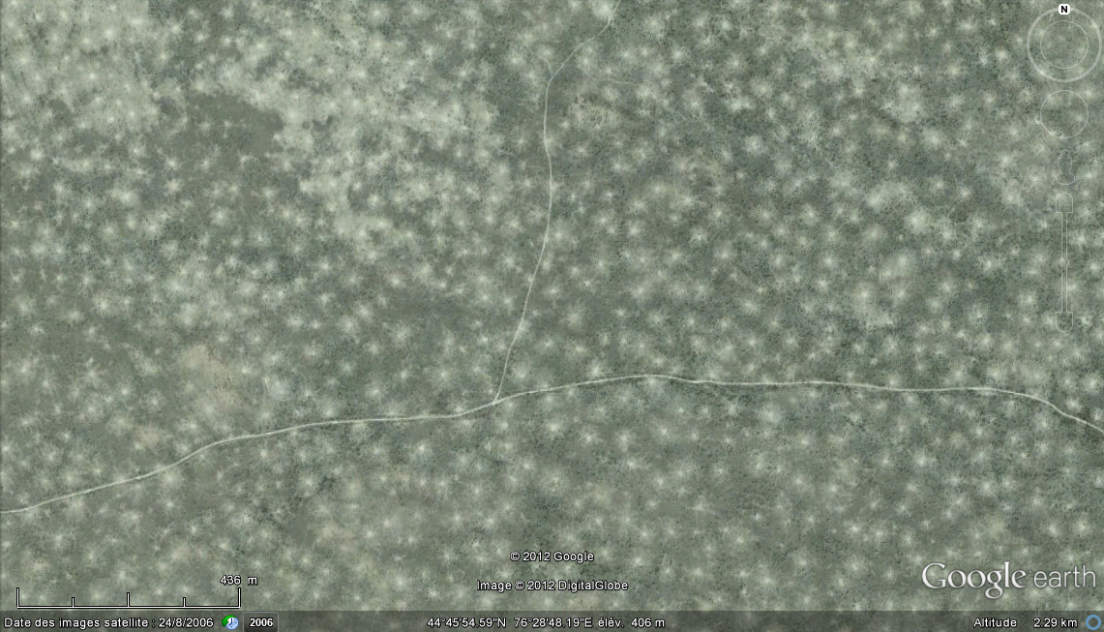
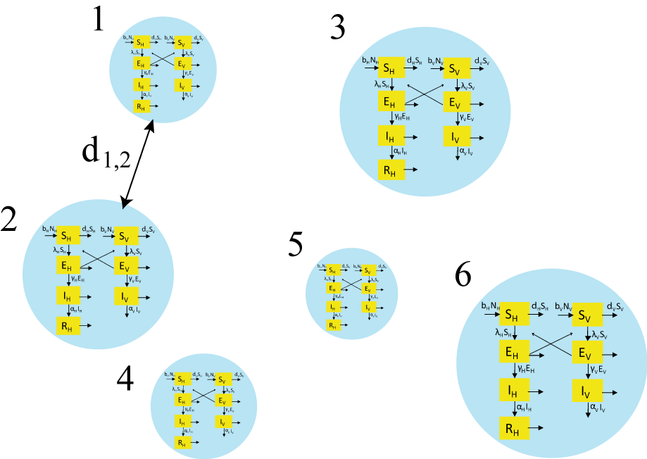
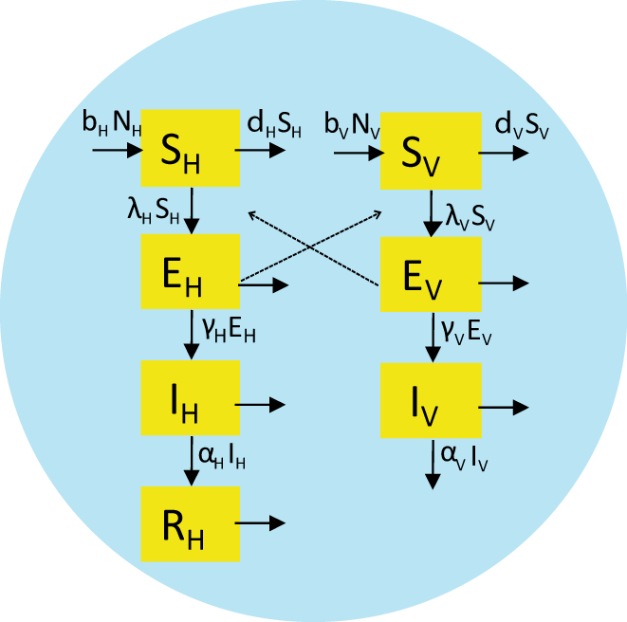
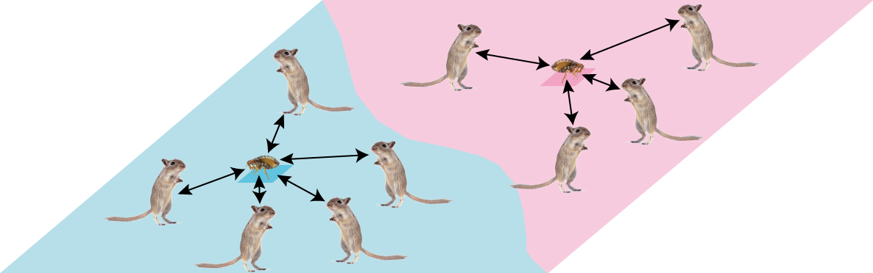
Multi-level organization from the individual to the metapopulation
level
formalism
METAPOPULATION
dispersal rate
m_{i,j} = f (d_{i,j})
0
500 m
ODE
system
COMMUNITY
= burrow system
INDIVIDUAL
Multi-agent
system

Slide 5
Coupling Individual Based Modeling (IBM) and Population Level Modeling (PLM)
INPUT
MAS
(IBM)
stochastic
ODE system
(PLM)
deterministic
OUTPUT
Seasonally forced individual parameters
(derived from littérature)
Population level parameters associated with uncertainty
- Prevalence
(time sequence,
mean, max)
Time to extinction
-Final size of epidemics
-Propagation speed

Slide 6
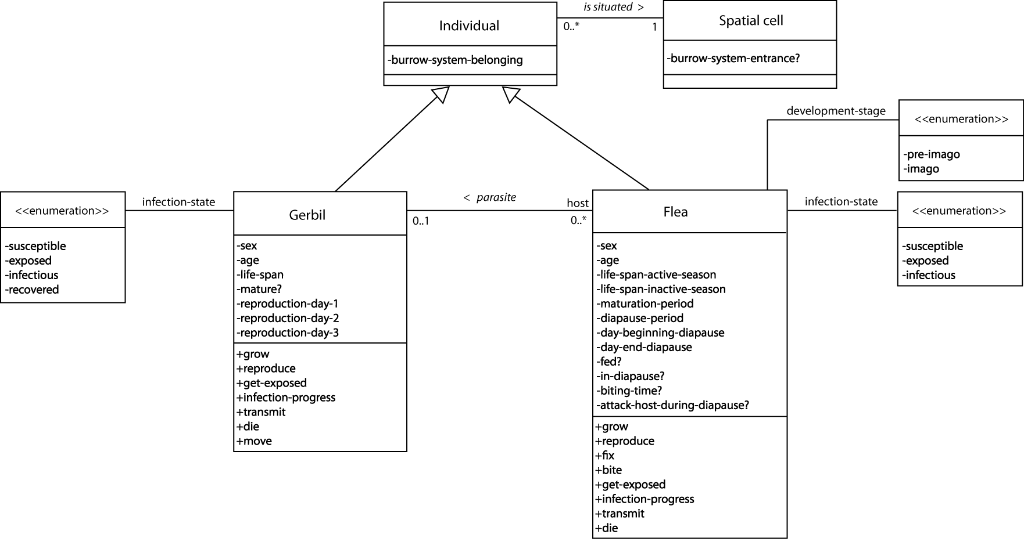
The Individual Based Model : a Multi-Agent System
- Population fertility and mortality
- Gerbil foraging activity
Within community
transmission dynamics

Slide 7
The (meta)Population Level Model: a system of Ordinary Differential Equations
- IBM derived within-community dynamics
- between-community dynamics due to gerbil dispersal

Slide 8
The (meta)Population Level Model: a system of Ordinary Differential Equations
Seasonal forcing:
IBM derived seasonally forced parameters:
  Fertility and mortality rates
  Transmission coefficient in the incidence function
Other seasonally forced parameters:
  Dispersal coefficient
Consequence:
Correct damped oscillations tending to a stable fixed point observed in the basic deterministic model

Slide 9
IBM derived seasonally forced parameters
Time varying fertility and mortality rates
GERBILS IBM reproduction period: Apr-Oct 2 or 3 litters per reproduction period - minimum gestation period between two litters (30 days) average litter size: 5,5 +/- 1.5 (gaussian distribution) maturation period: 105 days average life span: 247 days (Gamma distribution) | PLM daily fertility rate (averaged over 12sim*6 years) daily mortality rate (av. over 12sim*6 years)
07/04/2015
Quelle utilité de la modélisation dynamique en géographie ?
9

Slide 10
IBM derived seasonally forced parameters
Time varying fertility and mortality rates
FLEA IBM average diapause period: 135 days (Poisson) proportion of non diapausing fleas: 10 % proportion of fleas mating after their first blood meal: 50 % daily oviposition rate: 3.6 eggs/day (Gaussian) emergence success: 18 % average maturation period: 32 days (Poisson) average life span as imago (active season): 15 days (Poisson) average life span as imago (inactive season): 41 days (Poisson) | PLM daily imago fertility rate (averaged over 12sim*6 years) daily mortality rate (averaged over 12sim*6 years)
07/04/2015

Slide 11
IBM derived seasonally forced parameters
Transmission parameters
 | Parameter | Ref. value / D or S | Reference source
IBM specific | Unblocked flea biting rate | 0.3 days⁻¹ / D | Lorange et al., 2005
 | Blocked flea biting rate | 1 days⁻¹ / D | Lorange et al., 2005
 | Probability for a diapausing flea to attack host | 20 % / S | Vashchenok, 1997 ; Krasnov, 2008
 | Flea-to-host transmission probability | 0.45 / S | Lorange et al., 2005
 | Host-to-flea transmission probability | 0. 5 / S | assumed
Common IBM and PLM (periods are converted to rates) | Flea latent period (extrinsic incubation period) (possibility of early phase transmission not considered) | 216 hours / D | Bibikova and Klassovskii, 1974 ; Lorange et al., 2005
 | Flea infectious period (the rate of blockage formation is assumed 1) | 84 hours / D | Lorange et al., 2005
 | Gerbil latent period | 96 hours / D | Park et al., 2007
 | Gerbil infectious period | 144 hours / D | Korneyev and Karpov, 1977 ; Park et al., 2007 ; Schmid et al., 2012
 | Gerbil letality proportion | 0.12 / D | Zhang et al., 2012
 | Gerbil immunization period (resistant gerbils are assumed to have no bacteremia) | 200 days / D | Park et al., 2007 ; Zhang et al., 2012
Host and vector incidence functions

Slide 12


IBM derived seasonal incidence functions
Estimate Std. Error t value Pr(>|t|)
0.1335800 0.0002737 488 <2e-16
Estimate Std. Error t value Pr(>|t|)
0.5365917 0.0006494 826.3 <2e-16
0.5 % 99.5 %
Estimate 0.1328750 0.1342851
0.5 % 99.5 %
Estimate 0.5349188 0.5382645
Estimate Std. Error t value Pr(>|t|)
0.0294216 0.0001101 267.1 <2e-16
Estimate Std. Error t value Pr(>|t|)
0.0719407 0.0003343 215.2 <2e-16
0.5 % 99.5 %
Estimate 0.02913787 0.02970537
0.5 % 99.5 %
Estimate 0.07107957 0.07280189
07/04/2015

Slide 13
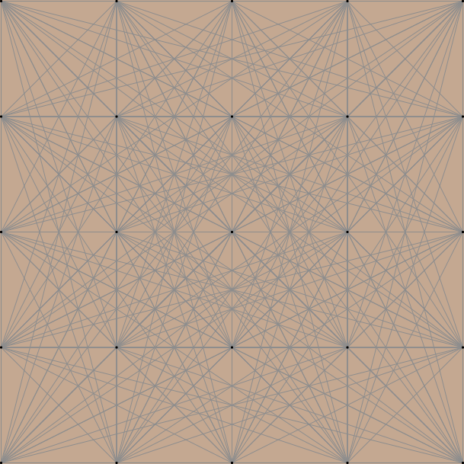
Population level model parameters
Gerbils’ dispersal
Exponential density function fitted to dispersal distribution (Davis et al., 2008)
+
1 2 3 4 5
1 0.000000e+00 8.946798e-09 8.946798e-09 1.421911e-04 8.946798e-09
2 8.946798e-09 0.000000e+00 3.984040e-08 5.639620e-07 2.550786e-11
3 8.946798e-09 3.984040e-08 0.000000e+00 1.849122e-08 1.621507e-06
4 1.421911e-04 5.639620e-07 1.849122e-08 0.000000e+00 1.231424e-09
5 8.946798e-09 2.550786e-11 1.621507e-06 1.231424e-09 0.000000e+00
Matrix of dispersal rates m_{i,j}
dispersal rate
m_{i,j} = f (d_{i,j}, time)
07/04/2015

Slide 14
The (meta)Population Level Model:
Reference simulation
population dynamics without infection over 20 years in 1 community:
population size

Slide 15
The (meta)Population Level Model:
Reference simulation: 100 gerbil communities and 1 infected individual introduced
prevalence
SIMULATED | Vector prevalence | Host prevalence
median | 0.000040 | 0.000105
mean | 0.0072 | 0.0193
max | 0.2284 | 0.4501
FROM OBS. TIME-SERIES | Host prevalence | source
mean | 0.008-0.012 (GTMM) 0.01-0.06 (autoregressive modelling) | Stenseth et al., 2006 Kausrud et al., 2007
max | 0.4 (obs. averaged over sites) 0.3-0.8 (autoregressive modelling) | Storvik, 2010 Kausrud et al., 2007
Kazakh Scientific Centre for Quarantine and Zoonotic Diseases:
Serious concern at 0.008 host prevalence
07/04/2015
15

Slide 16
The (meta)Population Level Model:
Sensitivity analysis
Uncertainties in the transmission coefficients betaH and betaV computed from the stochastic IBM :
Multi-normally distributed deviation range derived from the interval confidence and the standard error of estimates betaH and betaV
N=500 simulations

Slide 17
The (meta)Population Level Model:
Sensitivity analysis
Uncertainties in the transmission coefficients betaH and betaV computed from the stochastic IBM :
Results from t=6000 to t=7300

Slide 18
The (meta)Population Level Model:
Sensitivity analysis
Sensitivity to the spatial density of gerbil communities:
Effect on the maximum host prevalence and the mean host prevalence

Slide 19
The (meta)Population Level Model:
Sensitivity analysis
Sensitivity to the flea-to-host ratio in terms of carrying capacities:
Effect on the maximum (left) and the mean (right) host prevalence

Slide 20
The (meta)Population Level Model:
Sensitivity analysis
Sensitivity to gerbils’ dispersal:
Effect on the maximum host prevalence and the mean host prevalence

Slide 21
Discussion:
From the individual to the population
  Populations are finite and made of heterogeneous spatially distributed individuals
  The PLM is always an approximation to the underlying IBM
  Lack of analytical studies of IBMs (too cumbersome)
  How to integrate noise due to individual and spatial variations in population-level epidemic models?
  Without the need of invoking a seasonal forcing, noise can maintain oscillations by constantly perturbing the system away from its steady state (stochastic amplification)

