Slide 1
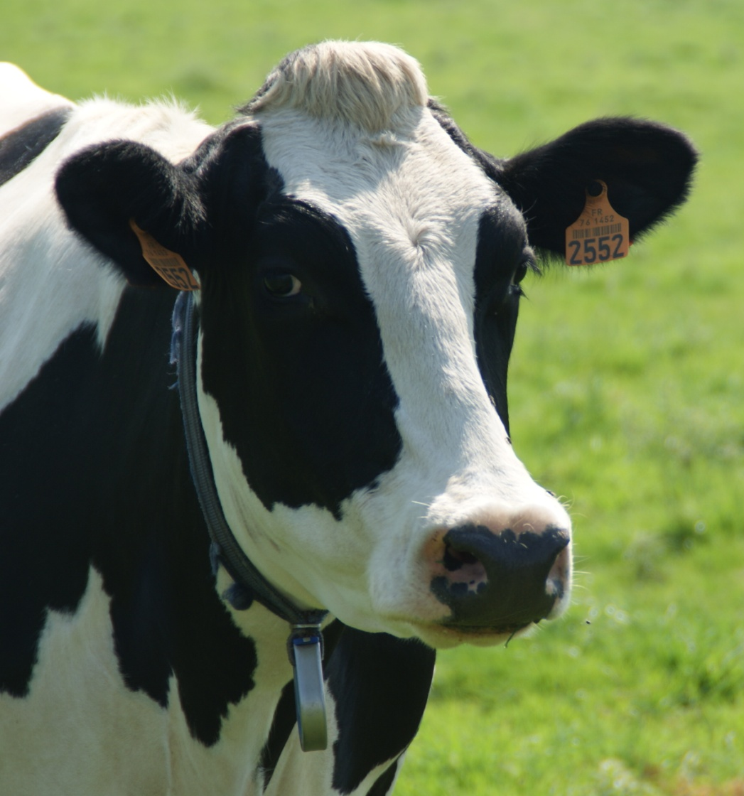
International issues
in dairy cattle
genetics
Vincent Ducrocq
Jouy-en-Josas, France
Notes:
First of all, let me assure you that it is really a great honour for me to be standing in front of you to give this Leroy fellowship lecture. The topic I chose today « International issues in dairy cattle genetics » may seem a bit narrower and more specialized than most Leroy lectures given in the recent past. I picked it because theinternational aspect is particularly relevant for EAAP, it is strongly connected to Interbull, an organisation which has a long relationship with EAAP and last but not least, it is an area where things are moving fast

Slide 2
Outline
New context: genomic era
Principles of international genetic evaluations / Interbull
How do farmers get access to the best bulls with genetic
or genomic evaluations
from countries which are Interbull members
from the others (with/without genetic or genomic evaluations)
Key messages
Notes:
Before actually talking about these International evaluations, I will introduce genomic selection, especially for those who have hibernated for the past 5 years and have missed the last 4 or 5 EAAP meetings. I need this introduction to make things clearer later. I’ll spend some time on the general principles of International genetic evaluations, as implemented by Interbull. And then I will try to describe how these evaluations can be accessed and used by farmers or AI technicians or breeding companies, from two perspectives; in countries which are Interbull members and in other countries. And I’ll finish with some key messages

Slide 3
Genomic selection: very fast adoption
Started between 2008 and 2010
Reference population = genotyped progeny-tested bulls
from which estimates of the effect of tiny chromosome
segments are computed
Reference population size = key parameter of accuracy of genomic selection
Notes:
In Western Europe and North Americ,a the adoption of GS has been extremely quick. It all started say between 2008 and 2010. Today, the RP used in countries like France, The netherlands, The Nordic countries and Germany include more than 25000 PT bulls and several tens of thousands of male and female calves are genotyped every year, to such a pointthat organized progeny testing is now decreasing or has completely disappeared like in France. More remarkably, the proportion of AI performed with young bulls is now reaching up to 75% in some countries

Slide 4
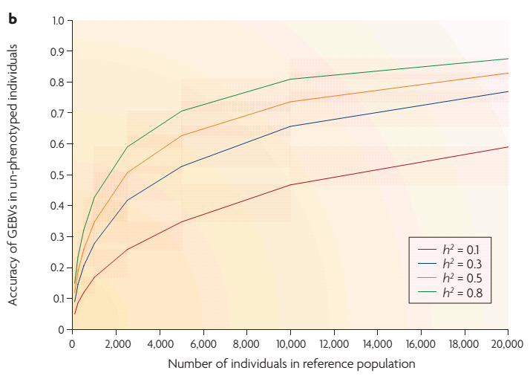
Importance of reference population size
Goddard M.E, Hayes J.E.
Genetics, 2009
Notes:
Which at the time in 2008 consisted of 4000 progeny tested bulls. This graph from Goddard and Hayes represents the typical reliability of GEBV obtained as a function of the size of the reference population. Here consider only the top 2 curves which correspond to values depending on the trait under consideration when progeny tested bulls are used in the refrence population while the two others represent what would be the reliability when genotyped cows with own perfomance are used as reference population. As you can see, the use of progeny tested bulls saves a lot of genotyping for a much higher reliability. Now, seeing that, it is obvious that there is an interest in increasing the reference population size but within country, the number of progeny tested bulls is far from infinite.
4

Slide 5
Tens of thousands of young calves genotyped each year
Organized progeny testing: decreased or abandoned
Market share of semen from young bulls: 40 to 75%
Genomic selection: very fast adoption
Notes:
In Western Europe and North Americ,a the adoption of GS has been extremely quick. It all started say between 2008 and 2010. Today, the RP used in countries like France, The netherlands, The Nordic countries and Germany include more than 25000 PT bulls and several tens of thousands of male and female calves are genotyped every year, to such a pointthat organized progeny testing is now decreasing or has completely disappeared like in France. More remarkably, the proportion of AI performed with young bulls is now reaching up to 75% in some countries

Slide 6
International Genetic Evaluations
National evaluations are not directly comparable
(different traits, different production system and environments, different recording systems, different models of analysis)
For the past 30 years, Interbull has made such comparisons possible (+ has contributed to the international recognition of national evaluations (harmonization, validation))
Notes:
Now let’s turn to our main subject: international genetic evaluations. One important fact is that the results of national evaluations that have been routinely done for decades to evaluate and select bulls are not directly comparable because from one country to another, traits may sligthly differ, same thing for recording system, model of analysis and even more importantly for environment, production system and management. It is a bit like trying to compare price of a particular item from two countries which have different currencies.
This is why Interbull was created. We just celebrated its 30th birthday last week-end but in practice it became really important in the mid-niteties when the first international evaluation started, thanks to a number of key persons, in particular Jan Philippson on the political side and Larry Schaeffer on the scientific side.

Slide 7
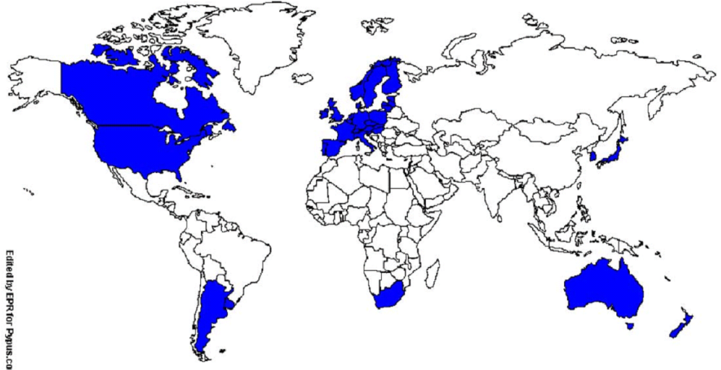
32 member countries
Interbull
6 (groups of) breeds: Holstein, Simmental (including Montbéliarde) Brown Swiss, “Red” Dairy cattle, Jersey, Guernsey.
Traits: Production, Type, Udder Health, Fertility, Longevity, Workability, Calving traits
Notes:
Interbull is an organisation with currently 32 country members indicated in blue here. Its computing center is located at Uppsala in Sweden and it performs international genetic evaluations 3 times a year for 6 breeds or groupd of breedd for all traits of economic importance, production…

Slide 8
Meta-analyses of national results of bulls
International genetic evaluations
MACE = Multiple Across Country Evaluation
EBV bull A
EBV bull B
EBV bull C
EBV bull D
EBV bull B
EBV bull D
EBV bull E
EBV bull F
EBV bull A
EBV bull D
…
EBV bull C
EBV bull H
EBV bull B
EBV bull A
…
EBV bull E
EBV bull J
+ pedigree
MACE
EBV bull C
EBV bull F
EBV bull G
EBV bull H
EBV bull D
EBV bull F
EBV bull I
EBV bull J
EBV bull B
EBV bull F
…
EBV bull E
EBV bull J
EBV bull A
EBV bull B
…
EBV bull H
EBV bull J
Notes:
International genetic values are the product of a meta-analysis of national evaluations of bulls, via a method called by the acronym of MACE, developped by LS. So 3 times a year, ecah particpating country sends to Interbull EBV of all their bulls, MACE is applied combinaing all these sources of information and each country gets back breeding values of all the bulls sent, whatever their country and on their own « scale » , that is on a scale comparable with what was sent.

Slide 9
How much reranking ?
Depends on genetic correlation
between countries
(= a measure of Genotype x Environment interaction)
Country B
Country B
Corr = 0.90
Corr = 0.90
Country A
Within Europe or North America
(for production traits)
Notes:
Because environment differs, bulls rank differently from one country to another and the amount of reranking is a direct function of the genetic correlation between countries (that is, a trait like milk yield is considered as a different trait in say, France and New-Zealand. To illustrate this reranking, I simulated here EBV of the same bulls in two countries assuming a genetic correlation of 0.90 between the two countries. 0.90 is a typical value observed for production traits within European countries or between a European country and a North American country. Red triangles here represents the top 10% of the bulls. You see that even with such a high correlation of 0.90, reranking exists and some good bulls in country A may just be country B and vice versa

Slide 10
How much reranking ?
Country B
Corr = 0.90
Corr = 0.75
Corr = 0.90
Country A
Corr = 0.50
Corr = 0
Notes:
Here you have the same graphs for other values of genetic correlations, 0.75, 0.50 and the extreme case (hopefully never observed) 0

Slide 11
How much reranking ?
Between New Zealand or
Ireland and continental Europe
(or some fertility traits)
Corr = 0.75
Between Kenya and UK
(Ojango et al, 2003)
Corr = 0.50
Notes:
These other values are not unrealistic at al. For example 0.75 is a typical value observed for production traits in complete grazing systems like in NZ and Ireland and continental Europe or North America. It is also observed for fertility traits that are not defined, processed and recorded in the same way in all countries. And values as low as 0.50 have been obtained in even more distinct environmen. For example in this study by Ojango and Pollott in 2003 for production in Holstein in UK and Kenya. Here some good bulls in one country can be really bad in the other.

Slide 12
Farmers /breeding organisations: Consequences
Strongly depends on the country situation
Is it an Interbull member? (access to international ranking on own national scale)
Even more complex with genomic evaluations
Access to a (inter)national reference population ?
Notes:
Now how do farmers, AI technicians or breeding organisations can make use of Interbull information? Well, this strongly depends on the situation of the country in particular whether the country is an Interbull member country or not, that is whether international ranking on your own country scale can be accessed or not.
When it is not the case, some importing countries which are lucky enough to have a neigbour which is itself an Interbull country member, it can take advantage of the situation. Here I took two examples: Croatia and Chile. I am not even sure that they are aware of this but it is an alternative. But for many countries, eg China, Russia or Tunisia, the choice of a proper scale is not obious.
This is the situation for genetic evaluations, for genomic evalutions, it is even more complex because many Interbull member countries do not have genomic evaluations yet.

Slide 13
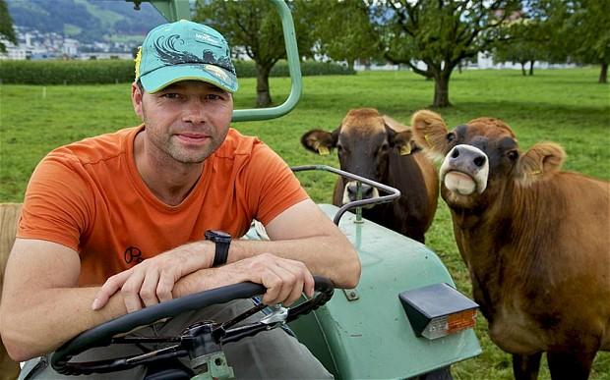
Interbull members
Notes:
Let’s illustrate this, first for genetic evaluations. Take a farmer from an Interbull member country, for example France. To buy the best semen doses for his cows, he has several sources of information. First, national breeding values computed in France. Second, national breeding values computed in other countries but which are not comparable with the national ones. It is like having within country comparisons of price of a particular object, for several countries not using the same currency. But these BV are all sent to Interbull so this farmer also have the EBV of all bulls on the French scale, that is in French currency

Slide 14
Non members
Europe? too many scales !!!
which one to choose ?
?
Notes:
If this same farmer, AI technician or semen salesman is from a non member country, he has in front of him all these lists that are not comparable. But he is clever, he can get the top list of the best bulls worldwide on the scale of any Interbull member country. The problem is then: which scale to choose for his selection decision? Well, we would like him to pick a scale in Europe, but which one? Who knows which one is best. We all believe it is our own and we have good reasons to think it is, including in France, but who understands these reasons. So in practice, the most popular scale is the American one….

Slide 15
US scale
 | Net merit (NM$) (2010)
(Milk)+Fat+Protein | 35
Longevity (PL) | 22
Somatic cells | −10
Fertility (DPR) | 11
Calving diff./ Stillbirth | -5
Type composite
Udder composite | 7
Feet/legs composite | 4
Body size | −6
48
17
Source 1: Net merit as a measure of lifetime profit: 2010 revision J. B. Cole et al., AIPL, ARS-USDA
Notes:
In any country, to choose the best bulls on many traits, EBVs are combined into what we call a total merit index. The american TMI is the Net merit in $ and here you have the respective weights given to the main traits in this Net Merit. The sum of these weights in absolute value is 100. You see that the Net Merit has a weight of about 1/3 on a production trait, 48 % on functional traits and 17% on type traits with a negatie weight on body size. This kind of combination is relatively similar to what we currently have in most European countries.

Slide 16
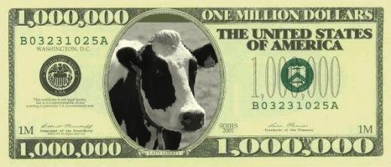
US scaleS
 | Net merit (NM$) (2010) | TPI (2011)
(Milk)+Fat+Protein | 35 | 43
Longevity (PL) | 22 | 10
Somatic cells | −10 | -5
Fertility (DPR) | 11 | 11
Calving diff./ Stillbirth | -5 | -3
Type composite |  | 10
Udder composite | 7 | 12
Feet/legs composite | 4 | 6
Body size | −6
48
29
28
17
Source 1: Net merit as a measure of lifetime profit: 2010 revision J. B. Cole et al., AIPL, ARS-USDA
Source 2: http://www.holsteinusa.com/genetic_evaluations/ss_tpi_formula.html
Notes:
The problem is that... The US also have a second total merit index, the TPI and this is the main scale which is advertised in importing countries. Perhaps because it has more 0’s on the bank note… TPI gives a much lower overall weight to functional trait and a much larger one on type, without penalty for size.
It is typically used by registered breeders that are in interested in shows.

Slide 17
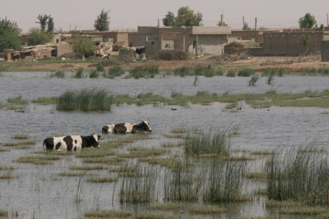
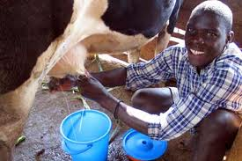
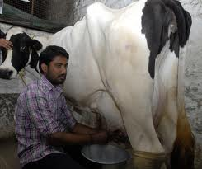
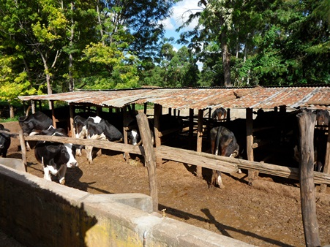
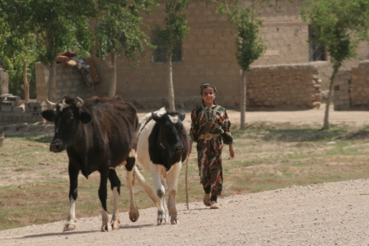
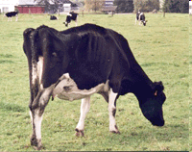
TPI: the worst possible choice for many countries
Very strong emphasis on type: the big “show” cow
Not adapted to suboptimal environments !
Most American farmers don’t use it !
Notes:
Now, I will be perhaps provocative but for me TPI is the worst possible choice for many importing countries, because it’s very strong emphasis on the big, show cows not adapted to their sometimes harsh environment. An indirect proof of this is that even in the US, most farmers in particular commercial framers don’t use it.

Slide 18
Alternatives do exist !
Use Net Merit $ !
Use Interbull results on a more adequate Interbull scale (New-Zealand, Ireland, South Africa, Argentina …)
For low input environments: choose a more sustainable Total Merit Index combining Interbull information
30% Fertility, 30% Health, 20% Longevity, 10% Production, 10% Feet and legs ?
➔ A much larger choice of (cheaper) bulls
➔ genetic level may still be (too) high for production
➔ for exporting countries: larger range of bulls
Notes:
But alternative exist. Net merit is one. Some of the Interbull countries have suboptimal environments and their scale could be better choice than the US or European one. Another strategy which in my opinion, is not enough put forward by Interbull itself is, whatever the scale chosen , to propose to countries with harsh environments TMI where functional traits receive a much much larger attention than production. This would give to importing countries a larger choice of cheaper bulls producting more sustainable cows, and to exporting countries the possibility to sell semen of a larger range of bulls.
Indeed, genetic level for production of just average bulls in western europe may already be too high for countries with harsh environments as in the pictures from the previous slide and
18

Slide 19
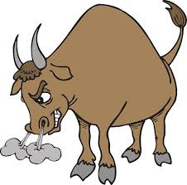
Genomic era: Interbull members
Reference
population
EBV
GENO
Notes:
Now, let’s turn to the situation of genomic breeding values. In France as in quite a few other countries, our French farmer has access to a list of so-called genomically enhanced breeding values. Initially, thee were derived from the French reference population…

Slide 20
Interbull members : the ideal situation
EBV
Notes:
So the increase of RP size must come from combining RP across countries. Here, I describe the ideal situation. Genotyped progeny tested bulls are available n several countries. If both EBV and genotypes are sent to Interbull, Interbull can combine EBV and if they send international breeding values of all bulls to each country on its own scale

Slide 21
: Brown Swiss
Interbull members : the ideal situation
GENO
EBV
Notes:
as well as genotypes from the other countries, each country can develop much more accurate genomic evaluations (see the previous graph). Then if genotypes of young bulls are also exchanged, this farmer will have a top list of the best young bulls in the world as if they were all born in France (please replace France by favorite country here). Well, this is the ideal case and in fact, it does exist: it is the current situation for the Brown Swiss breed, through the Intergenomics consortium gathering 8-9 major countries, with Interbull acting as a central point.
It could be the same for the Simmental or the jersey but for some reasons, they did not follow this path and genomic evaluation is essentially within country.

Slide 22
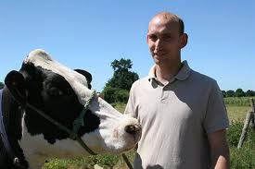
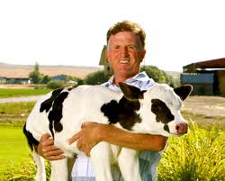
Reference populations
GENO
EBV
Notes:
But very quickly, some countries decided to merge their RP with some others, creating distinct consortia.

Slide 23
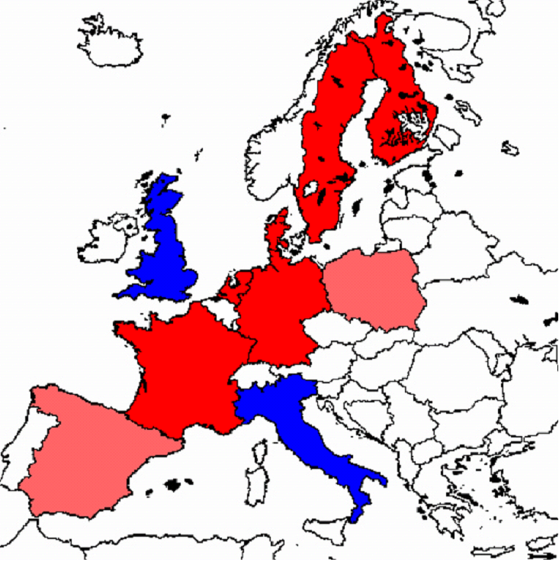
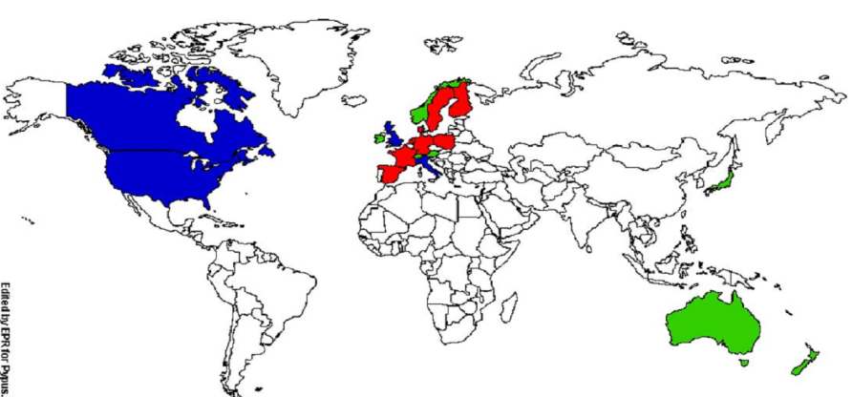
The Holstein situation
favors the largest (groups of) countries able to jointly assemble large reference populations ➔ 2 large consortia
Notes:
This led to the development of two large consortia in red and blue, the green ones being either isolated or with some bilateral exchanges.
The US and Canada created the first one, later joined by UK and Italy. The other one is Eurogenomics, involving France, Germany, the Netherlands and the Nordic countries, later joined by Spain and Poland. Eurogenomics now has a RP of more than 25000 progeny tested bulls.

Slide 24
Issues for countries with genomic evaluations
Each country has its own genomic evaluation with its own particularities and its own scale
Interbull does not have access to (Holstein) genotypes
How to insure fair across country GEBV comparison?
Interbull is developing a GMACE (extension of MACE) but faces technical + political problems
Notes:
In these consortia, each country still has its own genomic evaluation, with its own particularity and statiscal method and scale. So we are back in the pre-Interbull area. These GEBV are not directly comparable.
Now, Interbull does not have access to the genotypes as in Brown Swiss. They developed validation tests to make sure at least that each national genomic evaluation has some good properties but this clearly not enough to ensure fair trade. Interbull is currently developing an extension of MACE, called GMACE to mimic international MACE evaluations on each country scale but it suffesrs both technical and political problems and quite a few countries are currently reluctant to participate to GMACE.
Last but not least, we have shown that the classical genetic evaluations are becoming biased and perhaps severely biased when the only bulls that are allowed to have daughters are the ones strongly selected based on their GEBV.
24

Slide 25
Issues for countries with genomic evaluations
Interbull genetic evaluations are extremely important
Only way to combine reference populations from different countries !
BUT resulting genomic evaluations are better (G x E free) !
Notes:
In fact, this is a rather schizophrenic situation: good international genetic evaluations are essential to get reliable genomic evaluations. But
For any country, nothing is better than genomic evaluations on its own scale to get the best bull rankings, because genotypes are not influenced by the environment: it is like if all the young bulls worldwide were born in your own country.
25

Slide 26
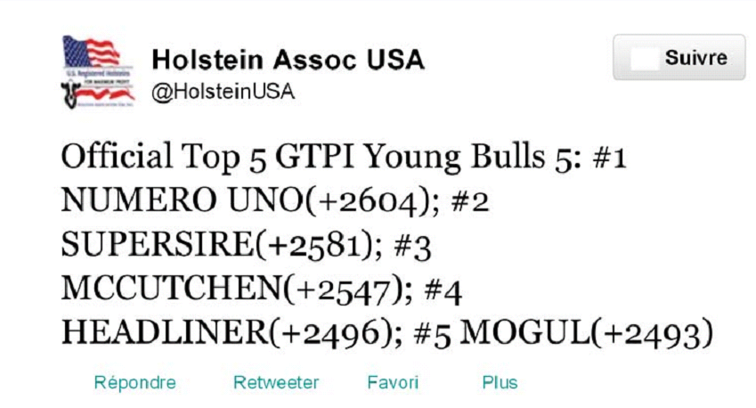
… for countries without genomic evaluations
How to benefit from genomic information ?
How to create a national reference population large enough?
How to join a consortium (and which one?)
How to compare foreign GEBV from different countries ?
Rely on GMACE ? Just starting (trust?)
Not comparable scales ➔ Currently the most popular is GTPI !
e.g., on tweeter:
Notes:
Now for the countries which do not have an own genomic evaluation, it is getting quite tough just to start, mainly because the consortia are already too far ahead and they don’t have much interest to accept new small members. GMACE is a nice perspective to benefit from genomic evaluation but it is not really ready yet. So we are back to the situation where they have in front of them lists of GEBV on scales that are not comparable. So they have to pick one and guess which is one is the most popular…. The GTPI. An illustration of the franzy about GTPI is that even from teewter you can get the most recent GTPI rankings.
26

Slide 27
A longer term, more sustainable alternative
Help (sufficiently large) countries with performance recordings
to join Interbull
and to benefit from existing reference populations
… in order to develop genomic evaluations adapted to the local conditions and to import the best young bulls worldwide for
the local needs
e.g., INRA program GENOSOUTH with South Africa, Brazil and India
Notes:
Now let’s dream a bit. A more sustainable alternative exists for the longer terms at least for sufficiently large countries. They first have
To join Interbull and then to establish collaborations with Interbull members to get access to genotypes from existing reference populations. Then they can develop their proper genomi evaluation in their own scale, that is they would have all what they need to know what are the best young bulls in their own environments and conditions.
INRA started last year a small program that we called GENOSOUTH to put this in practice and help countries like SA,Brazil and the longer term perhaps India to go this way.

Slide 28
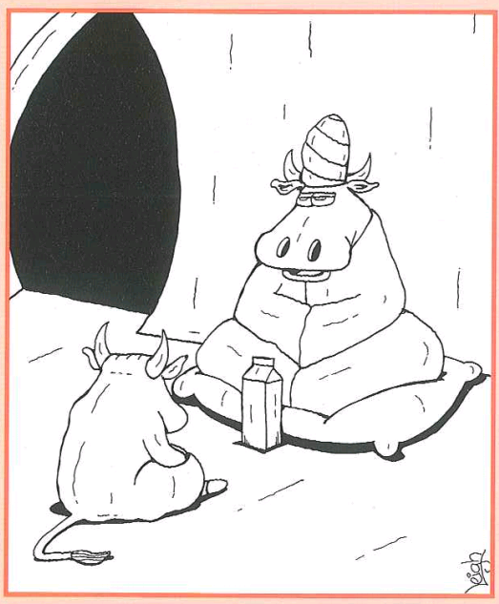
Key messages
Genomic selection is characterized
both by intense international collaboration
and strong economic competition,
in particular in Holstein
Even for large exporting countries, collaborations are still needed
use of sequence data: 1000 genome projects
phenotyping of new traits (feed efficiency, methane emission)
The gap between leading countries and the others is widening fast, to such an extent that « collaborative spirit » is declining
Notes:
Now comes the time of some conclusions. .. read

Slide 29
Key messages
Fair across-country comparisons are (and will
remain) a necessity
Interbull plays (and will play) a central role
For importing countries without own genetic/genomic evaluation: a proper choice of scale is essential and the (G)TPI is certainly NOT the most sustainable one
For (large) importing countries, becoming an Interbull member and developing an own genomic evaluation is strategic
A unique (€) scale for genetic evaluations would make Europe stronger on the international market

Slide 30
Ackowledgments
D. Boichard
P. Croiseau
C. Patry
S. Fritz
C. Hoze
X. David
S. Mattalia
S. Minéry
J. Promp
L. Journaux
LABOGENA
Thank you
Notes:
30

Slide 31
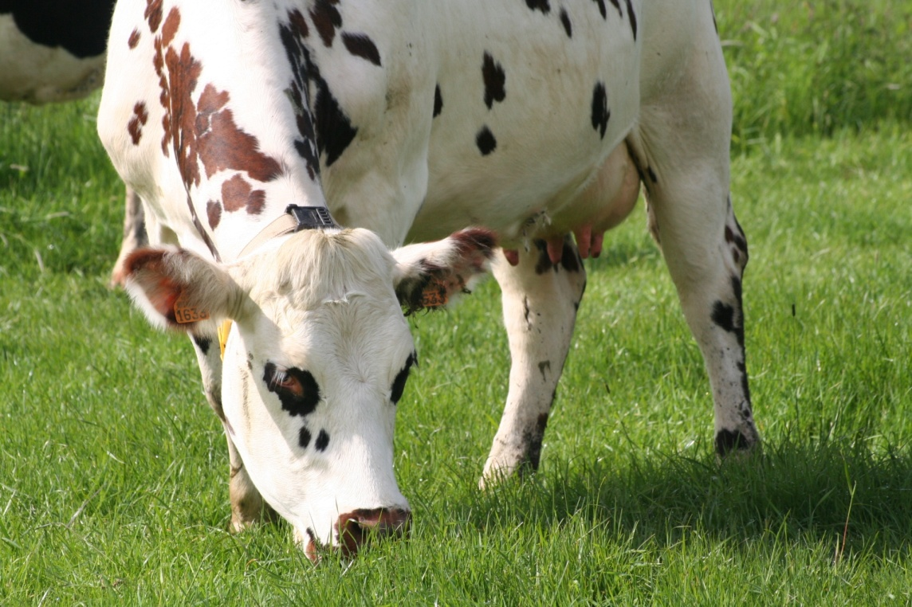
International issues
in dairy cattle
genetics
Vincent Ducrocq
Jouy-en-Josas, France

