Slide 1
Determinants of demand for forest recreation: Forest and population characteristics
Jens Abildtrup, INRA, UMR356 LEF, F-54000 Nancy, France
Serge Garcia INRA, UMR356 LEF, F-54000 Nancy, France
Soren Bøye Olsen, Copenhagen University, 1958 Frederiksberg C, Denmark
Anne Stenger INRA, UMR356 LEF, F-54000 Nancy, France
LEF workshop May 31 – June 1, 2012, Nancy
Notes:
1

Slide 2
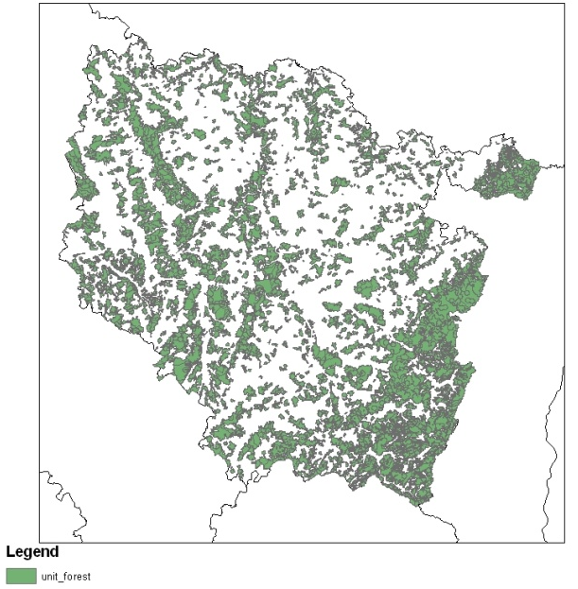
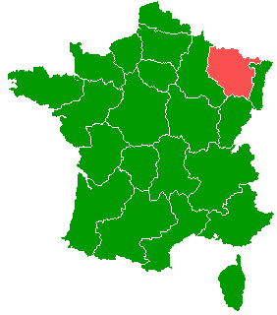
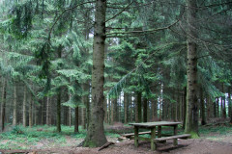
Background
Lorraine:
37 % forest (F 25%)
Short travel distance ( 13 km)
High frequency use of forests (26 visits per year)
Notes:
First some few words about forest recreation in Lorraine where we carry out our analysis.
Lorraine has a relative high share of forest land use 37 % compared to about 25 % in France on national level
This means that people in Lorraine have a short distance to visit a forest. The most visited forest during is in avarage only 13 km from home
And they visit the forest often. The sample in our survey visited in average 26 times per year.
Also compared to other recreational sites – forests are visited most often
One more word that will show important later. About half of the forest is privately owned. You can put a sign at the entrance to say that you dont want visitors – but few does that – an most visitors dont know who is the owner private of commune or state

Slide 3
Overall objectives and approach
Estimate the determinants of demand for forest recreation
Forest characteristics
Accounting for substitution and complementary sites – spatial explicit
Socio-demographic characteristics of population
Overall approach
Travel cost method based on revealed and stated travel behaviour
Data enrichment
Reduce problems of multicollinarity and forest attribute endogeneity
Notes:
3
The overall objective develop a framework that enables to evaluate the welfare economics effect of changing access to or quality of a forest in a given spatial context taking into account substitution sites at the given site and the local population.
I will in a minute describe our approach more in detail: but first some overall words.
Our study is not the first studying recrational use of forest in France but we have the first study addressing the attributes or characterics of the forests.
In the present study we want also to see forest in a context being spatial explicit. That is we want to derive a model where we consider local substitutes and complementary sites. Therefore being able to estimate the value of improving the quality of the forest a given specific location in Lorraine. And we want also to address the characteristics of the population – of course – where are they living with respect to the forest but also to investigate whether wtp varies with socio-demographic characteristics.
Overall our approach is standard. We use the travel cost method – using both stated and revealed preference data.
We combine the revealed preference data with stated data – it is from a choice experiment – to have more information from each individual. But also to reduce potential problems with multicollinarity – that forest in a neighbour may be relative similar and – as we will see later – there may be a problem of endogeity of forest attributes. We will see later, that as pointed out yesterday we may find parking places where the forest managers know that people – for other reasons – go.

Slide 4
Methodological issues
Large choice sets: >5000 forest units in Lorraine, ~ 125 different forests within 20 minutes by car
Site selection model (Random utility model) and trip demand model (“linked model), Bockstael et al. 1988, Hausman et al. 1995 JPE
Sampling in choice set, Feather et al. 1994 AJAE, Nerella and Bhat 2004 Trans. Res. B
Identification of visited forests: Use of Google map
Comparison of revealed and stated preferences
=>Error component mixed logit: Bhat et Castelar 2002 Trans. Res. B, Hensher 2008, Res in Transp. Econ;
>30% walk or go by bicycle to forest => implications for travel costs
model transport mode choice explicitly, Bell and Strand 2003 Land Econ.
Notes:
4
The nature of our data raises some methodological issues we have to cope with. These also represent the paricularity of our study and the contribution to the forest recreation literature. These will be focus of the presentation while the focus will be less on the numbers – the results are not definitive so – they may also be revised later.
First, there are many forest in Lorraine – more than 5000 forests – I will define later how we define forests.
More than 100 forests can be reached withing 20 minutes by car.
To idenfity the value of forest attributes we want to model the selection of recreation site. However, modelling this using demand systems, for example corner solution models, that are often suggested as the theoretical most attractive models are not really tractable in our case. Therefore we use the RUM to model the choice of forest site on given choice occation and then model the number of visits in a second stage usign a partication or trip model. This is the socalled linked model approach which have been widely used in different forms in the literature.
To make our analysis computable tractable we do however, use sampling in choice set. That is, we use only some of the alternatives that an individual could have visited – as an alternatives in the random utility model. Mcfadden has shown that this give the same results when we standard assumption in conditional logit models are meet – the assumption of independence of irrelevant alternatives. However, as our previous studies have shown, this condition may not be met and therefore we use the mixed logit approach to relaxe the assumptions of the condition logit. So you may say that there is now a contradiction. We use Mixed logit to avoid the assumption of independence of irrelevant alternatives and at the same time we sample in choice set which require this assumption to be met. However, imperical evidence has shown that if we do not reduce the choice set too much by sampling it may not be big problem. We rely on this
With the large number of forest in the choice set we also have a problem in identifying which forest has actually been visited. As we will see we solve this by letting the repondents identifying the visited forest on a map
Furthermore, by using two different dataset we have to evaluate if we can combine the two data set. Normally, a nested logit formulation have been used to account for different variances in the unobservables in the two dataset. However, we will apply a error component mixed logit specification.
Finally, almost alll studies consider only forest visited by car. However in our case about 30% walk or bike. We try to model the choice of transport mode explicitly in data letting it depend on the forests in a given location

Slide 5
Outline
Methodology applied
Survey and data
Results
Discussion and perspectives
Notes:
Next three slides will show in more detail our model applied
Then I will talk a little about our survey and, I think, rather innovative way of implementing the survey
Then some results

Slide 6
Methodology: The linked model (overview)
The linked model: e.g. Bockstael et al. 1987, Hausman et al. 1995 JPE
Stage 1: Site selection model – Random Utility Model (RUM)
Stage 2: Trip demand model – negative binominal model
The link between the two stages: Expected utility or consumer surplus of one trip
Notes:
As mentioned before we apply the linked model. In the first stage me model site selection using the Rum
In the second stage we model the demand for visits – here during one year.
We use standard approach here the negative binominal model –
The link between the two models is the expected maximum utility of visiting a forest at a given choice occation – this can be calculated for given location using the RUM.

Slide 7
Methodology: Site selection
Combining RP and SP data. Utility by individual n visiting forest j in choice situation t
SP
RP
Notes:
In fact we will consider two different site selection models. 1 where we focus on combining the two dataset – stated and revealed preference data and 2. we focus on integrating transport mode - We have estimated them seperately here – future work has to integrate these two models.
This model may seem complicated. I hope I can give you the intuition:
In the Rum we assume that the respondent visit the forest giving the highest utility. Here I have written the utility of visiting the different forests. Which consist of observed utility by the research and some utility not obseved by the researcher.
We analyse 7 choices by each individual. First the choice of most visited forest between the alternative forest available in the neighbourhood of an individual. And then 6 hypothetical choices – in a choice experiment where they chose between the most visited forest duing the last 12 months and two hypothetical forest that we present for them. They do this 6 times – each time we change the characterictics of the hypothetical forests.
Consider the last of the three lines in the equation above. This are the utility for visiting the forest in the respondents choice set. The utility depend on x which is the characterics of the site – are there a parking place etc. It is multiplied with a parameter which is considered respondent specific to account for preference heterogeneity. This could be random or modelled as a function of the characteristics of the individual.
Then we have p which is the price of visiting the forest – here approximated by the distance. The distance depend both on the location of respondent and the forest considered.
And then we have a error term that we will assume to be extreme value distribution.
The first two lines represent the utility for the forests in the hypothetical choice situation. In the both equations we have added an error component my that is restricted to 0 to account for differences in the variance of the error term in between the two dataset. Furthermore, we include a constant term in the status quo forest, that is the forest visited. This account for that when we have considered the attributes of the forest where may still be an additional utility of visitin the forest they have visited most often during the last year.

Slide 8
Methodology: Site and transport mode selection
The utility function for individual n for visiting forest j with transport mode m
Notes:
Here we integrate the transport mode choice in the site selection model. The intuition here is that we write utility functions assuming car and walking for visiting a forest. We include a constant in the car utility functions and a error component. That is we assume that there is some utility or disutility of going by car that is not associated by costs – direct cost like gasoline and alternative time costs. We include also an error component term to account for different substitution behaviour between forest when walking or taking the car.

Slide 9
Methodology: The linked model
Assuming ε_{nk} is i.i.d. extreme value the expected maximum utility of one trip to a forest (the link):
Assuming random parameters the expected value should be simulated using estimated parameter distributions:
Notes:
The intuition

Slide 10
Methodology: The linked model II
Trip demand model: negative binominal model
Where the probability of t_{n} visits in forest during 12 months is
Where
Notes:
Not go into detail with the modelling approach – it is standard.
We take into the number of trips is non-negative integer
Compared to traditional poisson model we apply the more flexible negative binominal model
The model is estimated with two main types of variables.
Individual characteristics and the characteristics of the location.
Estimated by negative my maximum likelihood

Slide 11
Data: The survey
Web-based questionnaire send to random sample in Lorraine 2010:
Previous use of forests for recreation
Choice experiment on hypothetical use of forests
Characteristics of the respondent
Location identified by municipality (commune Small administrative unit)
Notes:
The survey is web based on a random sample of population in Lorriane
We ask
Location is commune average size of commune is 10 square km

Slide 12
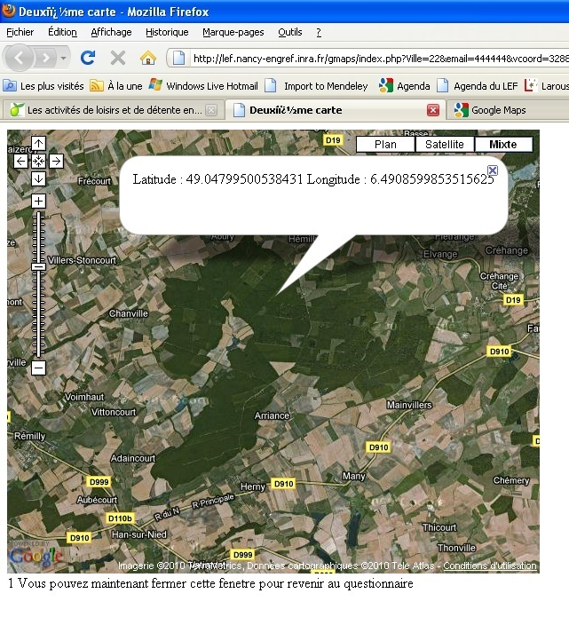
The survey
Where is the forest located where
you have gone most often during the
last 12 months ?
Click on the the forest on the map
Self-reporting:
I have found the forest | 88.9%
I didn’t find the forest because it was to difficult | 6.5%
I have not found the forest because it was the map was not appropriate for locating the forest | 4.6%
Notes:
After been indstructed in using the google map people are asked to click on the forest visited
Centre on postcode

Slide 13
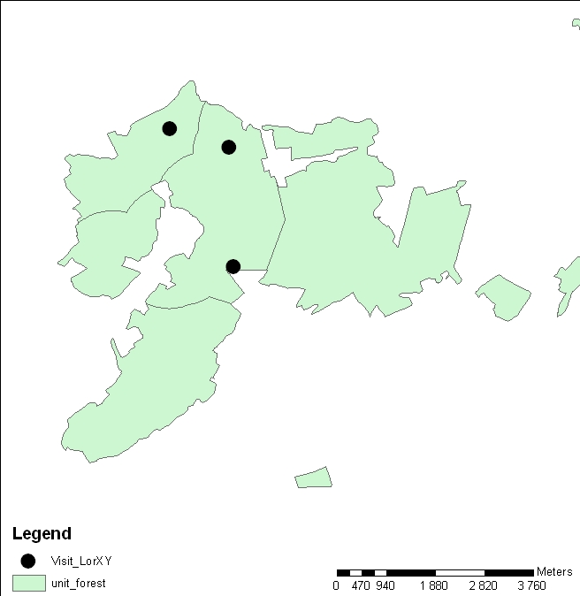
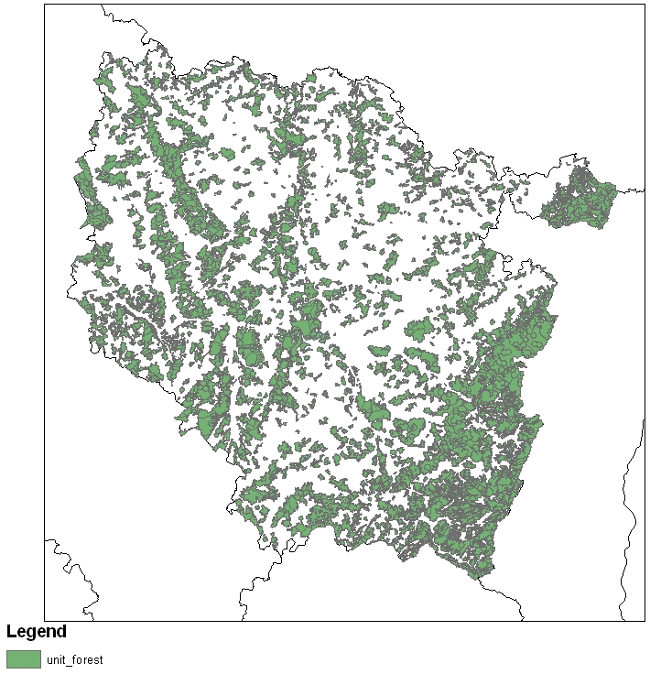
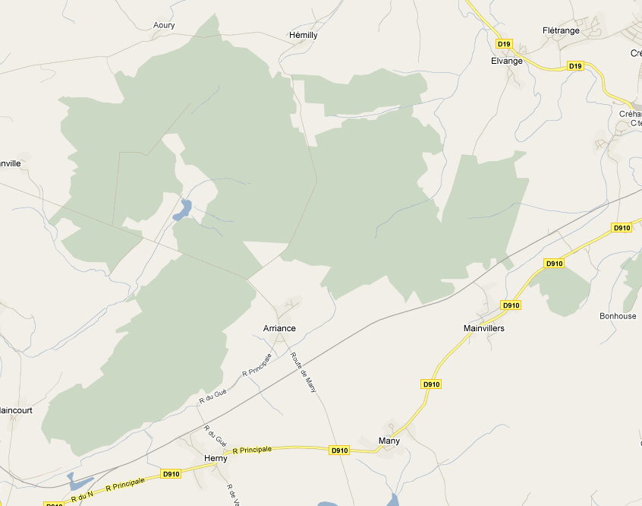
The survey
Defining a forest relevant recreation?
Forests in Lorraine
Google
Map
Where the
forest are
located
Notes:
Less than 10 ha
More than 500 ha, divide the forest.
Roads where used.
If there we know from the map that there is a certain entrance to the forest a circle is made around the forest

Slide 14
Choice set example
Choose the forest you would have gone to if the two alternative forest existed
when you went to the forest the last year
Characteristics of the forests | The forest you visited most often the last year | Alternative 1 | Alternative 2
Dominant tree species | Mixed tree species | Mixed tree species | Conifers
Trekking paths | One path | No paths | More paths
Recreational facilities | Parking | No | Parking and picnic
Access to wetland | No water | Lake or river | No water
Distance from your home | 13 km | 5 km | 20 km
I prefer …(tick one): | ❑ | ❑ | ❑
Notes:
Here is an example of choice situation in the choice experiment. The three colonns is the the three forest they have to choose between.
The first is the forest visited most often and the other two is hypothetical forest we ask them to imagine. The forest are considered equal with exception of the 5 attributes we use here to describe the forests. We use dominant tree species, precences of trekking paths and recreation facilities, picnic and parkings, presence of lake or rivers and finally the distance ot the forest. The characterics of the forest visited is given by the repondent before the choice experiment using this

Slide 15
Attributes
 | Describe the forest you have visited most often the last 12 months
Tree species |  |  |  |  | Cochez une possibilité
 | Broadleaves |  |  |  |  |  | q
 | Conifers |  |  |  |  |  | q
 | Mixed species |  |  |  |  |  | q
Trekking paths |  |  |  | Cochez une possibilité
 | No trekking paths |  |  |  |  |  | q
 | One trekking path |  |  |  |  |  | q
 | More than one trekking path |  |  |  |  |  | q
Facilities |  |  |  |  | Cochez une possibilité
 | none |  |  |  |  |  | q
 | Parking |  |  |  |  |  | q
 | Picnic |  |  |  |  |  | q
 | Parking and picnic |  |  |  |  |  | q
Water |  |  |  |  | Cochez une possibilité
 | no |  |  |  |  |  | q
 | Lake or river |  |  |  |  |  | q
Distance between residence and forest |  |  |  |  |  | _______km
Notes:
You also ask to their subjective description of the forest based on the attribute we use in our choice experiment

Slide 16
Data: Sample representativeness
818 usable responses
(526 had visited forest and had identified visited forest)
2% response rate (as expected from this internet panel)
Overweight of
Males
Elderly males
Middle-aged females
High income
Notes:
From Lorraine we had 818 completed questionnaires
However only 526 individuals had been in forest and had also identified forest on map

Slide 17
Results – common SP and RP parameters
 |  |  | Random parameters SP and RP data |  |  | Derived standard deviations of parameter distributions
Variable |  |  | Coefficient |  | P[|Z|>z] | Coefficient |  |  | P[|Z|>z]
Broadleaves |  |  | 0.79 | *** | 0.000 | 0.49 |  | *** | 0.002
Mixed species |  |  | 0.90 | *** | 0.000 | 0.86 |  | *** | 0.000
One trekking path |  |  | 0.55 | *** | 0.000 | 0.40 |  | *** | 0.009
More than one trekking road |  |  | 0.72 | *** | 0.000 | 0.89 |  | *** | 0.000
Parking or picnic |  |  | 0.21 | ** | 0.016 | 0.57 |  | *** | 0.001
Parking and picnic |  |  | 0.15 |  | 0.113 | 0.85 |  | *** | 0.000
Lake and/or river |  |  | 0.63 | *** | 0.000 | 0.47 |  | *** | 0.000
Distance (km) |  |  | -0.13 | *** | 0.000 | 0.13 |  | *** | 0.000
Private forest |  |  | -0.45 | *** | 0.012 | 0.01 |  |  | 0.979
Private and public forest |  |  | -0.21 |  | 0.110 | 0.17 |  |  | 0.415
Standard dev. of altitude |  |  | 0.00 |  | 0.976 | 0.00 |  |  | 0.888
Log(area) |  |  | 0.66 | *** | 0.000 | 0.00 |  |  | 0.974
Probability of finding blueberries |  |  | 0.47 |  | 0.597 | 0.35 |  |  | 0.791
ASC1 (Status quo alternative) |  |  | 0.39 | *** | 0.000 | 0.91 |  | *** | 0.000
ASC2 |  |  | 0.00 |  |  | 2.0 |  | *** | 0.000
McFadden Pseudo R-squared |  |  |  |  | 0.72
 | N=526 | Number of choices =526*7=3682
RP & SP
RP
*: p<0.1, **: p<0.05, ***: p<0.01
Notes:
The first results is where I combine the revealed and stated data set. I have assumed that the parameters in utility function are the same in the utility functions for visiting hypothetical forest and real observed forests. However, I allow for different scale factors between the two dataset.
The first 8 parameters concerns the coffecient on attributes both observed in stated and revealed preferences while the next five is concerning only the revealed preference data.
We also see that most of the paraters have significant standard deviation. That is significant preference heterogeneity with respect to attributes considered in the choice experiment.
We have used normal distributed parameter except for distance which is assumed to the triangular distributed and respected to negative values.
The first results I show is a model where I combine the two data set and assume that the parameters values are the same. Note that in the revealed dataset I include also attributes that is not used in the choice experiment.
Husk calculate MWTP for real comparisons
Husk LR test
And scale variance

Slide 18
Results: SP and RP
Variable |  | Coefficient |  |  | P[|Z|>z] |  | Coefficient |  |  | P[|Z|>z]
 |  |  | SP data |  |  |  | RP data
Broadleaves |  |  | 0.78 | *** |  | 0.0000 | 0.45 |  | 0.3366
Mixed species |  |  | 1.01 | *** |  | 0.0000 | 0.60 |  | 0.1421
One trekking path |  |  | 0.39 | *** |  | 0.0000 | 0.53 | *** | 0.0038
More than one trekking road |  |  | 0.61 | *** |  | 0.0000 | 0.33 |  | 0.1774
Parking or picnic |  |  | 0.11 |  |  | 0.1831 | 0.68 | *** | 0.0099
Parking and picnic |  |  | 0.077 |  |  | 0.3806 | 0.78 | *** | 0.0069
Lake and/or river |  |  | 0.64 | *** |  | 0.0000 | 0.38 | ** | 0.0348
Distance (km) |  |  | -0.044 | *** |  | 0.0000 | -0.38 | *** | 0.0000
Private forest |  |  |  |  |  |  | -0.59 | ** | 0.0189
Private and public forest |  |  |  |  |  |  | -0.27 |  | 0.1450
Standard dev. of altitude |  |  |  |  |  |  | -0.0087 |  | 0.1204
Log(area) |  |  |  |  |  |  | 0.82 | *** | 0.0000
Probability of finding blueberries |  |  |  |  |  |  | 1.71 |  | 0.2144
ASC1 (Status quo alternative) |  |  | 0.458 | *** |  | 0.000
ASC2 |  |  | 0 | -
*: p<0.1, **: p<0.05, ***: p<0.01
Notes:
Here I present a model where i allow the mean value of the cofficients to vary between data sets. First two colomns are related to the stated preference while the third and fourth are concerning

Slide 19
Comparison of marginal WTP (Unit=km)
Variable |  | Dataset-specific parameters |  | Common parameters
 |  | WTP SP data | WTP RP data | WTP RP & SP data
Broadleaves |  | 19.47 | 1.24 | 7.79
Mixed species |  | 24.22 | 1.8 | 8.65
One trekking path |  | 9.81 | 1.71 | 6.18
More than one trekking road |  | 15.33 | 1.11 | 6.99
Parking or picnic |  | 2.68 | 2.32 | 1.95
Parking and picnic |  | 2.80 | 2.6 | 1.68
Lake and/or river |  | 14.80 | 1.26 | 6.24
Distance (km) |  | - | - | -
Private forest |  |  | -1.93 | -4.43
Private and public forest |  |  | -0.77 | -2.23
Standard dev. of altitude |  |  | -0.03 | 0.00
Log(area) |  |  | 2.60 | 6.78
Probability of finding blueberries |  |  | 2.97 | 6.35
ASC1 (Status quo alternative) |  | 1.50 |  | 5.49
ASC2
RP & SP
RP
NB: Bold numbers: where marginal utility is significant – significance of the marginal WTP has not been tested explicitly
Notes:
To compare the size of the parameter values we have to normalize them with the marginal utility of income here measured in distance km. We have not converted the distance into costs. This was basically because in the choice experiment we did not ask about how they will go to the forest and the cost will depend on this choice.
In bold are marginal wtp based on significant parameters – This is not necessarily the same as saying that the wtp are significant but this is still needed to be done. The estimates are here based on the simulation of the individual specific marginal willingness to pay
We see that there are large differences in MWTP between dataset…

Slide 20
Results: RP data, Transport mode choice
Variable |  | Coefficient |  | P[|Z|>z]
Broadleaves |  | 0.29 |  | 0.573
Mixed species |  | 0.42 |  | 0.389
One trekking path |  | 0.71 | *** | 0.094
More than one trekking road |  | 0.077 |  | 0.771
Trekker*one trekking path |  | 2.1 | *** | 0.003
Trekker*more trekking paths |  | 0.83 |  | 0.454
Parking |  | 0.92 | *** | 0.001
Lake and/or river |  | 0.038 |  | 0.839
Travel cost car (car cost and time cost) |  | -0.47 | *** | 0.000
Travel cost walking (alternative time cost) |  | -0.10 | *** | 0.000
Private forest |  | -0.87 | *** | 0.003
Private and public forest |  | -0.48 | ** | 0.015
Standard dev. of altitude |  | -0.001 |  | 0.934
Log(area) |  | 0.80 | *** | 0.000
Number of attractions |  | 0.026 |  | 0.542
ASC for car mode |  | -3.0 | *** | 0.000
McFadden Pseudo R-squared | 0.56
N=526 Number of choices=526
Notes:
Now I show the results of the integrated forest site and transport mode choice model. It is only based on the rp data.
I assume common forest attribute parameter values. Only the cost of transport I let be choice transport mode dependent. Here costs are measured in Euros.
The other attributes are more or less the same besides I have not included picnic places. I had some estimation problems when I had this in

Slide 21
Trip model – number of visits in forest
Variable | Coefficient |  | P[|Z|>z]
Constant | 1.63 | *** | 0.007
Inclusive value | 0.09 | *** | 0.009
Population density | -0.019 |  | 0.361
Share of urban green space in the town | -0.29 |  | 0.893
Income | -0.034 | ** | 0.048
Female | -0.48 | *** | 0.000
Hunter | 0.86 | *** | 0.000
Forest owner | 0.45 | *** | 0.001
Higher education | 0.14 |  | 0.189
Lives in an apartment | -0.21 | *** | 0.052
Often buying organic products | 0.20 | *** | 0.000
Member of a trekking club | 0.55 | *** | 0.001
Lives with a partner | -0.24 | ** | 0.013
Alpha (over dispersion) | 1.40 | *** | 0.000
N | 818

Slide 22
Trip model – number of visits in urban parks
Variable | Coefficient |  | P[|Z|>z]
Constant | 0.24 |  | 0.814
Inclusive value | -0.048 |  | 0.450
Income | 0.13 | ** | 0.000
Female | 0.075 |  | 0.609
Hunter | -0.10 |  | 0.786
Forest owner | -0.85 | *** | 0.006
Higher education | 0.024 |  | 0.861
Lives in an apartment | 0.52 | *** | 0.000
Often buying organic products | 0.11 | *** | 0.054
Member of a trekking club | 0.39 |  | 0.239
Lives with a partner | 0.24 |  | 0.154
Population density | 0.27 | *** | 0.000
Share of urban green space in the town | 0.57 |  | 0.828
Alpha (over dispersion) | 3.1 | *** | 0.000
N | 818
Notes:
This is the model I have used to calculate the inclusive value that i Have used in th rip model

Slide 23
Trip model – number of visits in urban parks
Variable | Coefficient |  | P[|Z|>z]
Constant | -0.25 |  | 0.455
Share of forest in municipality | -0.82 | ** | 0.024
Income | 0.12 | *** | 0.000
Female | 0.11 |  | 0.480
Hunter | -0.076 |  | 0.820
Forest owner | -0.80 | ** | 0.012
Higher education | 0.083 |  | 0.572
Lives in an apartment | 0.56 | *** | 0.000
Often buying organic products | 0.12 | ** | 0.033
Member of a trekking club | 0.43 |  | 0.159
Lives with a partner | 0.27 |  | 0.103
Population density | 0.22 | *** | 0.000
Share of urban green space in the town | 0.14 |  | 0.955
Alpha (over dispersion) | 3.1 | *** | 0.000
N | 818
Notes:
B

Slide 24
Discussion and perspectives
People (our sample) can identify a visited forest on a (Google) map
Results based on stated and revealed preferences data differ in our case
What data to use for policy analysis?
Possible to cope with transport mode choice explicitly in a RPL model
Notes:
With respect to the survey: we conclude that using map is a possible way to identity a forest
In our case – there are differences based on what dataset to use – this raised some important issues on what data to use for the policy analysis
We show how choice of transport mode can be modelled explicitly in a Random paramter logit model

