Slide 1
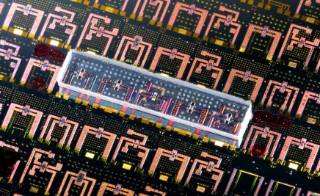
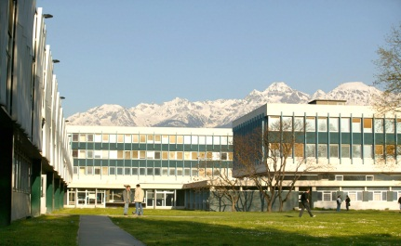
Advanced approach to local magnetic field computation in magnetocaloric materials characterization
PhD student M. ALMANZA, Post-doc A. RAMINOSA, director A. Lebouc, S. Miraglia
UMR CNRS 5269 - Grenoble-INP – Université Joseph Fourier
Notes:
The necessity for numerical simulation of magnetic cooling system to have intrinsec property of materials, lead us to this studies.
The aim is to obtain the magnetic curve B(H) through an extraction magnetometer with an error estimation.
And because it’s a intrinsic property the result must be independant of the shape.

Slide 2
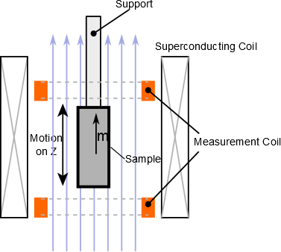
Quick reminder of Extraction Magnetometer
Ι . Intro
Measure of magnetic moment project on Z
Homogeneous material
$$𝓂_{z}(H_{0})=\int_{V_{sample}}{\vec{M}\left(H\right).\vec{z} dV }$$
$$[A.m^{2}]$$
$$[A/m]$$
isotropy on the material
symetries on the sample
$$𝓂_{z}\left(H_{0}\right) \vec{z}=\int_{V_{sample}}{\vec{M}\left(H\right) dV }$$
$$\vec{z}$$
And
$${M\left(H\right) ≠ 𝓂}_{z}(H)/V$$
because heterogeneity of H and $H≠H_{0}$
Notes:
Just a quick reminder of extraction magnetometer
But it is not a system inversible because of the scalar product
With hypothesis of … we can expect to have an inversible system
But we can not

Slide 3
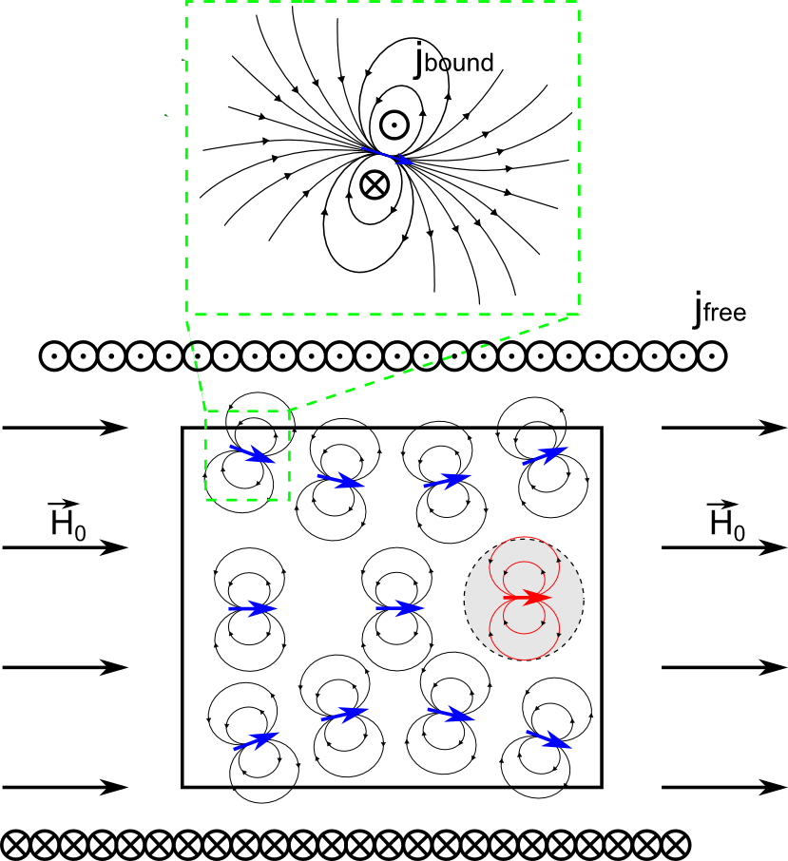
Applied Field & Internal Field
Ι . Intro
Difference between applied field $H_{0}$ and the internal field $H$
The gray volume feels :
the applied field $H_{0}$
The field induce by the magnetization of its neighbours $H_{d}$
$$H=H_{0}+H_{d}$$
Notes:
Therefore

Slide 4
Applied Field & Internal Field
Ι . Intro
Difference between applied field $H_{0}$ and the internal Field $H$
Helmholtz decomposition
$$H=H_{0}+H_{d}$$
Demagnetizing field respect
$$div\left(μ_{0}H_{d}\left(M\right)+M\right)=0$$
$$rot H_{d}\left(M\right)=0$$
$$H_{d}\left(M\right)→0 in ∞$$
We define $H_{d}=−gradφ_{d}$
$$φ_{d}\left(M\right)\left(x\right)=$$
$$−\frac{1}{4π}\int_{Ω}{\frac{divM\left(y\right)}{\left|x−y\right|}dy+\frac{1}{4π}\int_{∂Ω}{\frac{M\left(y\right).n\left(y\right)}{\left|x−y\right|}}}dy$$
Notes:
- Magnetic scalar potential
- In this part we show inhomogenity induce by the demag. Field and the demag. Field are not easy to compute in order to get the magnetic property of the measured sample because we have multiple interaction in the sample

Slide 5
Advanced approach in magnetocaloric materials characterization
Introduction of the demagnetizing field and the heterogeneity
Demagnetizing Factor
Formulation as an inverse Problem
Demagnetizing Factor as an inverse problem
Perspectives
Notes:
In some case the cope with the effect of demagnetizing field by using the notion of demag. factor

Slide 6
Demagnetizing Factor
I. Intro > II. Demag. Factor
In elliptical shape
The magnetic field is constant inside the body
The demagnetizing field can be write as $H_{d}=−NM w$ith N only function of the geometry
But experimentaly it is difficult to have elliptical shape
$$𝓂_{z}(H_{0})=\int_{V_{sample}}{M\left(H\right) dV }$$
$$M\left(H\right) =𝓂_{z}(H_{0})/V$$
$$H=H_{0}+H_{d}$$
$${H=H}_{0}−N𝓂_{z}(H_{0})/V$$
$${H=f(H}_{0})$$
$$M\left(H\right) =𝓂_{z}(f^{−1}(H))/V$$
Notes:
Voir si il y a des cas plus générales

Slide 7
Generalization of the demagnetizing Factor
I. Intro > II. Demag. Factor
In general shape
1st The field is not constant inside the body
2nd extention of the notion of demagnetizing field define as:
3rd approximation
Approximations are difficult to validate
$$𝓂_{z}(H_{0})=\int_{V_{sample}}{M\left(H\right) dV }$$
$$<M\left(H\right)> =𝓂_{z}(H_{0})/V$$
$$\int_{V}{H_{d}dv=−N_{m}\int_{V}{Mdv}}$$
$${<H>=H}_{0}−N_{m}<M\left(H\right)>$$
$${<H>\sim H}_{0}−N_{m}M\left(<H>\right)$$
$${<H> \sim f(H}_{0})$$
With N function of the geometry and $M(H)$
$M\left(H\right) \sim$<$M\left(H\right)>=𝓂_{z}(f^{−1}(<H>))/V$
Notes:
In this case we have many approximation that are very hard to justify to explain

Slide 8
Test of the method
I. Intro > II. Demag. Factor
Test the method based on numerical simulation
Numerical setup
Cylinder shape with radius 20 and $high/2$ = [5, 10, …,55]
Generalized demagnetizing factor interpolated from D.X Chen table* But it is difficult to choose with non linear material
Magnetization curve give by arctan. model with $J_{s}=1.3 T$ and $μ_{r}=10$
Magnetometer simulation
Analyse the Homogeneity of the field
Magnetization $M\left(H\right)$ ~ Gd
Simulation FEM
Compute $\vec{𝓶}$
1st strategy : use of generalized demagnetizing factor
Estimation $$M\left(H\right)$$
Comparaison
*D.-X. Chen, J. A. Brug, et R. B. Goldfarb, « Demagnetizing factors for cylinders », IEEE Transactions on Magnetics, vol. 27, nº 4, p. 3601 ‑3619, juill. 1991.

Slide 9
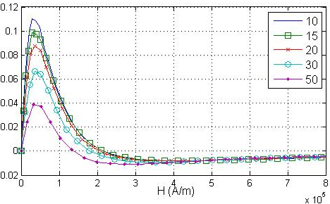
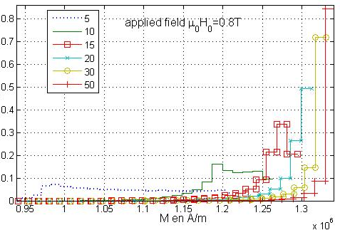
Result of the simulation
I. Intro > II. Demag. Factor
Error of the method
Homogeneity of the field
Error between $M(H)$ and his estimation
Normalized error
Magnetization volumic density normalized
A long sample improve the efficiency of the method
Because the demagnetizing field decrease
Notes:
Even though
Bend part of the curve

Slide 10
Advanced approach in magnetocaloric materials characterization
Introduction of the demagnetizing field and the heterogeneity
Demagnetizing Factor
Formulation as an inverse Problem
Demagnetizing Factor as an inverse problem
Perpectives

Slide 11
Inverse problem
I. Intro > II. Demag. Factor > III. Inv. formulation
Scheme of the inverse problem and method of resolution
How to parametrize the magnetic curve « an unknown curve »
With the previous test of the method we obtained anl error equal to zero with 3 parameters models because the magnetization is defined with the same model
Magnetometer experiment
Magnetization $M^{n}\left(H\right)$ ~ Gd
Simulation FEM
Mesure $\vec{𝓶}$
Evolution of parameters (of the magnetic curve)
Simulation for inverse problem resolution
Error
$$M^{n+1}\left(H\right)$$
Field distribution
Magnetization $M\left(H\right)$ ~ Gd
Extraction
Compute $\vec{𝓶}$
Iterative loop

Slide 12
How to parametrize the magnetic curve for the inverse problem
I. Intro > II. Demag. Factor > III. Inv. formulation
Degree of freedom
Generalized demagnetizing factor
Parametric function
Model with 3 parameters ${(l+μ}_{0})H+\frac{2J_{s}}{π}arctg\left(\frac{π\left(μ_{r}−1\right)μ_{0}H}{2J_{s}}\right)$
Model with 4 parameters $H_{a}=μ_{0}H\frac{{ μ}_{r}−1}{J_{s}}$ and $B\left(H\right)={(l+μ}_{0})H+J_{s}\frac{ H_{a}+1−\sqrt{{\left(H_{a}+1\right)}^{2}−4H_{a}\left(1−a\right)}}{2(1−a)}$ avec $a∈\left[0,0.5\right]$
Parametric point (interpolated)
Linear, Cubic, Spline interpolation
1
3
4
5 to $∞$
Complexity
Computation time
Notes:
Computation time could be very long fonction of the geometry, of the mesh, solver and so on

Slide 13
Advanced approach in magnetocaloric materials characterization
Introduction of the demagnetizing field and the heterogeneity
Demagnetizing Factor
Formulation as an inverse Problem
Generalized demagnetizing Factor as an inverse problem
Perpectives

Slide 14
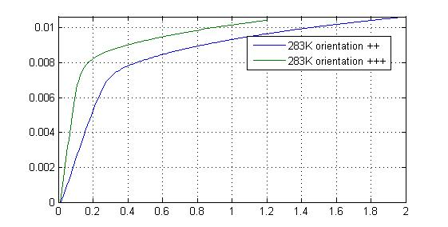
Prismatic sample in the magnetometer
I. Intro > II. Demag. Factor > III. Inv. Formulation > IV. Prismatic sample
$$H_{0}$$
Gd prismatic sample 1x2x6 mm
$$H_{0}$$
Orientation ++
Orientation +++
Magnetic moment $[A.m^{2}]$
Applied field ${μ_{0}H}_{0} [T]$
Notes:
Electric discharge machining, Length, longest

Slide 15
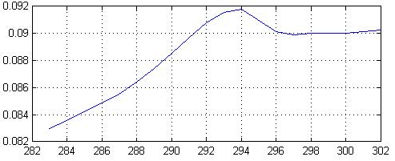
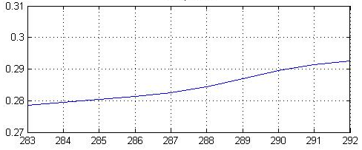
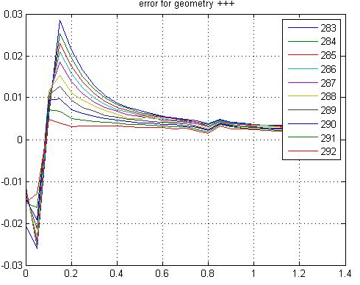
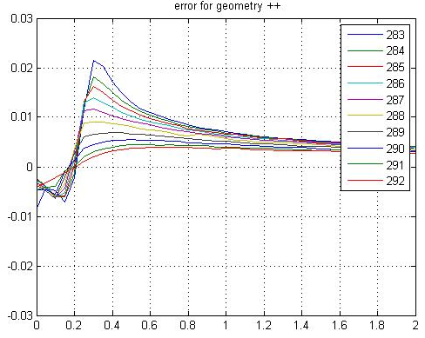
Inversion based magnetometer mesurement
I. Intro > II. Demag. Factor > III. Inv. Formulation > IV. Prismatic sample
Demag. factor function of temperature for orientation +++
Demag. factor function of temperature for orientation ++
Error on the magnetic moment
Temperature in K
Temperature in K
Error on the magnetic moment
Error on the magnetic moment
Relative error
Relative error
External Field
External Field
Notes:
Now we do the resolution of the inverse problem
Even though
Convergence criterion

Slide 16
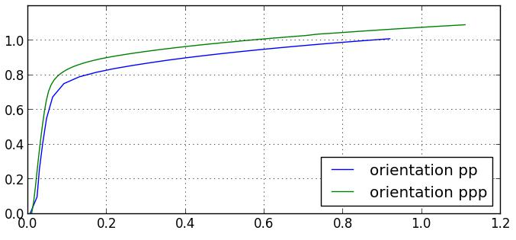
V. Perspectives
I. Intro > II. Demag. Factor > III. Inv. Formulation > IV. Prismatic sample > V. Perspectives
Magnetization curve ${M(μ}_{0}H)$ at 283 K
Method of comparaison
Error on the magnetic moment
B(H) should be the same for any shape
Anistropie from process or Gd
Use of cubic sample
Now we use parametric function and interpolated point
To have a best fit of the magnetization curve to reduce the error NOW less than 0.5% on the magnetic curve (2h for one curve)
Try to have an error estimation on the magnetization curve
Now we start to propagate the errors on $Δs$
Propagate the error througth the Maxwell Relation to have an estimation on the errors on the $Δs$ (intrinsec)
Magnetization $μ_{0}$M$[T]$
$$μ_{0}H [T]$$

Slide 17
Thanks for your attention
Question ?
By morgan.almanza@g2elab.grenoble-inp.fr

